Slide 1
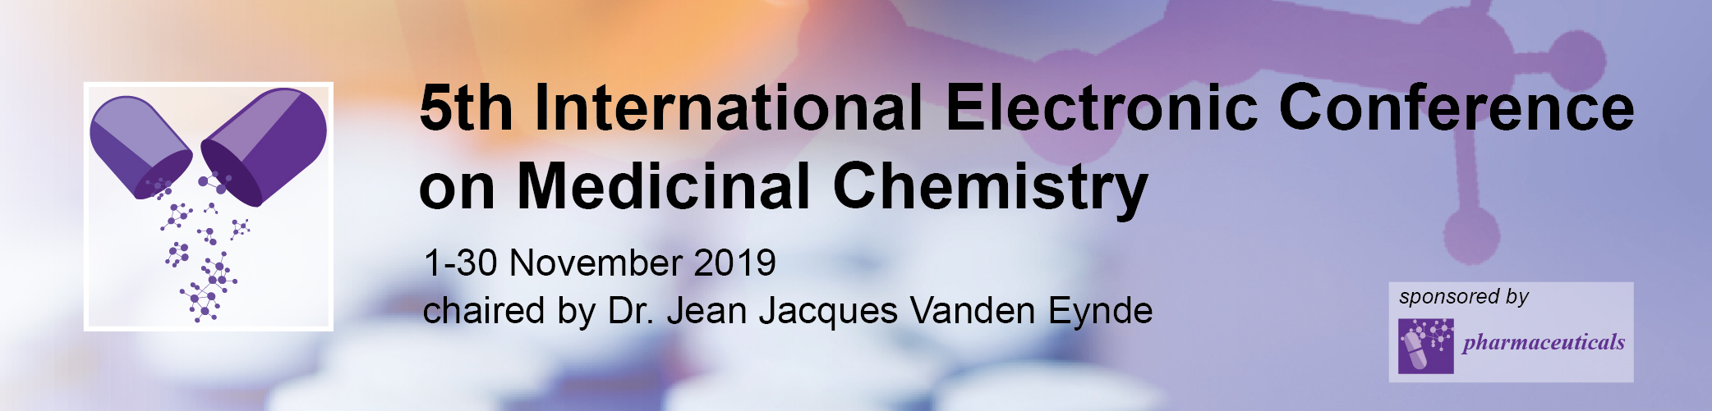

In the search of new xanthine oxidase inhibitors: 3-Phenylcoumarins versus 2-phenylbenzofurans
Benedetta Era¹, Giovanna L. Delogu¹, Francesca Pintus¹, Antonella Fais¹
and Maria J. Matos^{2,}*
¹ Department of Life and Environmental Sciences, University of Cagliari, 09042 Monserrato, Cagliari, Italy
² Departamento de Química Orgánica, Facultade de Farmacia, Universidade de Santiago de Compostela, 15782, Santiago de Compostela, Spain
* Corresponding author: mariajoao.correiapinto@usc.es

Slide 2
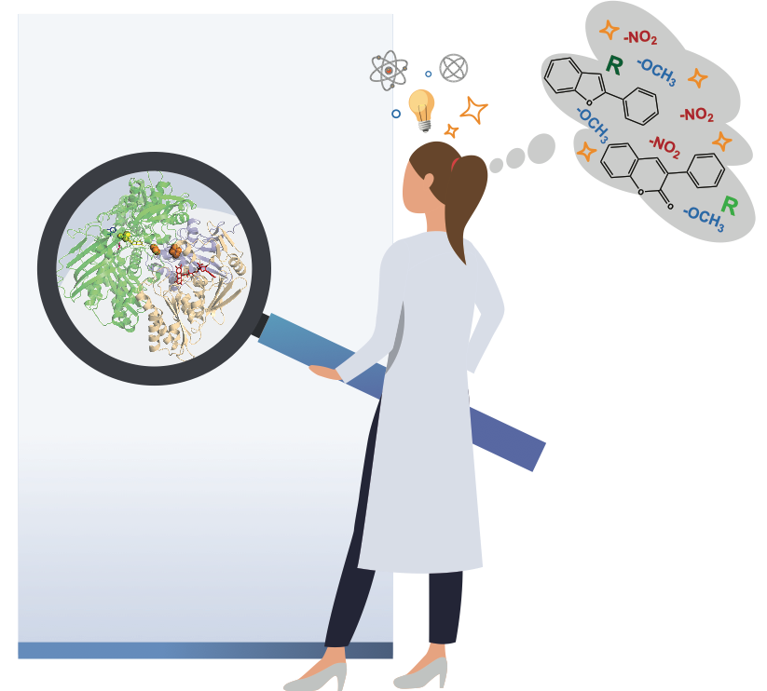
In the search of new xanthine oxidase inhibitors: 3-Phenylcoumarins versus 2-phenylbenzofurans

Slide 3
Abstract:
Xanthine oxidase (XO) is an enzyme that catalyzes the oxidation of hypoxanthine to xanthine, and this one to uric acid. This process reduces molecular oxygen to O₂^{⋅−}. Hydroxyl free radicals and hydrogen peroxide, both of which are byproducts of XO activity, can caused oxidative stress in human cells. Overproduction of uric acid in the body leads to hyperuricemia, which is also linked with gout. Uric production in the body can be lowered by XO inhibitors. Inhibition of XO has also been proposed as a mechanism for improving cardiovascular health. Therefore, the search for new efficient XO inhibitors is an interesting topic in drug discovery.
3-Phenylcoumarins and 2-phenylbenzofurans are privileged scaffolds in Medicinal Chemistry. Their structural similarity makes them interesting molecules for a comparative work. Methoxy and nitro substituents were introduced in both scaffolds. A preliminary study gives some insights into the synthesis and biological activity of these molecules against this important target. In general, the studied 3-phenylcoumarins proved to be better XO inhibitors than the similarly substituted 2-phenylbenzofurans. Further studies are still needed to optimize the structure and increase the potential of these molecules as XO inhibitors for the treatment of gout.
Keywords: Xanthine oxidase inhibitors; 3-Phenylcoumarins; 2-Phenylbenzofurans.

Slide 4

Introduction
PURINE CATABOLISM
HYPOXANTHINE
H₂O+O₂
H₂O₂
Xanthine oxidase
Xanthine oxidase
URIC ACID
XANTHINE
H₂O₂
H₂O+O₂
Xanthine oxidase inhibitors

Slide 5
Results and discussion

Slide 6
Results and discussion
Table 1. Inhibitory activity of 3-phenylcoumarins and 2-phenylbenzofurans against xanthine oxidase at 100 µM.
*At 100 µM (highest concentration tested) the compounds precipitated. NI=No inhibition
Compounds | Inhibitory activity (inhibition % ± SD)
1 | 75.4±0.2
2 | 19.2±0.7
3 | 76.6±1.6
4 | 85.1±3.2
5 | 40.4±4.0
6 | 22.5±1.2
7 | 26.3±3.6
8 | *
9 | 36.5±0.9
10 | NI
11 | *
12 | NI

Slide 7
Results and discussion
Table 2. Theoretical physicochemical properties of compound 4 calculated with molinspiration.
Physicochemical properties | Compound 4
miLogP | 3.73
Polar surface area (Å2) | 85.27
H-bond acceptor atoms | 6
H-bond donor atoms | 0
Volume | 248.88
Rotatable bonds | 3
Drug likeliness (Lipinski) | Yes

Slide 8
Conclusions
In summary, we investigated XO inhibitory activity of twelve compounds, and found eight active compounds, displaying three of them inhibitory activity above 75%, at 100 µM. All the 3-phenylcoumarins proved to be active on the studied target. The most active molecule (compound 4) is a 3-phenylcoumarin bearing a nitro group at position 6 of the coumarin ring and a methoxy one in para position of the 3-phenyl ring. Our results highlighted a relationship between the scaffold, the nature of the substituents and their position within the scaffold, and XO inhibitory activity. Besides being the most promising compound against the enzyme, compound 4 also presented pharmacokinetics and drug-likeness characteristics that support it as a promising molecule for designing effective XO inhibitors.

Slide 9







Acknowledgments
@mariacmatos
mariajoao.correiapinto@usc.es

