Slide 1
Conformation and stability of Interferon α2b under the influence of mono and oligoribonucleotides
Roman Nikolaiev*, Yevhenii Stepanenko, Svitlana Cherniiy, Zenovii Tkachuk
Institute of Molecular Biology and Genetics of NASU, 150, Ac. Zabolotnogo St., Kyiv, Ukraine, 03680
* Corresponding author: romanfromukrain@gmail.com

Slide 2
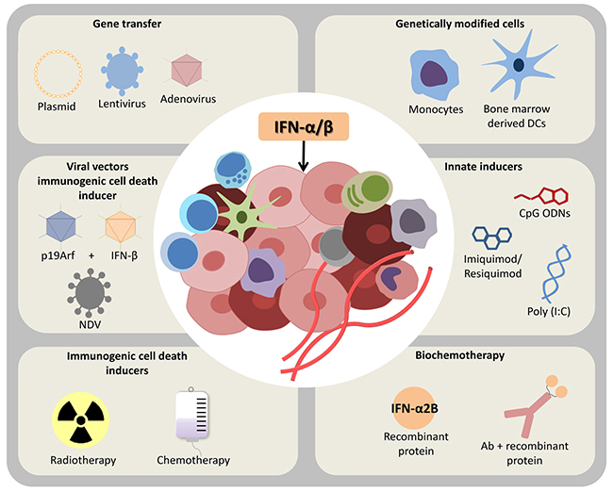
Conformation and stability of Interferon α2b under the influence of mono and oligoribonucleotides
Reference: https://doi.org/10.18632/oncotarget.19531

Slide 3
Abstract: Oligonucleotides antiviral drugs have actively used in medicine, but the molecular mechanism of their action remains unclear. We studied the conformation changes of IFN with ligands, the quenching and lifetime of fluorescence, and isothermal titration calorimetry (ITC).
The most active quenching and decrease lifetime of fluorescence INF, when titrated with NMPs and ORNs, was obtained using acid forms in combination with mannitol. And when titrated INF saline forms slightly different from control. Spectra of circular dichroism show the decrease in the structure of the number of secondary elements when interacting between INF and acidic forms nucleotides. An increase in the content of secondary structure in the interaction between INF and salt forms ligands. The ITC curves titration indicate that the reaction between protein and acidic ligands is exothermic. And between INF with saline ligands endothermically. Exothermic protein-ligand interaction increases the conformational mobility of the protein and endothermic decrease.
The ORNs have the advantage of interacting with proteins, unlike salt ORNs and NMPs, because they have a stronger binding. Thus, we assume the same compound in various forms may act as an inhibitor and activator for the protein.
Keywords: Oligonucleotides; Interferon α2b; lifetime of fluorescence; isothermal titration calorimetry

Slide 4
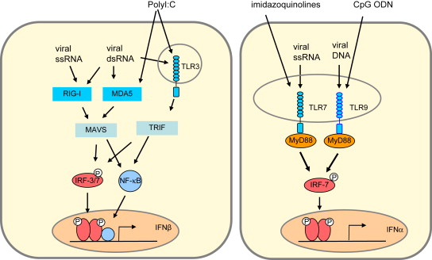
Introduction
Reference: https://doi.org/10.1016/j.fsi.2008.02.004
Oligonucleotides antiviral drugs have been actively implemented in medicine during the last decades. Nevertheless, the molecular mechanism of their action is still unclear. In the previous work we showed, the combination of oligonucleotides with alcohol sugar D-mannitol leads to changes in their biological activity and efficiency. ORNs increase interferon production and stimulate non-specific antivirus protection, but the molecular mechanism of its action is still unclear. We studied the interactions between Interferon α2b and mononucleotides (NMP), yeast oligoribonucleotides (ORNs), their Na+ salts (ORNsNa), and ORNs with D­mannitol (ORNs:D­M). We study the interaction and conformational changes of IFN with ligands, the quenching and lifetime of fluorescence, and isothermal titration calorimetry (ITC).

Slide 5
Results and discussion
The most active quenching and decrease INF, when titrated with NMPs and ORNs, was obtained using acid forms in combination with mannitol lifetime of fluorescence. The quenching and lifetime of fluorescence INF when titrated saline forms slightly different from control. Thus, when using the ORN:D­M, quenching was 28%. INF has a lifetime of 2.95 ns, after interacting with ORN and ORN:D-M INF has a fluorescence lifetime of 2.37 and 2.32 ns, respectively.
The quenching and lifetime of fluorescence INF when titrated AMP:D­M - 17% and 1.92 ns, respectively, GMP:D­M - 45% and 2.53 ns, CMP:D-M - 42% and 2.24ns, UMP:D-M - 13% and 2.25 ns. The analysis of the IFN secondary structure by Bestsel shows the decrease in the structure of the number of secondary elements when interacting between INF and acidic forms nucleotides. On the other hand, an increase in the number of secondary elements in the interaction between INF and salt forms NMPs and ORNs were obtained.
The ITC curves titration of INF with ORNs and NMPs indicate that the reaction of the interaction between protein and acidic ligands is exothermic and with saline endothermically. It is known that exothermic protein-ligand interaction increases the conformational mobility of the protein and endothermic decrease.

Slide 6
The dependence of the fluorescence intensity of IFN-α2b on the concentration of different forms of oligoribonucleotides and AMP
a
b
The dissociation constant Kd=1,11±0.09µM µM in the fluorescence quenching interaction between INF and ORNs-D-M. The dissociation constant between IFN and ORNs is Kd=2,36±0.47µM, between INF and ORNsNa - Kd=2,15±0.16µM and INF and ORNsNa-D-M Kd=3.13±0.46µM. The dissociation constant Kd=1,74 ±0.09µM µM in the fluorescence quenching interaction between INF and AMP-D-M. The dissociation constant between IFN and AMP is Kd=7,95±0.41µM, between INF and AMPNa - Kd=12,1 ±0.19µM and INF and AMPNa-D-M Kd=9.4±0.73µM. The results obtained for quenching the IFN-α2b fluorescence intensity with the addition of ORN and AMP show that ligands of nucleic nature in acid form, and especially in combination with mannitol, are more strongly bound to interferon α-2b in comparison with saline analogs. That served as an impetus for further research.

Slide 7
The dependence of the fluorescence intensity of IFN-α2b on the concentration of different forms NMP
Various binding sites can explain the effects of different forms of ORNs and NMPs on the secondary structure of the INF. The ORNs and ribonucleotides have the advantage of interacting with proteins, unlike salt ORNs and nucleotide monophosphates, because they have a stronger binding. To test this assumption in the case of nucleotide ligands, we plan to conduct studies with the interferon receptor.
T = 25 ºC; scanning range 300 - 450 nm; scanning speed - 200 nm / min; excitation gap width - 2.5 nm; the width of the radiation gap is 2.5 nm; cuvette - 1cm; conc. protein - 1μM; conc. titrants ≈ 10 μM; 50 mM TRIS-HCl, pH 7.5.

Slide 8
Thermodynamics of interaction of interferon α-2b with different forms of ORNs
a
b
c
Changes in energy parameters in the interaction of interferon α-2b with ORNs:
a) enthalpy; b) entropy; c) Gibbs energy
* - statistically significant difference compared to control (acid form), Р≤0,05.

Slide 9
Thermodynamics of interaction of interferon α-2b with different forms of AMP
a
b
c
Changes in energy parameters in the interaction of interferon α-2b with AMP:
a) enthalpy; b) entropy; c) Gibbs energy
In the interaction of interferon and ORN and NMP in acidic form, the reaction is exothermic. The ITC curve is endothermic between interferon and ORN and NMP in salt form.
* - statistically significant difference compared to control (acid form), Р≤0,05.

Slide 10
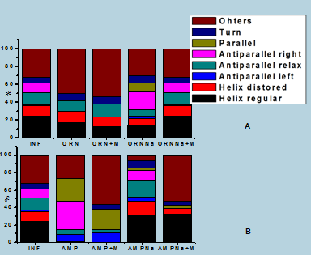
Influence of ORNs and AMP on the secondary structure of interferon α-2b
The analysis of IFN secondary structure shows that ORNs and AMP in acid form, and especially in combination with mannitol, lead to changes in conformational mobility due to the increased content of disordered sites At the same time, salt analogs increase the number of structured secondary elements and significantly increase the conformational stiffness of interferon. To determine the energy parameters of protein-ligand interactions, we used ITC.
Influence of a) ORNs and b) AMP on the secondary structure of interferon α-2b

Slide 11
The fluorescence lifetime of interferon α-2b with ORN and AMP
a
b
Dependence on IFNα-2b fluorescence life when given
a) oligoribonucleotides and b) AMP
Energy Transfer Efficiency - The ratio of the number of energy transfer events to the number of donor excitation events
* - statistically significant difference compared to control (interferon), Р≤0,05.

Slide 12
The fluorescence lifetime of interferon α-2b with CMP and GMP
a
b
Dependence on IFNα-2b fluorescence life when given
a) CMP and b) GMP
* - statistically significant difference compared to control (interferon)), Р≤0,05.

Slide 13
The fluorescence lifetime of interferon α-2b with UMP
Pulse-time spectroscopy shows a higher efficiency of non-radiative transfer of energy from interferon to ORN and AMP in acidic form, due to the closer distance between the molecules and the higher Foster transfer rate.
* - statistically significant difference compared to control (interferon), Р≤0,05.

Slide 14
Conclusions
ORNs and NMPs in acidic form and combination with mannitol bind more strongly to interferon α-2b than to saline analogs;
In the interaction of interferon and ORN and NMP in acidic form, the reaction is exothermic. The ITC curve is endothermic between interferon and ORN and NMP in salt form;
ORN and acidic NMP, and especially in combination with mannitol, lead to a change in conformational mobility by increasing the content of disordered sites. At the same time, salt analogs increase the number of structured secondary elements and probably increase the conformational rigidity of interferon;
Pulse-time spectroscopy shows a higher efficiency of non-radiative energy transfer from interferon to ORN and NMP in acidic form, due to the closer distance between molecules and the higher Foster transfer rate.

