Slide 1



Nutrient composition, antioxidant and antiproliferative activities of Clausena excavata and Murraya koenigii
Wan Nor I’zzah Wan Mohamad Zain^{1,}*, Asmah Rahmat², and Fauziah Othman³, Taufiq Yap Yun Hin⁴
¹ Faculty of Medicine, Universiti Teknologi Mara, Sungai Buloh Campus, Jalan Hospital, 47000 Sungai Buloh, Selangor, Malaysia;
² Faculty of Medicine and Health Sciences, Universiti Putra Malaysia, 43400 UPM Serdang, Selangor, Malaysia
³Faculty of Health and Life Sciences, University Drive, Off Persiaran Olahraga, Section 13, 40100 Shah Alam, Selangor, Malaysia
⁴Faculty of Science, Universiti Putra Malaysia, 43400 UPM Serdang, Selangor, Malaysia
* Corresponding author: wnizzah@uitm.edu.my

Slide 2
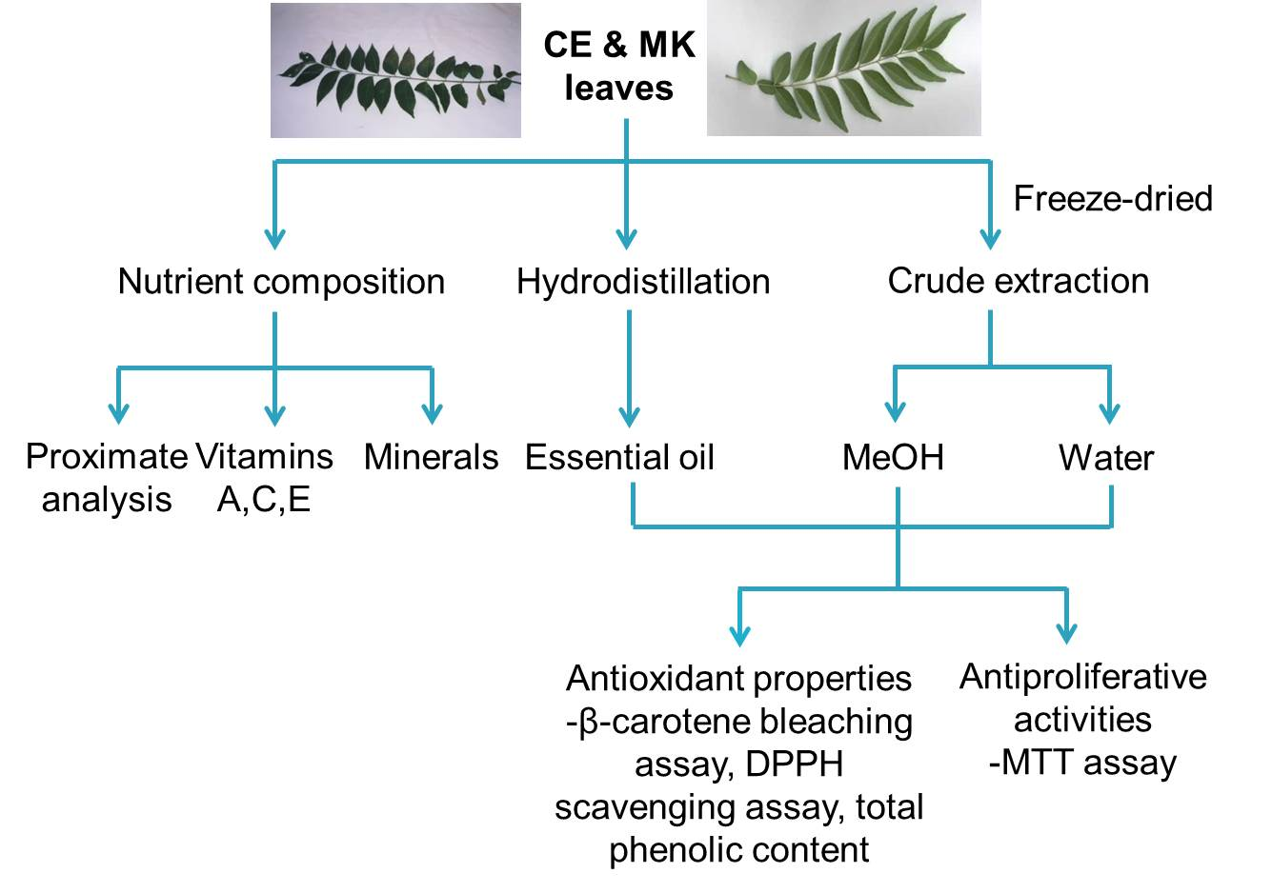
Nutrient composition, antioxidant and antiproliferative activities of Clausena excavata and Murraya koenigii

Slide 3
Abstract:
Clausena excavata (CE) and Murraya koenigii (MK) have shown potential medicinal values of herbal plants, thus they were investigated for their nutrient composition. MK possessed higher carbohydrate but lower fiber than CE. Vitamin A is higher in MK but lower vitamin C and E than CE. Antioxidant and antiproliferative activities of CE and MK crude extracts and essential oils and the composition of essential oil were also examined. The hydrodistilled essential oil was analysed by GC/MS. CE and MK leaf oils were made up of safrole and β-farnesene. Phenolic contents of the methanolic extracts of both plants were higher than the water extracts with CE exhibited higher phenolic content. Antioxidant activities were measured via inhibition of linoleic acid oxidation and scavenging of DPPH radicals. The methanolic extracts exhibited significant activities in both assays. MK methanolic extract and oil significantly inhibited linoleic acid oxidation but weakly scavenged DPPH radical than CE. Antiproliferative activities against HepG2, MCF-7, MDA-MB-231, HeLa and CAOV3 were determined using MTT assay. MK methanolic extract and oil possessed the most potent antiproliferative effects. In conclusion, the methanolic extracts especially MK have the great potential in antioxidant and antiproliferative activities. Further investigations are required to explain the underlying mechanisms.
Keywords: Antioxidant; Antiproliferative; Clausena excavata; Murraya koenigii; Nutrient composition

Slide 4
Introduction
Clausena excavata (CE)
Rutaceae family
known as Chemama, Kemantu hitam, Pokok cherek in Malaysia; Sicherek in Sumatra; Fia fan & San Soak in Thailand (Soepadmo et al 1991)
a shrub, with a strong smell; the leaves have a characteristic curry-like smell when crushed
in traditional medicine, various parts of the plants have been used for abdominal pain, as a poultice for sores, headaches, cold, ulceration of the nose (Ridley 1925), for malaria & dysentery (Wu et al 1992)
Murraya koenigii (MK)
Rutaceae family
a curry leaf plant; the leaves being used as a flavoring in curries
a small tree & found widely in East Asia
in traditional medicine, various parts of the plant have been used for the treatment of headache, toothache, stomachache, influenza, rheumatism, traumatic injury, insect & snake bites, dysentery & astringent (Burkill 1966, Kong et al 1986).

Slide 5
Introduction
Biological activities of CE
antipoliferative activities against cancer cell lines (Arbab et al 2012, Al-Abboodi et al 2017, Waziri et al 2016, Andas et al 2015), antioxidant (Albaayit et al 2014), antilarval (Cheng et al 2009), antibacterial (Sunthitikawinsakul et al 2003), antifungal (Sunthitikawinsakul et al 2003), anti-HIV1(Kongkathip et al 2005), gastroprotective (Albaayit et al 2016), wound healing (Albaayit et al 2015), anti-obesity (Cho et al 2018)
Biological activities of MK
antioxidant (Ramkissoon et al 2013, Husna et al 2018), antidiabetic (Yadav et al 2002, Ponnusamy et al 2010, Bhat et al 2011, Husna et al 2018), antibacterial, antihypertensive, antiproliferative (Bhattacharya et al 2010, Syam et al 2011, Ahmadipour et al 2015, Arun et al 2017, Hobani et al 2017, Utaipan et al 2017, Nooron et al 2017), antimicrobial (Panghal et al 2011), nephroprotective (Mahipal and Pawar 2017), antilarval (Patil et al 2010)

Slide 6
Introduction
Importance of study
Although there are countless studies being carried out, scientific interests on both plants continue to develop
There are limited literatures reporting on the nutrient composition of CE. Moreover, little is known about the antioxidative and antiproliferative properties of CE’s essential oil
Provides additional information on the usefulness of CE and MK

Slide 7
Introduction
Specific objectives
To examine the nutrient composition of CE & MK
To determine the antioxidant properties of CE & MK
To elucidate the antiproliferative activities of CE & MK on several human tumour cell lines

Slide 8
Experiment 1
Nutrient composition
Proximate analysis (moisture, ash, crude fiber, protein, carbohydrate and fat) (Association of Official Analytical Chemists, 1984 & Tee et al 1996)
Vitamins A, C & E –> HPLC analysis (Tee et al 1996, Abushita et al 1997, Shin & Godber 1993)
Minerals content (calcium, magnesium, sodium, potassium, iron, copper & zinc content) -> AAS

Slide 9
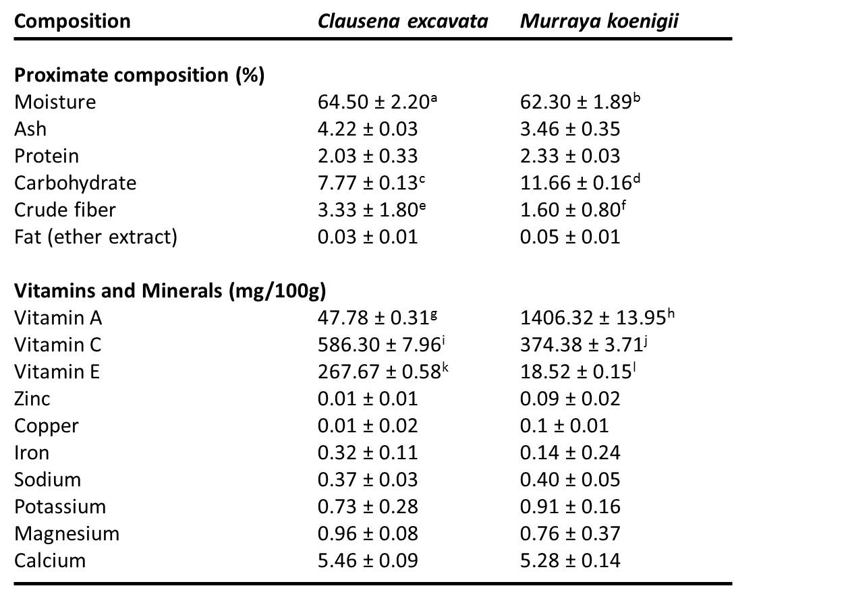
Results: Nutrient composition
Table 1. Data shown as mean ± S.D (n=6). Different letters indicate significant difference at the level of p<0.05. Results for each constituent were compared between Clausena excavata and Murraya koenigii.

Slide 10
Experiment 2
Hydrodistillation of essential oil
Fresh leaves (300 g) -> Hydrodistillation (6 hours) using Clavenger apparatus
Essential oil obtained -> GC-MS-analysis

Slide 11
Results: Hydrodistillation of CE oil
Oil yield : 0.7%
The oil was mainly made up of safrole (89.85%)
Minor components > 1% : α-α, 4-trimethyl benzenemethanol (3.13%), 3-cyclohexene-1-carboxaldehyde (1.34%) & terpinolene (1.16%)
The others < 1%

Slide 12
Results: Hydrodistillation of MK oil
Oil yield : 0.2%
MK oil was mainly made up of -farnesene (42.85%)
Other components : naphthalene (12.17%), -caryophyllene (8.09%), caryophyllene (5.47%) and eudesmol (4.34%)
Minor components > 1% : caryophyllene oxide (1.93%), nerolidyl acetate (1.83%), globulol (1.69%), cyclohexane, 1-ethenyl-1-methyl-2,4-bis(1-methylethenyl)-cyclohexane (1.65%), pseudocumene (1.49%), -farnesene (1.16%) and spathulenol (1.00%)
The others < 1%

Slide 13
Experiment 3
Antioxidant properties (Antioxidant activity)
β-carotene bleaching assay
The rate of β-carotene bleaching can be slowed down in the presence of antioxidants (Velioglu et al 1998)
The antioxidant activity was measured

Slide 14
Results: Antioxidant properties (β-carotene bleaching assay)
Fig. 1: Murraya koenigii essential oil (MK EO) showed the highest AA (91.01 ± 1.40 %), followed by Murraya koenigii methanol extract (MK MeOH) (86.13 ± 0.07 %) which were significantly higher than the standards: BHT (BHT50), α-tocopherol (TOC50) and ascorbic acid. Data shown as mean ± S.D; n=6. Different letters indicate significant difference at the level of p<0.05. Comparison was made between all samples and standards.

Slide 15
Experiment 4
Antioxidant properties (Free radical scavenging activity)
DPPH free radical scavenging assay (Blois, 1958, Lai et al 2001)
The capability of sample to scavenge the DPPH radical was measured
Dose-response curve was plotted to obtain EC50
BHT, ascorbic acid and α-tocopherol were used as standards

Slide 16
Results: Antioxidant properties (DPPH free radical scavenging assay)
Fig. 2: All standards inhibit 50% DPPH radical at 0.11-0.14 mg/ml; which were stronger than other studied samples. The methanol extracts from both samples inhibit 50% DPPH radical at lower concentrations (CE MeOH: 0.89 ±0.25 mg/ml) (MK MeOH: 1.69 ± 0.01 mg/ml) compared to water extracts. EC₅₀ values of both CE and MK essential oils were not detected at the concentration tested. Data shown as mean±S.D; n=6.

Slide 17
Experiment 5
Antioxidant properties (Total phenolic content)
Folin-Ciocalteu assay (Singleton and Rossi 1965)
Absorbance was measured spectrophotometrically at 725 nm
The total phenolic content was expressed as gallic acid equivalents (GAEs) in milligrammes per g sample extract

Slide 18
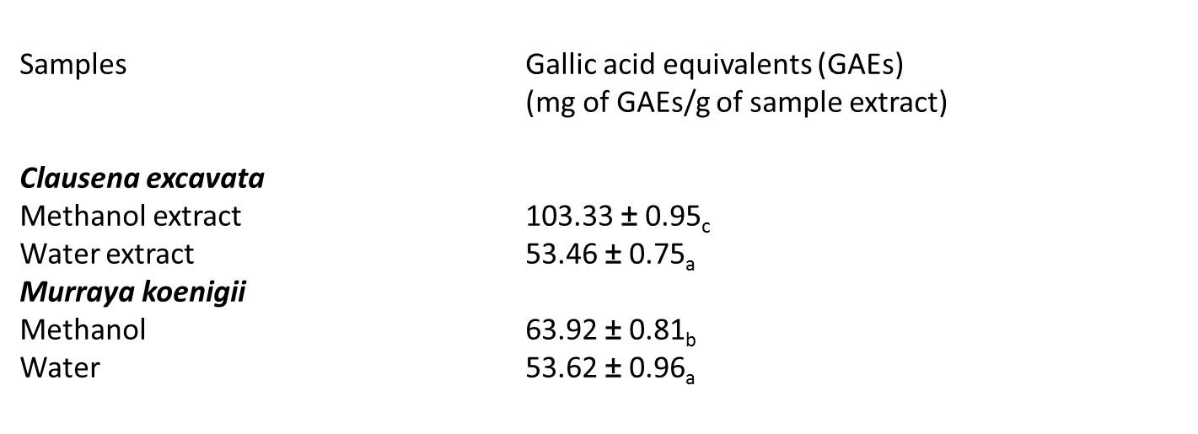
Results: Antioxidant properties (Total phenolic content)
Table 2: Methanol extracts from both samples showed higher total phenolic content than the water extracts. Data shown as mean ± S.D; n=6. Different letters indicate significant difference at the level of p<0.05. Comparison was made between methanol and water extracts of the respective samples.

Slide 19
Experiment 6
Antiproliferative activities
HepG2 (hepatic cancer), MCF-7 (hormone-dependent breast cancer), MDA-MB-231 (non-hormone-dependent breast cancer), HeLa (cervical cancer) & CAOV3 (ovarian cancer) were obtained from American Type Culture Collection (ATCC)
HepG2, MCF-7, HeLa; cultured in RPMI-1640, MDA-MB-231, CAOV3; in DMEM + 10% foetal bovine serum + 1% penicillin-streptomycin with fungizone, at 37ºC with 5% CO₂
CE & MK methanol extracts, water extracts & essential oils; dissolved with 100% DMSO to 10 mg/ml, diluted with medium to 100 µg/ml for MTT assay

Slide 20
Experiment 6
Antiproliferative activities (Cell proliferation assay)
MTT assay (Roche, Germany)
Tumour cells were treated with CE & MK methanol extracts, water extracts & essential oils (10-100 µg/ml) & incubated for 96 h
An equivalent serial dilution of DMSO was used as control treatment
ELISA measurement at 550 nm
Dose-response curve was plotted to obtain IC₅₀

Slide 21
Results: MTT assay
MCF-7
HeLa
HepG2
MDA-MB-231
CAOV3
Fig. 3. The effect of CE & MK methanol extracts, water extracts & essential oils on proliferation of MCF-7, HeLa, HepG2, MDA-MB-231 & CAOV3 assessed using the MTT assay. DMSO (vehicle) does not inhibit 50% cell growth (data not shown). Data shown as mean ± S.D; n=6.

Slide 22
Results: MTT assay (cont.)
Table 3. IC₅₀ values of CE & MK methanol extracts, water extracts & essential oils on HeLa, MCF-7, HepG2, MDA-MB-231 & CAOV3. Different letters indicate significant difference at the level of p<0.05. Results were compared between samples treated on the same cell line (same row). The IC₅₀ value is defined as the concentration of sample required to inhibit 50% of the cancer cells proliferation. ND indicates IC₅₀ value was not detected at the concentration tested. Data shown as mean ± S.D; n=6.

Slide 23
Discussion
CE & MK leaves contained a moderate amount of proximate composition as well as minerals and vitamins which may be useful for the evaluation of dietary information. The nutrient composition might also contribute to the total antioxidant activity (de Souza et al 2014).
The MeOH extracts of both plants performed better in the lipid peroxidation and free radical scavenging activities suggesting the antioxidant active and probably phenolic compound in this study has a high activity.
MK oil exhibited higher antioxidant & antiproliferative activities compared to CE oil which could be due to the compounds in their essential oils.

Slide 24
Discussion
The MTT assay revealed that the methanol extracts of both CE and MK also contain antiproliferative compound, which exhibited growth inhibitory effect on almost all human cancer cell lines tested.
Both CE & MK methanol extract contained high amount of phenolic than the water extracts suggesting the growth inhibitory effects of the MeOH extract. Therefore, it is believed that inhibition of cell growth is closely associated with antioxidant properties of the extract (Rodriguez 2016).

Slide 25
Conclusions
CE & MK proved to possess interesting properties, emerging from their nutrients composition & the evaluation of their in vitro biological activities.
The MeOH extracts especially MK MeOH extract has the great potential in antioxidant & antiproliferative activities.
However, further chemical work and pharmacological evidences are required to establish the possible correlation among the mentioned activities of the extract.

Slide 26


Acknowledgments
Universiti Putra Malaysia -FRGS 55166
Universiti Teknologi Mara 600 IRMI/MyRA 5/3/LESTARI (042/2017)
THANK YOU

Slide 27
References
Ahmadipour, F., Noordin, M. I., Mohan, S., Arya, A., Paydar, M., Looi, C. Y., ... & Yong, C. L. (2015). Koenimbin, a natural dietary compound of Murraya koenigii (L) Spreng: inhibition of MCF7 breast cancer cells and targeting of derived MCF7 breast cancer stem cells (CD44+/CD24−/low): an in vitro study. Drug design, development and therapy, 9, 1193.
Al-Abboodi, A. S., Rasedee, A., Abdul, A. B., Taufiq-Yap, Y. H., Alkaby, W. A. A., Ghaji, M. S., ... & Al-Qubaisi, M. S. (2017). Anticancer effect of dentatin and dentatin-hydroxypropyl-β-cyclodextrin complex on human colon cancer (HT-29) cell line. Drug design, development and therapy, 11, 3309.
Albaayit, S. F. A., Abba, Y., Abdullah, R., & Abdullah, N. (2014). Evaluation of antioxidant activity and acute toxicity of Clausena excavata leaves extract. Evidence-Based Complementary and Alternative Medicine, 2014.
Albaayit, S. F. A., Abba, Y., Abdullah, R., & Abdullah, N. (2016). Prophylactic effects of Clausena excavata Burum. f. leaf extract in ethanol-induced gastric ulcers. Drug design, development and therapy, 10, 1973.
Association of Official Analytical Chemists (1984). Official Methods of Analysis. 14th Edition (Williams, S., ed), AOAC, Virginia.
Andas, A., Abdul, A. B., Rahman, H. S., Sukari, M. A., Abdelwahab, S. I., Samad, N. A., ... & Arbab, I. A. (2015). Dentatin from clausena excavata induces apoptosis in HEPG2 cells via mitochondrial mediated signaling. Asian Pac. J. Cancer Prev, 16, 4311-4316.
Arbab, I. A., Looi, C. Y., Abdul, A. B., Cheah, F. K., Wong, W. F., Sukari, M. A., ... & Mohamed Elhassan Taha, M. (2012). Dentatin induces apoptosis in prostate cancer cells via Bcl-2, Bcl-xL, Survivin downregulation, caspase-9,-3/7 activation, and NF-κB inhibition. Evidence-Based Complementary and Alternative Medicine, 2012.
Arun, A., Patel, O. P., Saini, D., Yadav, P. P., & Konwar, R. (2017). Anti-colon cancer activity of Murraya koenigii leaves is due to constituent murrayazoline and O-methylmurrayamine A induced mTOR/AKT downregulation and mitochondrial apoptosis. Biomedicine & Pharmacotherapy, 93, 510-521.
Bhat, M., Zinjarde, S. S., Bhargava, S. Y., Kumar, A. R., & Joshi, B. N. (2011). Antidiabetic Indian plants: a good source of potent amylase inhibitors. Evidence-Based Complementary and Alternative Medicine, 2011.
Bhattacharya, K., Samanta, S. K., Tripathi, R., Mallick, A., Chandra, S., Pal, B. C., ... & Mandal, C. (2010). Apoptotic effects of mahanine on human leukemic cells are mediated through crosstalk between Apo-1/Fas signaling and the Bid protein and via mitochondrial pathways. Biochemical pharmacology, 79(3), 361-372.

Slide 28
References
Blois, M. S. (1958). Antioxidant determinations by the use of a stable free radical. Nature 181:1199-1200.
Burkill, I. H. (1966). A Dictionary of the Economic Products of the Malay Peninsula. Kuala Lumpur: The Malaya Nature Society.
Cheng, S. S., Chang, H. T., Lin, C. Y., Chen, P. S., Huang, C. G., Chen, W. J., & Chang, S. T. (2009). Insecticidal activities of leaf and twig essential oils from Clausena excavata against Aedes aegypti and Aedes albopictus larvae. Pest Management Science: formerly Pesticide Science, 65(3), 339-343.
Cho, Y. R., Lee, J. A., Kim, Y. Y., Kang, J. S., Lee, J. H., & Ahn, E. K. (2018). Anti-obesity effects of Clausena excavata in high-fat diet-induced obese mice. Biomedicine & Pharmacotherapy, 99, 253-260.
de Souza, V. R., Pereira, P. A. P., da Silva, T. L. T., de Oliveira Lima, L. C., Pio, R., & Queiroz, F. (2014). Determination of the bioactive compounds, antioxidant activity and chemical composition of Brazilian blackberry, red raspberry, strawberry, blueberry and sweet cherry fruits. Food chemistry, 156, 362-368.
Hobani, Y. H. (2017). The role of oxidative stress in koenimbine-induced DNA damage and heat shock protein modulation in HepG2 cells. Integrative cancer therapies, 16(4), 563-571.
Husna, F., Suyatna, F. D., Arozal, W., & Poerwaningsih, E. H. (2018). Anti-Diabetic Potential of Murraya Koenigii (L.) and its Antioxidant Capacity in Nicotinamide-Streptozotocin Induced Diabetic Rats. Drug research.
Kong, Y. C., Ng, K. H., But, P. P. H., Li, Q., Yu, S. X., Zhang, H. T., Cheng, K. F., Soejarto, D. D., Kan, W. S., Waterman, P. G. (1986). Sources of the anti-implanation alkaloid yueh chukene in the genus Murraya, J.Ethanopharmacol 15: 195-200.
Kongkathip, B., Kongkathip, N., Sunthitikawinsakul, A., Napaswat, C., & Yoosook, C. (2005). Anti‐HIV‐1 constituents from Clausena excavata: Part II. carbazoles and a pyranocoumarin. Phytotherapy Research: An International Journal Devoted to Pharmacological and Toxicological Evaluation of Natural Product Derivatives, 19(8), 728-731.
Lai, L. S., Chou, S. T. and Chao, W. W. (2001). Studies on the antioxidative activities of hsian-tsao (Mesona procumbens hemls) leaf gum. J. Agri Food Chem 963-968.

Slide 29
References
Mahipal, P., & Pawar, R. S. (2017). Nephroprotective effect of Murraya koenigii on cyclophosphamide induced nephrotoxicity in rats. Asian Pacific journal of tropical medicine, 10(8), 808-812.
Nooron, N., Ohba, K., Takeda, K., Shibahara, S., & Chiabchalard, A. (2017). Dysregulated Expression of MITF in Subsets of Hepatocellular Carcinoma and Cholangiocarcinoma. The Tohoku journal of experimental medicine, 242(4), 291-302.
Panghal, M., Kaushal, V., & Yadav, J. P. (2011). In vitro antimicrobial activity of ten medicinal plants against clinical isolates of oral cancer cases. Annals of clinical Microbiology and Antimicrobials, 10(1), 21.
Patil, S. V., Patil, C. D., Salunkhe, R. B., & Salunke, B. K. (2010). Larvicidal activities of six plants extracts against two mosquito species, Aedes aegypti and Anopheles stephensi. Trop Biomed, 27(3), 360-365.
Ponnusamy, S., Ravindran, R., Zinjarde, S., Bhargava, S., & Ravi Kumar, A. (2011). Evaluation of traditional Indian antidiabetic medicinal plants for human pancreatic amylase inhibitory effect in vitro. Evidence-Based Complementary and Alternative Medicine, 2011.
Ramkissoon, J. S., Mahomoodally, M. F., Ahmed, N., & Subratty, A. H. (2013). Antioxidant and anti–glycation activities correlates with phenolic composition of tropical medicinal herbs. Asian Pacific journal of tropical medicine, 6(7), 561-569.
Ridley, H. N. (1925). Endemic plants. J. Bot, 63, 182-183.
Rodriguez-Casado, A. (2016). The health potential of fruits and vegetables phytochemicals: notable examples. Critical reviews in food science and nutrition, 56(7), 1097-1107.
Singleton, V. L. and Rossi, J. A. (1965). Colorimetry of total phenolics with phosphomolybdic-phosphotungstic acid reagents, American Journal of Enology and Viticulture 16:144–158.Soepadmo et al 1991
Sunthitikawinsakul, A., Kongkathip, N., Kongkathip, B., Phonnakhu, S., Daly, J. W., Spande, T. F.,& Rochanaruangrai, S. (2003). Coumarins and carbazoles from Clausena excavata exhibited antimycobacterial and antifungal activities. Planta Medica, 69(02), 155-157.

Slide 30
References
Sunthitikawinsakul, A., Kongkathip, N., Kongkathip, B., Phonnakhu, S., Daly, J. W., Spande, T. F., ... & Yoosook, C. (2003). Anti‐HIV‐1 limonoid: first isolation from Clausena excavata. Phytotherapy Research: An International Journal Devoted to Pharmacological and Toxicological Evaluation of Natural Product Derivatives, 17(9), 1101-1103.
Syam, S., Abdul, A. B., Sukari, M. A., Mohan, S., Abdelwahab, S. I., & Wah, T. S. (2011). The growth suppressing effects of girinimbine on HepG2 involve induction of apoptosis and cell cycle arrest. Molecules, 16(8), 7155-7170.
Tee, E. S., Kuladevan, R., Young, S. I., Kor, S. C. and Zakiyah, H. O. (1996). Laboratory Procedures in Nutrient analysis of foods. Division of Human Nutrition, Institute for Medical Research, Kuala Lumpur.
Utaipan, T., Athipornchai, A., Suksamrarn, A., Jirachotikoon, C., Yuan, X., Lertcanawanichakul, M., & Chunglok, W. (2017). Carbazole alkaloids from Murraya koenigii trigger apoptosis and autophagic flux inhibition in human oral squamous cell carcinoma cells. Journal of natural medicines, 71(1), 158-169.
Velioglu, Y. S., Mazza, G., Gao, L. and Oomah, B. D. (1998). Antioxidant Activity and Total Phenolics in Selected Fruits, Vegetables and Grain Products. J.Agric. Food Chem. 46: 4113-4117.
Waziri, P. M., Abdullah, R., Yeap, S. K., Omar, A. R., Abdul, A. B., Kassim, N. K., ... & Imam, M. U. (2016). Clausenidin from Clausena excavata induces apoptosis in hepG2 cells via the mitochondrial pathway. Journal of ethnopharmacology, 194, 549-558.
Wu, Tian-Shu, Shiow-Chyn Huang, Jeng-Shiow Lai, Che-Ming Teng, Feng-Nien Ko and Chang-Sheng Kuoh. (1992). Chemical and antiplatelet aggregative investigation of the leaves of Clausena excavata. Phytochemistry 32: 449-451.
Yadav, S., Vats, V., Dhunno, Y., Grover, J. K. (2002). Hypoglycemic and antihyperglycemic activity of Murraya koenigii leaves in diabetic rats. J. Ethnopharmacol 82: 111-116.
Thank you

