Slide 1




A novel approach for ER⁺ breast cancer treatment: A new compound that modulates aromatase and ER
Cristina F. Almeida ^{1,} *, Ana Oliveira ², Pedro A. Fernandes ², Georgina Correia-da-Silva ¹, Maria J. Ramos ², Tiago V. Augusto ¹, Natércia Teixeira ¹ and Cristina Amaral ¹
¹ UCIBIO.REQUIMTE, Laboratório de Bioquímica, Departamento de Ciências Biológicas, Faculdade de Farmácia, Universidade do Porto
² Laboratório de Bioquímica Teórica, UCIBIO e Departamento de Química e Bioquímica, Faculdade de Ciências da Universidade do Porto
* Corresponding author: cristina-almeida96@hotmail.com

Slide 2
A novel approach for ER⁺ breast cancer treatment: A new compound that modulates aromatase and ER
Graphical Abstract
E
MT1
MT1
E
A
HSP
E
A
ER
CYP19
E
E
ER
ER
CYP19 Degradation
p
p
E
E
A
Androgens
ER
ER
E
Estrogens
p
p
ERE
CYP19
Aromatase
Transcription of target genes
ER
Estrogen Receptor

Slide 3
Abstract
Estrogen receptor-positive (ER⁺) breast cancer is the most common subtype of breast cancer worldwide. Estrogens, after being synthetized by aromatase, bind to ERα promoting breast cancer proliferation. Besides the success of the already approved therapies, they induce several side effects, reason why it is crucial to discover novel therapeutic approaches. Considering this, our goal is to discover multi-target compounds able to simultaneously inhibit aromatase and modulate ERα. For that, the known aromatase inhibitors (AIs) and ERα antagonists were collected and chemical descriptors were constructed and organized in clusters. After that, the selected compounds were analyzed by molecular docking. Anti-aromatase activity was evaluated in human placental microsomes. Aromatase and ERα expression was assessed by Western-Blot in ER⁺ an aromatase-overexpressing breast cancer cell line (MCF-7aro).
One compound (MT1) was selected to be studied in microsomes and in MCF-7aro cells. This compound was not able to inhibit aromatase in microsomes, but curiously, MT1 decreased aromatase protein levels in MCF-7aro cells. Furthermore, MT1 impaired ERα activation, acting as an ERα antagonist. This represents a great advantage for breast cancer treatment, since aromatase and ERα are key targets in this type of cancer.
Keywords: ER⁺ Breast Cancer, Aromatase, ERα, Multi-target

Slide 4
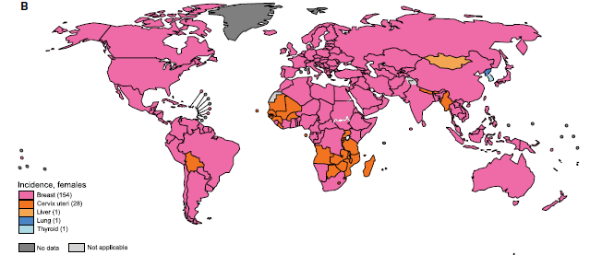
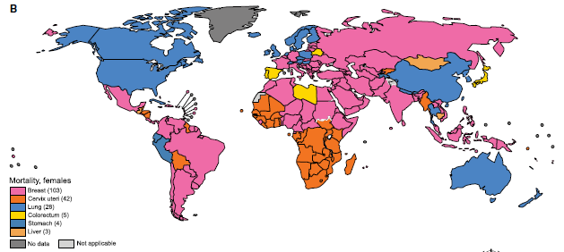
Introduction
Breast cancer
2018
Incidence
Mortality
New cases/2018: 2 088 849
Deaths/2018: 626 679
Bray F. et al (2018) CA CANCER J CLIN, 68:394–424
The Global Cancer Observatory, March 2019

Slide 5
Introduction
Breast cancer
Breast cancer
ER⁺/PR⁺
HER2⁺
Triple Negative
70-80% ER⁺
60% pre-menopausal women
75% post-menopausal women
Amaral C et al. (2017) J Steroid Biochem Mol Biol;171:218-28

Slide 6
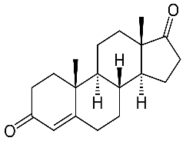
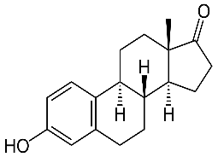
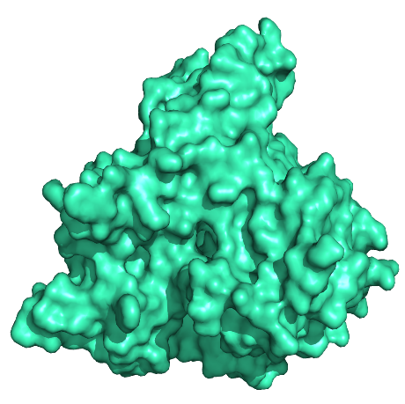
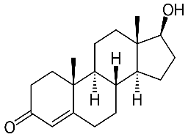
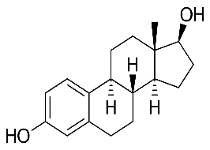
Introduction
Aromatase (CYP19)
Belongs to the cytochrome P450 family
Product of the CYP19A1 gene on chromosome 15
Highly expressed in the ovaries of pre-menopausal women and in adipose cells of post-menopausal women
In ER⁺ breast cancer patients is overexpressed
Responsible for the conversion of androgens into estrogens
Androstenedione
Estrone
Aromatase
Testosterone
Estradiol
Augusto TV et al. (2018) Endocr Relat Cancer;25(5):R283-R301

Slide 7
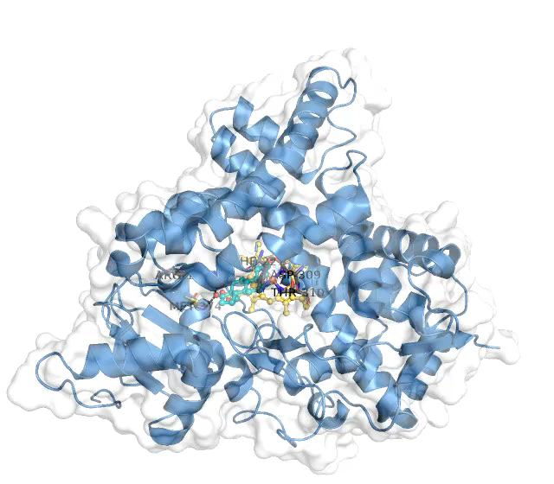
Introduction
Aromatase

Slide 8
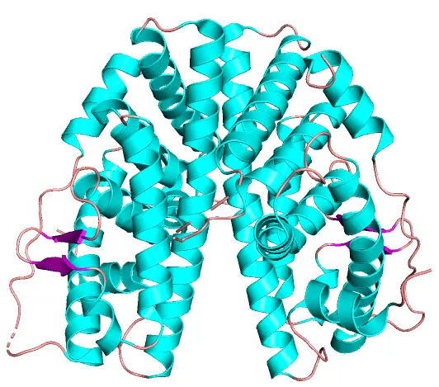
Introduction
Estrogen Receptor (ER)
ERs
ERα
ERβ
Growth and survival of breast epithelial cells, through cell proliferation and inhibition of apoptosis
Anti-proliferative and pro-apoptotic properties
Tumor development
Tumor suppression
Augusto TV et al. (2018) Endocr Relat Cancer;25(5):R283-R301

Slide 9
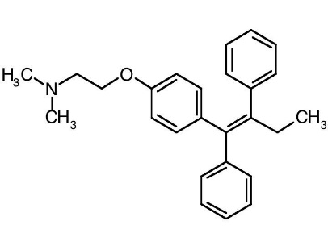
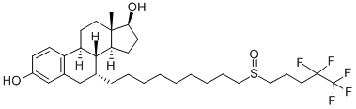
Introduction
Endocrine Therapy
ER Modulators
Tamoxifen
Fulvestrant
Pre-menopausal women
Pre- and post- menopausal women
Augusto TV et al. (2018) Endocr Relat Cancer;25(5):R283-R301

Slide 10
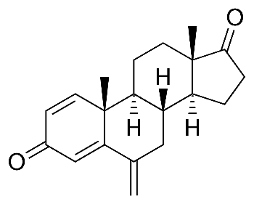
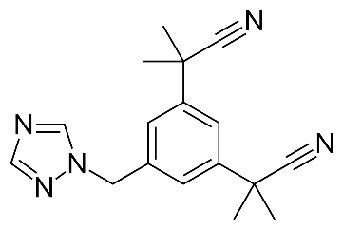
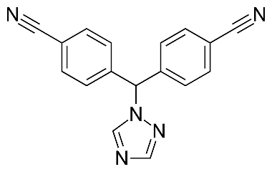
Introduction
Endocrine Therapy
Aromatase Inhibitors (AIs)
Non-Steroidal
Steroidal
Exemestane
Anastrozole
Letrozole
Post-menopausal women and pre-menopausal women after ovaries ablation
Augusto TV et al. (2018) Endocr Relat Cancer;25(5):R283-R301

Slide 11
And if we find a compound able to inhibit aromatase and simultaneously modulate ERs activity?

Slide 12
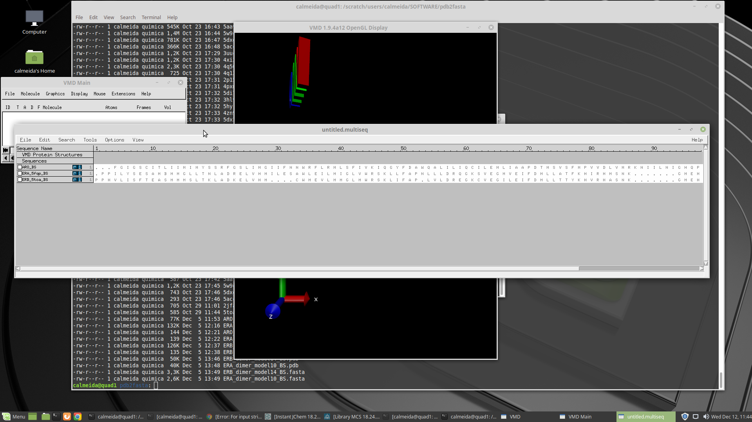
Sequence Alignment
Aromatase
ERα
ERβ
Aromatase
ERα
ERβ
. . .
Aromatase
ERα
ERβ
Conservation of important residues

Slide 13
Are the ligands of these targets similar?

Slide 14
Aim
Understand the specificities of each set of compounds that interact with each one of the three targets
Find the common features
Discover a multi-target compound

Slide 15

Results and discussion
2619 aromatase inhibitors
+
3701 ERα antagonists
+
665 ERβ agonists
=
6985
nM
1210 aromatase inhibitors
+
1557 ERα antagonists
+
73 ERβ agonists
=
2840

Slide 16
Results and discussion
Chemical Descriptors Evaluation – 1D Descriptors
The majority of the AIs has a molecular weight between 100 g/mol and 300 g/mol
ERα antagonists have higher molecular weights
AIs have volumes mainly between 301 Å³ and 600 Å³
ERα antagonists have higher molecular volumes

Slide 17
Results and discussion
Chemical Descriptors Evaluation – 1D Descriptors
The majority of AIs have log P values between 1.0 and 3.0
ERα antagonists presente log P values between 2.1 and 5.0
The majority of the compounds have 3 or 4 rings

Slide 18
Results and discussion
Chemical Descriptors Evaluation – 1D Descriptors
The majority of the compounds have between 2 and 5 donor groups
More than 60% of AIs do not have any acceptor group
ERα antagonists have tipically 2 acceptor groups

Slide 19
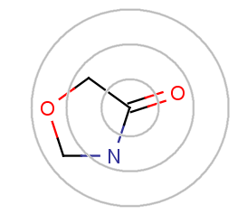
Results and discussion
Extended-Connectivity Fingerprints – 2D Descriptors
Constructed with ChemAxon software
Represent molecular structures by means of circular atom neighborhoods
ECFPs are circular topological fingerprints designed for molecular characterization, similarity searching and structure-activity models
Applied in VS studies
Source: ChemAxon

Slide 20
Results and discussion
2840 Compounds
75
Clusters
1
Similarity between 0.6 and 0.9
49
175 clusters
3
25
1
2
1
2 clusters containing compounds of the three targets

Slide 21
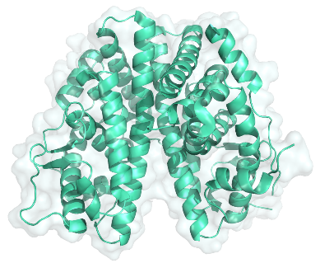
Results and discussion
The selected compound was designated as MT1
Aromatase inhibition
Aromatase
Human placental microsomes
MCF-7aro cells
ERα
Radiometric assay
Western-Blot
qPCR

Slide 22
Results and discussion
Anti-aromatase activity of MT1
Compound | Anti-aromatase activity (%)
MT1 (2 µM) | -2.81 ± 3.05
Exe (1 µM) | 97.86 ± 0.52
Ana (1 µM) | 99.12 ± 0.02
Let (1 µM) | 99.69 ± 0.06
MT1 is not able to inhibit aromatase

Slide 23
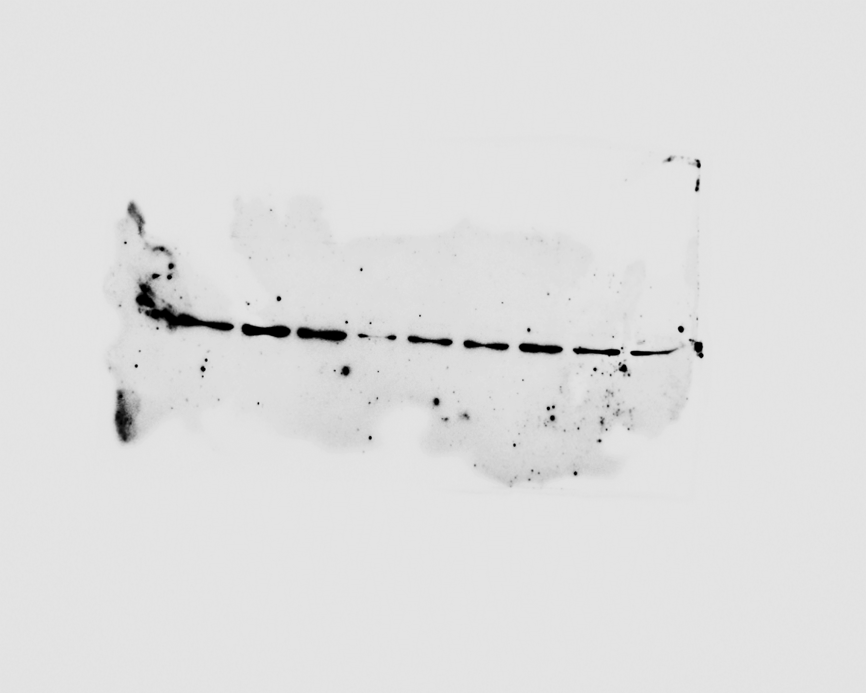
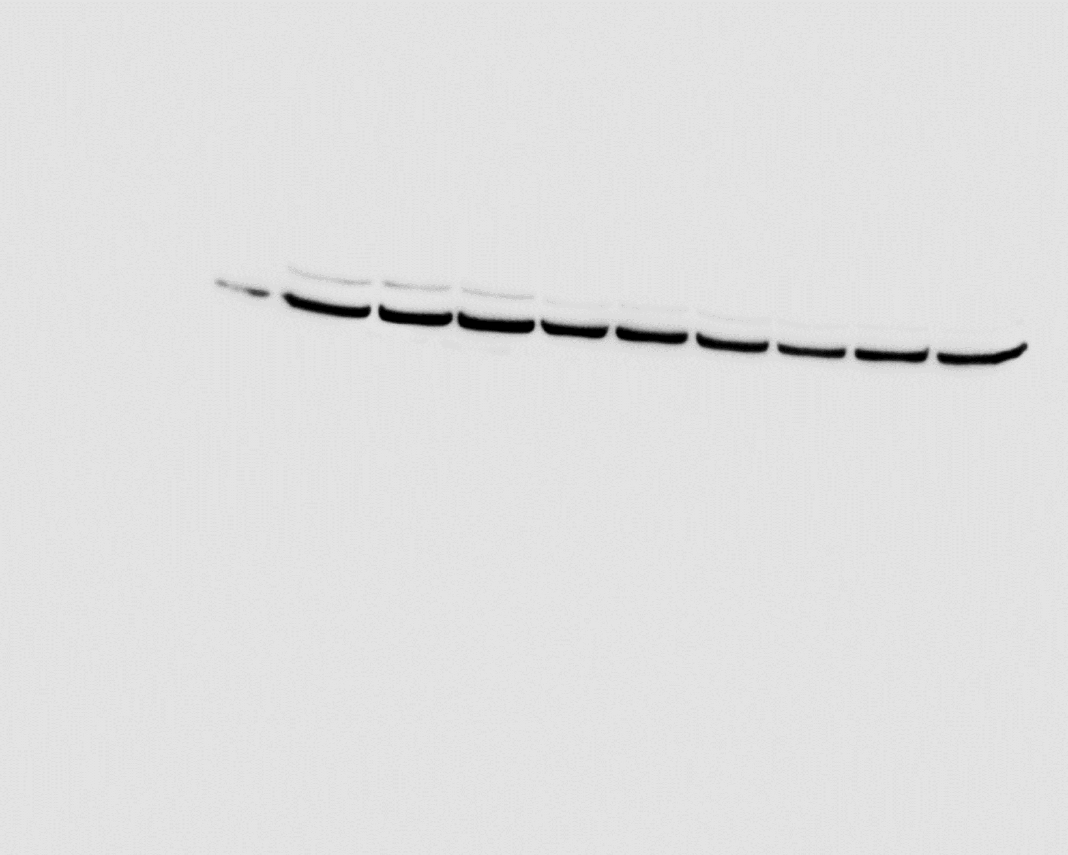
Results and discussion
MT1 effects on aromatase expression levels in MCF-7aro cells
Western-Blot of aromatase
A
Aromatase
58 kDa
β-tubulin
55 kDa
MT1 induced a decrease of 44% on aromatase expression levels

Slide 24
Are the effects induced by MT1 on aromatase expression levels a result of a decreased CYP19A1 gene expression or a consequence of aromatase degradation?

Slide 25
Results and discussion
MT1 effects on CYP19A1 transcription levels in MCF-7aro cells
PCR analysis
Housekeeping gene: α-tubulin
MT1 did not induce any change in CYP19A1 transcript levels

Slide 26
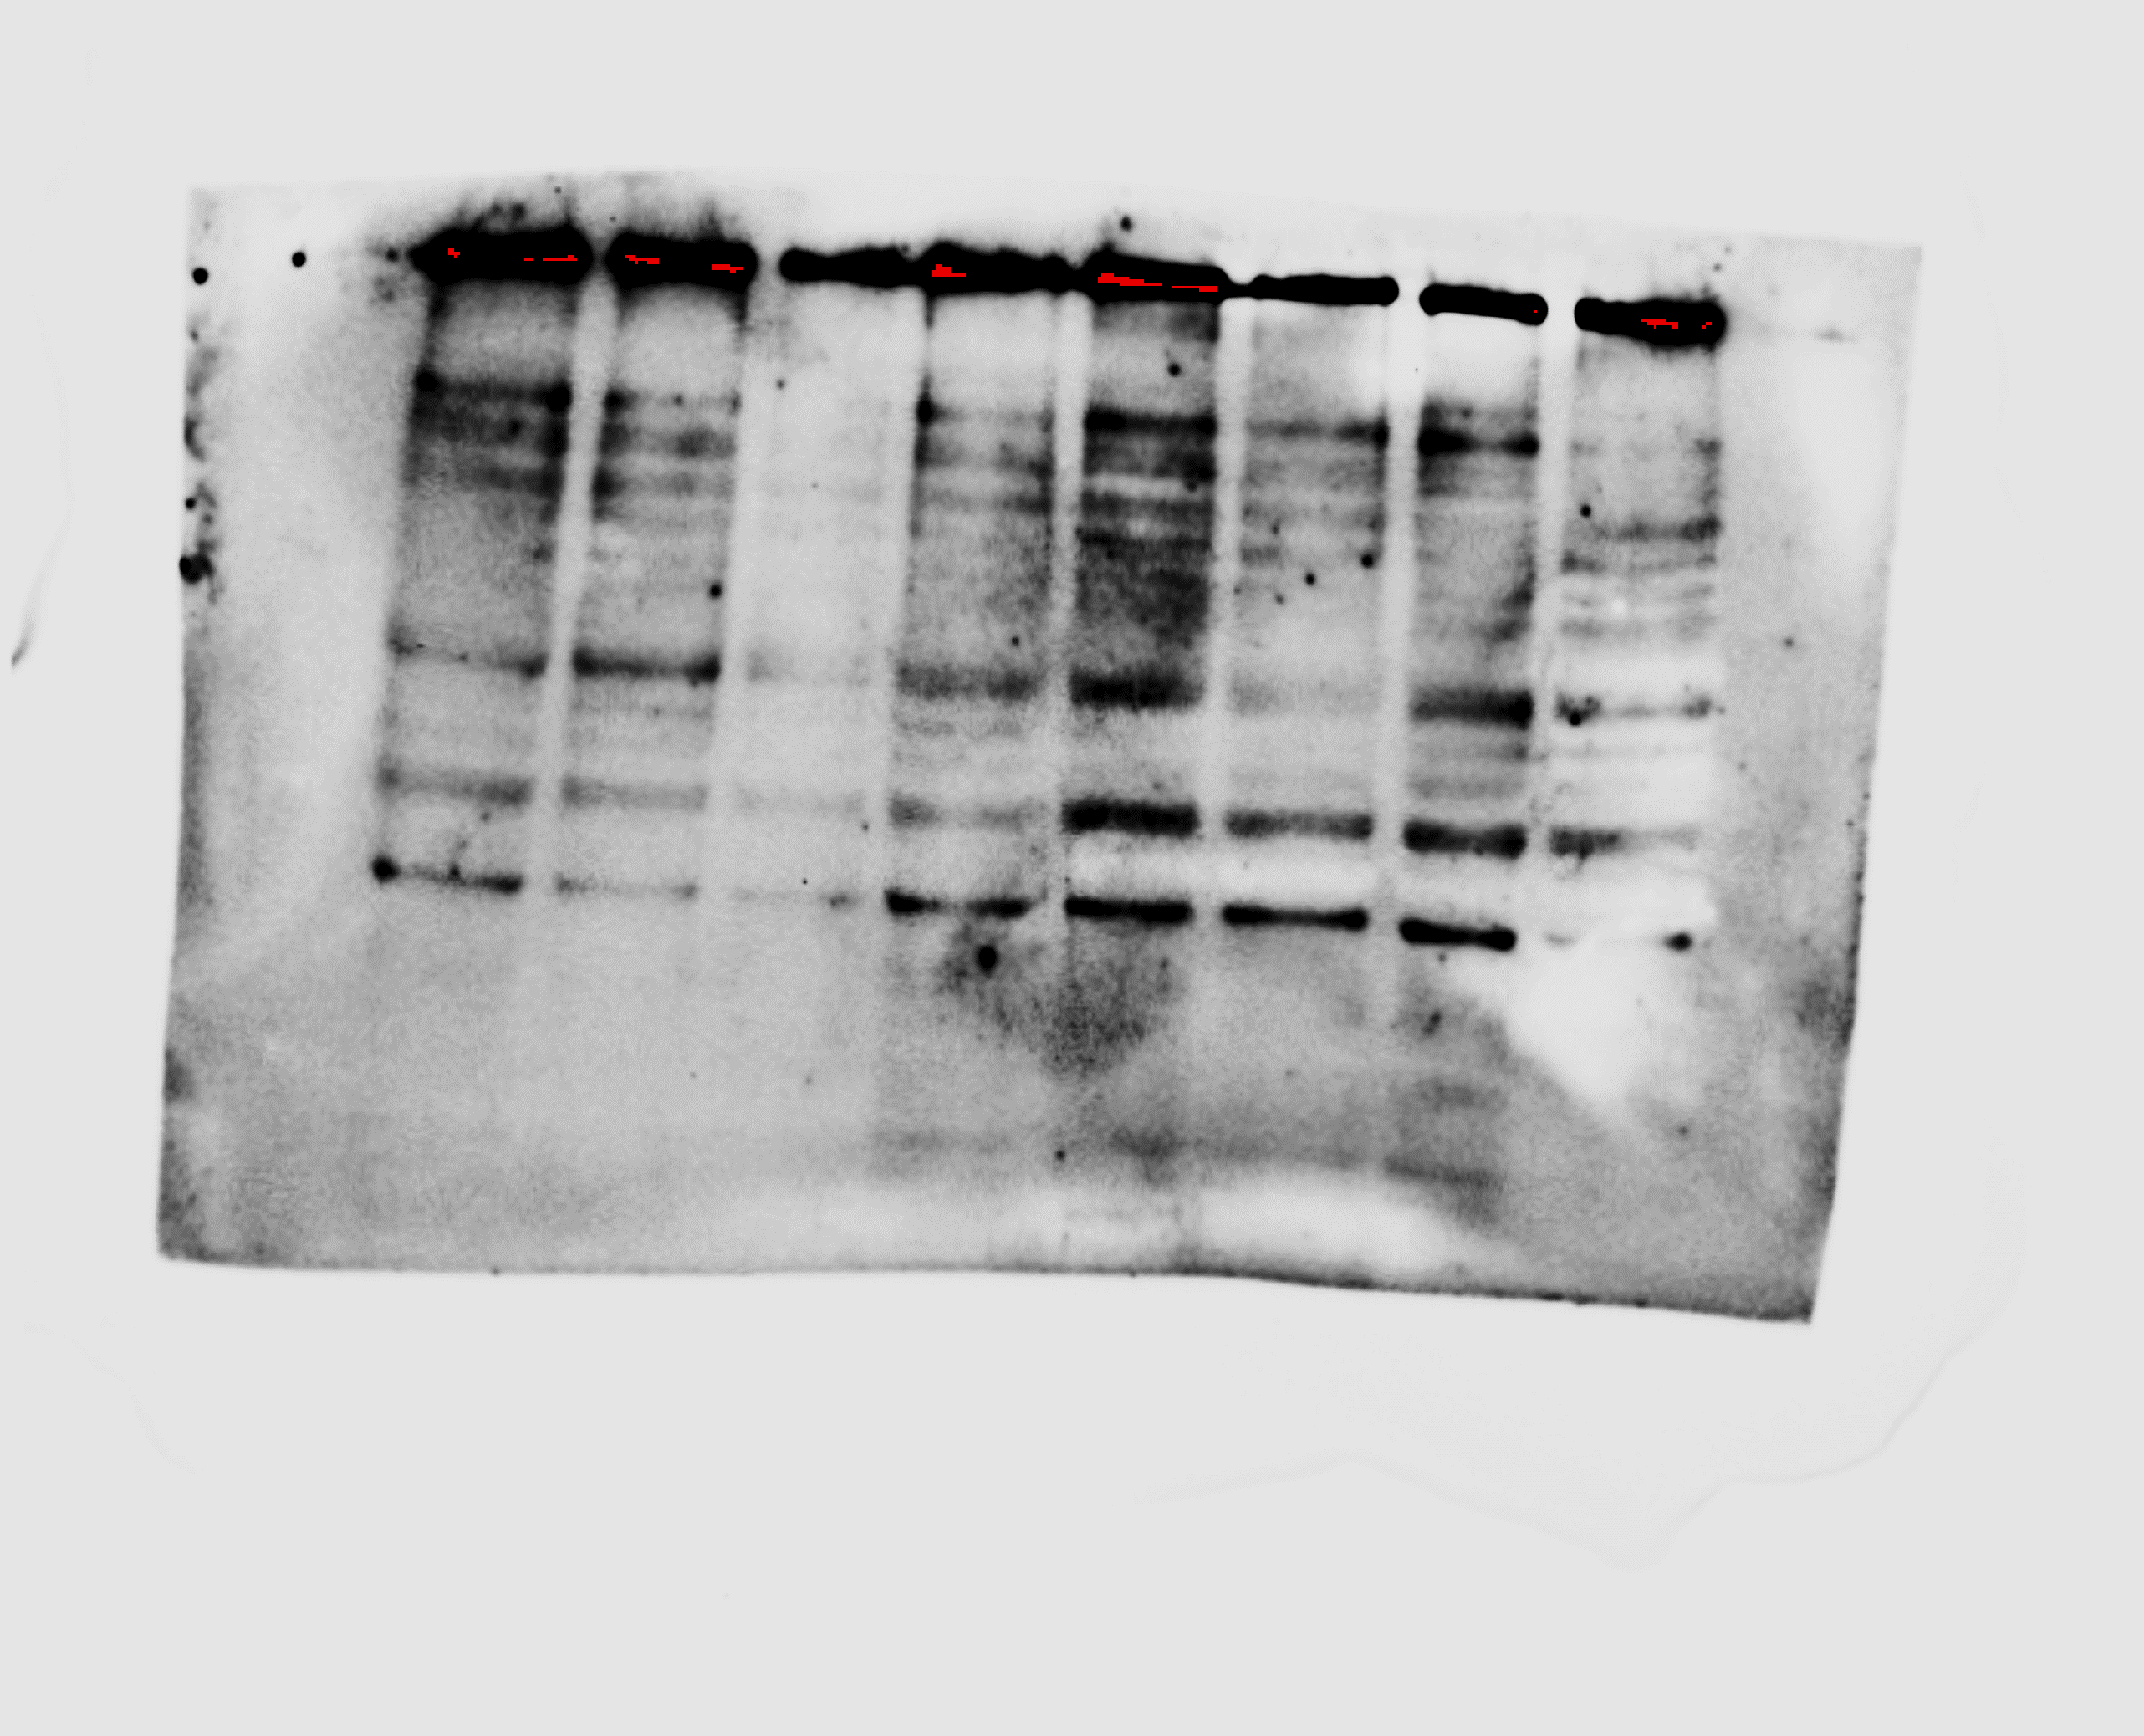
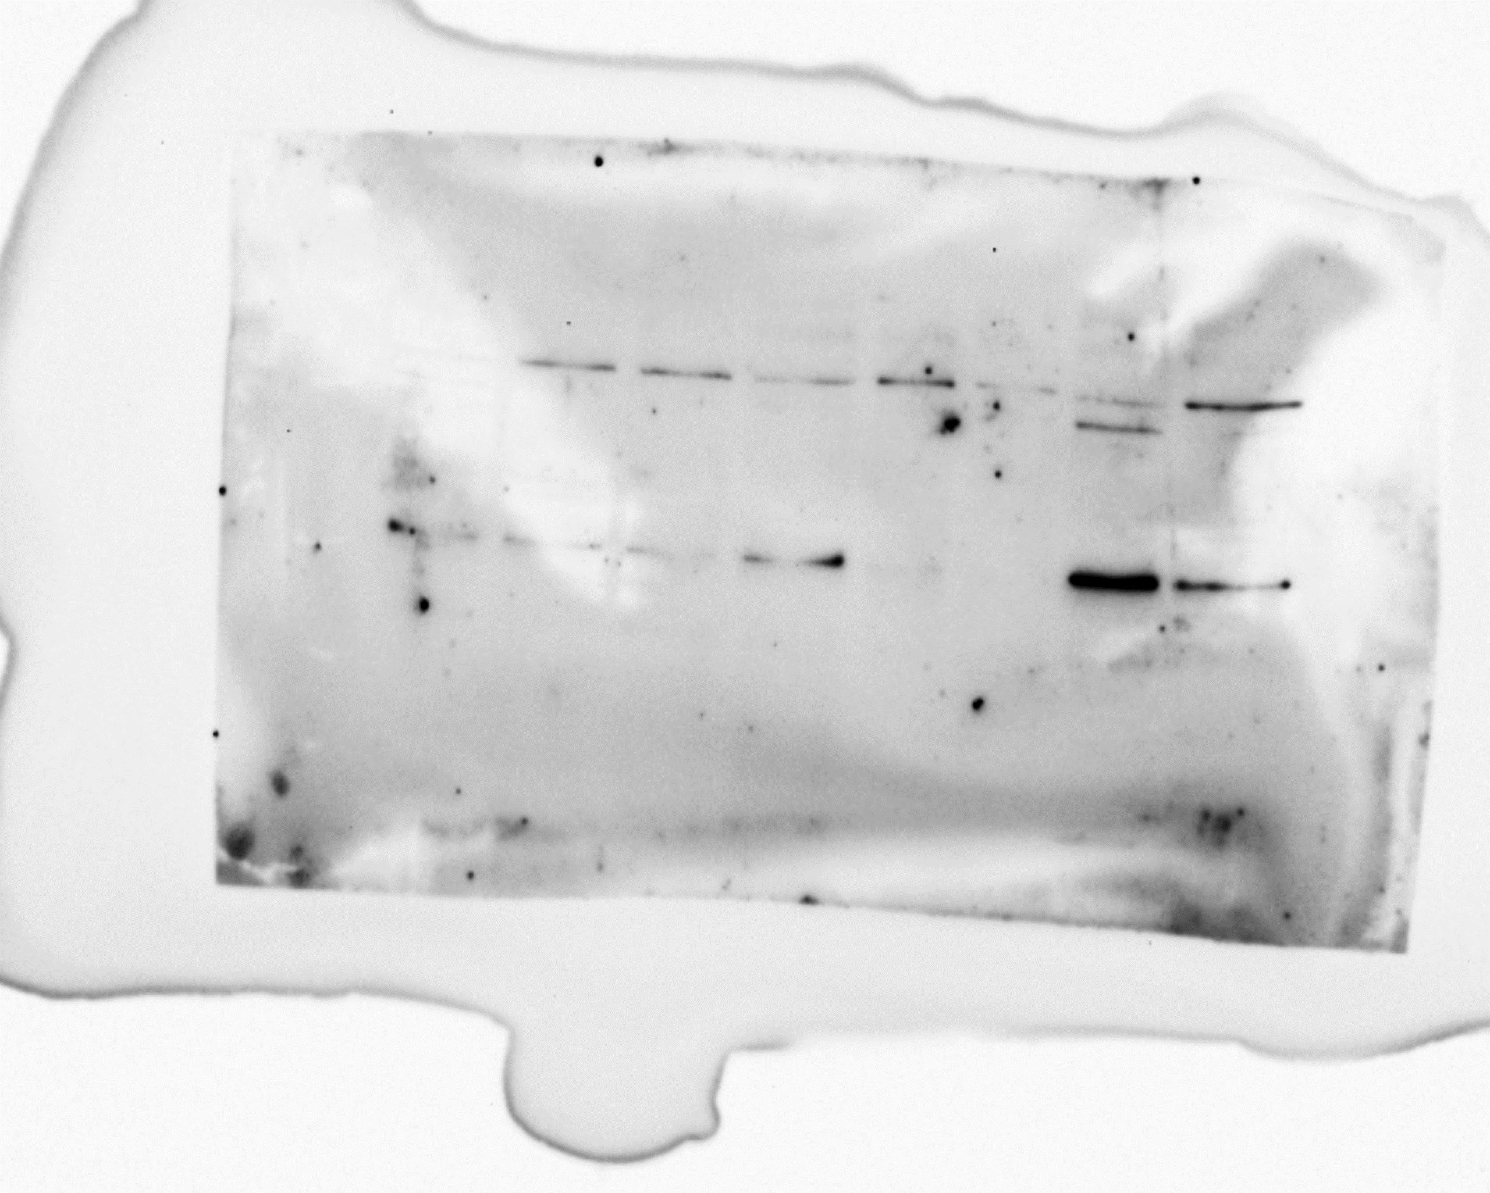
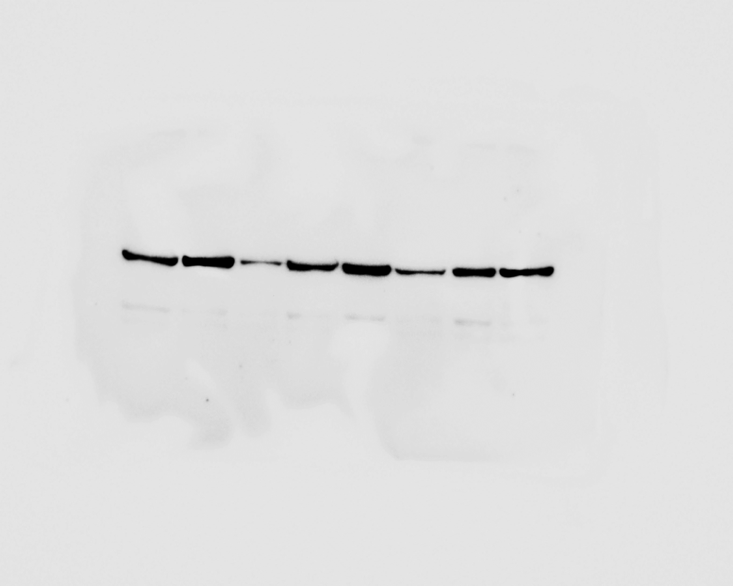


Results and discussion
MT1 effects on ERα activation in MCF-7aro cells
Western-Blot of ERα phosphorylation at Ser118 and Ser167
p-ERα^{S118}
(66 kDa)
p-ERα^{S167}
(66 kDa)
ERα
(66 kDa)
ERα
(66 kDa)
β-tubulin
(55 kDa)
β-tubulin
(55 kDa)
MT1 may act as an ERα antagonist

Slide 27
Conclusions
Molecular Descriptors analysis:
Aromatase inhibitors and ERα antagonists have similar values of molecular weight, volume, rings and donor groups.
The main difference among all the compounds is the number of acceptor groups
The compound selected, MT1:
Did not inhibit aromatase but induces aromatase degradation
Impairs ERα activation, acting as an ERα antagonist
MT1 is able to modulate two key targets of ER⁺ breast cancer, which represents a great advantage in this type of cancer

Slide 28

Hit to lead transformation
Alteration of the substituents
Strong compound
Weak compound

Slide 29
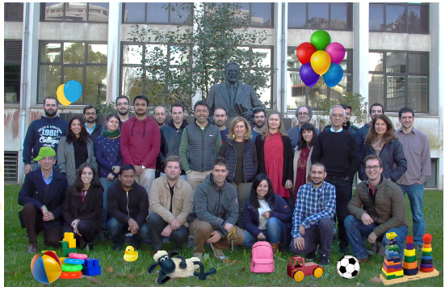




Acknowledgments
Cristina Almeida
Pedro A. Fernandes
Maria J. Ramos
Ana Oliveira
Cristina Amaral
Tiago Augusto
Natércia Teixeira
Georgina C. Silva
SFRH/BPD/98304/2013 attributed to Cristina Amaral
FCT/MCTES (UID/Multi/04378/2019)

