Slide 1
The in-silico identification of potent natural bioactive anti-dengue agents by targeting the human hexokinase 2 enzyme
Foysal Ahammad¹, Fazia Adyani Ahmad Fuad^{1,}*
¹ Department of Biotechnology Engineering, International Islamic University Malaysia, Kuala Lumpur 50728, Malaysia.
* Corresponding author: fazia_adyani@iium.edu.my

Slide 2
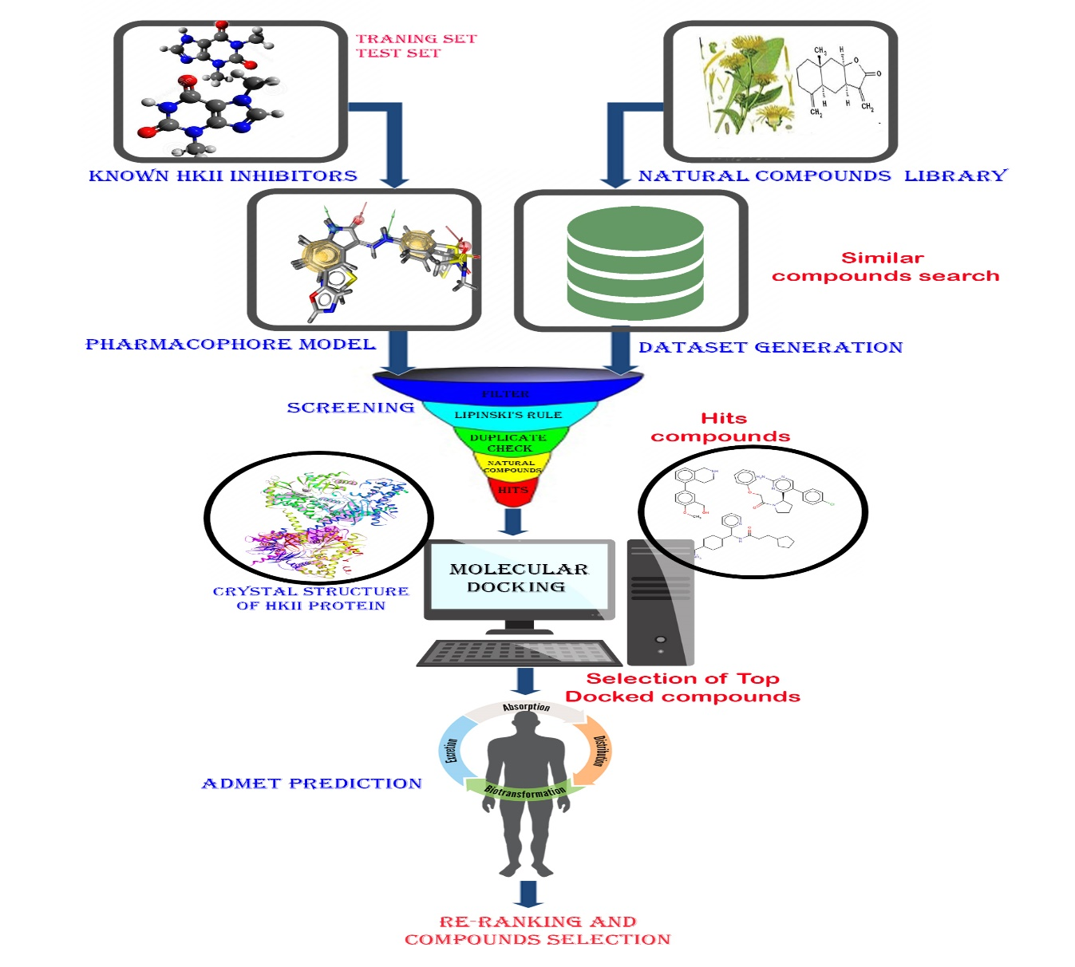
The in-silico identification of potent natural bioactive anti-dengue agents by targeting the human hexokinase 2 enzyme

Slide 3
Abstract:
Background: Hexokinase 2 (HKII) is a rate-limiting and the ﬁrst key enzyme of glycolysis, responsible for the biosynthesis of glucose-6-phospate (G6P) and is up- regulated in dengue virus (DENV) infected cells. During DENV infections, the glycolytic pathway of the host is activated by the pathogens, and inhibition of glycolysis by targeting HKII enzyme can signiﬁcantly block the infectious DENV production.
Objectives: The main aim of this study was to computer-aided identification of natural bioactive anti-dengue agents that can inhibit the activity of human HKII enzyme.
Methods: A ligand-based pharmacophore model (LBPM) was developed using previously known inhibitors of HKII enzymes to ensure the optimal molecular interactions with the specific target. Virtual screening (VS), molecular docking (MD) and the absorption, distribution, metabolism, excretion, and toxicity (ADMET) approaches were used to identify potential and specific natural human HKII inhibitors.
Result: Based on MD results and binding interaction analysis, four compounds D-Glucose hydrate, (2R,3R,4S,5S)-2,3,4,5,6-Pentahydroxyhexanal, (S)-2-Amino-3-hydroxy-N'-(2,3,4-trihydroxybenzyl) propanehydrazide hydrochloride, (2S)-2-Amino-3-hydroxy-N’, N'-bis[(2,3,4-trihydroxyphenyl)methyl] propanehydrazide were predicted to be the basis for lead optimization. They bind to the active site of human HKII and virtually behave as strong competitive inhibitors.
Conclusion: The results demonstrated 4 hits compatible with the active site of HKII enzymes. The current results will be further evaluated in the wet lab by both in vitro and in vivo testing for the development of potential DENV inhibitor.
Keywords: Virtual screening , Pharmacophore modeling, Molecular docking, in-silico drug design.

Slide 4
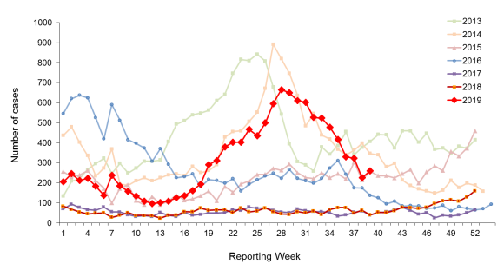
Introduction- Dengue as a matter of fact
There is no specific antiviral treatment currently available for dengue fever.
Annually 400 million people around the world infected by dengue virus, 50 million developed severe form of dengue and 25,000 death.
“WHO Dengue Situation Updates 579” 12,293 dengue case reported in 2019, which is higher than the same period in 2017 and 2018.
Dengue cases reported weekly in 2013-2019

Slide 5
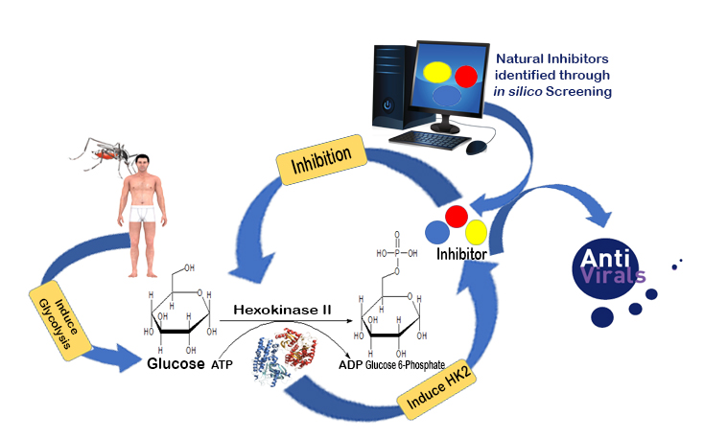
Introduction
Role of Hexokinase 2 (HK2) in dengue and effect of HK2 inhibition
The expression of hexokinase 2, the first enzyme of glycolysis, is upregulated in DENV-infected cells and Inhibition glycolysis targeting HK2 enzymes can significantly block the infectious DENV production.

Slide 6
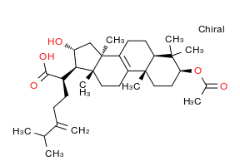
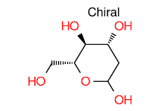
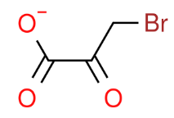
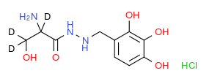
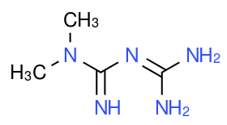
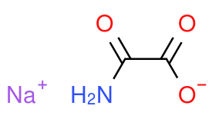
Results and Discussion- Known inhibitors of HK2 enzymes
An advance literatur search were performed for identification of known HK2 enzymes and six known inhibitors of human HK2 were identified
2-Deoxy-d-glucose (2-DG)
Pachymic acid (PA)
3-Bromopyruvate (3-BrP)
Benserazide (BZ)
Metformin (MF)
Sodium Oxamate (SO)

Slide 7
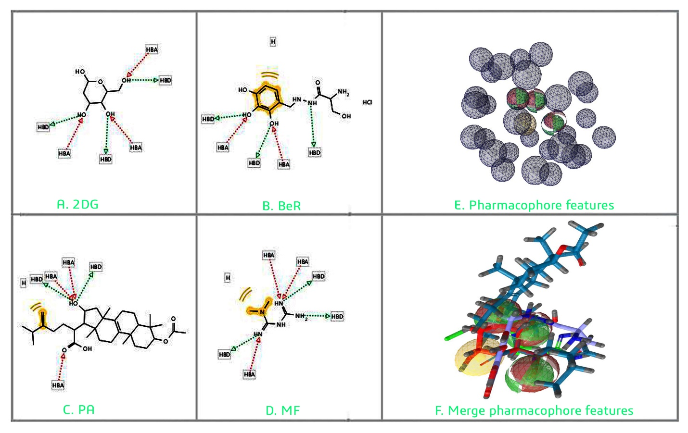
Results and Discussion- Pharmacphore Modeling
2-Deoxy-d-glucose (2DG), Pachymic acid (PA), Benserazide (BeR) and Metformin (MF) were selected as a Training-Set (TS) and 3-Bromopyruvate (3BP) and Sodium oxamate (SO) were selected as Test set . Total seven pharmacophore features was generated. LigandScout 3.12 software was used to pharmacophre model generation.
3 Red spheres shape indicating Hydrogen bond acceptor, 3 Green spheres shape indicating Hydrogen bond donar and 1 Yellow spheres indicating hydrophobic features of the training set.

Slide 8
Results and Discussion
Pharmacophore feature matching and Screening
Pharmacophore feature matching screening and receptor‑based docking approach was used for finding the novel hit compounds. Several drug databases (ZINC,Ambinter) were used for this study. The pharmacophore model was used as a 3D query for screening against the drug databases and 40 hits compounds was generated.
Known Inhibitors of
HKII enzymes
Similarity searching from natural compounds library
Pharmacophore Modeling using LigandScout
Screening compounds using common pharmacophore features
40 hits

Slide 9
Results and Discussion- Molecular Docking
The 40 hits compounds were docked using the PyrX AutoDock vina tool. The top 10% compounds were selected according to the lowest binding energy (binding energy ≥ -10 Kcal/mol).
Ligand ID | Compound Name | Binding Affinity (Kcal/mol)
Amb22230513 | D-Glucose hydrate | -10.20
Amb22262982 | (2R,3R,4S,5S)-2,3,4,5,6-Pentahydroxyhexanal | -10.10
Amb22747066 | (S)-2-Amino-3-hydroxy-N'-(2,3,4-trihydroxybenzyl) propanehydrazide hydrochloride | -10.20
Amb35803407 | (2S)-2-Amino-3-hydroxy-N’, N'-bis[(2,3,4-trihydroxyphenyl)methyl]propanehydrazide | -10.00
List of compounds selected based on molecular docking.

Slide 10
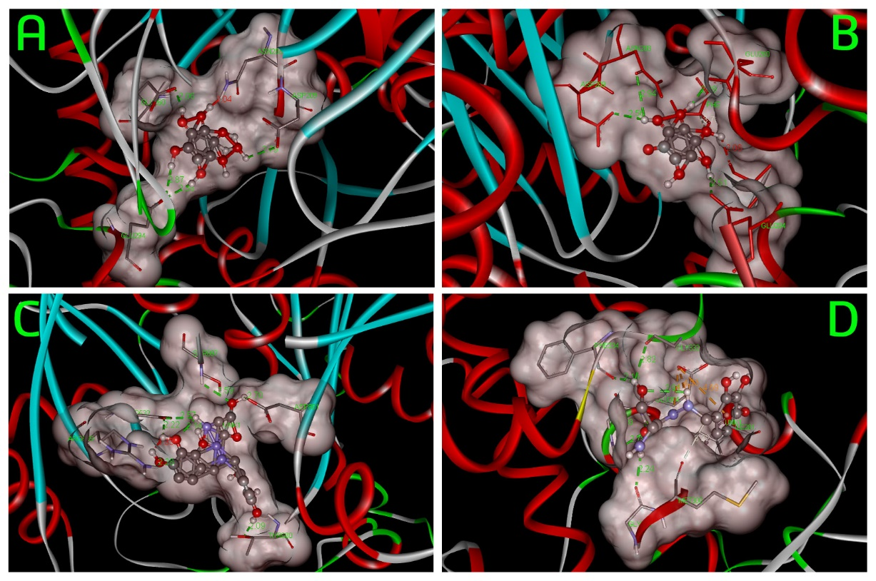
Results and Discussion- Interactions of 4 compounds with HKII
(A). D-Glucose hydrate, (B) (2S,3R,4R,5S)-2,3,4,5,6-Pentahydroxyhexanal, (C). (2S)-2 Amino-3-hydroxy-N’, N'-bis[(2,3,4-trihydroxyphenyl)methyl]propanehydrazide and (D). (S)-2-Amino-3-hydroxy-N'-(2,3,4-trihydroxybenzyl) propanehydrazide hydrochloride show the binding activities with HKII protein.

Slide 11
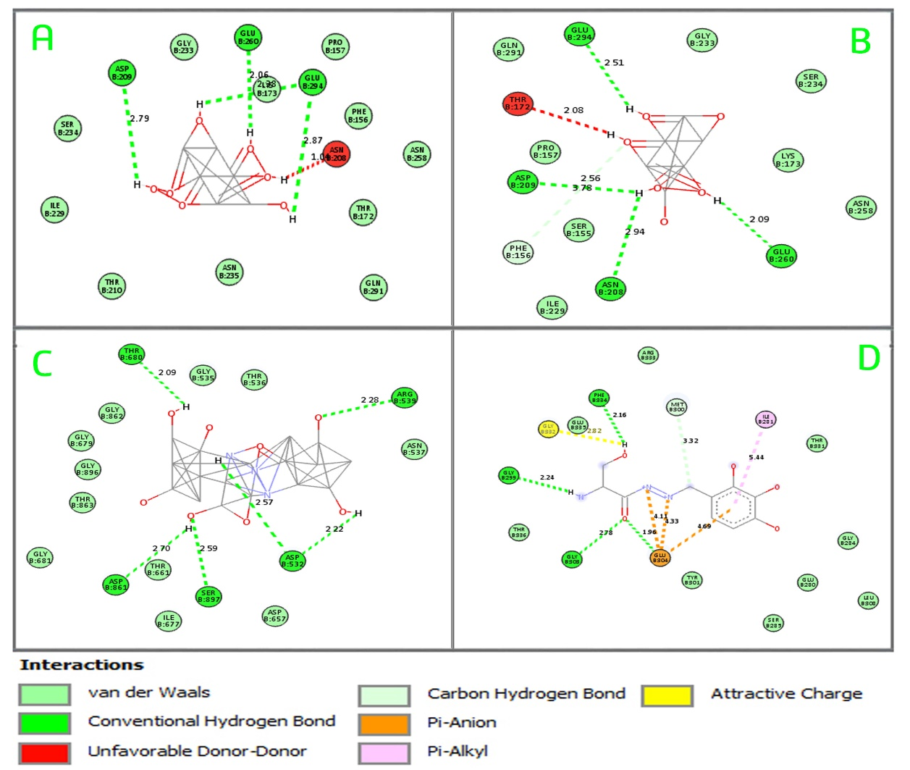
Results and Discussion- 2D Interactions of 4 compounds with HKII
(A). D-Glucose hydrate, (B) (2S,3R,4R,5S)-2,3,4,5,6-Pentahydroxyhexanal, (C). (2S)-2 Amino-3-hydroxy-N’, N'-bis[(2,3,4-trihydroxyphenyl)methyl]propanehydrazide and (D). (S)-2-Amino-3-hydroxy-N'-(2,3,4-trihydroxybenzyl) propanehydrazide hydrochloride show the binding activities with HKII protein.

Slide 12
Results and Discussion-
Absorption, Distribution, Metabolism, Excretion (ADME)
ADME properties of selected compounds were calculated by using the SwissADME server. Where GI absorptions were predicted according to the white of the BOILED egg.
Properties |  | Amb22747066 | Amb22230513 | Amb35803407 | Amb22262982
Physicochemical Properties | MW | 293.704 g/mol | 198.17 g/mol | 395.36 g/mol | 180.16 g/mol
 | Heavy atoms | 19 | 13 | 28 | 12
 | Arom heavy atoms | 6 | 0 | 12 | 0
 | Rotatable bonds | 6 | 5 | 8 | 5
 | H-bondacceptors | 7 | 7 | 10 | 6
 | H-bond donors | 7 | 6 | 9 | 5
Lipophilicity | Log P_{o/w} | -0.88 | -2.44 | -0.72 | -2.43
Water Solubility | Log S | Very high | Very high | Very high | Very high
Pharmacokinetics | GI absorption | Low | Low | Low | Low
Drug likeness | Lipinski | 1 Violation | 1 Violation | 2 Violation | 1 Violation
Medicinal Chemistry | Lead likeness | Yes | Yes | Yes | Yes

Slide 13
Results and Discussion- Toxicity Evaluation
The Toxicity Estimation Software Tool (TEST) was used to determine the toxicity of the selected compounds. In this study, the FDA and Consensus method were used to evaluate the toxicity and all of the 4 compounds have passed the toxicity test
Molecular ID With Ambinter Accession Number | 96-hour fathead minnow LC₅₀: -Log10(mol/L) |  | 48-hour D. Magna LC_{50:} -Log10(mol/L) |  | 48-hour T. pyriformis IGC₅₀ -Log10(mol/L) |  | Oral rat LD₅₀:-Log10(mol/kg) |  | Bioaccumulation factor Log10 |  | Developmental toxicity |  | Ames mutagenicity
 | Method
 | Con | FDA | Con | FDA | Con | FDA | Con | FDA | Con | FDA | Con | FDA | Con | FDA
Amb22747066 | 1.40 | 1.13 | 1.10 | 0.41 | N/A | N/A | 1.09 | 1.22 | N/A | N/A | N | N | N | N
Amb35803407 | N/A | N/A | N/A | N/A | N/A | N/A | 1.89 | 1.26 | N/A | N/A | N | N | N | N
Amb22262982 | 1.23 | 1.15 | 1.05 | 1.02 | 1.10 | 0.41 | 1.90 | 1.26 | N/A | N/A | N | N | N | N
Amb22230513 | 0.94 | 1.29 | 0.82 | 0.70 | 0.84 | 2.06 | 1.17 | 1.52 | -0.42 | 0.28 | N | N | N | N

Slide 14
Conclusion
Four inhibitory compounds chosen based on natural products have passed through a full cycle of in silico research.
The results demonstrated 4 hits compatible with the active site of HKII and have no or less toxicity.
The current results will be further evaluated in the wet lab by both in vitro and in vivo testing.
Acknowledgment
Authors thanks to the Ministry of Education Malaysia (MOE) for support the work through the fund's FRGS/1/2016/STG04/UIAM/02/1.

