Slide 1
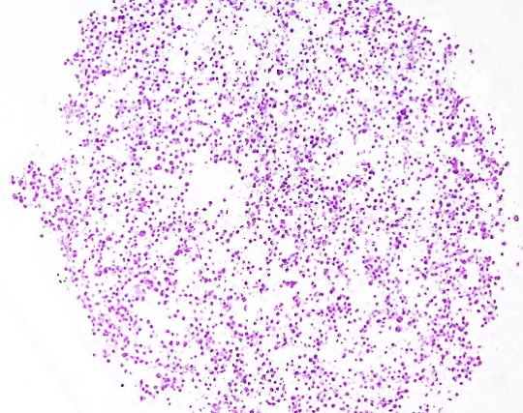
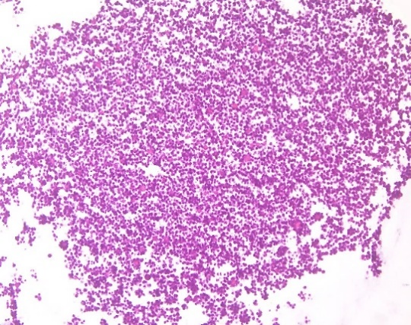
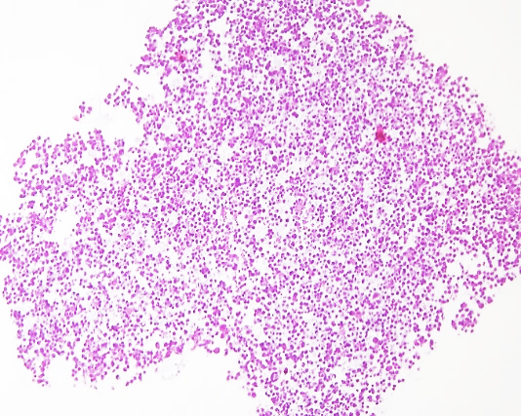
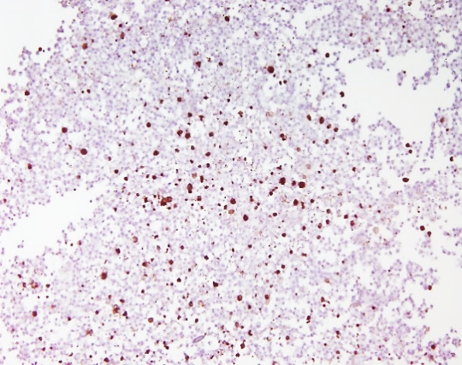
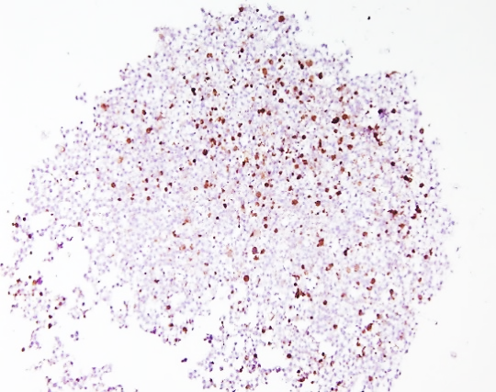
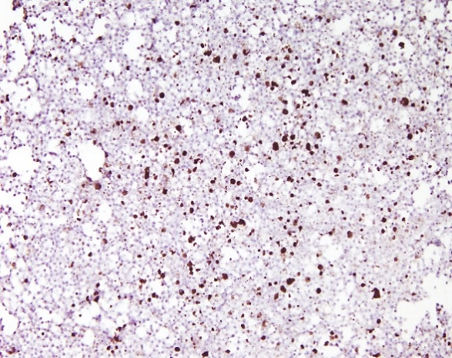
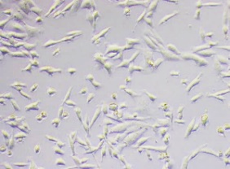
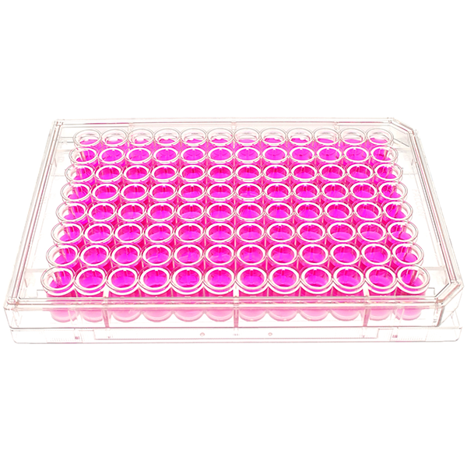
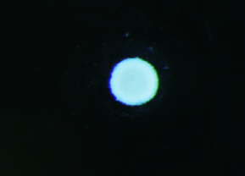
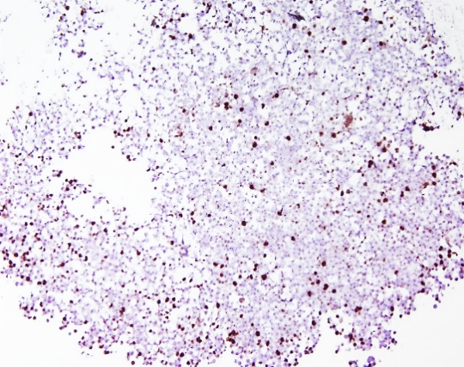
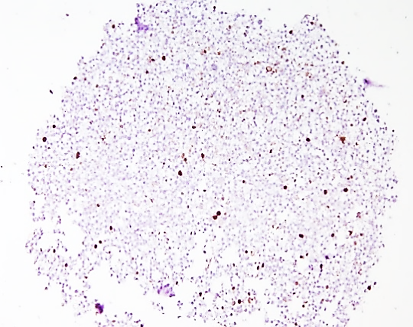
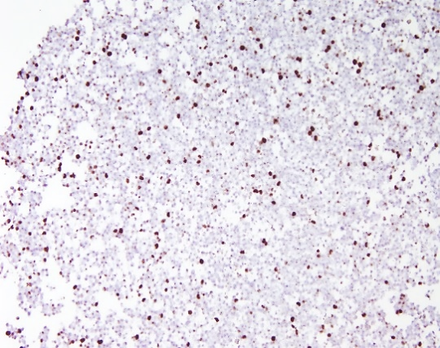
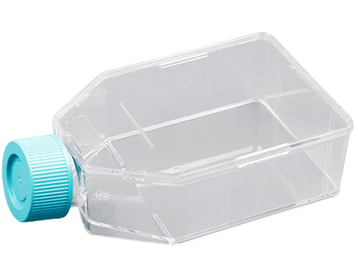
Anticancer activity of the seaweed compound fucoxanthin in breast cancer cell lines cultured as 2D and 3D models
Ana Catarina Macedo^{1,2}, Fernanda Malhão^{1,2}, Eduardo Rocha^{1,2}, Alice Ramos^{1,2}
¹ Laboratory of Histology and Embriology, Department of Microscopy, ICBAS - Institute of Biomedical Sciences Abel Salazar, University of Porto, Porto, Portugal.
² Team of Histomorphology, Physiopathology and Applied Toxicology, CIIMAR - Interdisciplinary Centre for Marine and Environmental Research, University of Porto, Matosinhos, Portugal.
Introduction
Breast cancer (BC) accounts for the most cancer-related deaths amongst women worldwide, implying an urgent need of finding new drugs more effective and less harmful than those currently in use [1]. Fucoxanthin (Fx) is a marine carotenoid derived from brown seaweed that has been showing antitumor effects on different cancer cell lines, mainly in 2D models [2]. However, 3D culture models have a better predictive capacity of in vivo cellular responses against cytotoxic compounds [3]. This study aimed to evaluate the potential anticancer effects of Fx versus Doxorubicin (Dox) (a conventional anticancer drug) in a panel of three BC cell lines representative of different molecular subtypes (MCF-7, SKBR3 and MDA-MB-231), and in a non-tumoral BC cell line (MCF-12A), cultured under 2D and 3D conditions.
Results and Discussion
2D cultures
3D cultures
Effects on cell viability and death
Effects on cell viability, proliferation and death
→ Fx and Dox induced cytotoxic effects on all the cell lines tested.
→ In 3D, cells were less responsive to Fx and Dox (no cytotoxic effects).
Figure 1- Effect of Fx and Dox on cell viability in MCF-7 (a), SKBR3 (b), MDA-MB-231 (c) and MCF12A (d) cell lines assessed by the MTT assay. Cells treated with 0.1% DMSO were included as negative control. Values are presented as mean + SD of at least three independent experiments. Significant differences (* P≤0.05 and ** P≤0.01) when compared with control were tested by one-way ANOVA, followed by post-hoc Holm-Sidak’s multiple comparison test.
Figure 3- Effect of Fx (10 µM) and Dox (1 µM) on the viability of MCF-7 (a), SKBR3 (b), MDA-MB-231 (c) and MCF12A (d) cell lines assessed by the MTT assay. Cells treated with 0.1% DMSO were included as negative control. Values are presented as mean + SD of at least four independent experiments. No significant effects were detected by one-way ANOVA analysis.
Dox increased cell death in MCF-12A cells.
No cell death or genotoxic effects registered in Fx-treated cells.
Dox affected the proliferation of SKBR3 and MCF-12 A cell lines. Also, there were less Ki67 positive cells in SKBR3 3D cultures treated with Dox.
Fx only caused antiproliferative effects on the SKBR3 3D models.
c)
Control
Dox
Fx
Figure 2- Effects of Fx (10 μM) and Dox (0.1 μM) on cell death in MCF-12A cells assessed by the nuclear condensation assay. Cells treated with 0.1% DMSO were included as negative control. Values are presented as mean + SD of at least three independent experiments. Significant differences (*** P≤0.001 and **** P≤0.0001) when compared with control were tested by one-way ANOVA, followed by post-hoc Holm-Sidak’s multiple comparison test.
HE
Experimental methodology
Caspase-3
Cell cultures
2D cultures
3D cultures
Ki67
Flat bottom microplates
Conical bottom ultra-low attachment microplates
Figure 4- Effect of Fx (10 µM) and Dox (1 µM) on cell proliferation of SKBR3 (a) and MCF-12A (b) cell lines, assessed by the BrdU assay. Cells treated with 0.1% DMSO were included as negative control. Values are presented as mean + SD of four independent experiments. Significant differences (* p < 0.05 and ** p < 0.01) when compared to the control were determined by one-way ANOVA, followed by a Holm-Sidak’s multiple comparisons test. Representative sections (c) of the SKBR3 3D models stained with haemotoxylin and eosin (HE) and immunostained against caspase-3 and Ki67 (brown staining) to assess cell death and proliferation, respectively. Scale bar: 200 μm.
Cancer cell lines – Molecular Subtypes
72 h exposure
2 h exposure
96 h exposure
→ MCF-7- Luminal A
→ SKBR3- HER2-enriched
→ MDA-MB-231- Triple-negative
→ MCF-12A
MTT assay
Nuclear Condensation assay
→ MTT assay
BrdU assay
Histological processing
Immunocytochemistry (Ki67 and caspase 3)
Conclusion
→ Comet assay
The in vitro data revealed that Fx may be a potential anticancer agent against BC cells, with differential effects according to the cell subtype. Also, the comparison between the two cell culture models indicated that cells’ resistance towards Fx and Dox anticancer activity increased under 3D conditions. The data warrants further studies on the underlying anticancer mechanisms.
Non-tumorigenic cell line
Acknowledgements
References
We thank the fundamental financial support of the ICBAS of the UPorto, namely via its Laboratory of Histology and Embryology and Master Program in Environmental Contamination and Toxicology. This research was also partially supported by the Strategic Funding UID/Multi/04423/2019 through national funds provided by FCT and ERDF, in the framework of the program PT2020. We also thank the team of Researcher João Paulo Teixeira of the Department of Environmental Health of National Institute of Health Dr. Ricardo Jorge (INSA) in the analysis of the comet assay data.
[1]- DeSantis, C.E. Bray, F. Ferlay, J. et al. (2015). Cancer Epidemiol Biomarkers Prev 24, 1495-506. DOI: 10.1158/1055-9965.EPI-15-0535
[2]-Kumar, S.R. Hosokawa, M. and Miyashita,K. (2013). Mar Drugs 11, 5130-47. DOI: 10.3390/md11125130
[3]-Santo, V.E. Rebelo, S.P. Estrada, M.F. et al. (2017). Biotechnol J 12, 1600505. DOI: 10.1002/biot.201600505

