Slide 1
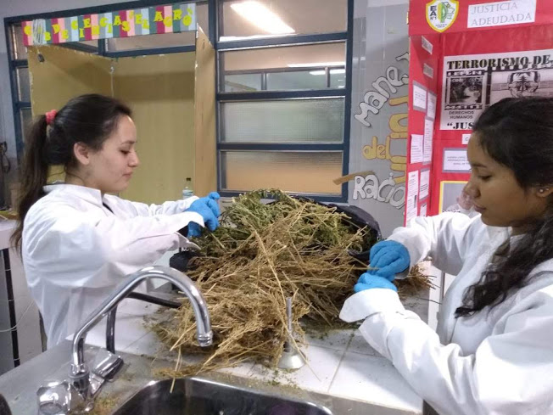
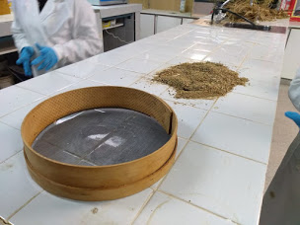
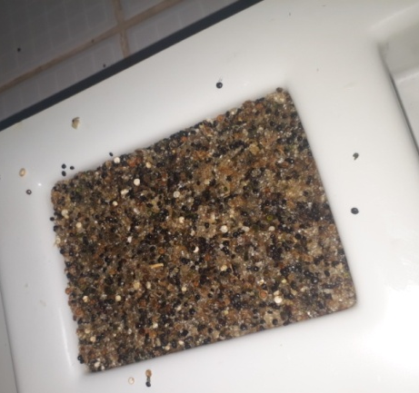
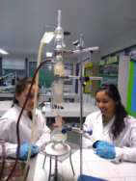
Food For Celiacs With Black Quinoa (Chenopodium petiolare kunth)
Authors: Melanie Mesa - Soledad Soto - Dr. Juan B. Beltramino
Provincial Agricultural School. N ° 1 - Gobernador Gregores Santa Cruz, Argentina.
INTRODUCTION
The manufacture of food products in southern Patagonia is characterized by having a high dependence on traditional raw materials for processing, which makes the sector, in any of its systems, family or intensive, highly unstable. Food manufacturing is currently limited mainly by the availability and high cost of conventional raw materials, necessary for processing. For this reason, the need to investigate new food sources that are economical, of high quality and available in our environment, quinoa ( Chenopodium quinoa ), can be a viable alternative in the partial replacement in the diet. This seed, being included as an unconventional raw material, for its excellent possibilities of adaptation to our environment and for having a protein of high biological value due to its high content of Lysine and its balance of essential amino acids, makes it comparable with other materials Premiums used in high quality diets.
Quinoa is a very valuable protein source in celiac disease because gluten is not among its protein fraction.
Obtaining an innovative product with great potential in the market that allows generating added value to the cultivation of grains such as quinoa, additionally that meet the expectations of consumers and contribute to a healthy and suitable diet for coeliacs.
FUNDAMENTAL COMPONENT: QUINOA
In the present trial we worked with wild quinoa seeds, of black color, that are born naturally in low areas, in Gobernador Gregores, it is a variety of small grain, bitter taste and with a high content of phenolic compounds. It was also used in the formulation of quinoa white bars. White quinoa has fewer saponins and is sweeter.
Quinoa is also called pseudocereal because it does not belong to the family of cereals, however thanks to its proportion of starch and its form of consumption it has been considered as a cereal. As such, quinoa provides most of its calories in the form of complex hydrates, but also provides about 16 to 25 g of protein per 100 g and offers about 6 g of fat in the same amount of food..
If compared with most cereals, it contains many more proteins and fats, although the latter are mostly unsaturated, highlighting the presence of omega 6 and omega 3 acids.
The biological value of the grains is due to the quality of the protein, that is to say its amino acid content. Significant amounts of all essential amino acids are found, particularly lysine, tryptophan and cystine.
To start using quinoa, it is important to pre-wash the seeds, rubbing them gently with your hands, under water, so that the layer of saponins that cover the seeds are removed and if they remain, it would give a bitter taste .
.
OBJECTIVE
Prepare a food for mass consumption, potentially suitable for celiacs from quinoa and honey from South Patagonia at low cost.
METHODOLOGY
It was searched in the area of ​​farms in the eastern part of the town that had the plant (wild quinoa), where whole plants were collected and in the period of seed. Visits were made to local quinoa and amaranth producers.
Laboratory work
Whole quinoa plants were taken to the school laboratory, allowed to dry at room temperature on the countertops and then extract the seeds, and separate leaves and stems.
The seeds were washed in beakers manually until they no longer produced foam. This was achieved after 3 or 4 washes.
Already dried they were crushed with mortar and pestle. A grind was obtained which was screened to obtain a crushing of 1000 microns of granulometry.
With the white quinoa, the same methodology was carried out as with the black quinoa, but in this case it was crushed until practically obtaining an integral flour of 300 microns.
School laboratory determinations:
Protein and lipid levels were determined from the white and black quinoa seeds in the form of a pool (50% of each). The determinations were made in triplicate by spectrophotometry for proteins and soxhlet for lipids.
FORMULATION OF THE BARS
Ingredients:
7 g of sucrose 20 g of Honey .
5 ml of soybean oil .
10 g white quinoa flour.
10 g crushed black quinoa.
.
RESULTS
The determinations of proteins and lipids in the school laboratory were: Protein level of Quinoa used, flour and crushed: 22%
Lipids: from the pool of both seeds: 2% (Since the percentages are so low, the results are not completely accurate).
The determinations of Proteins, carbohydrates and lipids of the bar were: Proximal calculations were performed:
Protteins 7,4%; Carbohiydrates 60,8:% Lípids 6,8%: Humidity 25%.
In every 100 g of quinoa bar there is an energy contribution of 368.1 calories.
CONCLUSION
It was possible to develop a product potentially suitable for coeliacs, rich nutritionally, using natural raw material from the Governor Gregores area and at a lower cost than commercial bars.

