Slide 1



Enhancing anticancer activity of spiropyrazoline oxindoles by disrupting p53-MDMs PPIs
Elizabeth A. Lopes^{1,}*, Margarida Espadinha¹, Matia Mori², Maurizio Botta², and Maria M. M. Santos^{1,}*
¹ Research Institute for Medicines – iMed.ULisboa, Faculty of Pharmacy, Universidade de Lisboa, Av. Prof. Gama Pinto, 1649-003 Lisbon, Portugal;
² Department of Biotechnology, Chemistry and Pharmacy, University of Siena, via Aldo Moro 2, 53100 Siena, Italy.
* Corresponding author: ed.lopes@ff.ulisboa.pt/mariasantos@ff.ulisboa.pt

Slide 2
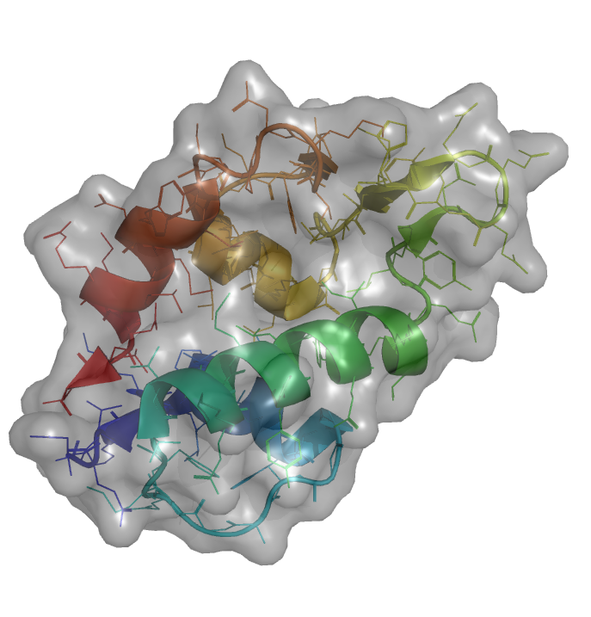
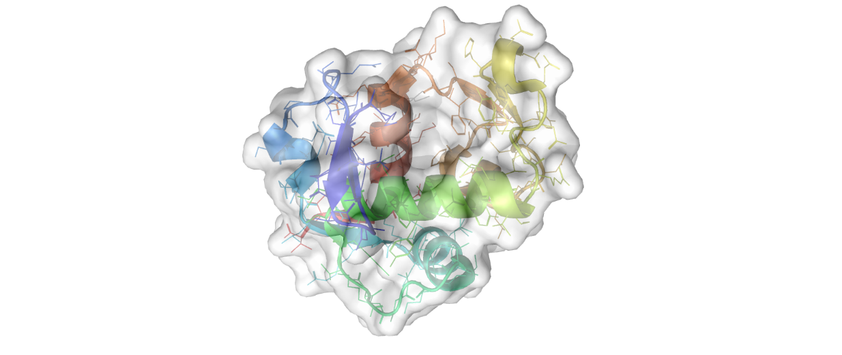


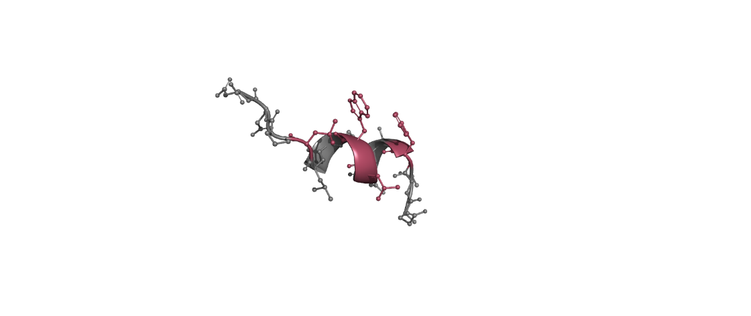
Enhancing anticancer activity of spiropyrazoline oxindoles by disrupting p53-MDMs PPIs
Graphical Abstract
MDMX
MDM2
inhibitor
TUMOUR SUPPRESSION
inhibitor
inhibitor
p53 Reactivation

Slide 3
Abstract:
The protein p53 is an attractive target in oncology because it can modulate several additional cellular processes that are relevant for the suppression of tumour development. In all types of human cancers, the p53 tumour suppressor function is inactivated by mutation or gene deletion or by negative regulators. For the full reactivation of wild-type p53, both interactions of p53 with the negative regulators have to be inhibited. Due to the lack of dual p53-MDM2/X PPIs inhibitors in clinical trials, it is urgent to develop small molecules that inhibit these interactions. Our research team has been working on the development of spiropyrazoline oxindoles to obtain dual p53-MDM2/X PPIs inhibitors. Hence, we have already developed derivatives with good antiproliferative activities in HCT-116 p53^{(+/+)} human colorectal carcinoma cell line, which induce apoptosis and cell cycle arrest at G0/G1 phase, and lead to a decrease of MDM2 levels. In this communication, we report the hit-to-lead optimization of this chemical family for the development of novel p53-MDM2/X interactions inhibitors. Furthermore, we report our most recent optimization of the synthesis of these new spiropyrazoline oxindoles derivatives and the first preliminary biological results.
Keywords: p53 activation, spiropyrazoline oxindoles, MDM2, MDMX

Slide 4

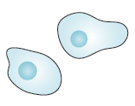
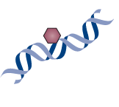


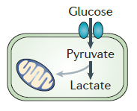



Introduction – p53 tumour suppressor
triggers
Cell cycle arrest
Apoptosis
Cell under stress
DNA repair
Senescence
p53 is activated
Oxidative stress
Hypoxia/ Anoxia
Activation autophagy
Inhibition stem cell self-renewal
Ribonucleotide depletion
Opposing metabolic reprogramming
Telomere erosion
Nutrient deprivation
Replication stress
Promote communication
within tumour microenvironment signalling
DNA damage
Restrain invasion and metastasis
Nature Reviews. Cancer 2014, 14, 359-370.
TUMOUR SUPPRESSION

Slide 5
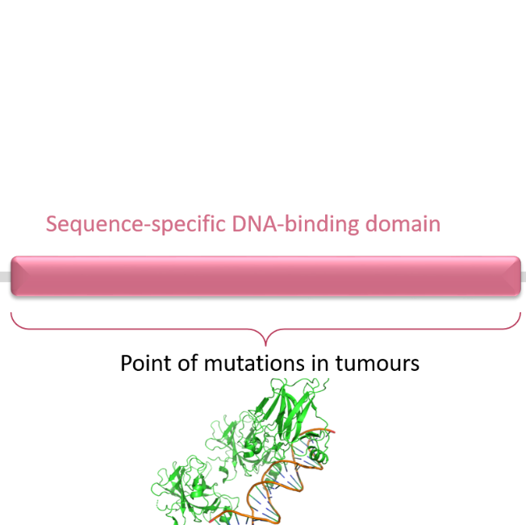


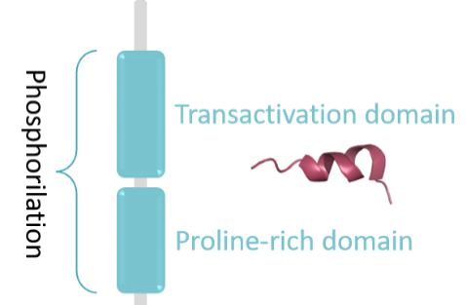
Introduction – p53 inactivation in tumours
The p53 tumour suppressor function is inactivated in all tumours
Strategies to reactivate:
Inhibit p53-MDM2/X interactions
Strategies to reactivate:
Give p53 original conformation
Full reactivation of p53 can only be achieved by inhibition
of dual p53-MDM2 and p53-MDMX PPIs
Curr. Topics Med. Chem. 2018, 18, 647-660.

Slide 6
Introduction – p53-MDM2 and p53-MDMX PPIs inhibitors in clinic
MDM2
MDMX
7 small molecules in clinical trials
1 stapled peptide in clinical trials
NO DUAL INHIBITORS
IN CLINICAL TRIALS
Curr. Topics Med. Chem. 2018, 18, 647-660.

Slide 7
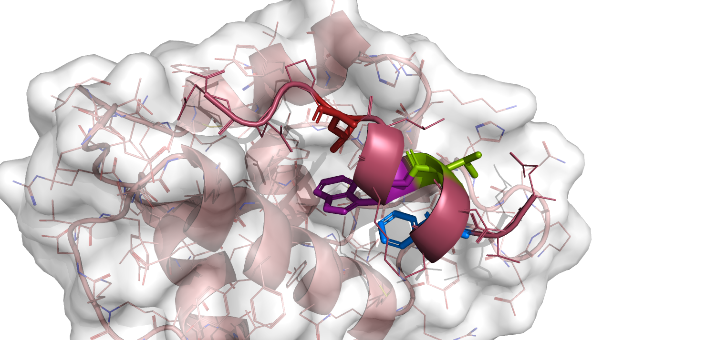
Introduction – Understanding MDM2 and MDMX pockets
MDM2
Interacts with p53 by 4 amino acid residues: ^{p53}Phe19, ^{p53}Leu22, ^{p53}Trp23, ^{p53}Leu26
Intermolecular van der Waals contacts
Two hydrogen bonds
  NH of ^{p53}Trp23 with ^{MDM2}Leu54 (2.8Å)
  NH of ^{p53}Phe19 with ^{MDM2}Gln72 (3.0Å)
Important pharmacophore feature
Trp23 sub-pocket can adapt its side chain depending on the groups in the Trp23 and Leu26 sub-pockets
^{MDM2}His96 (Leu26 sub-pocket) can adapt its side chain
Leu26
Leu22
Other important features:
π-π stacking interaction with ^{MDM2}His96 (enthalpic based binding)
^{MDM2}Tyr67 “out conformation” of Phe19 sub-pocket enlarges the space and leads to higher affinity
Trp23
Phe19
ChemMedChem 2019, 14, 1-11.

Slide 8
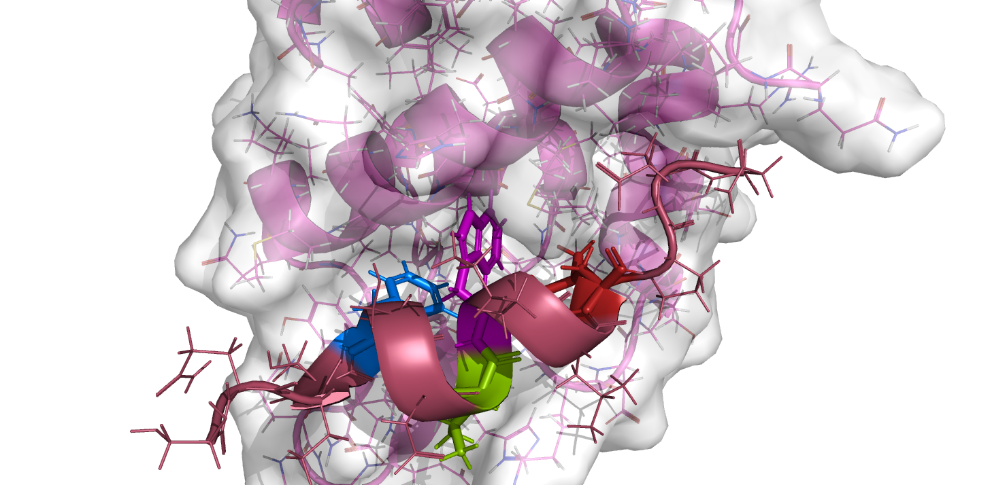
Introduction – Understanding MDM2 and MDMX pockets
MDMX
Interacts with p53 by 4 amino acid residues: ^{p53}Phe19, ^{p53}Leu22, ^{p53}Trp23, ^{p53}Leu26
Phe19 sub-pocket similar to MDM2
Trp23 sub-pocket is 2.0 Å shorter
^{MDM2}His96 is replaced by ^{MDMX}Pro96 residue
  No longer π-π stacking interaction is needed
^{MDM2}Leu54 and ^{MDM2}Ile99 are replaced by ^{MDMX}Met54 and ^{MDMX}Leu99
  Leu26 pocket is more shallow and deeper
Phe19
Trp23
Leu26
Other important features:
Carboxylate group can induce a flip of His55 enabling a strong hydrogen bond
  Water-mediated hydrogen bond with Lys51
Interactions with His55 can compensate weaker interactions in the Leu26 and Trp23 sub-pockets
Induction of dimerization of MDMX complexes
ChemMedChem 2019, 14, 1-11.

Slide 9
Introduction – Spirooxindoles
antimalarials
Biological activities of spirooxindoles
anticancer
Spirooxindoles
antimicrobial
antipyretic
First spirooxindole derivative synthetized by our group
Spiropyrazoline oxindoles
Substituents mimic the 4 amino acid residues of p53:
Spiroisoxazoline oxindoles
Library of 18 new compounds;
Tested in human colorectal carcinoma cell lines
p53-MDM2 interaction inhibitor.
Phe19
Leu22
Trp23
Leu26
Introduction of a fourth substituent
Bioorg. Med. Chem. 2014, 22, 577-584

Slide 10


Introduction – Spiropyrazoline oxindoles
Ph, p-OMePh, t-Bu
Identified as hit compounds
Ph, p-OMePh, CO₂Et, COPh,
H, Ph, o-ClPh
H, 5-F, 5-Br, 5-Cl, 6-Cl, 6-Br, 7-Cl
Library of 32 new compounds
Evaluated in human colorectal carcinoma cell line HCT-116 p53^{(+/+)} (wild-type p53)
Non-cytotoxic against HEK293T cell line up to 100 μM
Selected for further studies, including molecular docking
Disrupt p53-MDM2 PPI (BiFC assay)
Decrease MDM2 level
  Other mecanisms besides p53-dependent effects
Induce apoptosis
Induce cell cycle arrest in G0/G1 phase in a time-dependent manner
Eur. J. Med. Chem. 2014, 79, 266-272. Eur. J. Med. Chem. 2017, 139, 168-179.

Slide 11
Results and discussion – Synthesis
1,3-dipolar cycloaddition
Nitrile imine formed in situ
One step
Hydrazonyl Chlorides
3-Alkenyl Oxindoles
R⁴ : Alkyl or Aromatic
R⁵ : Aromatic
High yields
Commercially available starting materials
Eur. J. Med. Chem. 2014, 79, 266-272. Eur. J. Med. Chem. 2017, 139, 168-179. Frontiers in Chemistry 2019, 7, article 15.

Slide 12
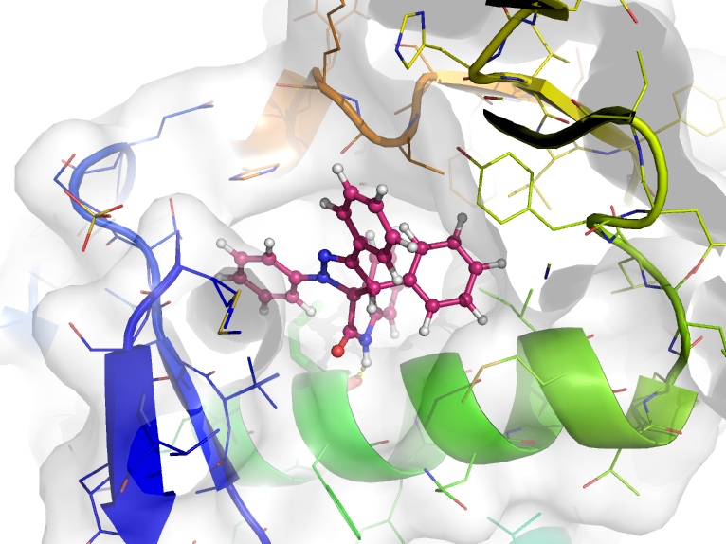
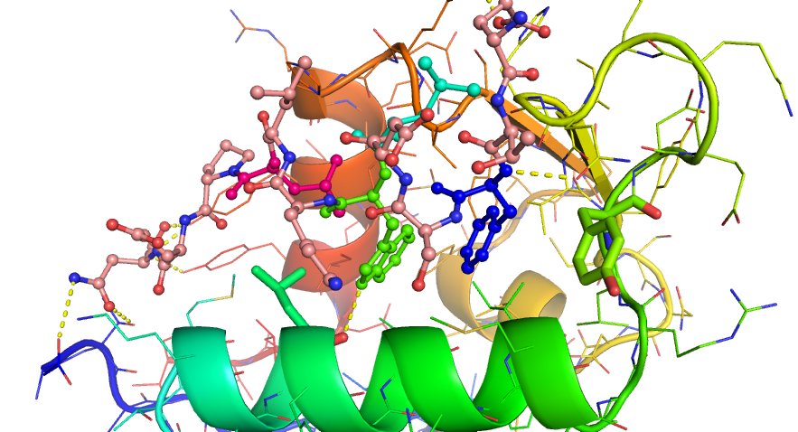


Results and discussion – In silico design
Docking pose of the binding of hit compound already identified and MDM2 (PDB ID 4WT2)
MDM2
cation-π interaction
Ph ring and aromatic ring of ^{MDM2}His96
π-π interaction
Ph ring and ^{MDM2}Tyr67
Hydrogen bond
NH of indole moiety and C=O of ^{MDM2}Leu54
Ligand energy minimization: SZYBKI (force field MMFF94S)
Software: Fred 3.2.0.2 (rigid receptor)
Validation with redocking of SAR405838

Slide 13
Results and discussion – In silico design
MDM2 optimizations
Leu22 pocket
Phe55 -
Ser92 -
Val93 -
Lys94 -
Glu95 -
Groups with hydrogen donors and chemical groups to increase solubility
Phe19 pocket
Highly hydrophobic pocket
- Gly58
- Gln59
- Ile61
- Met62
- Tyr67
- Val75
Val14 -
Thr15 -
Thr16 -
Ile19 -
Gln24 -
His96 -
Arg97 -
Tyr100 -
Leu26 pocket
- Leu54
- Leu57
- Leu82
- Phe86
- Phe91
- Val93
- Ile99
- Ile103
Very small pocket that only fits aromatic rings with small halogen atoms
Trp23 pocket
Small groups occupy a very small pocket inside the Trp23 pocket

Slide 14
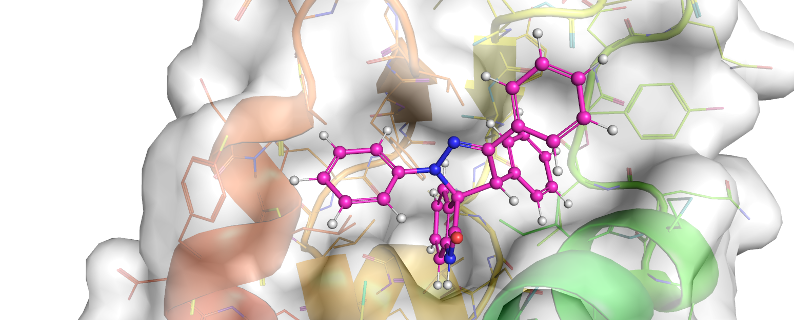
Results and discussion – In silico design
Docking pose of the binding of hit compound already identified and MDMX (PDB ID 3LBJ)
MDMX
Mainly hydrophobic interactions
No hydrogen bonds
Ligand energy minimization: SZYBKI (force field MMFF94S)
Software: Fred 3.2.0.2 (rigid receptor)
Validation with redocking of WK298 (MDMX)

Slide 15
Results and discussion – In silico design
MDMX optimizations
Leu22 pocket
Glu70 -
Gln71 -
His72 -
Lys93 -
Groups with hydrogen bearing groups and charges
Increases solubility
Phe19 pocket
Highly hydrophobic pocket with possible hydrogen bonds in residues such as Tyr and Gln
Flexible groups
- Ile60
- Met61
- Leu65
- Tyr66
- Gln71
- Val74
- Met54
- Leu56
- Gln57
- Leu81
- Leu85
- Phe90
- Lys94
- Val92
- Leu98
Val92 -
Pro95 -
Leu98 -
Tyr99 -
Leu26 pocket
Trp23 pocket
Small groups occupy a very small pocket inside the Trp23 pocket
Elongated hydrophobic pocket with hydrogen donor groups
Flexible groups

Slide 16

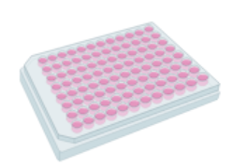
Results and discussion – Biological evaluation
A NEW CHEMICAL LIBRARY OF 30 COMPOUNDS
MDM2 fluorescence polarization (FP) competitive binding assay
Screening of the new library in human colorectal carcinoma cell lines
  HCT116 p53^{(+/+)}
  HCT116 p53^{(-/-)}
Current work
Hit compound (IC₅₀=10µM)
2 new compounds more active than the positive control

Slide 17
Conclusions
Synthesis
Spiropyrazoline oxindoles are synthetized by 1,3-dipolar cycloaddition between 2-indolinones and nitrile imines form in situ from hydrazonoyl chlorides.
In silico design
Spiropyrazoline oxindoles establish the two important pharmacophore interactions: the hydrogen bond between ^{MDM2}Leu54 and NH of the indole moiety and π- π stacking interaction with ^{MDM2}His96
Possible interactions around MDMX binding pocket can lead to extra interaction between MDMX and spiropyrazoline oxindoles and help to keep the ligand in the binding pocket.
Biological evaluation
It was identified a hit compound by MDM2 fluorescence polarization (FP) competitive binding assay.
Currently, it is being performed a screening in several cancer cell lines with wild-type p53.
MDMX competitive binding assay – FUTURE WORK

Slide 18
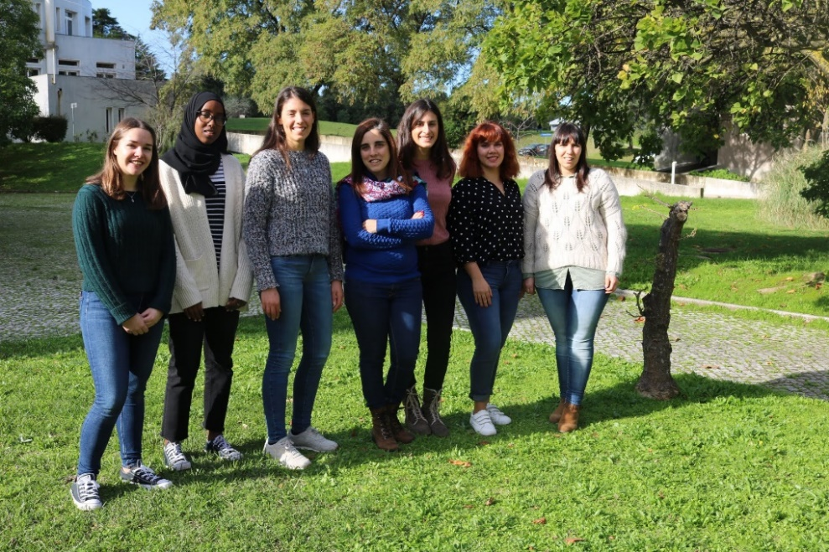
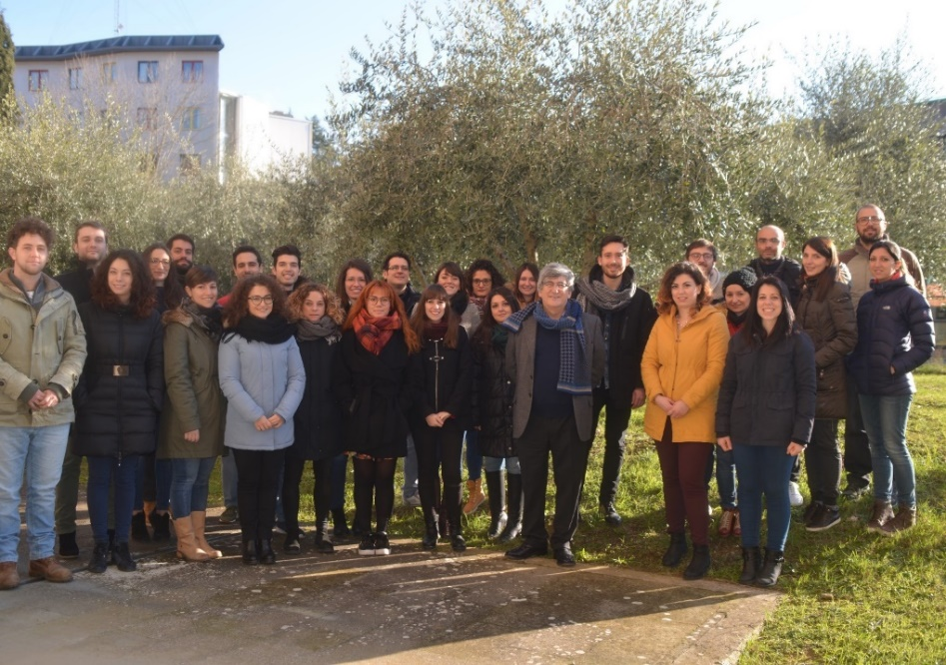



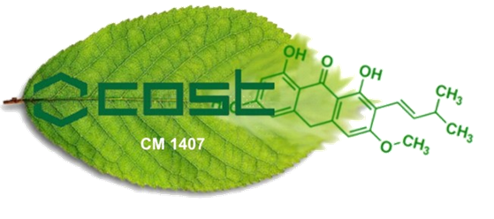

Acknowledgments
Fundings:
UID/DTP/04138/2019
CEECIND/01772/2017
PTDC/QUI-QOR/29664/2017
SFRH/BD/117931/2016
SFRH/BD/137544/2018
STSM grant 39244
Dr Maria M. M. Santos
Margarida Espadinha, MSc
Prof Cecília Rodrigues
Prof Maurizio Botta
Dr Mattia Mori
Prof Shaomeng Wang

