Slide 1
In vitro toxicity of α-amanitin in human kidney cells and evaluation of protective effect of polymyxin B
Rui Malheiro ^{1,}*, Vera Marisa Costa ¹, Maria de Lourdes Bastos¹ and Félix Carvalho ¹
¹ UCIBIO, REQUIMTE, Laboratory of Toxicology, Faculty of Pharmacy, University of Porto, Rua Jorge Viterbo Ferreira, 228, 4050-313, Porto, Portugal
* rui_malheiro@outlook.com

Slide 2
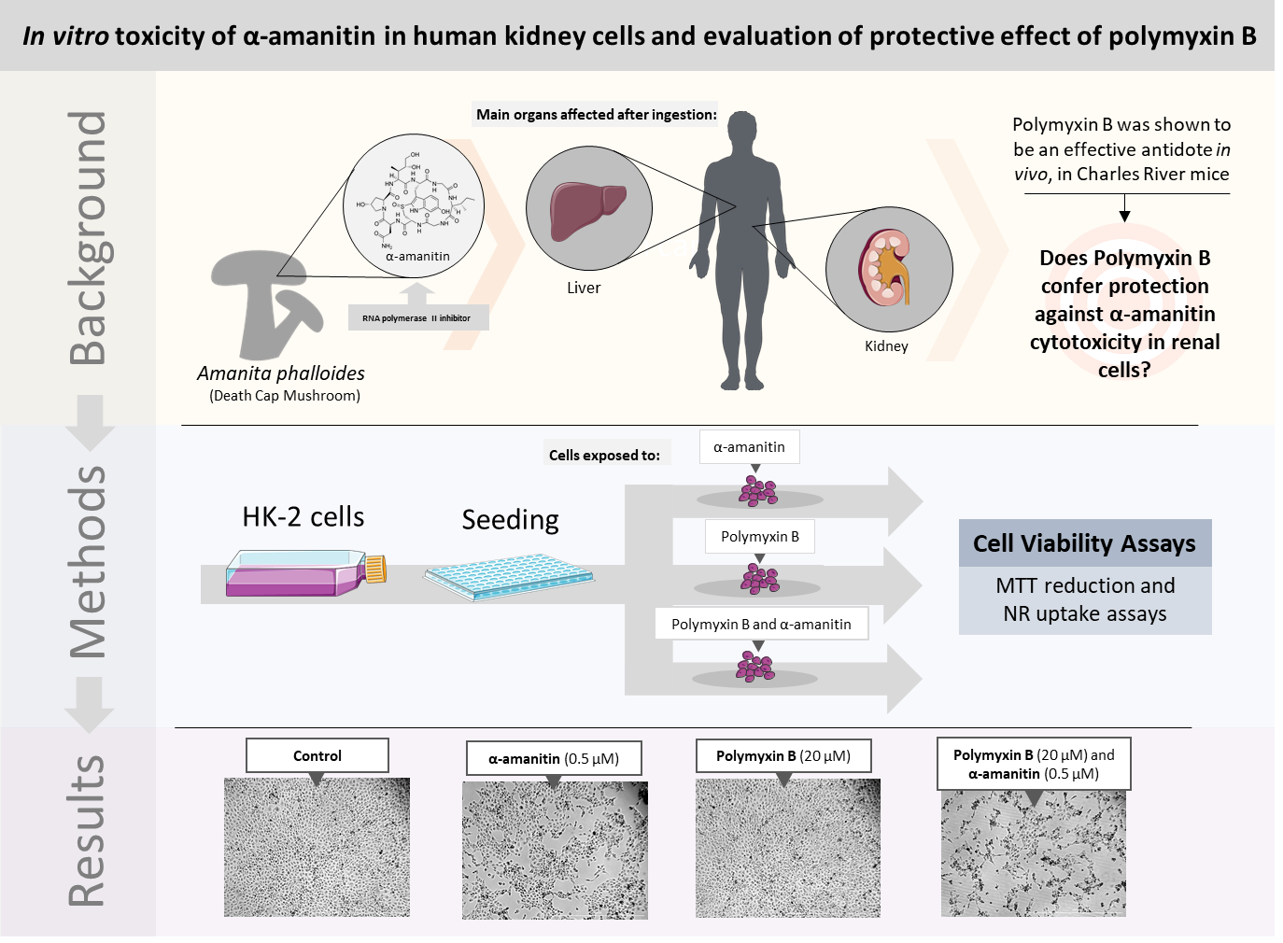

Slide 3
Abstract:
α-Amanitin intoxications have been associated with acute kidney injury and renal failure, besides its well-known hepatotoxic effects. Currently, no effective antidote against α-amanitin toxicity exists. Recent in vivo studies have shown that polymyxin B (PolB) decreases α-amanitin toxicity and that the associated renal damage is largely decreased by this antibiotic. This work aimed to characterize α-amanitin cytotoxicity in HK-2 cells and evaluate PolB’s putative antidotal effectiveness in this in vitro system.
HK-2 cells were exposed to α-amanitin (0.01-10 µM) at different time-points and cytotoxicity evaluated by the MTT reduction and neutral red uptake assays. To assess PolB putative protective effects, two paradigms were used: (i) 30 min pre-incubation with PolB followed by 48h incubation with α-amanitin (0.5 and 1 µM) or (ii) PolB co-incubation with α-amanitin (5 and10 µM) for 2h followed by a 48h drug/toxin-free period.
α-Amanitin led to cytotoxicity effects on kidney cells at clinical relevant concentrations. The effectiveness of a previously described antidote, PolB, was not verified in vitro, which highlights the importance of further investigation on this antidotal strategy and its mechanisms.
Keywords: Amatoxin; Nephrotoxicity; Antidote; Poisoning

Slide 4
Introduction

Slide 5
Introduction

Slide 6
Introduction

Slide 7
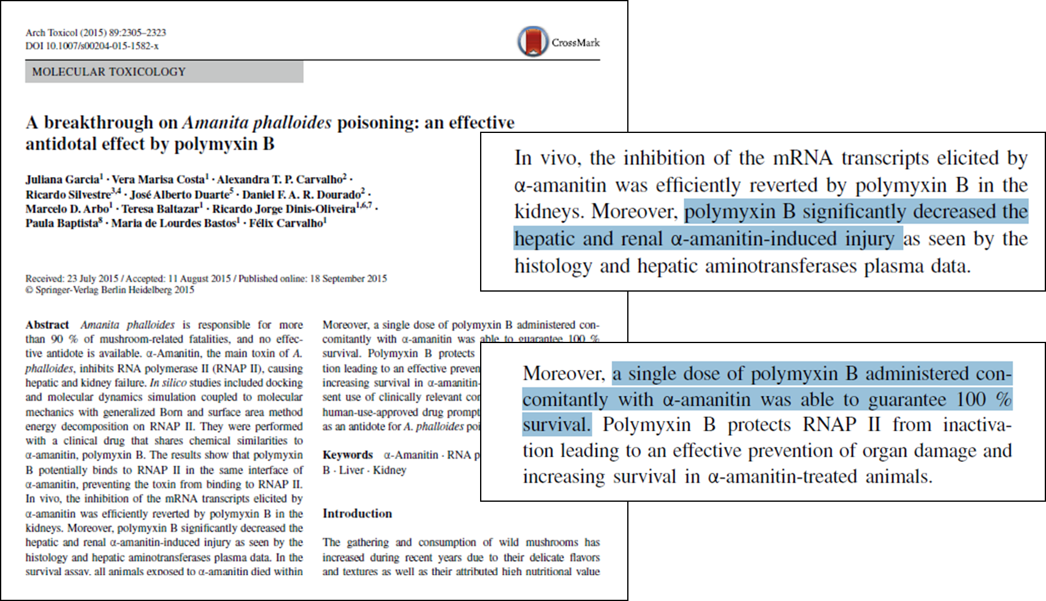
Introduction

Slide 8
Introduction
Aims
This work aims to characterize α-amanitin cytotoxicity in renal HK-2 cells and evaluate the putative protective effects of polymyxin B.

Slide 9
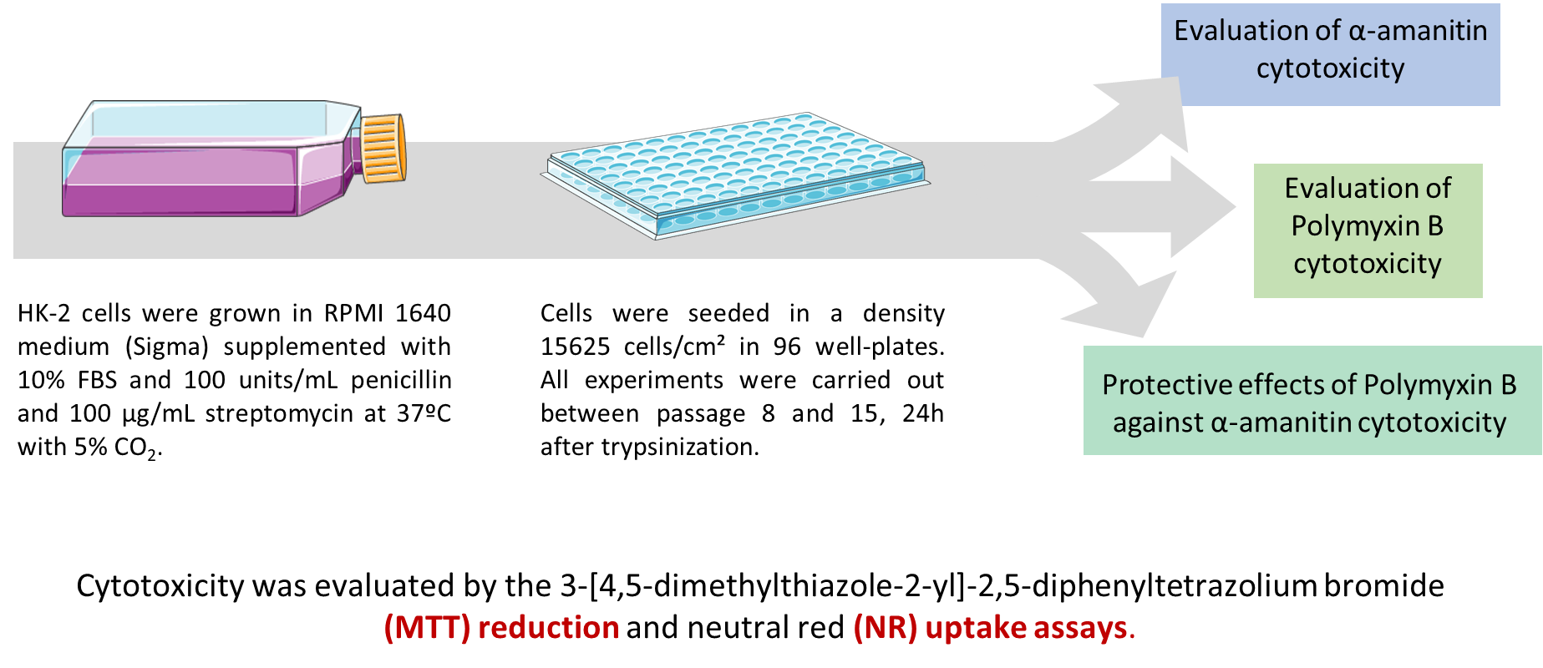
Methods

Slide 10
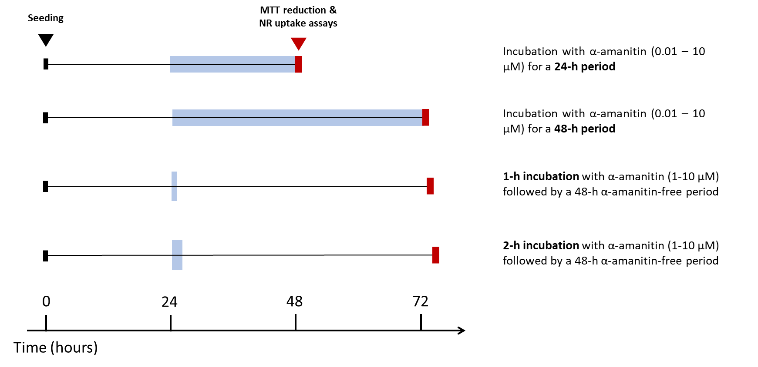
Cytotoxicity evaluation of α-amanitin

Slide 11
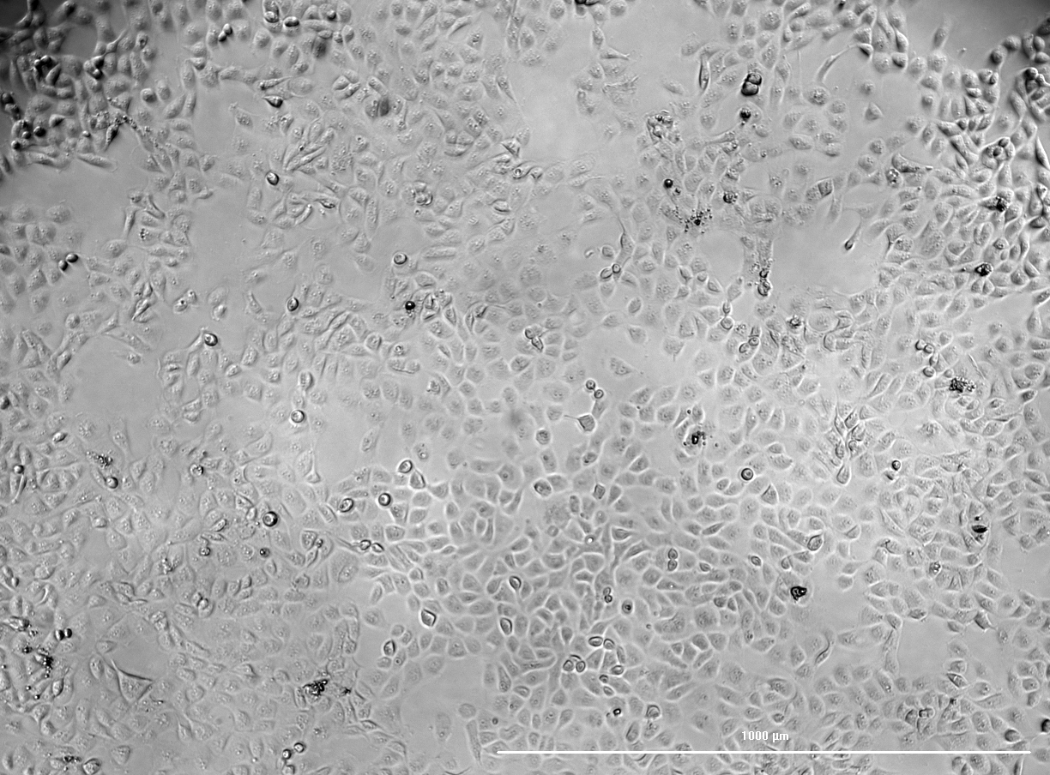
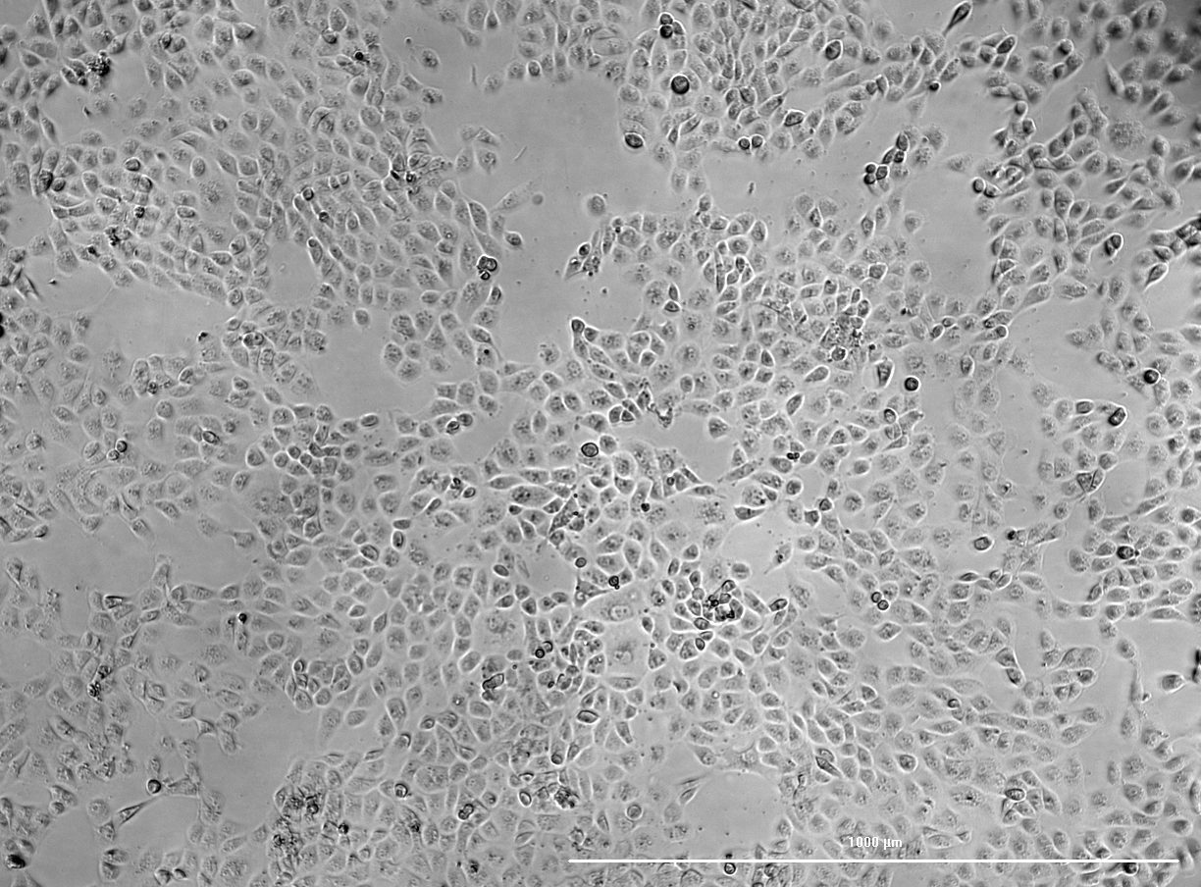
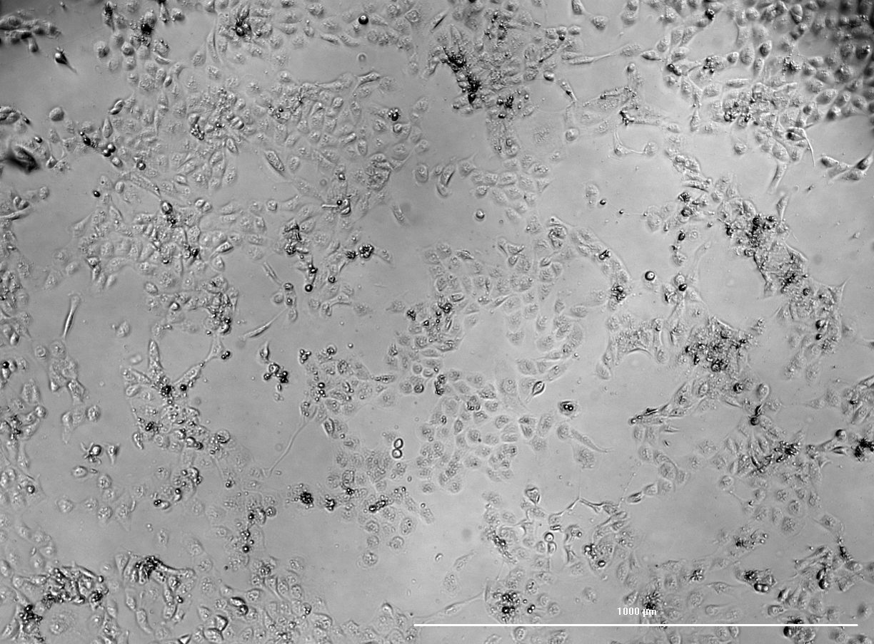
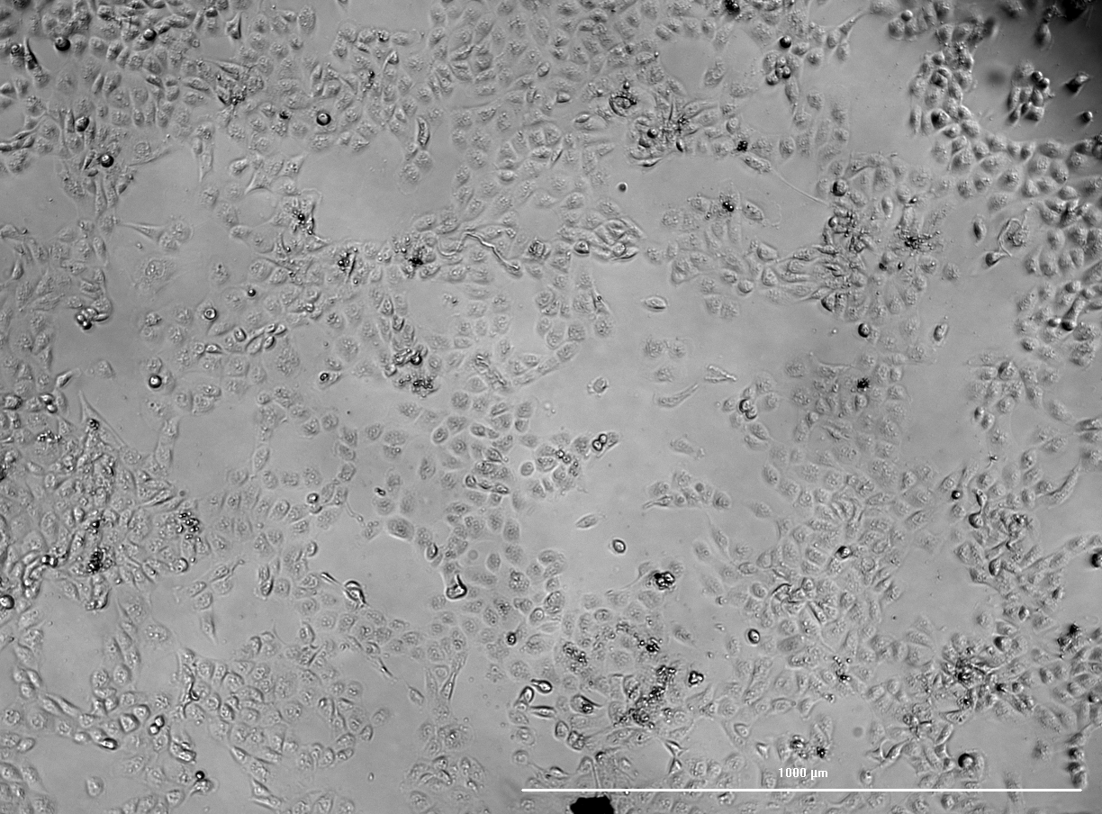
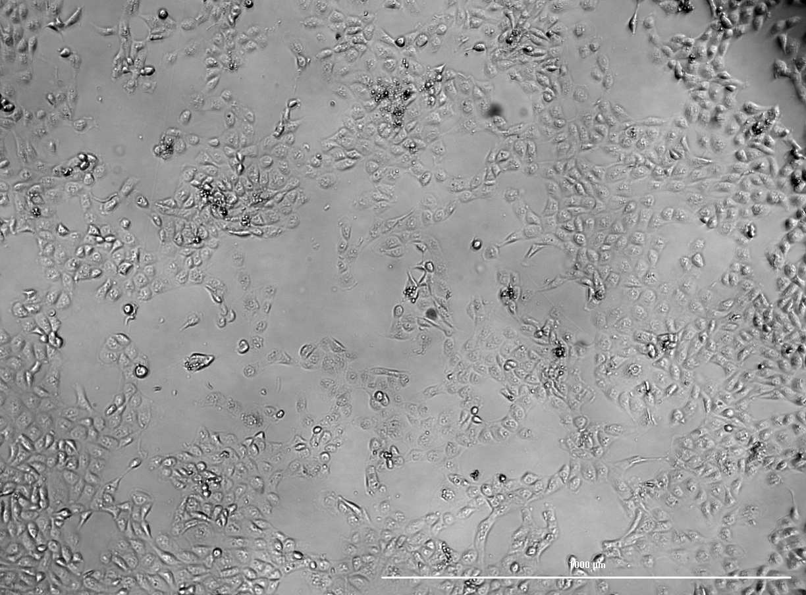
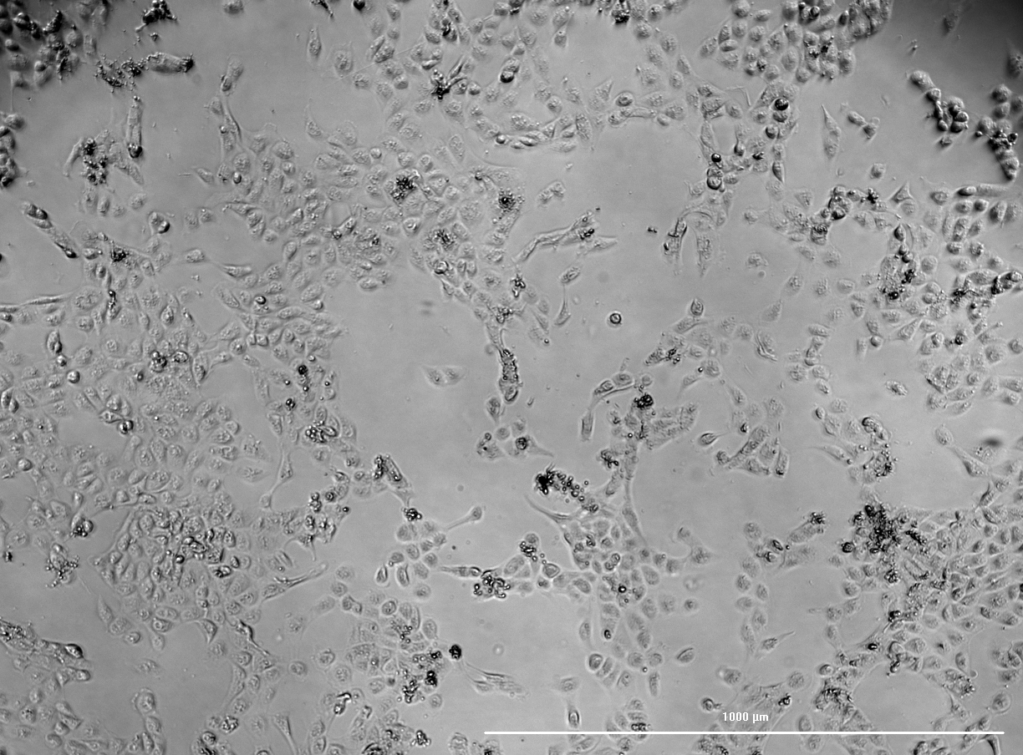
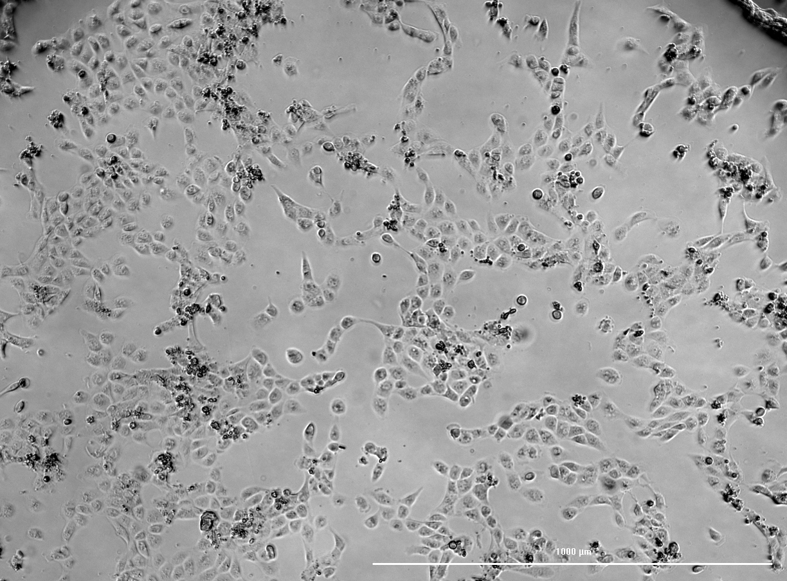
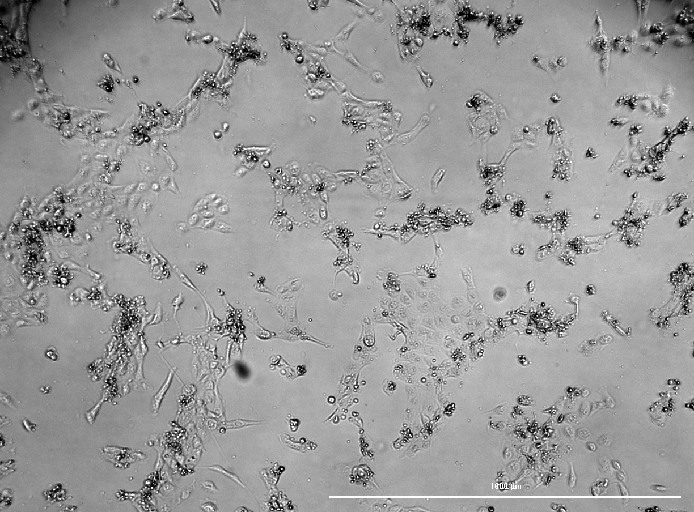
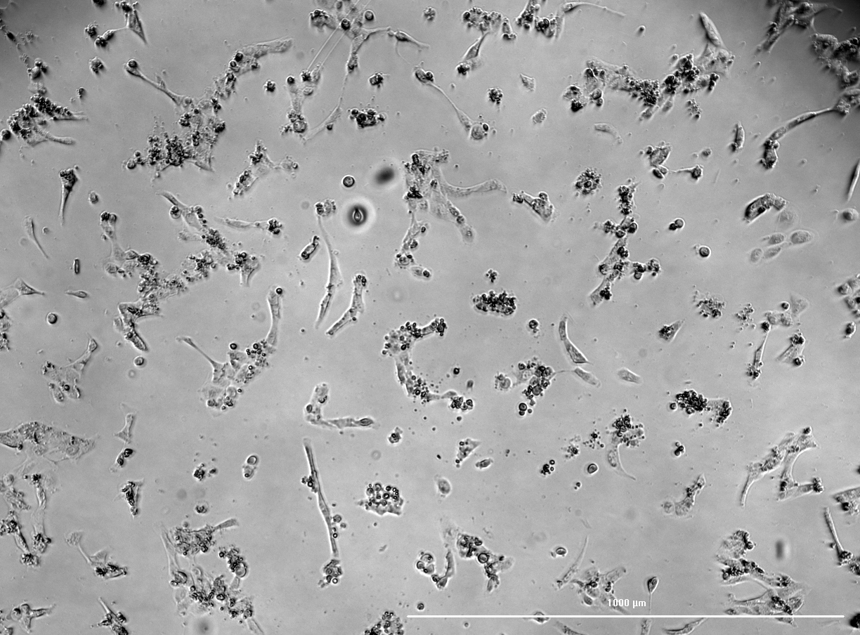
Results and discussion
A
α-amanitin cytotoxicity following a 24h incubation period
Bright-field microscopy of HK-2 cells after a 24h incubation with α-amanitin. (A) Control; (B) α-amanitin 0.01 µM; (C) α-amanitin 0.05 µM; (D) α-amanitin 0.1 µM; (E) α-amanitin 0.5 µM; (F) α amanitin 1 µM; (G) α-amanitin 2 µM; (H) α-amanitin 5 µM; (I) α-amanitin 10 µM.
B
C
D
E
F
G
H
I

Slide 12
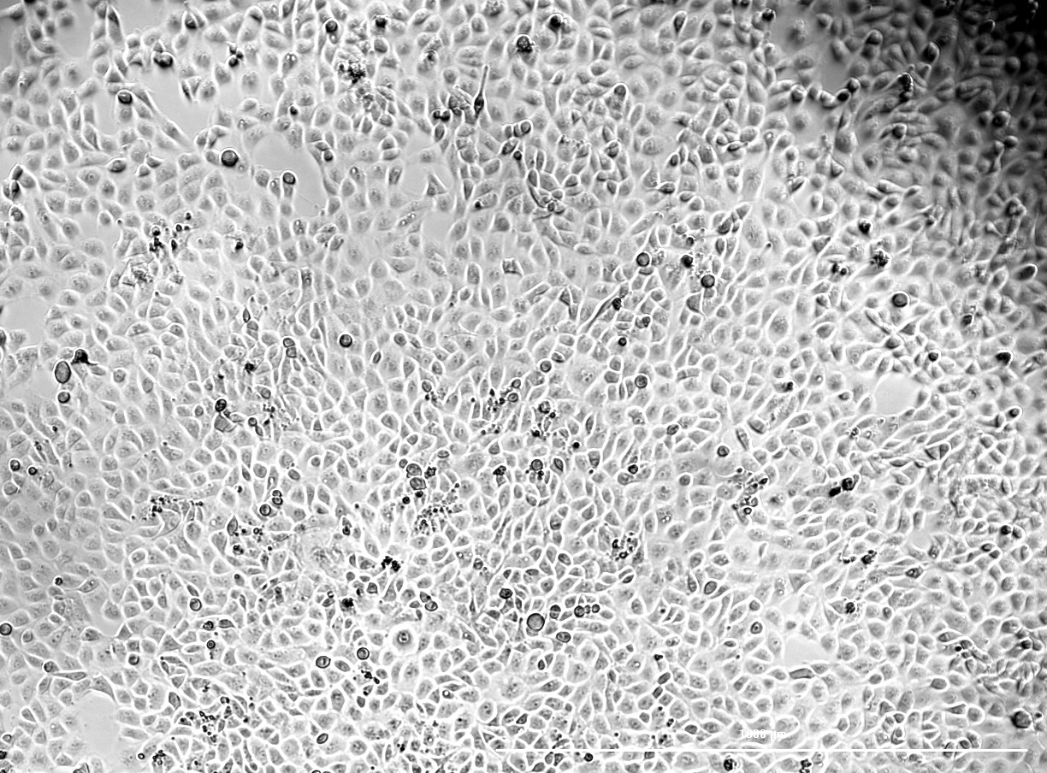
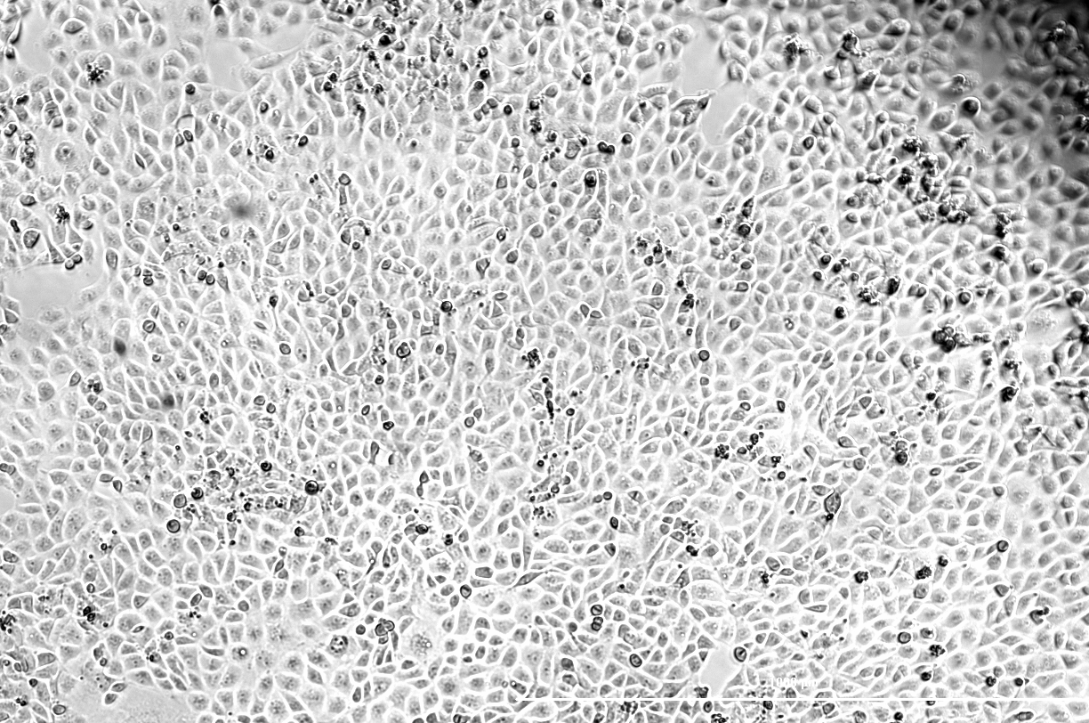
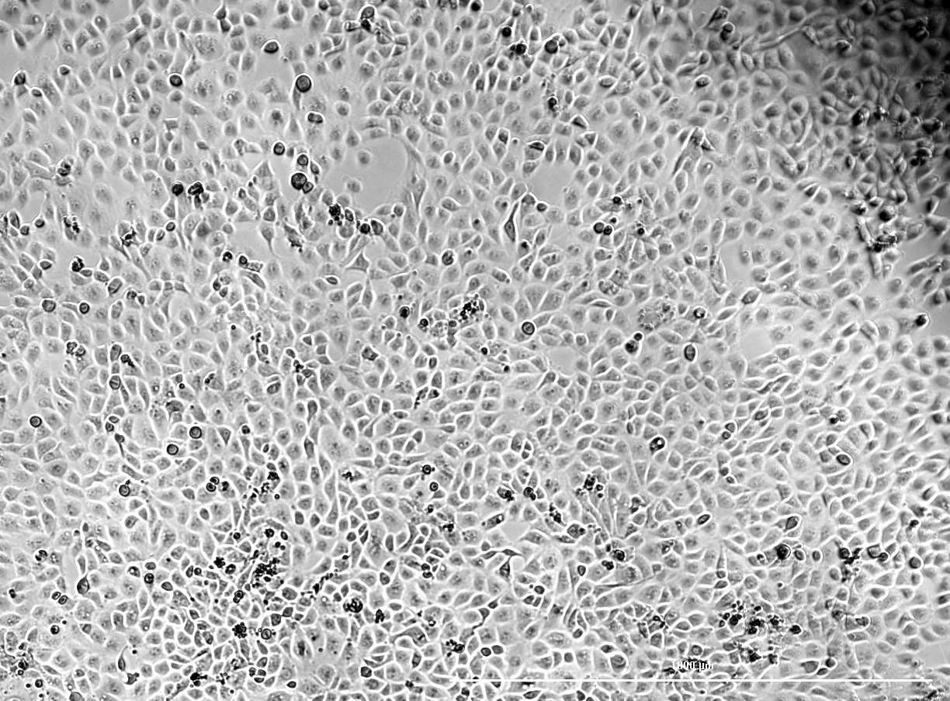
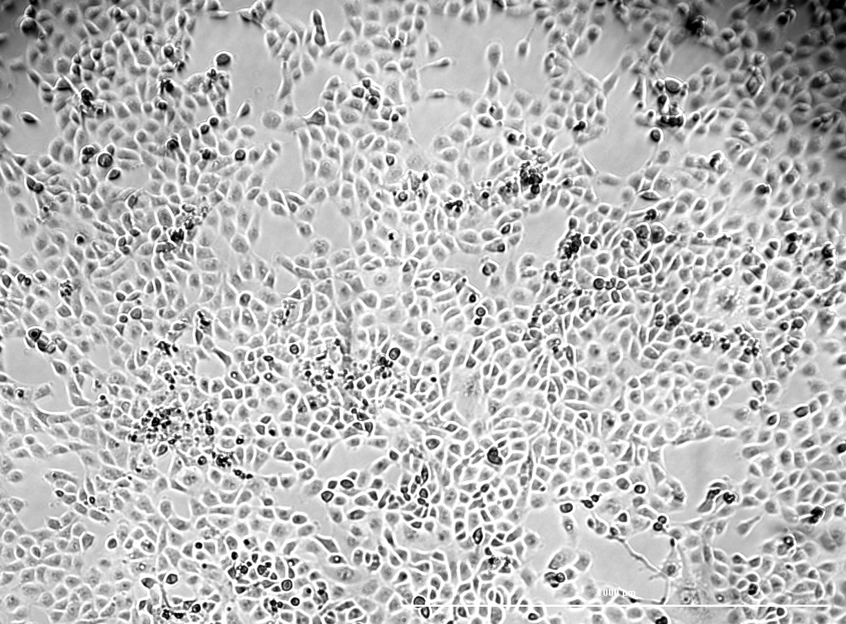
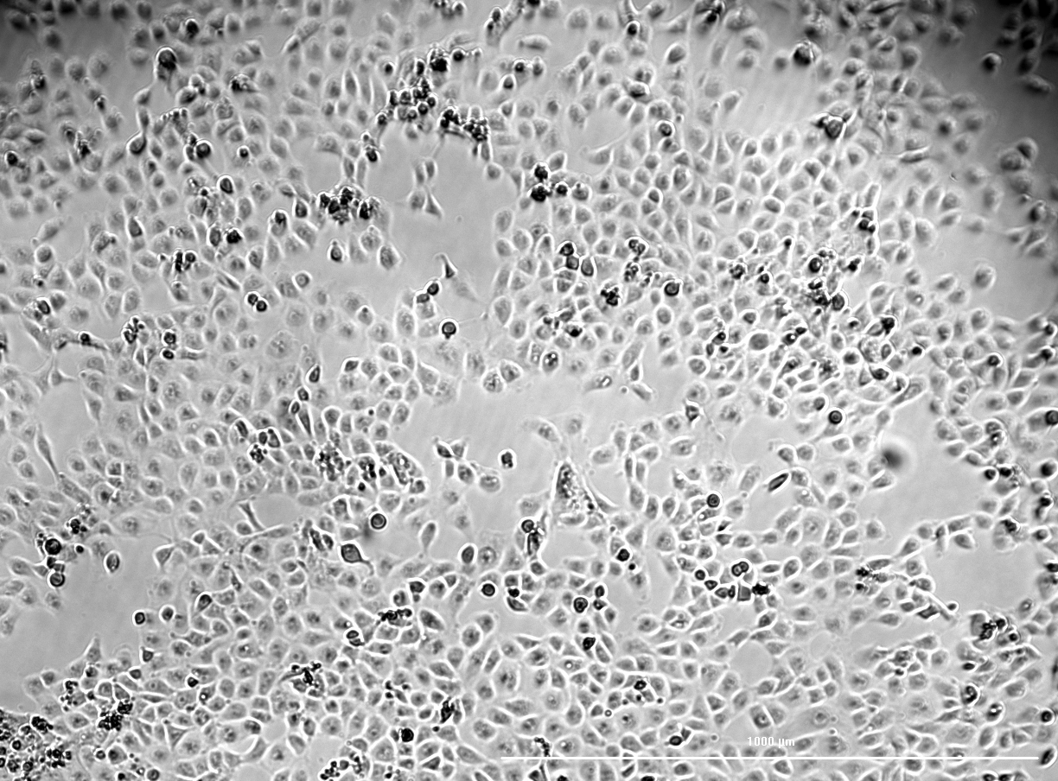
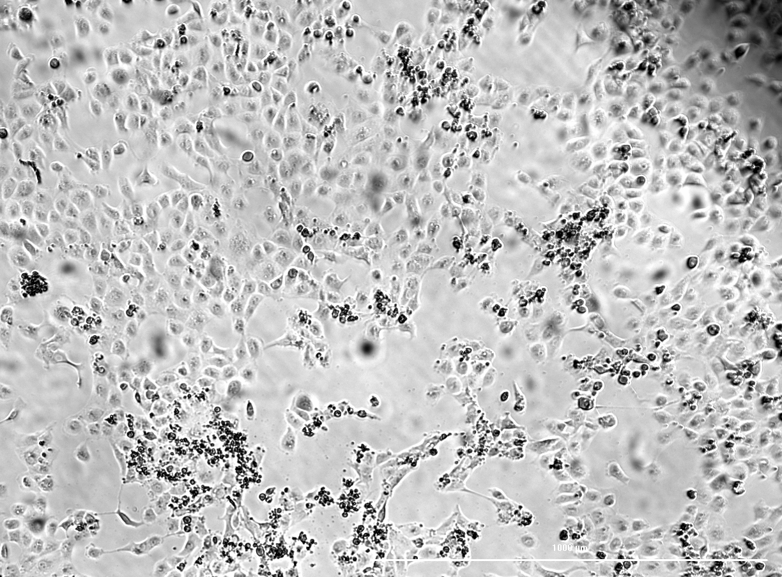
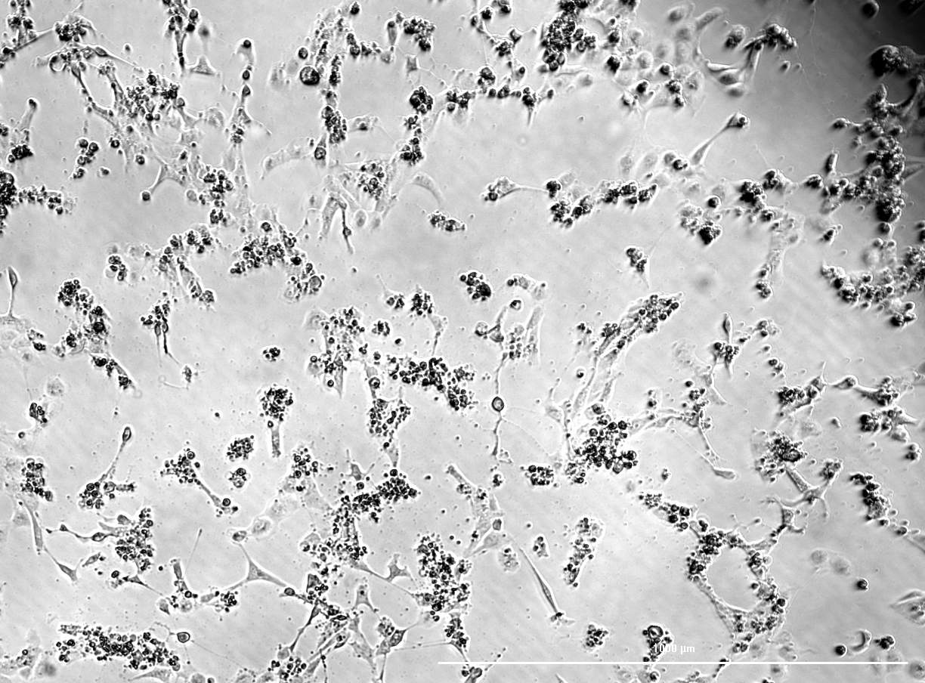
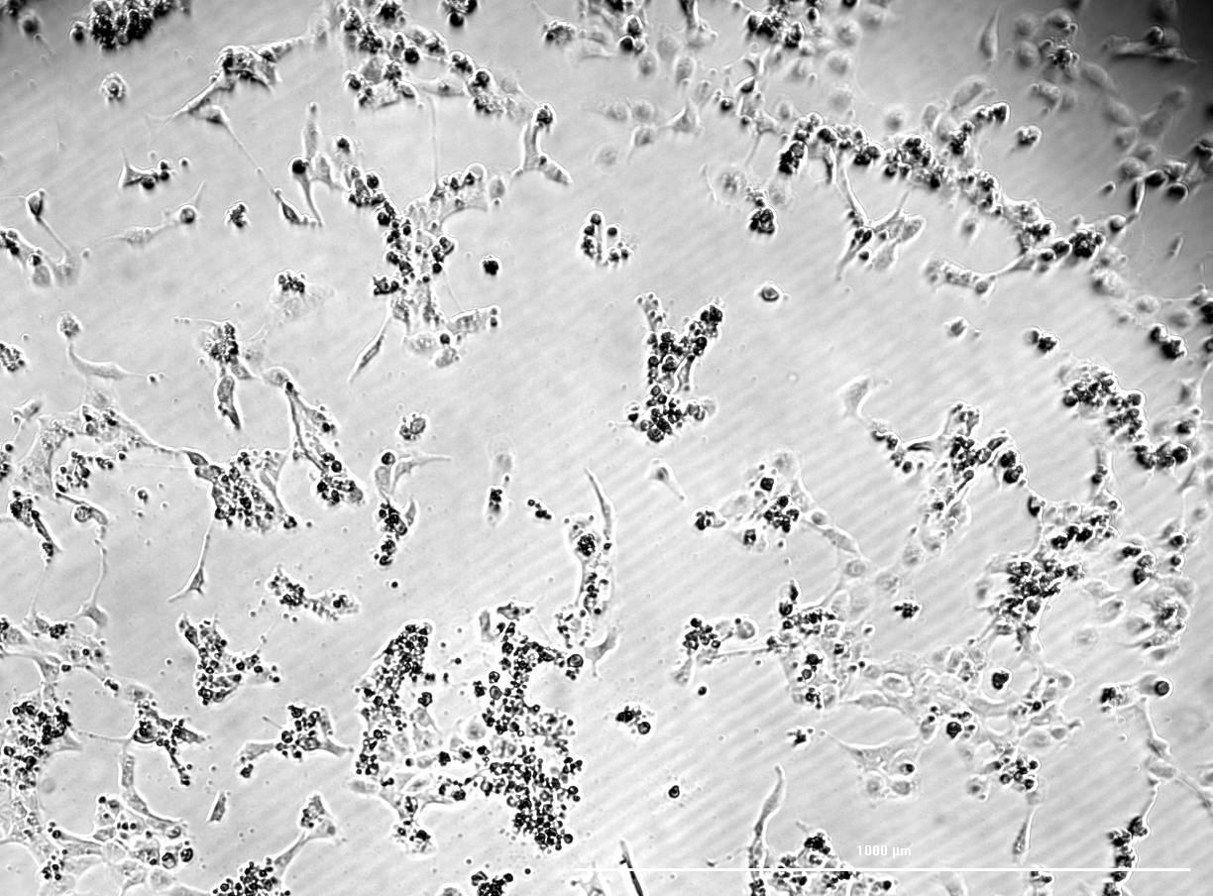
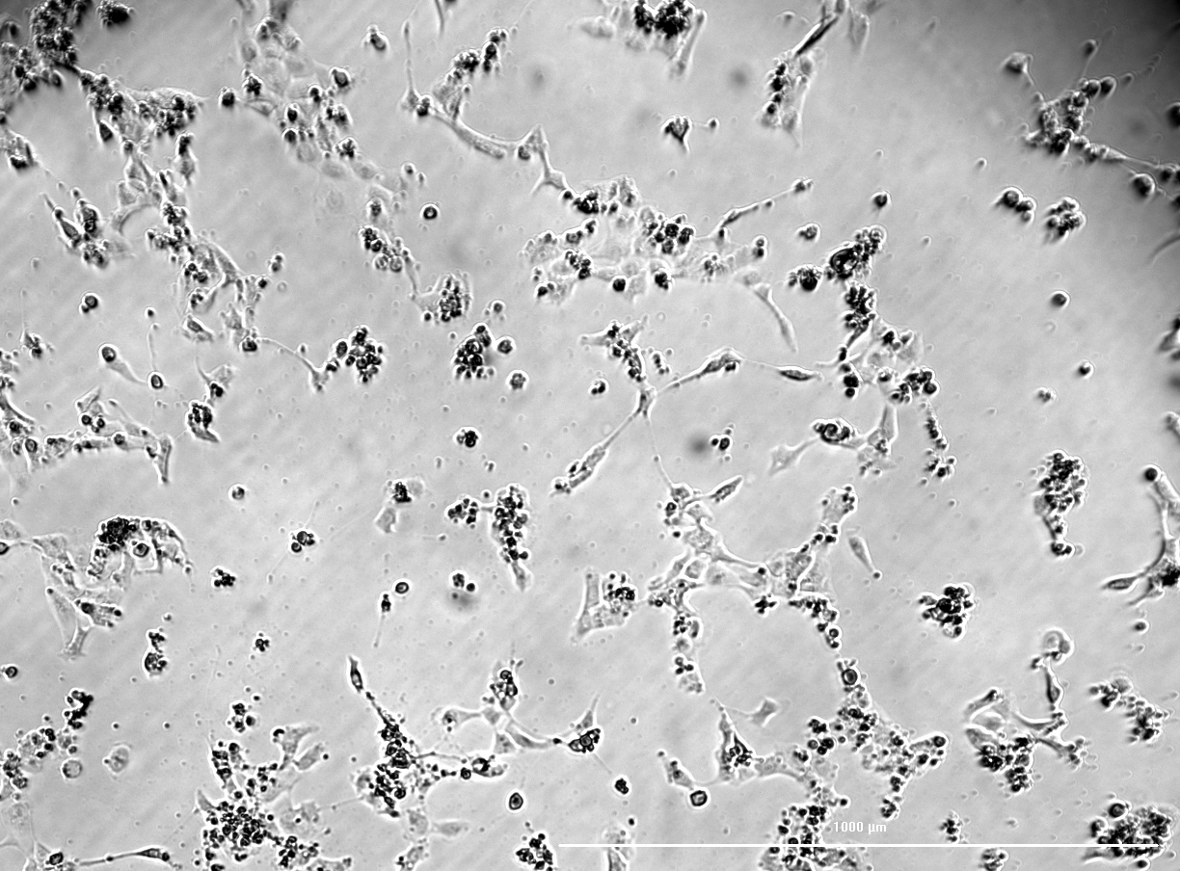
Results and discussion
A
α-amanitin cytotoxicity following a 48h incubation period
Bright-field microscopy of HK-2 cells after a 48h incubation with α-amanitin. (A) Control; (B) α-amanitin 0.01 µM; (C) α-amanitin 0.05 µM; (D) α-amanitin 0.1 µM; (E) α-amanitin 0.5 µM; (F) α amanitin 1 µM; (G) α-amanitin 2 µM; (H) α-amanitin 5 µM; (I) α-amanitin10 µM.
B
C
D
E
F
G
H
I

Slide 13
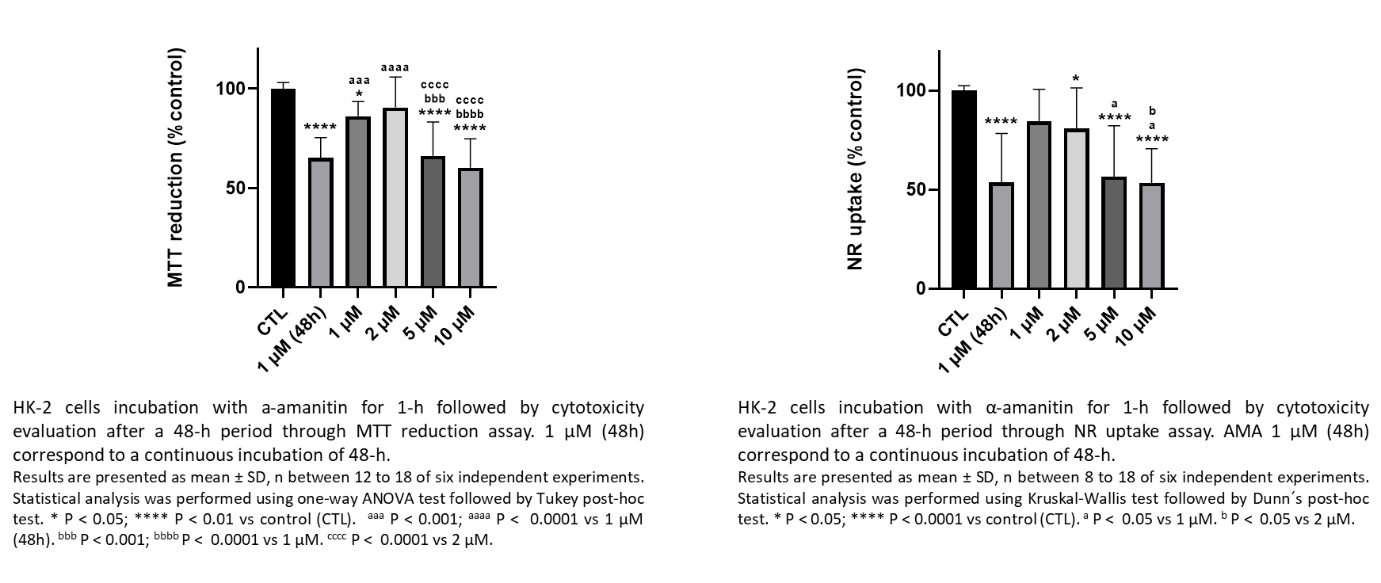
Results and discussion
α-amanitin cytotoxicity after 1h incubation followed by a 48h α-amanitin-free period
α-amanitin cytotoxicity after 2h incubation followed by a 48h α-amanitin-free period
Cell viability assays
Cell viability assays
 | MTT reduction | NR uptake
1 µM | ↓ | =
2 µM | = | ↓
5 µM | ↓↓↓↓ | ↓↓↓↓
10 µM | ↓↓↓↓ | ↓↓↓↓
 | MTT reduction | NR uptake
1 µM | ↓↓ | ↓↓
2 µM | ↓↓↓↓ | =
5 µM | ↓↓↓↓ | ↓↓↓↓
10 µM | ↓↓↓↓ | ↓↓↓↓
[α-amanitin]
[α-amanitin]

Slide 14
Cytotoxicity evaluation of Polymyxin B at 48h

Slide 15
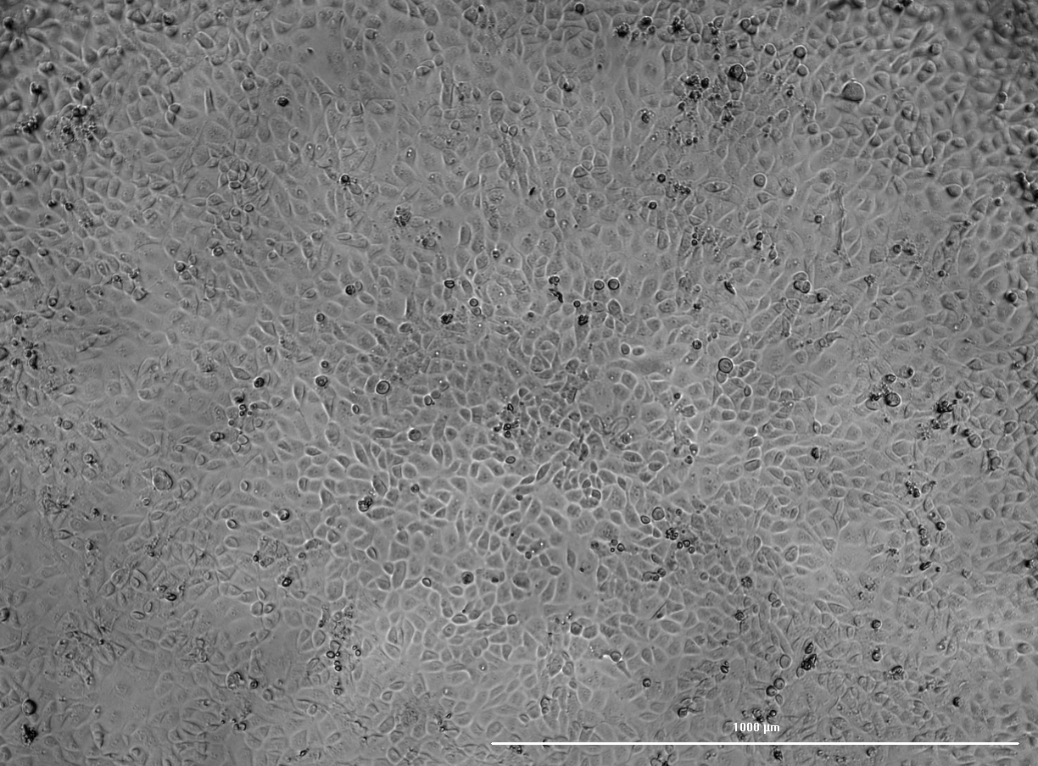
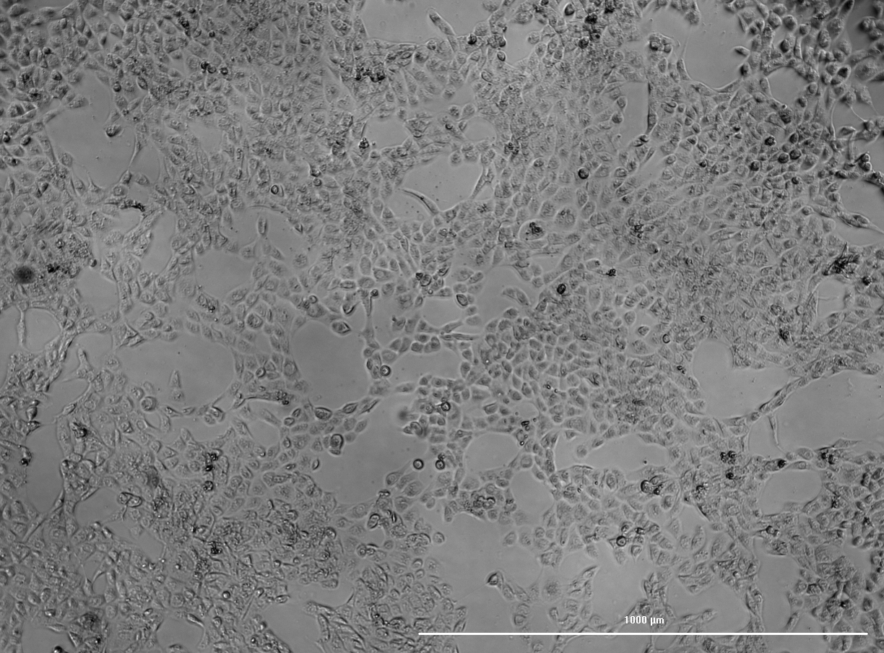
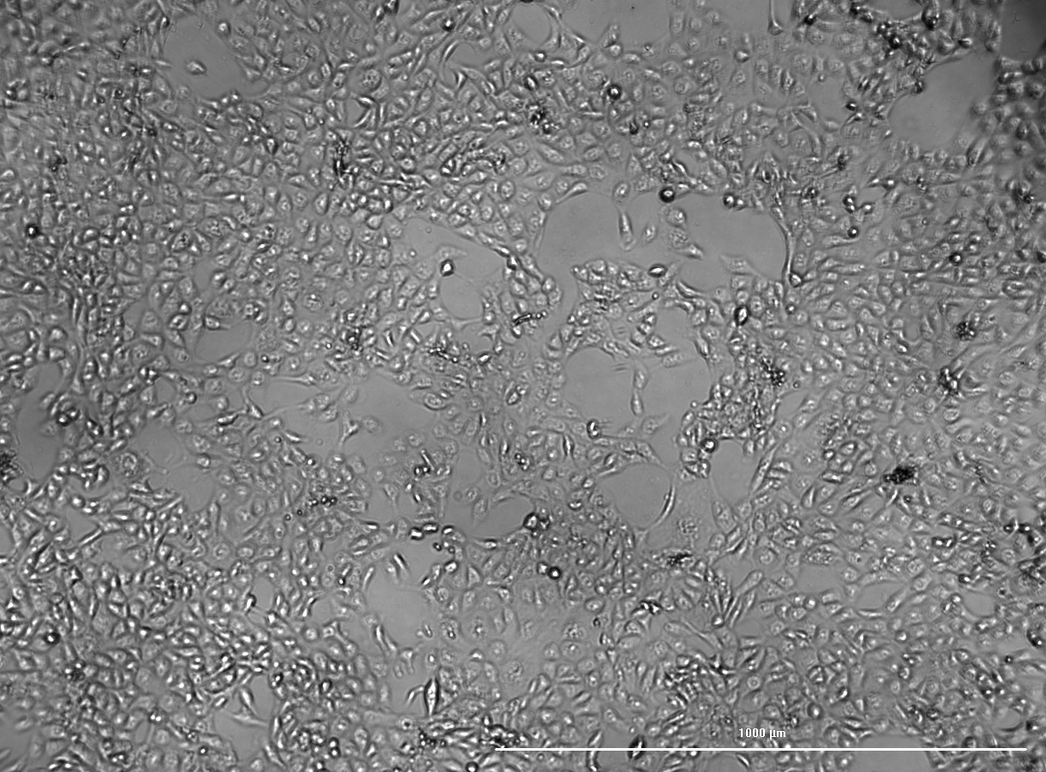
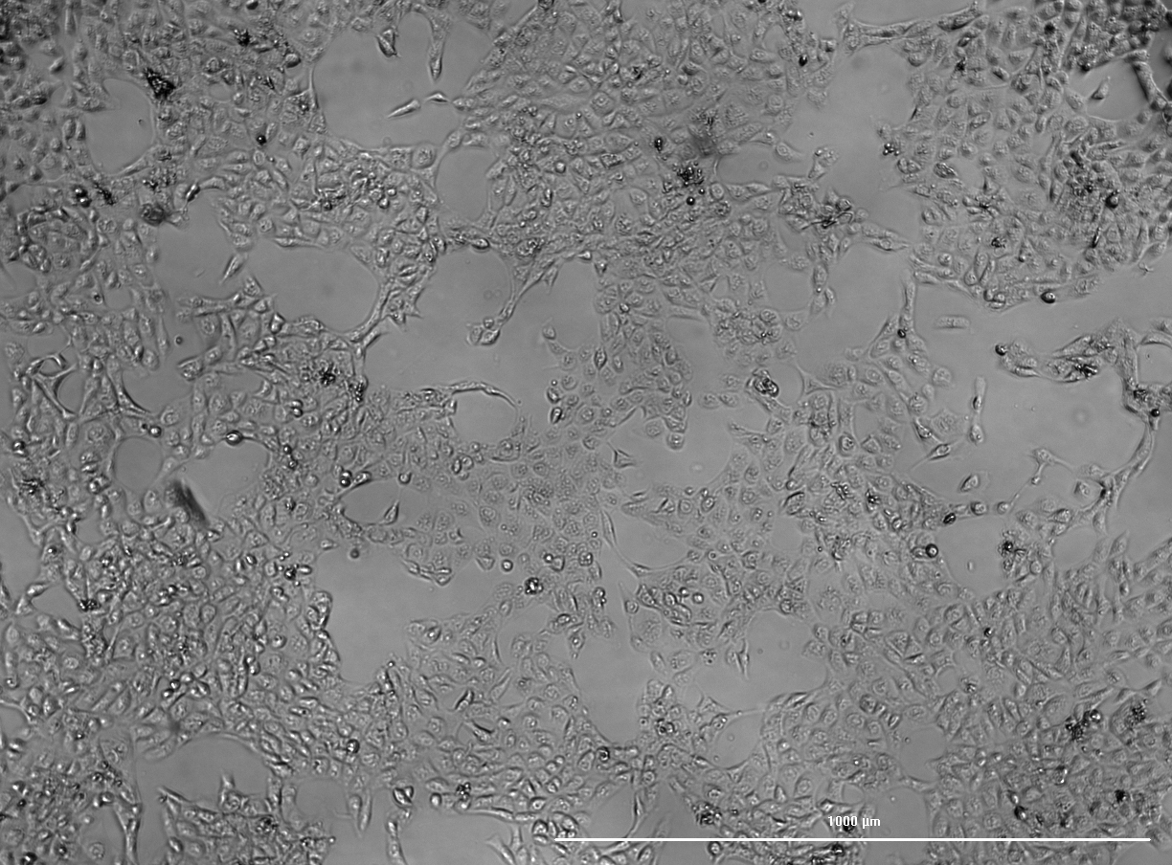
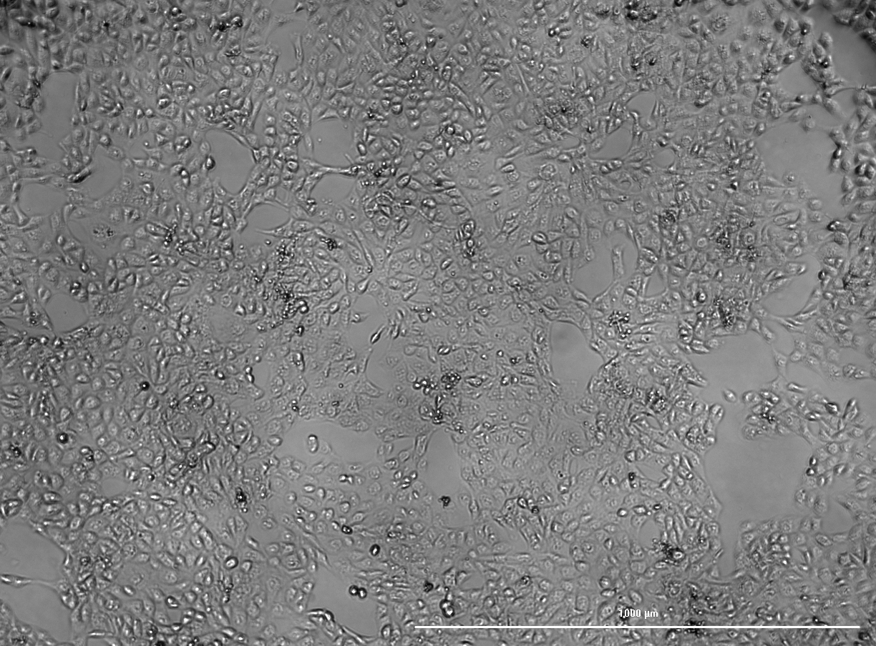
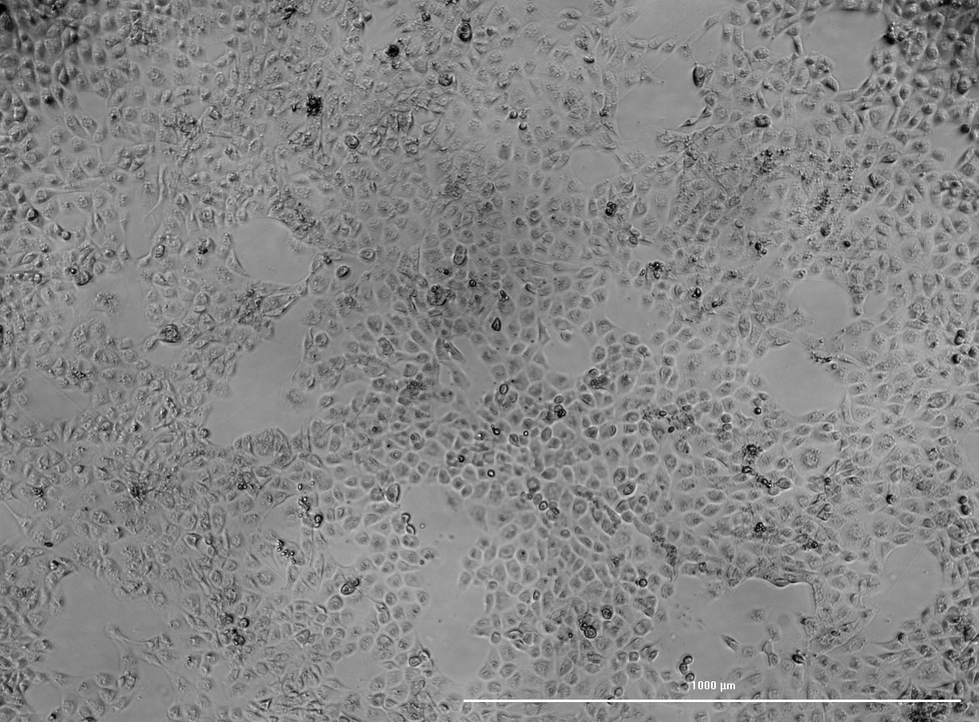
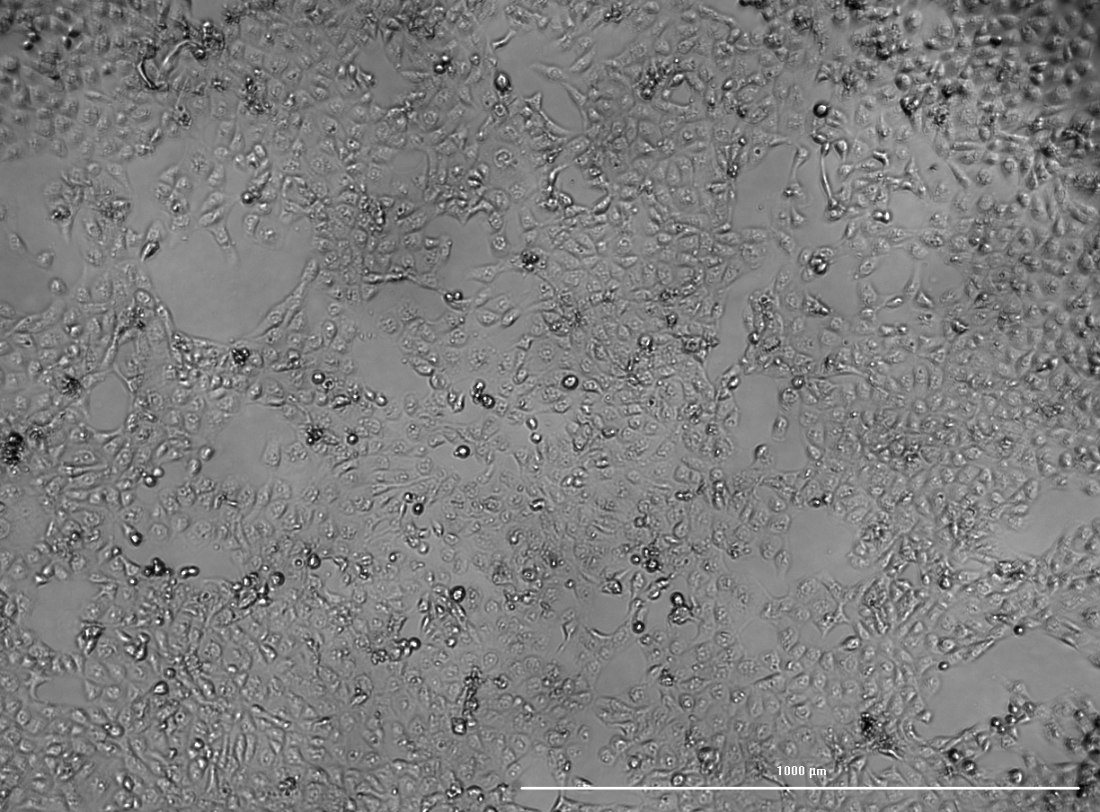
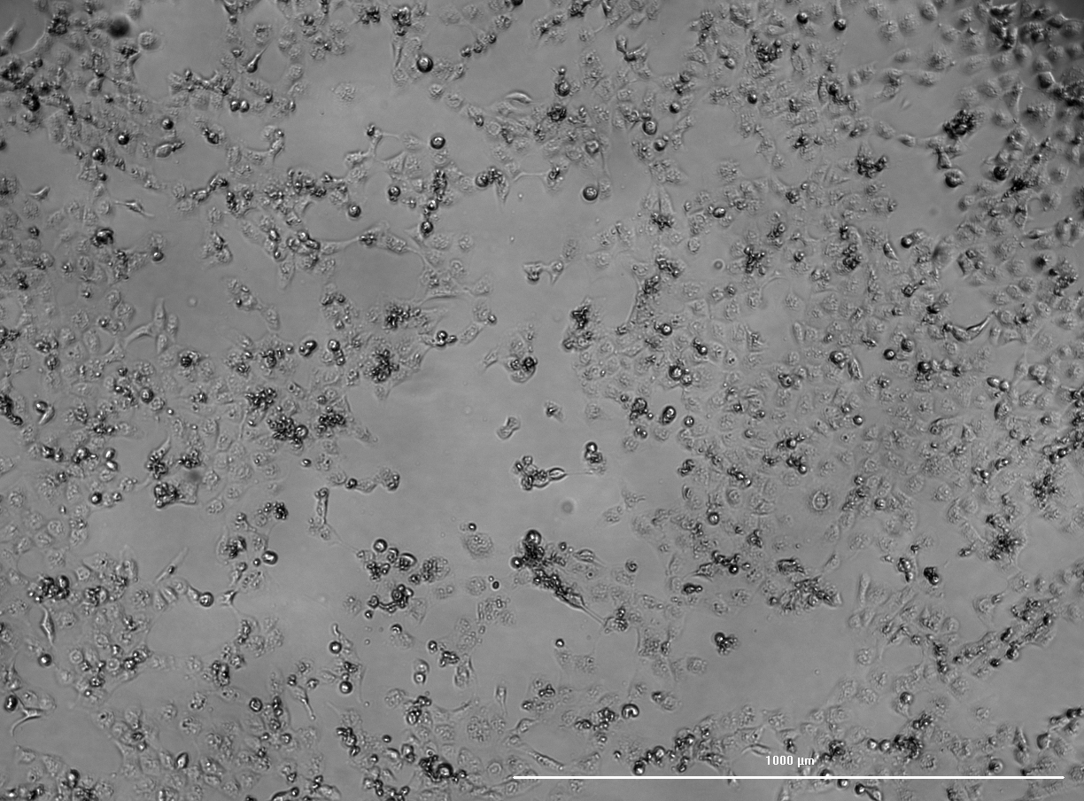
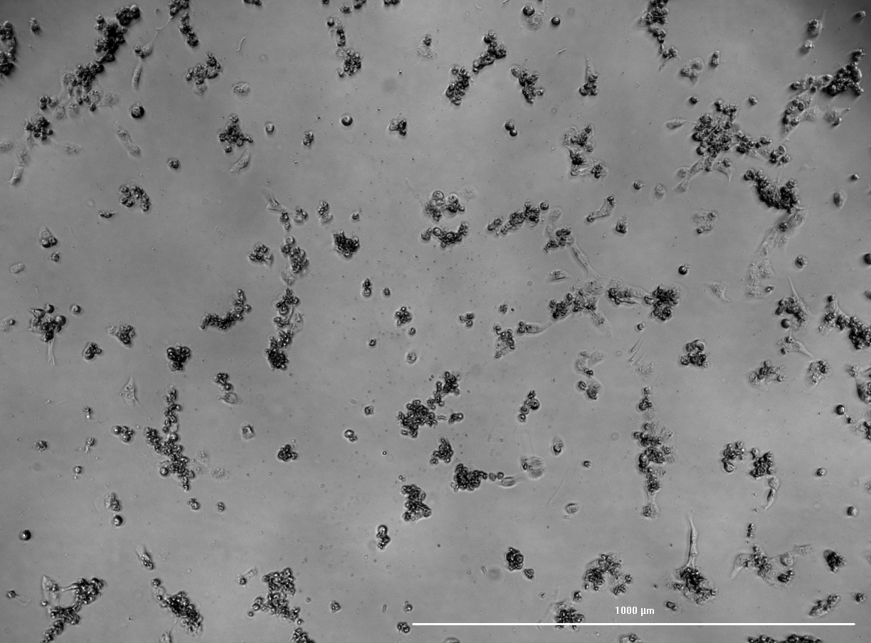
Results and discussion
A
Polymyxin B cytotoxicity following a 48h incubation period
Bright-field microscopy of HK-2 cells after a 48h incubation with Polymyxin B. (A) Control; (B) polymyxin B 0.1 µM; (C) polymyxin B 0.5 µM; (D) polymyxin B 1 µM; (E) polymyxin B 5 µM; (F) polymyxin B 10 µM; (G) polymyxin B 20 µM; (H) polymyxin B 50 µM; (I) polymyxin B 100 µM.
B
C
D
E
F
E
G
H

Slide 16
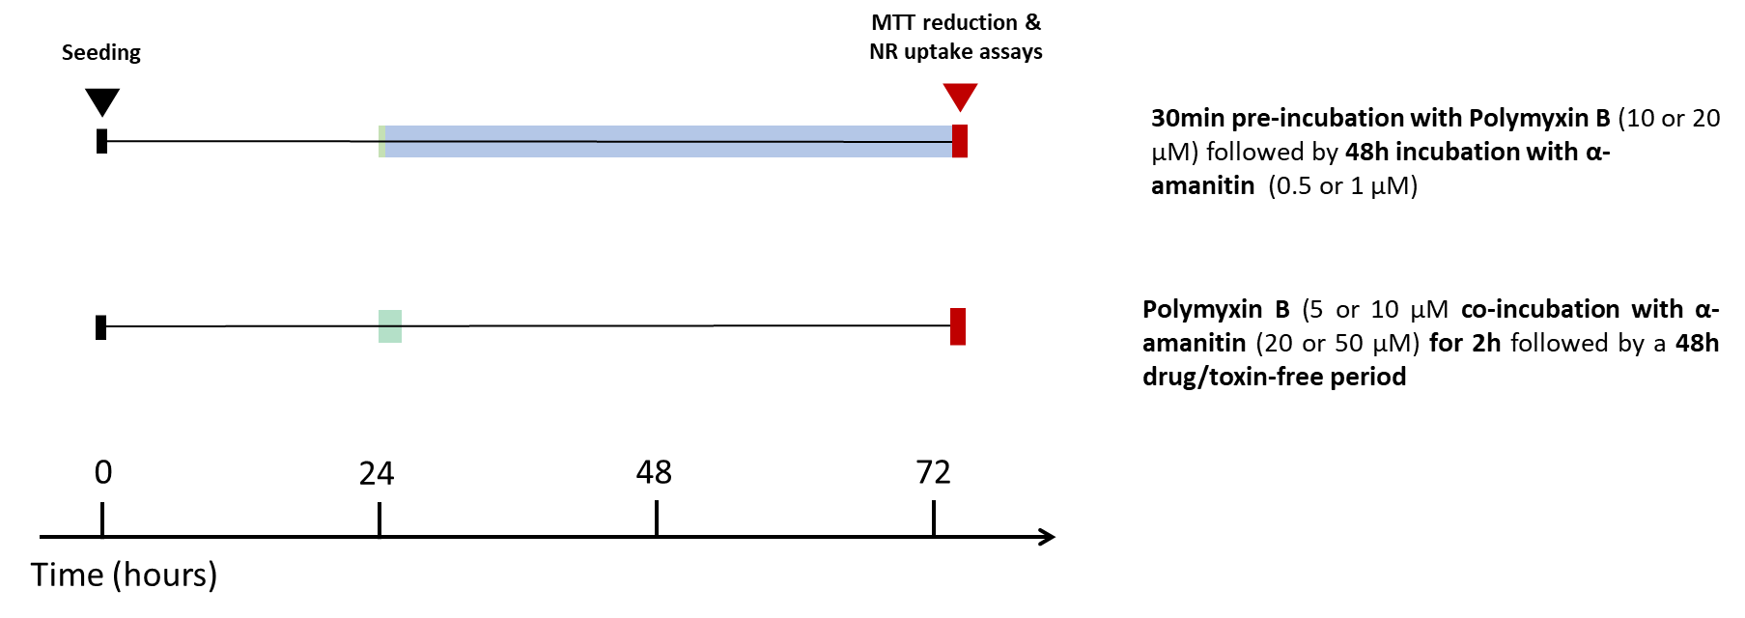
Putative effects of Polymyxin B against α-amanitin

Slide 17
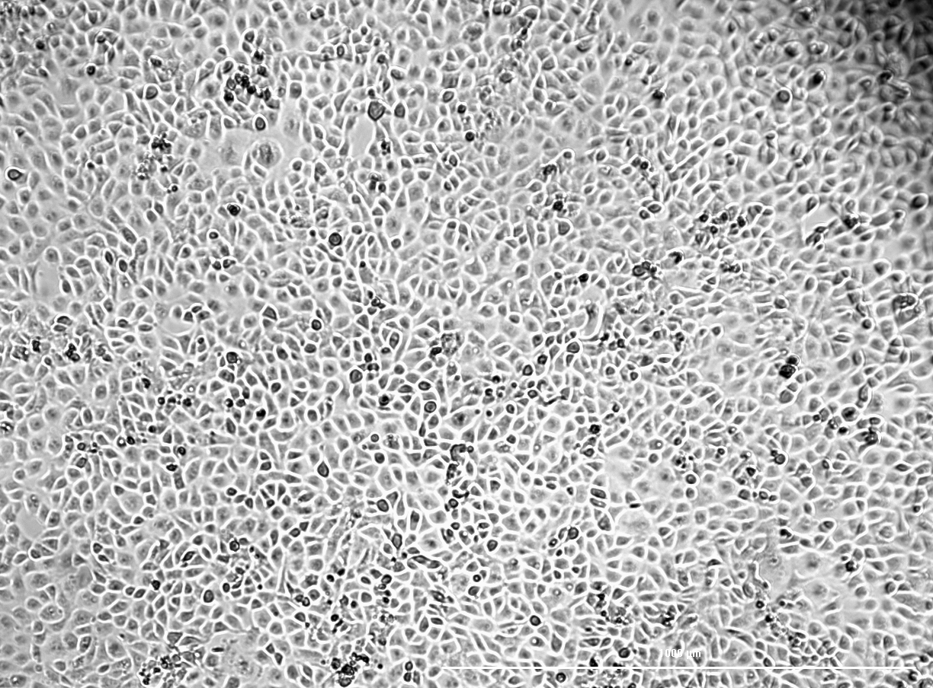
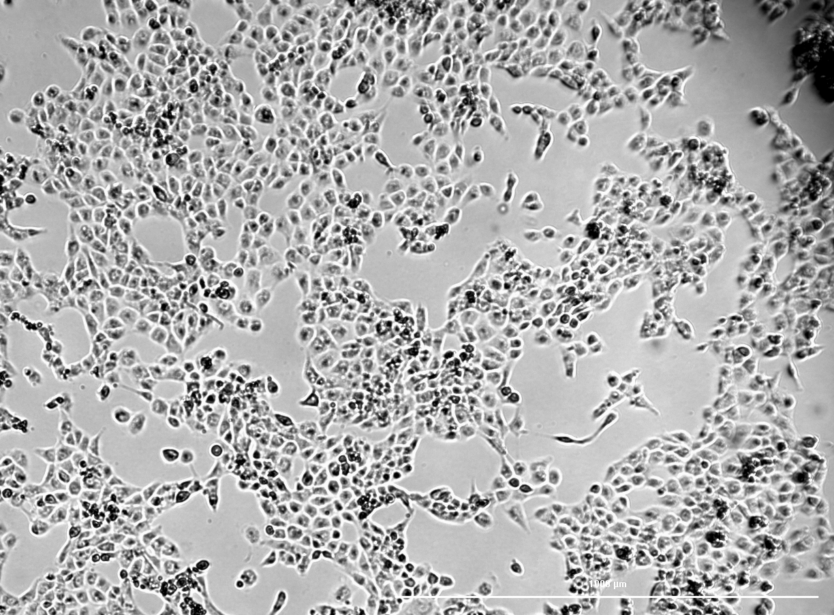
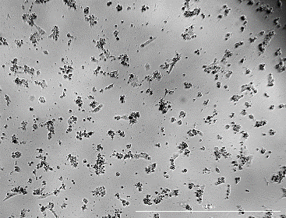
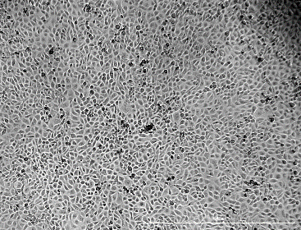
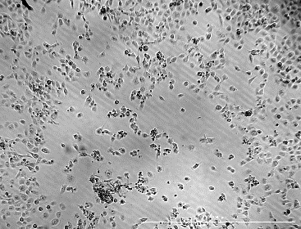
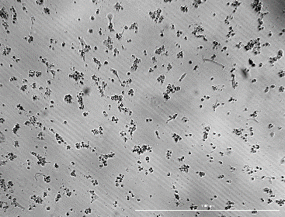
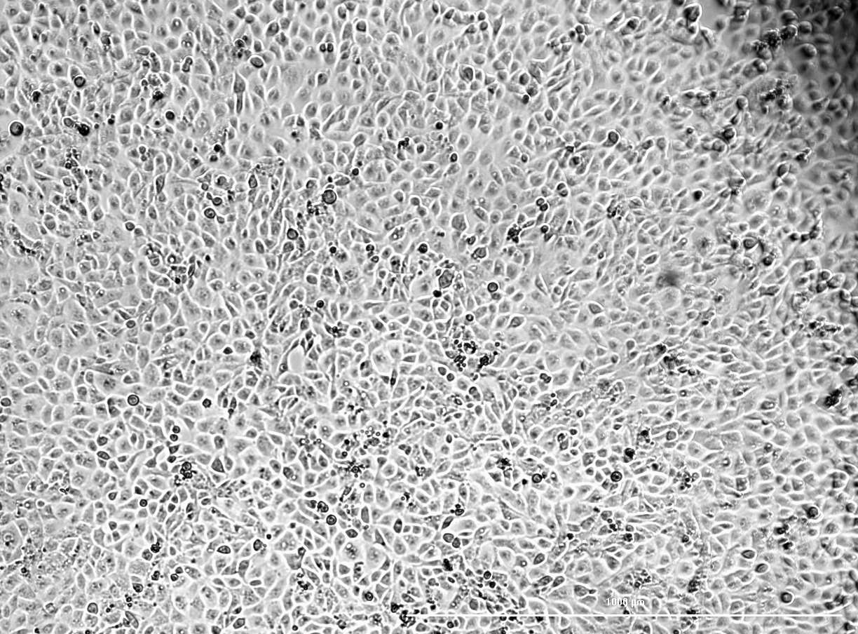
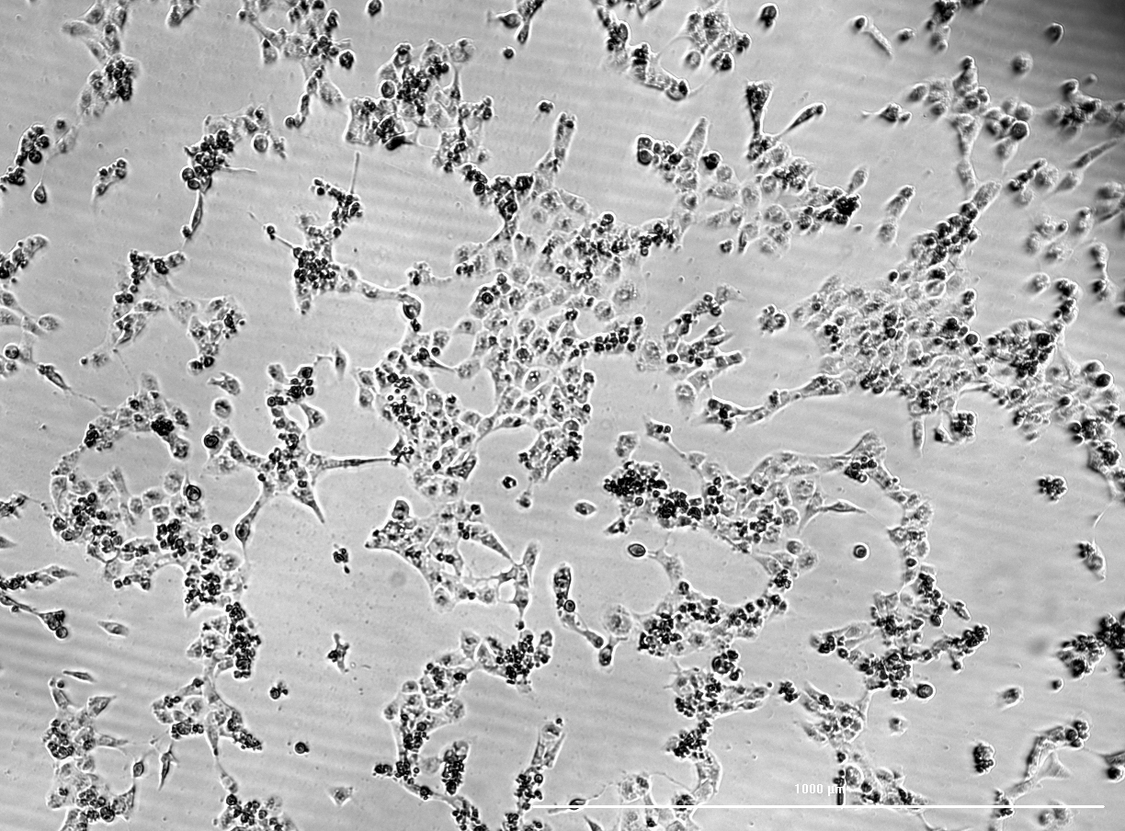
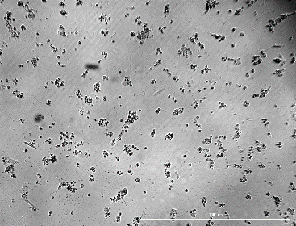
Results and discussion
α-amanitin 0.5 µM
α-amanitin 1 µM
A
B
C
Protective effects of Polymyxin B against α-amanitin:
Bright-field microscopy of HK-2 cells after 30min pre-incubation with Polymyxin B followed by 48h incubation with α-amanitin. (A) Control; (B) α-amanitin 0.5 µM (C) α-amanitin 1 µM; (D) Polymyxin B 10 µM; (E) α-amanitin 0.5 µM + Polymyxin B 10 µm; (F) α-amanitin 1 µM + Polymyxin B 10 µM; (G) Polymyxin B 20 µM; (H) α-amanitin 0.5 µM + Polymyxin B 20 µM; (I) α-amanitin 1 µM + Polymyxin B 20 µM.
D
E
F
Polymyxin B 10 µM
No difference was observed between cells exposed to α-amanitin and Polymyxin B and cells exposed to α-amanitin alone.
G
H
I
Polymyxin B 20 µM

Slide 18
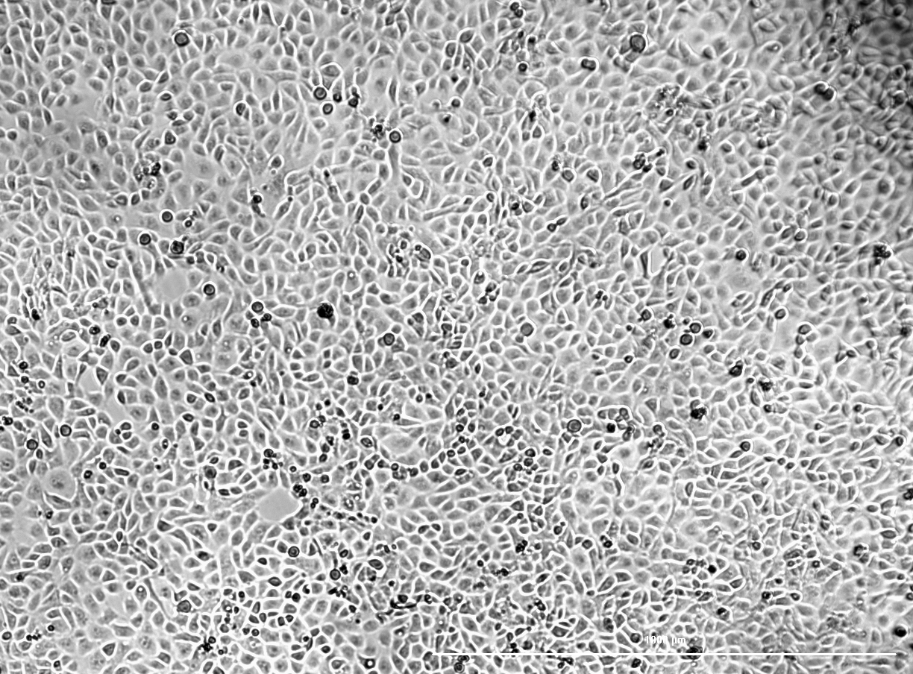
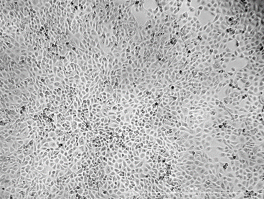
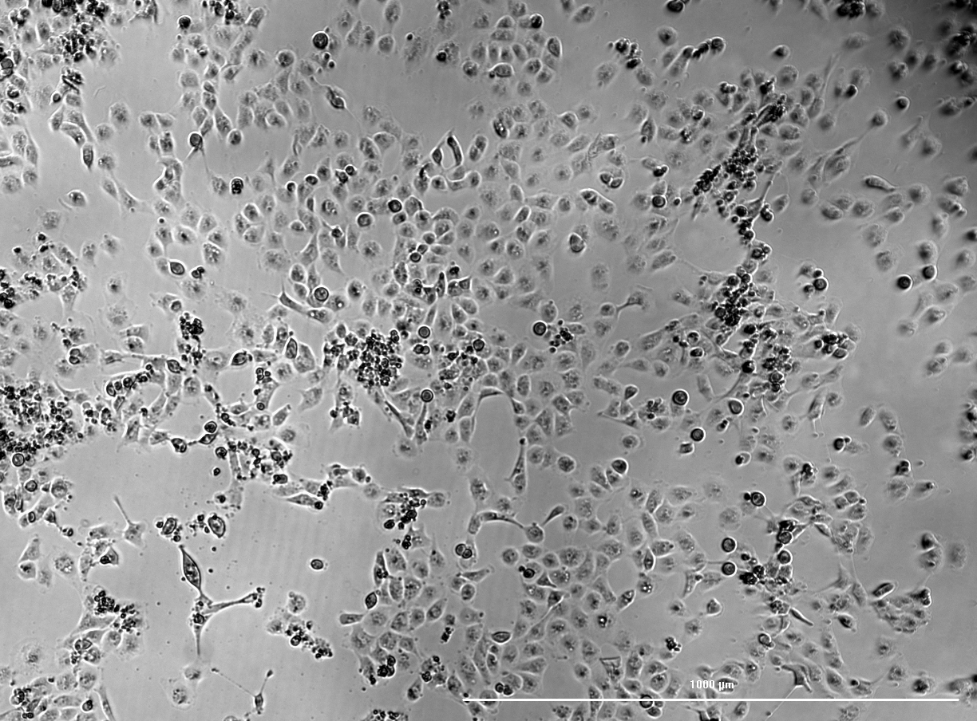
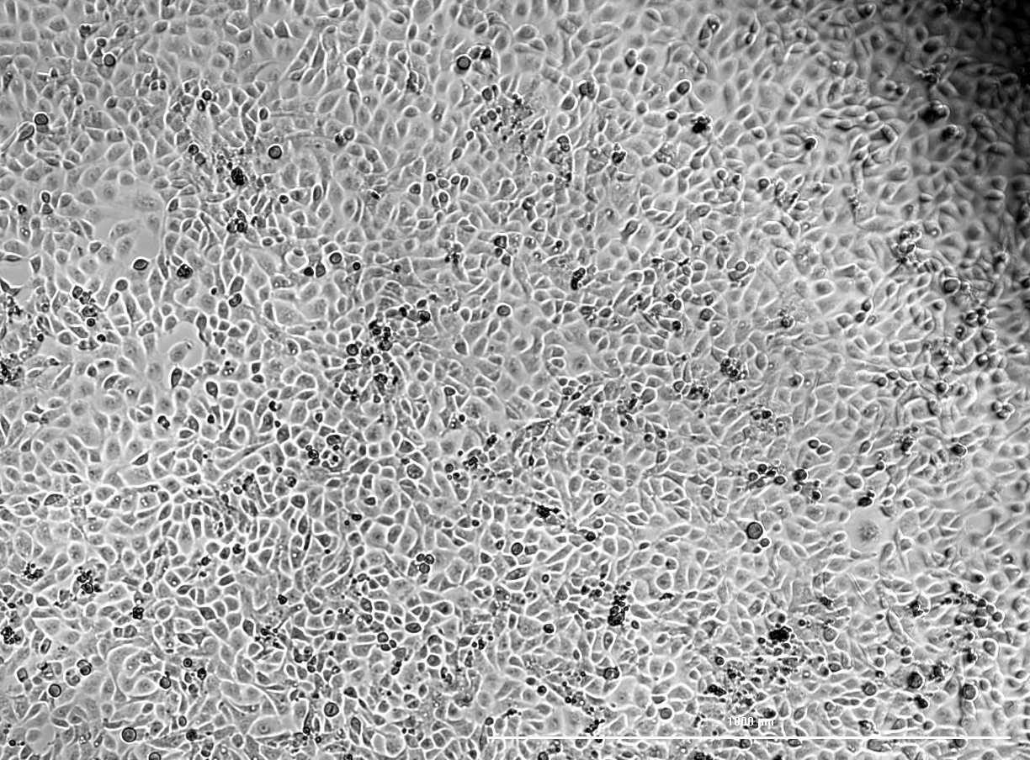
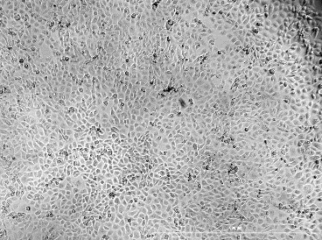
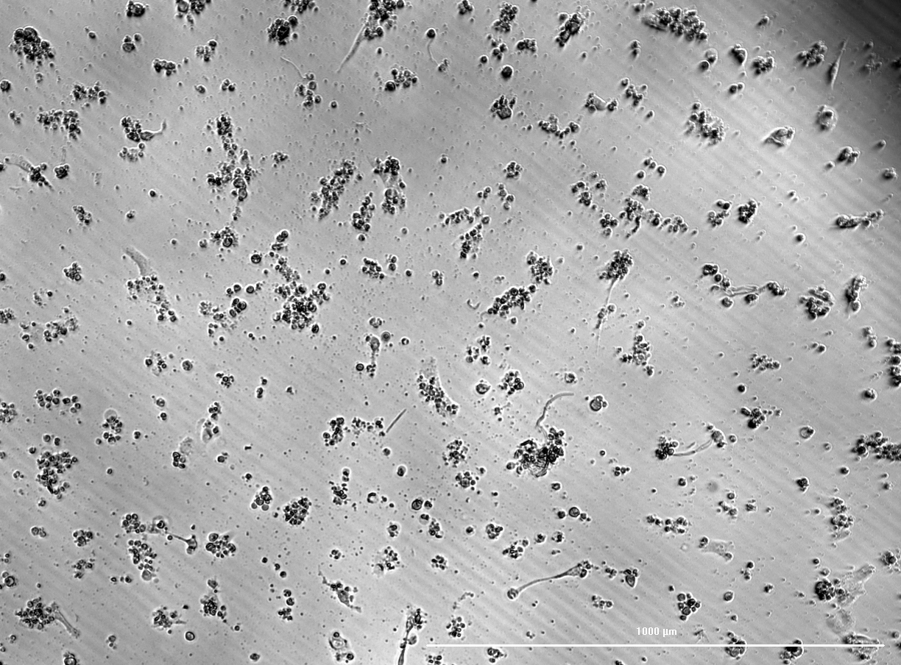
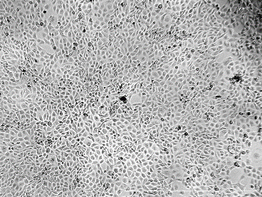
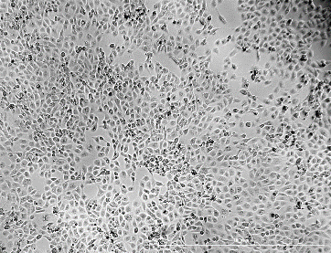
Results and discussion
α-amanitin 5 µM
α-amanitin 10 µM
A
B
C
Protective effects of Polymyxin B against α-amanitin:
Bright-field microscopy of HK-2 cells after Polymixin B co-incubation with α-amanitin for 2h followed by a 48h drug/toxin-free period. (A) Control; (B) α-amanitin 5 µM (C) α-amanitin 10 µM; (D) Polymyxin B 20 µM; (E) α-amanitin 5 µM + Polymyxin B 20 µM; (F) α-amanitin 10 µM + Polymyxin B 20 µM; (G) Polymyxin B 50 µM; (H) α-amanitin 5 µM + Polymyxin B 50 µM; (I) α-amanitin 10 µM + Polymyxin B 50 µM.
D
E
F
Polymyxin B 20 µM
No difference was observed between cells exposed to α-amanitin and Polymyxin B and cells exposed to α-amanitin alone.
G
H
I
Polymyxin B 50 µM

Slide 19
Conclusions
The observed α-amanitin toxicity was time- and concentration-dependent;
α-Amanitin toxicity was observed within 24h at concentrations higher than 1 µM in the MTT reduction assay;
After a 48h incubation, α-amanitin caused significant cytotoxicity above 0.5 µM.
Lower toxicity was observed in shorter incubation periods (1 or 2h)
a 5 times higher concentration was needed to obtain a similar effect to the 48h continuous incubation;
α-amanitin uptake by HK-2 cells is slow.
Polymyxin B did not cause significant toxicity in concentrations bellow 100 µM after a 48h incubation period in the MTT reduction assay.
Polymyxin B did not confer protection against α-amanitin cytotoxicity in all experimental paradigms tested.

Slide 20
Acknowledgments
This work was supported by FEDER funds through the Operational Programme for Competitiveness Factors – COMPETE and by national funds by the FCT within the project PTDC-DTP-FTO-4973-2014 – POCI-01-0145-FEDER 016545. VMC acknowledges Fundação da Ciência e Tecnologia (FCT) for her grant (SFRH/BPD/110001/2015), that was funded by national funds through FCT – Fundação para a Ciência e a Tecnologia, I.P., under the Norma Transitória – DL57/2016/CP1334/CT0006.

