Slide 1

The main products of cyclophosphamide bioactivation exert a cardiotoxic effect at clinical important concentrations in AC16 cardiac cells
Flávio Dionísio^{1*}, Ana Margarida Araújo¹, Margarida Duarte-Araújo², Paula Guedes de Pinho¹, Maria de Lourdes Bastos¹, Félix Carvalho¹ and Vera Marisa Costa¹
¹UCIBIO, REQUIMTE, Laboratory of Toxicology, Department of Biological Sciences, Faculty of Pharmacy, University of Porto, Porto, Portugal; ² LAQV/REQUIMTE, Department of Imuno-Physiology and Pharmacology, Laboratory of Pharmacology, Institute of Biomedical Sciences Abel Salazar, University of Porto, Porto, Portugal;
* Corresponding author: fdionisio@ff.up.pt

Slide 2
Abstract: Cyclophosphamide is used against lymphomas, solid tumors, namely breast, ovarian, bone and soft tissue tumors, in bone marrow transplant conditioning regimens and also in the treatment of autoimmune diseases. Despite its broad use, the application of cyclophosphamide is dose limited by its cardiotoxic effects, which have been linked to its intricate bioactivation process. In this study, we evaluated the cytotoxicity of cyclophosphamide (100 to 10000 µM) and two of its main metabolites, 4-hydroxycyclophosphamide (1 to 25 µM) and acrolein (5 to 100 µM) in AC16 cells, a human cardiomyocyte cell line. Furthermore, metabolomic evaluation was conducted in proliferative and differentiated cells after their incubation for 24h with subtoxic concentrations LC₀₅ of cyclophosphamide, 4-hydroxycyclophosphamide and acrolein.
Keywords: Cyclophosphamide; Metabolism; Chemotherapy; Cardiotoxicity

Slide 3
Graphical Abstract
Cyclophosphamide and metabolites
Cellular Damage Evaluation
Cell Viability Assays
AC16 human cardiomyocytes
GC-MS
Metabolic Profiling

Slide 4
Cyclophosphamide
Prodrug
Extensively metabolized to active metabolites
Treatment of lymphomas, solid tumors namely breast and ovarian and bone marrow transplants regimens
Dose limiting effect: cardiotoxicity

Slide 5
The role of metabolism
Cyclophosphamide
4-Hydroxycyclophosphamide
Aldophosphamide
Phosphoramide Mustard
CYP2B6
CYP2C19
CYP3A4
CYP3A4
ALDH1A1, ALDH3A1
Acrolein
Dechloroethyl
cyclophosphamide
Chloroacetaldehyde
4-ketocyclophosphamide
Carboxycyclophosphamide
Inactive metabolites
Active metabolites

Slide 6
Main Objectives
Determine the cytotoxicity of cyclophosphamide and its main toxic active metabolites in differentiated and proliferative AC16 human cardiac cells
Metabolic profiling of differentiated and proliferative AC16 cells incubated with subtoxic (LC₀₅) doses of cyclophosphamide and toxic active metabolites

Slide 7
Experimental Design: Cytotoxicity assays
Concentration-response curve of cyclophosphamide and two toxic active metabolites – 4-hydroxycyclophosphamide and acrolein
3-(4,5-dimethylthiazol-2-yl)-2,5-diphenyltetrazolium bromide (MTT) reduction assay as indicator of mitochondrial activity
Neutral Red (NR) uptake assay as indicator of lysosomal integrity
Two cellular states used: proliferative and differentiated

Slide 8
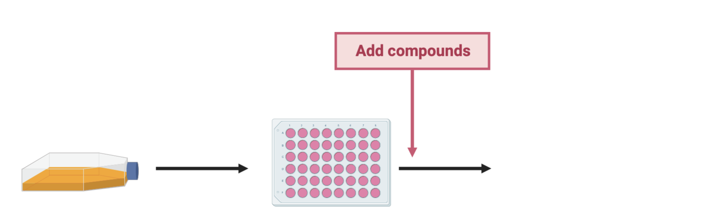
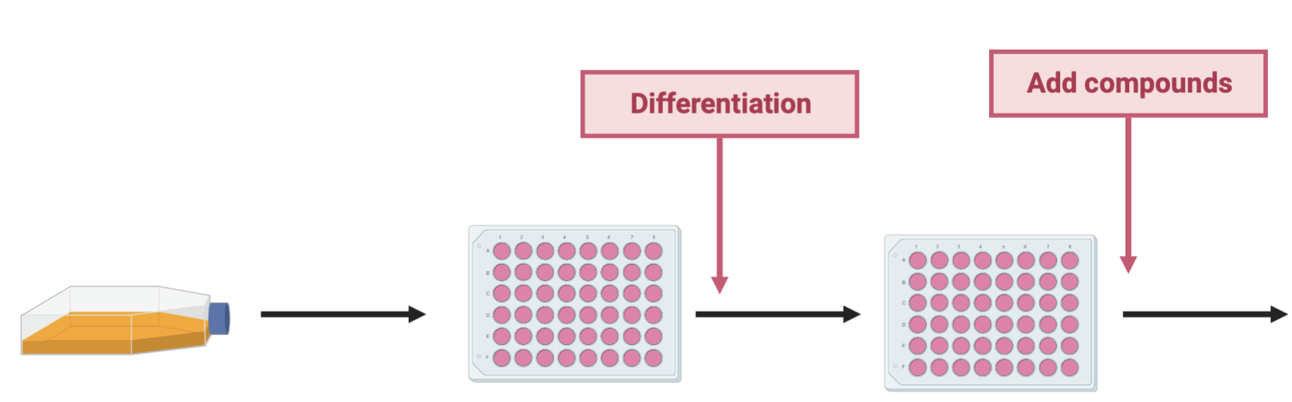
Experimental Design: Cytotoxicity assays
Cell viability assays:
MTT reduction assay
NR uptake assay
24h
24, 48 and 72h
DMEM/F12 + 12.5% Foetal Bovine Serum
Cell viability assays:
MTT reduction assay
NR uptake assay
24h
24h
24 and 48h
DMEM/F12 + 12.5% Foetal Bovine Serum
DMEM/F12 + 2% Horse Serum

Slide 9
Experimental Design: Metabolic Profilling
Profiling of the metabolome of AC16 cells, either proliferative and differentiated, incubated with cyclophosphamide, 4-hydroxycylophosphamide and acrolein
Analysis of intracellular metabolome
PLS-DA (presented graphics): supervised regression of the separation of two classes
If Q²>0.05 and p<0.05, the model has a robust separation of the two groups

Slide 10
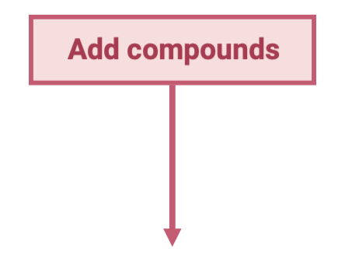
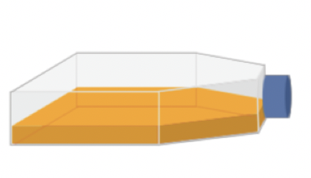
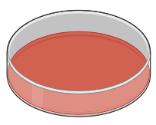


Experimental Design: Metabolic Profilling
Extraction (Methanol:Water)
GC-MS
Extraction (Methanol:Water)
Intracellular metabolome analysis

Slide 11
Results: Cytotoxicity Assays

Slide 12
Cytotoxicity Assays
MTT Reduction Assay
 | Differentiated |  |  |  |  | Proliferative
Cyclophosphamide (μM) | 1 000 | 2 500 | 5 000 | 7 500 | 10 000 | 1 000 | 2 500 | 5 000 | 7 500 | 10 000
24h | - | - | ++++ | ++++ | ++++ | - | - | +++ | ++++ | ++++
48h | - | ++++ | ++++ | ++++ | ++++ | - | - | ++++ | ++++ | ++++
72h |  |  |  |  |  | - | ++ | ++++ | ++++ | ++++
NR Uptake Assay
 | Differentiated |  |  |  |  | Proliferative
Cyclophosphamide (μM) | 1 000 | 2 500 | 5 000 | 7 500 | 10 000 | 1 000 | 2 500 | 5 000 | 7 500 | 10 000
24h | - | - | - | ++ | ++++ | - | - | ++++ | ++++ | ++++
48h | - | - | - | ++++ | ++++ | - | - | - | ++++ | ++++
72h |  |  |  |  |  | - | - | - | ++++ | ++++
Results expressed vs control (PBS -/- incubated)

Slide 13
Cytotoxicity Assays
MTT Reduction Assay
 | Differentiated |  |  |  |  | Proliferative
4-Hydroxycyclophosphamide (μM) | DMSO 0.05% | 1 | 5 | 15 | 25 | DMSO 0.05% | 1 | 5 | 15 | 25
24h | - | - | ++++ | ++++ | ++++ | - | - | - | ++++ | ++++
48h | - | - | ++++ | ++++ | ++++ | - | - | ++++ | ++++ | ++++
72h |  |  |  |  |  | - | ++ | ++++ | ++++ | ++++
NR Uptake Assay
 | Differentiated |  |  |  |  | Proliferative
4-Hydroxycyclophosphamide (μM) | DMSO 0.05% | 1 | 5 | 15 | 25 | DMSO 0.05% | 1 | 5 | 15 | 25
24h | - | - | - | ++++ | ++++ | - | - | - | ++++ | ++++
48h | - | - | ++++ | ++++ | ++++ | - | - | +++ | ++++ | ++++
72h |  |  |  |  |  | - | - | ++++ | ++++ | ++++
Results expressed vs control (PBS -/- incubated)

Slide 14
Cytotoxicity Assays
MTT Reduction Assay
 | Differentiated |  |  |  |  | Proliferative
Acrolein (μM) | 15 | 25 | 35 | 50 | 100 | 15 | 25 | 35 | 50 | 100
24h | ++++ | ++++ | ++++ | ++++ | ++++ | - | +++ | - | ++++ | ++++
48h | ++++ | ++++ | ++++ | ++++ | ++++ | - | ++++ | + | ++++ | ++++
72h |  |  |  |  |  | - | +++ | ++++ | ++++ | ++++
NR Uptake Assay
 | Differentiated |  |  |  |  | Proliferative
Acrolein (μM) | 15 | 25 | 35 | 50 | 100 | 15 | 25 | 35 | 50 | 100
24h | - | ++++ | ++++ | ++++ | ++++ | - | ++++ | ++++ | ++++ | ++++
48h | - | ++++ | ++++ | ++++ | ++++ | - | - | - | ++++ | ++++
72h |  |  |  |  |  | - | - | - | ++++ | ++++
Results expressed vs control (PBS -/- incubated)

Slide 15
Results: Metabolic Profilling

Slide 16
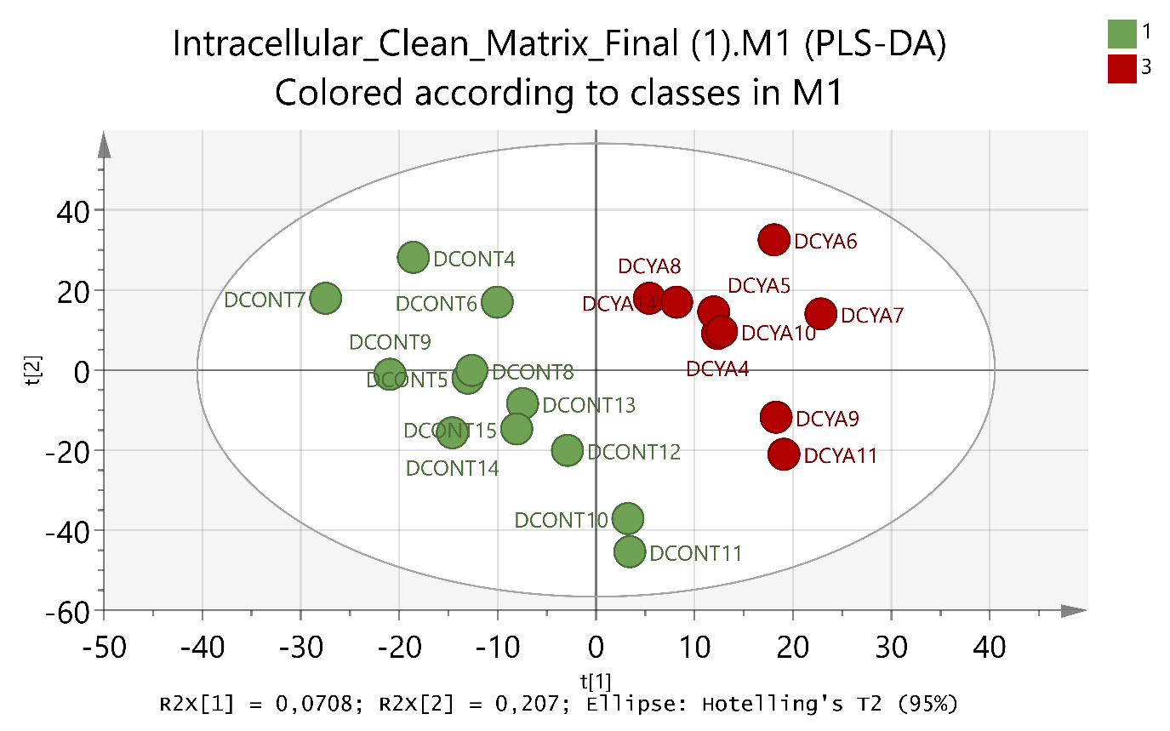
Differentiated AC16 cells
Control vs Cyclophosphamide
Q2<0.500; p>0.05

Slide 17
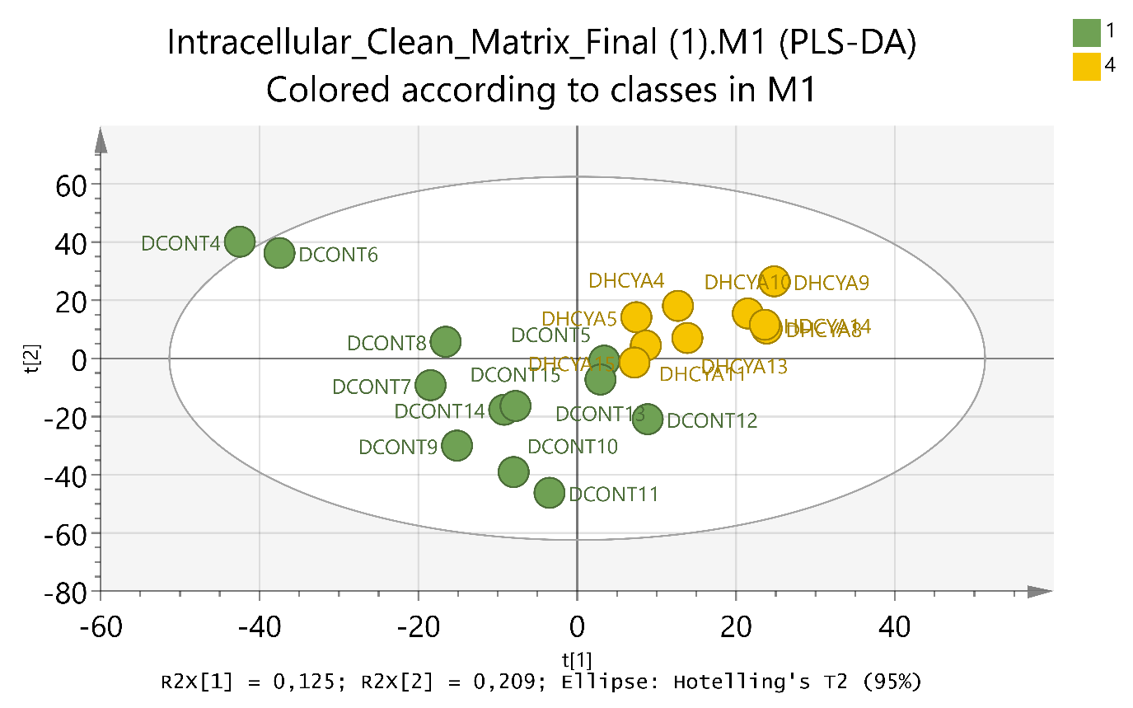
Differentiated AC16 cells
Control vs 4-Hydroxycyclophosphamide
Q2<0.500; p>0.05

Slide 18
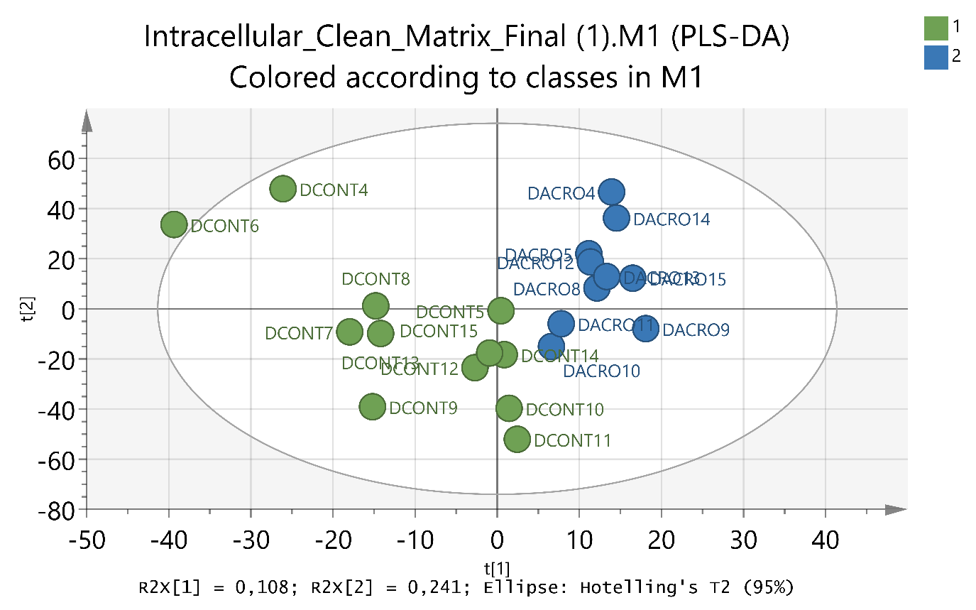
Differentiated AC16 cells
Control vs Acrolein
Q2<0.500; p>0.05

Slide 19
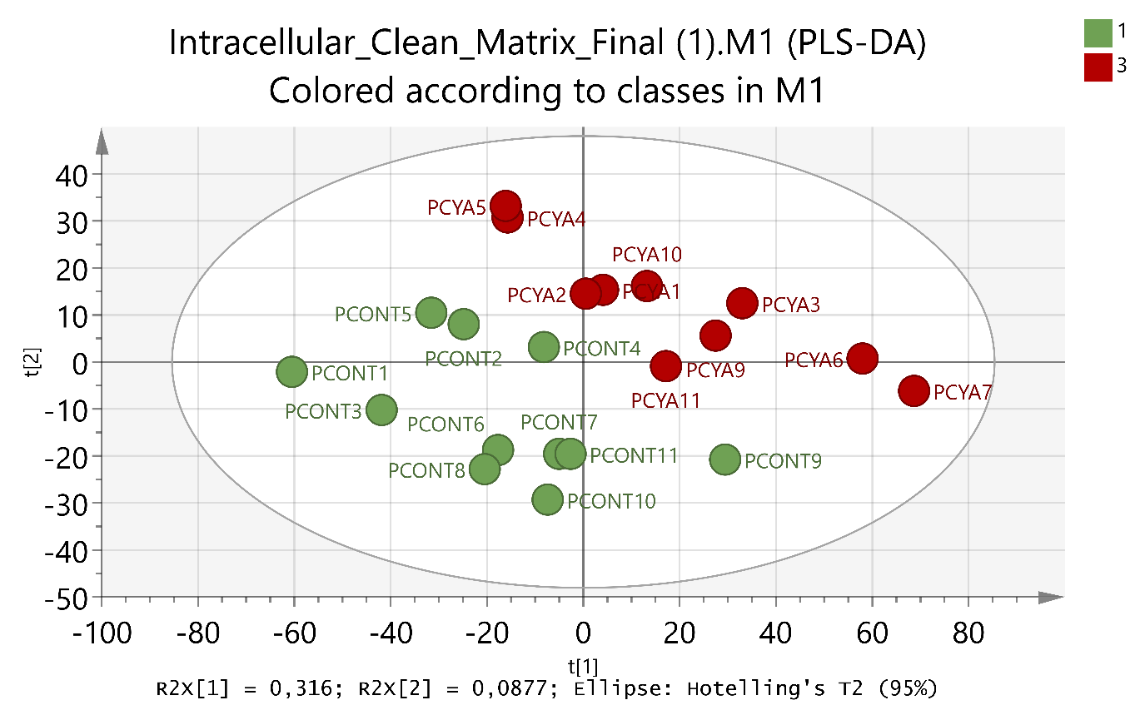
Proliferative AC16 cells
Control vs Cyclophosphamide
Q2<0.500; p>0.05

Slide 20
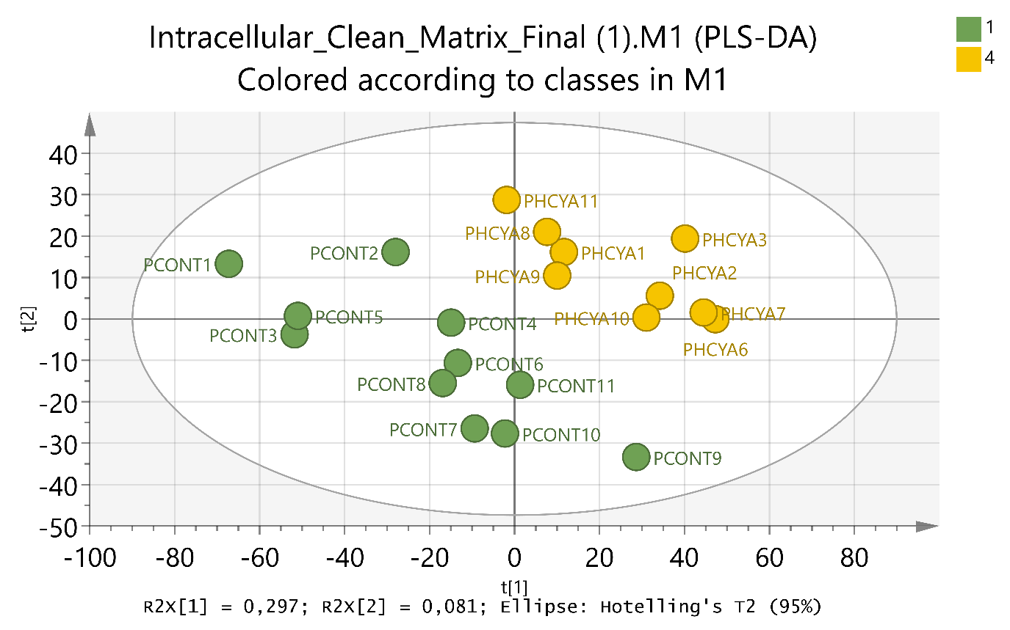
Proliferative AC16 cells
Control vs 4-Hydroxycyclophosphamide
Q2>0.500; p<0.05

Slide 21
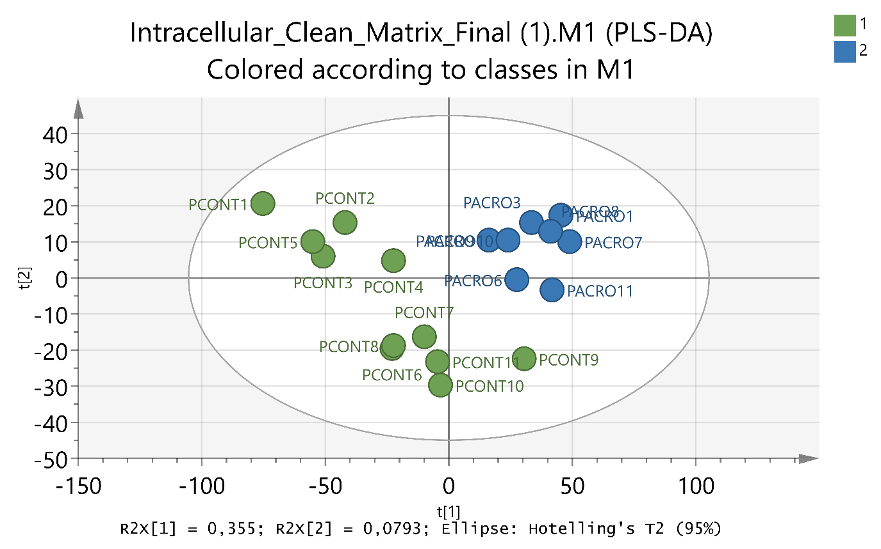
Proliferative AC16 cells
Control vs Acrolein
Q2>0.500; p<0.05

Slide 22
Discussion
 | Plasma concentration levels | Lowest Cytotoxic Concentration - Differentiated | Lowest Cytotoxic Concentration - Proliferative
Cyclophosphamide | Up to 250 μM# | 2 500 μM | 2 500 μM
4-Hydroxycyclophosphamide | 1 to 10 μM# | 1 μM | 5 μM
Acrolein | 1 to 10 μM# | 25 μM | 15 μM
#De Jonge M. E., Huitema A. D. R., Rodenhuis S., Beijnen J. H., Clinical Pharmacokinetics of Cyclophosphamide, Clinical Pharmacokinetics, 44(11), 2005, 1135-1164

Slide 23
Discussion
Differentiated Cells
 | Q² | p
Control vs Cyclophosphamide | <0.500 | >0.05
Control vs 4-Hydroxycyclophosphamide | <0.500 | >0.05
Control vs Acrolein | <0.500 | >0.05

Slide 24
Discussion
Proliferative cells
 | Q² | p
Control vs Cyclophosphamide | <0.500 | >0.05
Control vs 4-Hydroxycyclophosphamide | >0.500 | <0.05
Control vs Acrolein | >0.500 | <0.05

Slide 25
Conclusions
Cyclophosphamide is cytotoxic at relatively high concentrations
4-Hydrocycylophosphamide and acrolein are cytotoxic at clinically relevant concentrations
In AC16 proliferative cells, the metabolites cause a marked distinct metabolic pattern while cyclophosphamide does not
Robust separation of the intracellular results in control proliferative AC16 cells vs metabolites but not in the differentiated cells

Slide 26
Acknowledgements
AMA and VMC acknowledge FCT for their grants (SFRH/BD/107708/2015 and SFRH/BPD/110001/2015). VMC’s grant is funded by national funds through FCT – Fundação para a Ciência e a Tecnologia, I.P., under the Norma Transitória – DL57/2016/CP1334/CT0006. This work was supported by FEDER funds [Operational Program for Competitiveness Factors – COMPETE and by FCT within the project “PTDC/DTP-FTO/1489/2014 – POCI-01-0145-FEDER-016537”].

