Slide 1

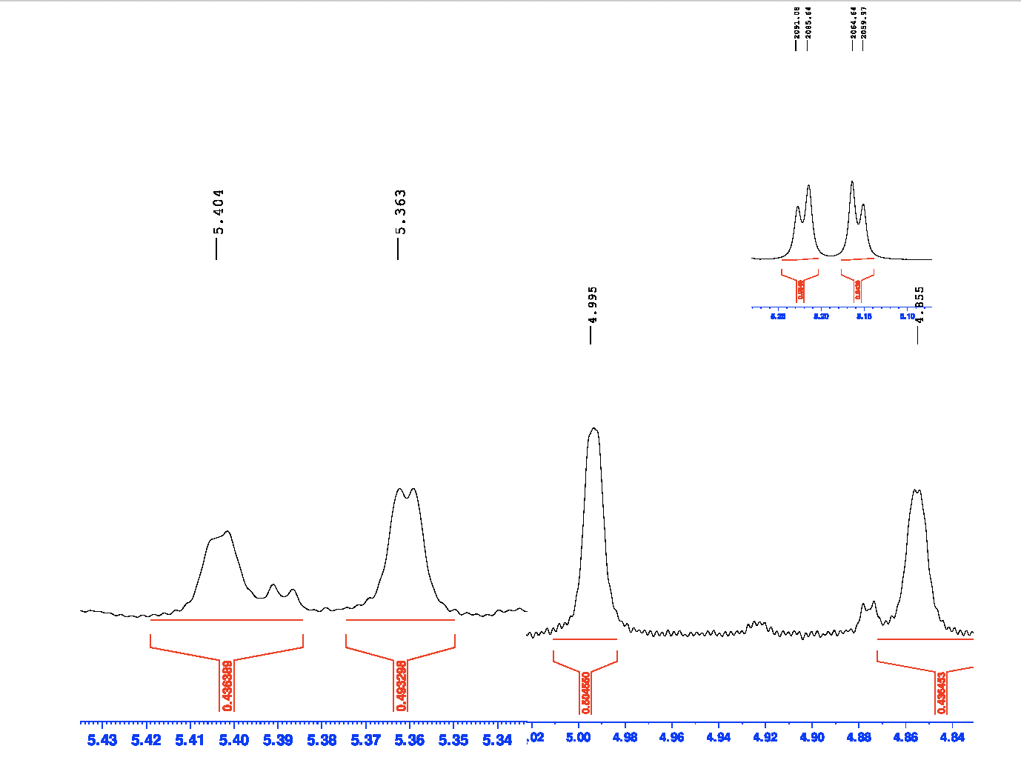
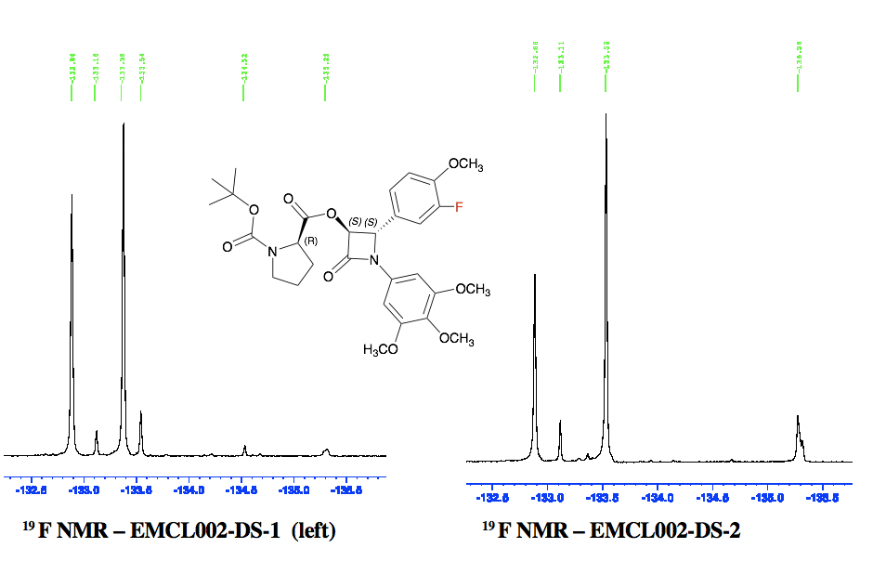
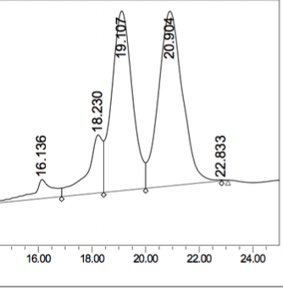
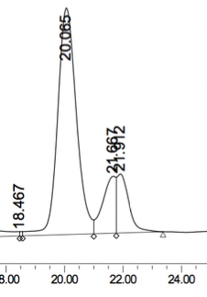
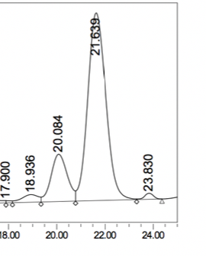
Stories from Staudinger: Synthesis of Chiral β-Lactams
Eavan McLoughlin, Mary Meegan, Niamh O’Boyle.
School of Pharmacy and Pharmaceutical Sciences, Trinity College Dublin, Ireland.
E-mail: mclougea@tcd.ie
Introduction
Combretastatin A-4 (CA-4) is a potent anticancer drug isolated from the wood of the South African tree Combretum caffrum acting by
inhibition of tubulin polymerisation. Isomerization of cis CA-4 to the trans form is observed both during storage and in vivo during metabolism.
This dramatically reduces antitumour activity. Our group has previously synthesized novel 3-hydroxy-1,4-diaryl-2-azetidinones by Staudinger
reaction, inducing cis-restriction and overcoming the problem of isomerisation of CA-4. A number of trans beta-lactams have shown
potent nanomolar antiproliferative activity in MCF-7 breast cancer cells with enhanced activity relative to CA-4.
First Aim: Staudinger Optimisation
Determine the necessary conditions to optimise the yield of the trans isomer of 3-hydroxy-1,4-diaryl-2-azetidinones in the Staudinger reaction. Trans isomers of 3-substituted-2-azetidinones are up to 50 times more potent than the corresponding cis derivatives.
Second Aim: Enantiomer Resolution
Isolation of enantiomers of the most potent azetidinones by formation of diastereomers and separation by column chromatography. Levo- and dextro-rotatory enantiomers may differ in biological activity relative to one another.
Pathways for cis & trans β-lactam isomer product formation during Staudinger syntheses
Relative stereochemistry is determined by the rate of ring closure; controlled by two competing factors:
Competition for direct ring closure
Isomerization of zwitterionic intermediate.
    Product is cis if k₁ > k₂.
    If k₂ = k₁ it, product is a mixture of cis & trans
    Zwitterionic intermediate must be allowed time to isomerize in situ.
    An acid chloride with an electron withdrawing group decreases the nucleophilicity of the enolate anion.
      In optimised conditions will allow for isomerization (k₂) to allow for trans ring closure.
Resolution using N-(tert-butoxycarbonyl)-L-Proline
Diastereomers were separated using flash column chromatography
Proline was subsequently cleaved using hydrazine dihydrochloride to reveal optically pure enantiomers
¹H NMR: H₃ & H₄ splitting pattern indicative of diastereomer rotameric derivatives.
Two sets of β – Lactam doublets present in pure diastereomer derivative compared to parent compound (top right)
¹⁹F NMR illustrated the presence of at least four rotamers with four fluorine signals.
¹H NMR of H_{3 &} H₄ doublets
β-Lactam proton integration indicates relative cis:trans ratio; J = 4 Hz for cis; J = 1 Hz for trans
Preliminary
4:6 Cis:trans
Cis δ 5.16 (d, 1H, J=5.5Hz), δ 5.219 (d, 1H, J=5.5Hz)
Trans δ 4.74 (d, 1H, J=1.875Hz), δ 4.785 (d, 1H, J=1.875Hz)
Experimental
82:18 Cis:trans
Cis δ 5.89 (d, 1H, J=5Hz), δ 5.25 (d, 1H, J=5Hz)
Trans δ 4.81 (d, 1H, , J = 1.3Hz), δ 5.31 (d, 1H, J = 1.3Hz)
Conditions for Staudinger Synthesis | Preliminary (P) | Experimental ( E ) | Optimized Conditions (OC)
Imine | Added to anhydrous toluene first at zero degrees | Added to anhydrous toluene first (1 Eq) at zero degrees again on ice | Imine added in portions to acetoxyacetylchloride and dry toluene.
Acetoxy acetylchloride | Added to imine in anhydrous toluene at zero degrees | Added in under ice to imine and acetoxyacetylchloride. | Added first to dry toluene without Imine
Duration of imine & acetoxy acetylchloride stirring prior to base addition | 0 minutes | 0-10 minutes | 25 minutes at reflux conditions Colour change from initial deep orange on addition of imine to acetoxyacetylchloride seen → yellow.
Triethylamine | Added immediately after addition of acetoxyacetylchloride at zero degrees. | Added after heating to reflux conditions (100 degrees), dropwise over 10 minutes. | Added in dropwise after 25 minutes of reflux.
Optimised Conditions
5:95 Cis:trans
Cis δ 5.89 (d, 1H, J=5Hz), δ 5.25 (d, 1H, J=5Hz)
Trans δ 4.81 (d, 1H, , J = 1.3Hz), δ 5.31 (d, 1H, J = 1.3Hz)
Verification of enantiomeric purity via optical rotation and chiral HPLC
001
Enantiomer 1: [α]²⁰_{D} : +25.14 (c 17.9mg/5mL)
Enantiomer 2: [α]²⁰_{D} : -25.38 (c 19.7mg/5mL)
001 trans racemic mixture 001 trans Enantiomer 001 trans Enantiomer 2
% Peak Area on Chiral HPLC
50:50 85:15 18:82
002
Enantiomer 1: [α]²⁰_{D} : +22.15 (c 15.8mg/5mL)
Enantiomer 2: [α]²⁰_{D} : -17.6(c 15.1mg/5mL) ee (%): 77%
Conclusions & Future Work
In order to favour zwitterion isomerization; k2 over direct ring closure; k1, the imine should be left to stir with the acid chloride for a period of time. 25 minutes was chosen as the ideal time.
Separation of enantiomers was achieved by synthesis of diastereomers and separation on column chromatography. These will be evaluated for their biochemical activity in future work. Future aims are to clarify the impact of absolute configuration on binding mode with tubulin and therefore bioactivity in MCF-7 cells
Acknowledgements
This project is supported by The Provost’s PhD Project Award awarded to Assistant Prof Niamh O’Boyle. These doctoral awards are generously funded through alumni donations and Trinity’s Commercial Revenue Unit and we would like to express our sincere gratitude for ongoing support.
References:
Pettit, G. R.; Singh, S. B.; Hamel, E.; Lin, C. M.; Alberts, D. S.; Garcia-Kendall, D., Isolation and structure of the strong cell growth and tubulin inhibitor combretastatin Experientia 1988, (45), 209
Ohsumi, K.; Hatanaka, T.; Fujita, K.; Nakagawa, R.; Fukuda, Y.; Nihei, Y.; Suga, Y.; Morinaga, Y.; Akiyama, Y.; Tsuji, T., SYNTHESES AND ANTITUMOR ACTIVITY OF CISRESTRICTED COMBRETASTATINS: 5-MEMBERED HETEROCYCLIC ANALOGUES Bioorganic & Medicinal Chemistry Letters 1998, 8, 3153-3158
N.M. O’Boyle, M. Carr, L.M. Greene, O. Bergin, S.M. Nathwani, T.McCabe, D.G. Lloyd, D.M. Zisterer, M.J. Meegan, Synthesis and evaluation of azetidinone analogues of combretastatin A-4 as tubulin targeting agents, J. Med. Chem., 53 (2010), p. 8569
Azizah M. Malebari Lisa M. Greene, S. M. N., Darren Fayne, Niamh M. O'Boyle , Shu Wang , Brendan Twamley , Daniela M. Zisterer , Mary J. Meegan b-Lactam analogues of combretastatin A-4 prevent metabolic inactivation by glucuronidation in chemoresistant HT-29 colon cancer cells. European Journal of Medicinal Chemistry 2017, 130, 261-285
*Lei Jiao, Y. L., and Jiaxi Xu, Origin of the Relative Stereoselectivity of the -Lactam Formation in the Staudinger Reaction, Journal of Americal Chemistry Society 2005, 128 (18), 6060-6069.

