Slide 1
Tackling bacterial resistance using antibiotics
as ionic liquids and organic salts
Miguel M. Santos^{1,}*, Inês R. Grilo², Ricardo Ferraz^{3,4}, Diogo A. Madeira¹, Bárbara M. Soares^{1,2}, Núria Inácio^{1,2}, Luís Pinheiro¹, Zeljko Petrovski¹, Cristina Prudêncio^{3,5}, Rita G. Sobral², Luís C. Branco¹
¹ LAQV-REQUIMTE, Departamento de Química, Faculdade de Ciências e Tecnologia, Universidade Nova de Lisboa, Caparica, Portugal; ² UCIBIO, Departamento de Ciências da Vida, Faculdade de Ciências e Tecnologia, Universidade NOVA de Lisboa, Caparica, Portugal; ³ Ciências Químicas e das Biomoléculas (CQB) e Centro de Investigação em Saúde e Ambiente (CISA), Escola Superior de Saúde do Instituto Politécnico do Porto, Porto, Portugal; ⁴ LAQV-REQUIMTE, Departamento de Química e Bioquímica, Faculdade de Ciências, Universidade do Porto, Porto, Portugal; ⁵ i3S, Instituto de Inovação e Investigação em Saúde, Universidade do Porto, Porto, Portugal.
* Corresponding author: miguelmsantos@fct.unl.pt

Slide 2
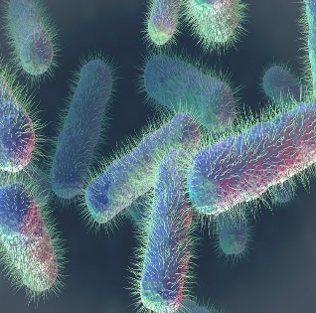
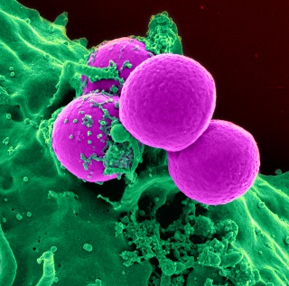
Tackling bacterial resistance using antibiotics
as ionic liquids and organic salts
Graphical Abstract
5 nM
Resistant E. coli
50 nM
5 nM
MRSA
500 nM
50 nM

Slide 3
Abstract: Bacterial resistance to current antibiotics has a major impact on worldwide human health, leading to 700K deaths every year. The development of novel antibiotics did not present significant progress, namely regarding clinical trials, over the last years due to low returns. Thus, innovative alternatives must be devised to tackle the continuous rise of antimicrobial resistance.
Ionic Liquids and Organic Salts from Active Pharmaceutical Ingredients (API-OSILs) have risen in academia for over 10 years as an efficient formulation for drugs with low bioavailability and permeability, as well as reduction or elimination of polymorphism, thereby potentially enhancing their pharmaceutical efficiency. To the best of our knowledge, our group is the first to perform research on the development of API-OSILs from antibiotics as a way to improve their efficiency. More specifically, we have successfully combined ampicillin, penicillin and amoxicillin as anions with biocompatible organic cations such as choline, alkylpyridiniums and alkylimidazoliums.
In this communication, we present our latest developments in the synthesis and physicochemical (DSC) characterization of OSILs from these antibiotics, in addition to in vitro antimicrobial activity data, in particular towards MRSA and multi-resistant E. coli, as well as sensitive strains of gram-positive and gram-negative bacteria.
Keywords: API-OSILs; bacterial resistance; β-lactam antibiotics; Ionic Liquids; MRSA

Slide 4
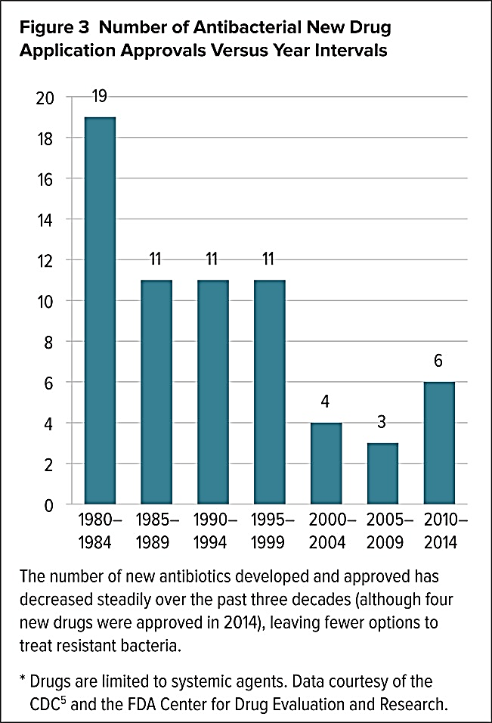
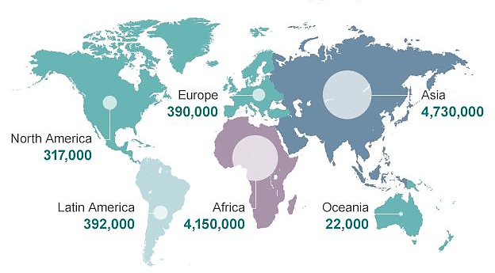
Introduction
Estimated deaths by resistant bacteria in 2050
Approved # of antibiotics since 1980
Reproduced from Review on Antimicrobrial Resistance 2014
10 million deaths by 2050
75b€ associated costs
Reproduced from C. Lee Ventola, MS. (2015). The Antibiotic Resistance Crisis. Pharmacy & Therapeutics, Vol.40, N. 4
Growing need for more effective antibiotics
Low returns from clinical trials

Slide 5
Introduction
Bacteria resistance to β-lactam antibiotics
β-lactamases enzymatic degradation
Mutations in porine channels (Gram-negative)
Efflux pumps (Gram-negative)
Mutations in PBPs
Altered binding site
Degradation of the β-lactam ring
Protein is no longer inhibited
Low affinity for such antibiotics

Slide 6
Problems to be addressed
Bioavailability
Low solubility of APIs in water and biological fluids
Poor permeability across biological membranes
Polymorphism
Distinct crystalline forms of a solid drug
Drug resistance
Efficiency reduction of drugs
Drug delivery
Lack of systemic site-targeting of the drug
Organic Salts and Ionic Liquids can be the alternative approach to address such API problems

Slide 7
Ionic Liquids
Organic salts with melting points lower than 100 ºC composed by an organic cation and an inorganic or organic anion
The physical and structural properties of the ILs are dependent on the cation-anion combinations
High thermal and chemical stability
High ionic conductivity
IL
Tuneable solubility of the IL in aqueous or organic solvents
Negligible vapour pressure
Adjustable solubility of scCO₂, organic compounds and transition metal complexes in the Ionic Liquid

Slide 8
3rd generation Ionic Liquids
API
API
+
-
+
-
New physical, chemical and biochemical properties
Modulate biopharmaceutical drug classification
Water solubility
Permeability
Drug formulation
Toxicity and metabolism
W. L. Hough, et al, New J. Chem. 2007, 31, 1429; ChemMedChem 2011, 6, 975; Annual Rev. Chem. Biom. Eng. 2014, 5, 527

Slide 9
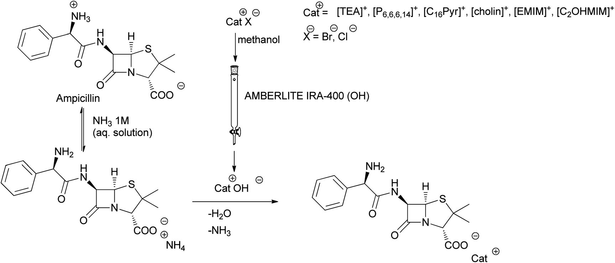
Results and discussion
Ampicillin
Neutralization method
71 – 95 %
The hydroxide cation is prepared by passing a methanolic solution of halide salt through an ion-exchange column and subsequently added to ampicillin in 1M ammonium buffer solution.
Med. Chem. Comm. 2012, 3, 494

Slide 10
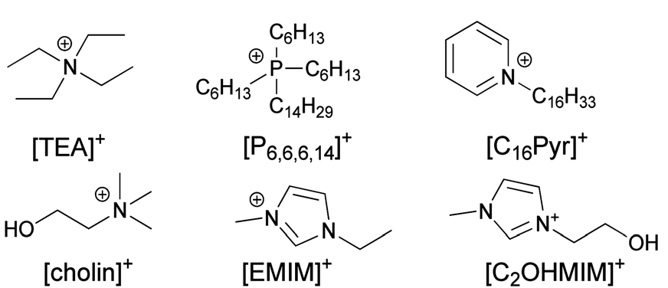
Thermal Properties of Ampicillin-OSILs
¹H NMR
¹³C NMR
FTIR
Elemental analysis
DSC
Compound | Physical State | T_{m}ª [ºC] | T_{g}^{b} [ºC] | T_{dec}^{c} [ºC]
[TEA][Amp] | Pale yellow solid | 79.0 | -18.64 | 214.75
[P_{6,6,6,14}][Amp] | Yellow viscous liquid | - | - | 297.65
[C₁₆Pyr][Amp] | Pale yellow solid | 86.0 | -19.64 | 269.39
[cholin][Amp] | Pale yellow solid | 58.0 | -20.12 | 221.29
[EMIM][Amp] | Pale yellow solid | 72.0 | -17.86 | 239.64
[C₂OHMIM] [Amp] | Pale yellow solid | 117.0 | -20.84 | 246.40

Slide 11
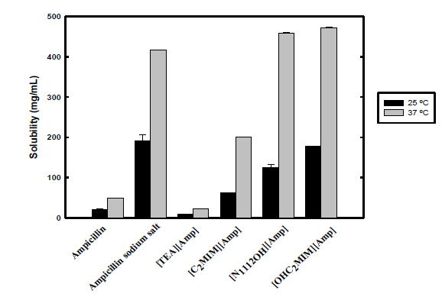
Water solubility
Water solubility & partition coefficient
Tuning of water solubility and octanol-water partition: tunable bioavailability
OSIL approach is much more versatile than the traditional salt (Na⁺) approach
Int. J. Pharm. 2013, 456, 553

Slide 12
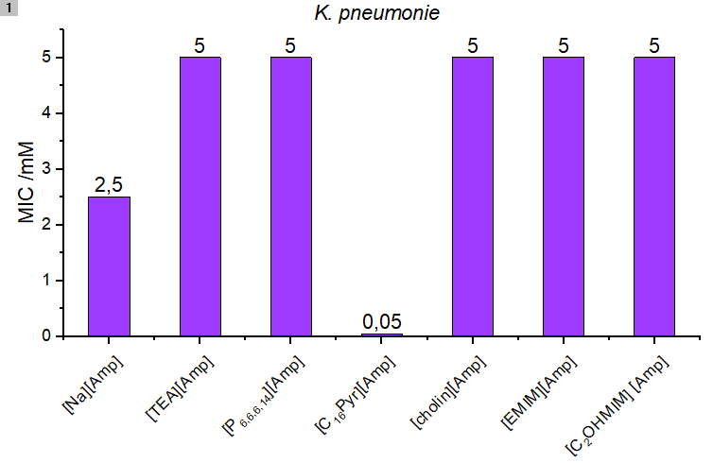
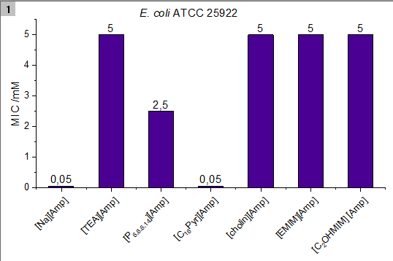
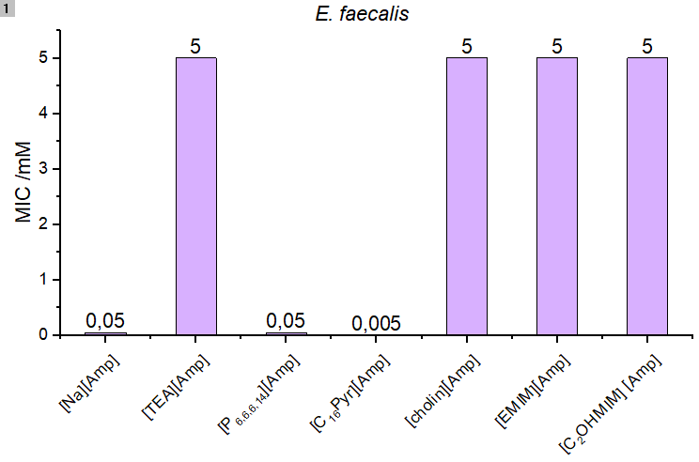
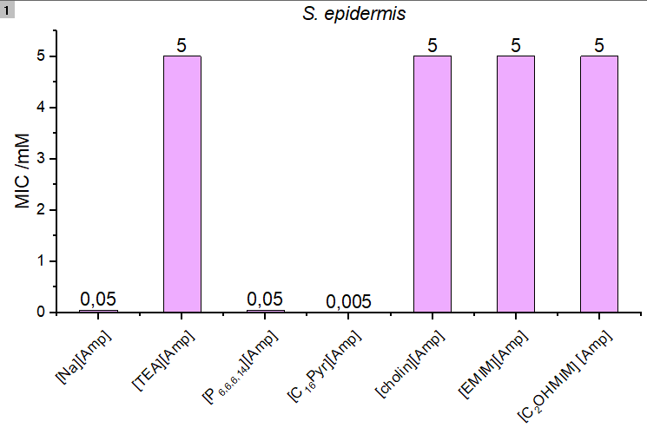
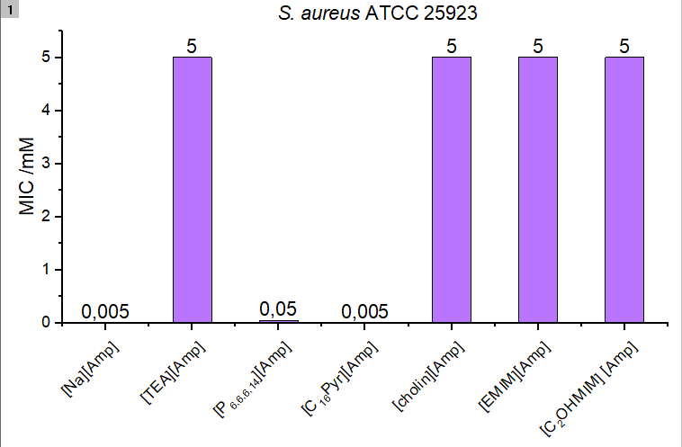
MICs (mM) of API-OSILs against gram-negative sensitive strains
10-50x increased activity was found for [C₁₆Pyr][Amp]
(Threshold: 5 mM)
RDIC = 50
RDIC = 1
RSC Advances 2014, 4, 4301
MICs (mM) of API-OSILs against gram-positive sensitive strains
RDIC = 10
RDIC = 10
RDIC = 1
RDIC: Relative Decrease in Inhibitory Concentration

Slide 13
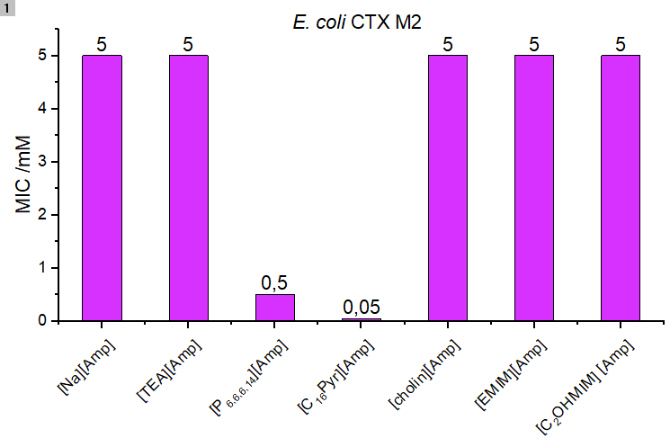
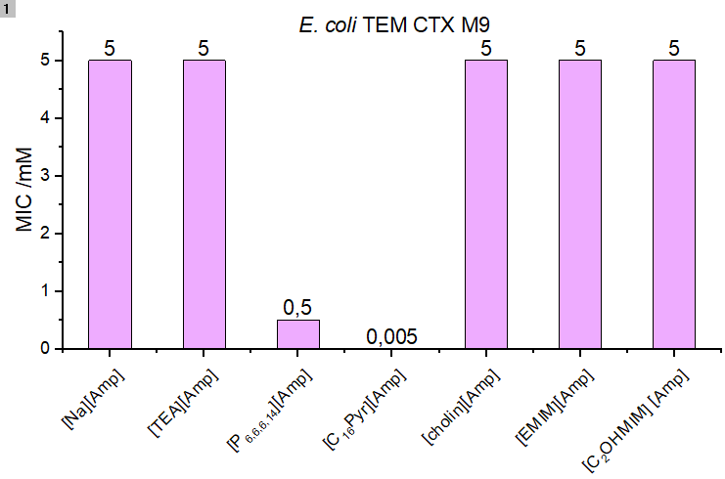
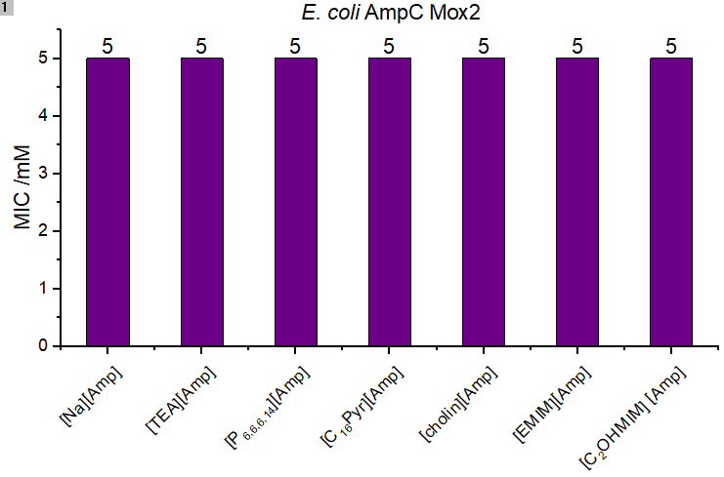
MICs (mM) of Amp-OSILs against E. coli resistant strains
RDIC ≥ 10
RDIC ≥ 100
RDIC ≥ 100
RDIC = 0
RDIC ≥ 1000
[C₁₆Pyr][Amp] was at least 100 to 1000 times more efficient against two of the Ampicillin-resistant E. coli strains tested in in vitro studies
(Threshold: 5 mM)
RSC Advances 2014, 4, 4301

Slide 14
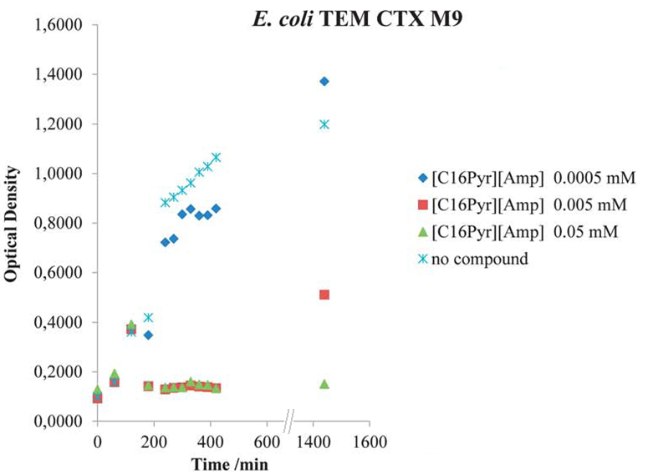
Growth inhibition of resistant E. coli bacteria strains
The growth of E. coli TEM CTX M9 and CTX M2 was efficiently inhibited by [C₁₆Pyr][Amp]
RSC Advances 2014, 4, 4301

Slide 15
Results and discussion
Penicillin and Amoxicillin
¹H NMR
¹³C NMR
FTIR
Elemental
analysis
DSC
Using the same (for Amoxicillin) or a different (for Penicillin G) procedure, hydrolized (secondary) β-lactam antibiotic cations were obtained

Slide 16
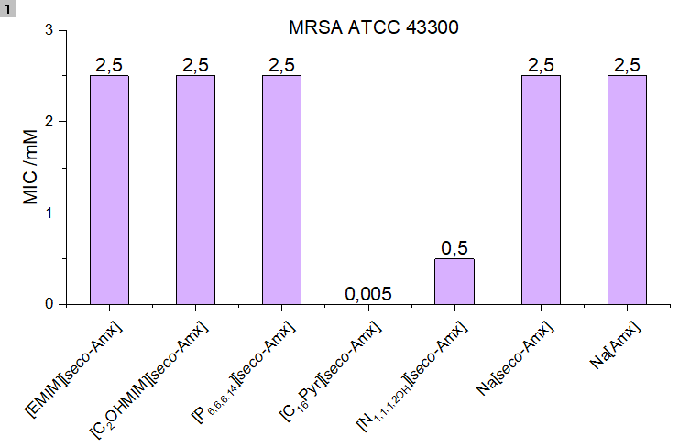
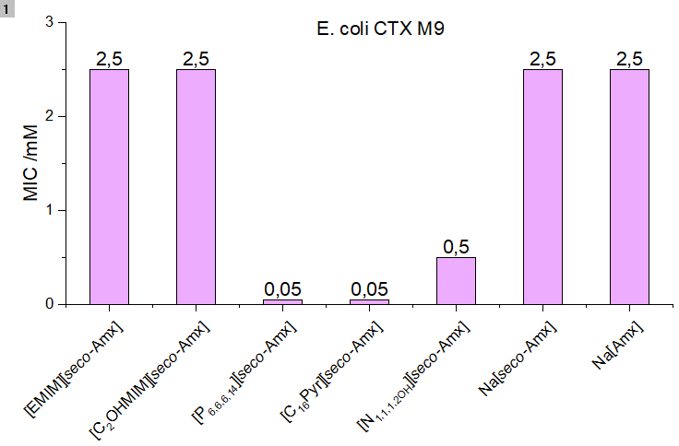
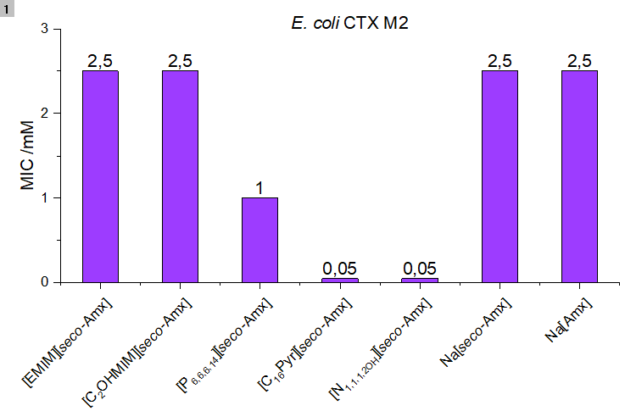
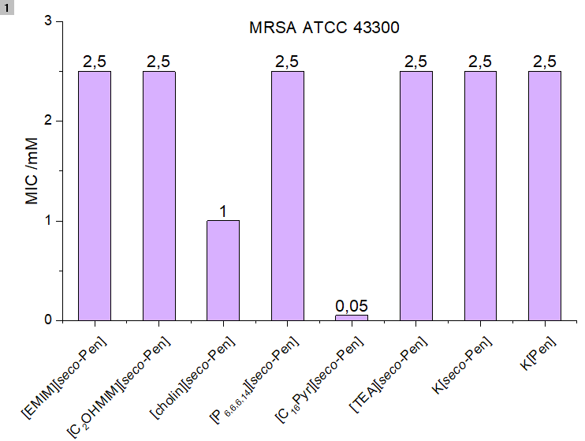
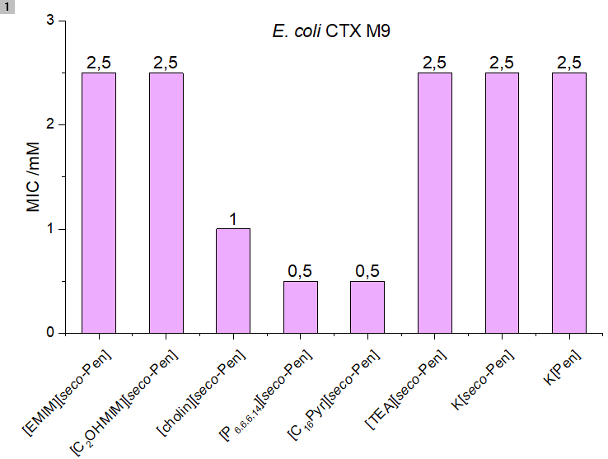
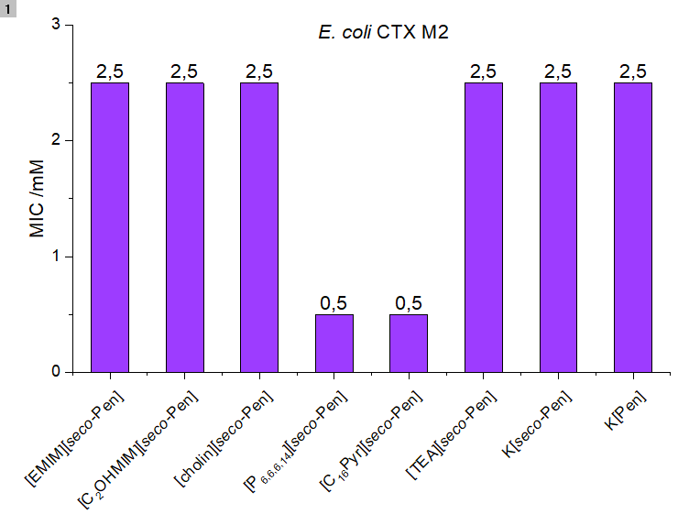
However, against resistant bacteria…
Amoxicillin-OSILs
RDIC ≥ 5
RDIC ≥ 5
RDIC ≥ 50
RDIC ≥ 500
RDIC ≥ 50
RDIC ≥ 2,5
(Threshold: 2,5 mM)
Penicillin-OSILs
RDIC ≥ 50
RDIC ≥ 5
RDIC ≥ 5
RDIC ≥ 2,5
RDIC ≥ 2,5

Slide 17
Conclusions
Using a simple and straightforward neutralization procedure, we were able to:
Synthesize six Amp-OSILs, five secoAmx-OSILs and six secoPen-OSILs;
The β-lactam ring was conserved in Amp, while on the other two families it was disrupted;
Amp polymorphism was eliminated, while water solubility and K_{ow} can be modulated according to the cation-anion combination;
Against sensitive bacteria, [C₁₆Pyr][Amp] was found to be 10-50 times more efficient than Na[Amp];
[C₁₆Pyr][Amp] showed a relative decrease in inhibitory concentration (RDIC) between at least 100 to 1000 towards E. coli resistant strains;
[C₁₆Pyr][secoAmx] and [C₁₆Pyr][secoPen] were particularly effective against MRSA (RDIC ≥ 500 and ≥ 50)
The activity of secoAmx and secoPen OSILs was surprising but it is not unprecendent - reversible inactivation of β-lactam antibiotic mediated by enzyme active site of PBPs in Enterococcus faecium was recently described (see Edoo, Z. et al. Scientific Report 2017, 7: 9136);
We are optimizing the structure of the cations in order to further enhance the antimicrobial activity of these antibiotics, and we are currently determining MICs for Amp-OSILs towards MRSA in addition to PBP2a – API-OSILs interaction studies for a deeper understanding of the action mechanism
We have optimized the procedure for the preparation of Amx-OSILs and further studies are underway.

Slide 18
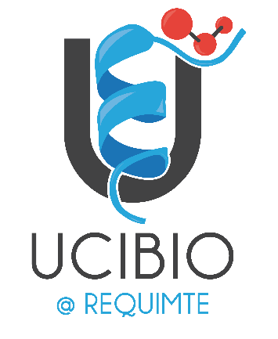
Acknowledgments
Work supported by FCT-MCTES (PTDC/QUI-QOR/32406/2017, PTDC/BIA-MIC/31645/2017, PEst-C/LA0006/2013, IF/0041/2013/CP1161/CT00), by the Associate Laboratory for Green Chemistry LAQV and by the Unidade de Ciências Biomoleculares Aplicadas-UCIBIO which are financed by national funds from FCT/MCTES (UID/QUI/50006/2013 and UID/Multi/04378/2013, respectively) and co-financed by the ERDF under the PT2020 Partnership Agreement (POCI-01-0145-FEDER-007265 and POCI-01-0145-FEDER-007728, respectively). Authors also thank Solchemar.

