Slide 1
FLOOD AND FLASH FLOOD HAZARD MAPPING USING THE FREQUENCY RATIO, MULTILAYER PERCEPTRON AND THEIR HYBRID ENSEMBLE
Mihnea Cristian POPA, Daniel Constantin DIACONU
4th International Electronic Conference on Water Sciences
Managing Water Resources from Aquifers, Rivers and Lakes

Slide 2
INTRODUCTION

Slide 3
Introduction
The importance of identifying the areas vulnerable for both floods and flash-floods is an important component of risk management. The assessment of vulnerable areas is a major challenge in the scientific world. Adaptation and mitigation have generally been treated as two separate issues, both in public politics and in practice, in which mitigation is seen as the attenuation of the cause, and studies of adaption look into dealing with the consequences of climate change.
The aim of this study is to provide a methodology-oriented study of how to identify the areas vulnerable to floods and flash-floods in the catchment by computing two indices: the Flash-Flood Potential Index (FFPI) for the mountainous and the Sub-Carpathian areas, and the Flood Potential Index (FPI) for the low-altitude areas, using the frequency ratio (FR), a bivariate statistical model, the Multilayer Perceptron Neural Networks (MLP), and the ensemble model MLP–FR.
The use of the two indices represents a preliminary step in creating flood vulnerability maps, which could represent an important tool for local authorities and a support for flood risk management policies.

Slide 4
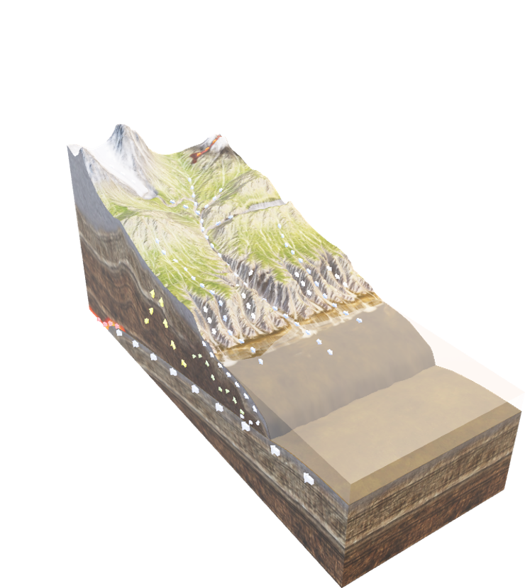
STUDY AREA AND DATA

Slide 5
Study Area
The present research represents a case study on the Buzău river catchment, one of the most affected regions by floods and flash-floods in Romania and was done by integrating bivariate statistical methods, machine learning techniques and GIS.
The Buzău river catchment is located in the south-eastern part of Romania at the cross between the historical regions of Muntenia and Moldova and is a left tributary of the Siret river having a total surface of 5264 km². The catchment overlaps 5 counties, Brașov, Covasna, Prahova, Buzău and Brăila and 116 territorial-administrative units. The Buzău river springs from the Ciucaș Mountains, located in the Curvature Carpathians, a southern group of the Eastern Carpathians, and has a total length of 302 km

Slide 6
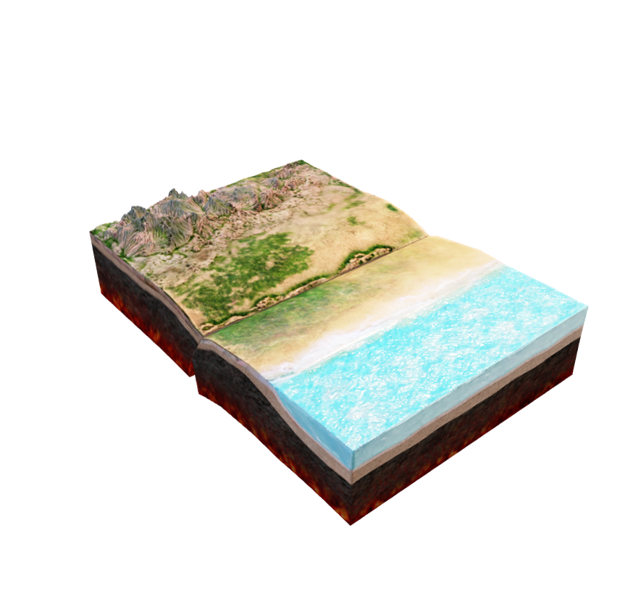
Study Area
The present study proposes the use of 14 flood conditioning variables, used to compute the Flood Potential Index (FPI), and 13 flash-flood conditioning variables, used to compute the Flash-Flood Potential Index (FFPI).
The 14 variables used for the FPI are as follows: slope, elevation, hydrological soil groups (HSG), slope aspect, elevation above channel (EaC), distance from rivers (DfR), saturated hydraulic conductivity (SHC), land-use, drainage density (DD), plan curvature (PLC), Topographic Position Index (TPI), Topographic Wetness Index (TWI), multi-annual precipitations (MaP) and the Convergence Index (CI).
The 13 variables used for the FFPI are as follows: slope, profile curvature (PC), HSG, slope aspect, slope length and steepness factor (L-S), Curve number (CN), CI, land-use, soil erodibility by water (SEW), DD, TPI, TWI, and MaP.

Slide 7
METHODOLOGY

Slide 8
Methodology
Frequency Ratio model (FR)
The Frequency Ratio (FR) bivariate statistical model is widely used in research especially for landslide and flood hazard mapping. The FR is used to determine the ratio of an area where a phenomenon is present or not and the probability ratio of an occurrence to a non-occurrence. The ratio is determined based on the relationship between the spatialized geographical factors and the flood or flash-flood locations. The high prediction ratio (PR) values show that a factor has a high influence on triggering a certain type of phenomenon. The PR was calculated based on the spatial association of each variable within the training dataset and was determined through the following equation:
where PR is the prediction ratio of each variable and SA represents the maximum and the minimum spatial association.
$$PR=\frac{\left({SA}_{max}− {SA}_{min}\right)}{\left({SA}_{max}− {SA}_{min}\right) min}$$

Slide 9
Methodology
Frequency Ratio model (FR)
Each raster of the flash-flood conditioning variables was reclassified based on the relative frequency values, which were determined as follows:
$$RF= \frac{R_{+}}{R_{tot}}$$
where RF is the relative frequency, R₊ is the Ratio (+) or the positive ratio and R_{tot} represents the sum of each positive ratio of a certain factor.
The FR model for the FPI and FFPI was determined through the following equation:
$$\begin{aligned}&FR=\sum_{j=1}^{n}{W_{ij}}\#\end{aligned}$$
where FR represents the Frequency ratio model applied for the FPI or FFPI, n is the number of flood conditioning variables, W_{ij} represents the weight of the class i of the parameter j.

Slide 10
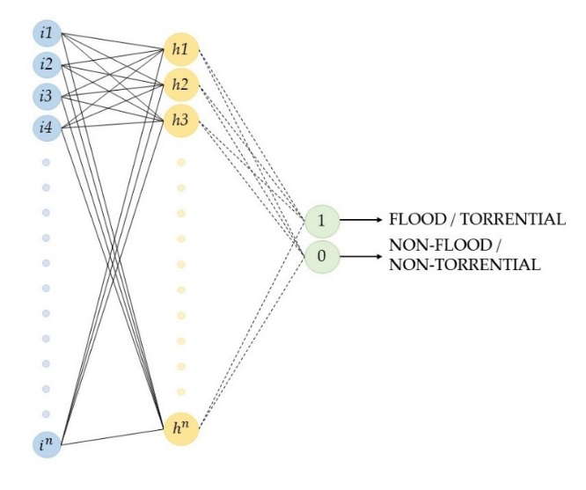
Methodology
Multilayer Perceptron (MLP)
The Multilayer Perceptron represents an artificial neural network (ANN) used for pattern recognition and consists of three main components, input layers, hidden layers and the output. A Multilayer Perceptron is based on the backpropagation algorithm, which represents a supervised learning technique.
The connection between the input and the output is made though the hidden layers and each connection with each neuron is represented through the following equation:
$$a_{j}= \sum_{i=1}^{V}{ω_{ij}^{\left(1\right)}x_{i}+ ω_{0}^{\left(1\right)}, j=1, …., Nh}$$
where Nh is the neurons in the hidden layer, ωij(1) represents the weight of each connection of the neuron xi and the input layer and the neuron of the second layer, ωo(0) represents the bias variable which prevents the parameter aj from becoming zero.

Slide 11
Methodology
Multilayer Perceptron (MLP)
Each hidden layer is connected to the output layer through neural connections which hold the output weights. Each connection has random values until they intersect another connection, where they are multiplied by the weights of that connection. Based on the final weights, the output layer generates an output decision encoded in values of 1 and 0. These decisions are determined through the following equation, where Od is the output decision, ωj and ω0 are the connection weights and represents h is the hidden layer.
$$O_{d}=\sum_{j=1}^{V}{ω_{j}^{\left(2\right)}hj+ ω_{0}^{\left(2\right)}}$$

Slide 12
Methodology
MLP-FR hybrid ensemble
After the Frequency Ratio of each flood and flash-flood conditioning factor was computed and normalized, each factor was reclassified based on the Ratio + values. The hybrid ensemble between the FR and the MLP consists in computing each reclassified factor with the PR of the MLP model. The role of ensemble methods is to develop more accurate methods which reduce the disadvantages of the “traditional” models or algorithms.

Slide 13
Methodology
Training and Testing the models
A very important step in the present study is represented by the training of the models and testing them, based on the locations where flash-floods or the torrential phenomena is either present or not. According to previous studies which use Machine Learning techniques , the training and testing data were split in a 70% ratio for the training samples and 30% for the testing samples. The flash-flood and torrential areas hold the value of 1 whilst the non-flash-flood and non-torrential areas are encoded with the value of 0. The training and testing samples also hold the values of the factors which overlap the locations with 1 and 0. The analysis of the samples was carried out in Microsoft Excel and in Weka. The resulted values were computed using ArcGIS, thus resulting the hazard maps.
The optimal split of the training and testing set used in the present paper was determined through successive testing using different split ratios, 80-20 and 90-10. The 70-30 split ratio used in this study can only be generalized for similar datasets

Slide 14
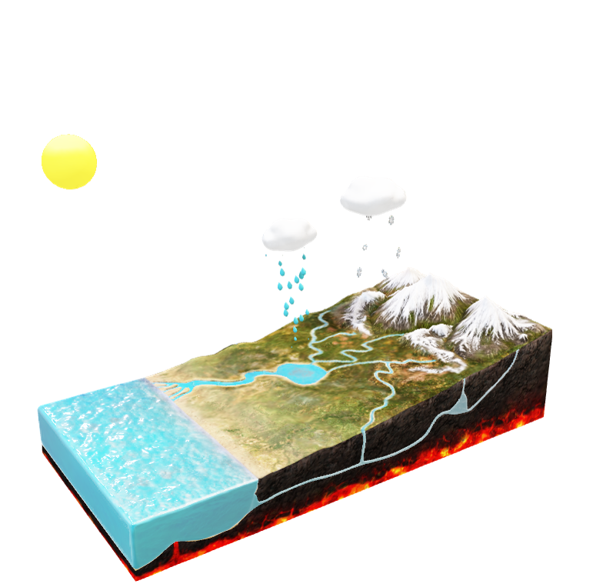
RESULTS

Slide 15
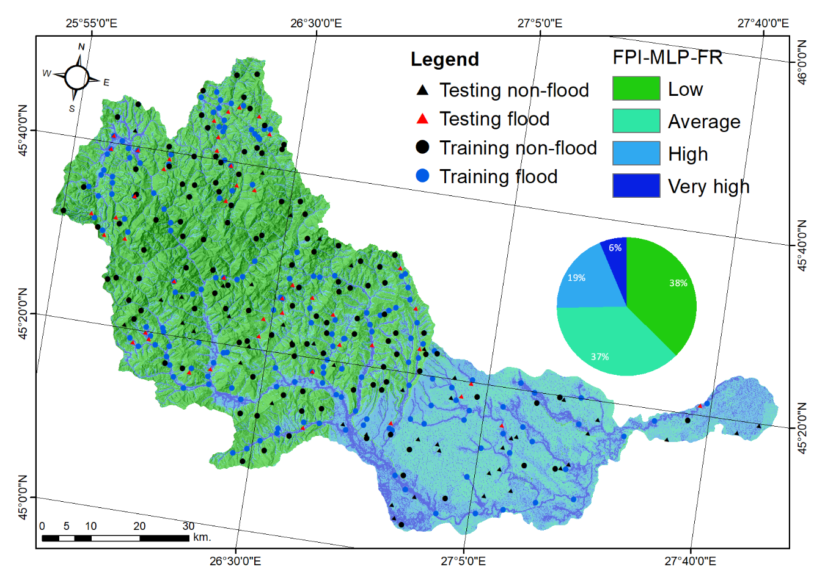
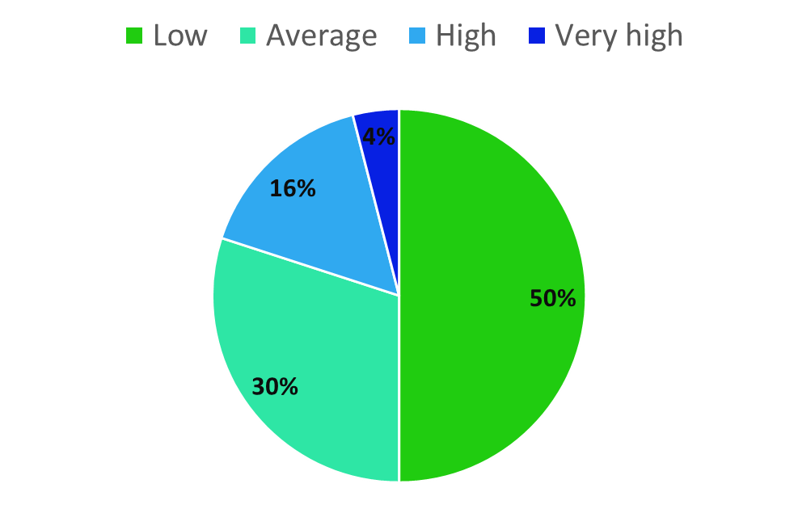
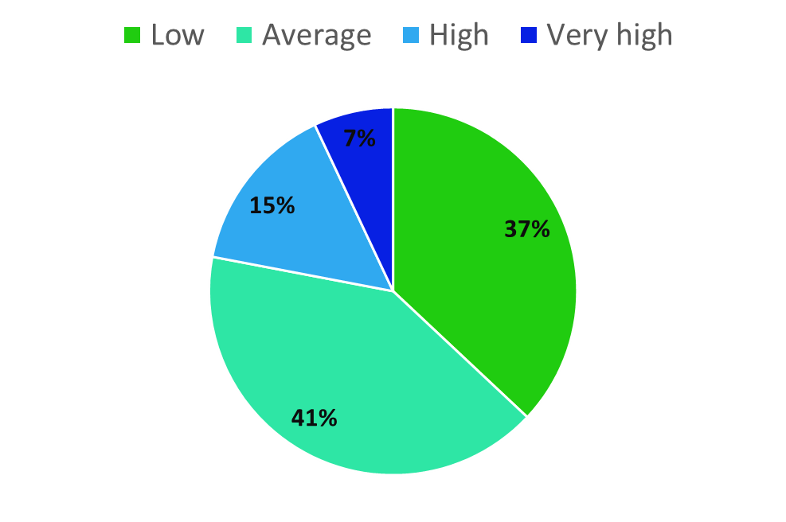
Results – Flood Potential Index (FPI)
1
Frequency Ratio (FR) model
2
Multilayer Perceptron (MLP) model
3
MLP-FR hybrid ensemble

Slide 16
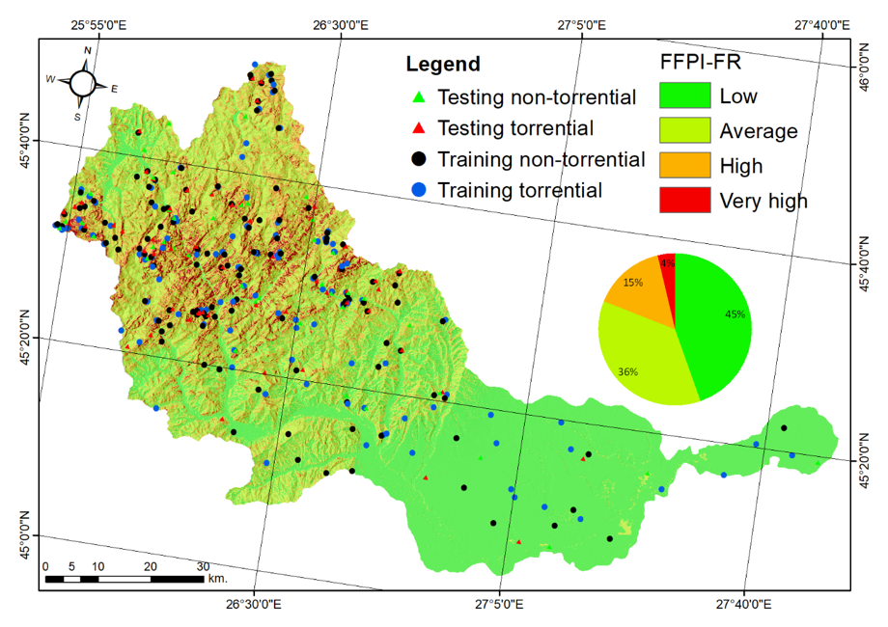
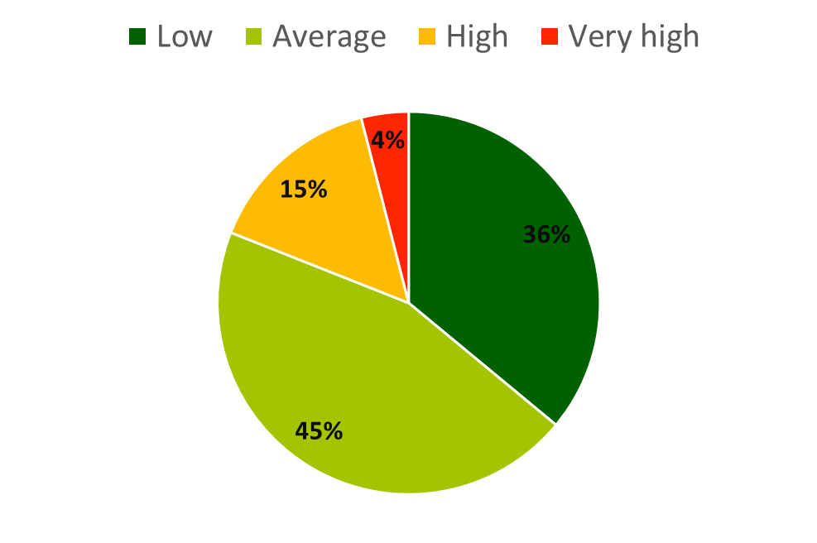
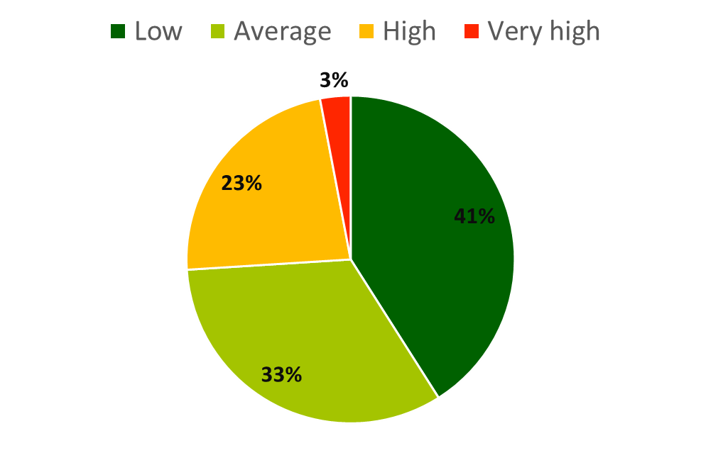
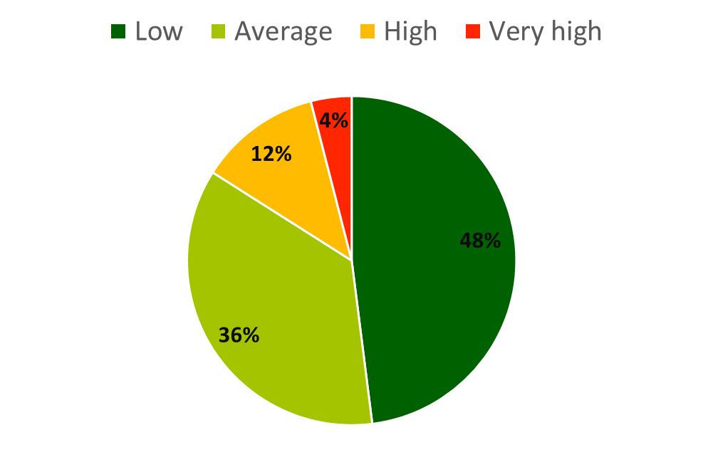
Results – Flash Flood Potential Index (FFPI)
1
Frequency Ratio (FR) model
2
Multilayer Perceptron (MLP) model
3
MLP-FR hybrid ensemble

Slide 17
Results – Flood and Flash flood hazard map

Slide 18
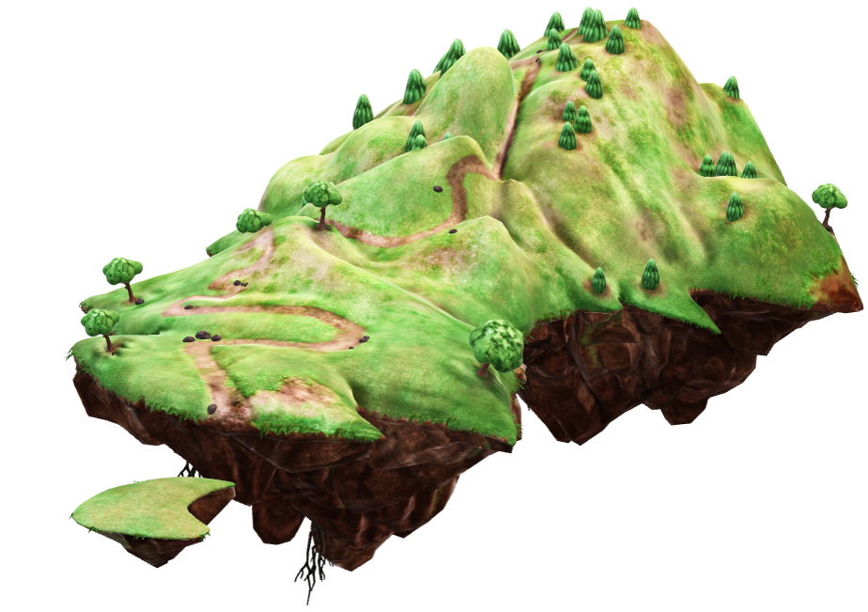
DISCUSSION

Slide 19
Discussion
This study has shown that it possible to create flood / flash-flood hazard maps using statistical models, machine learning and their hybrid ensemble. Creating such maps or developing new models / methodologies represent a useful tool for both local and national authorities to assess the zones vulnerable to such types of natural hazards.
The present research uses open-source data with a spatial resolution of 25 m, a resolution which does not affect the relevance of the results. The potential “limitations” of the research, would come of course from the spatial resolution of the data, but considering other previous studies which have used data with a less detailed resolution of 100 m, the results of the present study could be used by local authorities.

Slide 20
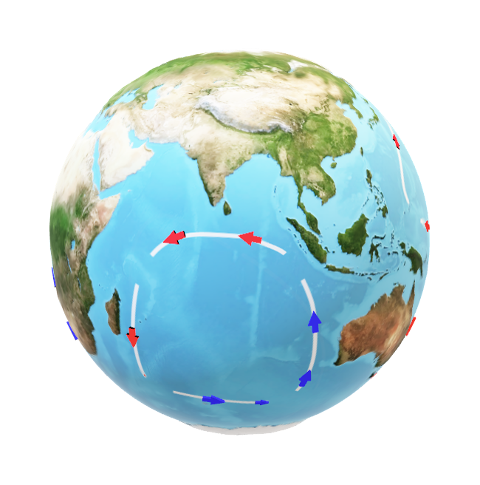
CONCLUSIONS

Slide 21
Conclusions
The methodology developed in this study was applied on the Buzău river catchment, known in Romania for being amongst the most affected catchments by these types of natural hazards. The methods used can be applied at a national level or on different river catchments, considering the increase in intensity of the climatic events and anthropic activities which nevertheless have a direct impact in the generation of floods and flash-floods.
The study shows the importance in developing methodologies for assessing the areas vulnerable to floods and flash-floods as the climatic events tend to intensify and the everchanging land-use makes it imperative to develop new methodologies with new approaches and more importantly an ease in obtaining outputs.
A distributed hydrological model has the advantage of performing spatially refined simulations of hydrological components over a large area, thus increasing the accuracy of data gives us the possibility to run the models on a large scale, with low costs and maximum benefits.

Slide 22
Relevant references
Costache, R., Flood Susceptibility Assessment by Using Bivariate Statistics and Machine Learning Models - A Useful Tool for Flood Risk Management, Water Resources Management, 2019, 10.1007/s11269-019-02301-z
Choubin et al., An ensemble prediction of flood susceptibility using multivariate discriminant analysis, classification and regression trees, and support vector machines, Science of the Total Environment, 2019, 10.1016/j.scitotenv.2018.10.064
Mojaddadi et al., Ensemble machine-learning-based geospatial approach for flood risk assessment using multi-sensor remote-sensing data and GIS, Taylor & Francis Online, Geomatics, Natural Hazards and Risk, 2017, 10.1080/19475705.2017.1294113
Zaharia et al., Mapping flood and flooding potential indices: a methodological approach to identifying areas susceptible to flood and flooding risk. Case study: the Prahova catchment (Romania), Frontiers in Earth Science, 2017, 10.1007/s11707-017-0636-1

Slide 23
THANK YOU

