Slide 1
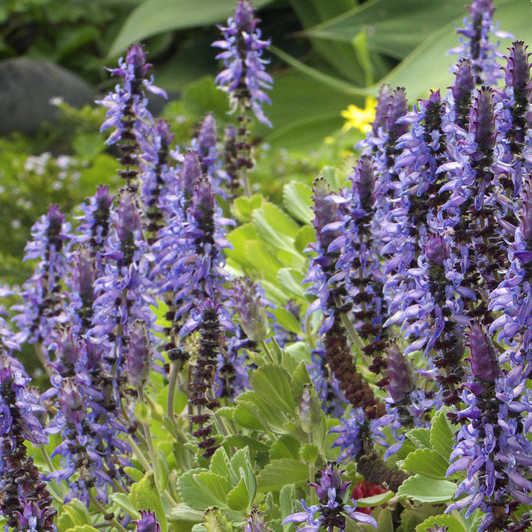
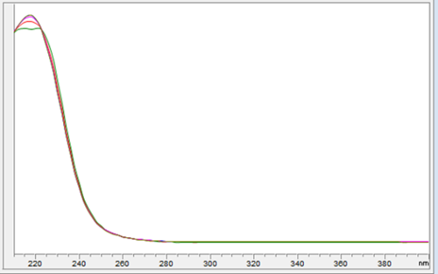
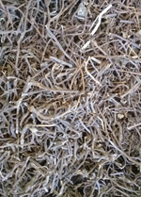
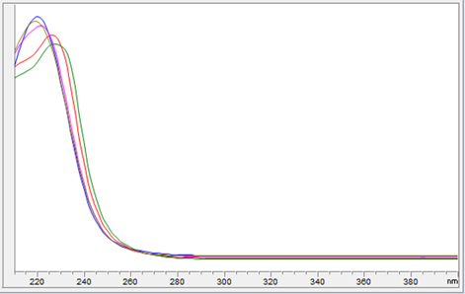
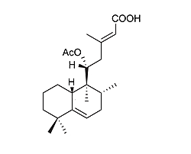
Optimization extraction study for the isolation of a bioactive diterpene from Plectranthuns ornatus Codd.
Joana Tavaresª, Eva Dominguez ^{a,b}, Epole Ntungwe^{a,b}, Vera Isca^{a,c}, Patrícia Rijo^{a,c}
ªCBIOS – Center for Research in Biosciences & Health Technologies, Universidade Lusófona de Humanidades e Tecnologias, Campo Grande 376, 1749-024 Lisbon, Portugal
^{b}Department of Biomedical Sciences, Faculty of Pharmacy, University of Alcalá, Ctra. A2, Km 33.600 – Campus Universitario, 28871 Alcalá de Henares, Spain
^{c}Instituto de Investigação do Medicamento (iMed.ULisboa), Faculdade de Farmácia da Universidade de Lisboa, Av. Prof. Gama Pinto 1649-003 Lisbon, Portugal
E-mail: patricia.rijo@ulusofona.pt
Background
Tuberculosis (TB) infects thousands of people every year and is a serious public health problem worldwide. The causative agent, Mycobacterium tuberculosis, is a bacterium that has elaborated survival mechanisms in the host.
The discovery of new antibiotics is essential for reducing TB deaths and natural products offer an excellent starting point for the discovery of these compounds due to their structural and functional diversity.
The genus Plectranthus belonging to the Lamiaceae family, such as mint and sage, exhibit a wide range of ethnobotanical uses. The P.ornatus species has diuretic, antipyretic, analgesic, antibiotic and anti-inflammatory properties and is used to relieve stomach and liver disorders.
Halimane's backbone diterpene (11R*-acetoxy-halima-5,13E-dien-15-oic acid) was previously isolated for the first time from an acetone extract of P.ornatus. This compound is described due to its antimicrobial, namely antitubercular activity. Thus, in this work, for a large-scale of the compound isolation, we optimized its extraction. Moreover, an acetonic ultrasound extraction was performed (extraction yield 7.082% (w / w)). Chromatographic isolation of 5.3 mg of pure diterpene, identified by HPLC-DAD, was also performed by comparison with an authentic sample.
Fig 1 - Plectranthus Ornatus Codd.
Methodology
1. Extract production procedure
2. Isolation and purification
3. Characterization by HPLC-DAD
Collection, drying and milling of the plant
Flash column
Polarity gradient type elution from n-hexane to ethyl acetate
Results
The milled plant (1,261 Kg) was put in acetone (13L) and subjected to ultrasound waves for 30 minutes
Two UV spectrums were performed from HPLC–DAD, the Hal isolated and an authentic sample from the group o made the RMN characterization of the compound
14 Fractions produced
Based on TLC similarity 5 fraction were united and re-cromatographed
Fig 2 - Absorption spectrum of authentic sample
Extract solution was filtered and the solvent evaporated
Dry column
Based on TLC analysis the purest fraction was recrystalized to obtained pure Hal (5.3 mg)
m_{extract} = 89.30g (yield of 7.082% (w/w)
Recrystallization served as a purifying process of the compound Hal
Fig 3 - Isolated compound absorption spectrum
Conclusion
An ultrasonic-assisted acetone extraction of P.ornatus was performed (extraction yield 7.082% (w / w)) .
This extract was chromatographed, and the purest fractions were recrystallized and 5.3 mg of a bioactive diterpene was obtained .
The presence of this compound was confirmed by HPLC-DAD by comparison with the spectrum of an authentic sample.
In future studies, it will be possible the exhaustive isolation of the diterpene of this extract allowing new biological studies with potential for the development of new tuberculostatic drugs.
Fig 4 - Compound Hal -
11R*-acetoxy halima-5,13E-dien-15-oic acid
[1]. Rijo, P., Gaspar-Marques, C., Simões, M. F., Jimeno, M. L., & Rodríguez, B. (2007). Further diterpenoids from Plectranthus ornatus and P. grandidentatus. Biochemical Systematics and Ecology, 35(4), 215–221.
[2]. Andrade, J. M., Custódio, L., Romagnoli, A., Reis, C., Rodrigues, M., Garcia, C., et al. (2018). Antitubercular and anti-inflammatory properties screening of natural products from Plectranthus species. Future Medicinal Chemistry, 10(14), 1677–1691.

