Slide 1

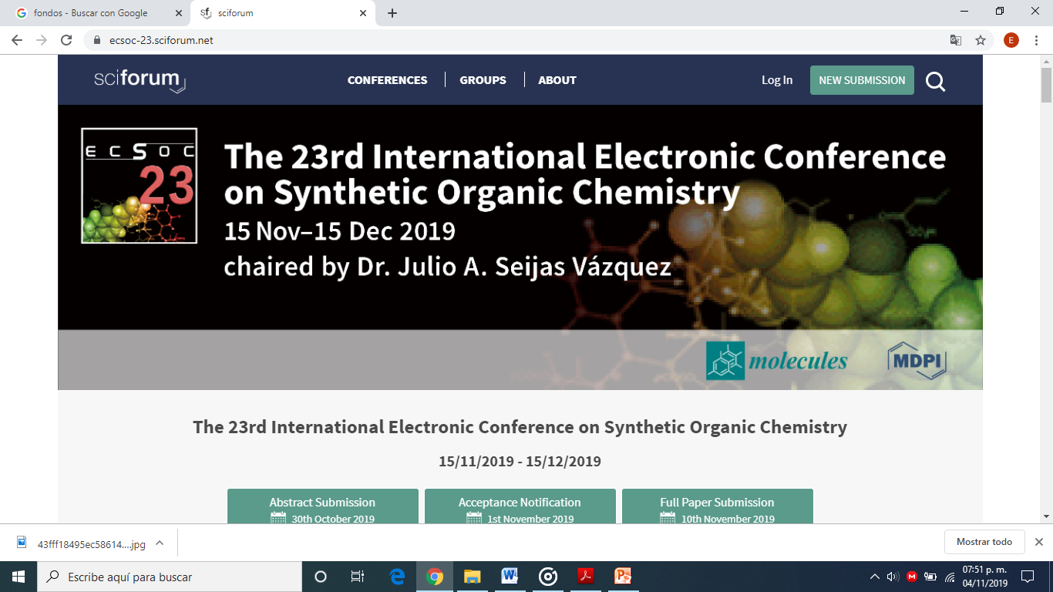
The 23rd International Electronic Conference on Synthetic Organic Chemistry
Green, microwave-assisted synthesis of O-perbutyrylated-alkyl-glycosides
Section: Microwave Assisted Synthesis
Emmanuel Pérez-Escalante, Luis Guillermo González-Olivares, Araceli Castañeda-Ovando, Verónica Salazar-Pereda, John F. Trant, Mirandeli Bautista-Ávila and Sergio Alatorre-Santamaría

Slide 2
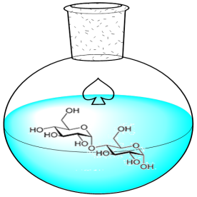


Introduction
Acylation as protective step in carbohydrate synthesis
Conventional heating and Lewis acids as common promoters
Time consuming and toxic catalysts

Slide 3

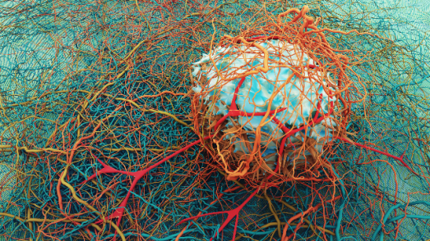
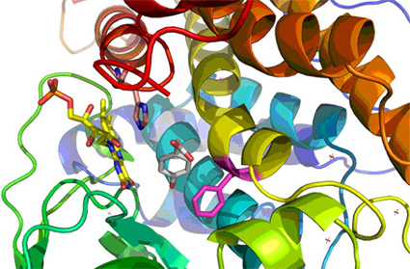
Introduction
Microwaves and imidazol = Swift and green option
O-perbutyryl-alkyl-glycosides
Carbohydrate enzymatic production
Biopharmaceutical properties

Slide 4
Methods
Imidazole + Room Temperature
and
Imidazole + M.W.
Characterization:
TLC
¹H-NMR
¹³C-NMR

Slide 5
Results
60 h for total consume of starter material
Imidazole + R.T.
Only 1 h for total consume of starter material
Imidazole + M.W.

Slide 6
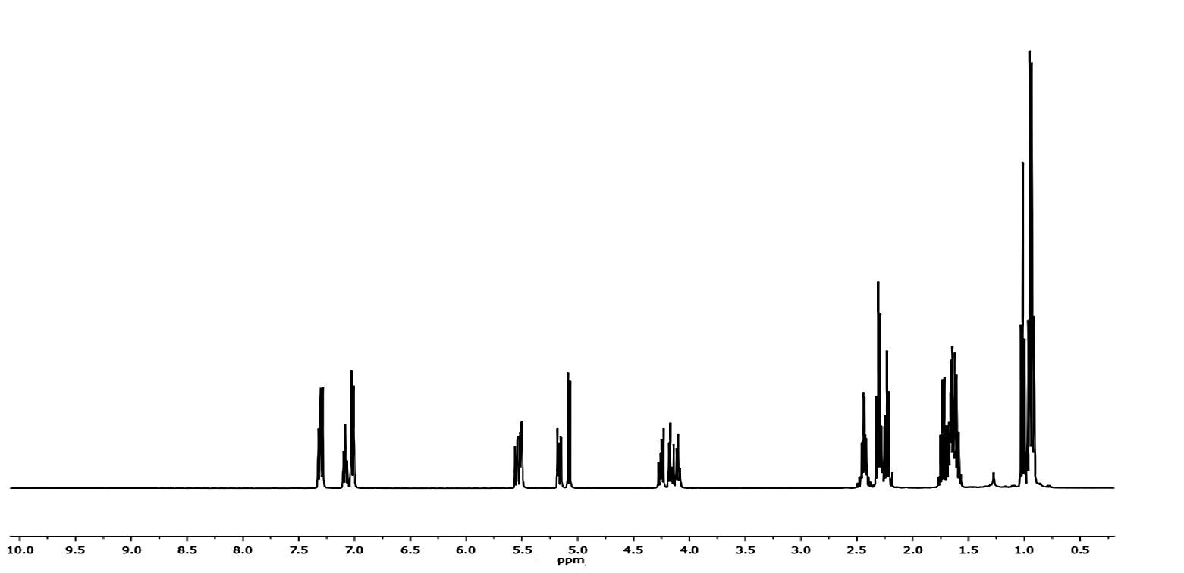
Results
δ 7.28 (m, 2H, H9 and H11), 7.06 (t, J = 7.4 Hz, 1H, H10), 6.99 (dd, J = 8.6 Hz, 0.9 Hz, 2H, H8 and H12), 5.55 – 5.46 (m, 2H, H6), 5.14 (dd, J = 10.5 Hz, 3.4 Hz, 1H, H3), 5.05 (d, J = 8.0 Hz, 1H, H1), 4.23 (dd, J = 11.1 Hz, 7.0 Hz, 1H, H4), 4.14 (dd, J = 11.2 Hz, 6.1 Hz, 1H, H2), 4.10 – 4.05 (m, 1H, H5), 2.46 – 2.36 (m, 2H, H16), 2.27 (dt, J = 7.3 Hz, 4.4 Hz, 4H, H20 and H28), 2.21 (t, J = 7.3 Hz, 2H, H24), 1.69 (dt, J = 9.6 Hz, 4.8 Hz, 2, H27), 1.66 – 1.55 (m, 6H, H15, H19 and H23), 0.99 (t, J = 7.4 Hz, 3H, H26), 0.91 (dt, J = 7.5 Hz, 4.5 Hz, 9H, H14, H18 and H22)
¹H-NMR (400 MHz, CDCl₃) of O-perbutyrylated-phenyl-galactose

Slide 7
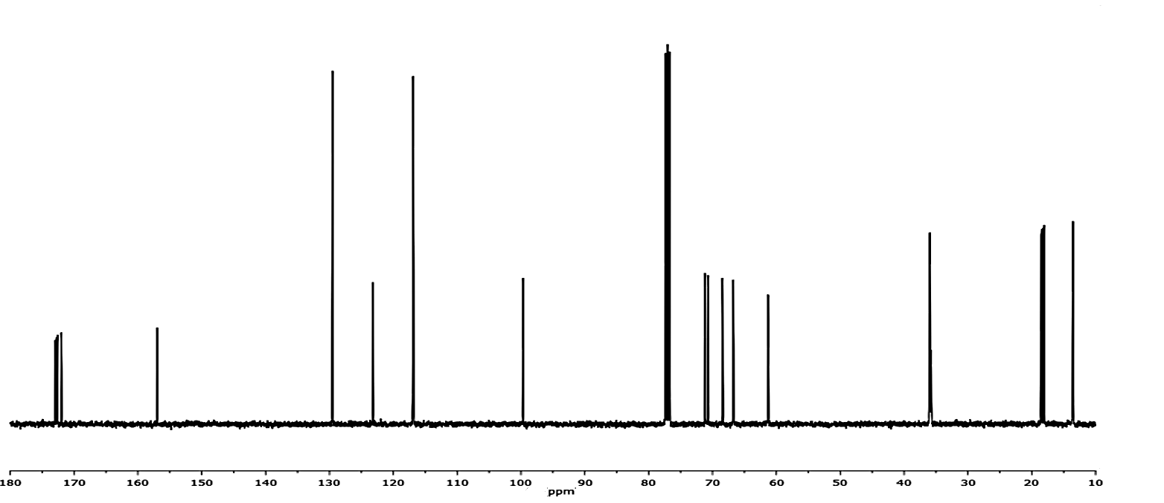
Results
δ 173.01-172.11 (C13, C17, C21 and C25), 157.13 (C7), 129.65 (C9 and C12), 123.33 (C10), 117.00 (C8 and C12), 99.81 (C1), 71.31 (C3), 70.85 (C5), 68.56 (C2), 66.88 (C4), 61.44 (C6), 36.03 (C16, C20, C24 and C28), 18.78 – 18.17 (C15, C19, C23 and C27), 13.69 (C14, C18, C22 and C26)
¹³C-NMR (101 MHz, CDCl₃) of O-perbutyrylated-phenyl-galactose

Slide 8
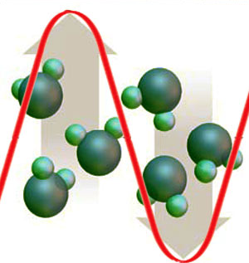
Conclusions
Excellent green strategy to
O-perbutyrylated-alkyl-glycosides synthesis

