Slide 1
Methanol, Ethanol and Glycerol oxidation study by graphite-epoxy composite electrodes with graphene-anchored nickel oxyhydroxide nanoparticles
João Pedro Jenson de Oliveira, Marta Bonet San Emeterio, Acelino Cardoso de Sá, Leonardo Lataro Paim and Manel del Valle

Slide 2
Outline
Introduction
Method
Characterization
Eletrooxidation of alcohols
Principal Component Analisys
Summary

Slide 3
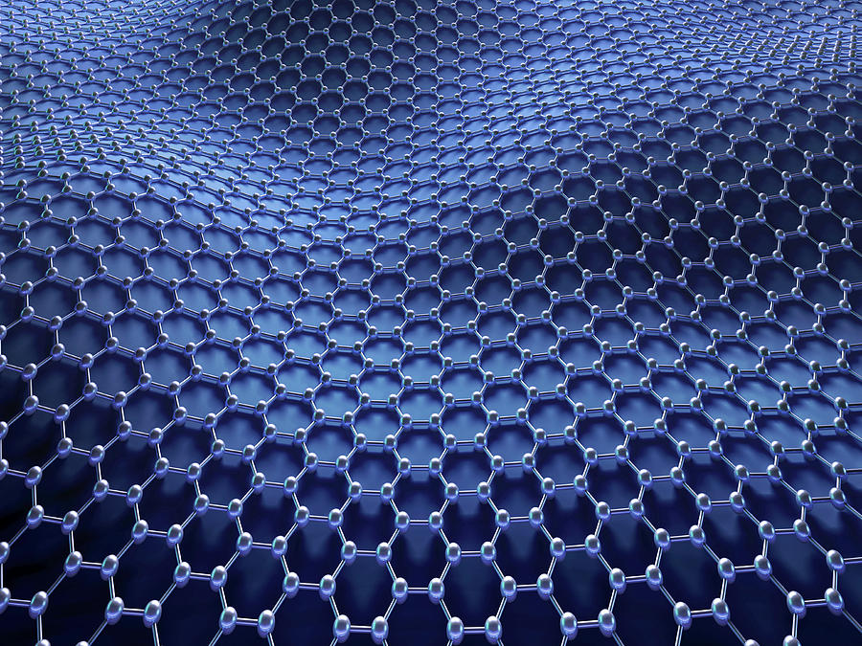
Introduction
Graphene Oxide
2D sheets formed by carbon atoms;
Large specific surface area;
High conductivity;
Great mechanical strength.

Slide 4
Introduction
Nanoparticles NiOOH
The high surface area to volume ratio of nanoparticles;
Good electrochemical activity in the oxidation of alcohols.

Slide 5
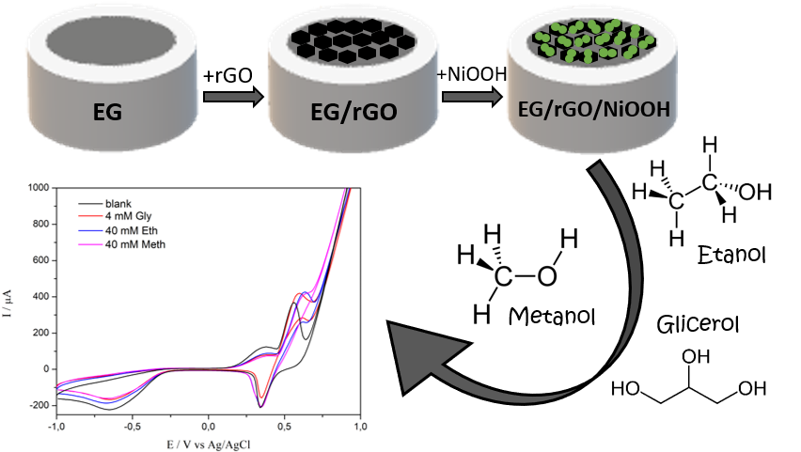
Method
Formation of graphite/epoxy substrates;
Graphene electrodeposition;
Nickel hexacyanoferrate electrodeposition;
NiOOH nanoparticles formation: NiHCF film degradation in basic medium;
Electrode application.

Slide 6
The average size of the NiOOH nanoparticles was 61 ± 16 nm.
Characterization

Slide 7
The EDX showed that the surface is composed of Ni, O and C, indicating that the electrosynthesis of nickel oxyhydroxide from nickel hexacyanoferrate (NiHCF) was a success, not presenting the elements Fe and K in the spectrum.
Characterization

Slide 8
The LOD for methanol, ethanol and glycerol were 2.16 mM, 2.73 mM and 0.09 mM, respectively, with sensitivity values of 1.32 µA mM⁻¹, 1.80 µA mM⁻¹ and 24.60 µA mM⁻¹, also for methanol, ethanol and glycerol.
Eletrooxidation of alcohols

Slide 9
Multivariate inspection of the data using Principal Component Analysis (performed with use of the ClustVis online tool) demonstrated the potential ability to discriminate between the different alcohols, whereas the explained variance with the first two components was as high as 89.7%.
Principal Component Analysis

Slide 10
Summary
A novel EG/rGO/np-NiOOH nanocomposites were prepared in three steps by electrodeposition method;
EDX confirmed the success of electrosynthesis of nickel oxyhydroxide in reduced graphene oxide. FEG-SEM characterization showed the NiOOH nanoparticles with an average size of 61 ± 16 nm were decorated on the EG/rGO sheets;
The as-synthesized EG/rGO/NiOOH nanocomposites exhibit excellent electrochemical behavior in the towards oxidation of glycerol, ethanol and methanol.

Slide 11
Acknowledges
Proc. Nº. 17/17559-1
Proc. Nº. 17/09123-9
Proc. Nº. 19/02343-9

