Slide 1
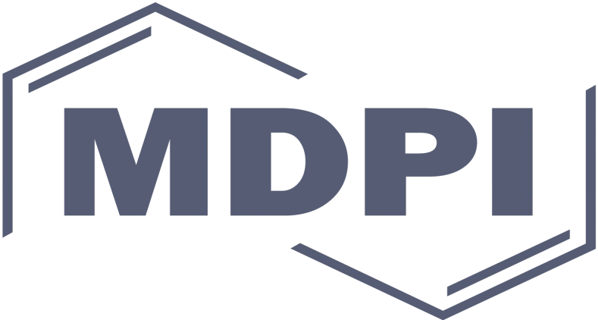
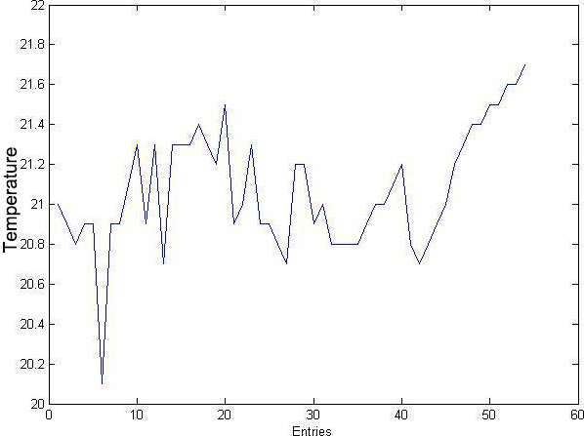
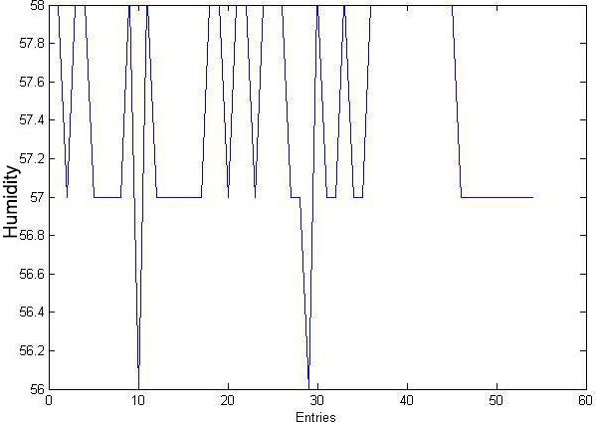
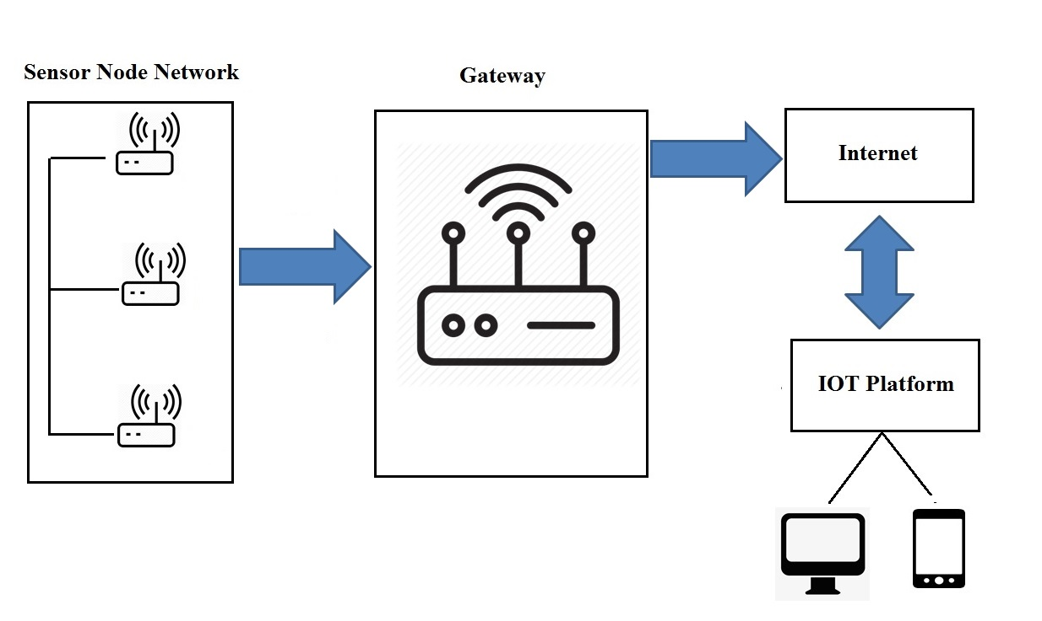
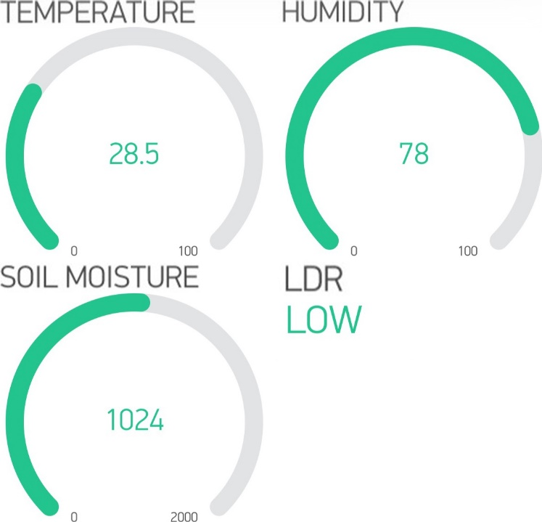
IoT Based Monitoring System for White Button Mushroom Farming
Arjun Subedi1, Achyut Luitel 1, Manisha Baskota 1 and Tri Dev Acharya 2, 3,*
* Correspondence: tridevacharya@kangwon.ac.kr; Tel.: +82-33-250-6232 (T.D.A.)
Abstract: In Nepal, most of the farmers depend upon the traditional agricultural practice. Adapting modern agricultural technology plays an important role in improving overall efficiency as well as the productivity of their yields. In modern agriculture, Internet of Things (IoT) connects farmers to their farm via the sensors so that they could easily monitor the real-time conditions of their farm from anywhere. White Button Mushroom is a widely cultivated crop among Nepalese farmers. Although being the most consumed and cultivated crop, it is still overshadowed by the traditional cultivation approach which is resulting low productivity, high manpower efficiency, more effort and cost. This work aims to develop a monitoring system to monitor the environmental conditions of a mushroom farm. It enables a user to monitor crucial factors such as temperature, humidity, moisture, light intensity on a mushroom farm through the end devices. White Button Mushroom requires optimum temperature ranging from 22°C to 25°C and humidity from 70% to 90%. Sensors are placed on fixed location and spots of the farm. Then, the sensors measure the status of parameters which are transmitted to the remote monitoring station via a low power Node MCU. Thus obtained data are stored in cloud platform. The codes for the controller are written in the Arduino programming language, debugged, compiled, and burnt into the microcontroller using the Arduino integrated development environment. The result shows successful monitoring of environmental conditions accessing the internet from anywhere. It minimizes human efforts and automates production, which could be beneficial to Nepalese farmers..
Keywords: IoT; end devices; sensors; monitoring station; Node MCU; Arduino
INTRODUCTION
RESULTS
The result was obtained after implementing the proposed hardware. The tested hardware were LM 35 (Temperature Sensor), DHT11 (Humidity Sensor), Soil Moisture Sensor and LDR. This system provides ATMEG328 microcontroller unit Node MCU that provides base for live monitoring of temperature, humidity, soil moisture and light intensity of the farm and sends the data to the end devices via cloud through Node MCU. The data thus obtained are almost equal and calibrated according to standard measurements of the weather station. The MATLAB data has been recorded through the temperature (LM35) and humidity (DHT11) sensors taking it at different time instances as the following figure:
This paper purpose the system to monitor the environmental conditions like temperature, humidity, soil moisture and lighting condition of the white button mushroom farm. The internet of things (IOT) is that the network of physical devices embedded with physics, software, sensors, actuators, and property that allow these objects to attach and exchange knowledge. As these kinds of structures need refinement, a scientifically designed mushroom farm needs heavy investment and hence is out of reach of small & marginal mushroom farmers. Also mushroom units need to keep their air-conditioning plants running almost round the year. For the large cultivation of the white button mushroom we consider the temperature, humidity, light and diseases. Mainly focusing on to reduce the human effort and enhance the yields, this system will provide a novel method to monitor the farm.
METHODOLOGY
Plot of Temperature
Plot of Humidity
The obtained data are sent to cloud whose interfacing was done by the Blynk application. Here, the measurements given by the sensors are directly sent to the cloud via the low powered Node MCU. Then, the measurements were accessed via an end user applications i.e. Blynk. The sensors measurements can be seen on Figure aside which shows the measurements of temperature, humidity, soil moisture and lighting condition of the farm.
Working Block Diagrams of System
CONCLUSION
Interfacing in Blynk
The project redefines the concept among farms, agronomists. Therefore, we can say that IOT has brought revolutionary change in monitoring, management and data analysis sector. Major sensors such as temperature and humidity sensor have been tested and their data are sent to IOT platforms for accessing and monitoring. Despite the fact, mushroom farming requires continuous monitoring in environmental parameters. Our system plays an important role in stepping in the field of automation of mushroom plants. This project will be beneficial in automation and monitoring of mushroom plants and will assist farmers in increasing the agriculture yield and take efficient care of mushroom production as the system will always provide helping hand to farmers for getting accurate live feed of environmental temperature and soil moisture with more accurate results reducing the manpower. Further we are planning to add others parameters like light and to develop a separate android application that provides an easy access to the field parameters for the farmers.
The block diagrams above are the basic idea how the project proceeds. It consists of the sensor nodes distributed on the various areas of the farm each covering the certain areas as shown in figure. The node consists of number of sensors that are temperature sensor, LDR, humidity sensor, soil moisture sensor with power managed system that is running from the renewable power source available in the field i.e. solar. Each node will consist of the same design and is illustrated above in the block diagram. The microcontroller in the node takes all the sensor readings data and sends it over to the gateway. It is simple light weight protocol for machine to machine communication designed for IoT. It works on publish subscribe basis. It publishes sensor data and sends it to the devices which are subscribed to it. It transports data from sensor to the gateway from each node. It will be a two-way communication. Basically, we can control and read nodes remotely using this protocol. Further from gateway we send data over to internet. The different IoT service providers, provides us the platform such to give data to users and public.
REFERENCES
A.Vermaa, The growing popularity of Mushroom production in Nepal https://guides.libraries.psu.edu/apaquickguide/
Jun Ma*, Quanliang Liu, Design of control system in mushroom greenhouse based on embedded platform. Key Lab of Advanced Transducers and Intelligent Control System, Ministry of Education, Taiyuan University of Technology, Taiyuan,03002, 4 (CHINA).
M F Mohammed , A Azmi, Z Zakaria , M F N Tajuddin , Z M Isa and S AAzmi, IoT based monitoring and environment control system for indoor cultivation of oyster mushroom. IOP Conf. Series: Journal of Physics: Conf. Series 1019 (2018) 012053.
Mohd Saiful Azimi Mahmud, Salinda Buyamin, Musa Mohd Mokji, M. S. Zainal Abidin , Internet of Things based Smart Environmental Monitoring for Mushroom Cultivation. Indonesian Journal of Electrical Engineering and Computer Science Vol. 10, No. 3, June 2018, pp. 847~852 ISSN: 2502-4752, DOI: 10.11591/ijeecs.v10.i3.pp847-852 .
Parvati Bhandari Megha Kimothi, IOT Based Design Implementation Of Mushroom Farm Monitoring Using Arduino Microcontrollers & Sensors. International Journal Of Engineering Sciences & Research Technology.
Pravinthraja.S, Roger Rozario.A.P, Nagarani.S, Kavitha.N.S, Raghul Kumar Sujesha Sudevalayam and Purushottam Kulkarni Keller, IOT Based Mushroom Monitoring System – A Survey. Pravinthraja.S al. International Journal of Recent Research Aspects ISSN: 2349-7688, Vol. 5, Issue 1, March 2018, pp. 311-314.

