Slide 1
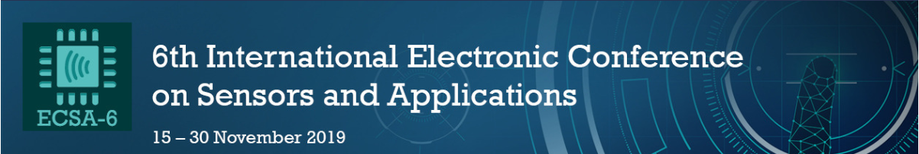

Dynamic Monitoring of Multi-Concentrated Silica Nanoparticles Colloidal Environment with Optical Fiber Sensor
University of Campinas – UNICAMP, Laboratory of Photonic Materials and Devices
Soares et al., Dynamic Monitoring of Multi-Concentrated Silica Nanoparticles Colloidal Environment with Optical Fiber Sensor
Marco César Prado Soares, Matheus Santos Rodrigues, Egont Alexandre Schenkel,
Willian Hideak Arita Silva, Gabriel Perli, Matheus Kauê Gomes, Eric Fujiwara and Carlos Kenichi Suzuki
School of Mechanical Engineering, University of Campinas, SP, Brazil
1

Slide 2
1. Introduction – Colloidal Suspensions
University of Campinas – UNICAMP, Laboratory of Photonic Materials and Devices
Soares et al., Dynamic Monitoring of Multi-Concentrated Silica Nanoparticles Colloidal Environment with Optical Fiber Sensor
University of Campinas – UNICAMP, Laboratory of Photonic Materials and Devices
Soares et al., Use of Optical Fiber Sensor for Monitoring the Degradation of Ac-Dex Biopolymeric Nanoparticles
University of Campinas – UNICAMP, Laboratory of Photonic Materials and Devices
Fujiwara et al., Characterization of Colloidal Silica by Optical Fiber Sensor
  Metal:
    Cu, Al, Ag, Fe;
  Ceramics and non-metallic solids:
    Al₂O₃, CuO, SiO₂, Si;
  Biomolecules;
  Polymeric particles.
  Water;
  Engine Oil;
  Organic solvents.
Dispersed phase + Base fluids
Li et al., 2008
2

Slide 3
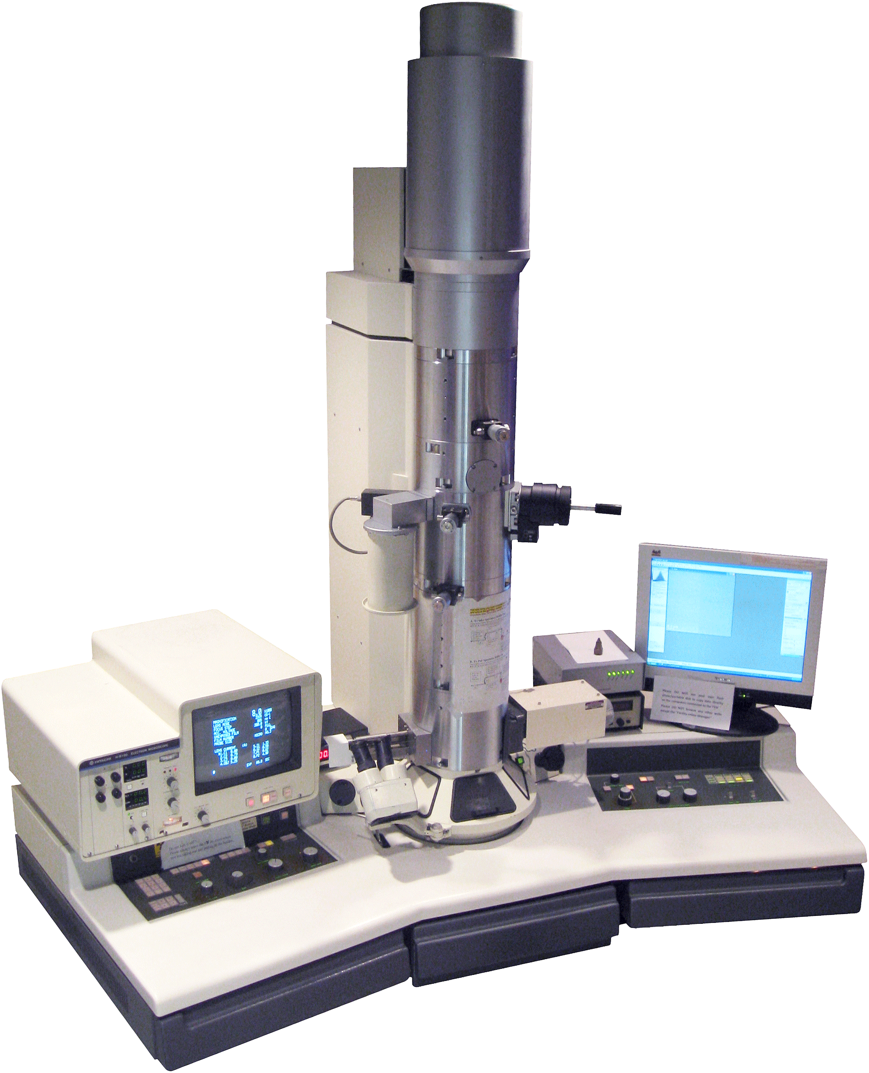
University of Campinas – UNICAMP, Laboratory of Photonic Materials and Devices
Soares et al., Dynamic Monitoring of Multi-Concentrated Silica Nanoparticles Colloidal Environment with Optical Fiber Sensor
University of Campinas – UNICAMP, Laboratory of Photonic Materials and Devices
Fujiwara et al., Characterization of Colloidal Silica by Optical Fiber Sensor
1. Introduction – Traditional Approaches for Colloidal Characterization
  Evaluation of particles size, morphology and concentration by laboratory techniques, such as:
    Transmission Electron Microscopy (TEM);
    Scanning Electronic Microscopy (SEM);
    Zeta potential measurements.
    Expensive and time consuming;
    Sample preparation;
    Difficulties in calibration.
TEM Equipment
3

Slide 4
University of Campinas – UNICAMP, Laboratory of Photonic Materials and Devices
Soares et al., Dynamic Monitoring of Multi-Concentrated Silica Nanoparticles Colloidal Environment with Optical Fiber Sensor
University of Campinas – UNICAMP, Laboratory of Photonic Materials and Devices
Fujiwara et al., Characterization of Colloidal Silica by Optical Fiber Sensor
2. Our Approach – Assessment with Optical Fiber Sensor
  Compact size;
  Immunity to electromagnetic interference;
  Chemically and biologically inert;
  Easy calibration;
  Fast sample preparation – dispersion of particles in water, with sonication;
  Easy data processing.
4

Slide 5
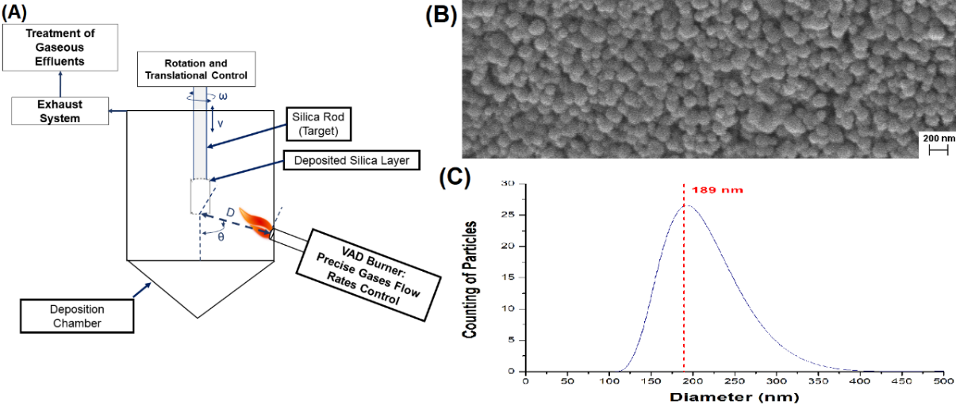
University of Campinas – UNICAMP, Laboratory of Photonic Materials and Devices
Soares et al., Dynamic Monitoring of Multi-Concentrated Silica Nanoparticles Colloidal Environment with Optical Fiber Sensor
University of Campinas – UNICAMP, Laboratory of Photonic Materials and Devices
Fujiwara et al., Characterization of Colloidal Silica by Optical Fiber Sensor
2. Preparation of Silica
Method of Vapor-phase axial
  deposition (VAD);
High deposition rate;
Particle size control.
(A) Schematics of the VAD system; (B) SEM image; (C) Size distribution of particles (average diameter of 189 nm).
Soares et al., Mat. Res., 2018
5

Slide 6
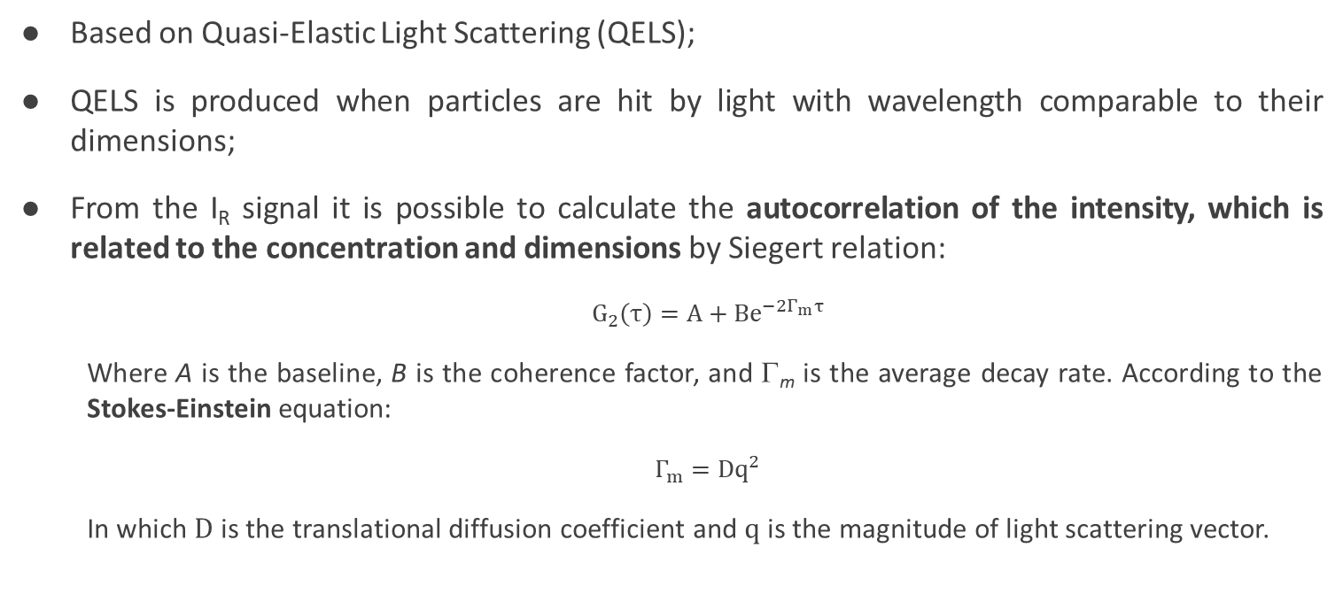
2. Optical Fiber Sensor
University of Campinas – UNICAMP, Laboratory of Photonic Materials and Devices
Soares et al., Dynamic Monitoring of Multi-Concentrated Silica Nanoparticles Colloidal Environment with Optical Fiber Sensor
University of Campinas – UNICAMP, Laboratory of Photonic Materials and Devices
Fujiwara et al., Characterization of Colloidal Silica by Optical Fiber Sensor
Based on Quasi-Elastic Light Scattering (QELS);
QELS is produced when particles are hit by light with wavelength comparable to their dimensions;
From the I_{R} signal it is possible to calculate the autocorrelation of the intensity, which is related to the concentration and dimensions by Siegert relation:
  $G_{2}\left(τ\right)=A+Be^{−2Γ_{m}τ}$
  Where A is the baseline, B is the coherence factor, and Γ_{m} is the average decay rate. According to the Stokes-Einstein equation:
  $Γ_{m}=Dq^{2}$
  In which $D$ is the translational diffusion coefficient and $q$ is the magnitude of light scattering vector.
6

Slide 7
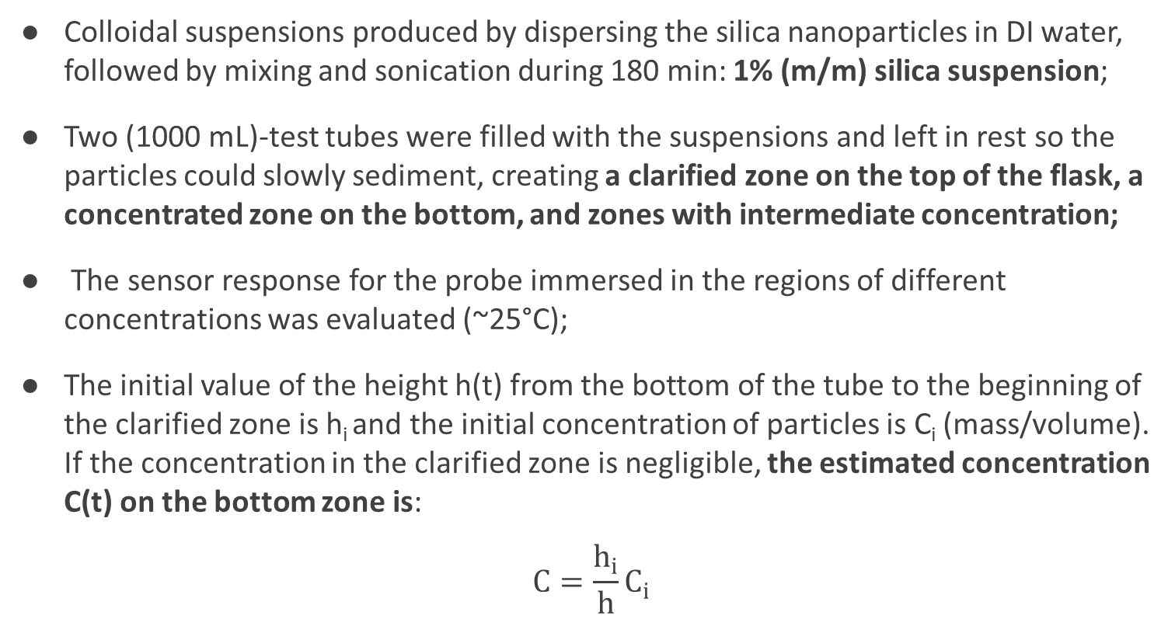
2. Assessment of Colloidal Concentration
University of Campinas – UNICAMP, Laboratory of Photonic Materials and Devices
Soares et al., Dynamic Monitoring of Multi-Concentrated Silica Nanoparticles Colloidal Environment with Optical Fiber Sensor
University of Campinas – UNICAMP, Laboratory of Photonic Materials and Devices
Fujiwara et al., Characterization of Colloidal Silica by Optical Fiber Sensor
Colloidal suspensions produced by dispersing the silica nanoparticles in DI water, followed by mixing and sonication during 180 min: 1% (m/m) silica suspension;
Two (1000 mL)-test tubes were filled with the suspensions and left in rest so the particles could slowly sediment, creating a clarified zone on the top of the flask, a concentrated zone on the bottom, and zones with intermediate concentration;
The sensor response for the probe immersed in the regions of different concentrations was evaluated (~25°C);
The initial value of the height h(t) from the bottom of the tube to the beginning of the clarified zone is h_{i} and the initial concentration of particles is C_{i} (mass/volume). If the concentration in the clarified zone is negligible, the estimated concentration C(t) on the bottom zone is:
$$C=\frac{h_{i}}{h}C_{i}$$
7

Slide 8
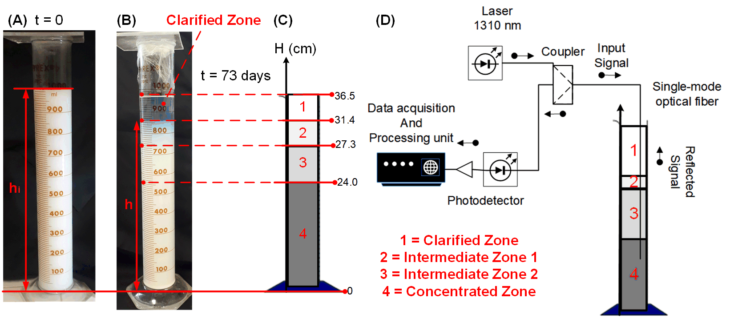
2. Assessment of Colloidal Concentration
University of Campinas – UNICAMP, Laboratory of Photonic Materials and Devices
Soares et al., Dynamic Monitoring of Multi-Concentrated Silica Nanoparticles Colloidal Environment with Optical Fiber Sensor
University of Campinas – UNICAMP, Laboratory of Photonic Materials and Devices
Fujiwara et al., Characterization of Colloidal Silica by Optical Fiber Sensor
8

Slide 9
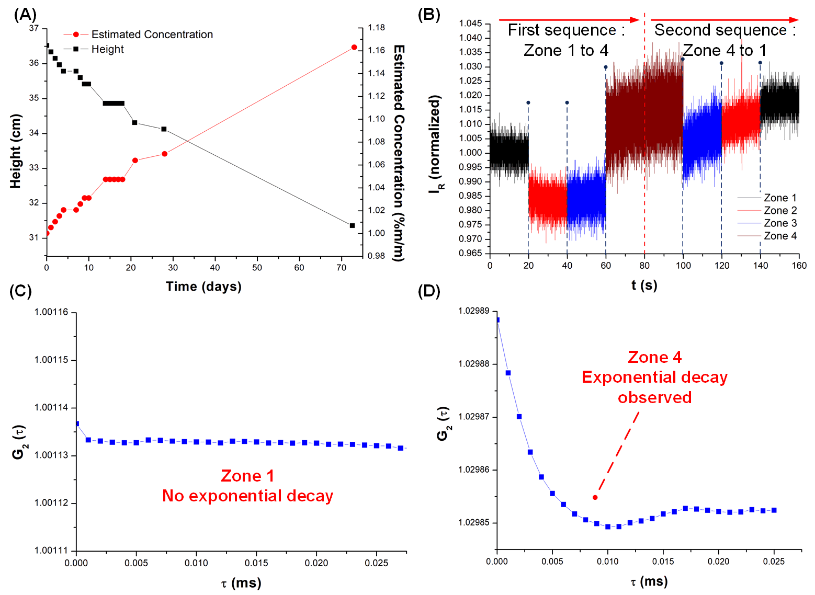
4. Results and Discussion
University of Campinas – UNICAMP, Laboratory of Photonic Materials and Devices
Soares et al., Dynamic Monitoring of Multi-Concentrated Silica Nanoparticles Colloidal Environment with Optical Fiber Sensor
University of Campinas – UNICAMP, Laboratory of Photonic Materials and Devices
Fujiwara et al., Characterization of Colloidal Silica by Optical Fiber Sensor
(A) Average values of the heights verified for the two tubes and concentrations estimated from Equation 3 (secondary vertical axis); (B) sequential step disturbances on the concentration of the OFS probe; (C) G₂(τ) obtained for Zone 1; (D) G₂(τ) obtained for Zone 4, with an exponential decay.
9

Slide 10
3. Results and Discussion
University of Campinas – UNICAMP, Laboratory of Photonic Materials and Devices
Soares et al., Dynamic Monitoring of Multi-Concentrated Silica Nanoparticles Colloidal Environment with Optical Fiber Sensor
University of Campinas – UNICAMP, Laboratory of Photonic Materials and Devices
Fujiwara et al., Characterization of Colloidal Silica by Optical Fiber Sensor
In all of the 73 days: no QELS detected on the clarified zone (the hypothesis that the clarified is approximately free of particles is correct);
Calibration curve was obtained: Γ_{m} for suspensions with known concentration of silica (Γ_{m} = 0.78288C + 0.10898, C in % m/m, R² = 0.95942) - 0.78288 x 10³ s⁻¹ sensitivity.
The sensor probe was sequentially moved from Zone 1 to Zone 4 (concentration of 1.16%, estimated from Equation 3), in a first sequence of step disturbances, and then a second sequence was performed, from Zone 4 to Zone 1.
10

Slide 11
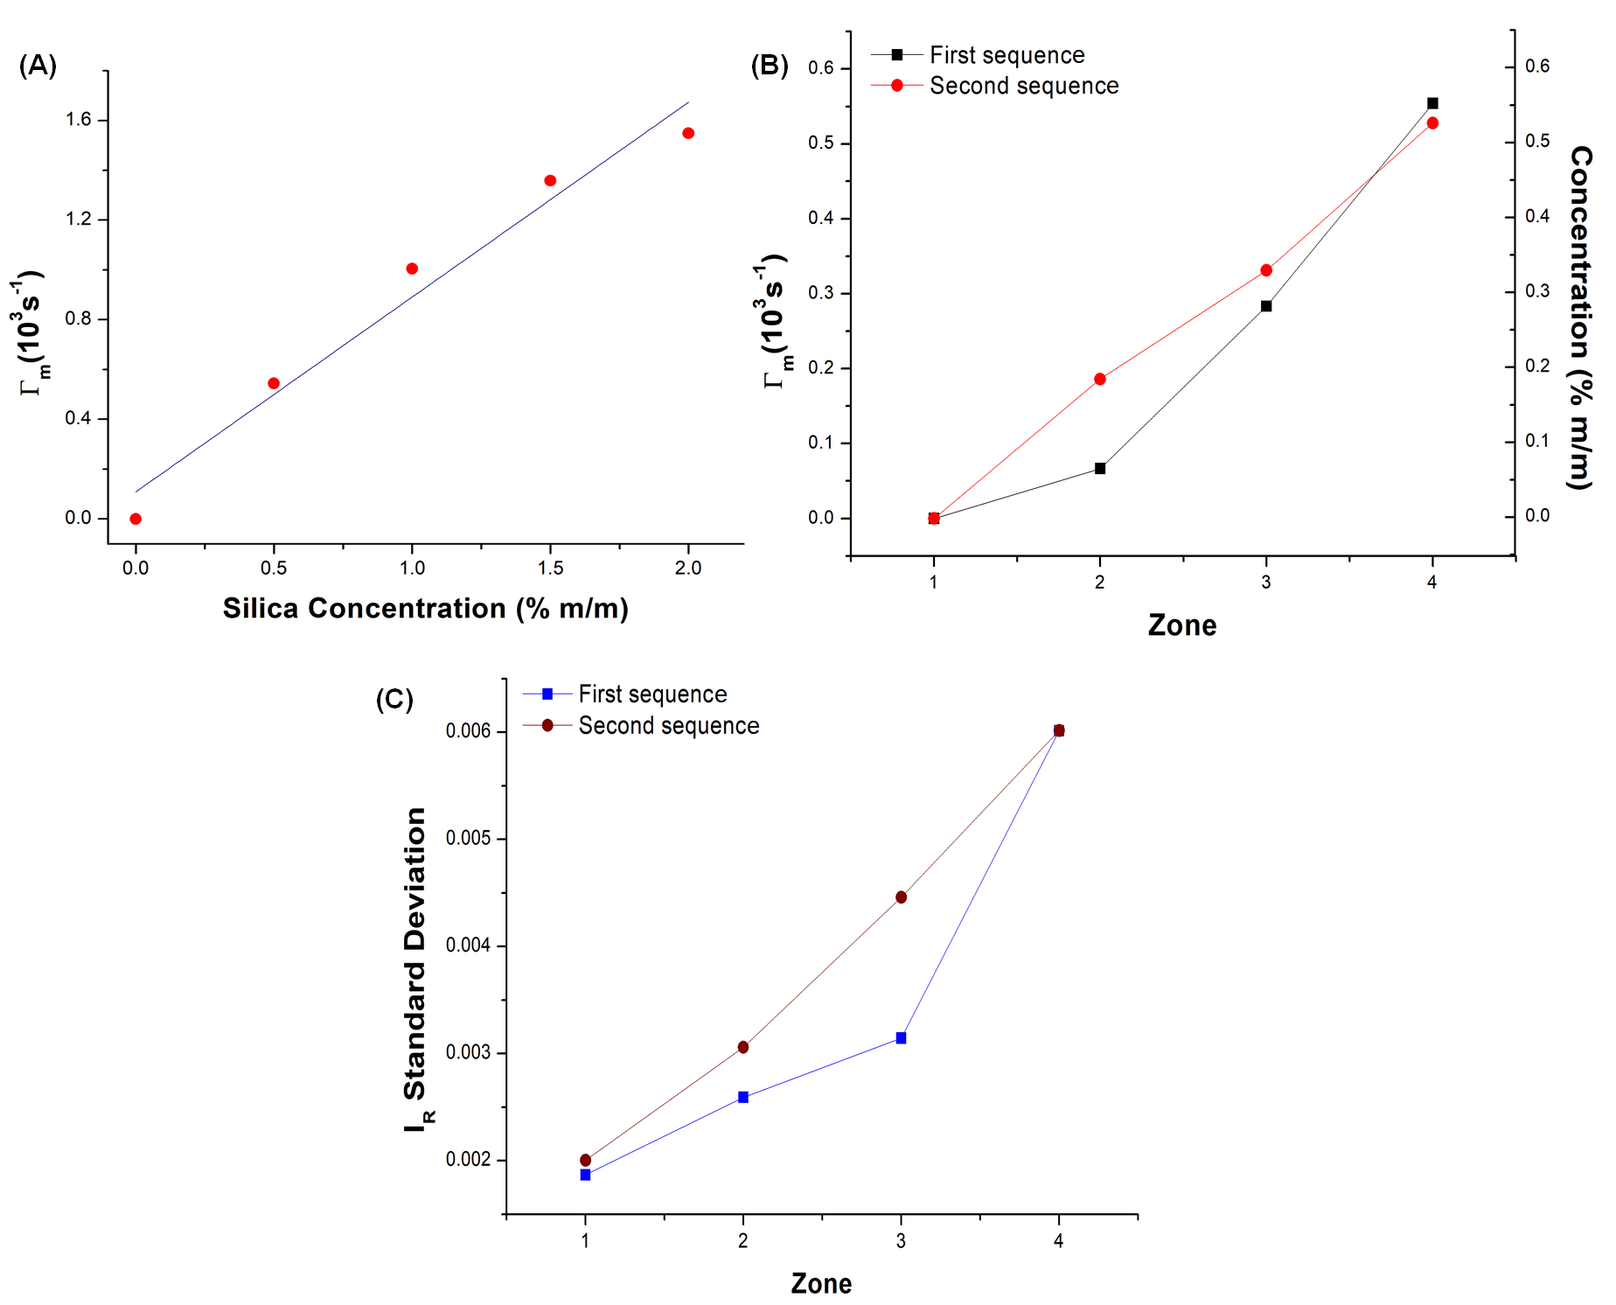
3. Results and Discussion
University of Campinas – UNICAMP, Laboratory of Photonic Materials and Devices
Soares et al., Dynamic Monitoring of Multi-Concentrated Silica Nanoparticles Colloidal Environment with Optical Fiber Sensor
University of Campinas – UNICAMP, Laboratory of Photonic Materials and Devices
Fujiwara et al., Characterization of Colloidal Silica by Optical Fiber Sensor
Calibration curve;
(B) Γ_{m} and concentrations;
(C) standard deviations in each zone.
11

Slide 12
3. Results and Discussion
University of Campinas – UNICAMP, Laboratory of Photonic Materials and Devices
Soares et al., Dynamic Monitoring of Multi-Concentrated Silica Nanoparticles Colloidal Environment with Optical Fiber Sensor
University of Campinas – UNICAMP, Laboratory of Photonic Materials and Devices
Fujiwara et al., Characterization of Colloidal Silica by Optical Fiber Sensor
Same tendencies between Γ_{m} and σ with similar behaviors for both sequences;
Small modifications of the average signal when the probe is moved from one zone to another, what is probably caused by fiber macrocurvature losses;
Lowest and highest signal-to-noise ratios (SNRs) evaluated as μ²/σ², where μ is the average signal: 2.604 x 10⁴ (Zone 4, second sequence) and 2.869 x 10⁵ (Zone 1, first sequence), respectively;
The measured concentrations were substantially inferior to the traditional sedimentation model: the particles are not all concentrated in a same zone, but distributed between them.
12

Slide 13
4. Conclusions
University of Campinas – UNICAMP, Laboratory of Photonic Materials and Devices
Soares et al., Dynamic Monitoring of Multi-Concentrated Silica Nanoparticles Colloidal Environment with Optical Fiber Sensor
University of Campinas – UNICAMP, Laboratory of Photonic Materials and Devices
Fujiwara et al., Characterization of Colloidal Silica by Optical Fiber Sensor
It was shown how a simple optical fiber sensor can be used for the monitoring of a multi-concentrated colloidal system;
An environment comprised of different sedimentation zones, suitable for the simulation of concentration step disturbances was created;
The method has showed itself reliable for the monitoring of such environment, providing data that can be interpreted both in terms of data dispersion or of the decay rate of the autocorrelation function, allowing the evaluation of the concentration;
The information collected with the system show that the real concentration values are very different from the ones estimated by the simple sedimentation models traditionally applied.
13

Slide 14




University of Campinas – UNICAMP, Laboratory of Photonic Materials and Devices
Soares et al., Dynamic Monitoring of Multi-Concentrated Silica Nanoparticles Colloidal Environment with Optical Fiber Sensor
Thank you for your attention!
Questions?
marcosoares.feq@gmail.com
fujiwara@fem.unicamp.br
FAPESP Grant 2017/20445-8
14
Notes:
14

