Slide 1
6th International Electronic Conference on Sensors and Applications
“Portable ECG system design using the AD8232 microchip and open-source platform”
Miguel Bravo-Zanoguera, Daniel Cuevas-González, Juan Pablo García-Vázquez, Roberto López-Avitia, Marco Reyna-Carranza
UNIVERSIDAD AUTÓNOMA DE BAJA CALIFORNIA
Facultad de Ingeniería
Mexicali, Baja California, México
15/Nov/2019

Slide 2
CONTENTS
Problem Statement
Background
General and Specifics Objetives
Materials and Methods
Results and Discussion
Conclusions

Slide 3
PROBLEM STATEMENT
Cardiovascular diseases (CVD) are one of the leading causes of death worldwide. WHO reports indicate that 31% of deaths are due to CVD.
In the last decades there has been an alarming increase in the population that presents cardiovascular problems, being one of the main causes of death worldwide, which due to lack of knowledge or identification of the problem tend to end up in death due to heart attack or heart conditions [1].
A trend that helps to address this problem is the development of medical devices for personal use, known as “mobile health”, with the use of technology such as: smartphones, monitoring sensors, and software applications that register , transmit or store user data to access their health condition at all times [2].
Mobile health wearables market is extremely fast-moving, and consumers demand more accurate battery-powered mobile devices.
Figure 1. Mobile Health Scheme.

Slide 4
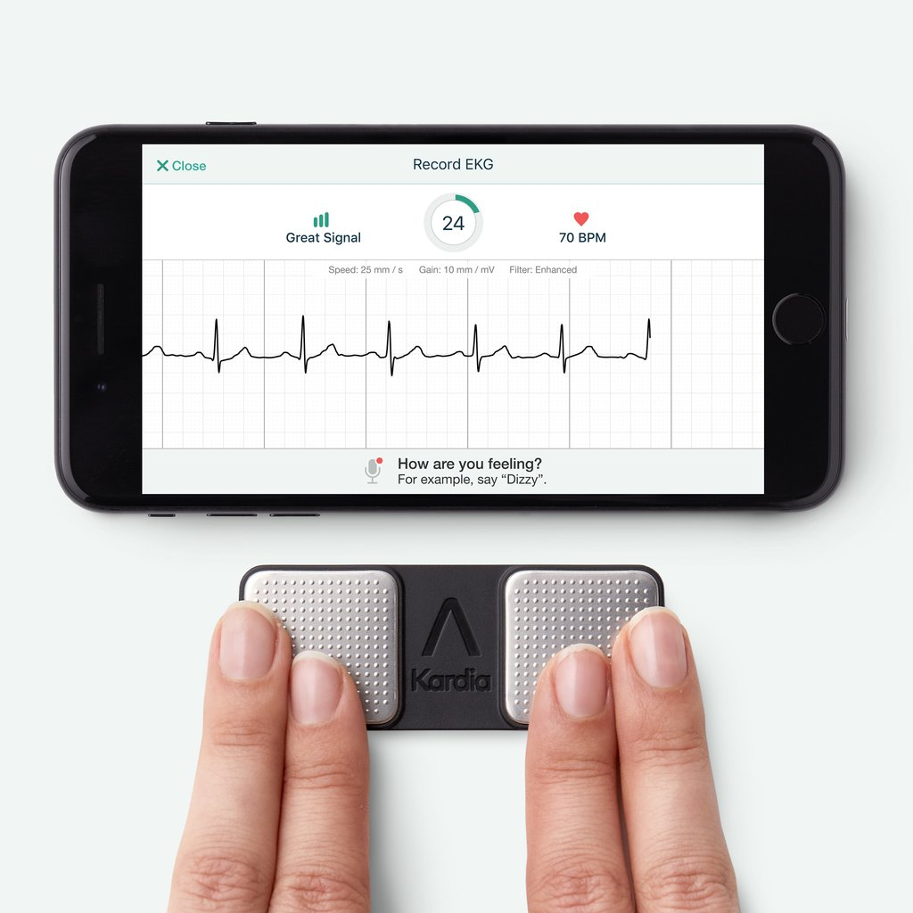
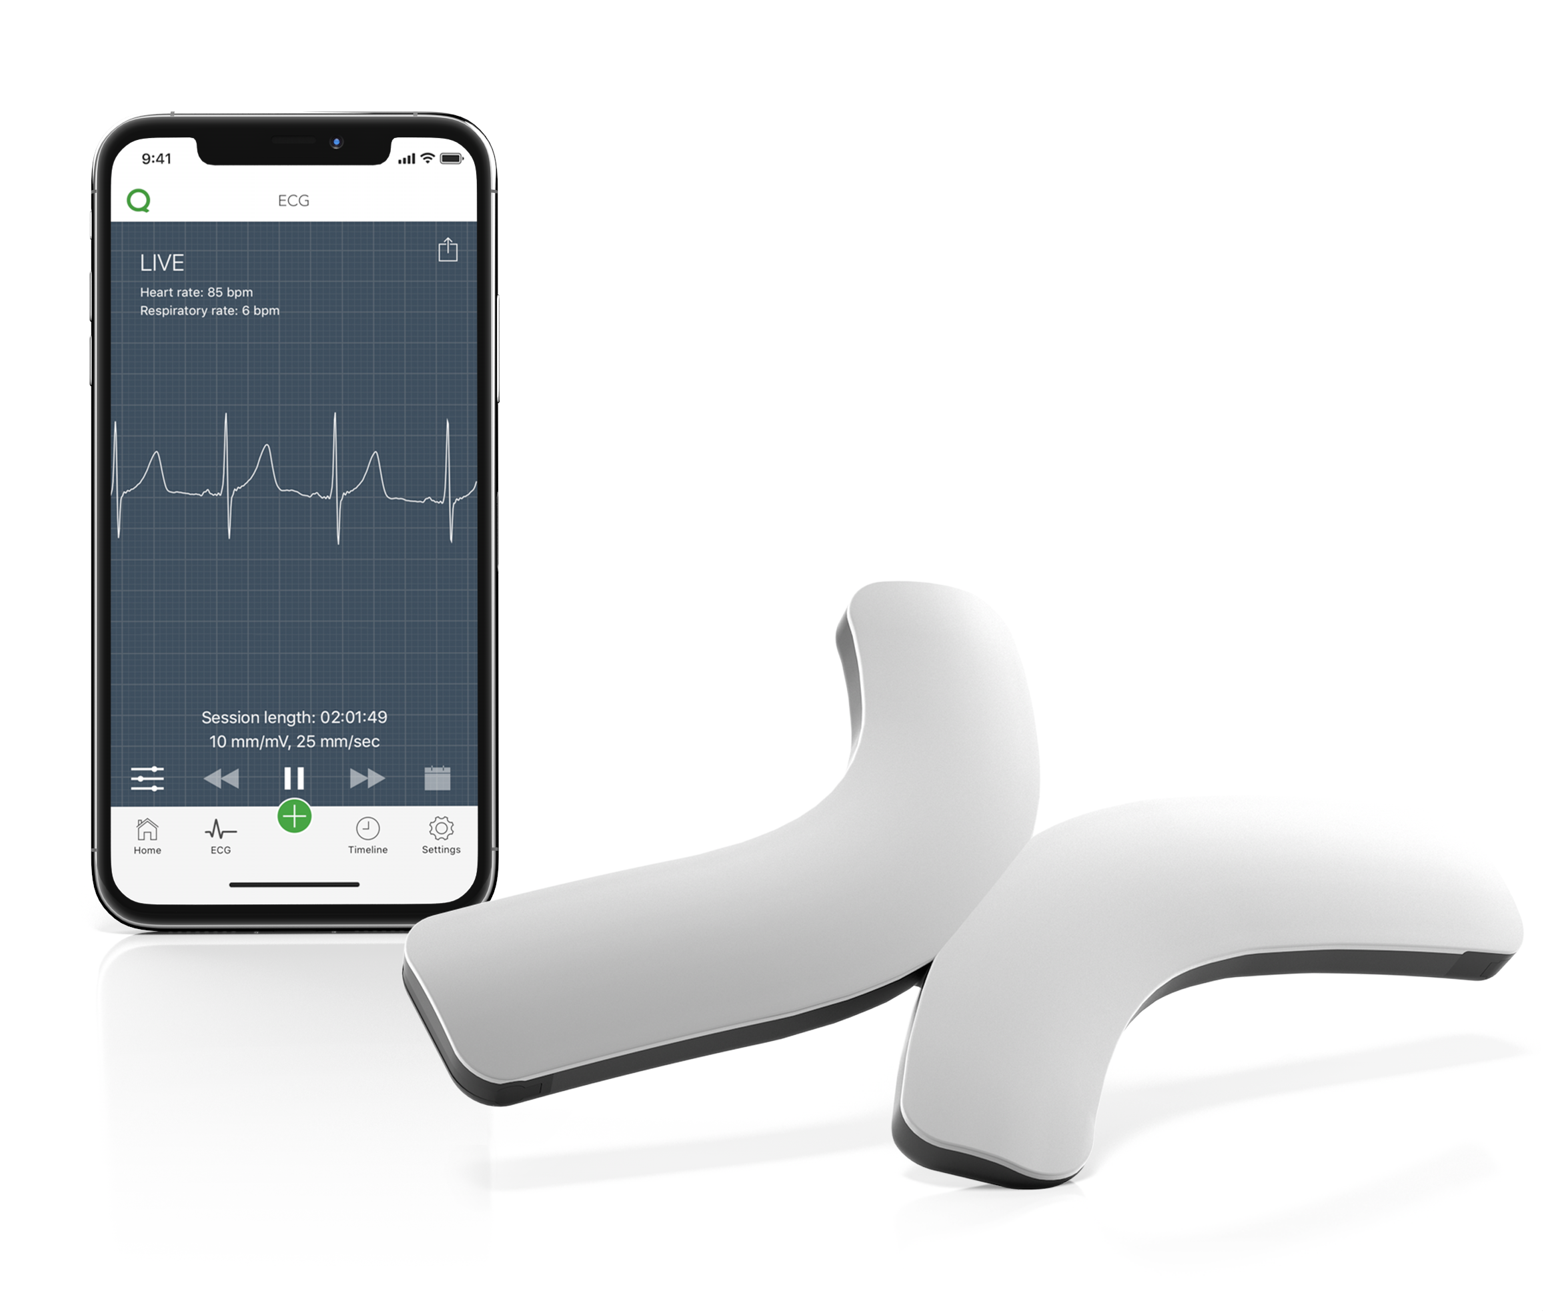
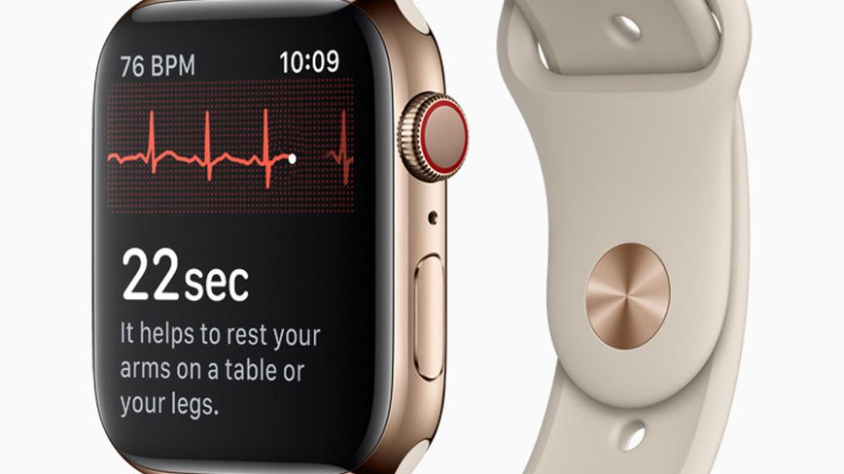
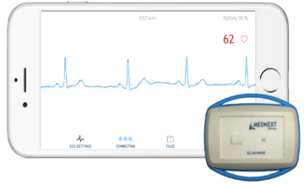
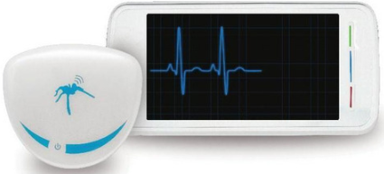
JUSTIFICATION
Iwatch series 4.
Alivecor, Kardia.
Qardiocore.
ECG ANYWHERE.
SPYDERDOCTOR.
Figure 2. Current Mobile Health Systems.
This project proposes the development of an ECG system with the AD8232 chip for long time recording and real-time ECG monitoring (online) in a low cost system based on an open source platform.
The proposed prototype offers the following advantages:
Long time ECG recordings
Real-time transmission on smart devices
ECG records with .txt format for easy information management.
3 communication protocols for connectivity with smart devices
The portable monitoring equipment allows to register the vital signs while the user performs his daily activities, and to capture events that occur infrequently or specific circumstances, and thus be able to make a more precise diagnosis.

Slide 5
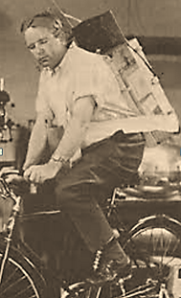
BACKGOUND
Electrocardiograph portability
Norman Holter in 1949 - backpack, about 37 Kg, with ECG registration and transmission.
Currently portable devices, “mobile health” for personal monitoring and health care.
Figure 3. First portable electrocardiograph.
Figure 4. Mobile Health Scheme.
The need to develop miniature equipment is considered by semiconductor companies that develop microchips.
Semiconductor companies
IMEC
Texas Instruments
Analog Devices
(Developing microchips for the development of miniature and “wearable” equipment )
Figure 5. Semiconductor companies.

Slide 6
PROJECT OBJECTIVES
General Objetive:
Manufacture a prototype of a portable ECG system with data logging and wireless data transmission, using the AD8232 chip as an initial analog stage, and open source development platform.
Specific Objetives:
Evaluate and validate the operation, scope and limitations of the AD8232 microchip, for monitoring the ECG signal.
Characterize the Arduino open source platform with C programming, to increase its performance in the application of a data acquisition system and application of digital filters in real time.
Design the circuit of a portable ECG system with the following modes of operation: serial transmission, microSD card recording, and Bluetooth transmission.

Slide 7
MATERIALS AND METHODS
Open-source hardware
AFE AD8232, adapter and simulation
Data ouput modes
Circuit implementation and testing
Open-source software
Buffer overrun problem

Slide 8
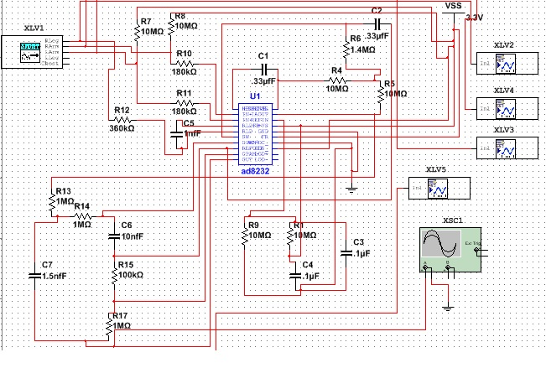
AD8232 CIRCUIT SIMULATION
Multisim simulation* Component development * Macromodel * Circuit design
Circuit Specs:
*Gain
*Cutoff frequencies
*Filters evaluation
System robustness:
*Montecarlo
*Temperature Analysis
*Worst Case
*Fourier Analysis
Figure 6. Circuit with SPICE component in Multisim software .

Slide 9
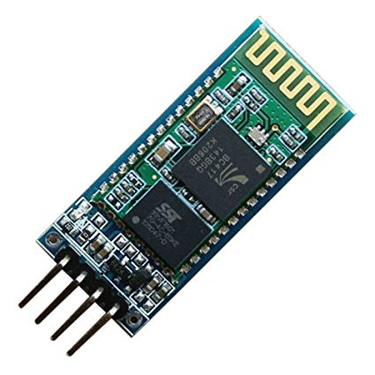
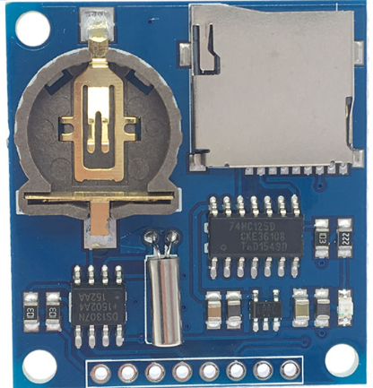
OPEN-SOURCE HARDWARE
Arduino Nano CH340
Bluetooth HC-06
Data Logger Shield
*ATmega328 Microcontroller
*16 MHz oscillator
*CH340 USB interface
*AT commands
*Integrated antenna and RF transceivers
*115,200 bauds operation
* RTC1307
*MicroSD reader
*Coin battery
*Level 5V to 3.3V regulator
Figure 7. Open-source boards and features.

Slide 10
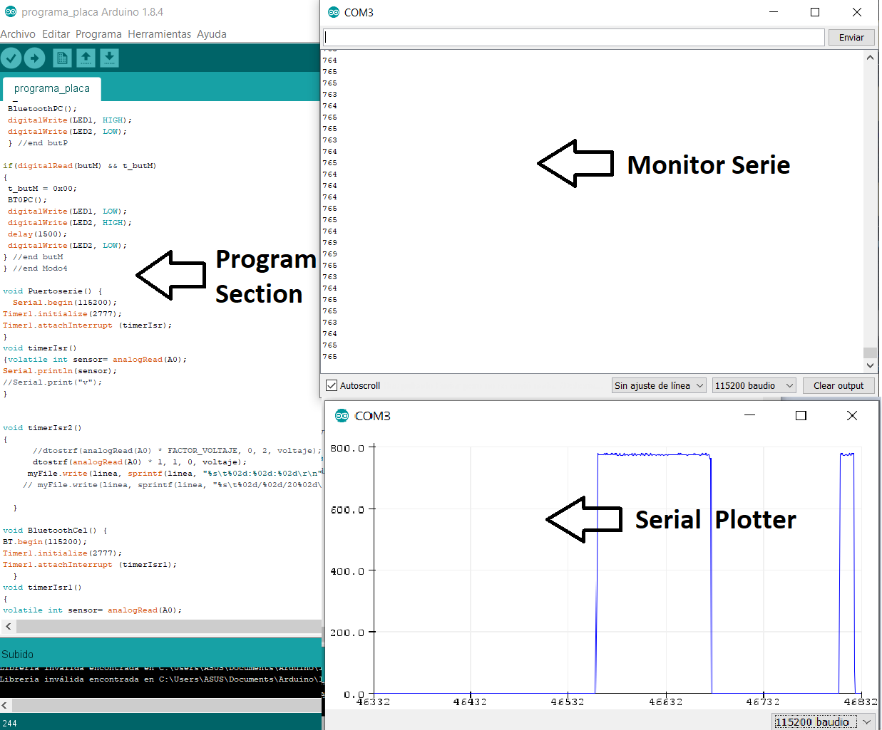
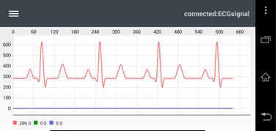
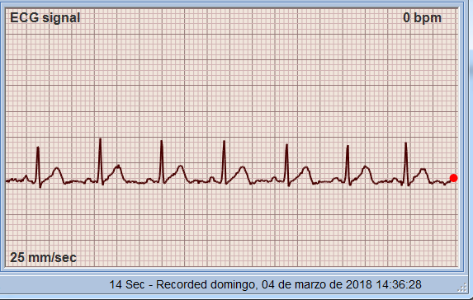
OPEN-SOURCE SOFTWARE
IDE Arduino
Arduino libraries
Serial Communication: Use of UART port.
SD Library: write the information to micro SD
Timer One: Interrupt programming
Software Serial: Virtual UART port configuration.
Bluetooth Graphics
Theremino
Figure 8. Open-source software and libraries.

Slide 11
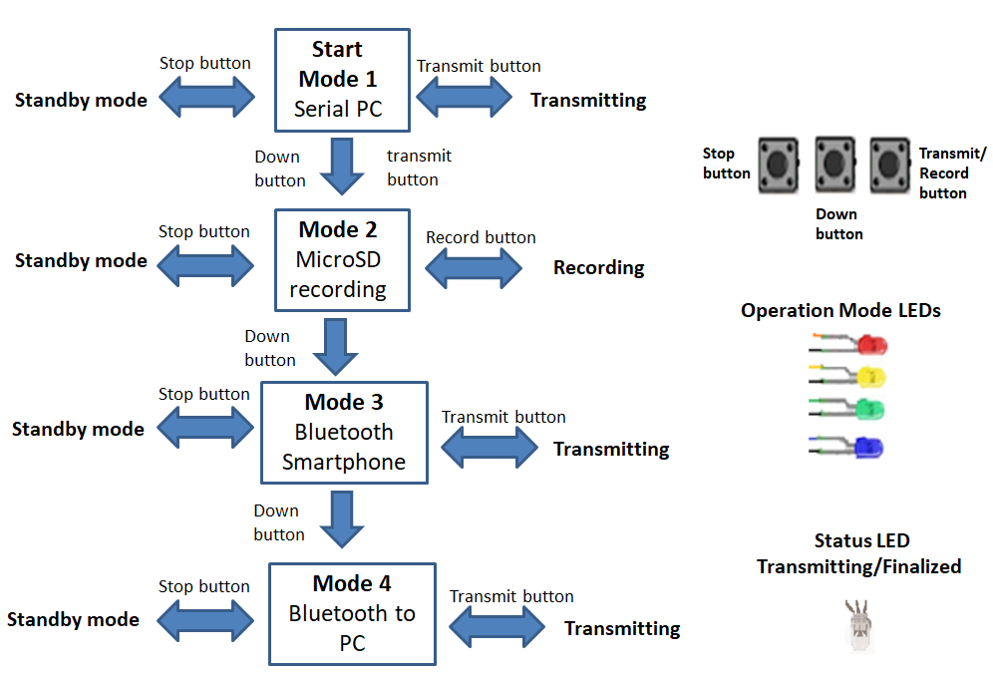
SOFTWARE-OPERATING MODES MENU
Figure 9. The operating menu of the portable ECG prototype is displayed. Pressing the down button will change the mode, and pressing transmit or record to start task, and the Stop button to end. The status LED will be green if it is being transmitted / recorded and it will be red if it is finished.

Slide 12
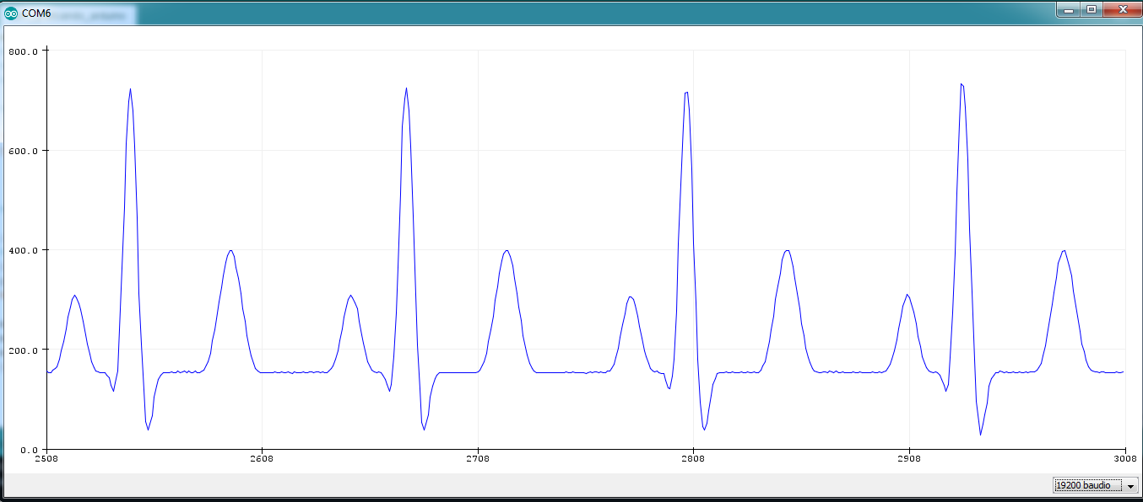
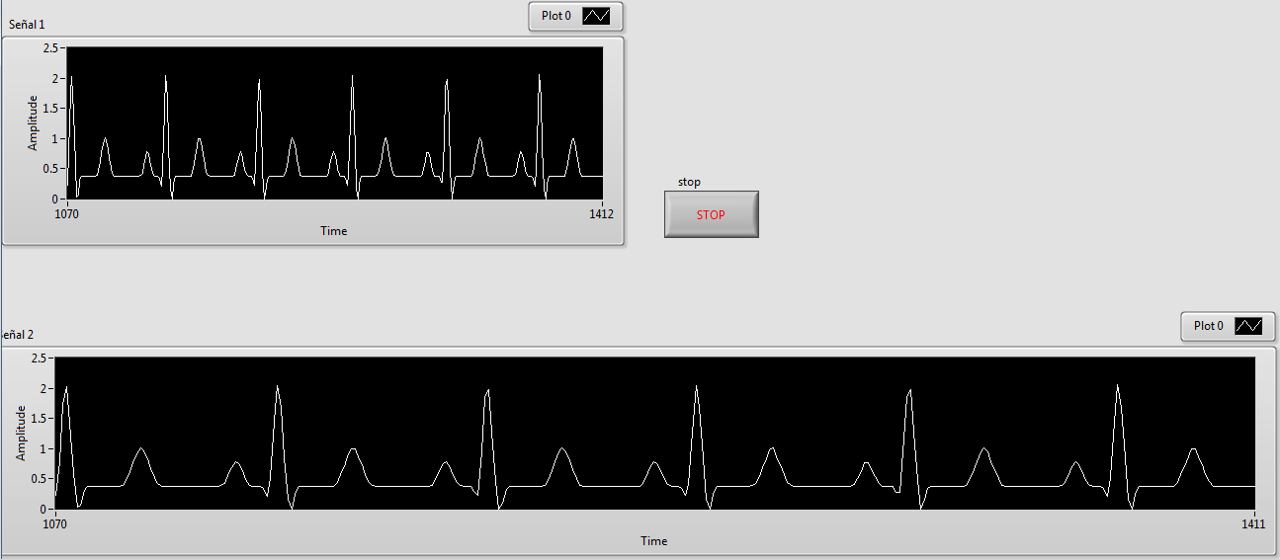
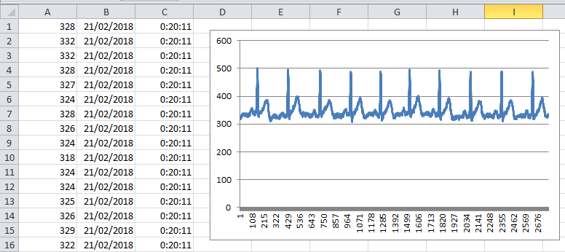
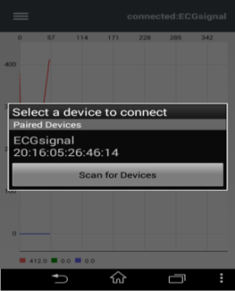
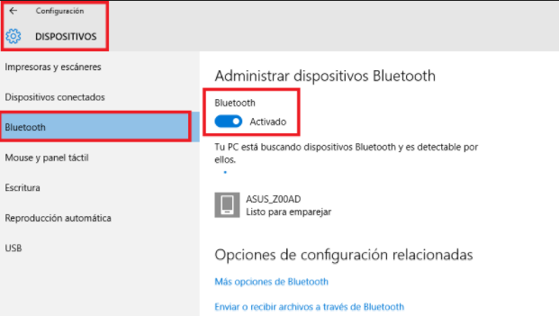
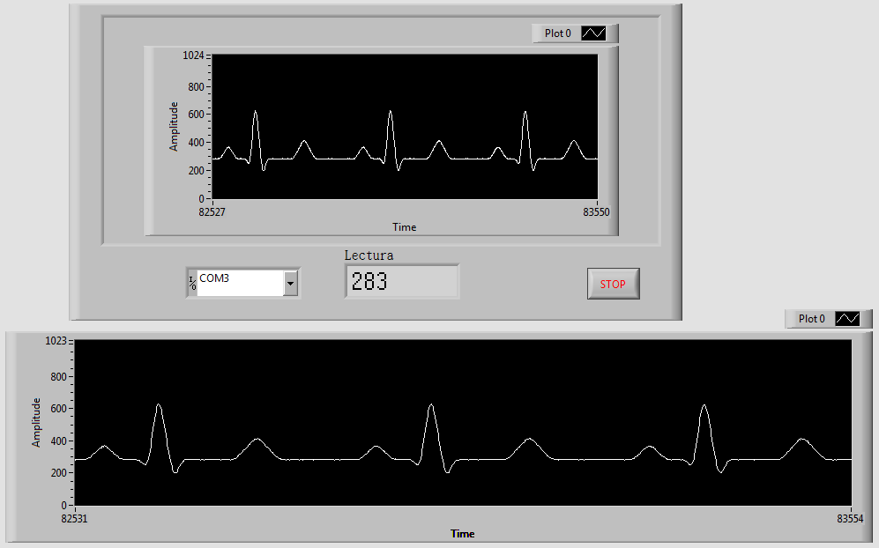
-SOFTWARE- DATA OUTPUT MODES
Operation mode: Serial transmission.
Operation mode: MicroSD recording.
Arduino Plotter Tool
Software LabView.
Software Excel.
Software Theremino.
Operation mode: Bluetooth transmission to smartphone.
Operation mode: Bluetooth transmission to PC.
Pair to the phone Bluetooth.
Arduino Graphics app on phone.
Pair to PC bluetooth
Software LabView.
Figure 10. Data outputs modes.

Slide 13
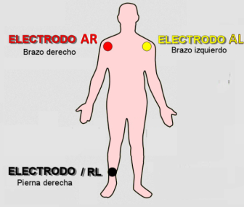
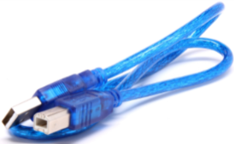
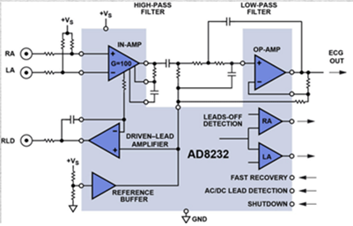
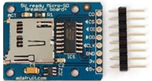
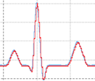
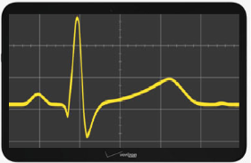
INTEGRATED PROTOTYPE
Hardware components
Input signal
Digital hardware
Transmission
Receiver
E/S digital
Mode 1
Serial Port
Laptop
Buttons
LEDs
MicroSD Card
AFE
Mode 2
MicroSD Card
ADC
A/D Converter
ARDUINO
nano
Smartphone
Mode 3 and 4
Bluetooth
Analog ECG signal
Reg. tiempo
Tablet
RTC ( Date and Time)
Figure 11. Integrated prototype.

Slide 14
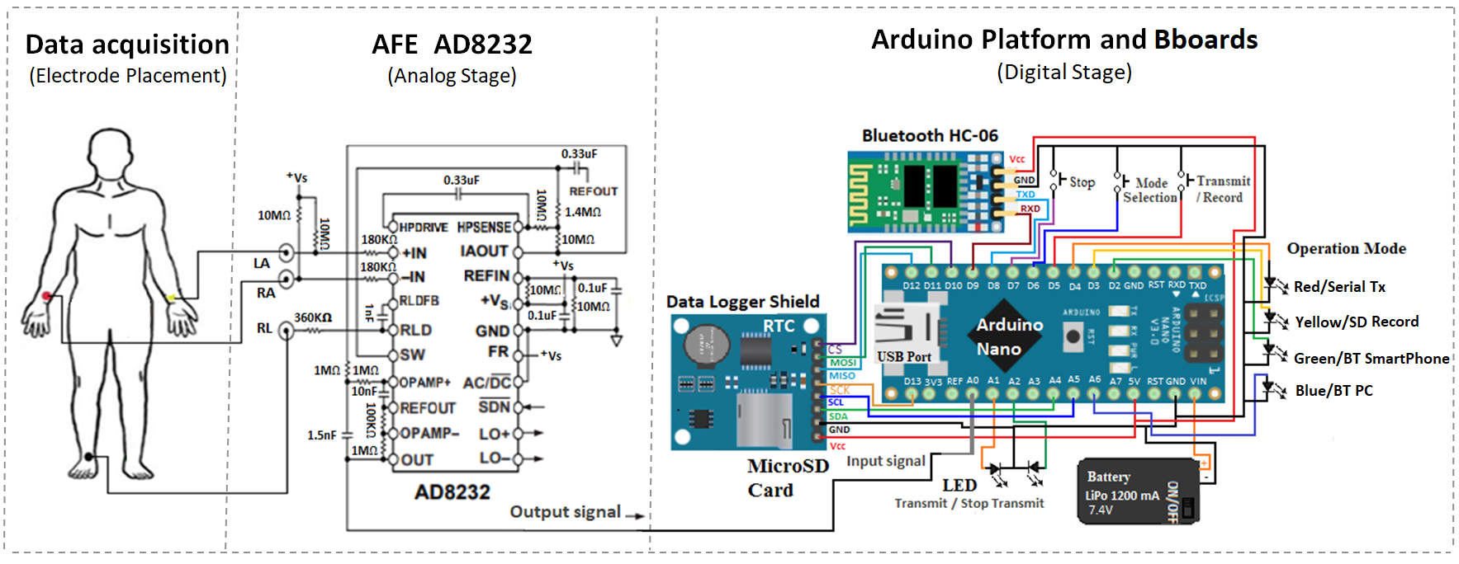
HARDWARE- CONNECTIVITY
Prototype connectivity
Figure 12. Prototype of portable ECG is shown. Circles on the person's body represent the position of electrodes. Two main sections: the analog AFE AD8232 and the Arduino modules.

Slide 15
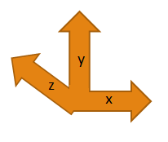
BREADBOARD PROTOTYPE
Breadboard Prototype Specifications
Breadboard 3M model 922309
Dimensions: 10.16x17.78cm
65 connection lines.
840 points.
Z-axis components on breadboard :
Data logger shield
Bluetooth module
Figure 13. Long-time recording ECG Breadboard prototype with Bboards.

Slide 16
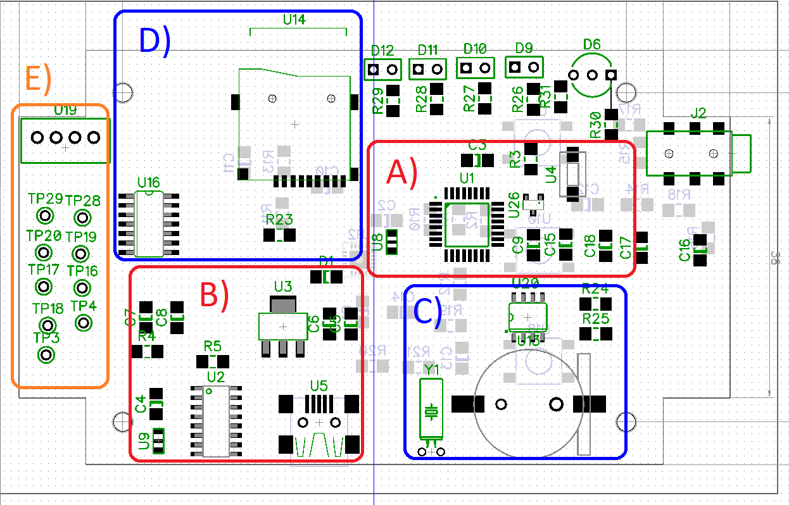
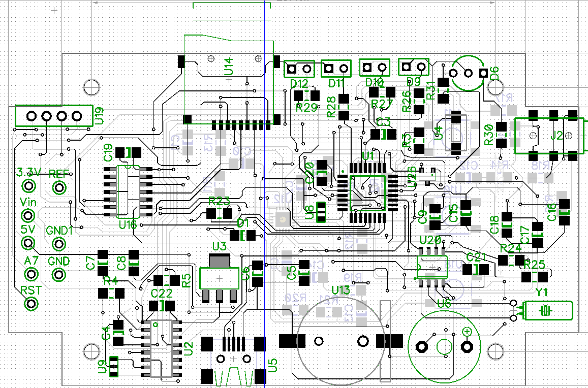
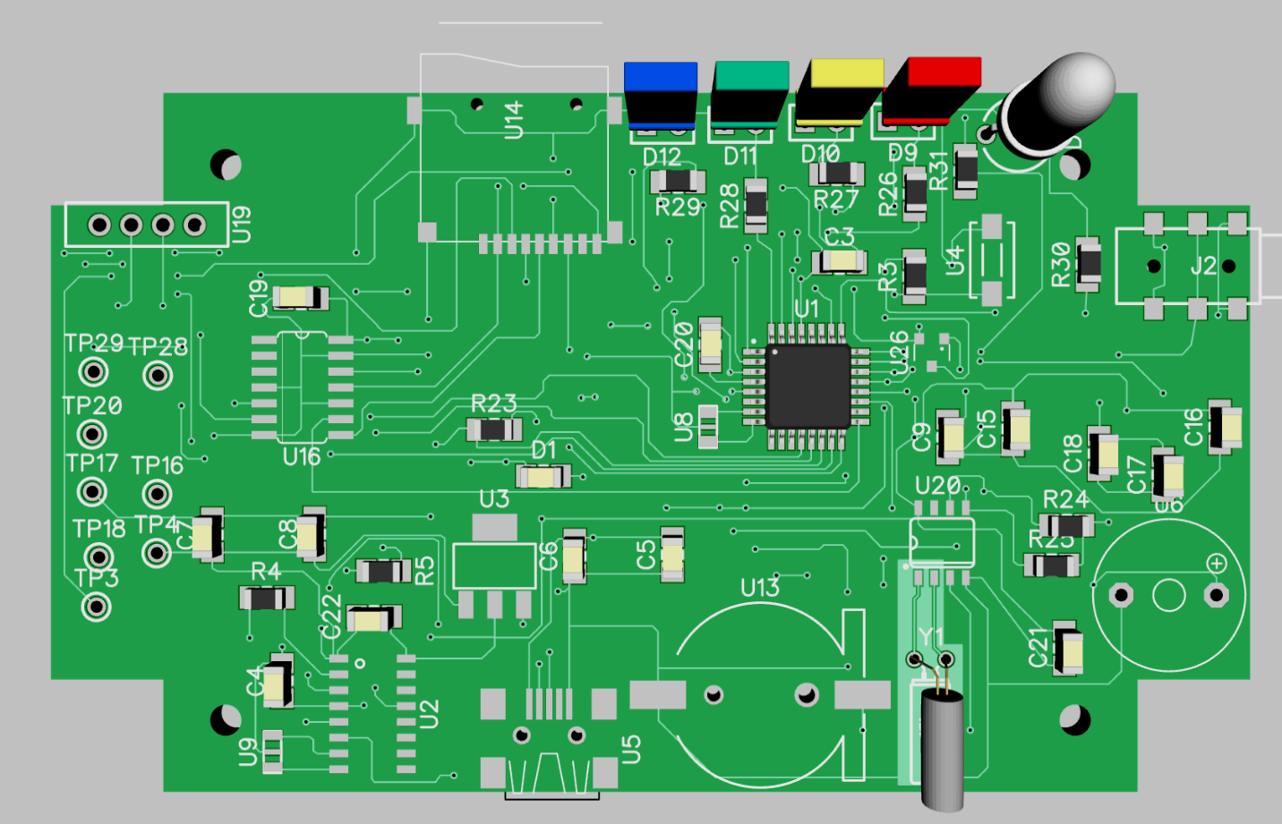
PCB AND PROCESS
Component placement
PCB design
3D model PCB
Figure 14. Component section: A) and B) Arduino Nano, C) and D) Data logger shield and E) HC-06 Bluetooth module and input, output, power and ground ports.
Figure 16. Custom PCB top view in 3D before manufacturing.
Figure 15. PCB circuit design in DIPTRACE software.

Slide 17
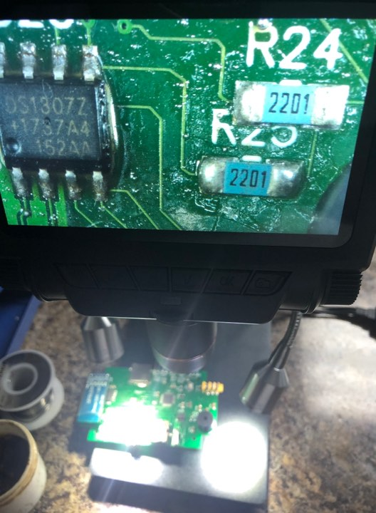
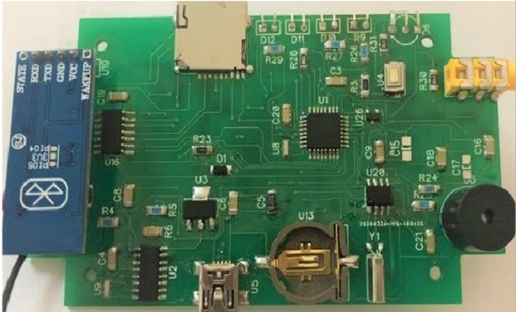
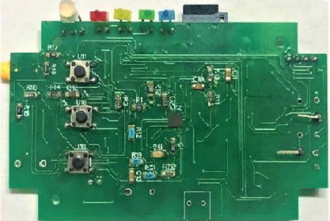
PCB AND PROCESS
Components assembly
Final Custom PCB
A)
A)
B)
B)
Figure 18. A) Printed circuit board (Custom PCB) top view, and B) bottom view.
Figure 17. Amplification station for surface mounting Andostar ADSM301.

Slide 18
BUFFER OVERRUN PROBLEM
When reviewing an ECG signal recorded in SD memory, it was observed that a peak of the QRS complex was not recorded complete.
Random phenomenon, without a pattern, sometimes 1 or 2 times / hour.
Events of 36 lost samples on average in a 1 or 2 hours ECG records.
Table 1. Characterization of the atypical event of the QRS complex in long-term ECG records.
Archive | Data points | Samples lost | % of lost samples
1 hour at 360Hz | 1,288,907 | 41 | 0.00318%
1 hour at 500Hz | 1,784,059 | 49 | 0.00274%
2 hours at 360Hz | 2,579,257 | 31 | 0.00120%
2 hours at 500Hz | 3,568,588 | 34, 27 | 0.001709%
Figure 19. Atypical event in the QRS interval in the ECG signal.
Through an experiment design, it was ruled out that the error is due to:
Function generators.
Error by Arduino Nano module, using other modules of the Arduino family.
Hardware error in datalogger module.
X Memory microSD card error.
Table 2. MicroSD memory write latency.
Capacity | Brand | Class | Write latency
1gb | Sandisk | 4 | 5312µs
2gb | Nokia | 2 | 6312µs
2gb | NA | 2 | 6840µs
4gb | Sandisk | 4 | 8240µs
4gb | Kingston | 10 | 4584µs
16gb | Sandisk ultra | 10 | 5312µs
32 gb | Sandisk | 4 | 6464µs
Arduino libraries work with 1 write buffer. A program was implemented to measure the latency time in microSD writing (Table 2), it was observed that when having a longer writing latency time the number of atypical data increased. If the latency of writing is high it can cause loss of information.

Slide 19
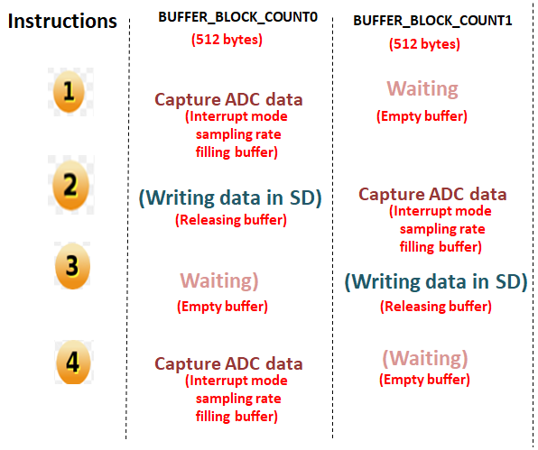
BUFFER OVERRUN PROBLEM CORRECTION
Solution implemented:
Double buffer implementation using available RAM memory to avoid data loss.
Performance tests:
Long-term ECG records were recorded using double write buffer (1,2,12, and 24 hours at 500Hz).
Low and high latency write memories were used.
Records were reviewed with automatic analysis methods.
The occurrence of atypical events in all records was eliminated.
Figure 20. Two buffers operation for writing data in SD memory.
Visual inspection of a record takes a long time and is tedious, automatic analysis alternatives were evaluated to detect these atypical events by introducing a control ECG signal with known atypical events.
Five software / Algorithms were evaluated to determine which could help detect our atypical events accurately. The options were: BioSigKit, Pan Tompkins Algorithm, nQRS detector, simple QRS for MATLAB, and Biomedical Workbench of LabVIEW.
The two options that had no errors when counting atypical events were: 1) Pan tompkins Algorithm and 2)Biomedical Workbench.

Slide 20
Metodología del proyecto
RESULTS
ECG Signals:
Figure 21. A) ECG signal transmitted by serial cable (breadboard prototype), B) ECG signal transmitted by serial cable (custom PCB), C) ECG record on microSD card (breadboard prototype), D) ECG record on microSD card (custom PCB), E) ECG signal transmitted by bluetooth via smartphone (breadboard prototype), F) ECG signal transmitted by bluetooth via smartphone (Custom PCB). The sampling frequency in all signals was 360 Hz.

Slide 21
Metodología del proyecto
RESULTS
Basic safety and performance
Tabla 3. Approval of ANSI / AAMI / IEC 60601-2-47: 2012 regulatory requirements
Tabla 4. Standards of quality and safety standards for the development of an electrocardiograph.
Parameter | ECG base en breadboard
Application | Monitoreo
Bandwidth | 0.5Hz-40Hz
Gain | 1100
Sample Rate | 360-2100Hz
dynamic range of operation | 0-3 mV
Patient leakage current | 1-2 µA
CMRR | 88.7dB
Input Impedance | 10MΩ
Signal noise | 20µV
Offset DC | ±300mV
Time Recording | 29 Hrs.
component accuracy | 1%
Name of Standar | Regulation
IEC 6060-1 parte 1 [38]. | Electromedical equipment parts 1: General requirements for basic safety and essential operation.
ANSI/AAMI/IEC 60601-2-47:2012 [21]. | Particular requirements for the basic safety and essential performance of ambulatory electrocardiographic systems.
ANSI/AAMI C12:2000/ (R) 2010 [22]. | Disposable electrodes

Slide 22
CONCLUSIONS
The results indicate that the AD8232 microchip is suitable for the AFE function, as it delivered a useful signal for a long-term single-lead ECG monitoring application. The ATmega328 microcontroller on the Arduino open-source platform also provided satisfactory results. With its various communication protocols, the microcontroller kept the fabrication cost low, maintained portability, and reduced the number of components and the design time of the prototype. The total cost of the prototype components was 20 USD; this renders a personal monitoring ECG system with prolonged recording time accessible to a larger sector of the population. This design does not seek to replace hospital equipment but can support the diagnosis, prevention, and management of cardiovascular disease

