Slide 1
Impedimetric lectin-based biosensors for
cancer-associated O-glycans
M. Luísa S. Silva
Centre of Chemical Research, Autonomous University of Hidalgo State, México
mluisasilva@portugalmail.pt

Slide 2
Introduction
oncogenesis
STn antigen
truncation of O-glycans
Tn antigen
T antigen
increased fucosylation
aberrant protein glycosylation
increased sialylation
increased β1,6 GlcNAc branching in N-glycans
tumoral cell
blood
secretion
aberrant glycans are cancer biomarkers accessible in blood

Slide 3
Introduction
detection of aberrant glycostructures
lectins
cancer-associated truncated O-glycan | lectin immobilized on the biosensor
STn | Sambucus nigra agglutinin (SNA) specifically recognizes the NeuAc-α2-6GalNAc-α1-O-Ser/Thr structure
Tn | Vicia villosa agglutinin (VVA) specifically recognizes the GalNAc-α1-O-Ser/Thr structure
T | Arachis hypogeae agglutinin (PNA) specifically recognizes the Gal-α1-3GalNAc-α1-O-Ser/Thr structure

Slide 4
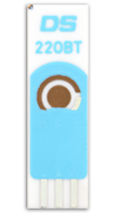
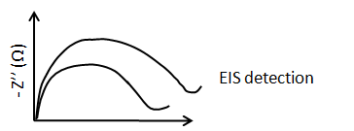
Introduction
The binding event between each lectin and the corresponding aberrant O-glycan was monitored by electrochemical impedance spectroscopy, measuring the increase in the biosensor’s impedance after incubating the samples. The increase in impedance was related to the lectin-glycan complex formation.
b
a
Au/SPE low temperature cure ink gold electrode; E_{w} (4 mm diameter)
Nyquist plots obtained (a) before and (b) after sample incubation

Slide 5
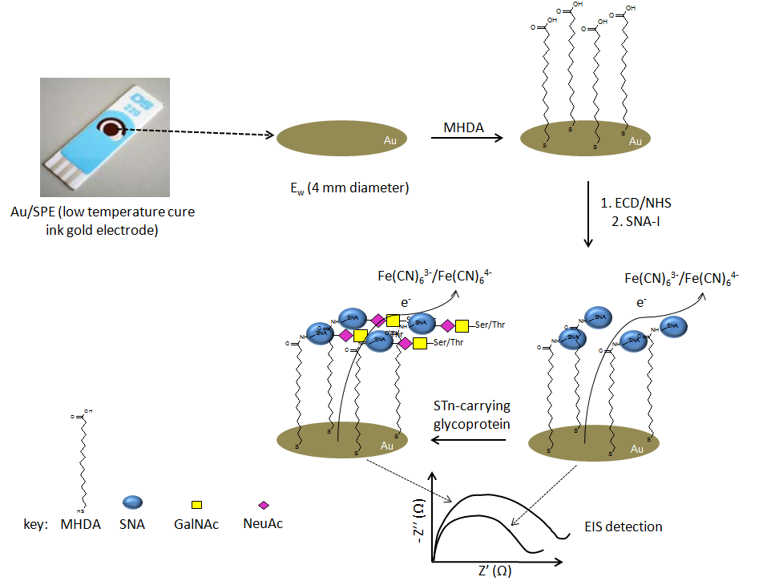
Biosensor construction
Figure 2 – Schematic diagram describing the construction of each lectin biosensor and detection of aberrant O-glycans by EIS: (a) alkanethiol/mixed alkanethiols self-assembled monolayer is formed via incubation of screen-printed electrodes for 24 h; (b) the carboxylic acid end of the alkanethiols are activated with ECD and NHS to allow covalent binding with the lectin; (c) the truncated O-glycan present in glycoproteins is captured based on the affinity of the lectin to the referred structure; (d) the formation of the complex lectin-truncated O-glycan is monitored by the increase in the electrode impedance (by electrochemical impedance spectroscopy).

Slide 6
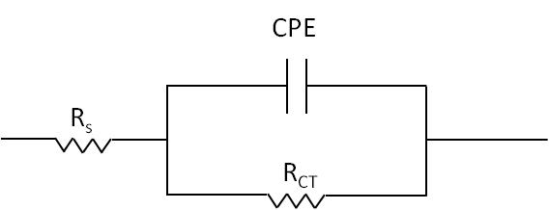
Biosensor construction
cancer-associated truncated O-glycan | lectin immobilized on the biosensor | model glycoprotein used to monitor complex formation during optimization
STn | SNA | bovine submaxillary mucin; human transferrin
Tn | VVA | asialofetuin; asialo-bovine submaxillary mucin
T | PNA | asialofetuin
Randles equivalent circuit for the developed biosensors. R_{s} – resistance of the electrolyte solution; CPE – constant phase element; R_{CT} – charge transfer resistance.

Slide 7
Results – selectivity
SNA biosensor
Nyquist plots obtained before and after incubating the blank biosensor (with no lectin) with BSM solutions (a) 0.01 µg ml⁻¹ and (b) 1.0 µg ml⁻¹, for 5 min at room temperature.

Slide 8
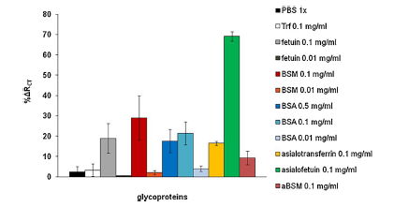
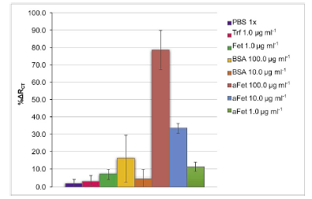
Results – selectivity
VVA biosensor
PNA biosensor
Response for several glycoprotein solutions, incubated for 10 min. Error bars indicate standard deviations of duplicate measurements with two independent biosensors for each solution.

Slide 9
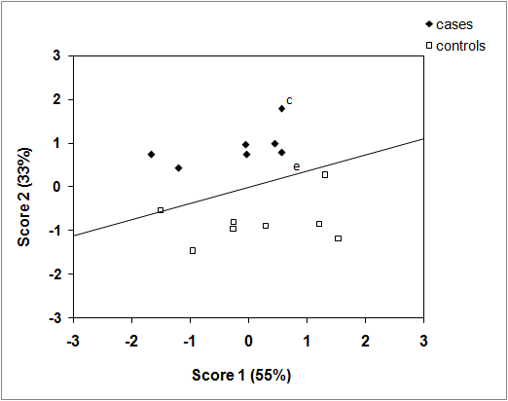
Results – sample analysis
SNA biosensor
Graphical representation of the first two scores of a PCA performed on the impedimetric data from sample analysis using the SNA biosensor. Each point represents an individual analysis of a sample; (a) – breast carcinoma, (b) – retroperitoneal located malignant tumour, (c and e) – pools with 25 different cancer samples, (d) – cervical-uterine carcinoma.

Slide 10
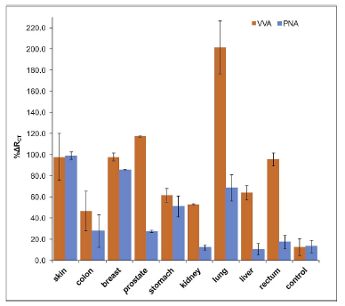
Results – sample analysis
VVA and PNA biosensors
Results obtained in sample analysis for VVA and PNA biosensors. Each sample pool refers to a type of carcinoma. Ctrl represents a pool of samples from healthy donors. Error bars indicate standard deviations of duplicate measurements with two independent

Slide 11
Conclusions
The developed biosensors showed high selectivity and high discrimination capacity between controls and cases.
For all the developed biosensors, in the optimized conditions, the assays were fast (around 20 min).
The EIS-based label-free detection simplified the construction and detection procedure.
The construction process was highly flexible and, with small, changes, could be applied to all lectin-based biosensors.
By using all biosensors for the analysis of the same cancer type, different glycosylation patterns could be observed, according to lectin specificity.
References
M. Luísa S. Silva, Evelin Gutiérrez, José A. Rodríguez, Catarina Gomes, Leonor David. Biosens. Bioelectron. 57 (2014) 254-261.
M. Luísa S. Silva, María G. H. Rangel. Sens. Actuators B 252 (2017) 777-784.
María. G. H. Rangel, M. Luísa S. Silva. Biosens. Bioelectron. 141 (2019) 111401.

Slide 12
Impedimetric lectin-based biosensors for
cancer-associated O-glycans
M. Luísa S. Silva
Centre of Chemical Research, Autonomous University of Hidalgo State, México
mluisasilva@portugalmail.pt

