Slide 1
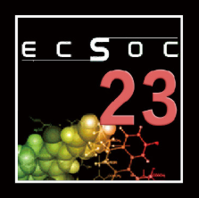
Microwave assisted synthesis and its cytotoxicity study of 4H-pyrano[2,3-a]acridine-3-carbonitrile intermediate: Experiment design for optimization using Response Surface Methodology
The 23rd International Electronic Conference on Synthetic Organic Chemistry
by
Dr. S. Mohana roopan
Assistant Professor (senior),
Department of Chemistry,
Chemistry of Heterocycles & Natural products Research Laboratory,
School of Advanced Science,
Vellore Institute of Technology,
Vellore.
Email: mohanaroopan.s@vit.ac.in
15/11/2019 to 15/12/2019

Slide 2
Introduction
Heterocycles – Cyclic compounds with 2 different atoms.
Nitrogen heterocycles – Nitrogen atom present in the cyclic ring

Slide 3
Importance of heterocyclic compounds
Heterocycles
Mukhtyar. S. Saini et al., A review: biological significances of heterocyclic Compounds. IJPSR. 2013, 4(3), 66-77.

Slide 4
Pyrane
Vitaly A. Osyanin et al., Tetrahedron 68 (2012) 5612-5618

Slide 5
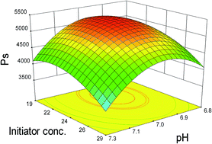
RSM (Response Surface Methodology)
Response Surface Methodology (RSM) is useful for the modeling and analysis of programs.
Explores the relationships between several explanatory variables and one or more response variables.
Help to better understand and optimize your response.
RSM
Effectively
Accurately
All factors

Slide 6
Literature review
Fathy A.E. et al., Synthesis and antimicrobial evaluation of naphtho[2,1-b]pyrano[2,3-d]pyrimidine and pyrano[3,2-e][1,2,4]triazolo[1,5-c]pyrimidine derivatives.
Acta. Pharm.,54, 13–26, 2004
Vyas D.H. et al., Synthesis and antimicrobial activity of some new cynopyridine and cynopyranes towards mycobacterium and other microorganism.
In. J. Chem., 48, 833-839, 2009
Magedov I.V. et al., Structural simplification of bioactive natural products with multicomponent synthesis. 4. 4H-Pyrano-[2,3-b]naphthoquinones with anticancer activity
Bioorg. Med. Chem. Let., 22, 5195–5198, 2012

Slide 7
Synthesis of 2-amino-10-chloro-4-(3,4-dimethoxyphenyl)- 12-phenyl-5,6-dihydro-4H-pyrano[2,3-a]acridine-3-carbonitriles

Slide 8
Mechanism of the reaction

Slide 9
RSM optimization of pyrane derivatives (3 a-f)
Experimental analysis of the CCD model 3a-f
Selected variables and levels used in the CCD
Variables | Levels
 | -1 | 0 | +1
TIME (min) | 2.5 | 5 | 7.5
WATTZ (W) | 100 | 200 | 300
TEMP (◦C) | 40 | 50 | 60
Time (Min) | Wattz (W) | Temp ◦C | Theoretical Yield (%) | Experimental Yield (%)
-1 | -1 | -1 | 52 | 52
1 | -1 | -1 | 60 | 62
-1 | 0 | -1 | 63 | 63
0 | 0 | -1 | 73 | 74
1 | 0 | -1 | 75 | 73
-1 | 1 | -1 | 62 | 62
0 | 1 | -1 | 74 | 72
1 | 1 | -1 | 79 | 84
-1 | -1 | 0 | 76 | 78
0 | -1 | 0 | 82 | 85
1 | -1 | 0 | 81 | 78
-1 | 0 | 0 | 81 | 85
0 | 0 | 0 | 89 | 90
1 | 0 | 0 | 90 | 88
-1 | 1 | 0 | 74 | 73
0 | 1 | 0 | 84 | 85
1 | 1 | 0 | 88 | 87
-1 | -1 | 1 | 79 | 76
0 | -1 | 1 | 83 | 82
1 | -1 | 1 | 80 | 84
12-Nov-19
9

Slide 10
RSM optimization of pyrane derivatives (3 a-f)
Analysis of Variance (ANOVA)
Source | DF | Seq SS | Adj SS | Adj MS | F | P
Regression | 9 | 1942.32 | 1942.324 | 215.814 | 22.51 | 0.000
Linear | 3 | 1285.21 | 378.138 | 126.046 | 13.14 | 0.001
Square | 3 | 447.82 | 574.436 | 191.479 | 19.97 | 0.000
Interaction | 3 | 209.29 | 209.294 | 69.765 | 7.28 | 0.006
Residual Error | 11 | 105.49 | 105.485 | 9.590
Total | 20 | 2047.81
Where DF – Degree of freedom, SS- Sum of Squares, MS- Mean Square
R² = 0.948
Quadratic Polynomial Equation
Yield = 89.58 + 4.619 Time + 1.08 Wattz + 5.61 Temp - 3.59 Time*Time - 5.96 Wattz*Wattz - 10.70 Temp*Temp + 2.43 Time*Wattz - 1.49 Time*Temp - 6.01 Wattz*Temp
12-Nov-19
10

Slide 11
Summary of synthesized pyrane derivatives (4.1a-f)
Compounds | R | M. P. ( ⁰C ) | Yield %
3 a |  | 206-208 | 90
3 b |  | 228-230 | 82
3 c |  | 136-138 | 84
3 d |  | 162-164 | 82
3 e |  | 154-156 | 82
3 f |  | 235-237 | 83

Slide 12
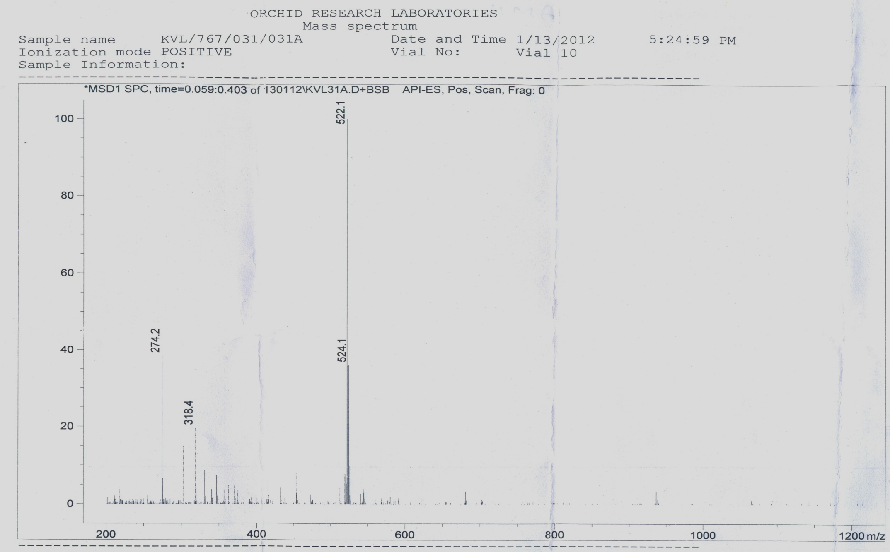
LC-Mass of 2-amino-10-chloro-4-(3,4-dimethoxyphenyl)-12-phenyl-5,6-dihydro-4H-pyrano[2,3-a]acridine-3-carbonitrile (3b)

Slide 13
Kamdar et al., 2011
Eshghi et al., 2011
HCOOH/reflux
NaN₃/DMF
SOCl₂/DMF
J Banothu et al., 2013
H₂NCHO/reflux
SOCl₂/AcOH
McCoy et al., 2010
N₂H₄ H₂O/ethanol
NH₂CONH₂/ethanol
NH₂CSNH₂/ ethanol
A. R. Saundane et al., 2013

Slide 14
Cytotoxicity study
Discovery of synthetic drugs with potential anti cancer activity is very initiative trend in various countries.
HeLa cell line is an immortal cell line used most commonly in medical research.
MTT assay is widely used to measure cell escalation and screening of anticancer drugs.
HDAC enzyme play crucial roles in various biological functions, including cell growth, differentiation, and apoptosis.
Recent studies have utilized HDACs as a promising target enzyme in anticancer drug development.

Slide 15
Cell viability under concentration of 25 μ/L of synthetic compounds, 3a-f.

Slide 16
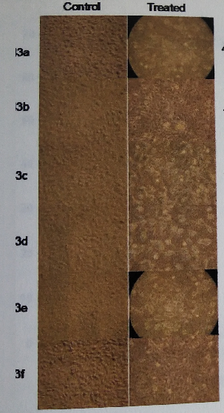
Dose-dependent inhibition of histone deacetylase enzyme activity by synthetic compounds (3a-f).

Slide 17
Future plan :Synthesis of pyrane derivatives, (4 a-e)
HCOOH/reflux
4 a
Pyrimidone
H₂NCHO
4 b
17

Slide 18
Conclusion
A series of novel Quinazalinone, Pyrimido, Pyrano compounds were synthesized.
All Synthesized derivatives were confirmed with FT-IR, ESI-MS, ¹H and ¹³C NMR spectroscopic techniques.
Cancer cell line studies, Apoptosis studies and HDAC enzymatic activities of synthesized derivatives were carried out.

Slide 19
References
Al-Omran, F.; Mohareb, R.M.; El-Khair, A.A. Molecules. 2011, 16, 6129-6147.
Bhattacharyya, P.; Pradhan, K.; Paul, S.; Das, A.R. Tetrahedron Lett. 2012, 53, 4687-4691.
Dokmanovic, M.; Clarke, C.; Marks, P.A. Mol. Cancer. Res. 2007, 5, 981-989.
Khan, A.T.; Lal, M.; Ali, S.; Khan, M.M. Tetrahedron Lett. 2011, 52, 5327-5332.
Lingaiah, B.P.V.; Reddy, G.V.; Yakaiah, T. Synth Commun. 2004, 34, 4431–4437.
Pandey, G.; Singh, R.P.; Gary, A.; Singh, V.K. Tetrahedron Lett. 2005, 46, 2137–2140.
Roopan, S.M.; Bharathi, A.; Palaniraja, J.; Anand, K.; Gengan, R.M. RSC Advances. 2015, 5, 38640-38645.
Williams, D.R.; Heidebrecht, R.W. J. Am. Chem. Soc. 2013, 125, 1843–1850.
Xu, W.; Huang, H.C.; Lin, C.J.; Jiang, Z.F. Bioorg. Med. Chem. Lett. 2010, 20, 3084-3088.
Yang, Y.; Haung, Y.; Qing, F.L. Tetrahedron Lett. 2013, 29, 3826-3830.
Zahonero, B.B.; Parra, M. Mol Oncol. 2012, 6, 579-589.
Roopan, S.M.; Bharathi, A.; Al-Dhabi, N.A.; Arasu, M.V.; Madhumitha, G. Sci Rep. 2017, 7, 39753.

Slide 20
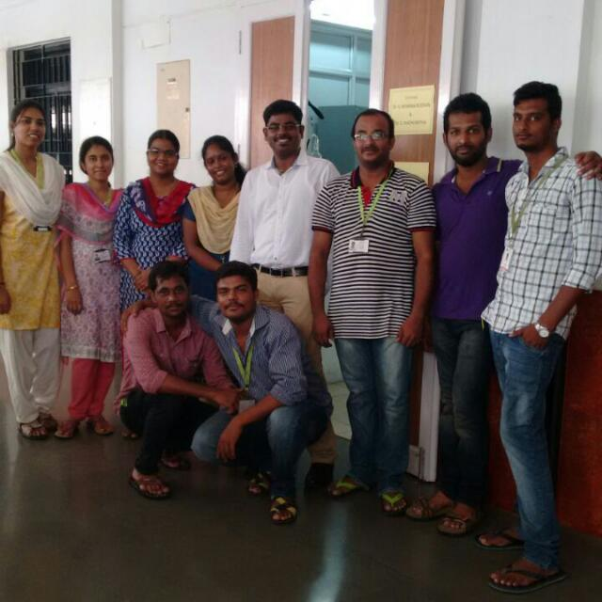
Acknowledgement
I would like to express my deepest thanks to my students for their support .

Slide 21
Thank you

