Slide 1
Fast tuning of topic models: an application of Rényi entropy and renormalization theory
Sergei Koltcov ^{1,}*, Vera Ignatenko ¹ and Sergei Pashakhin¹
¹ Internet Studies Lab, National Research University Higher School of Economics, 55/2 Sedova St., St. Petersburg, Russia, 192148.
* Corresponding author: skoltsov@hse.ru

Slide 2
Abstract
In practice, the critical step in build machine learning models of big data (BD) involves costly in terms of time and computing resources procedure of parameter tuning with grid search.
We have shown that topic modeling (a clustering method for large document collections) demonstrates self-similar behavior under the condition of a varying number of clusters. Such behavior allows using a renormalization technique.
A combination of renormalization procedure with Rényi entropy approach allows for fast searching of the optimal number of clusters.
In this work, the renormalization procedure is developed for the Latent Dirichlet Allocation (LDA) model with variational Expectation-Maximization algorithm.
The numerical experiments were conducted on two document collections with a known number of clusters in two languages.
This work presents results for three versions of the renormalization procedure: (1) a renormalization with the random merging of clusters, (2) a renormalization based on minimal values of Kullback-Leibler divergence and (3) a renormalization with merging clusters with minimal values of Rényi entropy.
Our work shows that the renormalization procedure allows finding the optimal number of topics 26 times faster than grid search without significant loss of quality.

Slide 3
Topic modeling
Topic modeling is based on the assumption that a document collection has a finite set of word distributions. Each such word distribution could be called a ‘topic’ or a thematical cluster. The probability of encountering a word w in a given document d is expressed as follows:
$$p\left(w | d\right)=\sum_{t}{p\left(w | t\right)p\left(t | d\right)=\sum_{t}{φ_{wt}θ_{td}},}$$
where t is a topic, $φ_{wt}$constitute matrix Φ (the distribution of words by topics), and $θ_{td}$form matrix Θ (the distribution of documents by topics).
We consider the Blei model [Blei, D.M.; Ng, A.Y.; Jordan, M.I.; 2003] of Latent Dirichlet Allocation with variational Expectation-Maximization algorithm, where the distribution of topics by documents is assumed to be Dirichlet distribution with T-dimensional parameter α (T is the number of topics).

Slide 4
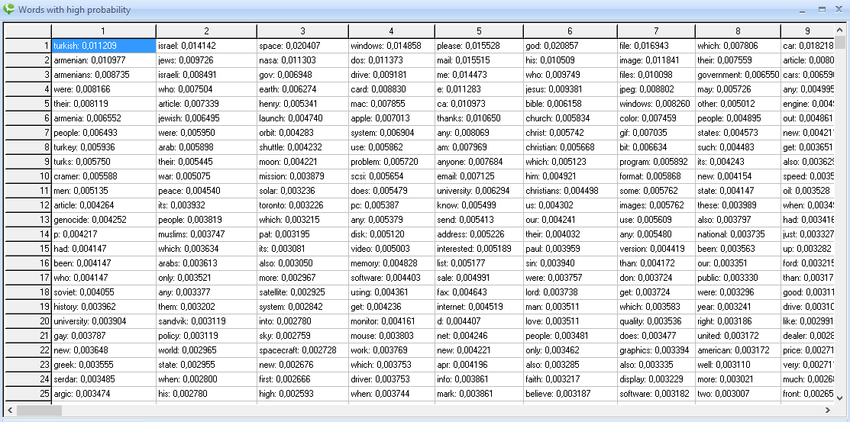
An example of matrix Φ (the distribution of words by topics)

Slide 5
An example of matrix Θ (the distribution of documents by topics)

Slide 6
Renyi entropy approach
The entropy approach to topic modeling (TM) tuning is based on computing Rényi entropy for each topic solution while varying the number of topics and hyperparameters [Koltcov, S.; 2018], [Koltsov S.; Ignatenko V.; Koltsova O;2019]. For TM, the Rényi entropy is expressed as follows:
$$S_{q}^{R}=\frac{\ln\left(Z_{q}\right)}{q−1}=\frac{qln\left(q \tilde{P}\right)+q^{−1}ln⁡(\tilde{ρ})}{q−1}$$
where q=1/T, T is the number of clusters or topics, $\tilde{ρ}=\frac{N}{WT}$is the density-of-states function, W is the number of unique words in the dataset, N is the number of words with high probability (i.e. with $φ_{wt}$>1/W),
$\tilde{P}=\frac{1}{T}{\sum_{wt}{φ}}_{wt}𝟙_{\{φ_{wt}−\frac{1}{W}\}}$is the sum of probabilities of all words with high probability, $𝟙_{\{x−y\}}=1$if $x≥y$ and $𝟙_{\{x−y\}}=0$if $x<y$.
It has been showed that the minimum point of Rényi entropy corresponds to the number of topics identified by human coders [Koltcov, S.; 2018]. Hence, the search for the $S_{q}^{R}$ minimum could substitute at least partly manual labor of marking up document collections, substantially simplifying TM tuning on uncoded datasets.

Slide 7
Renormalization
The algorithm of renormalization consists of the following steps:
We choose a pair of topics for merging according to one of the three possible criteria (they will be discussed further). Let us denote the chosen topics by $t_{1}$and $t_{2}$.
We merge the chosen topics. The word distribution of a ’new’ topic resulted from merging of $t_{1}$and $t_{2}$ is stored in column $φ_{∙t_{1}}$of matrix Φ:
$φ_{wt_{1}}≔φ_{wt_{1}}\exp\left(ψ\left(αt_{1}\right)\right)+$ $φ_{wt_{2}}\exp\left(ψ\left(αt_{2}\right)\right)$,
where $ψ$ is a digamma function. Then, we normalize the obtained column$φ_{∙t_{1}}$ so that $\sum_{t}{φ_{wt_{1}}=1}$ and recalculate $α_{t_{1}}≔α_{t_{1}}+α_{t_{2}}$. Then, we delete column $φ_{∙t_{2}}$from matrix Φ and element $α_{t_{2}}$from vector $α$. Further, vector $α$ is normalized so that $\sum_{t}{α_{t}=1}$. We have T−1 topics at the end of this step.
Since a new topic solution (matrix Φ) is formed in the previous step, we recalculate the global Rényi entropy for this solution.

Slide 8
Renormalization
Criteria of merging:
Merging of similar topics, where the similarity is estimated with symmetric Kullback-Leibler (Jensen-Shannon) divergence, and the topic pair is chosen based on the minimal value computed pairwisely.
Merging based on the minimum of Rényi entropy, where the topics with local minima values are summed together. Here local Rényi entropy is computed for a single topic.
Merging randomly selected columns.

Slide 9
Datasets
Dataset in Russian (Lenta.ru). This dataset contains news articles in the Russian language where each news item was manually assigned to one of ten topic classes by the dataset provider [https://www.kaggle.com/yutkin/corpus-of-russian-news-articles-from-lenta]. However, as some of these topics could be considered folded or correlated, this dataset could be represented by 7--10 topics. We considered a class-balanced subset of this dataset, which consisted of 8,624 news texts (containing 23,297 unique words).
Dataset in English (20 Newsgroups dataset [http://qwone.com/~jason/20Newsgroups/]). This well-known dataset contains articles assigned by users to one of 20 newsgroups. Since some of these topics can be unified, this document collection can be represented by 14-20 topics [Basu, S.; Davidson, I.; Wagstaff, K. , 2008]. The dataset is composed of 15,404 documents with 50,948 unique words.

Slide 10
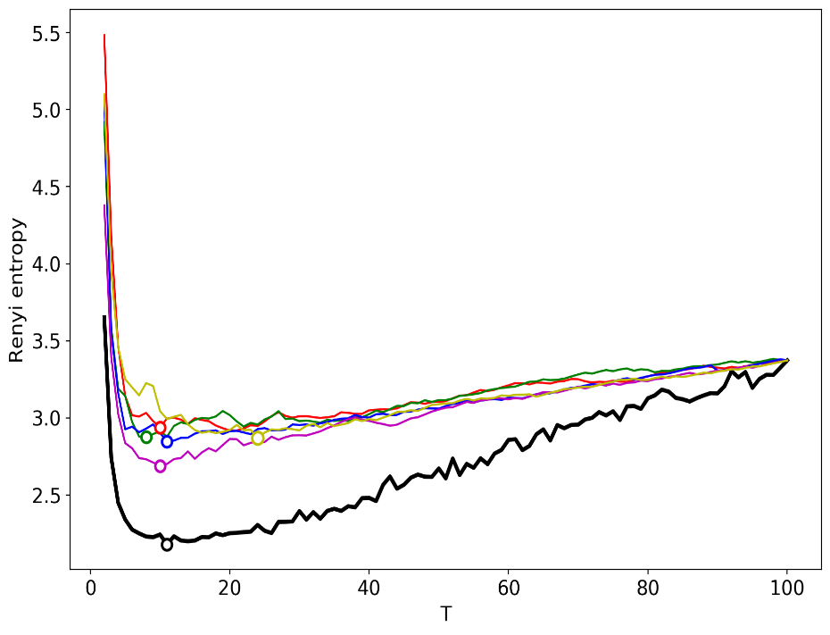
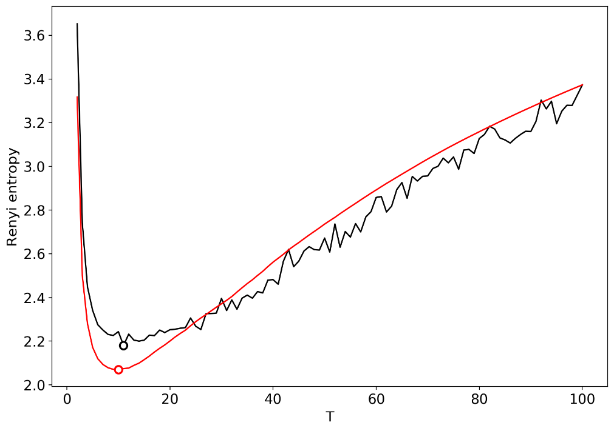
Numerical experiments
Results for the dataset in Russian.
Fig. 1. Rényi entropy curves. Black: successive topic modeling. Other colors: renormalization with the random merging of topics.
Fig. 2. Rényi entropy curves. Black: successive topic modeling; red is renormalization with
minimum local entropy merging.

Slide 11
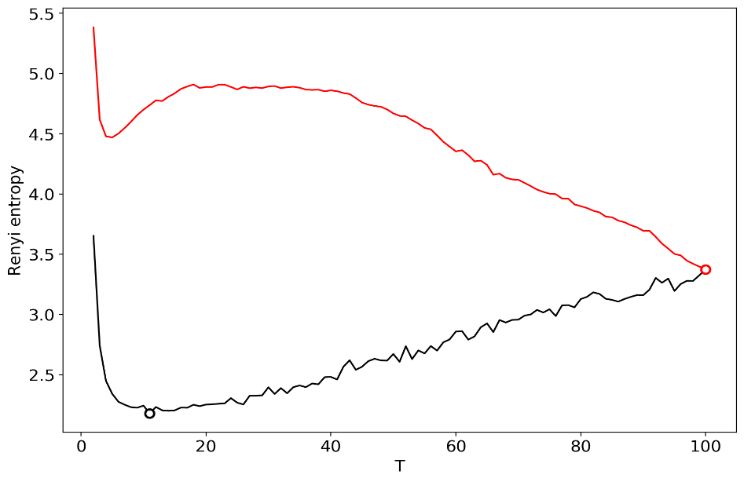
Numerical experiments
Results for the dataset in Russian.
Fig. 3 Rényi entropy curves. Black: successive topic modeling. Red: renormalization with minimum KL divergence principle of merging.

Slide 12
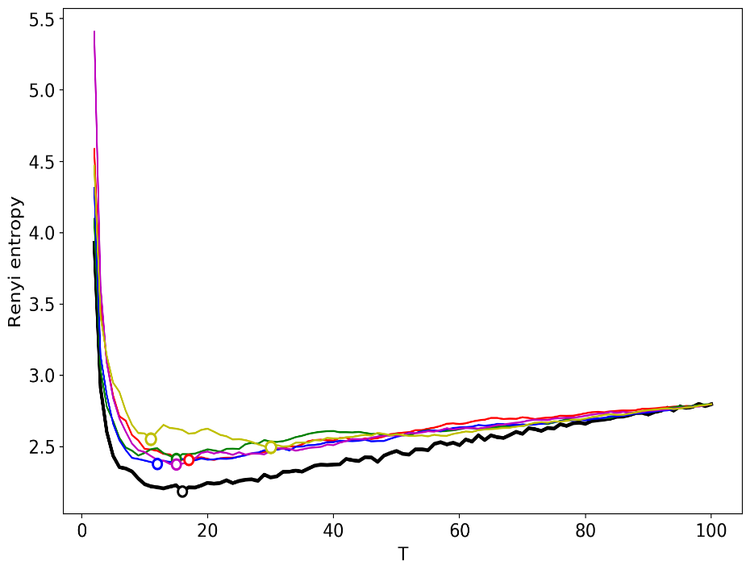
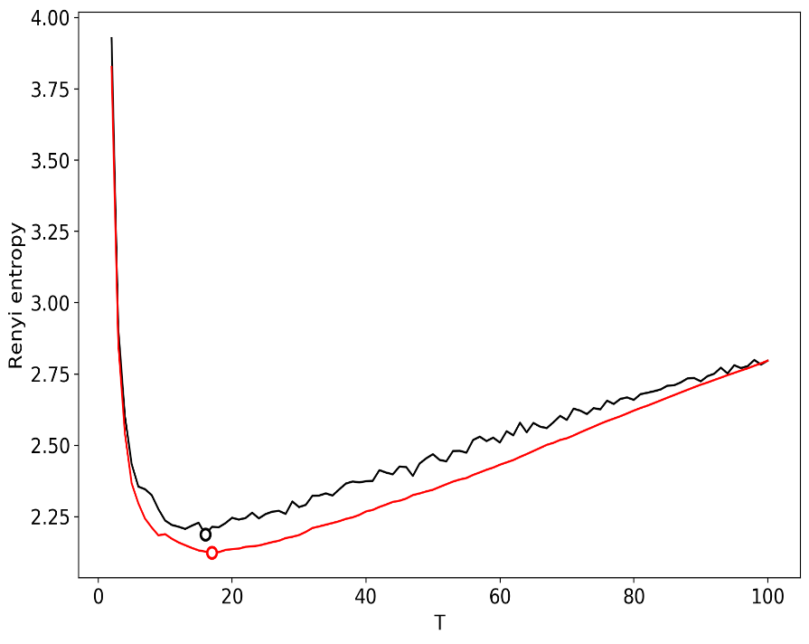
Numerical experiments
Results for the dataset in English.
Fig. 4. Rényi entropy curves. Black: successive topic modeling. Other colors: renormalization with the random merging of topics.
Fig. 5. Rényi entropy curves. Black: successive topic modeling; red is renormalization with
minimum local entropy merging.

Slide 13
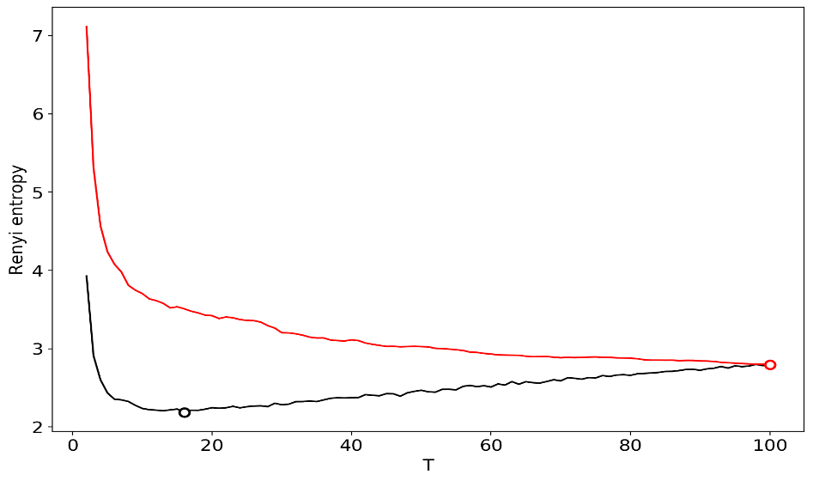
Numerical experiments
Results for the dataset in English.
Fig. 3 Rényi entropy curves. Black: successive topic modeling. Red: renormalization with minimum KL divergence principle of merging.

Slide 14
Computational speed
Dataset | Successive TM Simulation | Renormalization (random) | Renormalization (minimum Rényi entropy) | Renormalization (minimum Kullback-Leibler divergence)
Russian dataset | 780 min | 1 min | 1 min | 4 min
English dataset | 1320 min | 3 min | 3 min | 10 min
The first column corresponds to successive runs of topic modeling for T= [2, 100] in the increments of one topic. Calculation of a single topic solution on 100 topics takes 26 min for the dataset in Russian and 40 min for the dataset in English. One can see that renormalization provides significant gain in time that is essential when dealing with big data.

Slide 15
Results and Discussion
We demonstrated that renormalization based on merging of topics with minimum local Rényi entropy provides the best result in terms of accuracy and computational speed simultaneously. It was shown that for this type of renormalization, the global minimum point of Rényi entropy is almost equal (with an accuracy of ±1 topic) to the minimum point of Rényi entropy calculated according to successive topic modeling.
Renormalization with the merging of random topics also leads to satisfactory results; however, it requires multiple runs and subsequent averaging over all runs.
Renormalization based on minimum Kullback-Leibler divergence does not allow us to determine the optimal number of topics since there is no definite minimum of Rényi entropy.

Slide 16
Results and Discussion
Let us note that renormalization is applicable to datasets in different languages and with a different number of topics in the collections.
Application of renormalization allows us to speed up the searching of the optimal number of topics, at least in 26 times.
The proposed renormalization approach could be adapted for other topic models including models with a sampling procedure of inference.
Furthermore, our renormalization approach can be adapted for simultaneous estimation of the number of topics and fast tuning of other hyper-parameters of topic models, including regularization parameters.

Slide 17
Supplementary Materials
Samples of topic solutions and the source code of three types of renormalization are available online: https://www.sendspace.com/file/7pzm3j
Funding
The study was implemented in the framework of the Basic Research Program at the National Research University Higher School of Economics (HSE) in 2019.

