Slide 1
Photochemical dissipative structuring of the fundamental molecules of life
Karo Michaelian ^{1,}*
¹ Department of Nuclear Physics and Application of Radiation, Instituto de Física, Universidad Nacional Autónoma de México, Circuito Interior de la Investigación Científica, Cuidad Universitaria, México D.F., Mexico, C.P. 04510.
* Corresponding author: karo@fisica.unam.mx

Slide 2
Abstract: It has been conjectured that the origin of the fundamental molecules of life, their proliferation over the surface of Earth, and their complexation through time, are examples of photochemical dissipative structuring, dissipative proliferation, and dissipative selection, respectively, arising out of the non-equilibrium conditions created on Earth's surface by the solar photon spectrum. Here I describe the non-equilibrium thermodynamics and the photochemical mechanisms involved in the synthesis and evolution of the fundamental molecules of life from simpler more common precursor molecules under the long wavelength UVC and UVB solar photons prevailing at Earth's surface during the Archean. Dissipative structuring through photochemical mechanisms leads to carbon based UVC pigments with peaked conical intersections which endow them with a large photon disipative capacity (broad wavelength absorption and rapid radiationless dexcitation). Dissipative proliferation occurs when the photochemical dissipative structuring becomes autocatalytic. Dissipative selection arises when fluctuations lead the system to new stationary states (corresponding to different molecular concentration profiles) of greater dissipative capacity as predicted by the universal evolution criterion of non-equilibrium thermodynamics established by Onsager, Glansdorff, and Prigogine. An example of the UV photochemical dissipative structuring, proliferation, and selection of the nucleobase adenine from an aqueous solution of HCN under UVC light is given.
Keywords: origin of life; disspative structuring; prebiotic chemistry; adenine

Slide 3
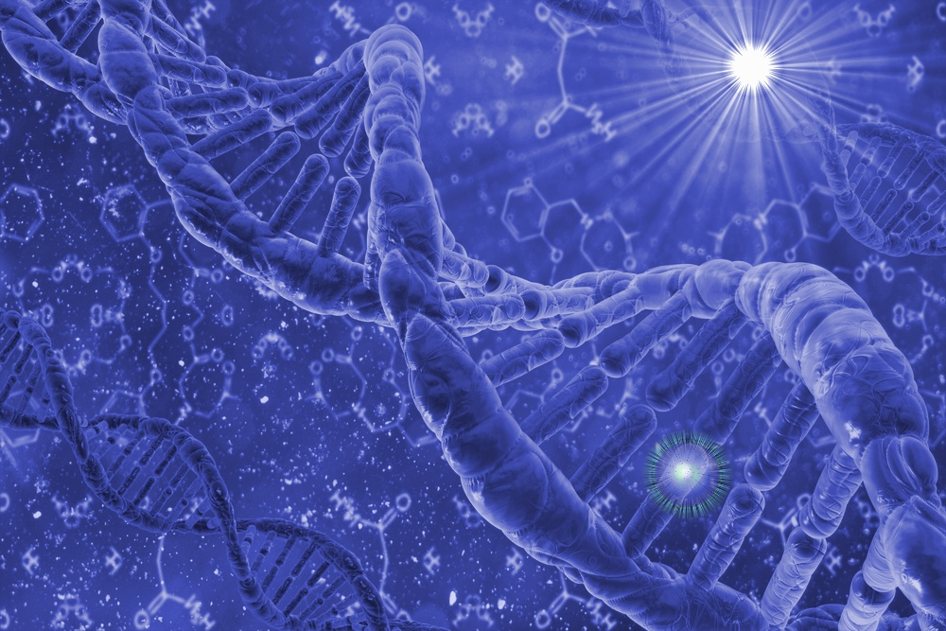
Thermodynamic Dissipation Theory
of the Origin and Evolution of Life
Life´s Function;
Sunlight --> Heat
1. Dissipative
Structuring
2. Dissipative
Proliferation
3. Dissipative
Selection
Michaelian, K., Thermodynamic Origin of Life, Cornell ArXivv, arXiv:0907.0042 [physics.gen-ph] 2009.
Michaelian, K., Thermodynamic Dissipation Theory for the Origin of Life, Earth Syst. Dynam., 2 (2011) 37-51.

Slide 4
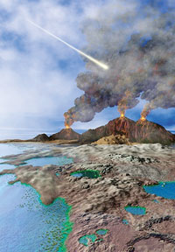
Physical Conditions at Life’s Origin (Sunlight?)
3,850,000,000 years ago
Vulcanos H₂S, H₂O, CO₂
Hot seas, 85°C
Atmosphere;
N₂, CO₂, H₂O, CH₄, H₂
No O₂, no O₃
UV light intense
Solar spectrum?

Slide 5
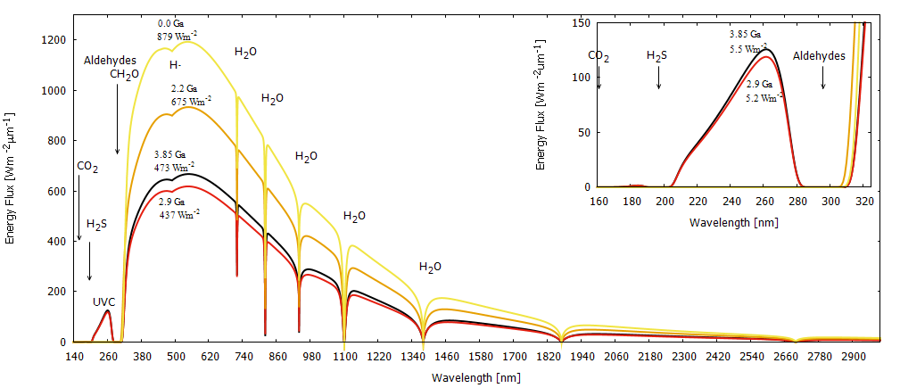
Solar Spectrum, Earth’s Surface
Sun Through Time
Atmosphere extinction,
(abs., scat. ) P=2 atm.
N₂
CO₂
H₂O
H₂S
CH₄
Aldehydes; CH₂O
O₂, O₃ >2.8 Ga
scattering
haze formation <2.8 Ga
M-UVC
L-UVC
Michaelian, K. and Simeonov, A., Biogeosciences 12, 4913—4937 (2015).

Slide 6
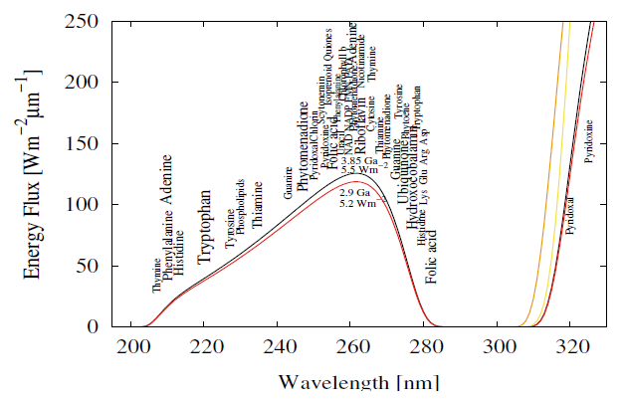
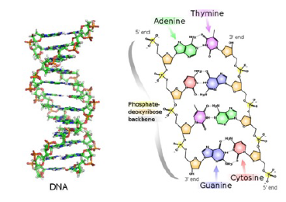
Nucleic acids, amino acids, fatty acids, coemzymes, are UV-C Pigments
Michaelian, K. and Simeonov, A., Biogeosciences 12, 4913—4937 (2015).

Slide 7
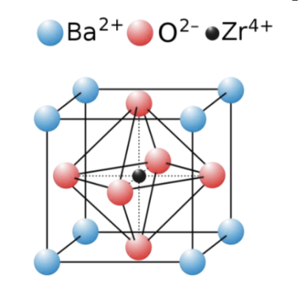
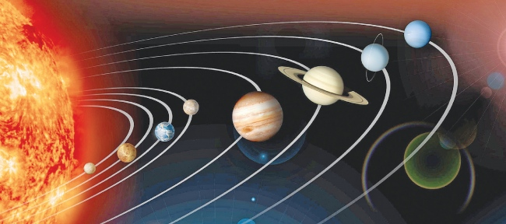
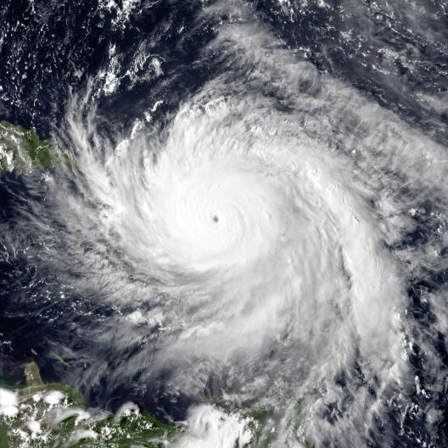
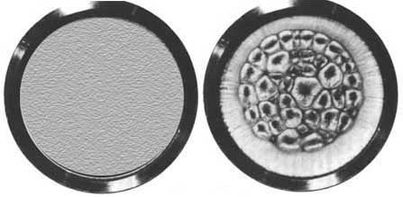
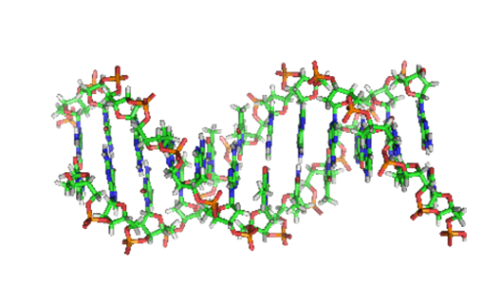
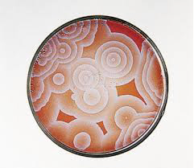
Dissipative Structuring
Two classes of structures;
1) Equilibrium – minimization of Gibb’s potential
2) Non-equilibrium – optimization of dissipation
Conjecture
Michaelian, K. Earth Sys. Dyn. 2011

Slide 8
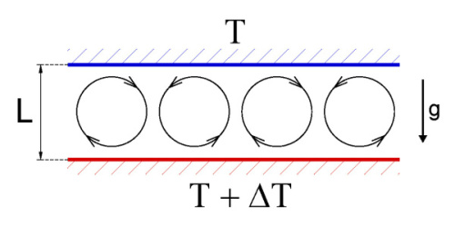
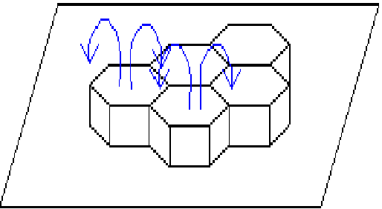
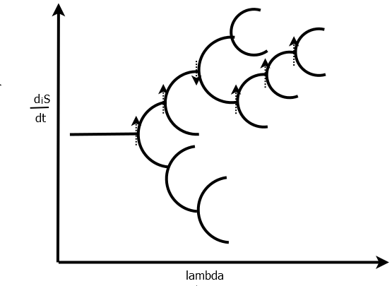
Dissipative Structuring
Macroscopic – coordinate degrees of freedom, e.g. Bénard Cell
Non-linear relation; X, J

Slide 9
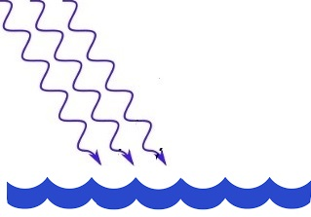
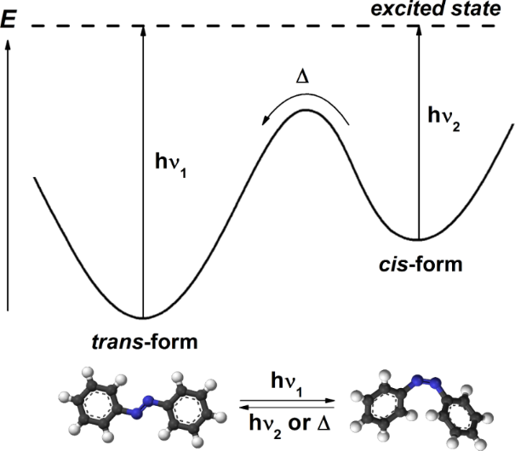
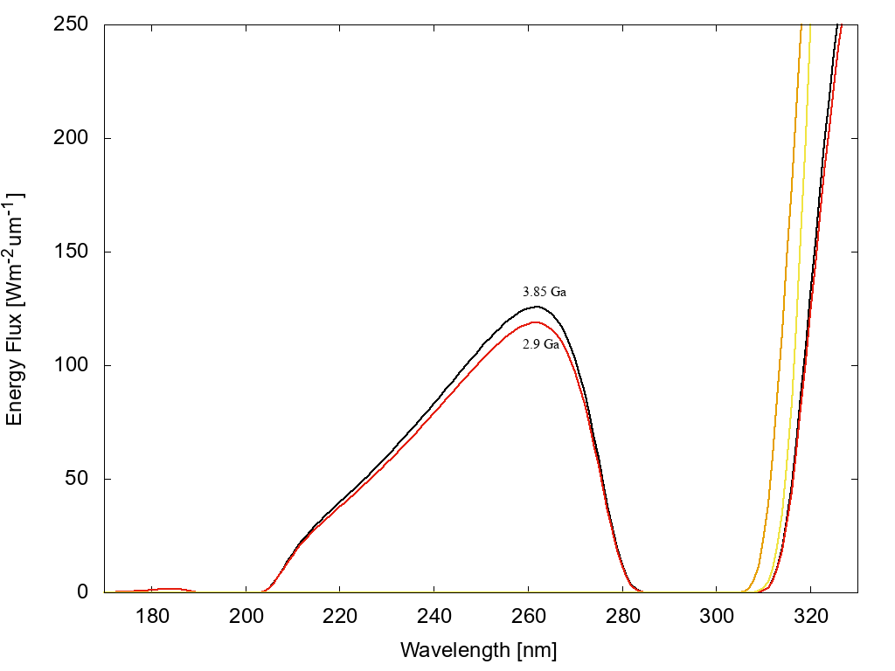
Microscopic Dissipative Structuring
Microscopic – molecular degrees of freedom
-- isomerizations, tautomerizations, rotations around bonds, charge transfer, exciplex formation, etc. (molecular reconfigurations)
UVC
e.g. Adenine (Ferris and Orgel, 1966)
Boulanger et al., Angew. Chem. Int. Ed. 2013, 52, 8000
Reactions can go “up hill” in energy or
“down hill” in entropy
Structuring to dissipate photon potential.
Michaelian, K., Microscopic Dissipative
Structuring and Proliferation at the Origin
Of Life, Heliyon, 3 e00424 (2017)
7
8
4
2
3

Slide 10
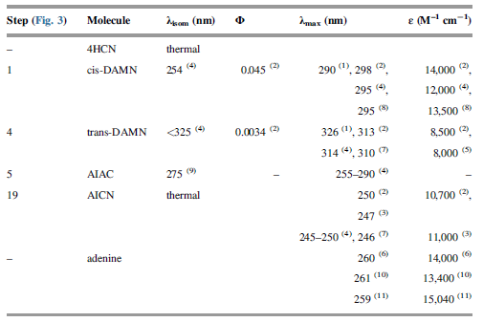
1
2
7
8
4
2
3
4
7
8

Slide 11
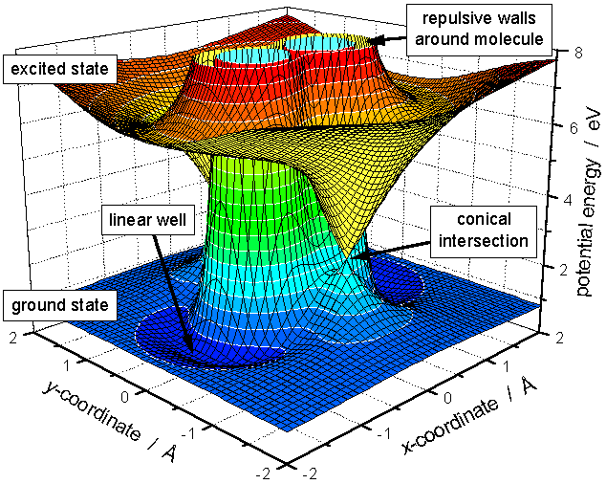
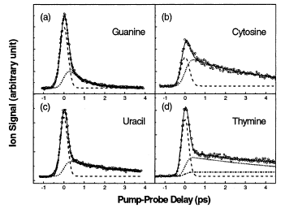
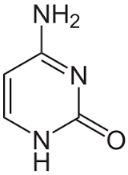
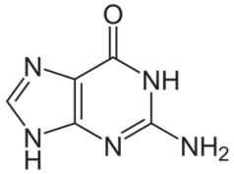
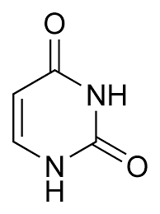
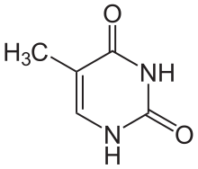
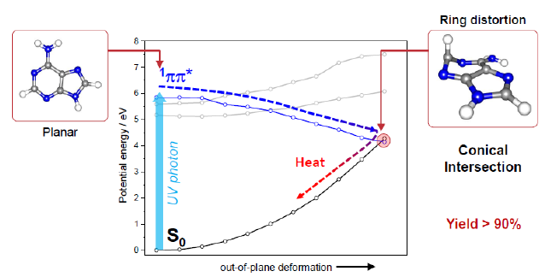
Rapid UV-C Dissipation RNA/DNA
Conical Intersection
Canuel et al., J. Chem. Phys. 122, 074316 (2005)
Kang et al., JACS 124, 12958-12959 (2002)
RNA/DNA bases extremely rapid dissipators
RNA/DNA resistant to destruction by UV light
Kleinermanns et al., Int. Rev. Phys. Chem. 32, 308 (2013)
Barbatti et al., PNAS 107, 21453 (2010)

Slide 12
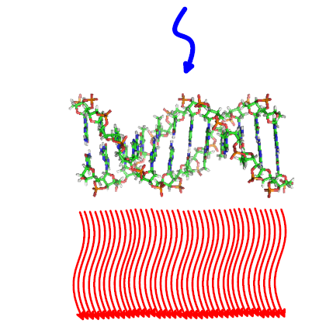
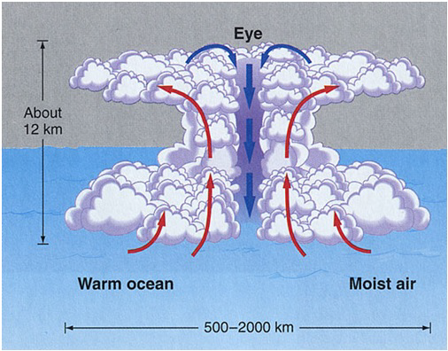
Dissipation RNA and DNA are Excellent Dissipative Structures
10⁻¹² s
Microscopic, UVC
Macroscopic, Infrared

Slide 13
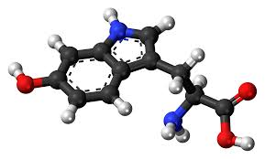
Resonant Energy Transfer
Not all fundamental molecules have a conical intersection
DNA + L-Tryptophan
Donor
Tryptophan
Aceptor
DNA
Tryptophan has affinity to DNA codon. Complex is greater dissipating system.
Evolution => Complexation => Greater dissipation

Slide 14
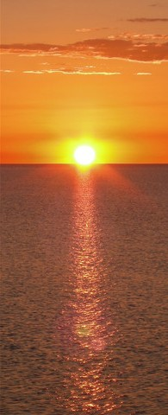
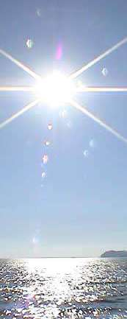
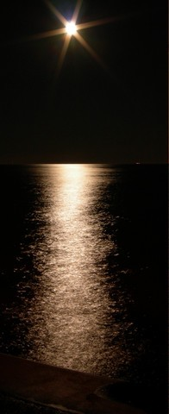
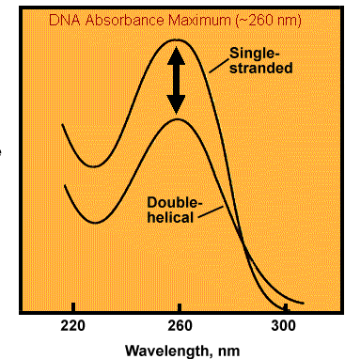
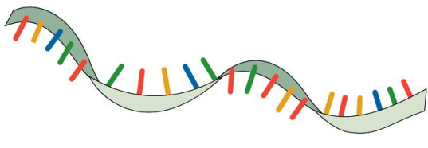
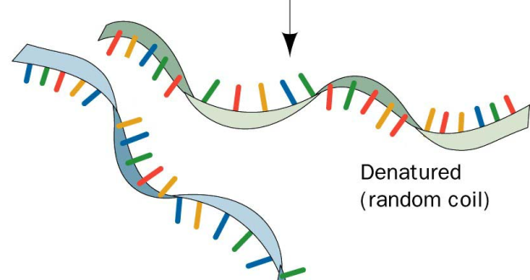
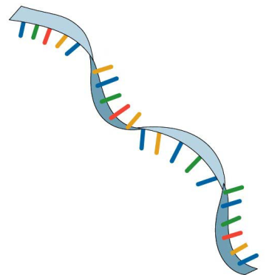
Dissipative Proliferation of RNA/DNA (enzymeless) UV and Temperature Assisted Reproduction (UVTAR)
Ocean temp < 85°C
hyperchromism
Michaelian, Earth Syst. Dynam. 2, 37–51 (2011)
Template directed autocatalytic photochemical reaction
Replication tied to photon dissipation – entropy production.

Slide 15
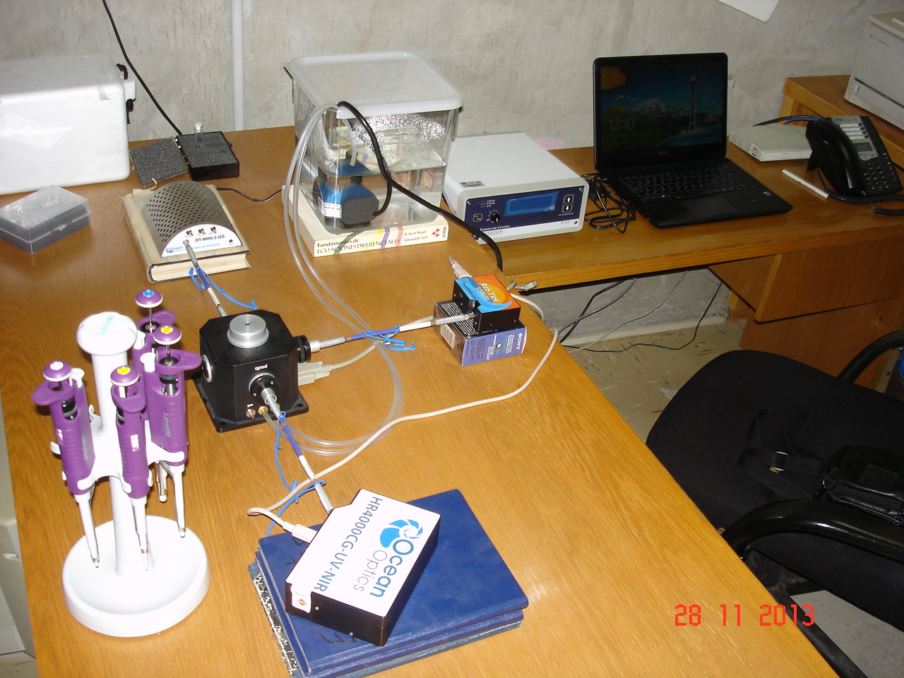
Experiment

Slide 16
Absorption Spectrum DNA
Hyperchromism
Michaelian, K. and Santillán Padilla, N., Heliyon 5, e01902 (2019).

Slide 17
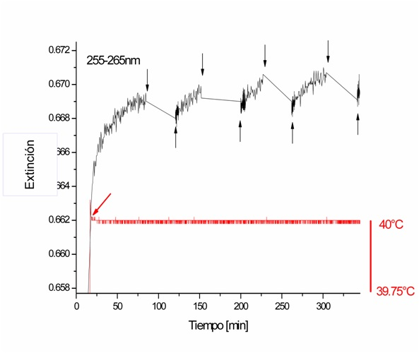
Expt.--UVC Light-induced Denaturing
Salmon Sperm DNA
25 bp DNA
Michaelian, K. and Santillán Padilla, N., Heliyon 5, e01902 (2019).

Slide 18
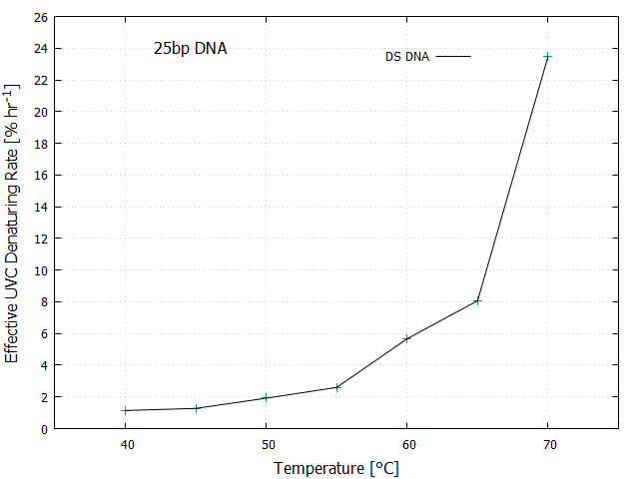
Temperature Dependence of UVC Light-induced Denaturing
Michaelian, K. and Santillán Padilla, N., Heliyon 5, e01902 (2019).

Slide 19
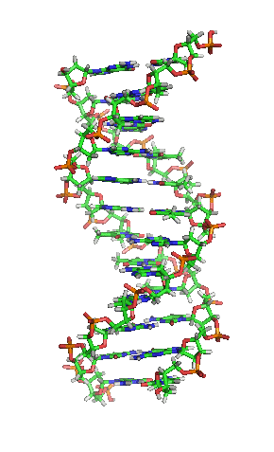
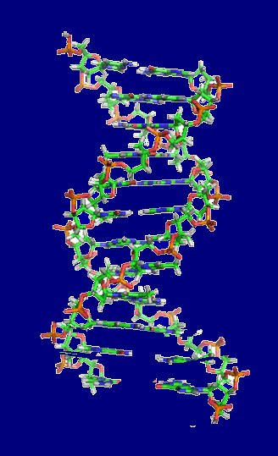
UVC –induced Denaturing

Slide 20
Dissipative Selection
Non-linear relation; X, J
Universal Evolution Criterion
Glansdorff-Prigogine Criterion
For autocatalytic chemical reactions

Slide 21
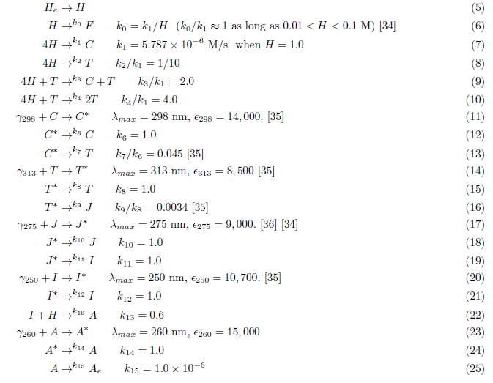

Slide 22
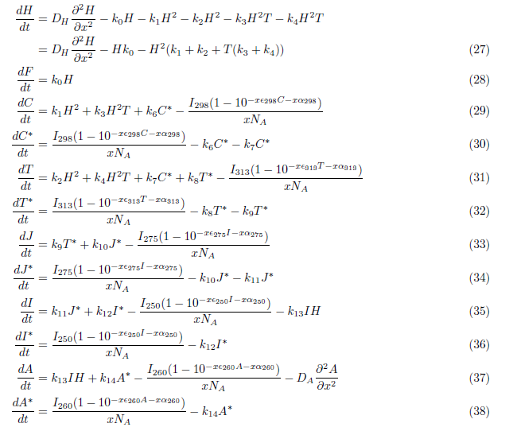

Slide 28
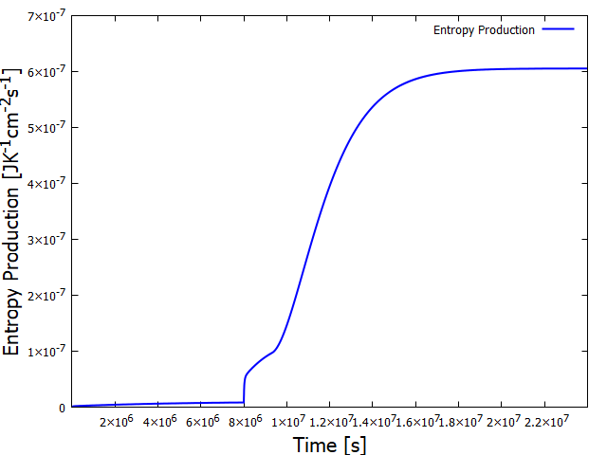
Conclusions
Life’s function
Sunlight → Heat (dissipation)
Dissipative
Structuring
Dissipative
Proliferation
UVTAR
Dissipative
Selection
Necessary and sufficient elements
for explaining origin and evolution
of life
Karo Michaelian, Inst. Física, UNAM

Slide 29
Participants
Colaborators
Oliver Manuel --- U. Missouri, US
Alex Simenov -- Cyril and Methodius University, Macedonia
José Manuel Nieto – U. of Havana, Cuba
Students
Vasthi Alonso Chávez Zulema Armas Vazquez Iván Lechuga Jiménez
Julián González González Jorge Arroyo Leonor
Noemí Hernández Carmona Julián Mejía Morales
Paty Jácome Paz Adriana Reyna Lara
Jessica Gatica Martínez Eduardo Cano Mateo
Norberto Santillán Padilla Oscar Rodríguez Reza
Projects DGAPA-PAPIIT
DGAPA-UNAM IN-118206, June, 2005.
2. DGAPA-UNAM IN-112809, January 2009.
3. DGAPA-UNAM IN-103113, January 2013.
DGAPA-UNAM IN-102316, January 2016.
DGAPA-UNAM IN-104920, January, 2020.

Slide 30
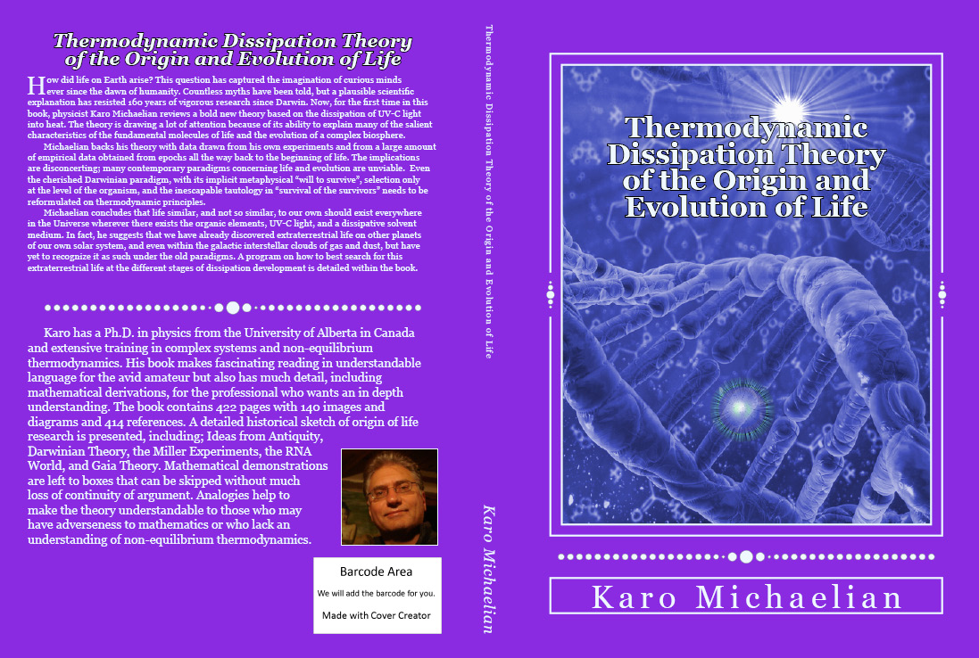
Book available;
ebook, ẞ-version- ResearchGate DOI: 10.13140/RG.2.1.3222.7443

