Slide 1
A THERMAL SENSOR-BASED DECISION SUPPORT SYSTEM FOR THE IDENTIFICATION OF ROOF LEAKS AND CRACKS
Dr. A. Paramasivam¹ & Dr. K. Kamalanand²
¹Department of Electrical and Electronics Engineering, B.S.Abdur Rahman Crescent Institute of Science and Technology, Chennai 600048.
²Department of Instrumentation Engineering, MIT Campus, Anna University, Chennai 600044.

Slide 2
OUTLINE
Introduction
Literature Survey
Objectives
Methodology
Results and Discussion
Summary and Conclusions
References

Slide 3
INTRODUCTION
Recent years, the majority of the commercial buildings in developing countries like India, Pakistan, Bangladesh etc. are constructed with cement material.
Due to the climatic changes, the cracks and leaks in the roofs/walls are very common since the walls are subjected to several seasons. So, it is mandatory to identify the leaks and cracks of walls at the initial stage to minimize severe effects.
The early detection of leaks and cracks avoids various drawbacks such as structural damage, repair cost etc.
In many cases, the paint coating hides the cracks of walls which is occurred internally leads to leaks at later stages. These internal cracks cannot be visualized by normal sights results in development of assistance systems.

Slide 4
A BRIEF SURVEY OF LITERATURE
An automated decision support system has increased significantly over the past few years and algorithms such as Naive Bayes classifier, support vector machines, artificial neural networks, etc. are widely used techniques in approaching the decision support problem.
Maniruzzaman et al. (2017) have adapted Gaussian Process based classification technique using three kernels such as linear, polynomial and radial basis kernel to classify diabetes. Further, the authors have investigated the performance of a GP-based classification technique in comparison to existing techniques such as Linear Discriminant Analysis (LDA), Quadratic Discriminant Analysis (QDA), and Naïve Bayes (NB).
Nikam (2015) have discussed the various classification algorithms such as K-Nearest Neighbor, Naïve Bayes, SVM and ANN along with their features and limitations.

Slide 5
OBJECTIVE
The objective of this work is to develop an automated decision support system to identify the leaks and cracks in walls of buildings.

Slide 6
METHODOLOGY

Slide 7
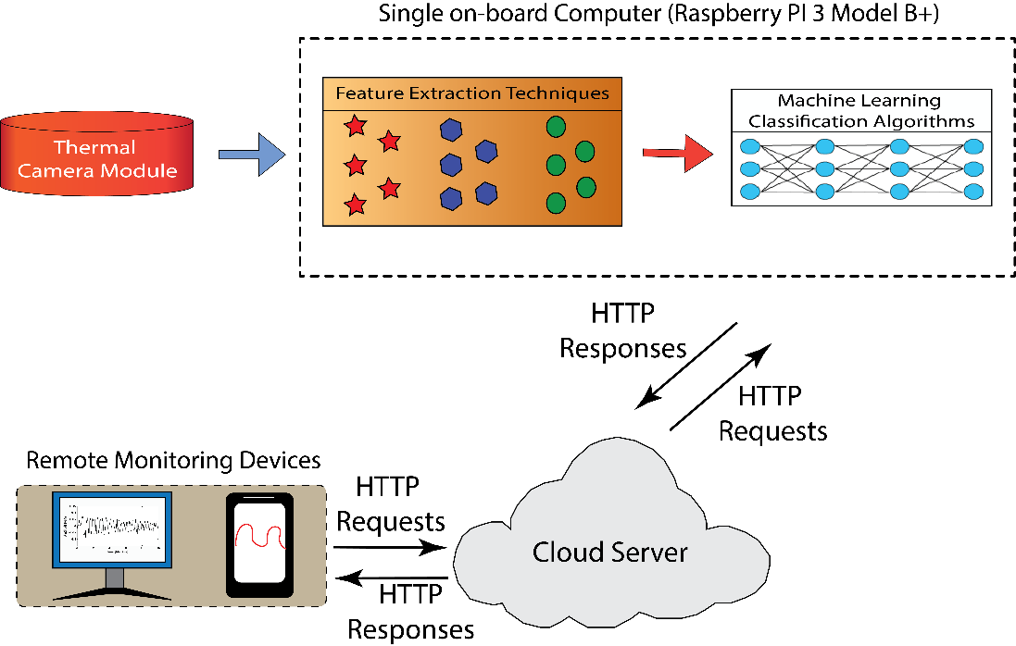
DESIGN OF DECISION SUPPORT SYSTEM

Slide 8
FEATURE EXTRACTION TECHNIQUES
Image Entropy is a
scalar value which represents the entropy of grayscale image.
measure of the disorder or randomness that can be used to characterize the texture of the input image.
Image entropy is expressed by an equation:
where, P_{i} is the probability that the difference between two adjacent pixels is equal to i, and log₂ is the base 2 logarithm.
The GLCM Energy is a sum of squared elements in the GLCM matrix.

Slide 9
SUPPORT VECTOR MACHINE CLASSIFIER
The proposed research work is a two-class binary classification problem, the adopted SVM classifier finds the most effective hyperplane which is a classification line and divides all input samples into two classes.
The input samples nearest to the classification line are called support vectors. The training set of the SVM classifier is expressed as
The classification line is derived as:
where, n is a sample vector represented to a high dimensional space, z is the class label of X. Further, the SVM classifier estimates and obtains the equation of classification line with the help of w and a parameters.

Slide 10
SUPPORT VECTOR MACHINE CLASSIFIER
SVM classifier has different kernel functions such as
Linear,
Gaussian,
Polynomial etc. which can be assigned for the decision function.
The kernel functions are used to construct optimal hyperplane in the new high dimensional feature space. The Linear SVM (LSVM) maps the non-linear input space into the new linearly separable space and it can be expressed as,
where, x_{i} and x_{j} are the input feature vectors. Further, the optimal separating hyperplane is constructed and all the vectors lying on one side of the hyperplane are labeled as -1, and all vectors lying on another side are labeled as +1

Slide 11
RESULTS AND DISCUSSION

Slide 12
ACQUIRED IMAGES USING THERMAL CAMERA
(a) (b)
Typical image acquired using thermal camera (a) with leak (b) without leak.
The 100 train images with and without leaks were acquired with thermal camera module at different locations were utilized to train SVM classifiers.
Also, 50 test images were acquired using thermal camera module, in which 25 images were with leaks and 25 images were without leaks.

Slide 13
PERFORMANCE OF SVM CLASSIFIERS
It is seen that the accuracy and sensitivity of SVM classifier with polynomial kernel is higher when compared to the other SVM kernels.
Also, it is observed that the SVM classifier with Gaussian kernel has very good sensitivity (91.6%) almost similar to the SVM classifier with Polynomial kernel.
It is seen that the accuracy and sensitivity of the adopted SVM classifier with polynomial kernel (order = 8) is 94% and 92% respectively. Also, it is observed that the performance of an SVM classifier can be improved by increasing various train images.
Therefore, the SVM classifier with Polynomial kernel is utilized to design an automated decision support system since it has good performance measures when compare to other SVM classifiers.

Slide 14
CONCLUSION
In this work, a decision support system was developed to the identify leaks and cracks in walls of buildings. The images of walls with and without leaks/cracks were acquired using thermal camera module.
Further, the informative features namely Image Entropy and GLCM Energy was extracted from the acquired thermal images and was utilized to develop efficient classification systems.
Also, the supervised learning-based Support Vector Machine (SVM) with three different kernels such as Linear, Gaussian and Polynomial (order=8) were used for the classification of images with and without leaks/cracks.
Results demonstrate that the SVM classifier with Polynomial kernel is good when compared to SVM with Linear and Gaussian kernels. It is observed that the accuracy and sensitivity of SVM classifier with Polynomial kernel is 94% and 92% respectively.
Therefore, the SVM classifier with Polynomial kernel was adopted as decision support system for the classification of leaks/cracks in walls of buildings.

Slide 15
REFERENCES
Maniruzzaman, M, Kumar, N, Abedin, MM, Islam, MS, Suri, HS, El-Baz, A S & Suri, JS 2017, ‘Comparative approaches for classification of diabetes mellitus data: Machine learning paradigm’, Computer Methods and Programs in Biomedicine, vol. 152, pp. 23-34.
Nikam, S. S. (2015). A comparative study of classification techniques in data mining algorithms. Oriental journal of computer science & technology, 8(1), 13-19.
Sung, K. K., &Poggio, T. (1998). Example-based learning for view-based human face detection. IEEE Transactions on pattern analysis and machine intelligence, 20(1), 39-51.
Dollar, P., Wojek, C., Schiele, B., &Perona, P. (2012). Pedestrian detection: An evaluation of the state of the art. IEEE transactions on pattern analysis and machine intelligence, 34(4), 743-761.
Wacker, M., & Witte, H. “Time-frequency techniques in biomedical signal analysis.” Methods of Information in Medicine, 52(4), (2013): 279-296.
Viertiö‐Oja, H., Maja, V., Särkelä, M., Talja, P., Tenkanen, N., Tolvanen‐Laakso, H., & Meriläinen, P. “Description of the Entropy™ algorithm as applied in the Datex‐Ohmeda S/5™ Entropy Module.” Acta Anaesthesiologica Scandinavica, 48(2), (2004): 154-161.

Slide 16
REFERENCES
Ekštein, K., & Pavelka, T. “Entropy and entropy-based features in signal processing.” In Proceedings of PhD workshop systems & control, (2004).
Panek, D., Kropik, P., & Predota, A. “On fractal dimension estimation.” Przeglad Elektrotechniczny (Electrical Review), 5, (2011): 120-122.
Boser, B et al. 1992, ‘A training algorithm for optimal margin classifiers’, In Proceedings of the fifth annual workshop on Computational learning theory, ACM, pp. 144-152.
Onay, A, Onay, M & Abul, O 2017, ‘Classification of nervous system withdrawn & approved drugs with ToxPrint features via machine learning strategies’, Computer Methods and Programs in Biomedicine, vol. 142, pp. 9-19.
Huang, MW, Chen, CW, Lin, WC, Ke, SW & Tsai, CF 2017, ‘SVM and SVM ensembles in breast cancer prediction’, PloS one, vol. 12, no. 1, pp. e0161501.
Lee, G, Gurm, HS & Syed, Z 2013, ‘Predicting complications of percutaneous coronary intervention using a novel support vector method’, Journal of the American Medical Informatics Association, vol. 20, no. 4, pp. 778-786.

Slide 17
THANK YOU

