Slide 1

Full-Scale Experiments for Development and Validation of a Robust Damage Detection Tool
Emmanuel Akintunde, Saeed Eftekhar Azam, Ahmed Rageh, Daniel Linzell
Department of Civil Engineering, University of Nebraska – Lincoln, Lincoln (NE), USA

Slide 2

Problem Statement
Aging Infrastructure, climate change, and increased traffic load motivates monitoring of infrastructure health
Visual Inspection considered inefficient
Necessity for smart monitoring of structural condition

Slide 3
Objective
Develop and validate damage feature that is :
Independent of traffic load
Independent of speed
Robust to measurement noise

Slide 4
Framework
Unsupervised Machine Learning:
Novelty detection
Damage features: Principal Component Analysis (PCA) as Proper Orthogonal Decomposition (POD) and Independent Component Analysis (ICA)
Strain measurements
Full-scale experiments for validation

Slide 5
Procedure:
Establish the damage feature mean for health bridge condition, then in the future:
Record bridge response to each vehicle in snapshot matrices
Calculate Independent Component Modes (ICMs) and/or Principal Component Modes (POMs) which are in this case Principal Component Modes (PCMs) of each snapshot matrix
Calculate the novelty index as Euclidean norm of deviation of ICMs or PCMs from healthy bridge state
Send an alarm if the deviation is outside its “normal” range

Slide 6
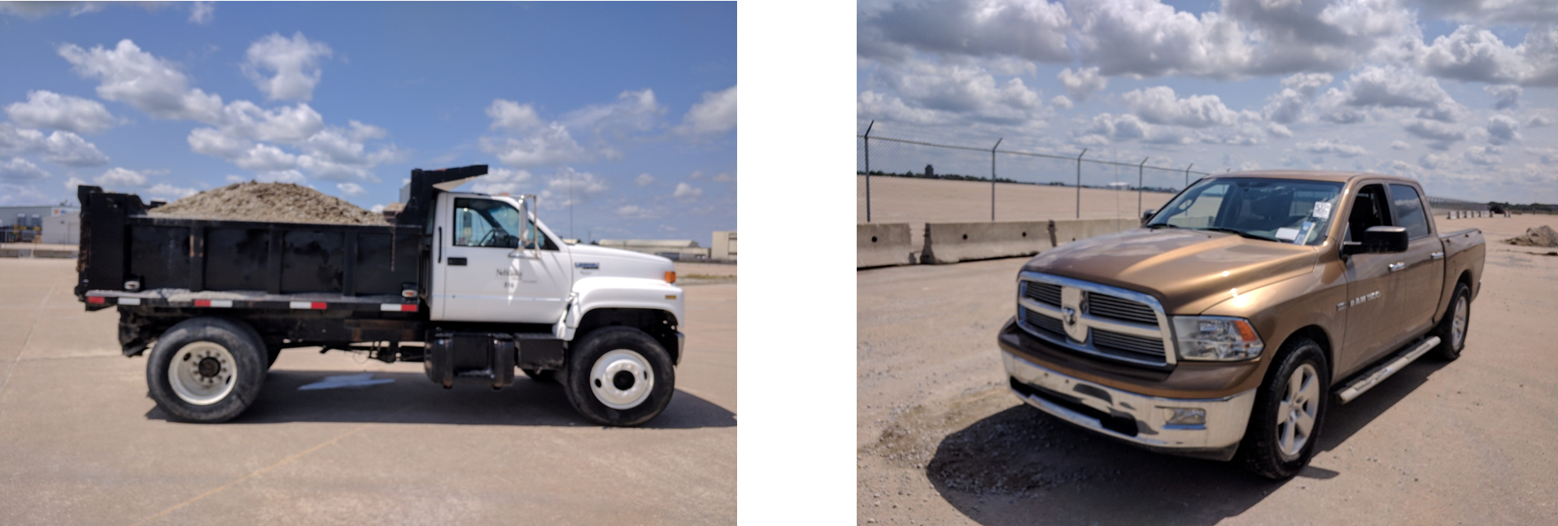
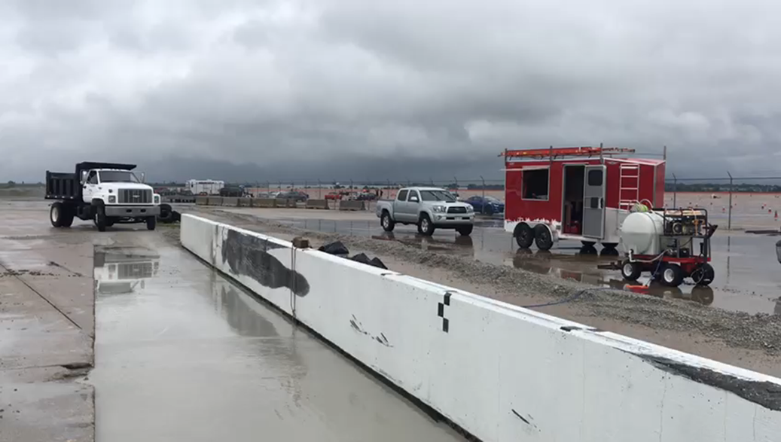
Test Overview
Vehicle/Load Specifications
Dump Truck (Empty and Filled)
Pickup Truck (5, 10 and 15mph)
Bridge State Specifications
Healthy Bridge (D#0)
Crash-Induced Damage (D#1)
Guard Rail Damage (D#2)
Slab Deck Damage (D#3)

Slide 7
Test Overview (Cont’d)
Vehicle/Load Specifications | Number of Vehicle Passages for each Damage State
 | Healthy Bridge | Bridge After Impact | Guard Rail Damage | Complete Slab Damage
Empty Dump Truck | 24 | 22 | 24 | 24
Filled Dump Truck | 22 | 22 | 23 | 23
Small Truck @ 05 mph | 11 | 11 | 13 | 13
Small Truck @ 10 mph | 11 | 13 | 13 | 13
Small Truck @ 15mph | 12 | 12 | 13 | 14

Slide 8
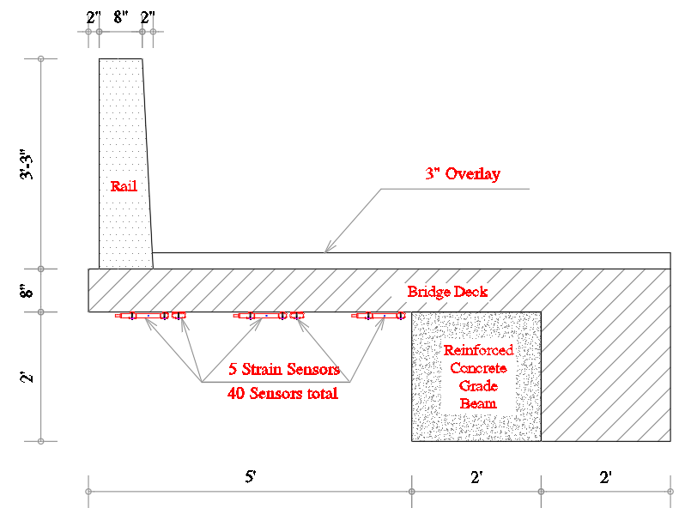
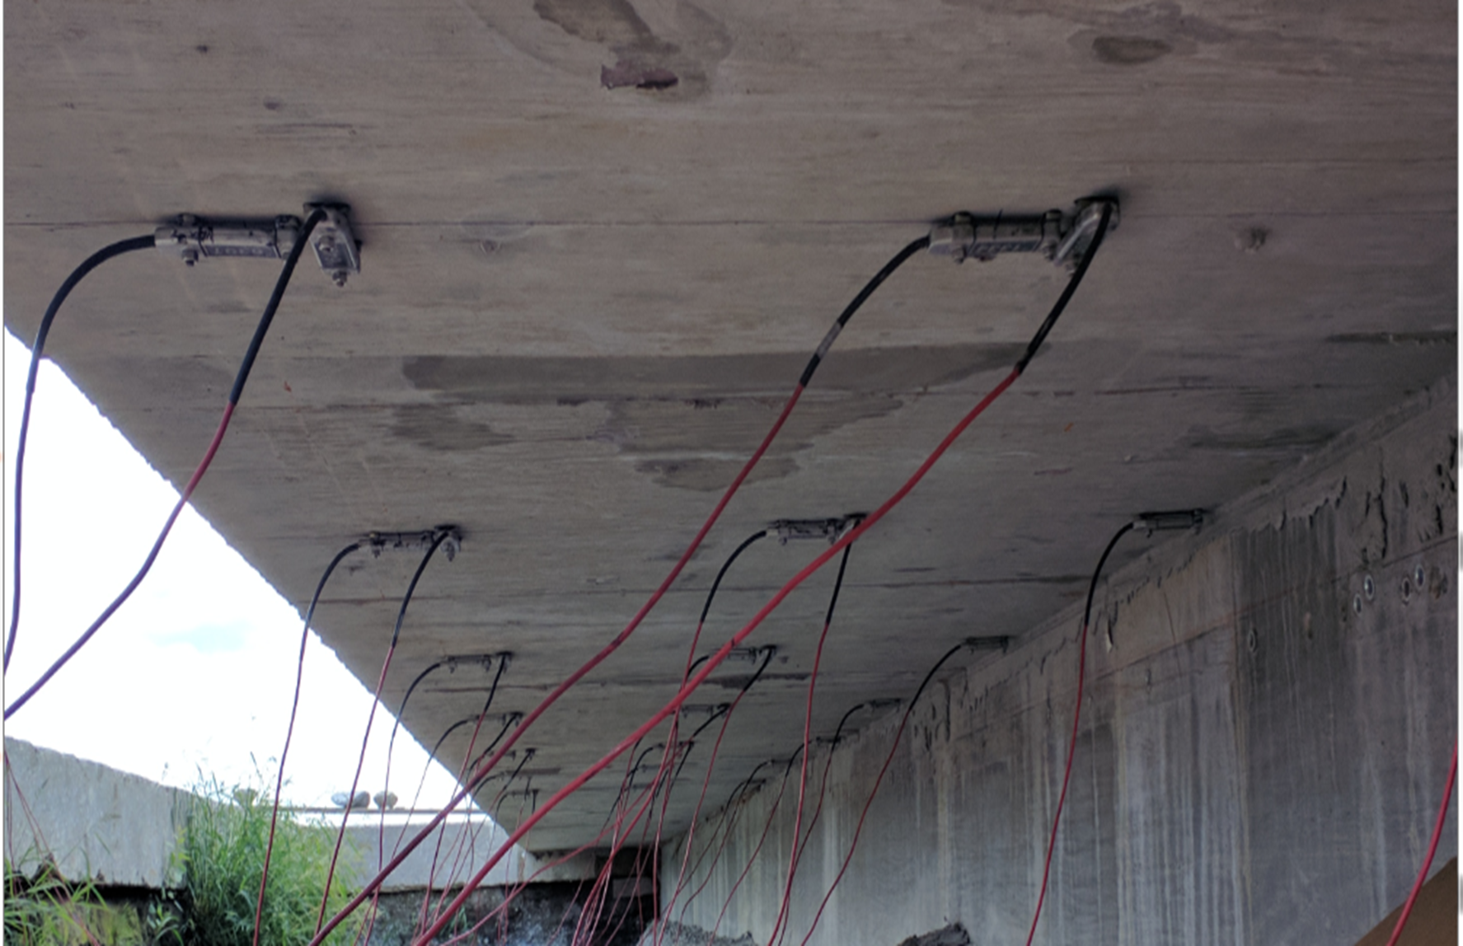
Instrumentation Plan

Slide 9
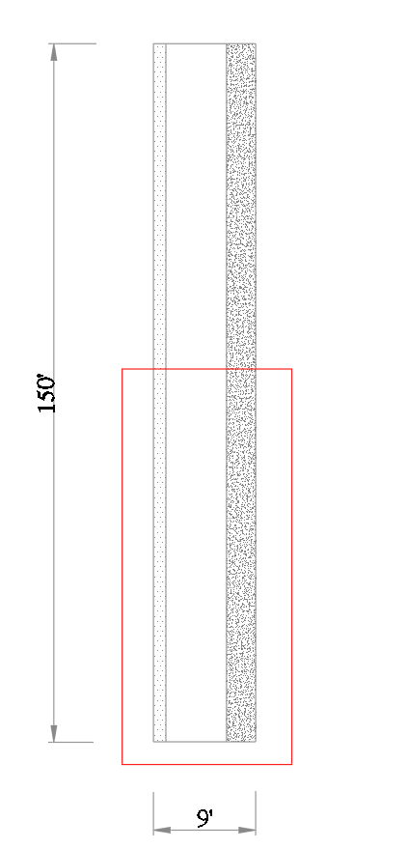
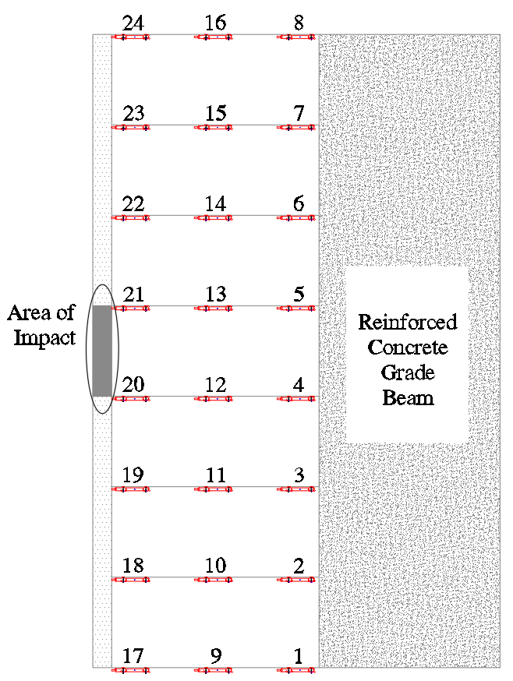
Instrumentation Plan (Cont’d)

Slide 10
Strain Comparison

Slide 11
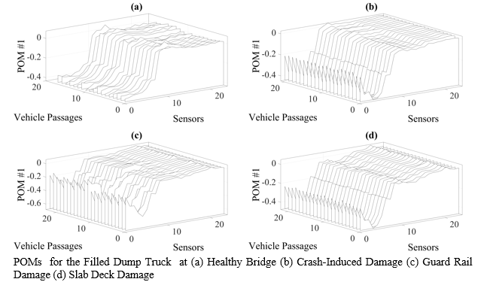
POMs for Filled Dump Truck

Slide 12
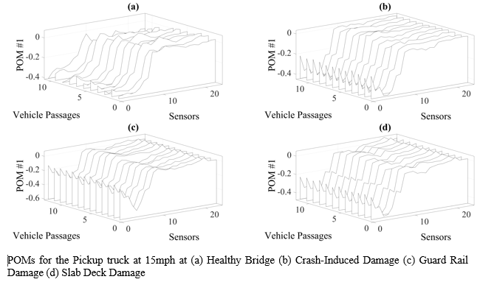
POMs for Pickup Truck @15mph

Slide 13
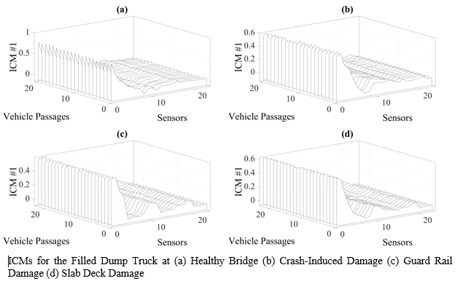
ICMs for Filled Dump Truck

Slide 14
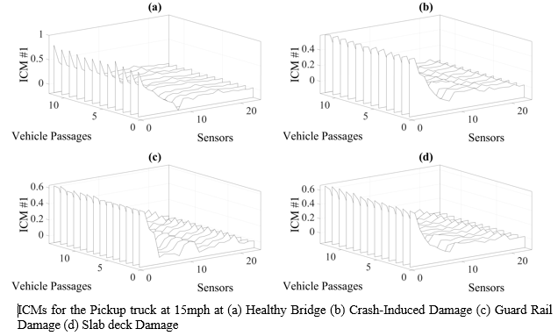
ICMs for Pickup Truck @ 15mph

Slide 15
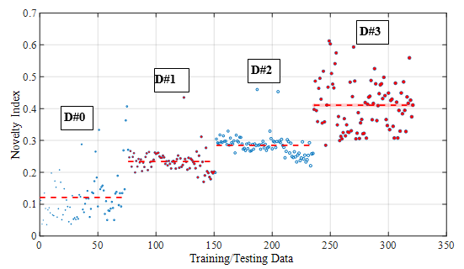
Novelty Detection from PCA using Sensors 1 – 24

Slide 16
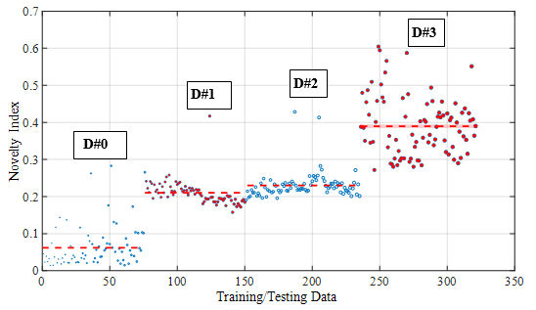
Novelty Detection from PCA using Sensors 1 – 8

Slide 17
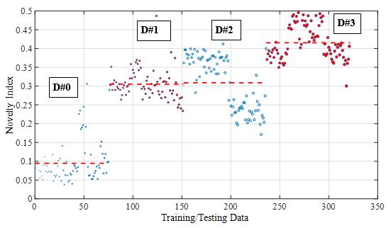
Novelty Detection from ICA using Sensors 1 - 24

Slide 18
Conclusions
Both PCA and ICA can be used for bridge damage detection under operational conditions in case the load trajectory is known
Both PCA and ICA are robust to measurement noise
Sparse strain measurements were enough for damage detection in the considered bridge type
An invisible damage was quantitatively detected

Slide 19


