Slide 1
Highly Multiplexed Label-Free Imaging Sensor for Accurate Quantification of Small-Molecule Binding Kinetics
Elisa Chiodi¹, Allison M. Marn¹, Matthew T. Geib¹, Fulya Ekiz Kanik¹, John Rejman², David AnKrapp², M. Selim Ünlü^{1,3}
1 Boston University, dept. of Electrical Engineering, Boston (MA) USA
2 Neogen Corp., Lansing (MI) USA
3 Boston University, dept. of Biomedical Engineering, Boston (MA) USA

Slide 2
Outline
The importance of small molecule characterization
Our approach: the Interferometric Reflectance Imaging Sensor (IRIS).
Beating the sensitivity limit: noise reduction methods and proof of concept experiments (Biotin, MW = 244Da).
Agro-biotech application: characterization of fumonisin B1 toxin (MW = 722 Da)
Conclusions and future work

Slide 3
Outline
The importance of small molecule characterization
Our approach: the Interferometric Reflectance Imaging Sensor (IRIS).
Beating the sensitivity limit: noise reduction methods and proof of concept experiments (Biotin, MW = 244Da).
Agro-biotech application: characterization of fumonisin B1 toxin (MW = 722 Da)
Conclusions and future work

Slide 4
Why small molecules?
21%
FDA approvals (2019)
73% of 2019 FDA approved drugs¹
4%
99% of all toxins²
2%
73%
[1] Mullard, Nature Reviews Drug Discovery 19, 79-84 (2020)
[2] Wishard, D. et al., T3DB: the toxic exposome database. Nucleic Acids Res. (2015)

Slide 5
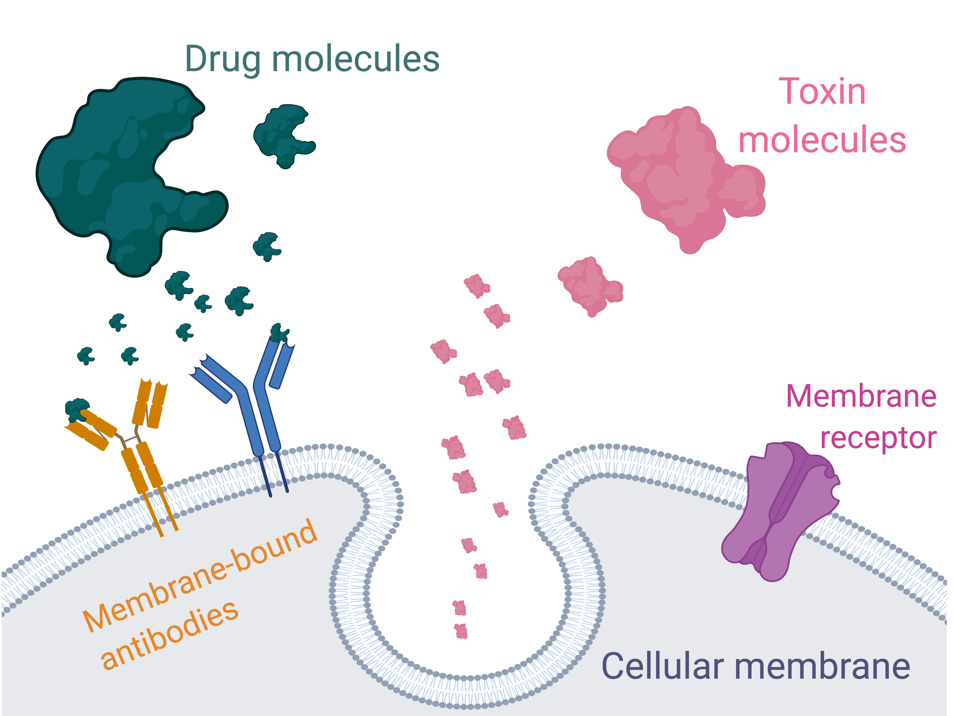
Why small molecules?
A small size implies…
Easy access to the cellular membrane
Easy antibody-based recognition

Slide 6
Outline
The importance of small molecule characterization
Our approach: the Interferometric Reflectance Imaging Sensor (IRIS).
Beating the sensitivity limit: noise reduction methods and proof of concept experiments (Biotin, MW = 244Da).
Agro-biotech application: characterization of fumonisin B1 toxin (MW = 722 Da)
Conclusions and future work

Slide 7
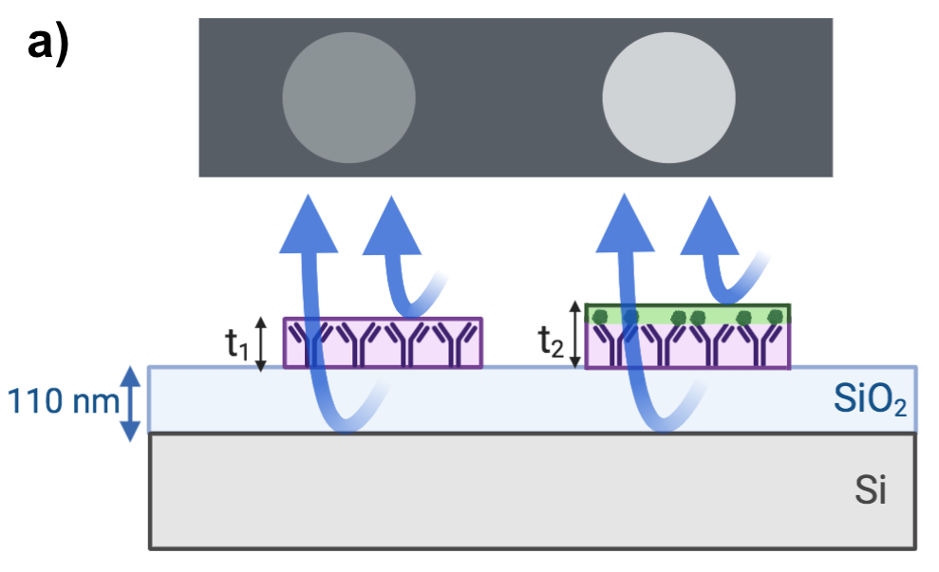
The IRIS system
t₁
t₂
Reflectance (A.U.)
Wavelength (nm)
[3] Daaboul, G.; Vedula, R.; Ahn, S.; Lopez, C.; Reddington, A.; Ozkumur, E.; Ünlü, M. LED-based Interferometric Reflectance Imaging Sensor for quantitative dynamic monitoring of biomolecular interactions. Biosens. Bioelectron. 2011, 26, 2221−2227.

Slide 8
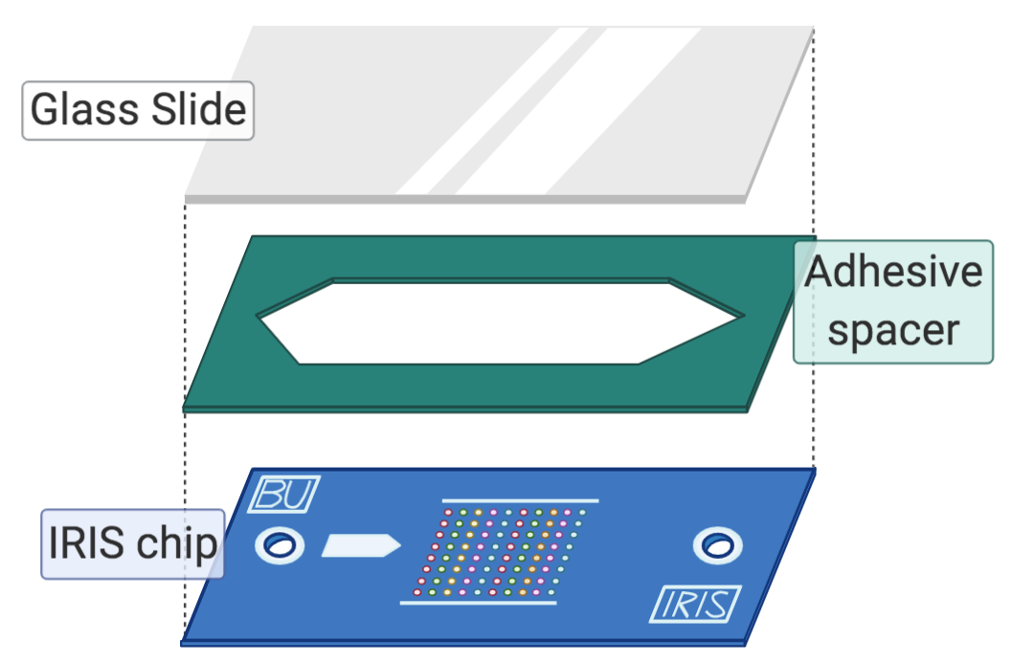
The IRIS system
Camera
Turn mirror
Integrating sphere
Beam splitter
4-color LEDs
2X objective
XYZ stage
Chip holder fixture
[3] Daaboul, G.; Vedula, R.; Ahn, S.; Lopez, C.; Reddington, A.; Ozkumur, E.; Ünlü, M. LED-based Interferometric Reflectance Imaging Sensor for quantitative dynamic monitoring of biomolecular interactions. Biosens. Bioelectron. 2011, 26, 2221−2227.

Slide 9
Our approach: from printing to quantifying
[4] Chiodi, E.; Marn, A.M.; Geib, M.T.; Ekiz Kanik, F.; Rejman, J.; AnKrapp, D.; and Ünlü, M.S.; Highly Multiplexed Label-Free Imaging Sensor for Accurate Quantification of Small-Molecule Binding Kinetics ACS Omega 2020 5 (39), 25358-25364

Slide 10
Outline
The importance of small molecule characterization
Our approach: the Interferometric Reflectance Imaging Sensor (IRIS).
Beating the sensitivity limit: noise reduction methods and proof of concept experiments (Biotin, MW = 244Da).
Agro-biotech application: characterization of fumonisin B1 toxin (MW = 722 Da)
Conclusions and future work

Slide 11
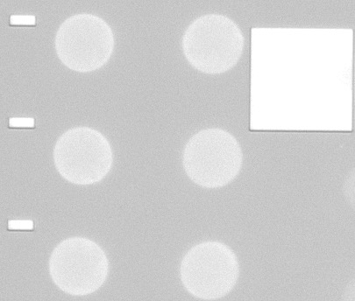
Noise reduction: time and spatial averaging
AVERAGE
Time

Slide 12
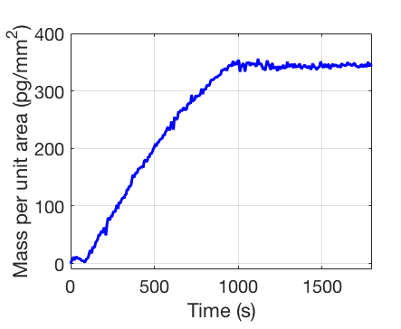
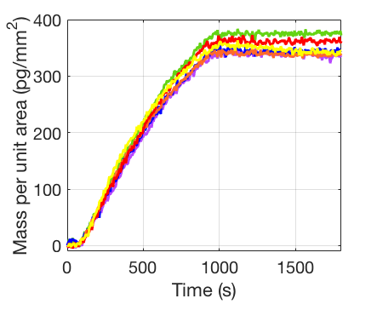
Noise reduction: time and spatial averaging

Slide 13
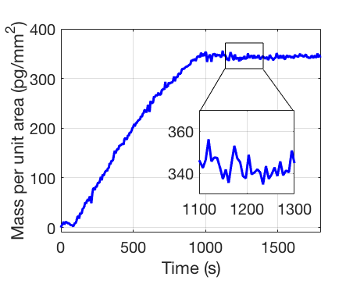
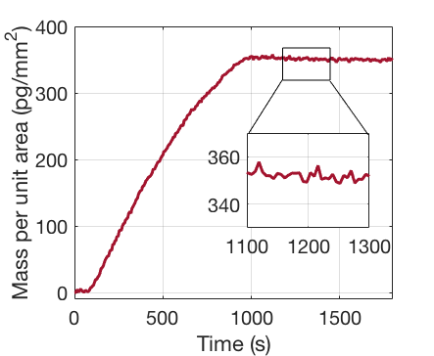
Noise reduction: time and spatial averaging
AVERAGE
SNR = 30
SNR = 92.5

Slide 14
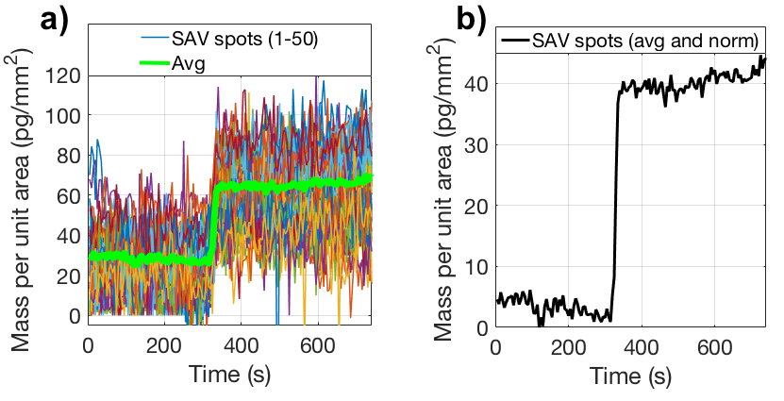
Proof of concept: biotin detection (244 Da)
Time avg: 100 frames
Spatial avg: 50 spots
[4] Chiodi, E.; Marn, A.M.; Geib, M.T.; Ekiz Kanik, F.; Rejman, J.; AnKrapp, D.; and Ünlü, M.S.; Highly Multiplexed Label-Free Imaging Sensor for Accurate Quantification of Small-Molecule Binding Kinetics ACS Omega 2020 5 (39), 25358-25364

Slide 15
Outline
The importance of small molecule characterization
Our approach: the Interferometric Reflectance Imaging Sensor (IRIS).
Beating the sensitivity limit: noise reduction methods and proof of concept experiments (Biotin, MW = 244Da).
Agro-biotech application: characterization of fumonisin B1 toxin (MW = 722 Da)
Conclusions and future work

Slide 16
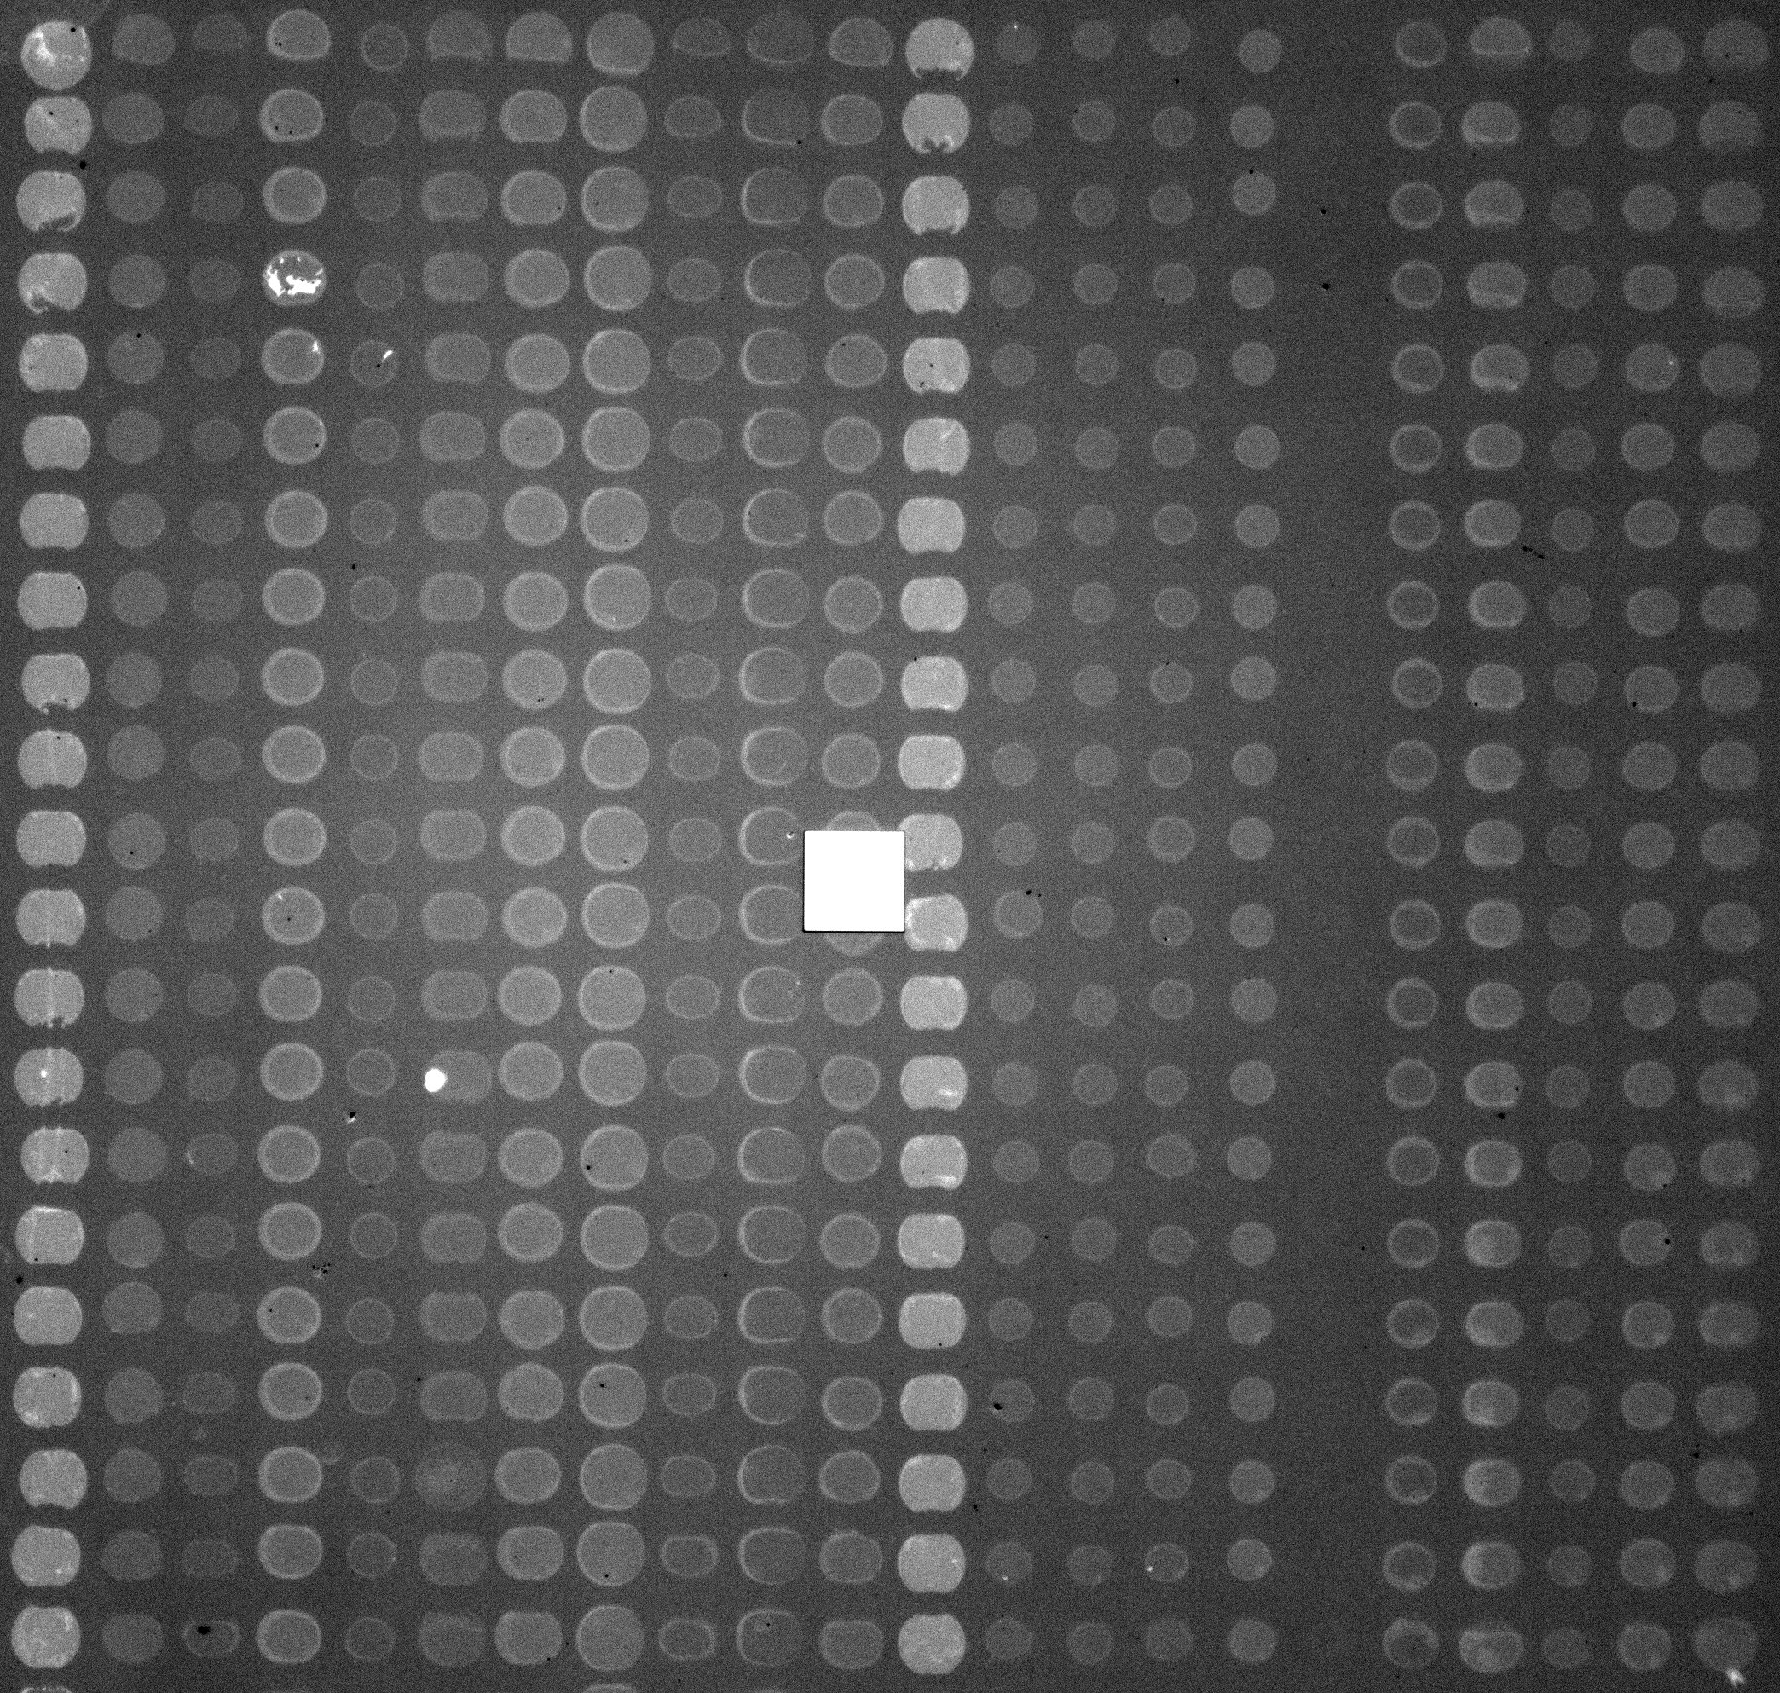
Fumonisin: characterization of a corn toxin
Neg.
CTx1-10
Neg.
KLH1-10
440 spots, 20-plex chip
200 μm
[4] Chiodi, E.; Marn, A.M.; Geib, M.T.; Ekiz Kanik, F.; Rejman, J.; AnKrapp, D.; and Ünlü, M.S.; Highly Multiplexed Label-Free Imaging Sensor for Accurate Quantification of Small-Molecule Binding Kinetics ACS Omega 2020 5 (39), 25358-25364

Slide 17
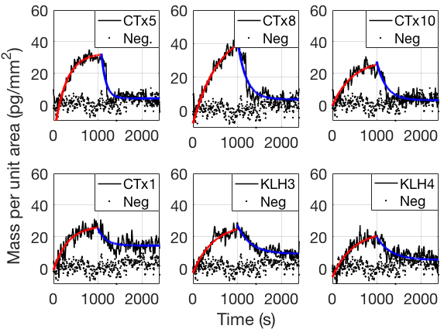
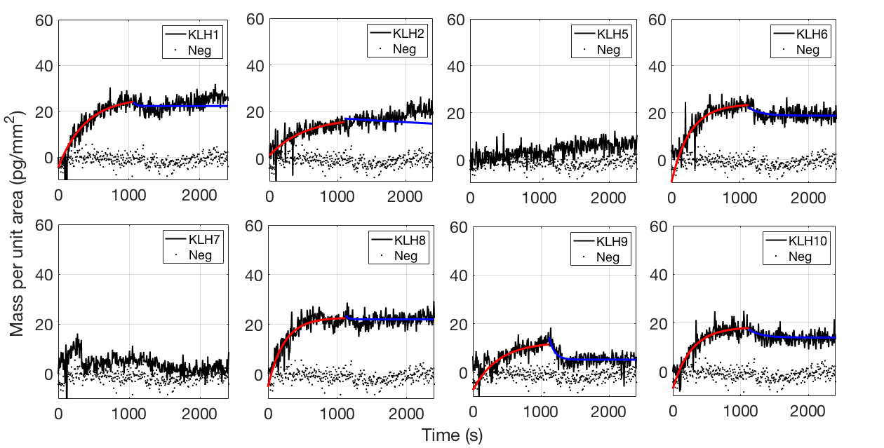
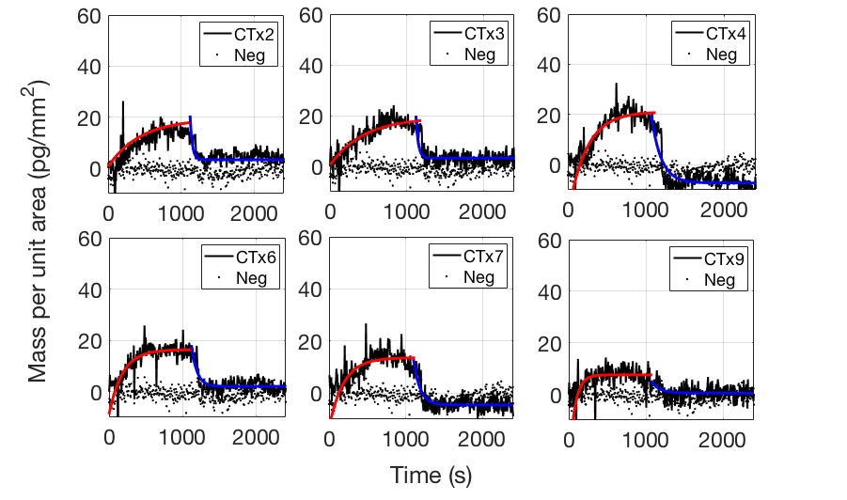
Fumonisin: characterization of a corn toxin
[4] Chiodi, E.; Marn, A.M.; Geib, M.T.; Ekiz Kanik, F.; Rejman, J.; AnKrapp, D.; and Ünlü, M.S.; Highly Multiplexed Label-Free Imaging Sensor for Accurate Quantification of Small-Molecule Binding Kinetics ACS Omega 2020 5 (39), 25358-25364

Slide 18
Fumonisin: characterization of a corn toxin
Antibody | k_{ON} (M⁻¹s⁻¹) | k_{OFF} (10⁻⁴s⁻¹) | K_{D}(μM)
CT1 | 15.6 ± 2.2 | 6.82 ± 3.2 | 44 ± 22
CT2 | 11.0 ± 2.2 | 8.77 ± 4.4 | 80 ± 43
CT5 | 30.8 ± 2.7 | 5.13 ± 1.9 | 17 ± 6
CT8 | 20.0 ± 2.1 | 5.3 ± 2.1 | 27 ± 11
CT10 | 13.6 ± 2.7 | 3.9 ± 3.2 | 28 ± 24
KLH1 | 8.2 ± 1.5 | 17.9 ± 4.7 | 219 ± 70
KLH2 | 4.0 ± 0.7 | 15.2 ± 3.3 | 377 ± 103
KLH3 | 9.3 ± 1.1 | 14.1 ± 3.0 | 151 ± 37
KLH4 | 31.9 ± 5.7 | 21.5 ± 5.3 | 67 ± 22
[4] Chiodi, E.; Marn, A.M.; Geib, M.T.; Ekiz Kanik, F.; Rejman, J.; AnKrapp, D.; and Ünlü, M.S.; Highly Multiplexed Label-Free Imaging Sensor for Accurate Quantification of Small-Molecule Binding Kinetics ACS Omega 2020 5 (39), 25358-25364

Slide 19
Outline
The importance of small molecule characterization
Our approach: the Interferometric Reflectance Imaging Sensor (IRIS).
Beating the sensitivity limit: noise reduction methods and proof of concept experiments (Biotin, MW = 244Da).
Agro-biotech application: characterization of fumonisin B1 toxin (MW = 722 Da)
Conclusions and future work

Slide 20
Conclusions and future work
The IRIS approach to small molecule characterization is…
Highly sensitive
Versatile and multiplexable
Label-free
Sensitivity can improve from current 1pg/mm² to 0.2pg/mm² thanks to a novel camera sensor
Bulk effect reduction methods: further reduction of noise

Slide 21
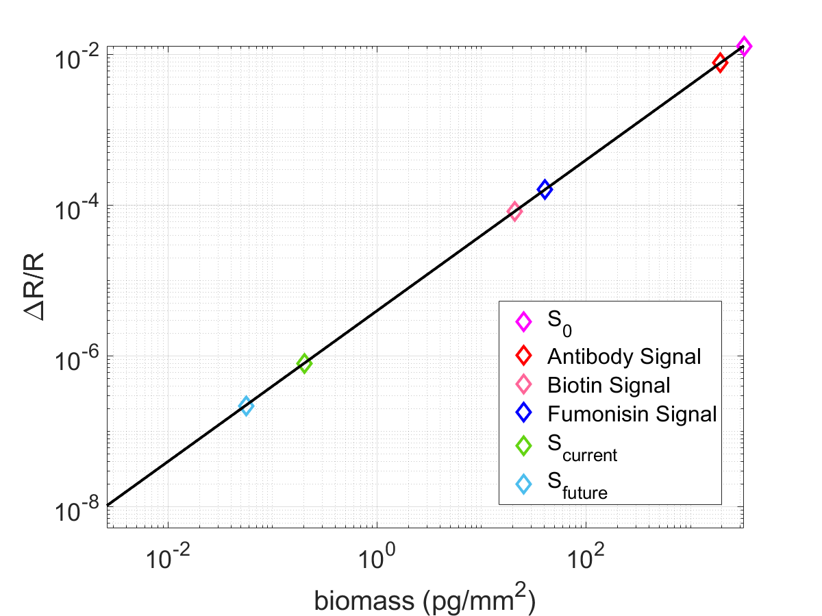
Conclusions and future work
[4] Chiodi, E.; Marn, A.M.; Geib, M.T.; Ekiz Kanik, F.; Rejman, J.; AnKrapp, D.; and Ünlü, M.S.; Highly Multiplexed Label-Free Imaging Sensor for Accurate Quantification of Small-Molecule Binding Kinetics ACS Omega 2020 5 (39), 25358-25364

Slide 22
Thank you!
Prof. Selim Ünlü
Allison M. Marn
Matthew T. Geib
Fulya Ekiz Kanik
David AnKrapp (Neogen, Corp.)
John Rejman (Neogen, Corp.)
Iris Celebi
Negin Zaraee
Celalettin Yurdakul

Slide 23
Any questions?
Elisa Chiodi
Ph.D. Candidate – OCN Laboratory @ Boston University
elich@bu.edu

