Slide 1
Magnetic rod-based metal-organic frameworks metal composites for colorimetric detection of hydrogen peroxide (H₂O₂) and pollutant elimination
by
Benjamin Edem Meteku
College of Chemical Engineering, China University of Petroleum

Slide 2
Outline
Introduction
Motivation
Methodology
Results
Conclusion
References

Slide 3
Introduction
Nanomaterials have gained significant attention in recent years due to their unique size (1-100 nm) and outstanding properties i.e. surface area, optical properties, ease of synthesis etc. [Roduner, 2006]
Potential applications of nanomaterials in various fields including biomedicine, gas storage, catalysis, environmental monitoring and remediation etc. [Maurin et al., 2017 and Meteku et al., 2020]

Slide 4
Introduction
There is an increase in demand for hydrogen peroxide due to its green nature and is currently used extensively in the paper industry, dentistry, environmental remediation decontamination of PPEs etc. [Beam et al., 2020]
Detection of hydrogen peroxide is of prime importance due to its cytotoxicity when concentrations are beyond a minimum threshold of 75 ppm. [Sun et al., 2016]

Slide 5
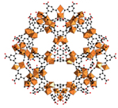
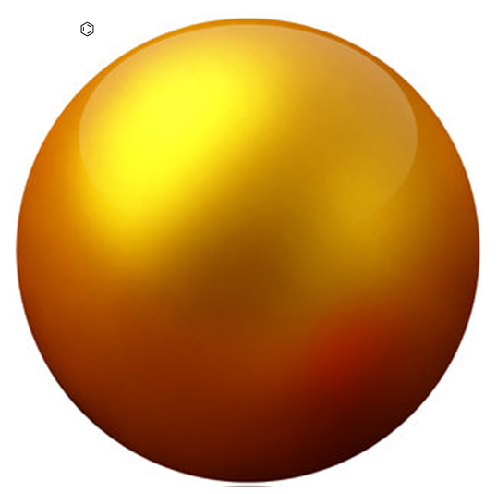
Motivation
Plausible synergistic effect between magnetite, MOF and Au properties
Motivation
The need for enhanced detection of Hydrogen peroxide

Slide 6
Methodology
CTAB assisted hydrolysis at 87ºC for 12 hrs to form β-FeOOH
Reduction of β-FeOOH at 240ºC for 8 hrs under N₂ using PAA for morphology preservation
MAA functionalization of nanorod followed by layer-by-layer growth of MIL-100(Fe) on magnetic rod
Deposition of reduced Au on Fe3O4@MIL-100(Fe)

Slide 7
Methodology
Colorimetric Detection of H₂O₂
Fe₃O₄@MIL-100(Fe)-Au (4 mg/mL, 100 μL)
+
Sodium acetate-acetic acid buffer solution ( pH =4, 2400 μL) +
TMB solution (1.55mM in ethanol, 480 μL)
+
H₂O₂( 30%, 100 μL)
(Incubation for 5 min. followed by UV-vis analysis)

Slide 8
Methodology
4-nitrophenol reduction
4-nitrophenol solution (0.18 mM, 6 mL)
+
freshly prepared NaBH₄ solution (0.2 M, 4 mL)
+
Fe₃O₄@MIL-100(Fe)-Au ( 4 mg)
Bacteria adsorption
Composite conjugation with antibody followed by bacteria adsorption with/without magnetic field

Slide 9
Results
a)TEM image of Fe₃O₄@MIL-100(Fe)-Au; b, c) STEM HAADF image of composite; Corresponding elemental analysis results d) Au; e) C; f) Fe and g) O

Slide 10
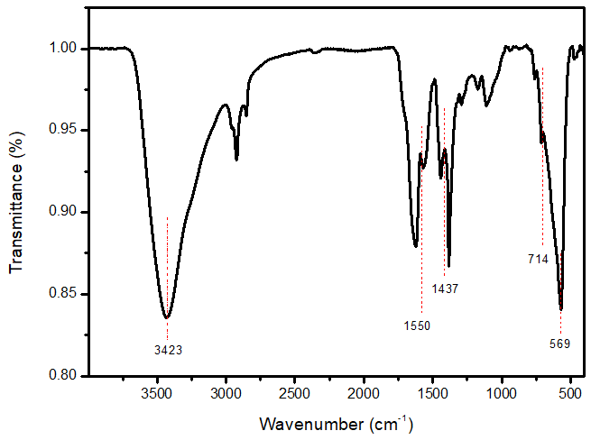
Results
a
b
a) XRD for Fe₃O₄@MIL-100(Fe)-Au; b) FTIR of Fe₃O₄@MIL-100(Fe)-Au

Slide 11
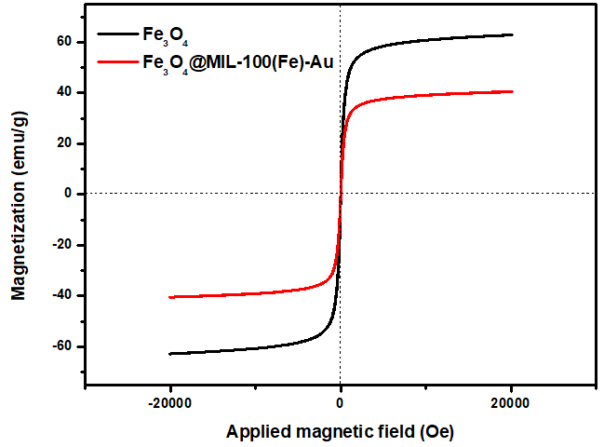
Results
a
b
TGA of Fe₃O₄, Fe₃O₄@MIL-100(Fe), and Fe₃O₄@MIL-100(Fe)-Au;
b) VSM for Fe₃O₄ and Fe₃O₄@MIL-100(Fe)-Au

Slide 12
Results
UV-vis spectra for TMB oxidation with H₂O₂ without nanozyme (black), with nanozyme(red), and with nanozyme on a magnetic field (blue)
( Inset picture: TMB+H₂O₂ (left), TMB +H₂O₂+Nanozyme (middle), and TMB +H₂O₂ + Nanozyme (on magnetic field) (right))

Slide 13
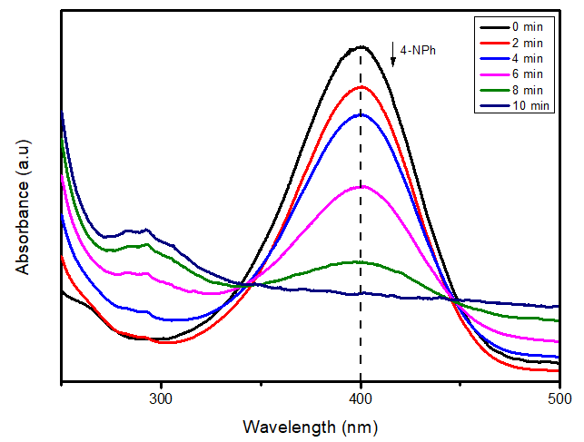
Results
UV-vis spectra for a) Non-magnetic field-assisted reduction of 4-nitrophenol
b) Magnetic field-assisted reduction of 4-nitrophenol

Slide 14
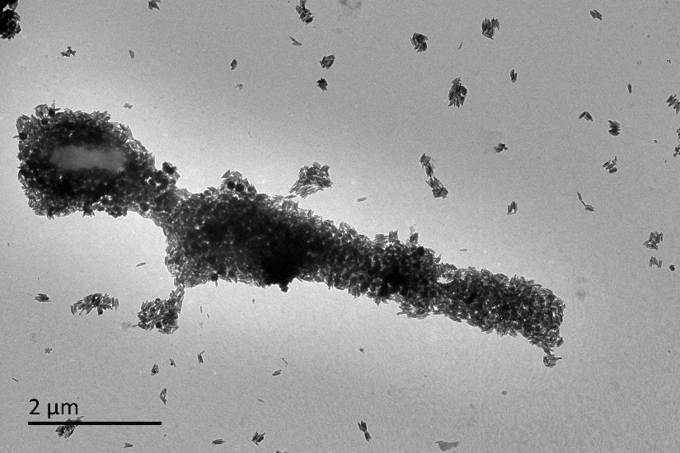
Results
a
b
TEM of a) Non-magnetic field-assisted bacteria adsorption (capture)
b) Magnetic field-assisted bacteria adsorption (capture)

Slide 15
Conclusion
Fe₃O₄@MIL-100(Fe)-Au was successfully used for the detection of H₂O₂ while the magnetic property of the Composite was further utilized to enhance the rate of detection
The synthesized composite proved to be versatile and can be used for pollutant degradation and dye adsorption

Slide 16
References
Roduner, E. Size matters : why nanomaterials are different. 2006, 583–592, doi:10.1039/b502142c
Maurin, G.; Serre, C.; Cooper, A.; Férey, G. The new age of MOFs and of their porous-related solids. Chem. Soc. Rev. 2017, 46, 3104–3107, doi:10.1039/c7cs90049j.
Meteku, B.E.; Huang, J.; Zeng, J.; Subhan, F.; Feng, F.; Zhang, Y.; Qiu, Z.; Aslam, S.; Li, G.; Yan, Z. Magnetic metal–organic framework composites for environmental monitoring and remediation. Coord. Chem. Rev. 2020, 413, 213261, doi:10.1016/j.ccr.2020.21326
Beam, E.; Cih, J.C.N.; Cih, M.D.A.; Ramar, K. Effect of vaporized hydrogen peroxide reprocessing on N95 respirators. 2020, 1–2, doi:10.1017/ice.2020.371
Sun, J.; Li, C.; Qi, Y.; Guo, S.; Liang, X. Optimizing colorimetric assay based on V2O5 nanozymes for sensitive detection of H2O2 and glucose. Sensors (Switzerland) 2016, 16, doi:10.3390/s16040584

