Slide 1


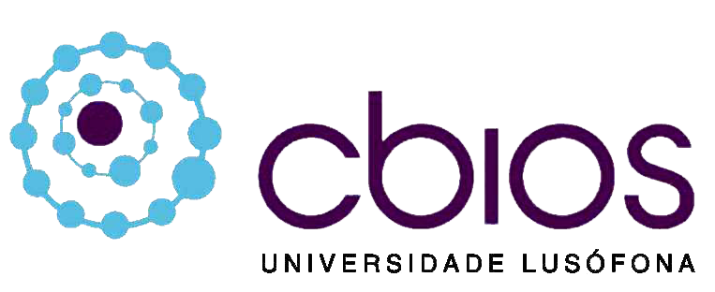


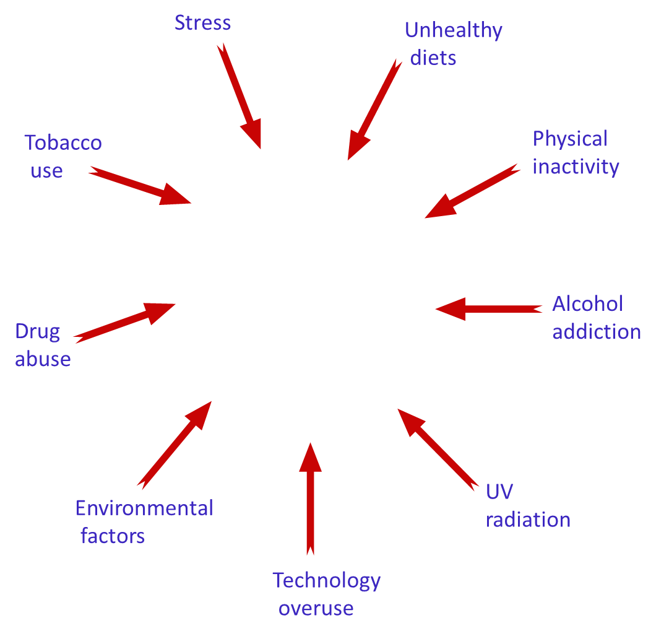
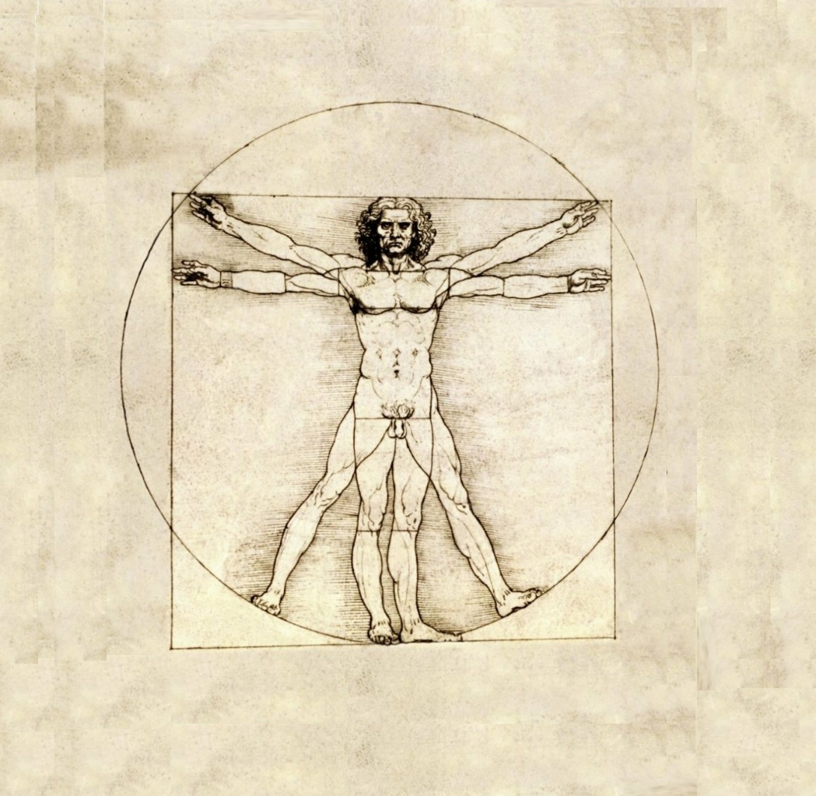
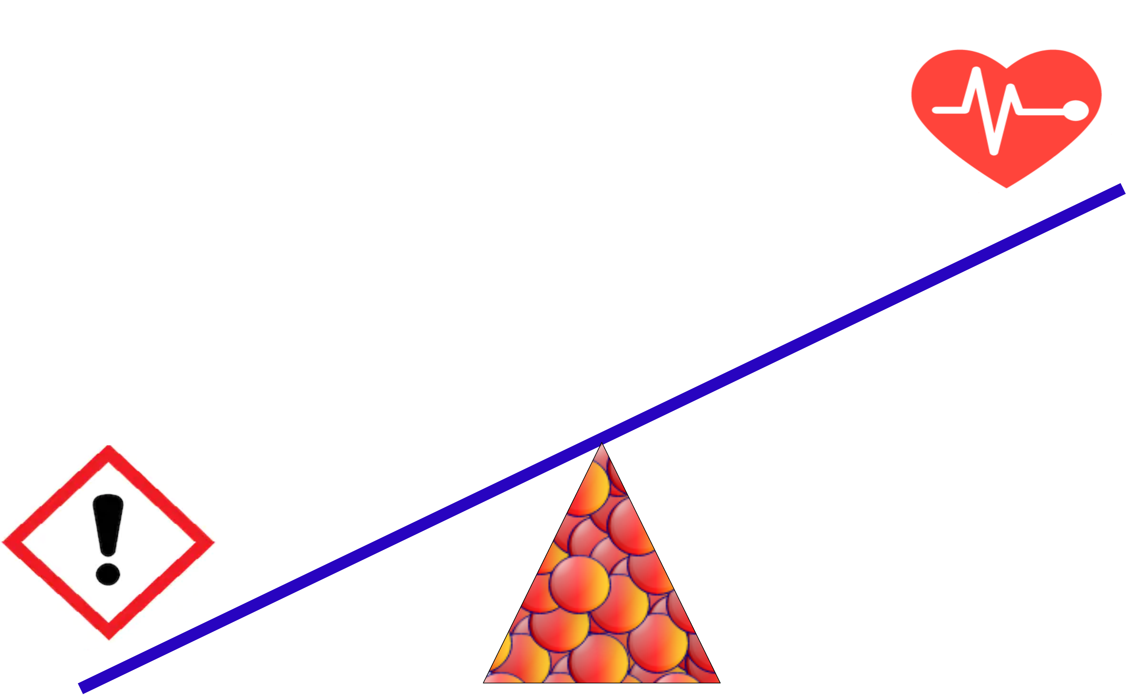
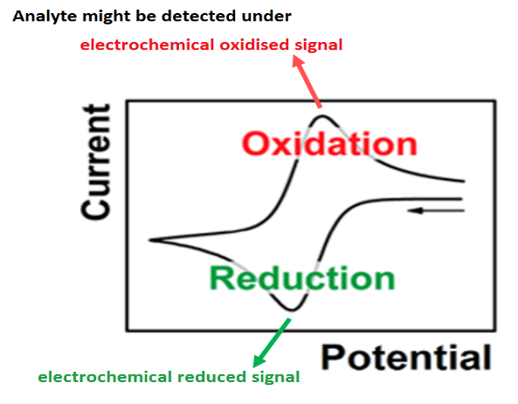
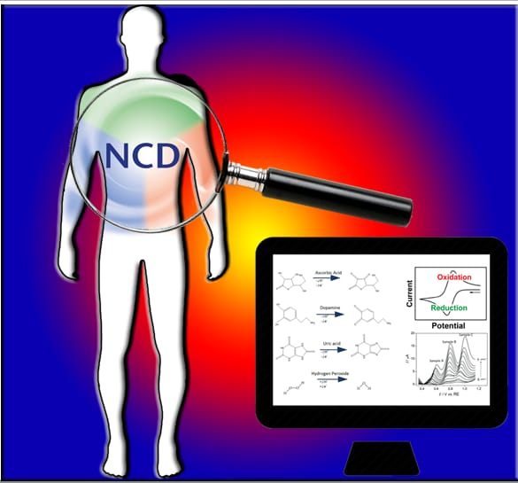
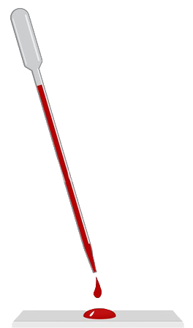
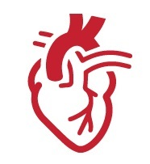
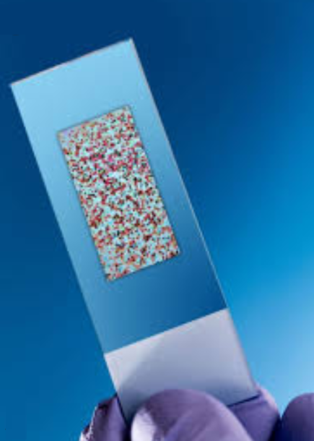

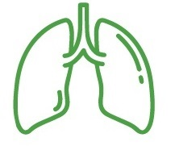
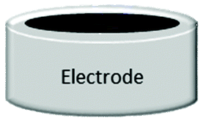

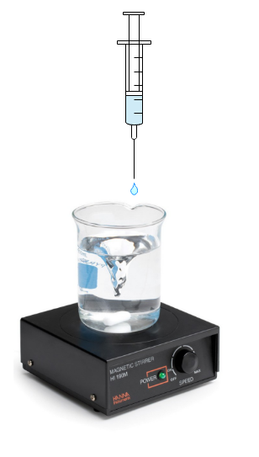
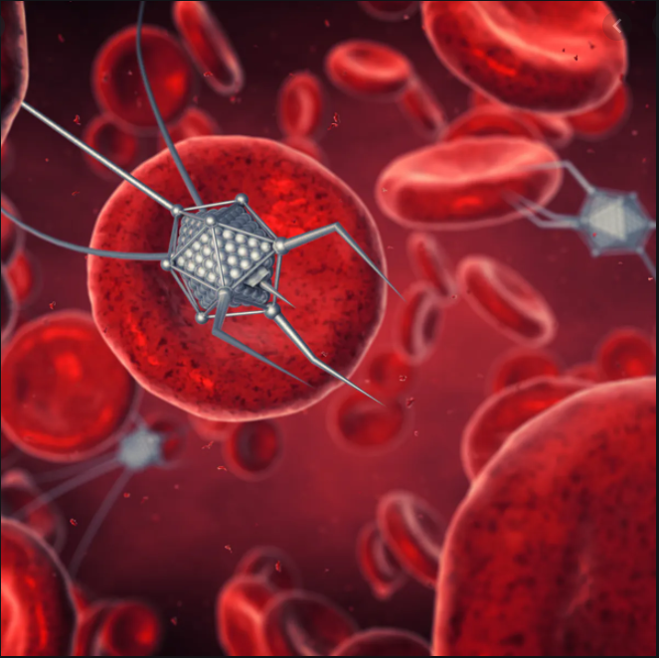

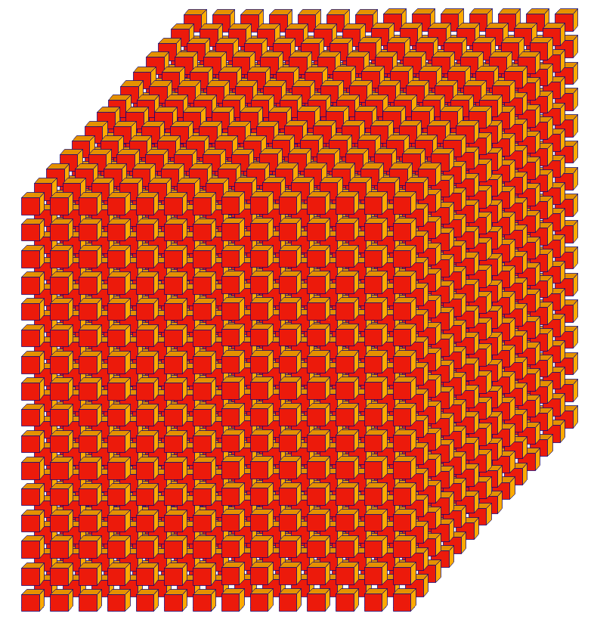
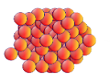




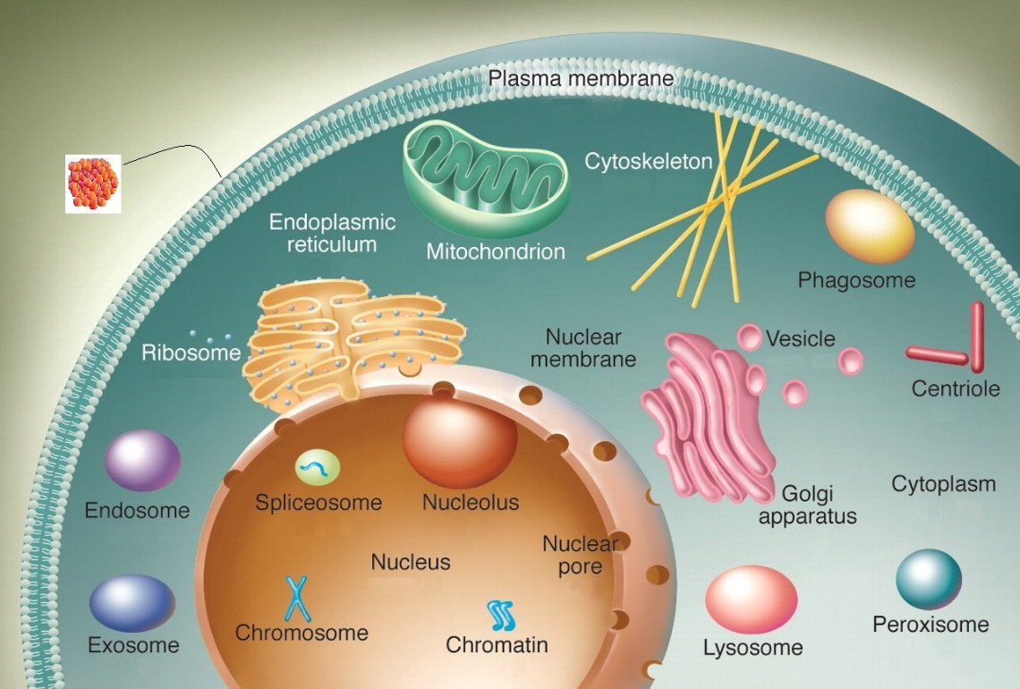
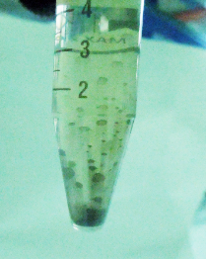
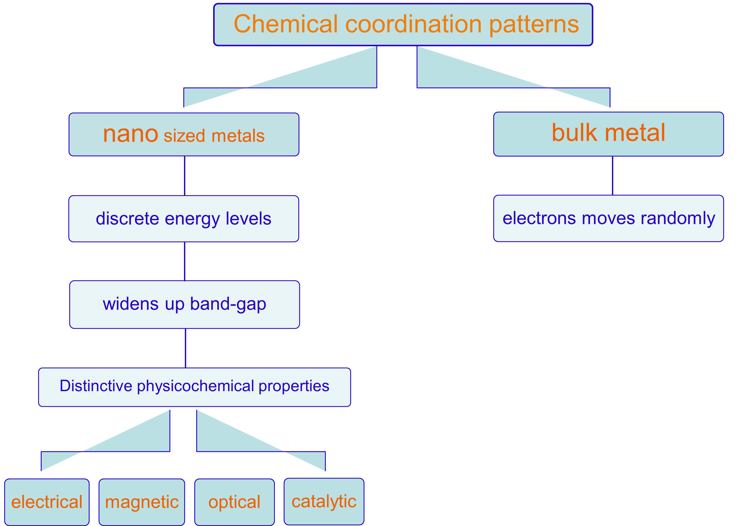
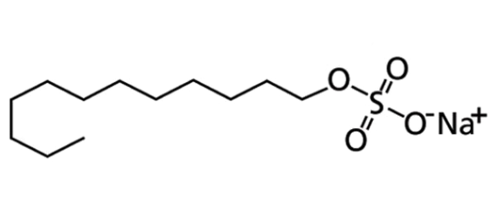
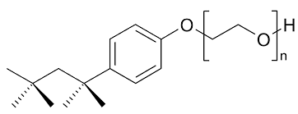
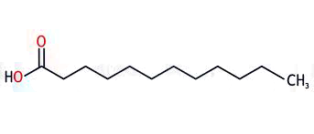
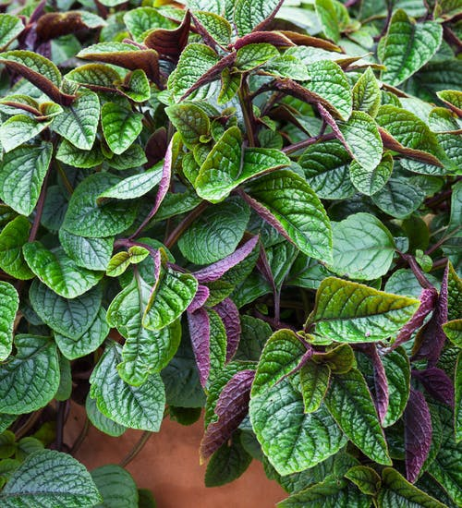
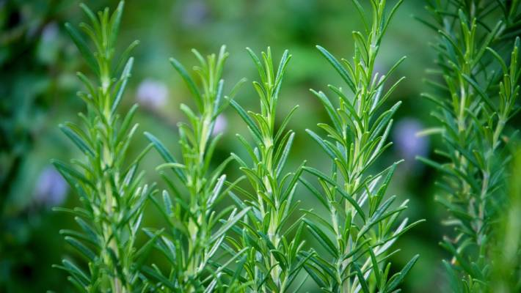
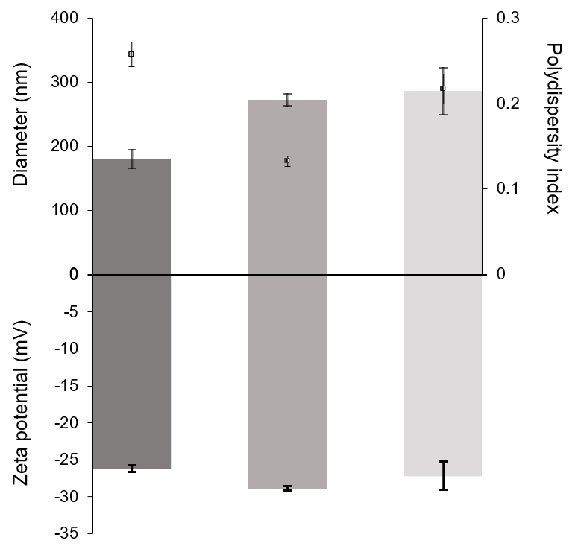






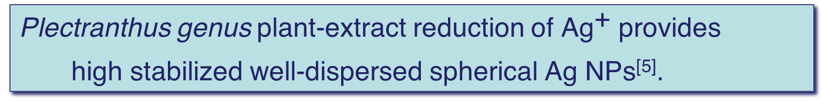


Development of new catalytic material for accurate detection of biological biomarkers related to most common Non-communicable diseases
Ana Morais^{a,b}, Marisa Nicolaiª, Belén Batanero^{c}, Patrícia Rijo^{a,d}
                a CBIOS - Center for Research in Biosciences & Health Technologies, Universidade Lusófona de Humanidades e Tecnologias, Campo Grande 376, 1749-024 Lisboa, Portugal.
                b Department of Biomedical Sciences, Faculty of Pharmacy, University of Alcalá, Ctra. A2, Km 33.600 – Campus Universitario, 28871 Alcalá de Henares, Spain.
                c Department of Organic & Inorganic Chemistry, Faculty of Pharmacy, University of Alcalá, Spain; belen.batanero@uah.es
                d iMed.ULisboa - Instituto de Investigação do Medicamento, Faculdade de Farmácia, Universidade de Lisboa, 1649-003 Lisboa, Portugal.
State of Art of Non-communicable disease
NAD(P)H Oxidase
Lipoxygenase
Cyclooxygenase
Xanthine oxidoreductase
Cytochrome P450
NADH C_{O}Q reductase
Cytochrome c oxidase
Dehydrogenases
Plasma membrane
Activation of ^{[1]}
$${\text{O}}_{2}^{\text{•−}}$$
Antioxidant species
Mitochondrion
mitochondrial metabolism
ROS
$${\text{H}}_{\text{2}}{\text{O}}_{\text{2}}$$
Recover physiological processes
$${}_{}^{\text{•}}{\text{OH}}$$
Protective
mechanism
Endoplasmic reticulum
organelles response
$$^{\text{1}}{\text{O}}_{\text{2}}$$
Inhibits ROS oxidative action
Capture/ linkage with ROS
Nucleus
Oxidative stress
$${\text{ONOO}}^{\text{−}}$$
Peroxisomes
Proteins structure/activity
Interfering with
cellular biological processes
Phospholipid membranes
permeability disruption
DNA strands damaging
Therapeutic / Diagnosis
Nanotechnology
► Early diagnosis
►Health management
NON
COMMUNICABLE
DISEASES
Cardiovascular condition
Chronic respiratory condition
Cancer
Diabetes
Nanomaterial on Accurate Diagnosis
Electrochemical sensing^{[2]}
NP synthesis
Biosensor sensitivity relies on electrode catalytic activity over electroactive species of analyte
Choice of catalytic material
is of utmost importance
for
electrochemical
biosensors.
Conventional synthesis
wet-chemical method
Precursor salt
aqueous sol.
Nanomaterial on drug delivery therapy
Nano-materials
Metal ion
is reduced to its
atomic zero-valence state
Reducing agent
+
Stabilizer
metal cation
cluster nucleation growth atom
clusters
stabilization
capping
growth
nucleation
Bulk Powder Nanostructure
High surface – area – to - volume ratio
Harmful
reducing agent
Sodium Borohydride
NPs suited^{[3]}
Pharmaceutical
&
Biochemical
industry
Nano-size $\text{⊥}$to wavelength of an electron
$$λ_{1}=2πr_{1}$$
Sodium Citrate
Nanoparticles
readily interact
with
eukaryotic cells ^{[2]}
AgNPs
Ascorbic Acid
Hydrazine Hydrate (Phenilhydrazine)
Figure 1: Nanoparticles crossing membrane cells barrier: by endocytosis /diffusion
Figure 3: Aqueous colloid of biosynthesized Ag NPs
Table 1: Physicochemical evaluation of prepared silver nanoparticles.
Δ particle size (Dynamic Light Scattering) & zeta potential (Electrophoretic Light Scattering)
SDS surfactant
Long chain stabilizers
Harmful
Plant-base Biogenesis
Reduce agent | Average particle size/nm | Zeta potential/mV
NaBH₄ | 180 | -29
P. R. Officinalis | 198 | -26
P. Ciliatus | 409 | -30
Triton x-100 surfactant
Phytochemical species usually trend to donate electrons to seeking electron species,
behaving as anti-oxidant.
Dodecanoic saturated fatty acid
[1] Morais, A.L.; Rijo, P.; Batanero, B.; Nicolai, M. Biomolecules and Electrochemical Tools in Chronic Non-Communicable Disease Surveillance: A Systematic Review. Biosens (accepted 7 September 2020).
[2] Morais, A.L.; Salgado, J.R.C.; Šljukić, B.; Santos, D.M.F; Sequeira, C.A.C. Electrochemical behaviour of carbon supported Pt electrocatalysts for H2O2 reduction, Int. J. Hydrog. Energy. 2012; Volume 37, pp. 14143–14151.
[3] Ullah Khan S.; Saleh T.A.; Wahab A.; Khan U.; Khan D.; Ullah W.; Rahim A.; Kamal S.; Ullah K.F.; Fahad S.; Nanosilver: new ageless and versatile biomedical therapeutic scaffold. Int J Nanomedicine. 2018; Volume 13, pp. 733–762.
[4] Zheng, Y.; Huang, Y.; Shi, H.; Fu, L. Green biosynthesis of ZnO nanoparticles by plectranthus amboinicus leaf extract and their application for electrochemical determination of norfloxacin. Inorg Nano-met Chem. 2019; Volume 49, pp. 277–282.
[5] Ajitha, B., Ashok Kumar Reddy, Y., & Sreedhara Reddy, P. Biosynthesis of silver nanoparticles using Plectranthus amboinicus leaf extract and its antimicrobial activity. Spectrochim. Acta A Mol. Biomol. Spectrosc. 2014; 128, 257–262.
Figure 2: Plectranthus Cilliatus & Plectranthus Rosmarinus Officinallis species
Terpenoids
Flavonoids
Alkaloid
Phytonutrients are the most commonly used Eukarya-domain reducing agents
Gives electrons to metallic anions turns them into their zero-valence atomic state^{[4]}
Plectranthus genus plant-extract reduction of ${\text{Ag}}^{\text{+}}$ provides
high stabilized well-dispersed spherical Ag NPs^{[5]}.
NaBH₄
Rosemary officiallis extract as reducing agent
Plenctractus ciliatus extract
Figure 2: Mean particle size, polydispersity index (top bars) and zeta potential (bottom bars) characterisation of synthesised Ag nanoparticles (n = 3, mean ±SD)

