Slide 1
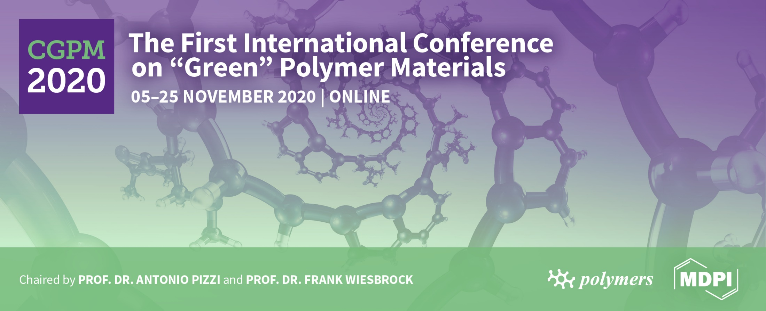

Biodegradable coating on packaging paper made from fibres of invasive plant species Fallopia japonica
Gregor Lavrič^{1,}* and Urška Vrabič Brodnjak²
¹ Pulp and Paper Institute, Bogišićeva 8, SI-1000 Ljubljana, Slovenia;
² University of Ljubljana, Faculty of Natural Sciences and Engineering, Snežniška 5, SI-1000 Ljubljana, Slovenia.
* Corresponding author: urska.vrabic@ntf.uni-lj.si

Slide 2
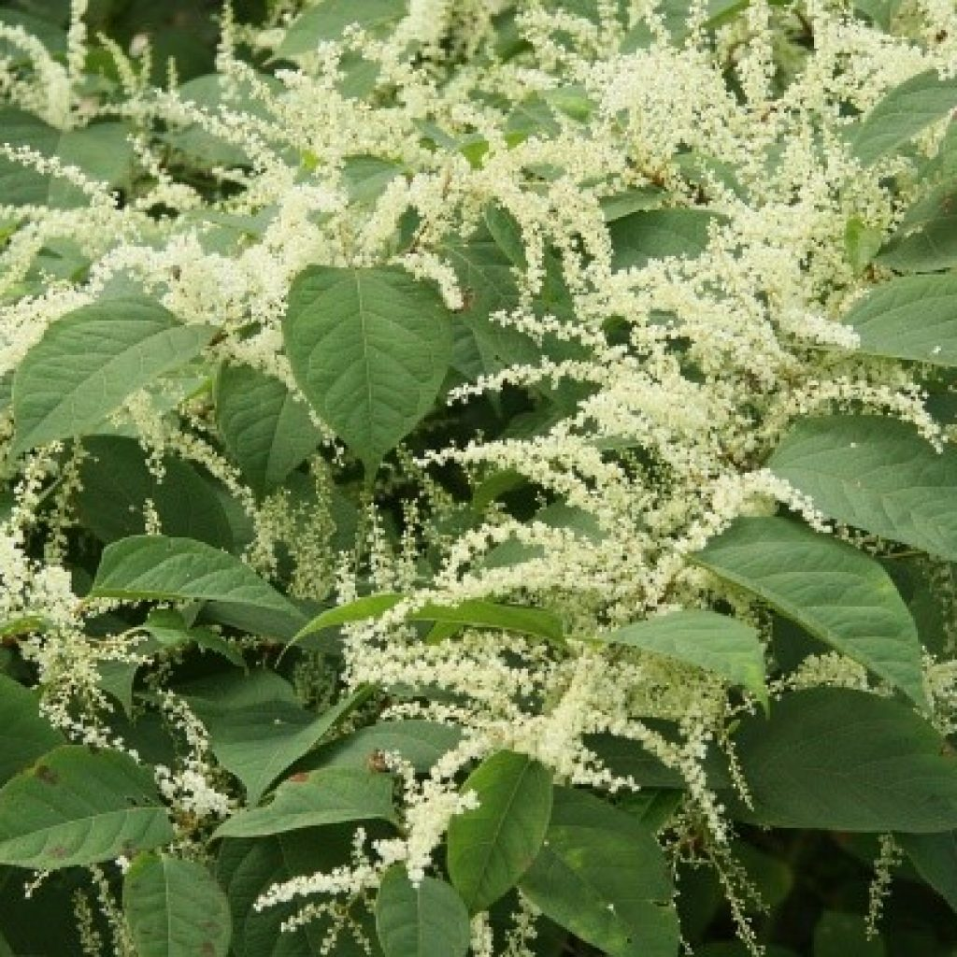

To minimise the environmental impacts and produce durable, ecological packaging, bio based polymers should be taken under consideration.
Furthermore, postconsumer management and recyclability need to be managed carefully.
Fallopia japonica is a plant, native to East Asia, Japan, China and Korea, but in North America and Europe it is classified as invasive species. The root system and strong growth of these plants can damage buildings, streets, paving, retaining walls.

Slide 3
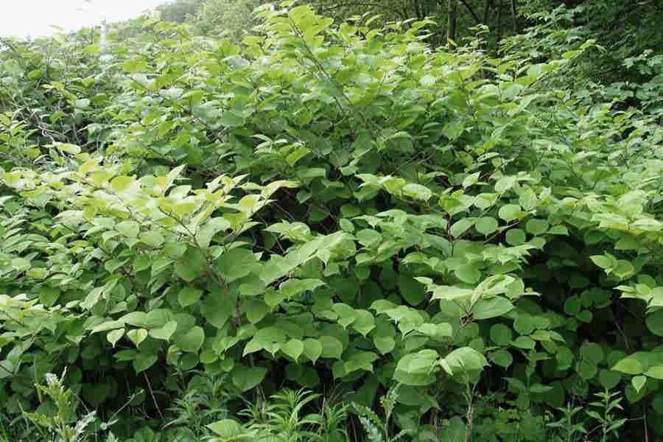
The stem biomass of Fallopia japonica contains 40 percent of cellulose, which is comparable to the raw materials from which paper fibers are typically produced.
With chemical and mechanical procedures and treatments, the fibers from Fallopia japonica were prepared and successfully the packaging paper has been produced.

Slide 4
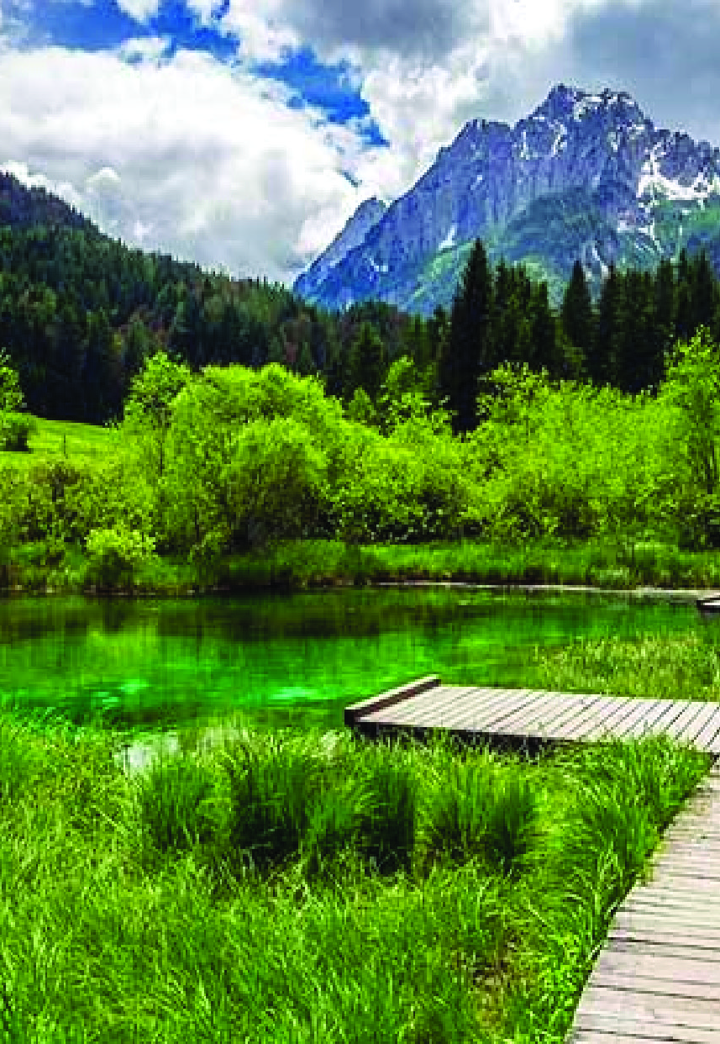



AIM OF OUR RESEARCH
Define a problem/find a solution
Bio degradable coating
Environmental impact
This research was part of the project “Applause – Alien Plant Spieces, from harmful to useful with citizens”, which was co-funded by the EU Regional Development Fund.

Slide 5
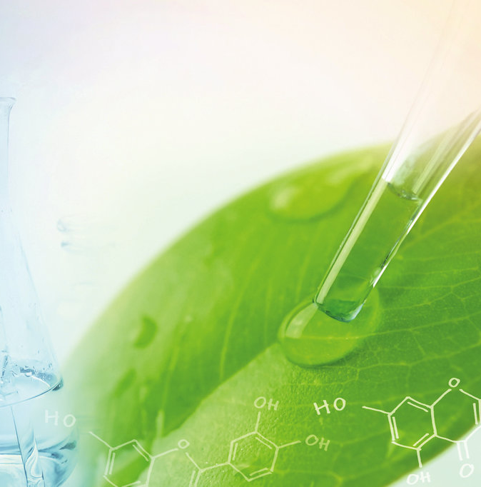
AIM
The aim of the study was to investigate the influence of different concentrations of chitosan in the coating solution (5 and 10 wt%) on the physical and mechanical properties of the paper with Fallopia japonica fibres.

Slide 6

Materials
Coating solution
Chitosan
Glycerol
Acetic acid
Paper made from Fallopia japonica, with grammage 100 g/m² was used. Paper was produced on a paper maschine (Andritz AG, Graz, Austria) located in Pulp and Paper Institute in Ljubljana, Slovenia.

Slide 7
Materials
Paper sheets were coated using two coating solutions of chitosan:
1) Uncoated paper − U
2) Coated with chitosan (5%) − C5
3) Coated with chitosan (10%) − C10

Slide 8

Coating procedure
First the solutions were prepared separately and the coating procedure was carried out.
Two different chitosan solutions were prepared:
dissolving 5 g or 10 g of chitosan in 100 ml of 2 % acetic acid and then adding 5 ml of glycerol.
Each of the solution was then mixed for 10 minutes at a stirring speed of 800 rpm (at 85°C) and cooled to room temperature.

Slide 9
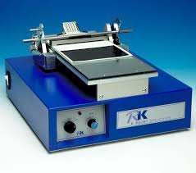
Coating procedure
After the solutions were prepared, the coatings were applied with a coater.
The samples were coated on a coating table at ambient temperature with a 120 µm rod bar. The coated samples were then dried (at 80 °C for 10 minutes).

Slide 10

Methods
Grammage, thickness, density
Moisture content, water vapor permeability (WVP), absorptiveness
Thermogravimetric analysis
Surface properties

Slide 11

RESULTS

Slide 12

Basic properties
Sample | Grammage [g/m²] | Thickness [mm] | Density [kg/m³]
U | 98 ± 1.5 | 0.17 ± 0.002 | 620 ± 2
C5 | 105 ± 0.5 | 0.22 ± 0.001 | 645 ± 3
C10 | 110 ± 0.3 | 0.23 ± 0.001 | 648 ± 1

Slide 13
Moisture content, absorptiveness (Cobb value) and water vapour permeability (WVP)

Slide 14
Tensile properties and thermogravimetric analysis
Sample | TS [MPa] |  | E (%)
 | MD | CD | MD | CD
U | 25 | 58 | 3.7 | 2.0
C5 | 36 | 59 | 4.9 | 3.6
C10 | 40 | 64 | 5.1 | 4.2

Slide 15
SEM analysis

Slide 16

CONCLUSION
Characteristic features of the plant Fallopia japonica showed that it can be used as part of paper production, including coated paper.
Bio-based chitosan coating has been successfully applied to paper.
Water barrier, tensile and thermal properties improved.
5% chitosan is sufficient for a suitable paper coating.

Slide 17

CONCLUSION
The solution for invasive plant spices could be a good solution for the environmental impact in Europe.
Properties of different bio-based coatings on Fallopia japonica paper will be investigated.

Slide 18
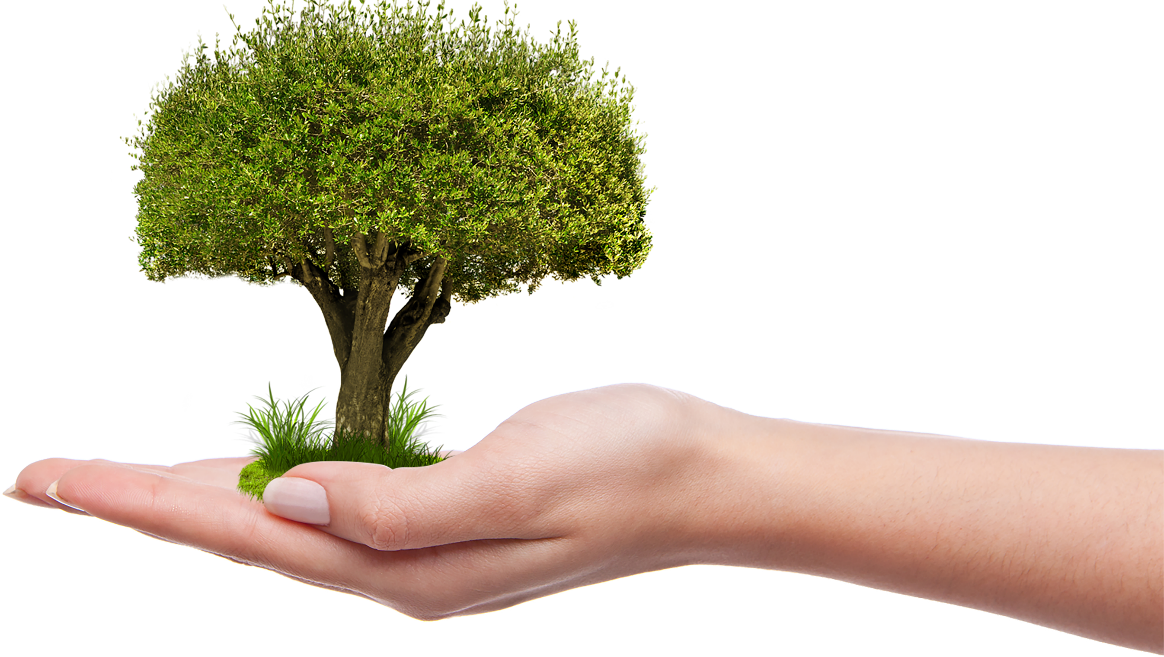
Thank you for your attention!
urska.vrabic@ntf.uni-lj.si
gregor.lavric@icp-lj.si

