Slide 1
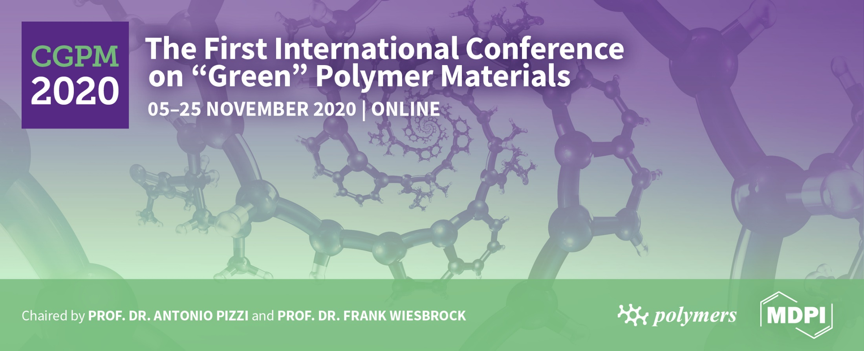
Shape-memory properties of 3D printed PLA structures
Guido Ehrmann, Andrea Ehrmann*
Bielefeld University of Applied Sciences, Bielefeld, Germany
* Corresponding author: andrea.ehrmann@fh-bielefeld.de

Slide 2
Abstract:
Polylactic acid (PLA) belongs to the few thermoplastic polymers that are derived from renewable resources such as corn starch or sugar cane. PLA is often used in 3D printing by fused deposition modelling (FDM) since it is relatively easy to print, does not show warping and can be printed without a closed building chamber. On the other hand, PLA has interesting mechanical properties which are influenced by the printing parameters and geometries. Here we present shape-memory properties of PLA cubes with different infill patterns and percentages. We investigate the material response under defined quasi-static load as well as the possibility to restore the original 3D printed shape. The quasi-static flexural properties are linked to the porosity and the infill structure of the samples under investigation, examined optically and by simulations. Our results underline the importance of designing the infill patterns carefully to develop samples with desired mechanical properties.
Keywords: polylactic acid; fused deposition modelling; 3 point bending test; shape-memory properties

Slide 3
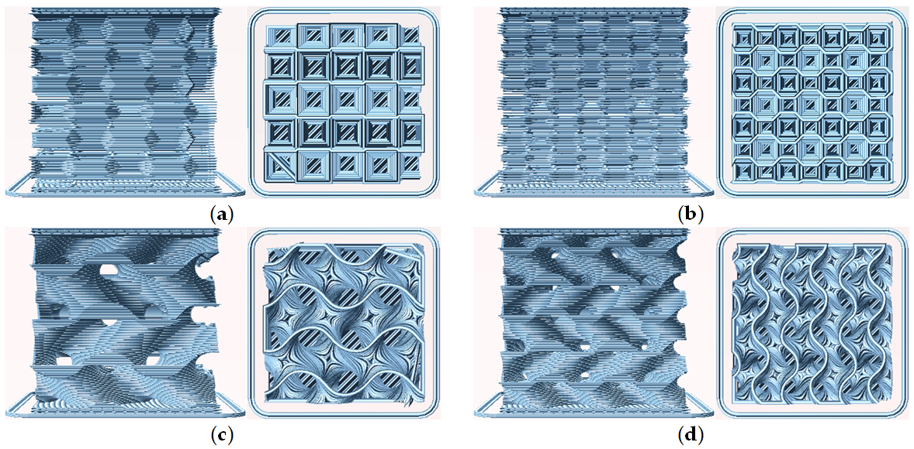
Materials and Methods
3D printing with a fused deposition modelling (FDM) printer Prusa I3 MK3
Filament: polylactic acid (PLA), a shape memory polymer
Standard printing parameters: nozzle 210 °C, bed 60 °C, nozzle diameter 0.4 mm, layer height 0.15 mm
Printing infill patterns only: gyroid / 3D honeycomb; density 10 % 15 %
(a) 3D honeycomb, 10 % infill (“H10”); (b) 3D honeycomb, 15 % infill (“H15”); (c) gyroid, 10 % infill (“G10”); (d) gyroid, 15 % infill (“G15”)

Slide 4
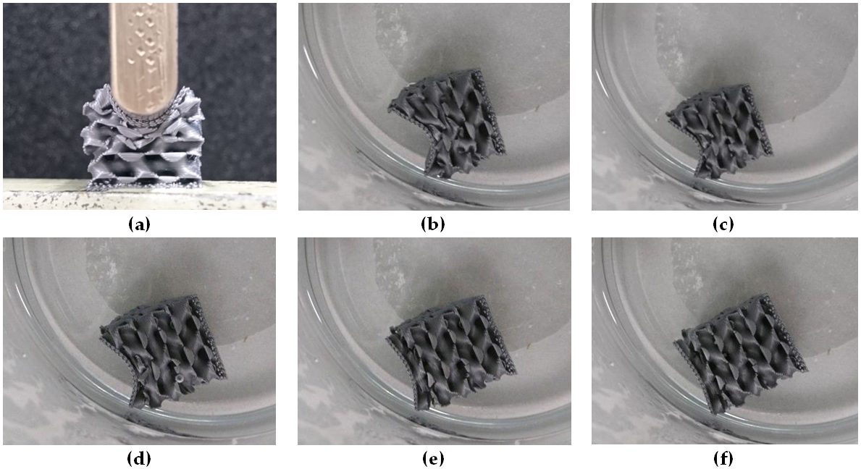
Results and Discussion
Test procedure (here for sample G15):
(a) Pressing sample G15 up to a maximum impact of 10 mm; (b)-(f) recovery process in water of 60 °C

Slide 5
Results and Discussion – quasi-static load tests
3D honeycomb more stable than gyroid
Higher infill density leads to significantly higher loads at identical impact
Recovery at 60 °C insufficient for self-healing of the specimens
3D honeycomb has no internal channels → warm water cannot penetrate well
Only partial recovery could be reached, better in gyroid samples
Future tests: higher recovery temperatures, designing new infill patterns combining the advantages of the recent ones

