Slide 1
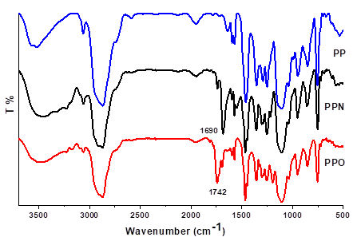
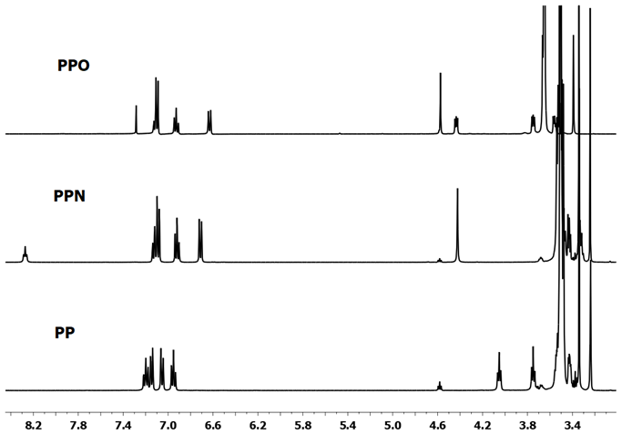
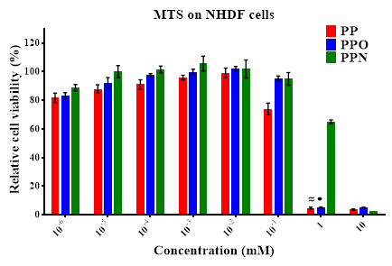
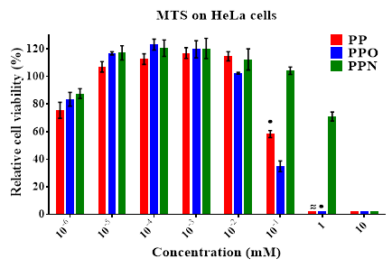
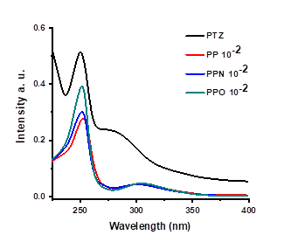
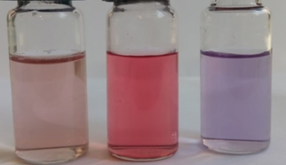
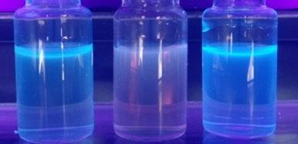
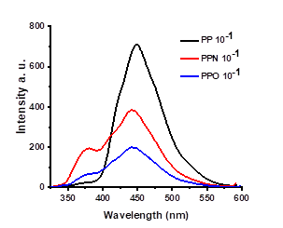
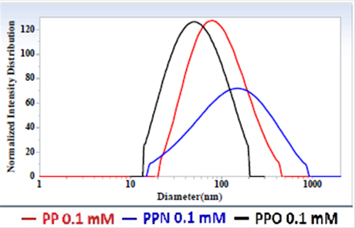
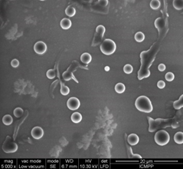
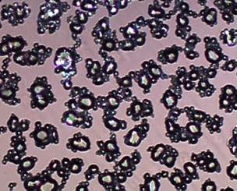
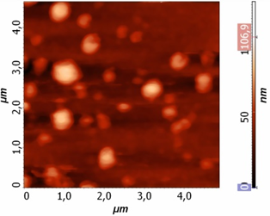
Water soluble PEGylated phenothiazines. Synthesis, characterization and antitumor properties
Sandu Cibotaru¹, Andreea-Isabela Sandu¹, Dalila Belei², Luminita Marin¹
1”Petru Poni” Institute of Macromolecular Chemistry of Romanian Academy, Iasi, Romania
2“Alexandru Ioan Cuza” University, Department of Organic Chemistry, Iasi, Romania
Introduction
Results and discussions
Phenothiazine (PTZ) is a fused ring heterocyclic compound with high potential to be used in a wide range of applications. Though, due to its poor solubility in ordinary solvents[1], its applicability in the biomedical field is limited. In this context the researchers attention went to finding new ways to increase its solubility. Therefore, in this study we used phenothiazine PEGylation with the final aim to obtain water soluble compounds, proper to be used in biomedical purposes[2].
Structural characterization
The PP and PPO presented a good antitumor activity on Human Cervical Cancer (HeLa) cells at concentration 0.1 mM, with a relative cell viability of 58 % for PP and 34 % for PPO.
The successful synthesis of the compounds was confirmed by FTIR and NMR spectroscopy. The FTIR spectra (Fig. 3) displayed the characteristic vibrations of the main groups present in the final compounds. The NMR spectra (Fig. 4) showed the disappearance of the chemical shifting characteristic to the hydrogen linked to the nitrogen atom of phenothiazine, and chemical shifting characteristic to the new synthesized compounds in the right ratio of their integrals.
Materials and methods
Figure 3. FTIR spectra of PEGylated compounds
Figure 4. ¹H-NMR spectra of PEGylated compounds
Three PTZ derivatives were obtained using three different synthetic routes. The first derivative was obtained by direct alkylation of a tosylated poly(ethylene glycol)PEG chain resulting the (PP) compound. The other two were synthesized by grafting the PEG chain via an ester function (PPO), and an amide function (PPN), respectively.
Photophysical behavior
Figure 9. Cell viability on NHDF and HeLa cells.
The photophysical behavior of the compounds was investigated by UV-vis spectroscopy in comparison with the pristine PTZ. The compounds absorption spectra (Fig. 5) showed the two absorption bands from phenothiazine, with the difference that the second one is bathochromic shifted with 25 nm. This is a consequence of aggregate formation, due to the amphiphilic nature of the compounds.
On the other side, the samples were able to emit blue light under UV lamp illumination (Fig. 2). The recorded emission spectra (Fig. 6) confirmed the visual observations by the presence in the spectra of a band with a maximum in the blue region at 450 nm.
Conclusions
Three PEGylated phenothiazines were synthesized and their structure was confirmed by FTIR and ¹H-NMR spectroscopy.
They presented slight luminescence.
Because of the PEG content the compounds were water soluble, and due to their amphiphilic nature they formed aggregates through self assembling.
The new compounds were biocompatible and two of them presented good antitumor activity.
PPO
PPN
PP
PPO
PPN
PP
Figure 5. UV-vis absorption spectra of PEGylated compounds and PTZ in water
Self-assembling behavior
Figure 1. Compounds water solution under natural light
Figure 2. Compounds water solution under UV light
The UV-vis findings, according to which the compounds are able to self assemble into aggregates, were confirmed by DLS (Fig. 7) measurements.
In all cases the aggregates were nanometric with a mean diameter of 200 nm and a quite low dimensional polydispersity. The morphological investigations by SEM, AFM and POM techniques (Fig. 8), demonstrated the spherical shape of the aggregates and their uniformity.
References
[1] S. Ahmadian, V. Panahi-Azar, M. A. A. Fakhree, W. E. Acree, Jr., A. Jouyban, J. Chem. Eng. Data. 56, 4352–4355 (2011)
[2] S. Cibotaru, A. I. Sandu, D. Belei, L. Marin, Mater. Sci. Eng. C. 116 111216 (2020)
Figure 7. DLS graphs of the studied compounds
Figure 6. Photoluminescence spectra of PEGylated compounds in water
a
b
c
In vitro biocompatibility
Scheme 1. Synthesis of the PEGylated derivatives.
All three compounds presented a good biocompatibility on Normal Human Dermal Fibroblast (NHDF) cells for concentrations up to 0.1 mM, while for PPN the concentration increased up to 1 mM.
Acknowledgment
All three compounds were characterized by spectroscopic, optical and morphological methods. Their biological activity was evaluated in vitro on NHDF and HeLa cell lines.
Figure 8. a) SEM b) POM images of the PP embedded into a solid PVAB matrix and c)AFM images of the PP in pure form
This work was supported by a project financed through a Romanian National Authority for Scientific Research MEN – UEFISCDI, grant project PN-III-P4-ID-PCCF-2016-0050

