Slide 1
Antimicrobial, antioxidant, and GC-MS analysis of hexane extract of the leaves of Solanum erianthum
By
Taye Alawode^{1,2*}, Labunmi Lajide², Bodunde Owolabi² and Mary Olaleye³
¹Department of Chemistry, Federal University Otuoke, Nigeria
²Department of Chemistry, Federal University of Technology Akure, Nigeria ³Department of Biochemistry, Federal University of Technology Akure , Nigeria
*Corresponding email: onatop2003@yahoo.com

Slide 2
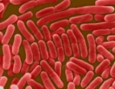
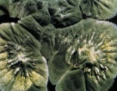
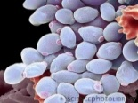
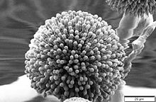
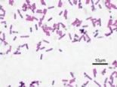
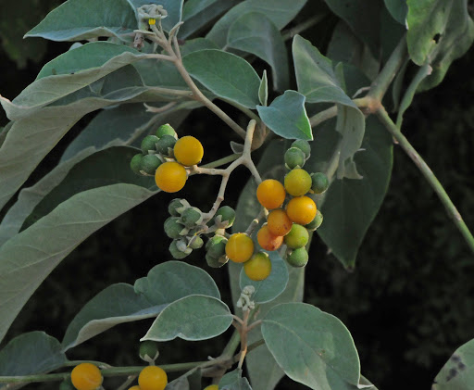
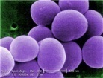
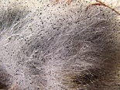
Antimicrobial, Antioxidant and GC-MS Analysis of Hexane
Extract of the Leaves of Solanum erianthum
Antimicrobial Assay
Hexane Extraction
GC-MS Analysis
Plant Antioxidants

Slide 3
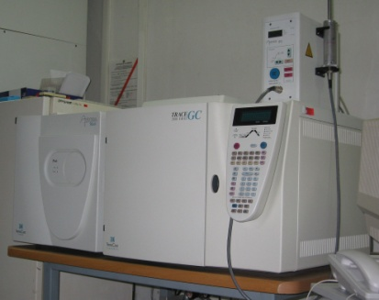
Antimicrobial, Antioxidant and GC-MS Analysis of Hexane
Extract of the Leaves of Solanum erianthum
Antimicrobial Assay
GC-MS Analysis
Hexane Extract
Solanum erianthum
Antioxidant Assay

Slide 4
ABSTRACT
Solanum erianthum is used in ethnomedicine for the treatment of various diseases. In the study, the hexane extract of the plant was screened for antimicrobial and antioxidant activities. Dried leaves samples were extracted with hexane. The extract was screened for activity against Staphylococcus aureus, Escherichia coli, Bacillus subtilis, Pseudomonas aeruginosa, Salmonella typhi, Klebisidlae pneumonae, Candida albicans, Aspergillus niger, Penicillium notatum and Rhizopus stolonifer at concentrations ranging between 6.25 mg/ml and 200 mg/ml using the agar diffusion method. The extract was screened for antioxidant activities using the DPPH free radical scavenging assay at concentrations between 0.0625 mg/ml and 1 mg/ml. All results were compared with those of the standard drugs. GC-MS analysis of the extract was thereafter carried out. Activities generally increased with the concentration in the antimicrobial assay. The highest zone of inhibition (28 mm) was obtained against S. aureus at 200 mg/ml. The extract, however, did not show a zone of inhibition as high as that of the standard drug (gentamycin and tioconazole) against any of the test organisms. IC₅₀ value of 0.729 was obtained in the DPPH assay which is higher than the IC₅₀ value (of 0.017) got for the standard Ascorbic acid. Some of the major compounds observed in extract include 1-octadecene (23.59 %), 9,12-Octadecadienoic acid (Z,Z) (14.01 %) and hexadecanoic acid ethyl ester (8.06 %). These compounds could have contributed to the bioactivities demonstrated by the extract.
Keywords: Solanum erianthum, hexane, antimicrobial, antioxidant, GC-MS

Slide 5
Introduction
Medicinal plants are widely employed as alternative form of treatment in many countries. Most often, however, the ethnobotanical uses of the plants are not backed up with scientific evidence.
Presently, research efforts are often directed at validating these claims. Where the medicinal properties are established, the biologically-active organic molecules responsible for the observed medicinal properties of the plants are isolated in pure form.
The present study investigates the leaves of S. erianthum for antimicrobial and antioxidant activities. The plant is used for the treatment of skin infections by traditional medical practitioners in south-western Nigeria.

Slide 6
Results and Discussion
Phytoconstituents in Hexane Extracts of leaves of S. erianthum
Tests | Extract
Tannins | -
Glycosides | -
Resin | -
Saponins | +
Phlobatanins | -
Flavonoids | +
Sterols | -
Phenols | +
Carbohydrate | -
Alkaloids | +
Terpenoids | -
Several compounds from these phytochemical groups have been reported to possess antibacterial, antifungal and antioxidant properties (Othman et al., 2019)

Slide 7
Results and Discussion (Cont’d)
Antibacterial activity
 | Mean Zone of Inhibition (mm)
Conc. (mg/ml) | SA | EC | BS | PA | ST | KP
200 | 28 | 26 | 26 | 24 | 20 | 24
100 | 24 | 22 | 22 | 22 | 18 | 20
50 | 20 | 18 | 20 | 20 | 16 | 18
25 | 18 | 14 | 16 | 18 | 14 | 14
12.5 | 14 | 12 | 14 | 12 | 12 | 12
6.25 | 10 | 10 | 12 | 10 | 10 | 10
MIC (mg/ml) | 1.25 | 2.50 | 2.50 | 2.50 | 2.50 | 2.50
Gentamicin (10 µg/ml) | 40 | 40 | 40 | 38 | 40 | 40
SA- S. aureus, EC – E. coli, BS – B. subtilis, PA – P. aeruginosa, ST – S. typhi,
KP – K. pneumonia

Slide 8
Results and Discussion (Cont’d)
Antifungal activity
 | Zone of Inhibition (mm)
Conc. (mg/ml) | CA | AN | PN | RS
200 | 22 | 20 | 20 | 18
100 | 20 | 18 | 18 | 16
50 | 18 | 14 | 16 | 14
25 | 14 | 12 | 14 | 12
12.5 | 12 | 10 | 12 | 10
6.25 | 10 | - | 10 | -
MIC (mg/ml) | 2.50 | 5.00 | 2.50 | 5.00
Tioconazole(10 µg/ml) | 26 | 28 | 28 | 28
CA – C. albicans, AN – A. niger, PN – P. notatum, RS – R. stolonifer

Slide 9
Results and Discussion (Cont’d)
Generally, it can be observed that the zones of inhibition increased with increasing concentrations of the extracts. This is in agreement with previous reports (Homaida et al., 2019).
S. aureus is most susceptible to the extract with MIC value of 1.25 mg/ml
Escherichia coli, Klebsiella pneumoniae and Staphylococcus aureus are gram negative bacteria. Gram-negative bacteria which are known for their ability to restrict the diffusion of hydrophobic compounds through their membranes. Antifungal resistance by C. albicans has also been reported to occur with long-term antifungal use and with recurrent infections
(Arendrup and Patterson, 2017).

Slide 10
Results and Discussion (Cont’d)
The antimicrobial activity observed against the test organisms could be due to the interactions of the plant active metabolites with the organism’s cytoplasmic membrane leading to the leakage of intracellular components and precipitation of cytoplasmic contents (Thangamani et al., 2016).

Slide 11
Results and Discussion (Cont’d)
DPPH Scavenging Activity: Standard versus Extract
The DPPH scavenging properties increased with the concentration of the extracts. Similar trends have been observed in previous studies (Pavithra and Vadivukkarasi, 2015).

Slide 12
Results and Discussion (Cont’d)
GC-MS Analysis: Some Compounds detected in the hexane extract of the leaves
t_{R}(min.) | Area (%) | Name of Compound | Quality (%)
11.816 | 1.35 | Butylated Hydroxytoluene | 98
14.162 | 1.23 | Heptadecane | 95
15.318 | 1.34 | Octadecane | 93
15.409 | 1.19 | Hexadecane,1,1’-oxybis | 81
15.787 | 2.28 | Cyclotetradecane, 1,7, 11-trimethyl-4-(1-methylethyl)- | 91
17.401 | 8.06 | Hexadecanoic acid, ethyl ester | 91
17.876 | 1.71 | Ethanol, 2-(Octadecyloxy)- | 93
18.551 | 2.33 | Eicosane | 95
18.608 | 0.58 | 1-Docosene | 90
19.060 | 14.01 | 9,12-Octadecadienoic acid (Z,Z) | 96
19.123 | 8.54 | Cyclohexene, 4-(4-ethylcyclohexyl)-1-pentyl | 95

Slide 13
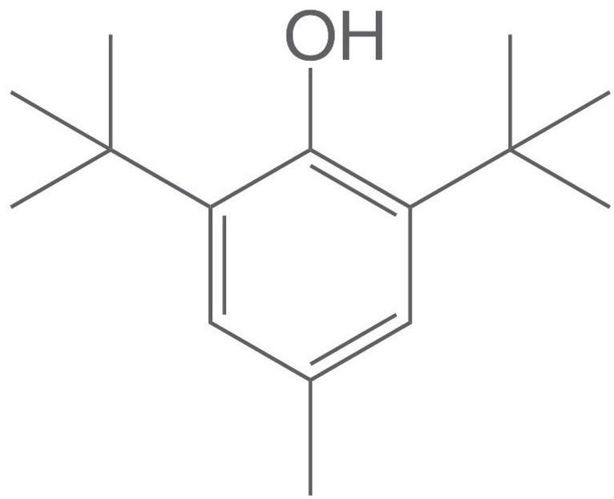
Results and Discussion (Cont’d)
Biological activities of some of the detected compounds (Cont’d)
Butylated Hydroxytoluene
Butylated hydroxytoluene (BHT) is a most commonly used antioxidant recognized as safe for use in foods containing fats, pharmaceuticals, petroleum products, rubber and oil industries (Yehye et al., 2015).

Slide 14
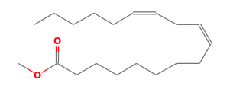
Results and Discussion (Cont’d)
Biological activities of some of the detected compounds (Cont’d)
9,12-Octadecadienoic acid (Z,Z)
Antiinflammatory, hypocholesterolemic, cancer preventive, hepatoprotective, nematicide, insectifuge(cide), antihistaminic, antieczemic, antiacne, 5-α reductase inhibitor, antiandrogenic, antiarthritic, anti coronary, antimicrobial (Adeoye-Isijola et al., 2018).

Slide 15
Results and Discussion (Cont’d)
Biological activities of some of the detected compounds (Cont’d)
Anticancer, antioxidant and antimicrobial activity (Mishra and Sree, 2007; Uma and Parvathavarthini, 2010)
Heptadecane
Anticancer, antioxidant and antimicrobial activity (Mishra and Sree, 2007; Uma and Parvathavarthini, 2010)
Octadecane

Slide 16
Results and Discussion (Cont’d)
Biological activities of some of the detected compounds (Cont’d)
Antioxidant, Hemolytic, Hypocholesterolemic, Nematicide (Tyagi and Agarwal, 2017)
Hexadecanoic acid, ethyl ester

Slide 17
Conclusion
The hexane extract of the leaves of S. erianthum demonstrated antimicrobial and antioxidant activities. While the activities obtained is not as high as those of the standard drugs, the extract has shown some potential as a source of antimicrobial and antioxidant compounds.

