Slide 1
Chromolaena odorata ethanol leaves extract attenuated testosterone-induced benign prostatic hyperplasia in male albino rats
Ifeoma Felicia Chukwuma¹*, Nene Orizu Uchendu¹, John Izuchukwu John¹, and Lawrence Uchenna Sunday Ezeanyika¹
Presented by: Chukwuma Ifeoma Felicia
¹Department of Biochemistry, Faculty of Biological Sciences, University of Nigeria, Nsukka, Nigeria.
* Corresponding author: chukwuma.ifeoma@unn.edu.ng; odoifeoma1@gmail.com .

Slide 2
Abstract
Benign prostatic hyperplasia (BPH), characterized by the proliferation of the stromal, and epithelial cells is one of the most frequent diseases in aging males. This study investigated the effect of ethanol leaves extract of Chromolaena odorata on testosterone-induced BPH in male albino rats. BPH was induced by subcutaneous injection of testosterone to experimental groups (B-F) for 28 days. Group A was not induced (normal control, received carboxymethyl cellulose (vehicle), group B (BPH-control) received vehicle while group C received 1 mg/kg body weight of finasteride (standard control), and groups D-F were administered different doses (100, 200, 400 mg/kg body weight) of the extract respectively for 21 days. Blood samples collected from the animals through retro-orbital bleeding after overnight fast were used for determination of prostate biomarkers using standard methods. Results show that Group C, and groups D-F, had reduction in serum levels of testosterone, dihydrotestosterone, prostrate sensitive antigen, malondialdehyde, aspartate aminotransferase and alanine aminotransferase activities, and an increase in superoxide dismutase and catalase activities compared with BPH-control. The results from this study showed that Chromolaena odorata leaves extract attenuated testosterone-induced BPH anomalies possibly through the prevention of oxidative stress making it promising phytotherapy for management of BPH in males.
Keywords: Chromolaena odorata; oxidative stress; benign prostatic hyperplasia; prostate sensitive antigen; antioxidants activity.

Slide 3
Introduction
Benign prostatic hyperplasia (BPH), a non-cancerous proliferation of epithelial, and stromal cells of the prostate gland is one of the most common age related diseases in aging men.
Causes of BPH include but are not limited to the following:
Age.
Oxidative stress.
Inflammation.
Metabolic syndrome.
Hormones.

Slide 4
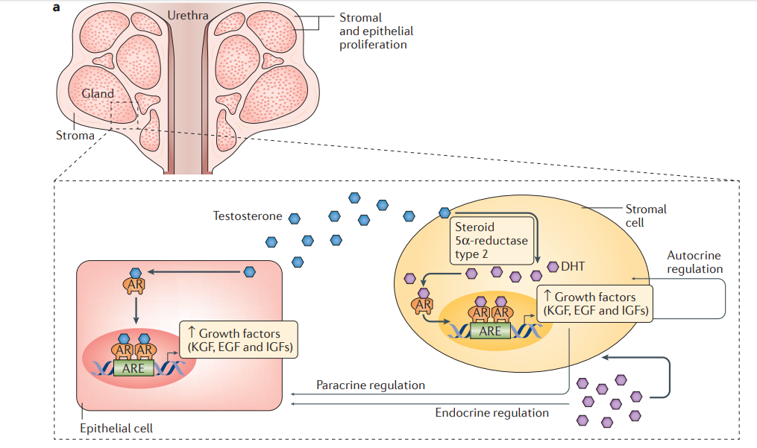
Fig. 1a: Role of testosterone in benign prostatic hyperplasia.
Chughtai et al., Nat Rev Dis Primers. 2016, 2:16031.

Slide 5
Management approaches
Watchful waiting: This includes advice about life style changes that can ameliorate symptoms (Nyami et al.2016).
Medical therapy: The most commonly drugs used for BPH are α- blockers, and 5α-reductase inhibitors (Ikeyi et al. 2020; Sun et al. 2020).
Surgery : This could be in form of prostate tissue compression, debulking of the adenoma and adenectomy (removal of adenoma) (Chughtai et al.2016)
.

Slide 6
Need for alternative management approach for BPH
Watchful waiting: Lack of self discipline may worsen symptoms over time.
Medical therapy: Hypotension, nasal congestion, headache, and sexual dysfunction.
Surgery: High cost of surgery, urinary tract infection, permanent sexual side effect and urinary incontinence.

Slide 7
Chromolaena odorata also known as Siam weed, bitter bush or Christmas bush is a perennial herb which belongs to Asteraceae family (Vijayaraghavan et al. 2017).
Pharmacological activities identified in the plant extract(s) include: Antioxidant, anti-inflammatory, anti-diabetic, hemostatic, hepatoprotective, anticancer and immunomodulatory activities (Vijayaraghavan et al 2017; kanase and Shaikh 2018).
Compounds isolated from the plants
Phenolic compounds have been isolated such as p-coumaric, vanillic acids, p-hydrobenzoic acid, and flavonoids such as flavones, chalcones, and flavonols (Kanase and Shaikh 2018).
Flavonone called odoratin (1)

Slide 8
Materials and methods
Identification & extraction of Chromolaena odorata leaves.
Experimental design
A total of thirty male albino rats divided into six groups of five animals each used for this study were treated as follows:
Group A: Not induced and not treatment, given only vehicle, carboxymethyl cellulose (Normal control)
Group B: BPH-induced and not treatment, given only vehicle (BPH- control)
Group C: BPH- induced and treated with 1 mg/kg b. w of finasteride (Standard control)
Group D: BPH induced and treated with 100 mg/kg b. w of the ethanol extract
Group E: BPH induced and treated with 200 mg/kg b. w of the ethanol extract
Group F: BPH induced and treated with 400 mg/kg b. w of the ethanol extract

Slide 9
Results and discussion
Table 1: Quantitative Phytochemical constituent of ethanol leaves extract
of Chromolaena odorata
Phytochemicals | Amount (mg/g)
Tannins | 0.72 ± 0.01
Saponins | 1.74 ± 0.03
Flavonoids | 0.93 ± 0.03
Alkaloids | 1.63 ± 0.02
Steroids | 0.40 ± 0.01
Glycosides | 0.21 ± 0.02
Values are expressed as Mean ± SD, n=3

Slide 10
Table 2:Acute toxicity study (LD₅₀) of ethanol leaves extract of Chromolaena odorata
Doses in mg/kg body weight | Number of deaths recorded
Phase 1 10 | 0/3
100 | 0/3
1000 Phase 2 | 0/3
1600 | 0/3
2900 | 0/3
5000 | 0/3
n=3

Slide 11
Table 3: Effect of ethanol leaves extract of Chromolaena odorata on prostate status of BPH-induced rats
GROUPS | Testosterone (ng/ml) | PSA (ng/ml) | DHT (ng/ml)
A | 3.40 ± 1.71 ª | 2.18 ± 0.94 ª | 2.78 ± 0.70 ^{a,b}
B | 8.96 ± 0.77 ^{d} | 6.72 ± 2.13 ^{c} | 3.26 ± 0.69 ^{b}
C | 4.14 ± 0.88 ^{a, b} | 2.90 ± 1.25 ^{a, b} | 2.24 ± 0.20 ª
D | 7.68 ± 1.12^{c,d} | 4.30 ± 1.64 ^{b} | 2.74 ± 0.73 ^{a, b}
E | 7.02 ± 2.06 ^{c,d} | 3.56 ± 0.39 ^{a, b} | 2.30 ± 0.21 ª
F | 6.02 ± 2.24 ^{b,c} | 3.22 ± 0.73 ^{a,b} | 2.40 ± 0.46 ª
Key: Group A: Not induced and not treatment (Normal control; given carboxymethyl cellulose (vehicle) ), Group B: BPH induced and not treatment, given only vehicle (BPH- control), Group C: BPH induced and treated with 1 mg/kg b. w of finasteride (Standard control) and Groups D-F: BPH induced and treated with 100, 200 and 400 mg/kg b. w of the ethanol extract respectively.
.

Slide 12
Table 4: Effect of ethanol leaves extract of Chromolaena odorata on malondialdehyde level, and antioxidant enzymes of BPH-induced rats
GROUPS | MDA (mg/ml) | SOD (U/mg) | CAT (U/mg)
A | 1.56 ± 0.52 ^{b} | 11.12 ± 0.17 ^{b} | 2.50 ± 0.23^{a,b}
B | 2.64 ± 0.61 ^{c} | 10.76 ± 0.21 ª | 2.05 ± 0.18 ª
C | 0.91 ± 0.22 ª | 10.92 ± 0.31 ^{a, b} | 3.35 ± 0.54 ^{a,b,c}
D | 2.78 ± 0.28 ^{c} | 10.92 ± 0.13 ^{a, b} | 3.21 ± 0.25 ^{b, c}
E | 1.46 ± 0.35 ^{a, b} | 11.06 ± 0.15 ^{b} | 4.00 ± 0.64 ^{c, d}
F | 1.25 ± 0.45 ^{a, b} | 11.10 ± 0.15 ^{b} | 4.20 ± 1.33 ^{d}
Key: Group A: Not induced and not treatment (Normal control; given carboxymethyl cellulose (vehicle) ), Group B: BPH induced and not treatment, given only vehicle (BPH- control), Group C: BPH induced and treated with 1 mg/kg b. w of finasteride (Standard control) and Groups D-F: BPH induced and treated with 100, 200 and 400 mg/kg b. w of the ethanol extract respectively.

Slide 13
Table 5: Effect of ethanol leaves extract of Chromolaena odorata on liver function enzymes in Testosterone-Induced Rats
GROUPS | AST (IU/L) | ALT (IU/L)
A | 19.80 ± 2.04 ^{a, b} | 19.20 ± 7.39 ^{a,b}
B | 23.40 ± 4.03 ^{b} | 30.80 ± 7.82 ^{c}
C | 17.80 ± 2.86 ª | 15.60 ± 4.82 ª
D | 20.60 ± 2.19 ^{a,b} | 30.20 ± 4.38 ^{c}
E | 18.80 ± 2.38 ª | 25.00 ± 6.44 ^{b,c}
F | 18.20 ± 2.68 ª | 20.60 ± 6.87 ^{a,b}
Key: Key: Group A: Not induced and not treatment (Normal control; given carboxymethyl cellulose (vehicle) ), Group B: BPH induced and not treatment, given only vehicle (BPH- control), Group C: BPH induced and treated with 1 mg/kg b. w of finasteride (Standard control) and Groups D-F: BPH induced and treated with 100, 200 and 400 mg/kg b. w of the ethanol extract respectively.

Slide 14
Table 6: Effect of ethanol extract of Chromolaena odorata on lipid profile of BPH-induced rats
GROUPS | CHOL (mmol/L) | TAG (mmol/L) | HDL-C (mmol/L) | LDL-C (mmol/L)
A | 4.74 ± 1.76 ª | 1.82 ± 0.20 ^{a,b} | 5.04 ± 0.39 ^{a,b,c} | 1.48 ± 0.41 ª
B | 7.82 ± 1.36 ^{b} | 2.29 ± 0.42 ^{c} | 3.88 ± 1.18 ª | 2.32 ± 0.52 ^{b}
C | 4.57 ± 0.65 ª | 1.66 ± 0.31 ª | 5.60 ± 0.48 ^{b,c} | 1.04 ± 0.26 ª
D | 7.62 ± 1.67 ^{b} | 2.22 ± 0.29 ^{b,c} | 4.63 ± 0.34 ^{a,b} | 2.22 ± 0.34 ^{b}
E | 7.27 ± 1.09 ^{b} | 2.15 ± 0.31 ^{b,c} | 5.15 ± 1.18 ^{b,c} | 1.50 ± 0.39 ª
F | 5.32 ± 1.23 ª | 1.92 ± 0.24 ^{a,b,c} | 5.98 ± 1.03 ^{c} | 1.32 ± 0.71 ª
Key: Group A: Not induced and not treatment (Normal control; given carboxymethyl cellulose (vehicle) ), Group B: BPH induced and not treatment, given only vehicle (BPH- control), Group C: BPH induced and treated with 1 mg/kg b. w of finasteride (Standard control) and Groups D-F: BPH induced and treated with 100, 200 and 400 mg/kg b. w of the ethanol extract respectively.

Slide 15
Conclusions
Results from this study showed that leaves extract of Chromolaena odorata reduced levels of testosterone, PSA, DHT, liver enzymes activities as well as cholesterol, triacylglycerol, and LDL-C, and increased antioxidant enzymes activities compared with the BPH-control. These findings indicates that leaves extract of Chromolaena odorata attenuated BPH anomalies and could be employed as promising phytotherapy for BPH treatment. However, the exert molecular mechanisms of its action needs to be ascertained.

Slide 16
Acknowledgments
The authors want to appreciate all the post graduate students, technical staff, and lecturers of the Department of Biochemistry, University of Nigeria, Nsukka, Nigeria who contributed towards the success of this research work

Slide 17
THANK YOU
FOR
LISTENING

