Slide 1
Industrial hemp as a promising source of anti-Inflammatory, anti-proliferative and antimycotic agents:
results from in silico, in vitro and ex vivo studies
Claudio Ferrante*,
Department of Pharmacy, University "G. d'Annunzio" of Chieti-Pescara,
Chieti 66100, Italy.
* Corresponding author: claudio.ferrante@unich.it

Slide 2
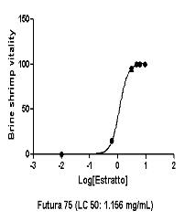
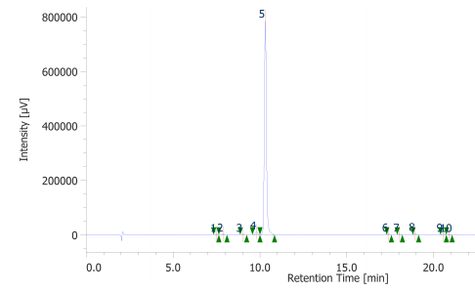
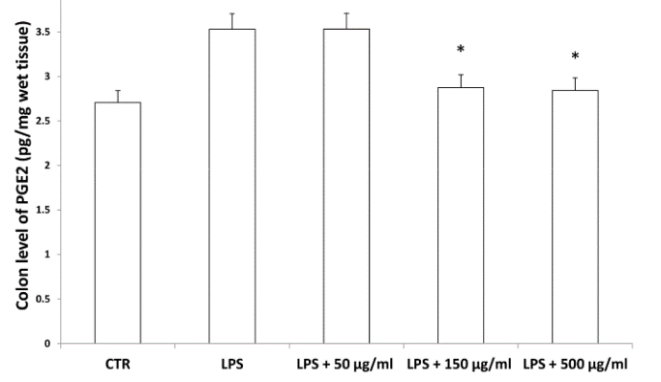
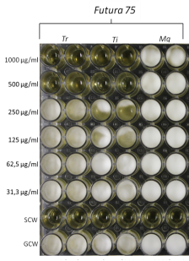
Industrial hemp as a promising source of anti-Inflammatory, anti-proliferative and antimycotic agents:
results from in silico, in vitro and ex vivo studies
Graphical Abstract
Biocompatibility
Industrial hemp
Phytochemical analysis
Antimycotic effects
Protective effects

Slide 3
Abstract:
Industrial hemp is cultivated as a source of fibers and nutrients. Multiple studies demonstrated antimicrobial, anti-proliferative, phytotoxic and insecticide effects of the essential oil. On the other side, only a few studies explored the potential pharmacological application of polar extracts. In the present study, we investigated the water extract from inflorescences of industrial hemp. The water extract was assayed for antiradical and anti-tyrosinase effects. We explored the extract effects on LPS-induced production of colon serotonin, dopamine, kynurenine pathways and (PG)E2. Anti-proliferative effects were also evaluated against human colon cancer HCT116 cell line. Antimycotic effects were investigated against Trichophyton rubrum, Trichophyton interdigitale, Microsporum gypseum. Finally, in silico studies were conducted in order to predict the putative targets. Hemp water extract was able to blunt LPS-induced reduction of serotonin and increase of dopamine and kynurenine turnover. Additionally, the reduction of PGE2 levels was observed as well. The extract inhibited the HCT116 cell viability, the growth of T. rubrum and T. interdigitale and the activity of tyrosinase, whereas docking studies highlighted the inhibitions of cyclooxygenase-1, carbonic anhydrase IX, and lanosterol 14-α-demethylase. The present findings suggest female inflorescences from industrial hemp as high quality by-products, thus representing promising sources of nutraceuticals and cosmeceuticals .
Keywords: Hemp; anti-inflammatory; anti-mycotic; anti-proliferative.

Slide 4
Introduction
Industrial hemp (Cannabis sativa) has been long cultivated throughout history as a valuable source of fibers and nutrients. Specifically, the fibers, isolated from the stalk, are used for manufacturing ropes, paper, clothing and construction materials (thermal and acoustic insulation), whereas hemp seeds demonstrated a high nutritional value, due to their richness in minerals, vitamins (i.e. A, C and E complexes), carbohydrates, proteins and lipids, these last consisting of linoleic (ω-6) and α-linolenic acid (ω-3) in the ideal ratio 3:1. Additionally, industrial hemp varieties are also bred to produce tetrahydrocannabinol (THC) in traces (<0.3%), and only certified varieties, with THC content < 0.2%, are admitted to cultivation, according to National and International Regulations (EU Regulation N°. 1124/2008-12 November 2008; Italian Regulation n°172/2017). Although the hemp chain production was principally focused on fiber production and seed-deriving foods, in the last years there has been a renewed interest in the study and valorization of hemp-deriving extracts, that are sources of terpenes, terpenophenolics, amino acids, fatty acids, sugars, hydrocarbons, flavonoids, with promising health-promoting and pharmacological effects. In this regard, multiple studies focused on the antimicrobial, anti-proliferative, phytotoxic and insecticide effects of the essential oil from hemp female inflorescences, sold dried for technical use and usually considered as a waste material of industrial hemp chain production. On the other side, only a few studies explored the potential pharmacological application of polar extracts from inflorescences. In our previous study, we showed antioxidant/anti-inflammatory and antimycotic properties of the certified hemp variety “Futura 75”, whose essential oil from inflorescences was also reported as an antibacterial and anti-proliferative agent. In the present study, we aimed to further characterize the water extract from the inflorescences of this hemp variety, through a qualitative phytochemical analysis and a pharmacological investigation aimed to evaluate protective effects in a toxicological experimental paradigm constituted by isolated rat colon and liver exposed to lipopolysaccharide (LPS). In this regard, we explored the effects of water hemp extract on serotonin, dopamine and kynurenine pathways, in rat colon, whereas prostaglandin (PG)E₂ levels were measured in both colon and liver. Anti-proliferative effects were also assayed against the human colon cancer HCT116 cell line. Taking into consideration the inhibitory effects induced by this extract on both Candida albicans and C. tropicalis [10], we also explored the antimycotic effects of Futura 75 water extract on multiple dermatophytes species, namely Trichophyton rubrum, Trichophyton interdigital, Microsporum gypseum. In parallel, we assayed the enzyme inhibition effect of the extract against tyrosinase, whose increased activity is related to skin hyperpigmentation, following mycotic infectious diseases, as well. Finally, in silico studies, including bioinformatics, network pharmacology and docking approaches were conducted in order to predict the putative targets underlying the observed pharmacological and microbiological effects.

Slide 5
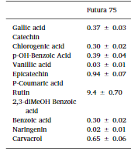
Results and discussion
The extract displayed a content of rutin (>9 µg/mg extract), that was considered putatively responsible, at least in part, of the protective effects exerted in the colon. Chlorogenic acid, gallic acid and carvacrol were also measured in the extract. The phenolic profile is also consistent with the scavenger, reducing, chelating and anti-tyrosinase properties, thus suggesting intrinsic antioxidant and enzyme inhibition effects that could account for multiple pharmacological applications.
Table 1. Total phenolic, flavonoid content, antioxidant parameters and tyrosinase inhibitory effect
Parameters | Results
Total phenolic content (mg GAE/g) | 21.16±0.10
Total flavonoid content (mg RE/g) | 7.05±0.63
DPPH (mg TE/g) | 14.87±0.59
ABTS (mg TE/g) | 39.00±0.43
CUPRAC (mg TE/g) | 47.53±0.18
FRAP (mg TE/g) | 27.53±0.27
Tyrosinase (mg KAE/g) | 18.67±0.28
GAE: Gallic acid equivalents; RE: Rutin equivalents; TE: Trolox equivalents. KAE: Kojic acid equivalents. Values are reported as mean ± SD. of three parallel experiments.

Slide 6
Results and discussion
The extract was also analyzed through ¹H-NMR. The suppression of water signal was directly applied, in order to explore the qualitative composition of the water extract itself. The chemical shift values, in the range 3-4 ppm, indicate that sugar fraction represents most of the extract phytocomplex,

Slide 7
Results and discussion
According to the aforementioned fingerprint analysis, a network pharmacology profile was built, plotting the selected compounds towards the putative targets yielded by SwissTagetPrediction software. The results of network pharmacology approach indicate the putative interaction of most selected phenolic compounds towards multiple carbonic anhydrase (CA) isoforms, and this was consistent with our recent findings. Intriguingly, the sole carvacrol showed potential capability to interact with cyclooxygenase-1 (COX-1).

Slide 8
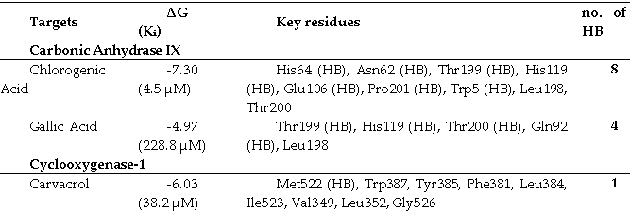
Results and discussion
Considering the up-regulated levels of both CA IX and COX-1 in colon cancer, thus suggesting the inhibition of these enzymes as a promising pharmacological tool to counteract colon cancer, we further investigated the putative interactions between gallic acid, chlorogenic acid and carvacrol towards these targets, through a docking approach. Chlorogenic acid has shown higher binding energy against carbonic anhydrase IX enzyme in comparison with gallic acid.

Slide 9
Results and discussion
Considering the docking results on CA IX and COX-1 enzymes, the water extract was also investigated for evaluating anti-proliferative effects towards the human colon cancer HCT116 cell that displayed a significant reduction of viability at the upper tested concentration (500 µg/mL), thus suggesting mild anti-proliferative effects.

Slide 10
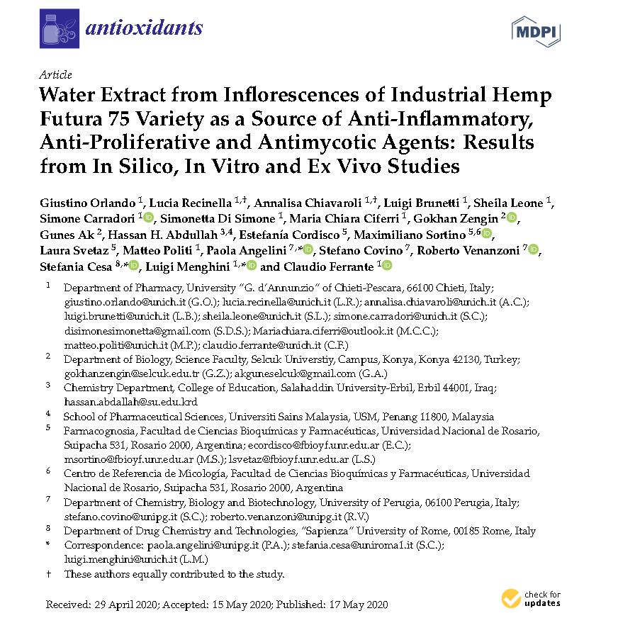
Results and discussion
The anti-inflammatory and antioxidant effects induced by hemp water extract were also investigated in isolated colon stimulated with LPS, and anti-oxidant effects were determined as 3-HK/KA and 5HIIA/5-HT ratio, respectively.
In the present study, we investigated for the first time the influence of hemp extracts on the two major tryptophan degradative pathways, namely kynurenine and and serotonin. In this context we hypothesize that hemp water extract is able to counteract the LPS-induced shift of tryptophan metabolism towards the production of pro-inflammatory metabolites.

Slide 11
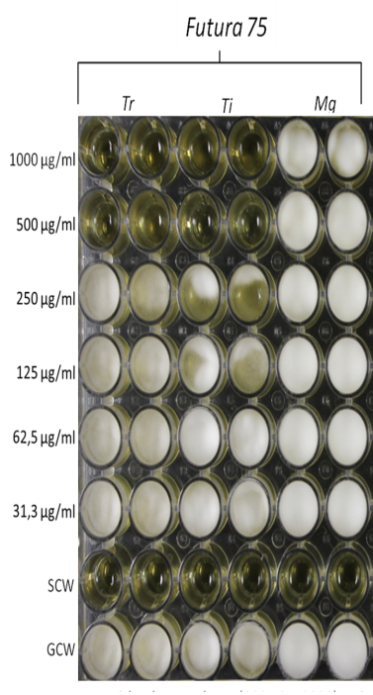
Results and discussion
In the present study we also evaluated the effects of the extract (500-1000 µg/mL) on different fungi strains, namely T. rubrum, T. interdigitale and M. gypseum, and involved in multiple skin alterations, including infectious granuloma and hyperpigmentation. No activity was observed against M. gypseum. These results could be added to the aforementioned inhibitory effect of the extract against tyrosinase, whose inhibition represents a cornerstone in the management of skin hyperpigmentation. The anti-mycotic effects could be also related, albeit partially, to the good submicromolar affinity of rutin towards lanosterol 14^{α}-demethylase, that plays a key role in fungal metabolism.

Slide 12
Conclusions
Concluding, the present findings highlight the potential of water extracts from industrial hemp inflorescences as sources of natural compounds that, besides the intrinsic antiradical activity, possess discrete mechanisms related to anti-inflammatory, anti-proliferative and antimycotic effects. In this context, and also in view of a more sustainable circular economy, it is desirable an improvement of industrial hemp chain production, taking into consideration the female inflorescences as high quality by-products with putative nutraceutical and cosmeceutical applications.

Slide 13
Acknowledgments
Plant material was provided by Hemp Farm Italia scarl [Tortoreto (TE), IT]. The ex vivo experimental paradigm was by Italian Health Ministry (Authorization N. F4738.N.XTQ, delivered on 11th November 2018).

