Slide 1
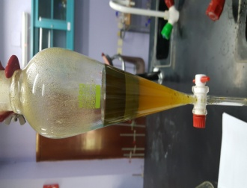
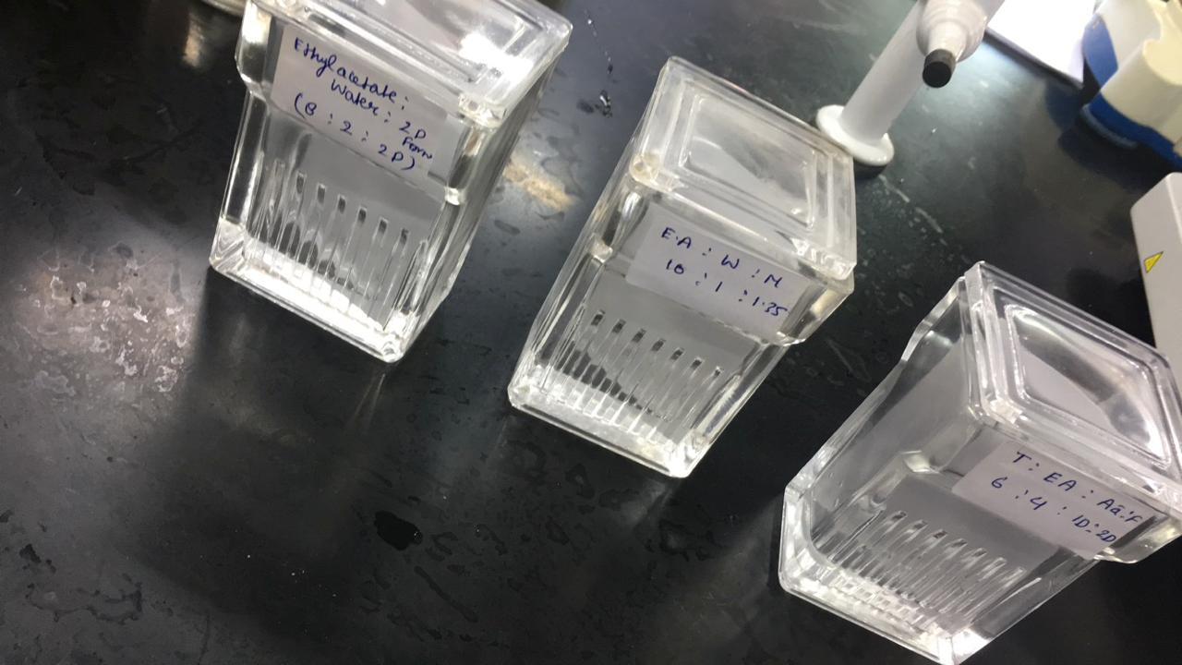
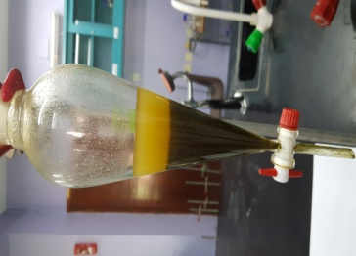
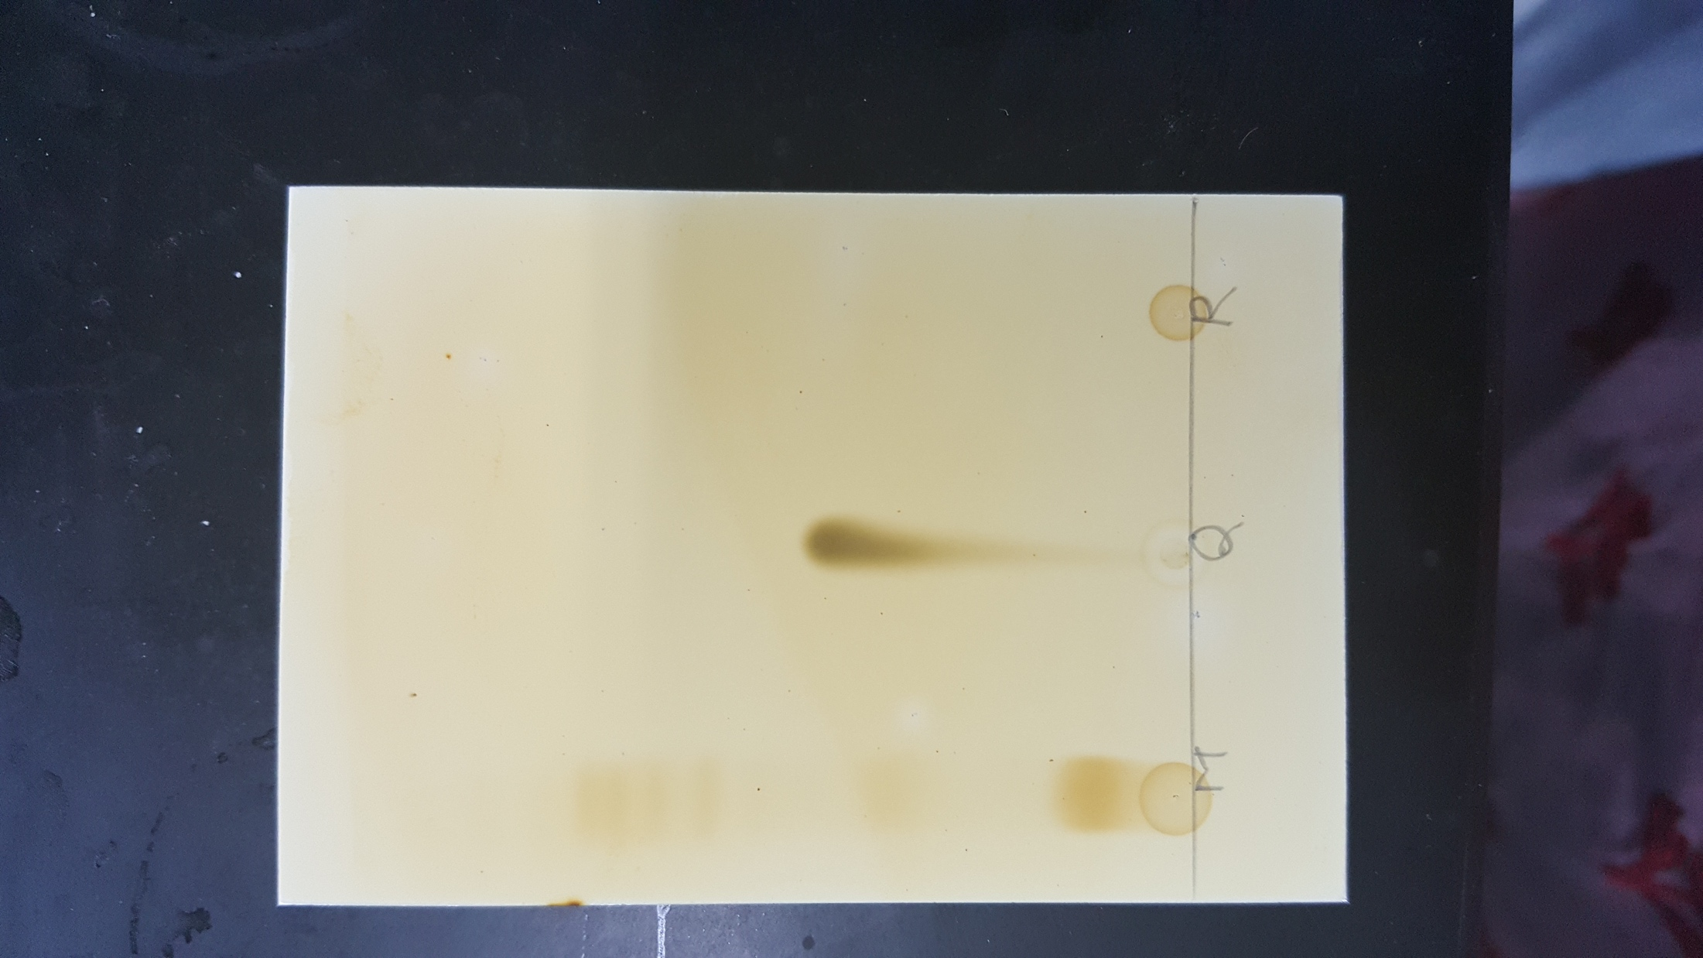
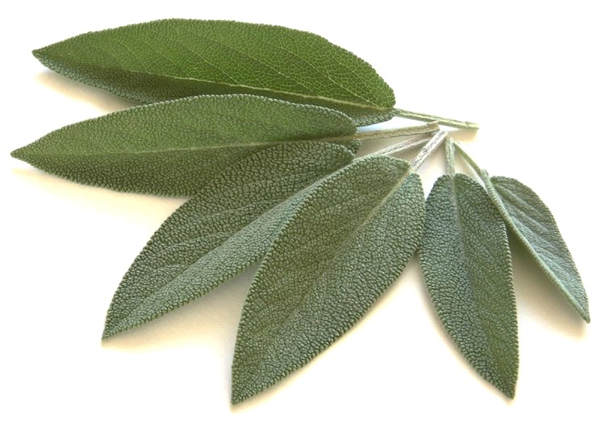
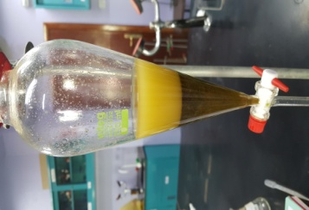
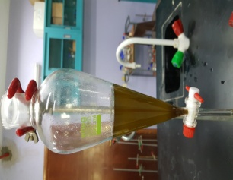
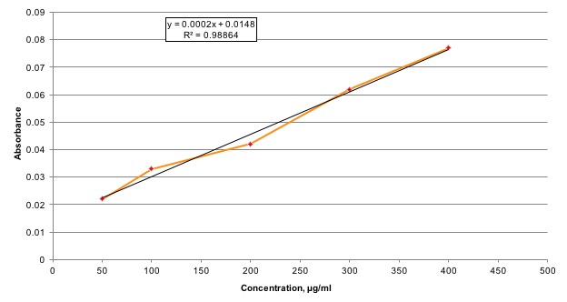
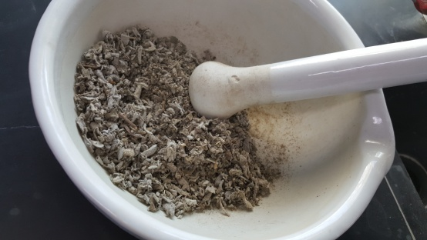
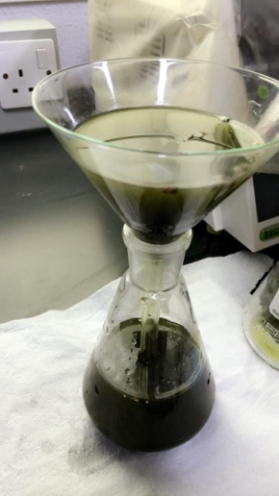
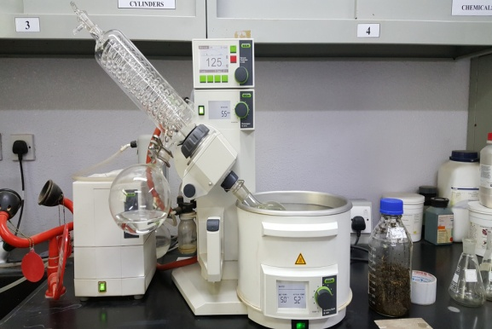
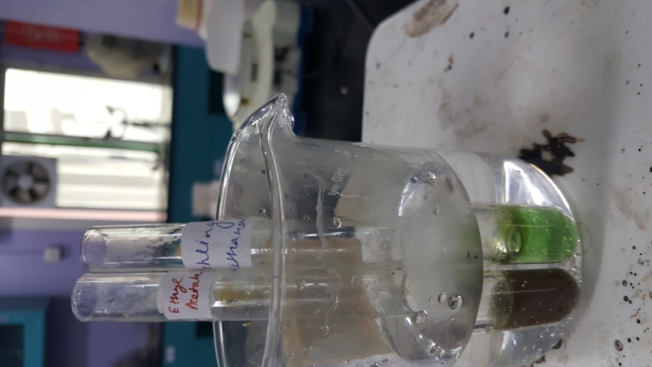
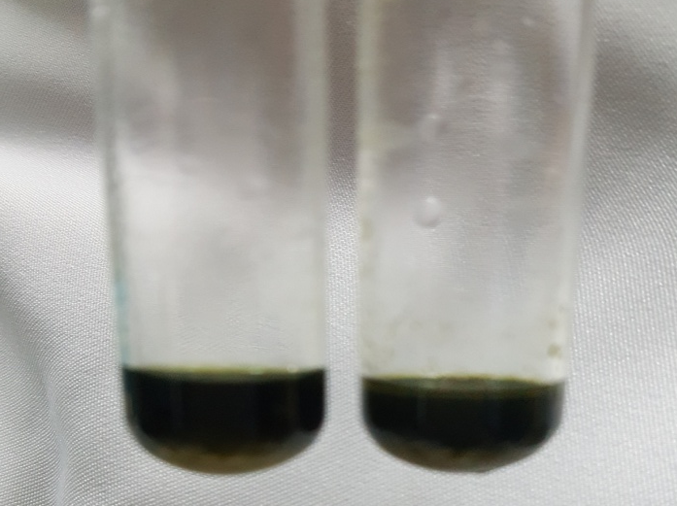
Fractionation, Chromatographic Screening and Quantification of bioactive compounds from the imperative medicinal plant Salvia officinalis
Shadma Wahab¹, Sarah Muryi Alshahrani¹ , Safiah Ali Asiri ¹, Linah Masoud Alyami¹, Khawlah Habib^{1,} Areej Mohmmed¹
¹Department of Pharmacognosy, College of Pharmacy, King Khalid University, Abha , Kingdom of Saudi Arabia.
Background
Fractionation
Result-II
Screening of ethanobotanical plants is a pre-requisite to evaluate their therapeutic potential and it can lead to the isolation of new bioactive compounds. ^{[1]}
Salvia officinalis is one of the most popular medicinal and culinary herbs used in the Arab world. ^{[2]}
In general it contains chemical constituents mainly flavones, phenolic acids, lupeol, beta-sitosterol, estrogenic principle and volatile oils.
Table-2 : Thin Layer Chromatographic studies
S. officinalis leaves | Solvent system | Extract R_{f} value | Standard R_{f} value
Methanol etract | Ethyl acetate: water: Methanol (10: 1: 1.35) | 3 Spots- 0.28 0.54 0.91 | 0.27 (R) 0.91 (Q)
Methanol extract | Toluene: Ethyl acetate: Acetic acid: Formic acid (3:2: 0.05: 0.15) | 4 Spots- 0.25 0.41 0.61 0.69 | 0.26 (Q)
cxcx
Antidiarrheal
Antiasthmatic
Immune boosting
cxcx
Standardization of extract using Flavonoid Rutin
Managing Depression
cxcx
cxcx
Relieve hot flashes and symptoms of menopause
Stimulates digestive systems
Result-I
Traditional uses of Miramia
Table-1: Phytochemical screening of all fractions
Problem
S.No | Phytochemicals | Tests | Observation | n- Hexane | Chloroform | Ethyl acetate | Methanol
1. | Test for Saponins | Foam Test | Presence of froth | - | - | - | +
2. | Test for Phenolic Compounds | Ferric chloride Test | green and blue color | - | + | + | +
 |  | Lead Acetate Test | Bulky white ppt | - | - | + | +
Salvia officinalis, is reported to possess wide range of pharmacological properties such as anti-hyperlipidemic, anti-inflammatory, antioxidant, anti-hepatotoxic, in gastric-disorders and as a memory enhancer. ^{[3]}
In spite of extensive traditional as well as pharmacological use of S.officinalis, published literature lack information about the phytochemical components of the herb growing in Asir region of Saudi Arabia.
Table-4 : Flavonoids content of the methanol extract
Extract | Flavonoid content (in µg/ml)
Methanol extract | 317.66
3. | Alkaloids | Dragendorff test | Prominent yellow orange spot | - | + | + | +
 |  | Wagner test | Reddish brown ppt | - | + | + | +
 |  | Mayer test | Turbid cream extract is obtained | - | + | + | +
Observation and Conclusion
Hypothesis
The phytochemical screening revealed that S. officinalis growing in the Asir region possess different classes of chemical compounds which may be attributed to different pharmacological properties of this plants.
The TLC analysis confirmed the presence of rutin and quercetin in the methanol fraction.
Quantitative estimation proved that the leaf contains a promising amount of flavonoid which may be the reason that sage has found increasing application in food formulations.
Further work of this study would be the correlation of the relationship of these active constituents for possible biological activities.
Present study including the qualitative and quantitative investigation of phytochemicals of S.officinalis growing in the Asir region of Saudi Arabia may aid in the exploration of the bioactive elements that are responsible for the therapeutic properties of Sage.
4 | Test for flavonoids | Shinoda test | Effervescence and orange to the red color | - | - | + | +
5. | Test for glycosides | Killer-Killani test | Reddish brown color | _ | _ | _ | _
 |  | Borntrager’s test | Rose red color appears in upper layer | _ | _ | _ | _
6. | Test for Tannins | Gelatin solution test | white precipitate | - | - | + | +
 |  | Ferric chloride test | blue color | - | - | + | +
Preparation of Extract
70 g of leaf powder was placed in a stoppered container with the solvent ethanol 95%.
Allowed to stand at room temperature for a period of seven days with frequent agitation to get the extract from Maceration technique.
The mixture was then strained, the marc is pressed and filtered
Extract was evaporated under reduced pressure and temperature by a rotary evaporator.
7. | Test for Carbohydrates | Molisch’s test | violet ring | - | - | + | +
 |  | Fehling’s solution Test | red precipitate | - | - | + | +
 |  | Barfoed’s test | red precipitate | - | - | + | +
8. | Test for Sterols | Salkowaski reaction | reddish brown ring | + | + | + | +
 |  | Libermann-Burchards reaction | Brown ring | + | + | + | +
References
A. Ghorbani, M. Esmaeilizadeh Pharmacological properties of Salvia officinalis and its components, Journal of Traditional and Complementary Medicine, 2017, 7 433-440.
David O. Kennedy, Phytochemicals for Improving Aspects of Cognitive Function and Psychological State Potentially Relevant to Sports Performance, Sports Medicine 2019, 49 (1) 39–58.
Positive Foam Test methanol
Positive Ferric chloride Test for phenolic compouns
Phytochemical Test Results
Positive Dragendorff test
Fehling Test positive
Negative
Acknowledgement
Shadma Wahab and co-authors declare sincere gratitude toward King Khalid University, Abha, Saudi Arabia, for providing the opportunity to carry out research.

