Slide 1
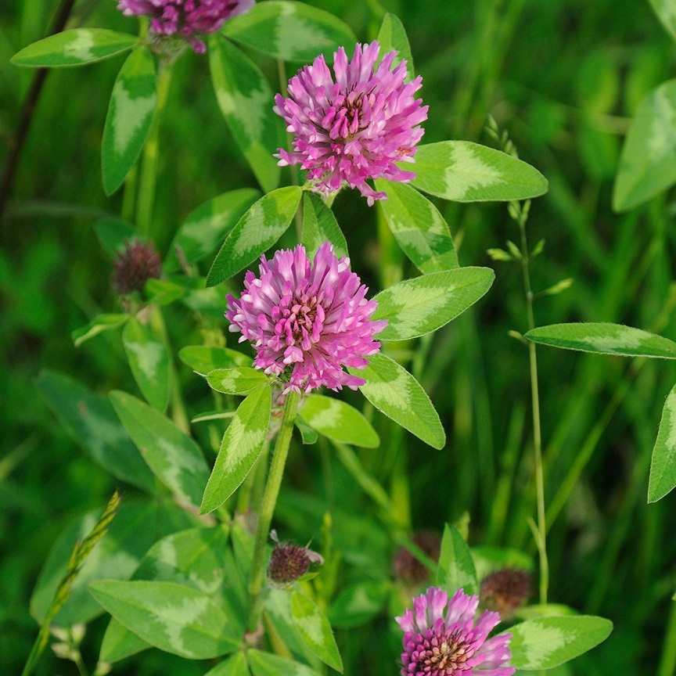
ISOFLAVONES IN RED CLOVER’S TEA INFUSIONS
^{1, 2}Edward MUNTEAN, ²Camelia URDA
¹University of Agricultural Sciences and Veterinary Medicine Cluj Napoca, Romania
²Research & Development Station for Agriculture, Turda, Romania
E-mail: edimuntean@yahoo.com
INTRODUCTION
The flowering tops of red clover (Trifolium pretense L.) are highly appreciated in traditional medicine for the content in biologically active substances, that make them helpful in the treatment of premenstrual syndrome, menopausal symptoms, mastalgia, dysmenorrhea, cardiovascular and inflammatory diseases, osteoporosis, as well as in the prevention of certain cancers. Hence, one can find them in a variety of preparations, including infusions, decoctions and tinctures. Among these bioactive substances, isoflavones are important phytoestrogens, being associated mainly with women’s health and increasingly used in dietary supplements [3].
Research objectives
Since the available data on red clover’s isoflavones refer on their concentrations in plant matrix [1-4], they are not of practical use for the assessment of flavonoids’ intake from tea infusions, hence the major aim of this work was to establish the content of isoflavones from infusions obtained from several herbal teas’ brands available on Romanian market
Fig 1. Red clover
MATERIALS & METHODS
15 herbal tea brands were purchased from local hypermarkets. ~2 g tea samples were weighed then infused with 100 mL boiling distilled water for 10 minutes; after filtration the infusion were left for cooling at room temperature, then the volumes were brought to 100 mL with distilled water. 5 mL from each infusion was subjected to solid phase extraction, the eluates being finaly filtrated through 0,47 membrane filters subjected to high performance liquid chromatographic (HPLC) analysys. This procedure was applied in three repetitions for each sample
Eight isoflavones were determined by a sensitive optimized HPLC method, using a Flexar system consisting from two UHPLC pumps, a solvent degaser, an autosampler, a column oven and an UV-VIS detector; Chromera was used for chromatographic data analysis. Baseline separations were accomplished for daidzin, glycitin, genistin, daidzein, genistein, glycitein, formonetin and biochanin A using a Kinetex column and gradient elution with acetonitrile and water, both with 0.1% acetic acid, in a total run time less than 9 minutes (fig.2). Quantifications were based on the external standard method; a summary of validation parameters is presented in table 1.
Table 1. A summary of validation parametrs for the HPLC method
 | Daidzin | Glycitin | Genistin | Daidzein | Glycitein | Genistein | Formonetin | Biochanin A
Concentration range [mg/L] | 1.2- 17 | 1.3 - 15 | 1.2 - 16 | 1 - 18 | 1.5 - 15 | 2 -16 | 1.2 - 16 | 2.1 - 20
Limit of detection [mg/L] | 0.008 | 0.009 | 0.043 | 0.031 | 0.021 | 0.035 | 0.041 | 0.052
Limit of quantification [mg/L] | 0.024 | 0.027 | 0.129 | 0.093 | 0.063 | 0.105 | 0.123 | 0.156
Liniarity (R²) | 0.9992 | 0.9999 | 0.9998 | 0.9970 | 0.9982 | 0.9977 | 0.9991 | 0.9997
Figure 1. Calibrations for several target isoflavones
RESULTS
The major isoflavones from the analyzed infusions obtained from the red clover tea brands were biochanin A, genistein, glycitein, genistin and formononetin (average concentrations between 0.55 – 5.65 mg/ 200 mL), followed by smaller concentrations of daidzein (0.26 mg/ 200 mL), while the glycosides daidzin and glycitin are only in trace amounts (0.05-0.09 mg/ 200 mL).
Each herbal tea infusion showed a particular isoflavone pattern, depending mainly on the genetic factors and environmental conditions in which the plants were grown, but overall, the HPLC profile of the analyzed red clover tea infusions prove that these can be considered as valuable sources of certain isoflavones.
Table 2. Descriptive statistics for isoflavones from herbal teas [mg/ 200 mL infusion]
 | Daidzin | Glycitin | Genistin | Daidzein | Glycitein | Genistein | Formonetin | Biochanin A
Average | 0.09 | 0.05 | 1.22 | 0.26 | 1.19 | 2.38 | 0.55 | 5.65
Stdev | 0.06 | 0.03 | 0.66 | 0.11 | 0.37 | 0.75 | 0.17 | 1.19
Max | 0.21 | 0.13 | 2.74 | 0.49 | 2.04 | 3.07 | 0.90 | 8.23
Min | 0.03 | 0.03 | 0.34 | 0.15 | 0.16 | 0.79 | 0.35 | 4.51
Figure 2. Representative HPLC chromatogram of isoflavones from a Trifolium pratense L herbal tea infusion (peak ID’s: 1-daidzin, 2-glycitin, 3-genistin, 4-daidzein, 5-glycitein, 6-genistein, 7-formonetin, 8-biochanin A)
CONCLUSIONS
A simple, reliable, fast and sensitive method has been developed for the analysis of these compounds using high performance liquid chromatography, accomplished with a Perkin Elmer Flexar UHPLC system with UV detection, enabling the separation of targeted isoflavones in less than 9 minutes.
This study can provide a framework for new applied researches, as well as a new improved method for quality control of red clover products.
REFERENCES
Krenn, L., Unterrieder, I., Ruprechter, R. (2002). Quantification of isoflavones in red clover by high-performance liquid chromatography. Journal of Chromatography B, 777(1-2), 123-128.
Malca-Garcia, G. R., Zagal, D., Graham, J., Nikolić, D., Friesen, J. B., Lankin, D. C., .. Pauli, G. F. (2019). Dynamics of the isoflavone metabolome of traditional preparations of Trifolium pratense L. Journal of ethnopharmacology, 238, 111865.
Ramos, G. P., Dias, P. M., Morais, C. B., Fröehlich, P. E., Dall’Agnol, M., Zuanazzi, J. A. (2008). LC determination of four isoflavone aglycones in red clover (Trifolium pratense L.). Chromatographia, 67(1-2), 125-129.
Wu, Q., Wang, M., Simon, J. E. (2003). Determination of isoflavones in red clover and related species by high-performance liquid chromatography combined with ultraviolet and mass spectrometric detection. Journal of chromatography A, 1016(2), 195-209.

