Slide 1
Plant natural products with anti-thyroid cancer activity
Javad Sharifi-Rad¹, Sadegh Rajabi², Miquel Martorell^{3,4,5}, Maria Dolores López⁶, María Trinidad Toro⁶, Susi Barollo⁷, Decio Armanini⁷, Patrick Valere Tsouh Fokou⁸, Giuseppe Zagotto⁹, Giovanni Ribaudo¹⁰, Raffaele Pezzani *^{,7,11,}
1 Zabol Medicinal Plants Research Center, Zabol University of Medical Sciences, Zabol 61615-585, Iran; javad.sharifirad@gmail.com
2 Department of Clinical Biochemistry, School of Medicine, Shahid Beheshti University of Medical Sciences, Tehran, Iran; sadegh.rajabi2017@gmail.com
3 Department of Nutrition and Dietetics, Faculty of Pharmacy, University of Concepcion, Concepcion, Chile; martorellpons@gmail.com
4 Centre for Healthy Living, University of Concepción, Concepción, Chile
5 Unidad de Desarrollo Tecnológico, Universidad de Concepción UDT, Concepcion Chile
6 Department of Plant Production, Faculty of Agronomy, Universidad de Concepción, Avenida Vicente Mendez, 595, Chillán 3812120, Chile; mlopezb@udec.cl, mariatoro@udec.cl
7 Endocrinology Unit, Department of Medicine (DIMED), University of Padova, via Ospedale 105, 35128, Padova, Italy; susi.barollo@unipd.it (S.B.), decio.armanini@unipd.it (D.A.), raffaele.pezzani@unipd.it (R.P.)
8 Faculty of Science, University of Bamenda, Bamenda-Bambili, Po. Box 39, Cameroon; ptsouh@gmail.com
9 Department of Pharmaceutical and Pharmacological Sciences, University of Padova, via Marzolo 5, 35131, Padova, Italy; giuseppe.zagotto@unipd.it
10 Department of Molecular and Translational Medicine, University of Brescia, Viale Europa 11, 25123, Brescia, Italy; giovanni.ribaudo@unibs.it
11 AIROB, Associazione Italiana per la Ricerca Oncologica di Base, Padova, Italy
* raffaele.pezzani@unipd.it

Slide 2
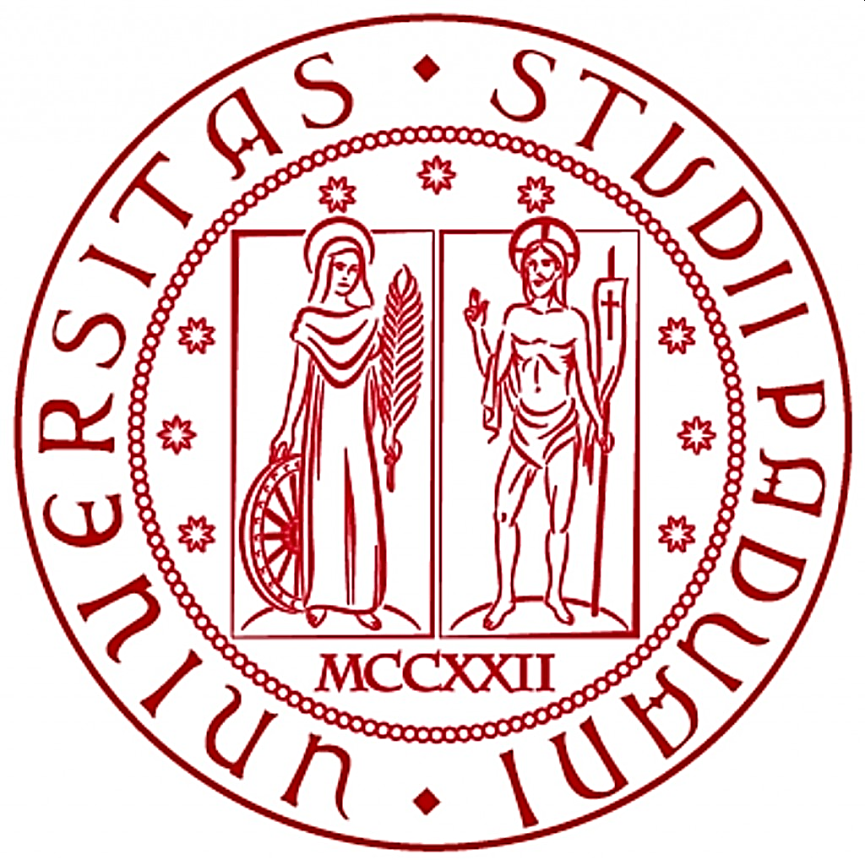
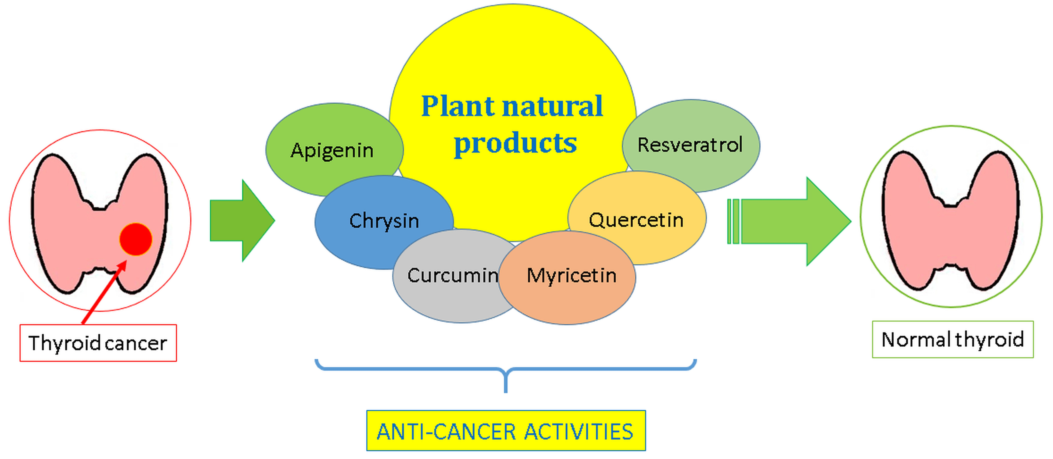
Raffaele Pezzani, University of Padova - Italy
Plant natural products with anti-thyroid cancer activity
Graphical Abstract

Slide 3
Raffaele Pezzani, University of Padova - Italy
Abstract:
Thyroid cancer is the most frequent endocrine malignancy, with more than 500,000 cases per year worldwide. Differentiated thyroid cancers are the most common forms with best prognosis, while poorly/undifferentiated ones are rare (2% of all thyroid cancer), aggressive, frequently metastasize and have a worse prognosis. For aggressive, metastatic and advanced thyroid cancer novel antitumor molecules are urgently needed and phytochemical products can be a rational and extensive source, since secondary plant metabolites can guarantee the necessary biochemical variability for therapeutic purpose. Among bioactive molecules that present biological activity on thyroid cancer, resveratrol, curcumin, isoflavones, glucosinolates are the most common and used in experimental model. Most of them have been studied both in vitro and in vivo on this cancer, but rarely in clinical trial. This review summarizes phytochemicals, phytotherapeutics and plant derived compounds used in thyroid cancer.
Keywords: Thyroid cancer; phytotherapy; plant natural products

Slide 4
Raffaele Pezzani, University of Padova - Italy
Thyroid cancer
Thyroid cancer is the most frequent endocrine malignancy in humans
Papillary thyroid cancer (PTC) ≈ 70-80%
Follicular thyroid cancer (FTC) ≈ 10-15%
Medullary thyroid cancer (MTC) ≈ 2%
Anaplastic thyroid cancer (ATC) ≈ 1-2%

Slide 5
Raffaele Pezzani, University of Padova - Italy
Thyroid cancer facts
Good prognosis
Sex ratio 3:1 (F:M)
Surgery
Radioactive Iodine ablation therapy
Chemotherapy
Targeted therapy
Replacement therapy
Suppression of TSH release
Treatments
For advanced, metastatic, recurrent thyroid cancer and for ATC
novel therapeutic approaches needed !

Slide 6
Aim
To explore the use of phytochemicals, phytopharmaceuticals,
plant derived natural products
in thyroid cancer
Raffaele Pezzani, University of Padova - Italy

Slide 7
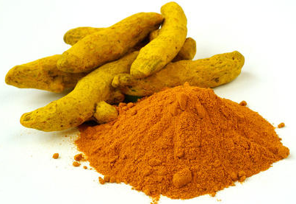
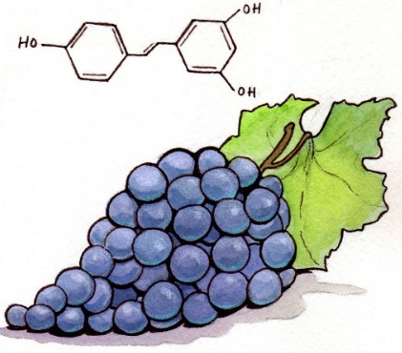
Raffaele Pezzani, University of Padova - Italy
Phytotherapeutics agents
Most studied and tested
Apigenin
Curcumin
Isoflavones
Quercetin
Resveratrol
PTC, ATC
PTC, FTC, ATC, MTC
PTC, FTC, MTC
PTC, FTC, ATC
PTC, FTC, ATC, MTC

Slide 8
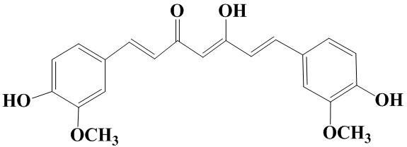
Raffaele Pezzani, University of Padova - Italy
Phytotherapeutics agents
Cell models:
K1, BCPAP, TPC-1 → PTC FTC-133 → FTC
8505C, CAL-62 → ATC TT, MZ-CRC-1 → MTC
Curcumin
PTC
Cell viability inhibition
Apoptosis induction
Induced ROS formation
Inhibited metalloproteinases
Adhesion, spreading and
migration inhibition
Cell cycle arrest
FTC
Cell viability inhibition
(down-regulation of PI3K/Akt)
Apoptosis induction
Inhibited metalloproteinases
and cyclooxygenase-2 (COX-2)
NF-κB inhibition
Cell cycle arrest
ATC
Cell viability inhibition
Apoptosis induction
Cell cycle arrest
MTC
Cell viability inhibition
(down-regulation of PI3K/Akt)
Apoptosis induction
Increased ROS production
blockade of PI3k/AKT and MAPK pathways

Slide 9
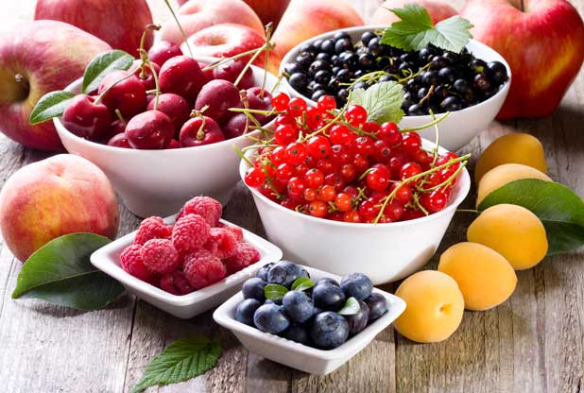
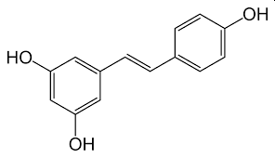
Raffaele Pezzani, University of Padova - Italy
Phytotherapeutics agents
Cell models:
BHP 2–7, BHP 18–21, TPC-1 → PTC
FTC133, FTC 236, FTC 238 → FTC
Thr.C1-PI 33, HTh7, 8505C, THJ-16T, THJ-21T → ATC TT → MTC
Resveratrol
PTC
Cell viability inhibition
Apoptosis induction
MAPK activation
FTC
Cell growth inhibition
Apoptosis induction
Autophagy activation
p53 and Notch1 increased
MAPK activation
ATC
↑ Cytotoxicity
Apoptosis induction
Cell cycle arrest
Upregulation of Notch1
MTC
Cell viability inhibition
Apoptosis induction
Augmented Notch 2

Slide 10
Raffaele Pezzani, University of Padova - Italy
Phytotherapeutics agents
Clinical trials
clinical evidence is scarce and restricted

Slide 11
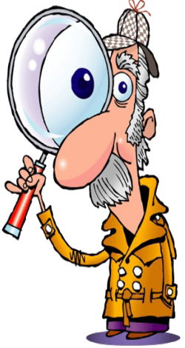
Raffaele Pezzani, University of Padova - Italy
Take home messages
Thyroid cancer
Common endocrine malignancy
Treatment based on surgery, excepted for advanced, metastatic, recurrent → new therapeutic approaches
Most promising and studied phytochemicals
curcumin and resveratrol

Slide 12
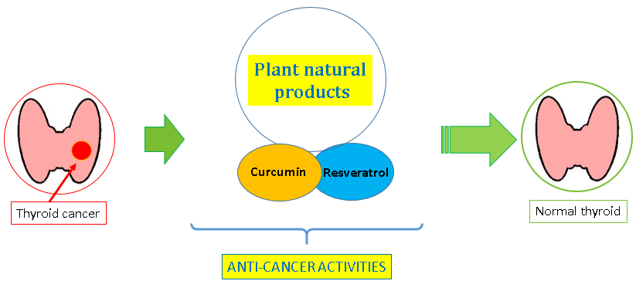
Raffaele Pezzani, University of Padova - Italy
Conclusions
Phytochemicals have been shown to reduce cell proliferation, viability, growth in different thyroid cancer cell models
Preclinical and more clinical studies are required to unveil the role of phytotherapeutics in the treatment and prevention of thyroid cancer

Slide 13
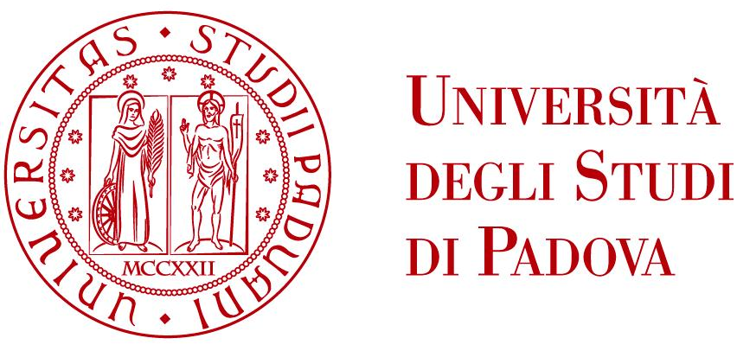
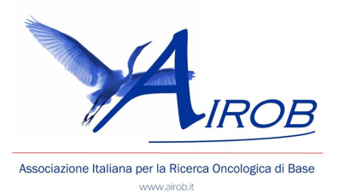
Raffaele Pezzani, University of Padova - Italy
Acknowledgments
Javad Sharifi-Rad, Sadegh Rajabi (from Iran)
Miquel Martorell, Maria Dolores López, María Trinidad Toro (from Chile)
Susi Barollo, Decio Armanini, Giuseppe Zagotto (from Padova, Italy)
Patrick Valere Tsouh Fokou (from Cameroon)
Giovanni Ribaudo (from Brescia, Italy)
Raffaele Pezzani, BSc, MD, PhD, University of Padova – Italy
Email: raffaele.pezzani@unipd.it

