Slide 1
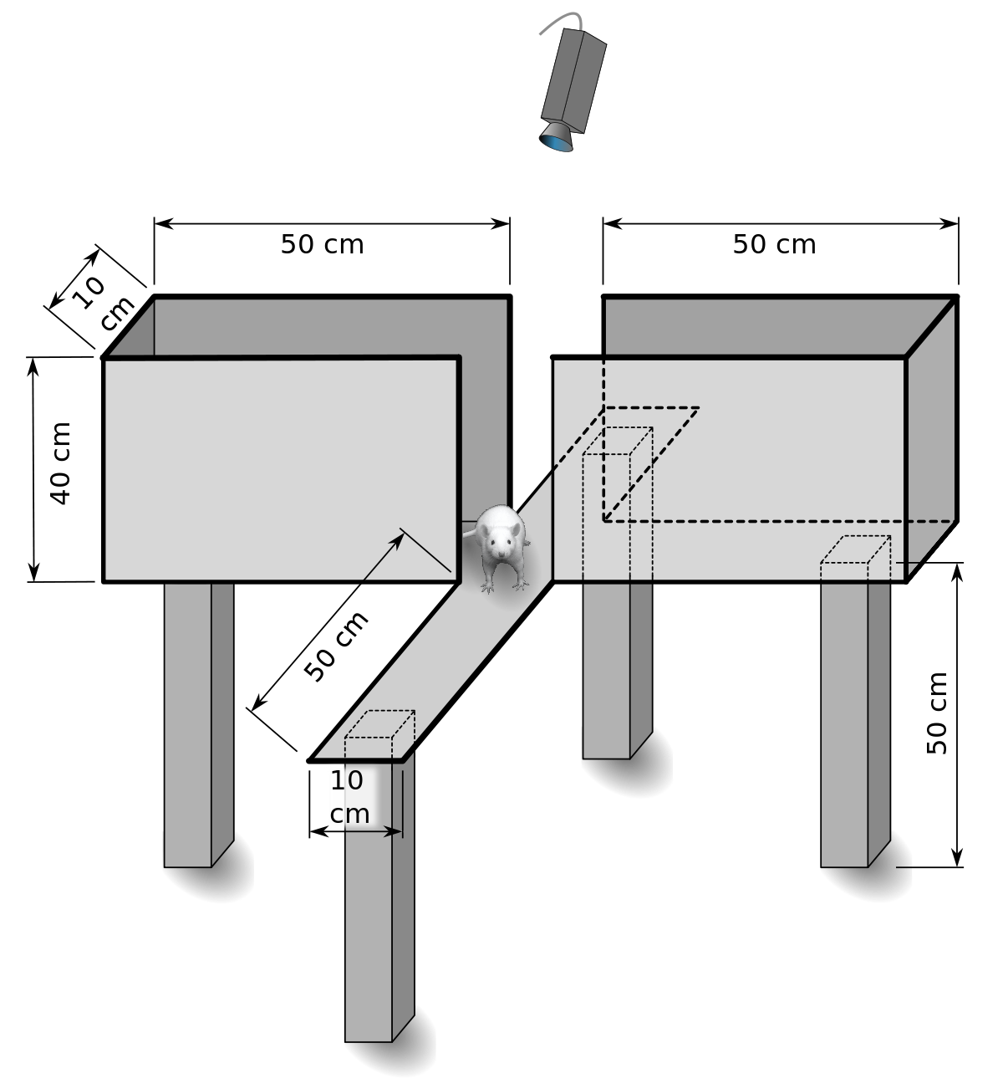
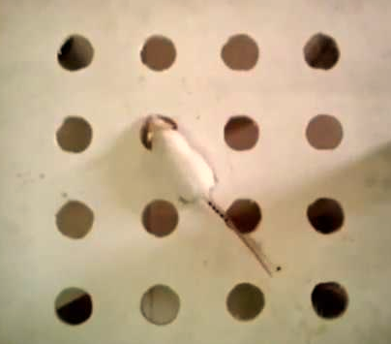
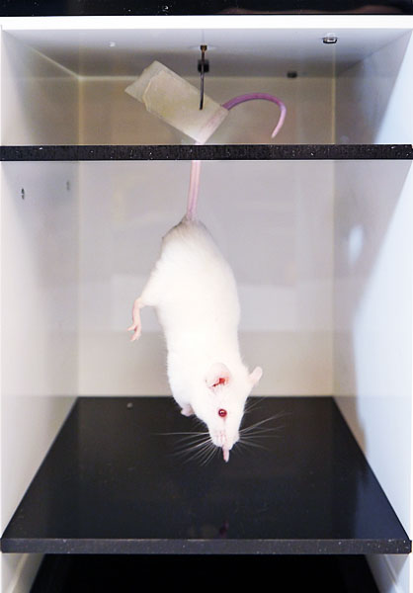
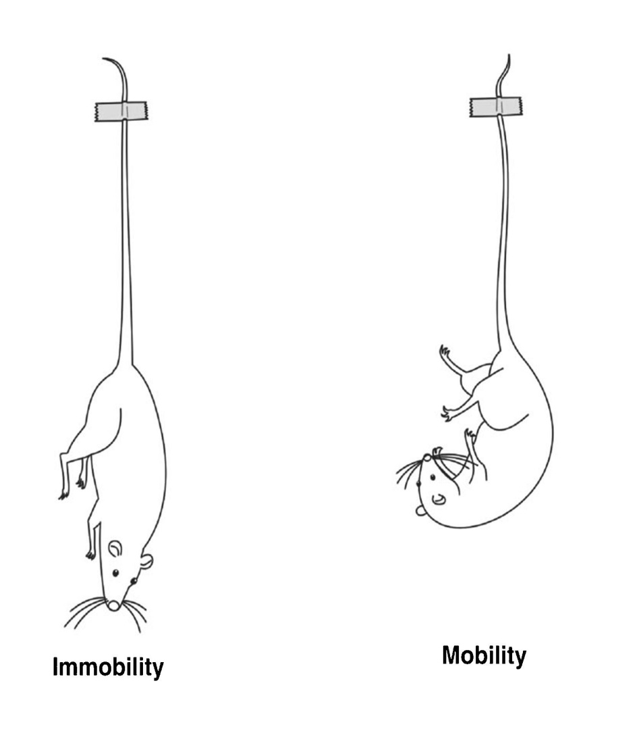
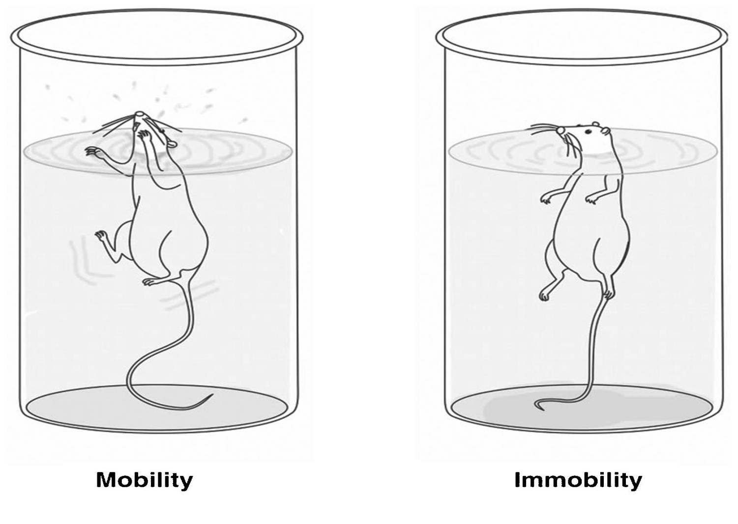
Anxiolytic, antidepressant and anti-inflammatory activities of water-soluble extract of beehive in Swiss albino mice
Abu Montakim Tareq¹, A.S.M. Ali Reza^{1,}*, Talha Bin Emran^{2,}*
¹ Department of Pharmacy, International Islamic University Chittagong, Kumira, Chittagong-4318, Bangladesh; ² Department of Pharmacy, BGC Trust University Bangladesh, Chittagong-4381, Bangladesh;
*Correspondence: alirezaru@gmail.com (A.S.M.A.R.); talhabmb@bgctub.ac.bd (T.B.E.);
ABSTRACT
Water-soluble extract of beehive (WSE-BH) is a gummy semisolid bioactive content of Apis cerana indica beehive. The current experiment aimed to determine the anxiolytic, antidepressant, and anti-inflammatory activities of WSE-BH, which extracted using distilled water. Anxiolytic and antidepressant activities examined using elevated plus maze (EPM), hole-board test (HBT), and forced swimming test (FST), tail suspensions test (TST), respectively in Swiss albino mice (27-32 g) of both sexes. Histamine-induced paw edema used for its anti-inflammatory activity of WSE-BH during acute inflammation induced in mice. The oral administration of WSE-BH (50 & 150 mg/kg) showed significant anxiolytic activities through time spent (30.80 and 38.19 %) and entry (47.16 and 53.89 %) in the open arm of EPM. In HBT, only 150 mg/kg exhibited a significant mean number of head dipping (7.53 times/min; P < 0.01) vs. diazepam (12.87 times/min; P < 0.0001). In FST and TST, both 50 and 150 mg/kg exhibited a significant (P < 0.0001) reduction in immobility comparable to imipramine hydrochloride. WSE-BH produced a significant inhibition of histamine-induced paw edema starting at 60 min time point, with a maximal percentage of inhibition (80.12%) achieved with a dose of 150 mg/kg at 180 min time point. The current results suggested that WSE-BH has promising anxiolytic, antidepressant, and anti-inflammatory activities.
Keywords: Apis cerana indica beehive; anxiolytic; antidepressant.
1. MATERIALS & METHODS
2. RESULTS
1.1. Anxiolytic activity
1.1.1. Elevated plus maze (EPM)
1.1.2. Hole board test (HBT)
CA
Head dipping
OA
CA= Closed Arm; OA = Opened Arm
WSE-BH = 50 & 150 mg/kg b.w., Diazepam = 1 mg/kg b.w. & Control (10 mL/kg), Time = 5 min/trial
1.2. Antidepressant activity
1.2.1. Tail suspension test (TST)
1.2.2. Forced swimming test (FST)
10 cm
25 cm
Treatment of Swiss albino mice with WSE-BH (50 and 150 mg/kg) showed significant anxiolytic, antidepressant and anti-inflammatory effects in comparison to control whereas the diazepam, imipramine hydrochloride and fexofenadine used as positive control.
(A & B) - EPM test - % time spent & entry in open arm
(C)- HBT- Number of head dipping
(D & E)- FST & TST
(F)- Histamine induced paw edema
Values are expressed as mean ± SEM. ªP < 0.05, ^{b}P < 0.01 and ^{c}P < 0.001 compared to the control (n=5).
19cm
Temp.= 25 ± 2 °C
WSE-BH = 50 & 150 mg/kg b.w., Imipramine = 20 mg/kg b.w. & Control (10 mL/kg),Time = 6 min/trial
3. CONCLUSION
1.3. Anti-inflammatory activity
The WSE-BH exhibited a significant anxiolytic and anti-inflammatory effects.
A similar result observed by the WSE-BH and imipramine whereas the 150 mg/kg showed the maximum inhibition.
The active compounds might be responsible for the pharmacological effects which required further study to evaluate the mechanism of WSE-BH.
1.3.1. Histamine-induced paw edema
Treatment with WSE-BH & control
Induced 0.1 mL histamine (1%) in Sub-plantar region of hind paw
Measure paw thickness in 0, 60, 120,180 and 240 min.
5 days
Babar, Z. M., I. Jaswir, A. M. Tareq, ASM. Ali Reza, W. M. Azizi, M. Hafidz et al. "In vivo anxiolytic and in vitro anti-inflammatory activities of water-soluble extract (WSE) of Nigella sativa (L.) seeds." Natural Product Research (2019): 1-6.
Kumar, BS Ashok, K. Lakshman, C. Velmurugan, S. M. Sridhar, and Saran Gopisetty. "Antidepressant activity of methanolic extract of Amaranthus spinosus." Basic and clinical neuroscience 5, no. 1 (2014): 11.
Somchit, M. N., J. H. Mak, A. Ahmad Bustamam, A. Zuraini, A. K. Arifah, Y. Adam, and Z. Zakaria. "Zerumbone isolated from Zingiber zerumbet inhibits inflammation and pain in rats." Journal of Medicinal Plant Research 6 (2012): 177-180.
## Positive control fexofenadine - administered 60 min before histamine injection & measure the paw thickness.

