Slide 1

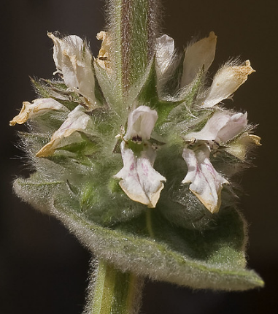
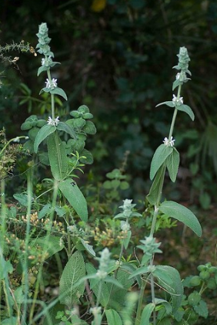
Phytochemical screening from the leaves extracts of Stachys mouretii
Abdelmoughite Ouakil¹, Soumaya El ismaili², Hanane El Hajaji¹, Amal Maurady², Ouafaa El Mahdi³, Brahim El Bali¹ and Mohammed Lachkar¹
¹Engineering Laboratory of Organometallic and Molecular Materials, Faculty of Sciences, Sidi Mohammed Ben Abdellah University, Po. Box 1796 (Atlas), 30000 Fez, Morocco.
²Laboratory of Innovative Technologies, Civil Engineering Department, ENSA of Tangier.
³Multidisciplinary Faculty, Sidi Mohammed Ben Abdellah University, Taza, Morocco.
Objectives
Our interest is focused in particular on :
Extraction of the leaves of Stachys mouretti with different solvents.
Preliminary phytochemical analysis
isolation and identification of new biologically active molecules.
Evaluation the biological activities.
results
Introduction
Percentage yield of crude extracts
After 12h continuous hot extraction of powder leaves of Stachys mouretii in hexane, 24h in ethyl acetate and 24h in methanol different amounts were obtained. The amounts that have been found are 3.9g of hexanic extract, 5.5g of ethyl acetat extract and 18,8g of methanolic extract.
Stachys mouretii is an endemic plant of Morocco belonging to the Lamiaceae family. The genus Stachys L. is one of the largest genera of the Lamiaceae (also known as Labiatae), and it consists of approximately 300 species displaying a remarkable range of variation. It is mainly distributed in the warm temperate regions of the Mediterranean and south-west Asia, with secondary distributions in North and South America and Southern Africa.
Different Stachys species, which are known as betony, woundwort or mountain tea in folk medicine and used in the preparations of yogurt or jelly or traditionally as flavorings and seasonings. Furthermore, plants of this genus have been used for centuries as herbal remedies in the treatment of several complaints. (1).
In recent years, pharmacological studies on different taxa of this genus demonstrated some effects of extracts or isolated components such as anti-inflammatory, antitoxic, antibacterial, antioxidant and cytotoxic. Many other Stachys are used for the healing of skin, stomach, ulcer, asthma, rheumatic diseases and vaginal tumors (1,2). Phytochemical studies on Stachys species reported the presence of phenylethanoid glycosides, iridoids, triterpenoids, steroids, diterpenes, flavonoids, fatty acids, polysaccharides and other secondary metabolites.
We have chosen Stachys mouretii as the object of our study since no investigation has been carried out on this species to date.
Fig. 1: Yields of Hexae, Ethyl acetate and Methanol extracts of Stachys mouretii.
Preliminary phytochemical screening
Preliminary phytochemical analysis showed the presence of major classes of secondary metabolites such as, sterols/steroids, terpenes/terpenoids, flavonoids and polyphenols (table 1). Saponins, tannins and alkaloids were found to be absent in all extracts.
Extracts Metabolites | Hexane | Ethyl acetate | Methanol
Sterols/Steroids Terpenes/Terpenoids Polyphenols Tannins Flavonoids Alkaloids Saponins | + + - - - - - | - - + - + - - | - - + - + - -
Table. 1 : Results of preliminary phytochemical screening of Stachys mouretii. Leaves extracts.
Methods
Conclusion
The phytochemical screening of Stachys mouretii leaves extracts revealed the richness of this plant in potentially bioactive compounds such as, sterols/steroids, terpenes/terpenoids, flavonoids, and polyphenols and the separation of these compounds is currently in progress.
Numerous reports available on phenolic compounds have demonstrated their usefulness in exhibiting potential biological activities such as antioxidant, antidiabetic, hepatoprotective, anti-inflammatory, antimicrobial, anticancer... (3,4) and according to our phytochimical study this plant can find applications in the medicinal fields.
Collection of plant material
The leaves of Stachys mouretii were collected in April 2018 from Talasmtan forest in the region of Ouazzane. Then, they were thoroughly washed with water to remove dust and dried under the shade at room temperature for 7 days. The dried leaves were ground using kitchen blender to obtain the course powder and kept in an air tight container till further use
Preparation of extracts
The dried powdered leaves of Stachysmouretii (160g) were extracted exhaustively by Soxhlet method with increasing polarity of solvents (hexane, ethyl acetate and methanol).
Phytochemical screening of leaves extracts
The identification of secondary metabolites was carried out via phytochemical screening using qualitative analyses based on a set of staining / precipitation reactions and thin layer chromatography techniques. These separating analyses use organic solvents and reagents allowing the detection of the sought molecules in a specific way.
References
(1). Venditti, A., Bianco, A., Nicoletti, M., Quassinti, L., Bramucci, M., Lupidi, G., & Lucarini, D. Fitoterapia. (2013), 90, 94-103.
(2). Demiray, H., Tabanca, N., Estep, A. S., Becnel, J. J., & Demirci, B. Saudi Pharmaceutical Journal, (2019, 27, 877-881
(3). Kumar, S., Pandey, A. K. Scientific World Journal, 2013.
(4). Sulaiman S, Ibrahim D, Kassim J, Sheh-Hong L. J Chem Pharm Res, 2011, 3, 436-444.

