Slide 1
Bactericidal action of cinnamon, clove and cajeput oils loaded onto CA/PCL wet-spun fibers for a localized, controlled biomolecule delivery
Helena P. Felgueiras*, Natália C. Homem, Marta A. Teixeira, Ana R. M. Ribeiro,
Joana C. Antunes, M. Teresa P. Amorim
Centre for Textile Science and Technology (2C2T), University of Minho, Campus de Azurém 4800-058 Guimarães, Portugal
* Corresponding author: helena.felgueiras@2c2t.uminho.pt

Slide 2
Bactericidal action of cinnamon, clove and cajeput oils loaded onto CA/PCL wet-spun fibers for a localized, controlled biomolecule delivery
S. aureus
E. coli
Cinnamon leaf,
Clove and Cajeput
Biomolecules
Syringe Pump
Microfiber
Polymer Solution
Bacteria Elimination
CA/PCL Microfiber
Coagulation Bath
Production of
Wet-Spun CA/PCL Microfibers
Essential Oils Loading
(Physical Binding)
Confirmation of Antimicrobial Efficiency
(Representation not to scale)

Slide 3
Abstract
Essential oils (EOs), which are complex biomolecules composed of volatile compounds, have emerged as a new strategy to deal with bacterial infections and as a valid alternative to synthetic drugs. Here, we report the modification of biodegradable wet-spun microfibers composed of cellulose acetate (CA) and polycaprolactone (PCL) with EOs, aiming at their localized, controlled release. Cinnamon leaf oil (CLO), cajeput oil (CJO), and clove oil (CO) were selected from a group of 20 EOs according to their minimal inhibitory concentration (MIC) against Staphylococcus aureus (<22.4 mg/mL) and Escherichia coli (<11.2 mg/mL). CA/PCL prepared at 10% and 14%wt in a 3/1 ratio in acetic acid and acetone were processed in the form of microfibers by wet-spinning at an extrusion rate of 0.5 mL/h directly into an ethanol coagulation bath. Microfibers were modified by immersion in ethanol solutions containing EOs at 2xMIC and ampicillin (control antibiotic). Incorporation was confirmed by UV-VIS, FTIR and TGA. After 72h, fibers contained ampicillin at MIC but only 14%, 66% and 76% of MIC for CLO, CO and CJO, respectively. Unloaded and loaded microfibers were characterized as uniform and homogeneous. Data showed that even at small amounts the EO-modified microfibers were effective against the tested bacteria. Considering the amount immobilized, CLO-containing fibers were deemed the most effective from the group, suggesting a superior affinity of the EOs active groups towards the CA/PCL matrix. These results indicate that CA/PCL microfibers loaded with EOs can be easily produced and applied in scaffolds for biomedical applications.
Keywords: microfibers; biocompatible polymers; essential oils; surface modification; bactericidal effect; localized biomolecule action.

Slide 4
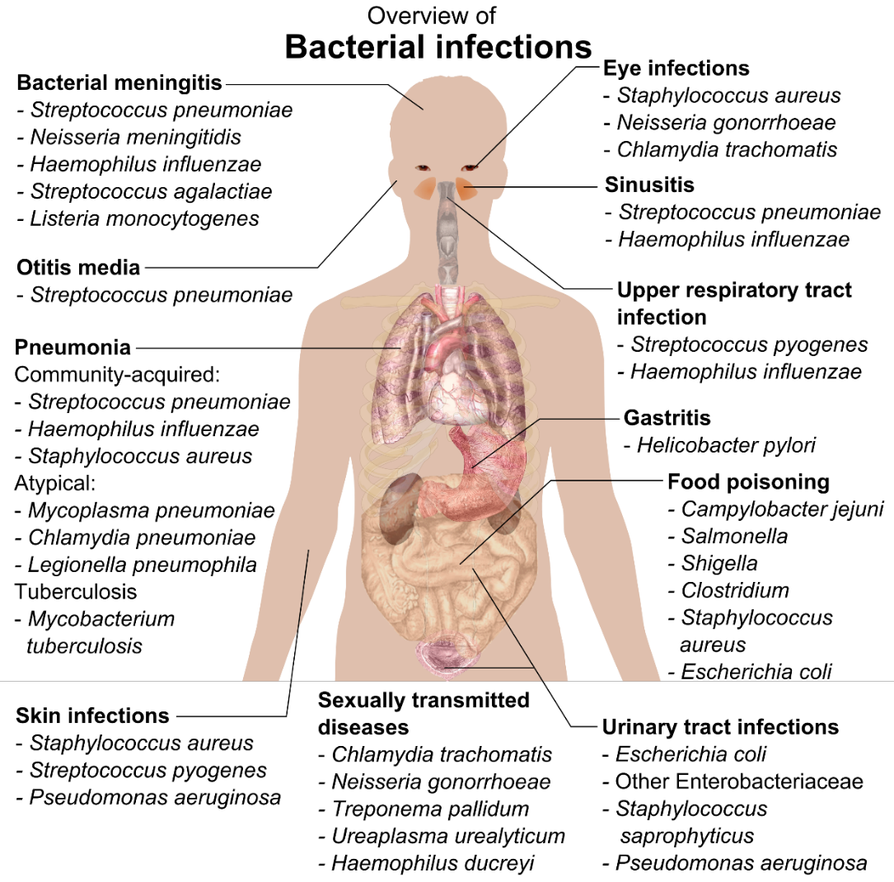
Introduction - Bacterial Infections
Recent projections indicate that bacterial infections may be the cause of approximately 10 million annual deaths worldwide by 2050
Willyard, C.. Nature 2017, 543, 15.

Slide 5
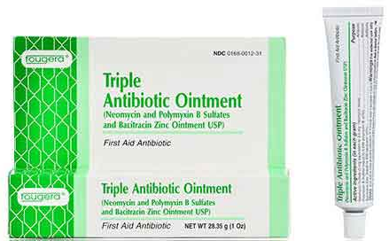
Introduction - Conventional Treatments vs Essential Oils (EOs)
Antibiotics/Antiseptic Agents
Essential Oils
Target bacterial functions, growth processes or the bacterial cell wall - bactericidal activities.
EOs are produced by more than 17,500 species of plants
Volatile biomolecules endowed with antimicrobial and regenerative potential
Rising of antibiotic resistant pathogens
Inefficient
Alternative
Tavares et al., Antibiotics 2020, 9, 314 - doi:10.3390/antibiotics9060314; Tavares et al., Biomolecules 2020, 10, 148 - doi:10.3390/biom10010148

Slide 6
Introduction - EOs Drawbacks
cytotoxic at increased concentrations, which prevents systemic delivery;
present low resistance to degradation by external factors (e.g. temperature, light, moisture);
highly volatile in their free, unloaded form.
Tavares et al., Antibiotics 2020, 9, 314 - doi:10.3390/antibiotics9060314

Slide 7
Goal
Engineer a biodegradable microfibrous target-delivery platform for EOs, that overcomes these biomolecules limitations for applications in infection control.

Slide 8
Methods - Wet-Spinning
Non-solvent induced phase inversion approach that allows the production of continuous polymeric microfibers, with a uniform morphology, by injecting a polymer solution into a non-solvent coagulation bath that prompts the solidification of the extruded material.
Syringe pumping the polymeric solution
Spinneret
Microfiber production
NE-1600 Syringe Pump
Coagulation bath
Felgueiras et al 2019 IOP Conf. Ser.: Mater. Sci. Eng. 634 012033, doi:10.1088/1757-899X/634/1/01203

Slide 9
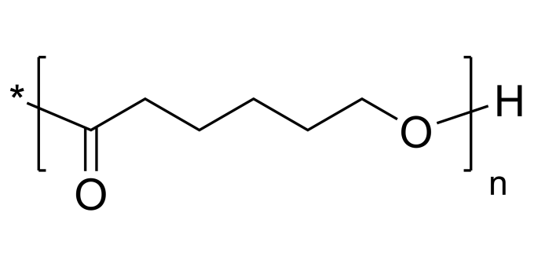
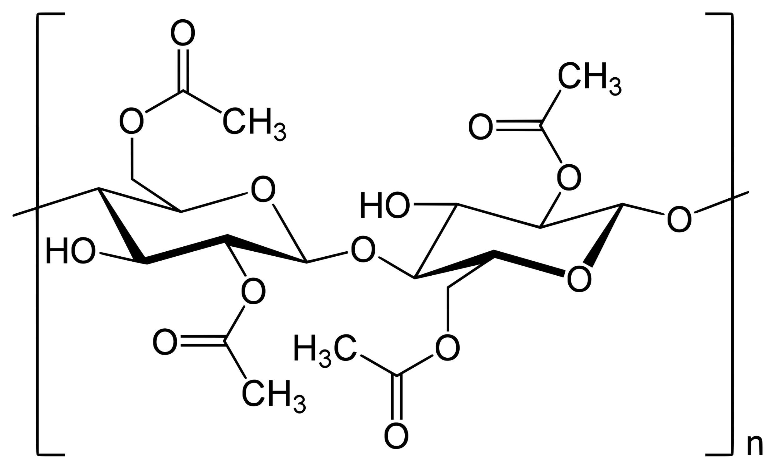
Methods - Microfiber Production
Biodegradable Polymers:
Polycaprolactone (PCL) Cellulose Acetate (CA)
Polymeric solution preparation:
Solvents – acetic acid and acetone
Polymer ratio – 3:1 CA/PCL (10/14 wt%)
Solubilization conditions – 1 h at 75 ºC and 200 rpm
Wet-spinning processing conditions:
Flow Rate – 0.5 mL/h
Needle Gauge – 18
Coagulation bath – Ethanol
Temperature of extrusion – 21 to 22 ºC

Slide 10
Results & Discussion - EOs Minimum Inhibitory Concentrations (MICs)
20 EOs with antimicrobial potential were examined for their MICs against the Gram-positive Staphylococcus aureus and the Gram-negative Escherichia coli bacteria, at initial concentration of 1x10⁷ CFUs/mL
Most effective:
Cinnamon leaf oil – CLO
Clove oil – CO
Cajeput oil – CJO
Control Antibiotic:
Ampicillin - A
Antimicrobial Agents | MICs (mg/mL)
 | S. aureus | E. coli
CLO | 0.82 | 0.82
CO | 0.83 | 0.83
CJO | 22.38 | 11.19
A | 0.03 | 0.03
*SD < ± 0.5 mg/mL
Tavares et al., Antibiotics 2020, 9, 314 - doi:10.3390/antibiotics9060314

Slide 11
Results & Discussion - Loading Efficiency
EOs Incorporation:
Substrate – CA/PCL microfibers
Solvent – Ethanol
EOs concentration – 2 x MIC value
Conditions – 72 h at RT and 200 rpm, protected from light
Loading Efficiency:
(mapped by UV-vis spectroscopy at 280 nm)
Antimicrobial Agents | Loading (MIC %, SD < ± 3.0%) | Concentration (mg/mL)
CLO | 14.42 | 0.12
CO | 66.08 | 0.55
CJO | 76.48 | 17.12
A* | 106.37 | 0.03
*Ampicillin was used as control to determine the maximum period for immobilization.

Slide 12
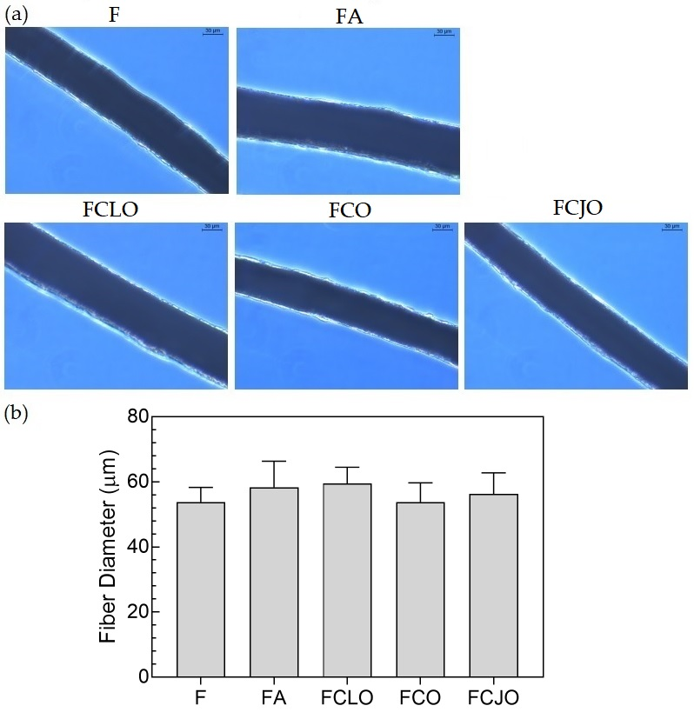
Results & Discussion - Fiber Morphology
Microfibers Observation:
Brightfield microscopy
40x Magnification (30 µm scale bar)
Fibers presented a uniform, homogeneous morphology, free from defects.
Fibers Diameters:
Averaged from 40 measurements
Diameters ranged between 54-59 µm.
* F – unloaded microfiber; FA, FCLO, FCO and FCJO – microfibers loaded with antimicrobial agents

Slide 13
Results & Discussion - Chemical Characterization
IRAffinity-1S, SHIMADZU spectrophotometer (Kyoto, Japan)
45 scans at a spectral resolution of 4 cm⁻¹ (diamond accessory)
1577 and 1543 cm⁻¹
Aromatic ring C=C skeleton vibration of an aromatic substance
1452 cm⁻¹
-C-OH bending vibration from the EOs alcohol moieties

Slide 14
Results & Discussion - Thermal Stability
STA 7200 Hitachi® (Fukuoka, Japan) with platinum pan
N₂ atmosphere, flow rate of 200 mL/min and T rise of 20ºC/min
1st step without EOs ≈ 150 ºC
1st step with EOs ≈ 220 ºC
2nd step ≈ 360 ºC
3rd step ≈ 400 ºC

Slide 15
Results & Discussion - Antimicrobial Action:
Killing Time Kinetics
Bacteria Concentration:
1x10⁵ CFUs/mL
Growth Conditions:
37°C and 120 rpm.
Incubation Periods:
0, 1, 2, 4, 6 and 24 h
Bacteria reduction was observed from the first moments of interaction.
Free EOs were more effective than loaded.

Slide 16
Results & Discussion - Antimicrobial Action:
Killing Time Kinetics
Bacteria Concentration:
1x10⁵ CFUs/mL
Growth Conditions:
37°C and 120 rpm.
Incubation Periods:
0, 1, 2, 4, 6 and 24 h
Log reduction was most significant after 24 h of culture. At this point, it was evident that S. aureus was more susceptible to the prolonged action of the EOs than the E. coli, the only exception being the CJO.

Slide 17
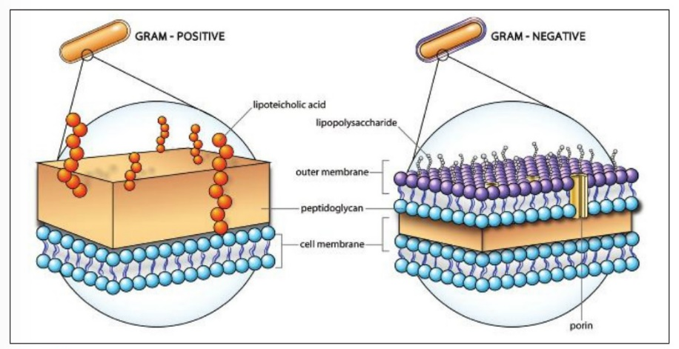
Results & Discussion - Antimicrobial Action:
Membrane Permeability
Bacteria Concentration: 1x10⁵ CFUs/mL (adjusted in 5% glucose)
Growth Conditions: 37°C and 120 rpm for 6 h
Conductance of bacteria suspensions can be used to examined the cell membrane penetration by antimicrobial agents.
Free state
Loaded
https://www.ddw-online.com/therapeutics/p320363-tackling-multi-drug-resistant-bacteria.html

Slide 18
Conclusions
EOs were successfully immobilized onto CA/PCL wet-spun fibers;
Microfibers displayed a uniform and homogeneous morphology with little variations in diameter;
FTIR and TGA data confirmed the successful incorporation of the EOs within the fibers by detecting characteristic peaks of the EOs and by demonstrating the increased overall thermal stability of the polymeric blend, respectively;
Even at small amounts, below MIC value, the EOs-modified microfibers promoted cell death compared to the control groups (unloaded and ampicillin-modified fibers), by disrupting and permeabilizing the cell cytoplasmic membrane;
The results demonstrated the potential of CA/PCL wet-spun microfibers loaded with EOs for applications in biomedicine, in which treatment of infections are a main target.
Full paper at: https://doi.org/10.3390/biom10081129
Felgueiras, H.P., et al. Biomolecules 2020, 10, 1129

Slide 19
Acknowledgments
2C2T Group
Thank you for your attention.
This work is financed by FEDER funds through COMPETE and by national funds through FCT via the projects
POCI-01-0145-FEDER-028074 (PEPTEX) and UID/CTM/00264/2019.

