Slide 1
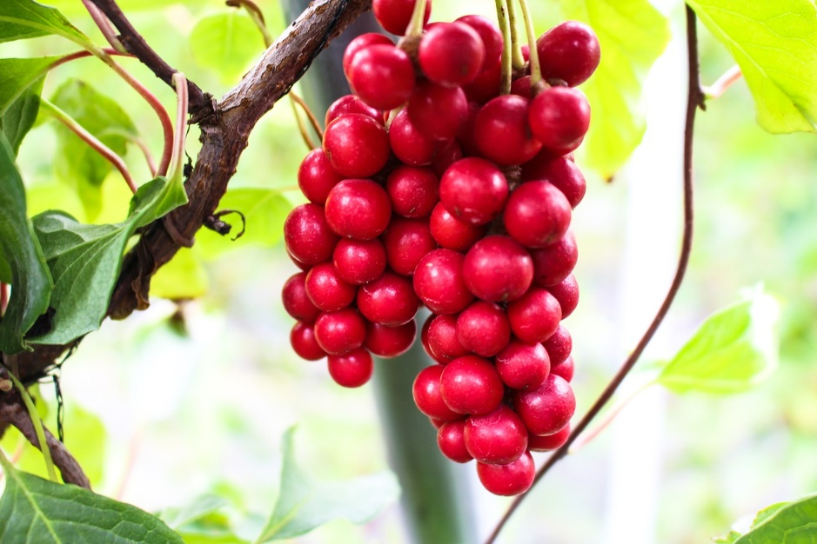
Schisandra chinensis for dementia: a narrative overview of reviews
Michele Antonelli, MD; Davide Donelli, MD; Fabio Firenzuoli, MD
CERFIT, Careggi University Hospital, Florence (Italy)
INTRODUCTION
Schisandra chinensis is a plant of Chinese origin with characteristic red berries (“five flavor fruit”) used for various medicinal purposes.
AIM
To understand if S. chinensis and its active compounds can have beneficial effects for age- and disease-related cognitive decline.
METHODS
Scientific databases: PubMed, Cochrane Library, Google Scholar.
Keywords: “Schisandra chinensis”, “schisandrin”, “dementia”, “cognitive”, “ageing”, “brain”, “Alzheimer*”.
Search date: October 12th, 2020.
RESULTS
Active compounds (lignans):
schisandrin A, schisandrin B, schisandrin C, gomisin A, schisanthenol, schisantherin A.
-------------------------------------------------------------------------------------------------------------------------------------------------------------------------------------------------------------------------------------------------------------------------------------------------------------------------------------------------------------------------------------------------------------------------------------------------------------------------------------------------------------------------------------------------------------------------------------------------------------------------------------------------------------------------------------------------------------------------------------------
Study populations:
mostly mice and rat models of neuro-degeneration and brain damage.
-------------------------------------------------------------------------------------------------------------------------------------------------------------------------------------------------------------------------------------------------------------------------------------------------------------------------------------------------------------------------------------------------------------------------------------------------------------------------------------------------------------------------------------------------------------------------------------------------------------------------------------------------------------------------------------------------------------------------------------------
Pharmacological effects (based on laboratory experiments):
reduction of amyloid-β-induced and glutamate-induced neurotoxicity,
decrease of neuro-inflammation (IL-1, IL-6, TNF-alpha, inducible NOS, PGE-2, COX-2),
regulation of neuronal apoptosis (calcium signaling pathway),
improvement of mood, cognitive performance and memory.
-------------------------------------------------------------------------------------------------------------------------------------------------------------------------------------------------------------------------------------------------------------------------------------------------------------------------------------------------------------------------------------------------------------------------------------------------------------------------------------------------------------------------------------------------------------------------------------------------------------------------------------------------------------------------------------------------------------------------------------------
Clinical evidence (limited):
improvement of cognitive performance when S. chinensis is administered in combination with Eleutherococcus senticosus and Rhodiola rosea.
CONCLUSIONS
Schisandra chinensis might have neuro-protective effects against some brain degenerative pathomechanisms and can be a valid option to study with dedicated clinical investigations.
BIBLIOGRAPHY
Kun, C., Feiyi, S., Jian, D., Feng, C., Guihua, W., Jiangping, Z., ... & Xiaowei, H. (2020). Network pharmacology-based study on the mechanism of Schisandra chinensis for treating Alzheimer's disease. Indian Journal of Pharmacology, 52(2), 94.
Nowak, A., Zakłos-Szyda, M., Błasiak, J., Nowak, A., Zhang, Z., & Zhang, B. (2019). Potential of Schisandra chinensis (Turcz.) Baill. in human health and nutrition: a review of current knowledge and therapeutic perspectives. Nutrients, 11(2), 333.
Sowndhararajan, K., Deepa, P., Kim, M., Park, S. J., & Kim, S. (2018). An overview of neuroprotective and cognitive enhancement properties of lignans from Schisandra chinensis. Biomedicine & Pharmacotherapy, 97, 958-968.

