Slide 1
Irradication of Pseudomonas aeruginosa via sodium alginate/gelatin films impregnated with chitosan microcapsules loaded with cinnamon leaf oil
Catarina S. Miranda*, Joana C. Antunes, Natália C. Homem* and Helena P. Felgueiras*
Centre for Textile Science and Technology
University of Minho, Guimarães, PORTUGAL
Corresponding author: catarinanda@gmail.com; natalia.homem@2c2t.uminho.pt; helena.felgueiras@2c2t.uminho.pt

Slide 2
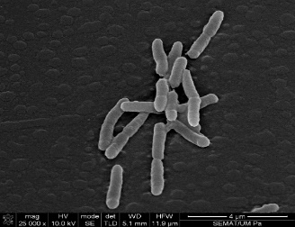
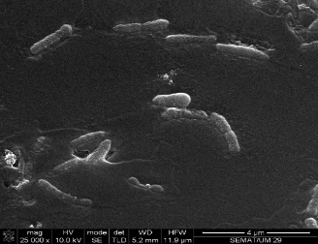
Irradication of Pseudomonas aeruginosa via sodium alginate/gelatin films impregnated with chitosan microcapsules loaded with cinnamon leaf oil
Tripolyphosphate (TPP)
Dyalise
Chitosan (CS)
Cinnamon leaf oil (CLO)
GN
CaC$l_{2}$
1h
1h
SA
Bacteria Elimination
Low stirring
4ºC overnight
Dried for 6 days at RT
Washed in d$H_{2}O;$
150 rpm; 15 min.

Slide 3
Abstract: The multidrug-resistant Pseudomonas aeruginosa is considered a public threat, with antibiotics increasing its resistance. Essential oils (EOs) have demonstrated significant effects against several microorganisms. However, due to their volatile nature they cannot be used in their free-state. Here, hydrogel-like films were produced from a combination of sodium alginate (SA) and gelatin (GN) to serve as delivery platforms for the controlled release of cinnamon leaf oil (CLO) entrapped within chitosan microcapsules. The minimum inhibitory concentration (MIC) of CLO was established at 39.3 mg/mL against P. aeruginosa. Chitosan microcapsules were prepared via ionotropic gelation with tripolyphosphate, encapsulating CLO at MIC. Successful production was confirmed by fluorescent microscopy using Nile red as detection agent. Microcapsules were embedded within a biodegradable SA/GN polymeric matrix processed via a solvent casting/phase inversion methodology with SA/GN used at 70/30 polymer ratio at 2wt% SA concentration. 2wt% CaCl2 was used as coagulation bath. The CLO-containing chitosan microcapsules homogeneous distribution was guaranteed by successive vortex and blending processes applied prior to casting. CLO controlled release from the films was monitored in physiological pH for 24h. Flexible, highly hydrated films were obtained, with the presence of loaded chitosan capsules being confirmed by FTIR. Qualitative/quantitative antimicrobial examinations validated the loaded film potential to fight P. aeruginosa.
Keywords: bio-based polymers; drug delivery platform; natural extracts; trigger-based release; bactericidal effects

Slide 4
Pseudomonas aeruginosa
Development of an infection by P. aeruginosa
Defined by the Infectious Diseases Society of America as a group of human pathogens with clinically relevant antibiotic resistance.
Buhl, M. et al. Expert Review of Anti-Infective Therapy (2015). https://doi.org/10.1586/14787210.2015.1064310

Slide 5
Treatments for bacterial infections
Antibiotics
Essential Oils
Target bacterial functions and growth processes; bactericidal activity
Mixtures of aromatic, volatile, lipophilic biomolecules, extracted from different regions of plants; strong anti-inflammatory, antiseptic, analgesic, spasmolytic, anesthetic and antioxidative properties
Antibiotic resistant pathogens
Citotoxicity at high concentrations; low resistance to degradation; high volatility
Felgueiras, H. P. et al. Biomolecules (2020). https://doi.org/10.3390/biom10081129

Slide 6
Nanocapsules
Increased drug-loading efficiency
Isolate the encapsulated payload from the surrounding
Avoid degradation and burst release
Structure of a nanocapsule
Deng S. et al. Nanomaterials (2020). doi: 10.3390/nano10050847

Slide 7
Polymeric shell
Chitosan
Alginate
Gelatin
Biocompatibility;
Endogenous metabolizable degradable productions;
Gelation conditions;
Mucoadhesive properties;
The strong cationic surface charge of chitosan can lead to nanoparticle aggregation, protein adsorption.
Fast ionic gelation with divalent cations;
Water-soluble salt;
Slow degradability;
Uncontrolled degradation kinetics.
Biodegradable protein;
Biocompatibility;
Water soluble.
Younes I. et al. Marine Drugs ( 2015). doi: 10.3390/md13031133
Sarker B. et al. Journal of Materials Chemistry B (2014). doi: 10.1039/c3tb21509a
Bigi A. et al. Biomaterials (2004). doi: 10.1016/j.biomaterials.2004.01.033

Slide 8
Goal
Engineer a hydrogel-like film delivery platform that guarantees the controlled release of cinnamon leaf oil for the eradication of P. aeruginosa-derived infections.

Slide 9
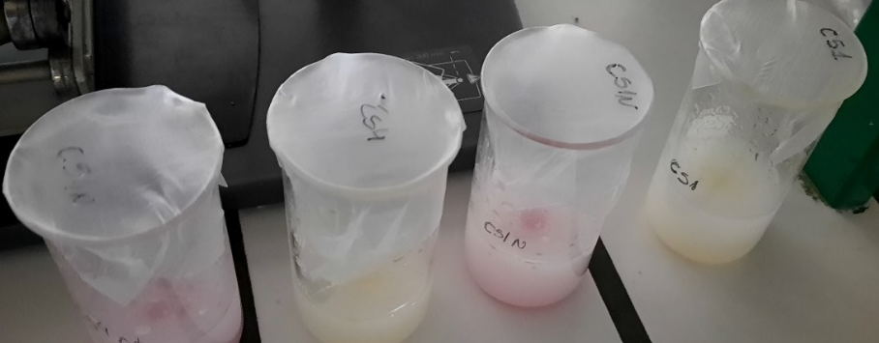
Microcapsules Production
Biodegradable Polymer:
Chitosan (CS)
Polymeric solutions preparation:
CS1: 0.25 mg/mL CS + 0.25 mg/mL TPP (tripolyphosphate) + 39.3 mg/mL CLO + d$H_{2}O$+ acetic acid (AA)
CS4: CS1 with adjusted pH to 5.145
Dialysis:
In a snakeskin dialysis membrane with 10,000 Da cut-off, for 24 h and 3 times bath exchange

Slide 10
Film Production
Biodegradable Polymers:
Sodium Alginate (SA) Gelatin (GN)
The solutions (SA and GN) were dissolved separately in distilled water at 50ºC for 1h and 3h, respectively.
Films:
SA 2% w/v + GN 1% w/v + d$H_{2}O+$ CaC$l_{2} \text{2\% }\text{w}\text{/}\text{v}+$CS1
SA 2% w/v + GN 1% w/v + d$H_{2}O+\text{CaC}l_{2} \text{2\% }\text{w}\text{/}\text{v}+$ CS4
SA 2% w/v + GN 1% w/v + d$H_{2}O$ $+$ CaC$l_{2}$ 2% w/v - used as a control
GN
CaC$l_{2}$
1h
1h
Washed in d$H_{2}O;150 rpm;15 min.$
SA
Low stirring
4ºC overnight; Dried for 6 days at RT

Slide 11
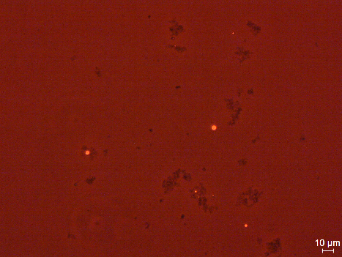
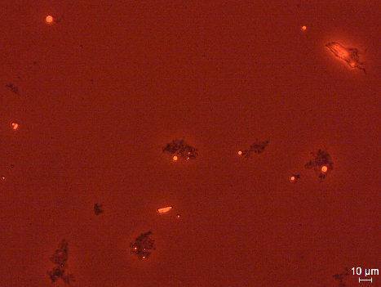
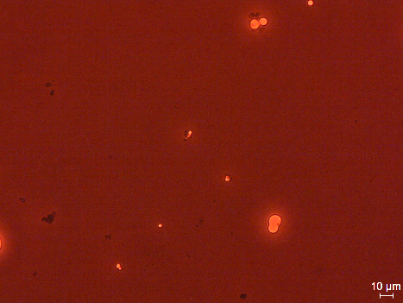
CLO-Loaded Microcapsules Morphology
Technique:
Fluorescence microscopy;
40x magnification (20 µm scale bar)
Observations:
Elimination of the non-reacted polymer with dialysis.
Greater microcapsule and unloaded chitosan aggregation on CS4 than on CS1.
Microcapsules produced with no pH adjustment were more successful.
Before dialysis
After dialysis
CS1
CS4

Slide 12
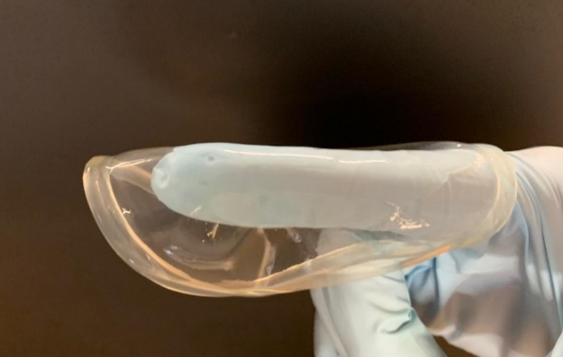
Films Morphology
Very hydrated films;
Flexible;
Homogeneous;
Regular distribution of microcapsules.

Slide 13
Chemical Characterization
Aromatic ring C=C skeleton vibration of an aromatic substance
Hydrogen bonded O–H stretching vibrations
Presence of CLO
C=O stretching vibrations of
the oil components
CLO was more easily noticeable on the CS4-containing films than on the CS1, which may indicate that the EOs molecules were larger

Slide 14
CLO Release Profile
Strongest burst release
Only started to release EO after 2 hours
Lower release profile for the CS4-containing samples

Slide 15
Antimicrobial Action
Time-kill kinetics and log reduction of the P. aeruginosa bacteria in contact with the unloaded and loaded films demonstrated the enhanced performance of the SA/GN/CS1 films in fighting bacteria in comparison with the SA/GN/CS4.

Slide 16
Conclusions
The incorporation of the CLO-containing CS microcapsules within the SA/GN fibers was confirmed;
The continuous release of the entrapped oil over a period of 24 h was attained, with a matched time kill kinetics against the P. aeruginosa bacteria;
CS1 loaded films were determined more effective than the CS4-loaded or the unloaded surfaces;
Future work will be aimed at improving the loading capacity and homogeneity of the microcapsules.

Slide 17
Acknowledgments
2C2T Group
Thank you for your attention.
This work is financed by FEDER funds through COMPETE and by national funds through FCT via the projects
POCI-01-0145-FEDER-028074 (PEPTEX) and UID/CTM/00264/2019. C.S.M. acknowledges FCT for the PhD grant with reference 2020.08547.BD

