Slide 1
Pharmacological study of Amaranthus spinosus L. roots
Kokou Atchou ^{1,}*, Povi Lawson-Evi ¹, Kossi Metowogo ¹, Kwashie Eklu-Gadegbeku ¹ and Kodjo AkliKokou ¹
¹ Laboratory of Physiology-Pharmacology, Unit of Pathophysiology, Bioactive Substances and Safety, Faculty of Sciences, University of Lome, Postbox 1515 Lome -Togo
* Corresponding author: n.k.atchou@gmail.com

Slide 2
Pharmacological study of Amaranthus spinosus L. roots
Protection against glomerulosclerosis & macular edema
Graphical Abstract
Lipoperoxidation (MDA) ↓ in the liver, kidneys & eyes
Detoxification (GSH) ↑ in the liver, kidneys & eyes
21 days treatment of diabetic STZ rats with A. spinosus extract & glibenclamide
Food & water intake, Body weight => ~ to normal
Urinary, biochemical & hematological parameters => ~ to normal
Basal glucose levels ↓ at 2nd & 3rd weeks
Oral glucose tolerance ↓

Slide 3
Abstract:
Amaranthus spinosus is a medicinal plant used traditionally to treat diabetes mellitus. This study aimed was to evaluate the antidiabetic activity of the plant in diabetic STZ rats. The antidiabetic activity of the hydroethanolic extract of the roots of A. spinosus was evaluated in diabetic STZ rats for 21 days. The results showed that A. Spinosus extract 500 mg/kg b.w and glibenclamide used as reference drug caused a significant (p < 0.0001) decrease in oral glucose tolerance and basal blood glucose levels in diabetic STZ. At the end of treatment, food and water intake, body weight, urinary, biochemical and haematological parameters were significantly (p < 0.0001) returned to normal in the treated groups. In the liver, kidneys and eyes, a significant decrease (p < 0.0001) in MDA and an increase in GSH was observed in treated rats. Histopathological studies of the kidneys and eyes revealed no damage in rats treated with extract of A. spinosus and glibenclamide in contrast to glomerulosclerosis and macular edema seen in untreated groups. These results show that A. spinosus roots has bioactive compounds and the extract 500 mg/kg b.w can be administered orally to treat type II diabetes and its complications related to oxidative stress.
Keywords: Bioactive compounds; diabetes; biochemical; hamatological parameters; histopathological studies.

Slide 4
Diabeties :
Metabolic disease
Global prevalence
Diagnosis
Affects people of all ages
In all geographic regions of the world
Evolution ↑
2019 => 9.3% or 463 million adults
2030 => 10.2% & 2045 => 10.6%
(IDF, 2019)
death => 1 person every second
Fasting blood glucose ≥ 7.0 mmol/L
(ADA, 2020)
blood glucose ≥ 11.1 mmol/L after OGTT

Slide 5
Diabeties :
Classification:
T1DM (5-10%), common in children and young people, result in a gradual loss of β cells by an autoimmune process leading to insulin deficiency
T2DM (90-95%) typically seen in adults, result from a decrease in the sensitivity of insulin receptors to insulin and dysfunction of β cells leading to insulin resistance and insulinopenia
GDM estimated at 15.8% of live births in women due to the resistance of cells to the action of insulin towards the end of the 2nd and 3rd trimester of pregnancy
Other types of diabetes due to various causes (ADA, 2020)

Slide 6
Diabeties
Symptoms: polyuria; polydipsia; body weight loss & blurred vision
Complications :
Infection & inflammation
Metabolic complications : hypoglycemia; Ketoacidosis & hyperosmolar coma; oxidative stress (Wachtel et al., 1991: Giacco & Brownlee, 2010)
Neurodegenerative complications :
Macroangiopathies : atherosclerosis; myocardial infarction, stroke
Microangiopathies: blindness and kidney failure (IDF, 2019)
Prevention : diet, physical exercise (in T2DM)
Treatment : T1DM: insulin & other alternatives.
T2DM: oral antidiabetics & insulin if needed

Slide 7
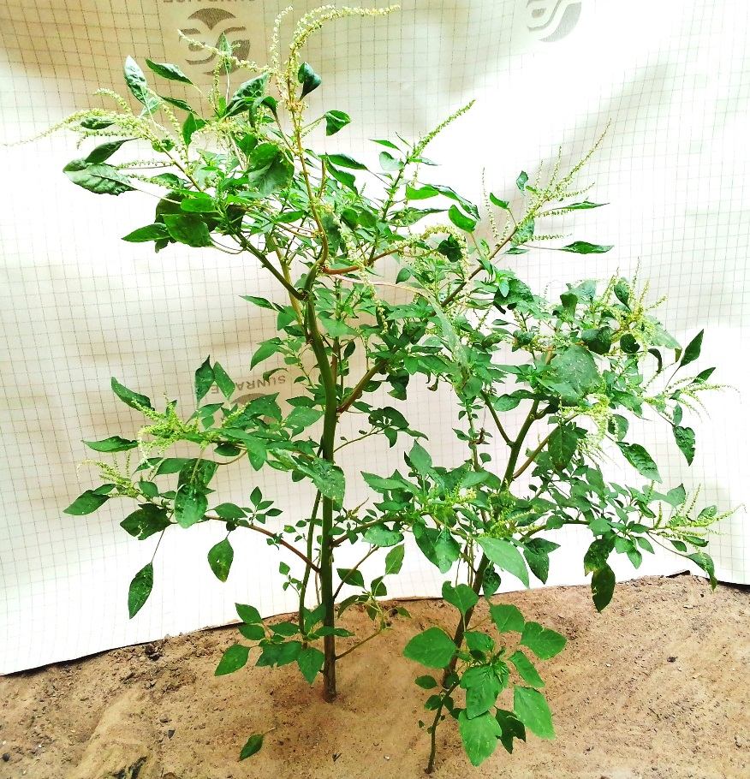
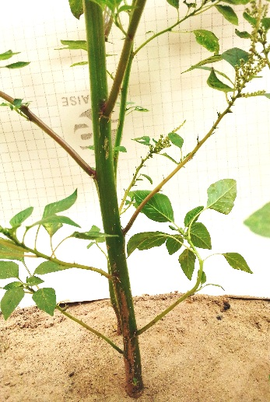
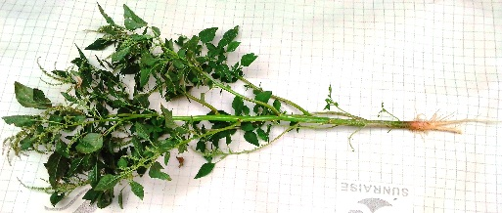
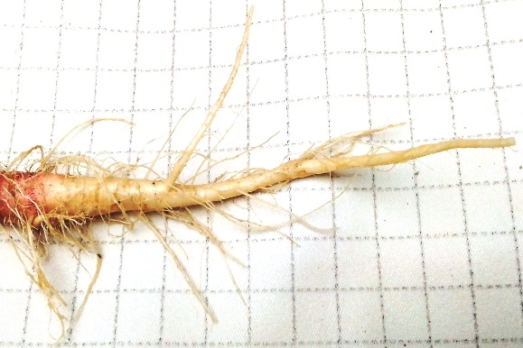
Medicinal plants are used as oral antidiabetics to treat T2DM and have insulin-sensitizing or insulin-secreting or insulin-modulating actions. A. spinosus is one of the medicinal plants whose roots are used in traditional medicine to treat diabetes.
Amaranthus spinosus L.

Slide 8
Aim of study
Evaluate the antidiabetic activity of Amaranthus spinosus in diabetic STZ rats
Objectives
Induce diabetes & complications in Sprague Dawley rats treated with fructose-lard for 20 days
Treat diabetes rats with A. spinosus for 21 days
Measure blood glucose levels in diabetes rats before and weekly during the experimental
Evaluate urinary, biochemical, hematological and histopathology parameters at the start and at the end of treatment.

Slide 9
Results and discussion
Effect of A. spinosus on basal glucose levels
Injection of STZ at 12th days => ↑ blood glucose levels (p < 0.0001). Treatment with A. spinosus 500 mg/kg (AS) & glibenclamide 0.6 mg/kg (Gliben) => ↓ in blood glucose levels (p < 0.0001) at 2nd (D35) and 3rd (D41) compared to UTC (Figure A). The air under the curve confirmed this ↓ in blood glucose levels (p < 0.0001) (Figure B).

Slide 10
Effect of A. spinosus on glucose intolerance
Diabetes rats were submited to OGTT at the end of 21 days of treatment.
After 2 g/kg of glucose overload in diabetes rats prior fasted, the treatment with A. spinosus 500 mg/kg & glibenclamide 0.6 mg/kg :
↓ in blood glucose levels (p < 0.0001) at time t = 30; 60; 120 & 180 min
The air under the curve confirmed this ↓ in blood glucose levels (p < 0.0001) compared to UTC

Slide 11
Effect of A. spinosus on water and food intake per group
Treatment for 21 days :
Water & food intake ↑ (p < 0.0001) in untreated control group compared to NC (Figure A)
Water & food intake ↓ (p < 0.0001) in treated groups with A. spinosus 500 mg/kg & glibenclamide 0.6 mg/kg compared to UTC (Figure B)

Slide 12
Effect A. spinosus on changes in body weight
Treatment for 21 days :
Body weight ↓ (p < 0.0001) in untreated control group compared to NC
Body weight ↑ (p < 0.0001) in treated groups with A. spinosus 500 mg/kg & glibenclamide 0.6 mg/kg compared to UTC.

Slide 13
Effect of A. spinosus on the relative weight of organs
Brain
Lungs
Heart
Liver
Eyes
Kidneys ↑ (p < 0.01) in UTC
No significant changes

Slide 14
Effect of A. spinosus on urinary parameters at the start and end of treatment
At the sart of treatment
Glycosuria, ketonuria, proteinuria, hematuria leukocyturia => present (p < 0.001) in diabetes rats compared to NC
At the end of 21 days of treatment
Untreated control group
Glycosuria, ketonuria, proteinuria, hematuria leukocyturia => present (p < 0.0001)
Groups treated with A. spinosus 500 mg/kg & glibenclamide 0.6 mg/kg
Glycosuria, ketonuria, proteinuria, hematuria leukocyturia => absent (p < 0.0001)

Slide 15
Effect of A. spinosus on biochemical parameters at the start and end of treatment
At the sart of treatment
serum creatinine; AST; CPK; triglycerides; total cholesterol; LDL-cholesterol => ↑ (p < 0.001) in diabetes rats compared to NC
At the end of 21 days of treatment
Untreated control group
Serum urea; creatinine; AST; ALAT; CPK; triglycerides; LDL-cholesterol => ↑
HDL-cholesterol => ↓
Groups treated with A. spinosus 500 mg/kg & glibenclamide 0.6 mg/kg
Serum urea; creatinine; CPK; triglycerides; LDL-cholesterol => ↓

Slide 16
Effect of A. spinosus on hematological parameters at the end of treatment
Untreated control group
MCH; platelets; WBC; neutrophils => ↓ (p < 0.001)
Lymphocytes => ↑ (p < 0.01) compared to NC
Groups treated with A. spinosus 500 mg/kg & glibenclamide 0.6 mg/kg
Platelets; lymphocytes => ↑ (p < 0.01)

Slide 17
Effect of A. spinosus in MDA & GSH content in the organs at the end of treatment
Untreated control group
In the liver => MDA ↑ (p < 0.0001) ; GSH ↓ (p < 0.01)
In the kidneys => MDA ↑ (p < 0.0001) ; GSH ↓ (p < 0.01)
In the eyes => MDA ↑ (p < 0.0001) ; GSH ↓ (p < 0.001)
Groups treated with A. spinosus 500 mg/kg & glibenclamide 0.6 mg/kg
In the liver => MDA ↓ (p < 0.0001) ; GSH ↑ (p < 0.001)
In the kidneys => MDA ↓ (p < 0.0001) ; GSH ↑ (p < 0.001)
In the eyes => MDA ↓ (p < 0.0001) ; GSH ↑ (p < 0.01)

Slide 18
Histopathological study after hematoxylin & eosin staining
Untreated group
Kidneys => glomerular sclerosis
Eyes => macular edema
Groups treated with A. spinosus 500 mg/kg & glibenclamide 0.6 mg/kg
Kidneys => normal
Eyes => normal

Slide 19
A. spinosus possessed bioactive compounds & ↓ significantly in oral glucose tolerance & in basal blood glucose levels of diabetes rats.
Our previous study => A. spiosus 125; 250 & 500 mg/kg b.w ↓ significantly (p < 0.0001) in ICR mice oral glucose tolerance & basal blood glucose levels (Atchou et al., 2020)
Others previous studies demonstrate antidiabetic activity of the leaves & whole plante of A. spinosus (Sangameswaran & Jayakar, 2008; Girija et al., 2011; Kumar et al., 2011; Bavarva & Narasimhacharya, 2013)

Slide 20
A. spinosus action in decreased in blood glucose levels was compared to glibenclamide => induction of insulin secretion & release (Rajasekaran et al., 2005; Pandarekandy, 2017).
In our previous study : A. spinosus induced in the presence of insulin,
no significant ↓ in blood glucose level of the chicken embryos in ovo at days 11
no significant ↑ in glucose uptake by muscles ex vivo
Confirmed intrapancreatic activity of A. spinosus (Lawson-Evi et al., 2020).

Slide 21
Administration of A. spinosus 500 mg/kg & glibenclamide offered protection against diabetes complications.
↓ in triglycerides; LDL-cholesterol & ↑ in HDL-cholesterol => correct dyslipidemia
↓ in CPK; LDL-cholesterol => protection against cardiovascular disease
↓ in ALAT; ASAT => hepatoprotection
↓ in uremia; creatinemia & disappearance of glucosuria, acetonuria, proteinuria, hematuria; leukocyturia => protection against diabetic neuphropathy confirmed in histopathological study
↓ in MDA & ↑ in GSH; HDL-cholesterol => ↓ in inflammation & protection against retinopathy confirmed in histopathological study
↓ in lipoperoxidation (MDA) & in detoxification processes (GSH) => also protection against brain; lungs; heart; liver; eyes & kidneys cibled by hyperglycemia.

Slide 22
In our previous study : A. spinosus showed,
the antioxidant and reducing power (Atchou et al., 2020)
In diabetes, chronicle hyperglycemia => oxidative stress, which is an important factor in the onset of diabetes. Oxidative stress => ↑ ROS production which induce membrane lipids peroxidation, tissues & DNA damage, then accelerate the onset of complications of diabetes (Goldstein et al., 1996; Li et Shah, 2003; Povi et al., 2015).
↓ in diabetes complications by A. spinosus => antioxidant & reducing activities

Slide 23
Conclusions
Evaluation of hydroethanolic extract A. spinosus roots in diabetes STZ SD rats for 21 days => ↓ in oral glucose tolerance & basal glucose levels. The mechanism of action of A. spinosus in blood glucose decreased was compared to glibenclamide by induction of insulin secretion and release from existing pancreatic β cells.
Treatment of diabetes STZ rats by A. spinosus => ↓ inflammation; ↓ membrane lipids peroxidation, ↑ detoxification processes & correct dyslipidemia ; thus protected against cardiovascular disease; nephropathy & retinopathy.
In this study, A. spinosus 500 mg/kg b.w can be used to treat T2DM and its complications related to oxidative stress. However, further studies are needed to elucidate all mechanism actions of extract, evaluate it toxicity & standardize the doses of extract in order to produce improve drugs.

