Slide 1
Antimicrobial properties of Lepidium satvium L. based green synthesis of Silver Nanoparticles
Zehra Edis ^{1,}*, Samir Haj Bloukh ² , Mustafa Ameen Alhamaidah ^{1,2} , Hamid Abu Sara ²
¹College of Pharmacy and Health Science, Department of Pharmaceutical Sciences, Ajman University, PO Box 346, Ajman, United Arab Emirates
²College of Pharmacy and Health Science, Department of Clinical Sciences, Ajman University, PO Box 346, Ajman, United Arab Emirates
Corresponding author: z.edis@ajman.ac.ae

Slide 2
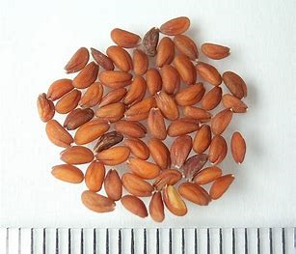
Antimicrobial properties of Lepidium satvium L. based green synthesis of Silver Nanoparticles

Slide 3
Abstract:
Antimicrobial and antibiotic resistance is a major threat to mankind due to increasing resistance towards existing medicinal drugs. Plant-based antimicrobials are promising alternatives to conventional drugs. Cress (Lepidium sativum L.) is known as garden cress, garden cress pepper weed or garden pepperwort and is a member of the Brassicaceae family. Lepidium satvium L. (LS) is widely spread throughout the world as a fast-growing annual herb. LS seed oil has antimicrobial, antioxidant, and anti-inflammatory activities. Silver nanoparticles (AgNP) gained attention due to their antimicrobial properties. We aimed to synthesize LS encapsulated AgNP to enhance the microbicidal activities of the nanoparticles and prevent microbial resistance by plant-based synergistic mechanisms. AgNP were prepared in a one-pot synthesis by plant-biomolecules-induced reduction of silver nitrate via green method. The biomolecules and metabolites in the aqueous LS extract act as reducing, capping and stabilizing agents of AgNP. Fourier transform infrared spectroscopy (FT-IR), Ultraviolet-visible spectroscopy (UV-Vis) and Dynamic light scattering (DLS) confirmed the composition of the LS-AgNP biohybrids. Antimicrobial testing by disc dilution method against a total of 9 reference strains of microorganisms verified excellent to intermediate antimicrobial activity. The Gram-negative pathogens E. coli WDCM 00013 and P. aeruginosa WDCM 00026 were highly inhibited, followed by good results for the Gram-positive bacteria S. aureus ATCC 25923, B. subtilis WDCM 00003, S. pyogenes ATCC 19615, E. faecalis ATCC 29212, and the fungus C. albicans WDCM 00054. Our biohybrid LS-AgNP showed increased antimicrobial activity with potential uses as disinfectant and wound care product.
Keywords: Lepidium sativum L.; antibiotic resistance; antimicrobial resistance; biomaterials; antimicrobial activity; synergism; green synthesis; silver nanoparticles

Slide 4
Introduction
Antimicrobial and antibiotic resistance are threatening the survival of mankind. The ESKAPEE micoorganisms (Enterococcus faecium, Staphylococcus aureus, Klebsiella pneumoniae, Acinetobacter baumannii, Pseudomonas aeruginosa, Enterobacter spp., and Escherichia coli) cause worldwide problems due to their resistance towards conventional drugs and antimicrobials. WHO listed them as high-risk pathogens.
Increased treatment durations, morbidity, fatality and exploding health care costs are markers for the urgent need of new generation antibiotic drugs and antimicrobial agents. The ESKAPEE pathogens belong to the most resistant species.
Nosocomial infections are part of the problem in the treatment of severely ill, immunocompromised patients with comorbidities. The contamination of health care and public settings with microorganisms cause secondary infections leading to severe complications for the patients.
Nanoparticles have antimicrobial properties and are excellent drug carriers with their large surface area, which deliver the needed compounds to their targets. Plant-biosynthesized silver nanoparticles (AgNP) are good candidates through their excellent antimicrobial properties.

Slide 5
Introduction
Cress (Lepidium sativum L.) is known as garden cress, garden cress pepper weed or garden pepperwort and is a member of the Brassicaceae family. Lepidium satvium L. (LS) is known and utilized worldwide as a fast-growing annual herb. LS seed oil is used since centuries in many cultures in ailments because of
antimicrobial, antioxidant, and anti-inflammatory activities.
We prepared LS-AgNP by an easy, one-pot method in aqueous medium. The plants’ bioactive compounds act as reducing, encapsulating and capping agents for the AgNP. LS-AgNP shows promising antimicrobial activities due to the synergistic effects of the biocompounds within the LS.
We tested the LS-AgNP against 9 different reference strains of microorganisms by the agar well and disc dilution methods. The results promise good perspectives for our LS-AgNP as basic microbicidal agents for topical treatment and disinfection.

Slide 6
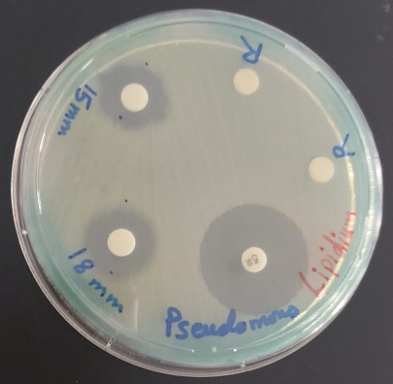
Results and discussion
The samples were analyzed by DLS, SEM/EDS, x-ray diffraction (XRD), UV-vis, and FT-IR. These methods confirmed the composition of LS-AgNP. Further measurements are under process, to verify the first round results. All the complexes are stable and stay homogenous when stored in the fridge.
The DLS showed the average particle size of 33 nm for the Ag nanoparticles. The AgNP were successfully encapsulated and stabilized by the biocomponents in the LS and produced small sized NP.
The antimicrobial properties of LS-AgNP show in comparison to common antibiotics strong to intermediate results against 9 reference strains of microorganisms (Figure 1, Table 1).
Figure 1. Antimicrobial disc dilution assay of LS-AgNP biocomplexe with positive control antibiotic cefotaxime (30 µg/disc). P. aeruginosa WDCM 00026.

Slide 7
Results and discussion
Table 1. Antimicrobial testing of antibiotics (A) and LS-AgNP by agar well method (AW) and disc dilution method (+). ZOI (mm) against microbial strains by disc diffusion assay as dilution series.
Strain | Antibiotic | A | AW | 1⁺ | 2⁺ | 3⁺
S. aureus ATCC 25923 | G | 28 | 19 | 12 | 10 | 0
S. pyogenes ATCC 19615 | C | 25 | 14 | 11 | 10 | 0
E. faecalis ATCC 29212 | G | 25 | 14 | 0 | 0 | 0
B. subtilis WDCM 00003 | G | 21 | 19 | 14 | 13 | 0
P. mirabilis ATCC 29906 | G | 30 | 20 | 0 | 0 | 0
P. aeruginosa WDCM 00026 | G | 23 | 22 | 18 | 15 | 0
E. coli WDCM 00013 | G | 23 | 23 | 16 | 15 | 0
K. pneumoniae WDCM 00097 | G | 30 | 20 | 15 | 11 | 0
C. albicans WDCM 00054 | NY | 16 | 12 | 14 | 0 | 0
* Agar well method (AW) of LS-AgNP with concentration of 50 µg/mL. Disc diffusion studies (6 mm disc impregnated with 2 mL of 50 µg/mL (1+), 2 mL of 25 µg/mL (2+) and 2 mL of 12.5 µg/mL (3+) of compound LS-AgNP. G Gentamicin (30 µg/disc). NY (Nystatin) (100 IU). 0 = Resistant. No statistically significant differences (p > 0.05) between row-based values through Pearson correlation. .

Slide 8
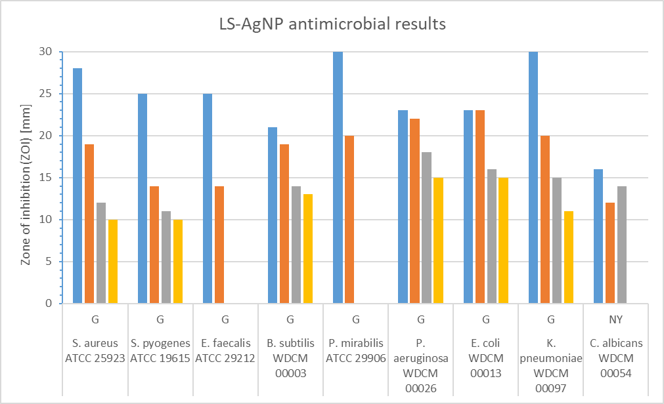
Results and discussion
The antimicrobial test results of LS-AgNP are shown in Figure 2.
Figure 2. * Agar well method (AW) of LS-AgNP with concentration of 50 µg/mL (orange). Disc diffusion studies (6 mm disc impregnated with 2 mL of 50 µg/mL (grey) and 2 mL of 25 µg/mL (yellow) of compound LS-AgNP. Antibiotics (blue): G Gentamicin (30 µg/disc). NY (Nystatin) (100 IU).

Slide 9
Results and discussion
LS-AgNP inhibited Gram-negative pathogens stronger than Gram-positive species and C. albicans. Disc diffusion studies resulted in smaller ZOI compared to agar well diffusion tests (Table 1, Figure 2).
LS-AgNP and the antifungal nystatin inhibited C. albicans in both agar well and disc diffusion studies similarly. The Gram-negative species E. coli WDCM00013 and P. aeruginosa WDCM 00026 showed similar inhibition zones for the antibiotic gentamycin and LS-AgNP.
The nanocompound LS-AgNP exhibits the highest inhibition zones in agar well diffusion assay (23 mm) against E. coli WDCM00013, followed by P. aeruginosa WDCM 00026, K. pneumoniae WDCM00097, P. mirabilis ATCC 29906, and the Gram positive S. aureus ATCC 25923 (ZOI = 20) at concentrations of 50 µg/mL (Table 1, Figure 2).
These results show high antifungal properties against C. Candida WDCM00054, as well as strong antibacterial inhibition of the Gram negative pathogens E. coli WDCM00013 and P. aeruginosa WDCM 00026.

Slide 10
Results and discussion
Our plant-based, LS-AgNP-compound is active against microorganisms reported as antibiotic resistant ESKAPEE pathogens, which can also form inter-kingdom biofilms in wounds leading to morbidity and mortality.
Rod-shaped bacilli are more susceptible than round shaped cocci towards our compounds. Among the Gram-positive cocci, the higher the complexity of the bacteria the higher the susceptibility. Clusters (S. aureus) are more susceptible than chains (S. pyogenes) and single bacteria (E. faecalis). We reported similar trends previously for the AgNP complexes with trans-cinnamic acid and extracts of cinnamomum zeylanicum with PVP as encapsulating agent.
Our LS-AgNP bio-nanocompound is one alternative solution against antimicrobial resistance.

Slide 11
Conclusions
ESKAPEE pathogens endanger mankind due to their resistance mechanisms against conventional antimicrobial agents. Plant-based, biosynthesized silver nanoparticles can be durable, biocompatible and sustainable solutions. Plant biocompounds exhibit antimicrobial properties due to their synergistic effects, which are the result of their fight against microorganisms since the beginning of time.
We investigated a combination of two known antimicrobial agents in form of LS-AgNP complexes. Our compounds exerted antimicrobial activity on Gram-negative and Gram-positive pathogens at a concentration of 50 µg/mL. Future investigations need to highlight in vivo applications of our complex and possible combinations with antibiotic drugs. Our biohybrid LS-AgNP showed increased antimicrobial activity with potential uses as disinfectant and wound care product.
The new complexes have promising microbicidal properties with potential to prevent biofilm formation. The easy and rapid synthesis increases its potential uses as disinfectants, sanitizers, coating materials in personal protective equipment (PPE), health care settings, public spaces and indoor environments.
The future of mankind depends on the availability of easily biosynthesized, antimicrobial agents with high effectiveness and abundant sources.

Slide 12
Acknowledgements
The authors gratefully acknowledge Ajman University for supporting this research.

