Slide 1
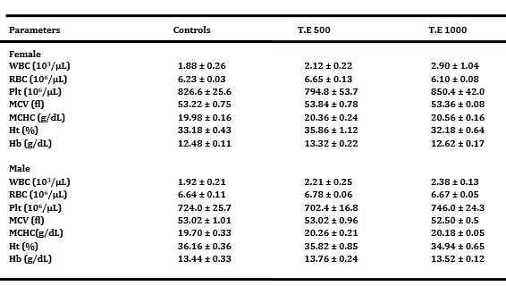
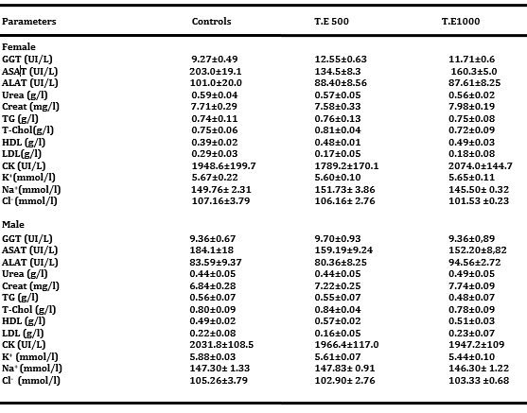
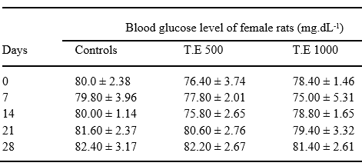
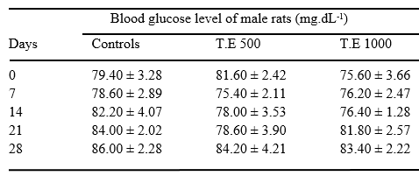
Acute and subchronic toxicity assessments of hydro alcoholic extract of roots of Anogeissus leiocarpus (Combretaceae)
Aku Enam MOTTO¹(*), Povi LAWSON-EVI¹, Aboudoulatif DIALLO², Kwashie EKLU-GADEGBEKU¹, Kodjo AKLIKOKOU¹, M. GBEASSOR.
¹Laboratory of Physiology/Pharmacology. Faculty of Sciences, University of Lome BP 1515 Togo
² Department of Toxicology, Faculty of Health Sciences, University of Lome BP 1515 Togo
Context
Anogeissus leiocarpus (Combretacae) is a tropical plant widely used to treat many diseases in traditional medicines. This study was designed to assess the oral acute and subchronic toxicity of the hydro alcoholic extract of roots of Anogeissus leiocarpus.
Materials and methods
In the acute test, the limit test dose of 5000 mg.kg⁻¹ of the extract was administered orally to 3 Sprague Dawley female rats and then observed individually 1 h post-dosing for 14 days. Hydro alcoholic extract (500, 1000 mg.kg⁻¹) was administered orally to both sexes of rats during 28 days. At the end of experimentation, general clinical signs, mortality, haematological and biochemical parameters and histopathological aspect were assessed.
Results & Discussion
The limit dose of 5000 mg.kg⁻¹ did not cause any mortality in the rats tested during the observation period. This suggests that the Lethal Dose 50 (LD50) > 5000 mg.kg−1 by oral administration in rats.
In subchronic toxicity study, no abnormalities in body weight, food consumption, clinical signs, serum biochemistry, electrolytes, hematology, organ weights were revealed in both sexes of rats treated with roots of Anogeissus leiocarpus at the doses of 500 and 1000 mg.kg⁻¹. Histopathological examination (liver, spleen and kidneys) were also normal (data not shown). Contrary to our results, the study of Agaie et al, (2007) on aqueous crude extract of leaves of Anogeissus leiocarpus during 28 days showed some changes in the biochemical profile of rats. This could be explained by the diversity of chemotypes of the plant.
Table 3: Effect of the total extract on hematological parameters
Total extract or distilled water was administered orally to rats every day during 28 days. Total blood was collected on 14 hours -fasted animals. Control: received distilled water. T.E 500, T.E 1000 (500 and 1000 mg.kg⁻¹) of total extract. N=5 per sex. Results were expressed as the mean ±ESM.
Figure 1: Effect of the total extract on body weight of female and male rats
Total extract or distilled water was administered orally to rats every day during 28 days. Body weight was taking each day before the treatment. Control: received distilled water. T.E 500, T.E 1000 (500 and 1000 mg.kg⁻¹) of total extract. N=5. Results were expressed as the mean ±ESM
Table 4: Effect of the total extract on serum biochemical parameters
Table 1: Effect of the total extract on basal blood glucose of female rats
Total extract or distilled water was administered orally to rats every day during 28 days. Total blood was collected on 14 hours -fasted animals. Control: received distilled water. T.E 500, T.E 1000 (500 and 1000 mg.kg⁻¹) of total extract. N=5 per sex. Results were expressed as the mean ±ESM.
Table 2: Effect of the total extract on basal blood glucose of male rats
Total extract or distilled water was administered orally to rats every day during 28 days. Serum was obtained on total blood of 14 hours -fasted animals. Control: received distilled water. T.E 500, T.E 1000 (500 and 1000 mg.kg⁻¹) of total extract. N=5 per sex. Results were expressed as the mean ±ESM.
Total extract or distilled water was administered orally to rats every day during 28 days. Total blood was collected on 14 hours -fasted animals. Control: received distilled water. T.E 500, T.E 1000 (500 and 1000 mg.kg⁻¹) of total extract. N=5 per sex. Results were expressed as the mean ±ESM.
Conclusion
The total hydro alcoholic extract of roots of A. leiocarpus is found to be nontoxic in rats following either a single dose or daily repeated doses for 28 days.
Bibliography
Agaie, B. M., Onyeyili, P. A., Muhammad, B. Y., Landan, M. J. Some toxic effects of aqueous leaf extract of Anogeissus leiocarpus in rats. Journal of Pharmacology and Toxicology, 2007; 2 (4), 396-401.

