Slide 1
Evaluation of genotoxicity of Anogeissus leiocarpus roots on mouse bone marrow cells in vivo
Aku Enam MOTTO¹(*), Povi LAWSON-EVI¹, Aboudoulatif DIALLO², Kwashie EKLU- GADEGBEKU¹, Kodjo AKLIKOKOU¹, M. GBEASSOR.
¹Laboratory of Physiology/Pharmacology. Faculty of Sciences, University of Lome BP 1515 Togo
² Department of Toxicology, Faculty of Health Sciences, University of Lome BP 1515 Togo
* Corresponding author: nam.motto@gmail.com

Slide 2
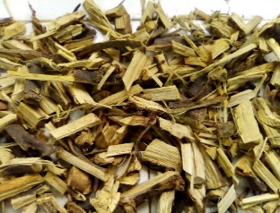
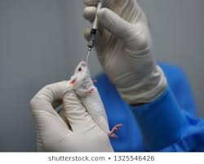
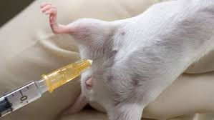
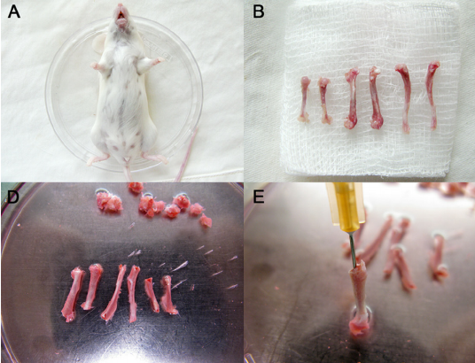
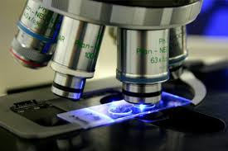
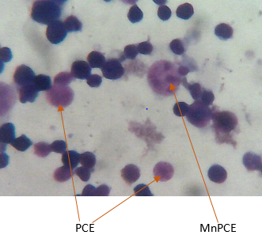
Evaluation of genotoxicity of Anogeissus leiocarpus roots on mouse bone marrow cells in vivo
Graphical Abstract
Roots of A. leiocarpus
Femur removed and bone marrow flushed for slides
Extract
Cyclophosphamide / Nacl 0.9 %
Extract:
Non - genototoxic
Prevents from genotoxicity
Non - cytotoxic
Genotoxicity caused by cyclophosphamide

Slide 3
Abstract:
Anogeissus leiocarpus (Guill and Perr) is a plant which widely spread throughout the tropical and subtropical areas. This study was designed to evaluate the potential eﬀects of roots of Anogeissus leiocarpus on mice bone marrow cells in vivo. 250, 500, 1000 mg.kg⁻¹ of total hydro alcoholic extract of roots of A. leiocarpus were evaluated for genotoxic, antigenotoxic and cytotoxic activities by a micronucleus test. The genotoxicity was induced by the administration of cyclophosphamide IP.
At the end of the treatment, no significant difference (p>0.05) was found between the body weight gain of the treated groups compared to the negative controls. Evaluation of the ratio of polychromatic erythrocytes to total erythrocytes (PCEs %) in the bone marrow had shown no significant difference between the groups treated with the extract and the untreated group. In pre treated groups with the extract at the doses of 250, 500 and 1000 mg.kg⁻¹, there was a significant (p<0.0001) decrease in MnEPCs compared to the positive controls; in a dose-dependent manner.
This study has revealed that the extract of A. leiocarpus was not genotoxic but rather possessed a protective eﬀect against the genotoxicity and cytotoxicity induced by cyclophosphamide.
Keywords: Anogeissus leiocarpus -micronucleus- genotoxicity- cytotoxicity

Slide 4
Introduction (1)
Genotoxicity is defined as the ability of a substance to induce damage, either direct or indirect, to genetic material resulting in breaks in DNA (clastogenic effect) or mutations in DNA (mutagenic effect).
Because of the toxic effect that chemical or natural substances can cause at the gene level, genotoxicity studies are therefore of great importance in assessing risks to human health (Quesnot, 2015; Fardel et al., 2010)
Due to the increasing use of herbal medicines in the treatment of various diseases (Folashade et al., 2012), many toxicological studies have been carried out to show the safety or harmfulness of these plants.

Slide 5
Introduction (2)
Anogeissus leiocarpus, a plant of the combretaceae family is widely used in traditional medicine in Togo to treat various pathologies including diabetes (Kpodar et al., 2015)
Previous work in our laboratory has shown the antihyperglycemic activity of the hydro alcoholic extract of the roots of the plant in vivo and was found to be nontoxic in rats following either a single dose or daily repeated doses for 28 days (Motto et al., 2020 a; Motto et al., 2020 b)
Still with the aim of showing the safety of this plant, the present study was undertaken to evaluate the effect of the hydro alcoholic extract of the roots of Anogeissus leiocarpus on erythrocytes of the bone marrow of mice.

Slide 6
Materials
Plant material
Roots of Anogeissus leiocarpus were harvested in Tsévié, Zio (TOGO) in the month of July 2018. A voucher specimen was identified and deposited in the herbarium of Laboratory of Botany and Plant Ecology under the number TOGO 15483.
Animals
ICR mice (30±5g) were housed in standard environmental conditions (temperature 24–25°C, relative humidity and a 12t/12 h light-dark cycle) and fed with standard rat diet and water ad libitum.
Principles of laboratory animal care as described in institutional guidelines and ethics of Laboratory of Physiology/Pharmacology of University of Lome-Togo (ref: 001/2012/ CB-FDS-UL) were followed.

Slide 7
Methods (1)
Hydro alcoholic extraction
About 400 g of roots of Anogeissus leiocarpus were extracted in water/ethanol (5:5) for 72 hours. The crude extract was filtered on Whatman paper and evaporated in vacuum at 45°C using a rotary evaporator (IKA® RV20 digital). The yield of the dry extract was 5.68 % and was stored at 4°C (Motto et al.,2020)
Genotoxicity by micronucleus test of roots of Anogeissus leiocarpus in mice bone marrow
OECD 474 test guidelines with slighty modifications (OECD, 2014)

Slide 8
Methods (2)
After 7 days of pre-treatment, animals of group I and groups III, IV, V received 0.9% NaCl I.P., while group II, VI, VII, VIII received a dose of 100 mg/kg of cyclophosphamide I.P. Thirty hours after injection, all animals were euthanized.
I: untreated control ; distillated water (5ml.kg⁻¹)
II: positif control; distillated water (5ml.kg⁻¹)
8 groups of 5 mice
III, IV, V: treated respectively (250, 500 et 1000 mg.kg⁻¹ ) T.E
VI, VII, VIII: pretreated respectively ( with 250, 500 et 1000 mg.kg⁻¹ ) T.E

Slide 9
Methods (3)
Measured parameters
Any sign of toxicity + Body weight (beginning and end)
marrow bone was flushed for the preparation of slides (Krishna and Hayashi, 2000) and slides were observed using a binocular microscope
Frequency of MnEPC ➔ Genotoxicity
PCE/PCE + NCE ➔ Cytotoxicity
Micronucleus and erythrocyte counting
Micronuclei from chromosomal aberrations in polychromatic erythrocytes were recorded per 5000 polychromatic erythrocytes. % of immature erythrocytes was established per 1000 erythrocytes.

Slide 10
Methods (4)
Micronucleus and erythrocyte counting
% MnPCE = ((number MnPCE) / (number PCE + NCE)) x 100
% PCE = ((number of PCEs)/ (number of PCEs + number of NCE s)) x 100
MnPCE= Micronucleus in polychromatic erythrocyte
PCE = Polychromatic erythrocyte
NCE = Normochromatic erythrocyte
Statistical analysis
Data were expressed as Mean ± SEM (standard error of the Mean) using the GraphPad Prism 7 software. Statistical differences between groups were determined by ANOVA followed by Tukey test and considered significant for p < 0.05

Slide 11
Results and discussion (1)
Effect of total extract on body weight of mice
During the treatment, no abnormalities were reported in behaviour in the different groups compared to controls.
No significant difference (p>0.05) was found between the body weight gain of the treated groups compared to the negative controls. (data not shown).

Slide 12
Results and discussion (2)
Effect of total extract on bone cells
An increased incidence of micronucleated polychromatic erythrocytes (MnPCE) in treated animals, is a sign of inducing of chromosomal damage (OECD, 2014)
The total extract at the doses of 250, 500 and 1000 mg.kg⁻¹ had no significant effect on the number of MnPCE compared to the negative control. This showed a non-genotoxic effect of the extract (Table 1)
Contrary, the administration of cyclophosphamide (positive control) induced a significant (p<0.0001) increase up to 69% in MnPCE compared to the negative controls (Table 1)
In fact, cyclophosphamide is an anti-cancer agent with alkylating properties used in chemotherapy that induces gene mutations, chromosomal aberrations, micronuclei and chromatid exchanges in somatic cells (Luzhna et al., 2013)

Slide 13
Results and discussion (3)
Table 1: Effect of A. leiocarpus on bone marrow cells
Mice | Normal |  | T.E 250 |  | T.E 500 |  | T.E 1000 |  | Control
 | MnPCEs/ 5000 PCEs | PCEs% | MnPCEs/ 5000 PCEs | PCEs% | MnPCEs/ 5000 PCEs | PCEs% | MnPCEs/5000 PCEs | PCEs% | MnPCEs/ 5000 PCEs | PCEs%
1 | 6.55 | 54.57 | 5 | 41.94 | 5.5 | 41.94 | 4.29 | 43.44 | 15.69 | 39.67
2 | 4.47 | 53.63 | 4 | 38.67 | 4.5 | 42.62 | 7 | 33.64 | 21 | 40
3 | 7.5 | 40.90 | 5.5 | 44.05 | 5 | 39.39 | 5.71 | 43.44 | 20 | 45.45
4 | 3.33 | 42.30 | 4.85 | 46.43 | 4 | 42.03 | 4.5 | 47.20 | 15 | 46.66
5 | 4.16 | 41.17 | 4.4 | 45.24 | 6 | 40.32 | 6 | 37.70 | 21 | 40
M ± SEM | 5.70 ± 0.78 | 46.52 ± 3.10 | 4.75 ± 0.25 | 43.26 ± 1.36 | 5 ± 0.35 | 41.26 ± 0.60 | 5.5 ± 0.5 | 41.08 ± 2.40 | 18.54 ±1.32#### | 42.35 ± 1.52
Normal: negative control treated with distillated water; Control: positive control given cyclophosphamide at 100 mg.kg⁻¹; T.E 250, 500 and 1000: were treated respectively with the total extract at 250, 500 and 1000 mg.kg⁻¹ ; # # # # p < 0,0001 (compared to normal)

Slide 14
Results and discussion (4)
Effect of total extract on bone cells
Compared to positive controls, in the groups pre treated groups with the extract of A. leiocarpus at the doses of 250, 500 and 1000 mg.kg⁻¹, there was a significant decrease (p<0.0001) in MnEPCs of 34; 44 and 62%, respectively after the administration of cyclophosphamide
And this decrease was in dose-dependent manner (Table 2 )
In pre-treated mice, the extract has shown a protective action against genotoxicity induced by cyclophosphamide in the bone marrow.

Slide 15
Results and discussion (5)
Table 2: Effect of A. leiocarpus after the administration of cyclophosphamide on bone marrow cells
Mice | Normal |  | Control |  | T.E 250 + C |  | T.E 500 + C |  | T.E 1000 + C
 | MnPCEs/5000 PCEs | PCEs% | MnPCEs/5000 PCEs | PCEs% | MnPCEs/5000 PCEs | PCEs% | MnPCEs/5000 PCEs | PCEs% | MnPCEs/5000 PCEs | PCEs%
1 | 6.55 | 54.57 | 15.69 | 39.67 | 12.5 | 44.28 | 11.25 | 41.66 | 8.33 | 40
2 | 4.47 | 53.63 | 21 | 40 | 12.5 | 45 | 11 | 40.62 | 6.25 | 43.33
3 | 7.5 | 40.90 | 20 | 45.45 | 10 | 42,5 | 9.33 | 36.36 | 6 | 37
4 | 3.33 | 42.30 | 15 | 46.66 | 13.33 | 46,66 | 10 | 42.5 | 7.25 | 41.66
5 | 4.16 | 41.17 | 21 | 40 | 12.3 | 44.2 | 10 | 45 | 6.95 | 42
M ± SEM | 5.70 ± 0.78 | 46.52 ± 3.10 | 18.54 ±1.32#### | 42.35 ± 1.52 | 12.12 ± 0.56**** | 44.53 ± 0.67 | 10.31 ± 0.35**** | 41.23 ± 1.41 | 6.95 ± 0.41**** | 40.80 ± 1.08
Normal: negative control treated with distillated water; Control: positive control given cyclophosphamide at 100 mg.kg⁻¹; T.E 250 +C, 500+C and 1000+C: were pre- treated respectively with the total extract at 250, 500 and 1000 mg.kg⁻¹ and received cyclophosphamide at 100 mg.kg⁻¹ . # # # # p < 0,0001 (compared to normal); ****p < 0,0001 (compared to controls).

Slide 16
Results and discussion (6)
Effect of total extract on bone cells
At the dose of 1000 mg.kg⁻¹, the incidence of MnEPC was 1.39. 10⁻³ compared to 2.42. 10⁻³ % at the dose of 500 mg.kg⁻¹ (table 3)
General cytotoxicity can be assessed by the ratio PCE/PCE+NCE. The ratio decreased as well as the frequency of MnPCE increased (OECD, 2014)
Compared to the negative control group, there was no significant difference between the groups treated with the extract and the untreated group in the evaluation of the ratio of (PCEs %) in the bone marrow compared to the negative control group (Tables 1 and 2).
This suggested a non-cytotoxic activity of the total extract of Anogeissus leiocarpus on mouse bone marrow cells

Slide 17
Results and discussion (7)
Table 3 : Frequency of micronucleus in bone marrow cells after treatment and pre treatment with total extract of A. leiocarpus
mice | MnPCEs % (10⁻³)
 | Normal | Control | T.E 250 | T.E 500 | T.E 1000 | T.E 250 + C | T.E 500 + C | T.E 1000 + C
1 | 1.31 | 3.14 | 1.00 | 1.10 | 0.86 | 2.5 | 2.25 | 1.66
2 | 0.89 | 4.2 | 0.80 | 0.90 | 1.40 | 2.5 | 2.2 | 1.25
3 | 1.5 | 4 | 1.10 | 1.00 | 1.14 | 2 | 1.86 | 1.2
4 | 0.66 | 3 | 0.97 | 0.80 | 0.90 | 2.66 | 2 | 1.45
5 | 0.83 | 4.2 | 0.88 | 1.20 | 1.20 | 2.46 | 2 | 1.39
M ± SEM | 1.04±0.15 | 3.70±0.26 | 0.95±0.05 | 1.00±0.07 | 1.10±0.10 | 2.42±0.11 | 2.06±0.07 | 1.39±0.08
Normal: negative control treated with distillated water; Control: positive control given cyclophosphamide at 100 mg.kg⁻¹; T.E 250, 500 and 1000: were treated respectively with the total extract at 250, 500 and 1000 mg.kg⁻¹; T.E 250+C, 500+C and 1000+C: were pre-treated respectively with the total extract at 250, 500 and 1000 mg.kg⁻¹ and received cyclophosphamide at 100 mg.kg⁻¹

Slide 18
Conclusions
It emerges from this study that the hydro alcoholic extract of roots of Anogeissus leiocarpus:
is not genotoxic
has the ability to prevent chromosomal damages
is non-cytotoxic
Further studies will be carried out to evaluate the reproductive toxicity and teratogenic toxicity of the plant

