Slide 1
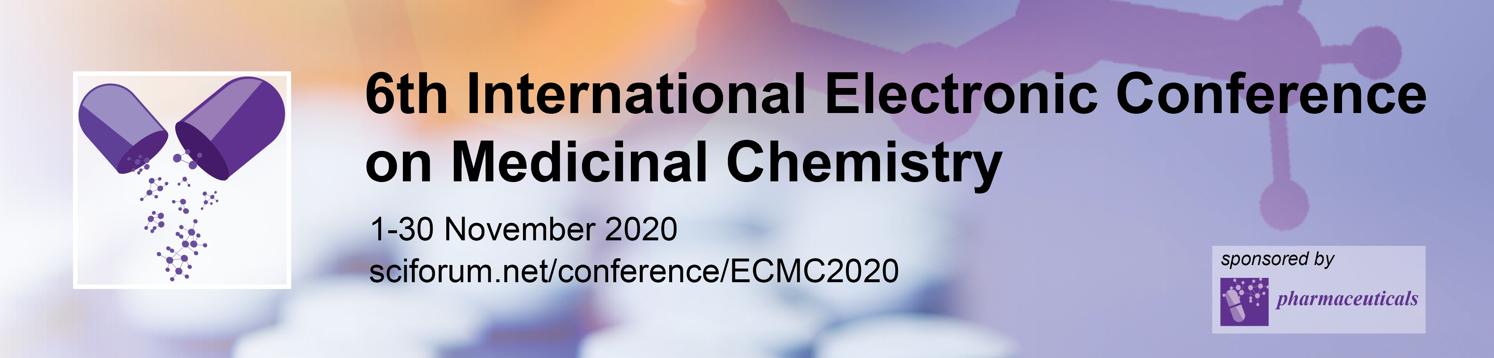

Saponin from Acacia concinna (Wild.) DC. inhibits pancreatic lipase and enhance lipolysis in 3T3-L1 adipocyte
Wijitrapha Ruangaram ¹, Zhuoyue Zhao ¹, and Eisuke Kato ^{1,*}
¹ Laboratory of Food Biochemistry, Division of Applied Bioscience, Graduate School of Agriculture, Hokkaido University, Kita-ku, Sapporo, Hokkaido 060-8589, Japan
* Corresponding author: eikato@chem.agr.hokudai.ac.jp

Slide 2
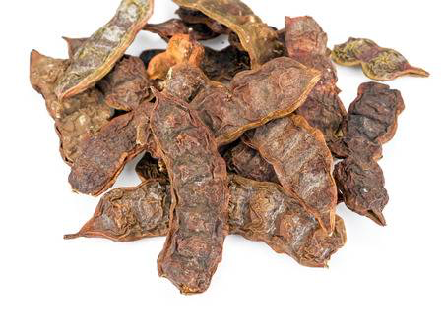
Saponin from Acacia concinna (Wild.) DC. inhibits pancreatic lipase and enhance lipolysis in 3T3-L1 adipocyte
Graphical Abstract
Anti-obesogenic bioactive principle
Photo
Acacia concinna pod
A. concinna Saponin
Pancreatic lipase inhibition: IC₅₀ = 7.93 μg/mL extract
3T3-L1 lipolysis enhancement: EC₅₀ = 58 μg/mL extract

Slide 3
Abstract:
Overweight and obesity are turning into serious health problem. Natural products contained in medicinal plants are expected to be an effective source for the treatment of obesity. Acacia concinnais a medicinal plant, which was previously found to have high anti-obesogenic potential. However, the bioactive compound contained in the plant is undiscovered. In this study, we isolated the bioactive compound in the pod of A. concinna and evaluated its activity to inhibit pancreatic lipase and enhance lipolysis in 3T3-L1 adipocyte, two bio-activity related to anti-obesogenic potential.
Chromatographic purification of the extract of A. concinna pods guided by pancreatic lipase inhibitory activity assay gave mixture of saponins as the bioactive principle of A. concinna pods. Structural analysis by acidic or alkaline breakdown followed by chromatographic purification and spectrometric analysis gave acacic acid (triterpene), monoterpene with sugar (quinovose or xylose), and several sugars (glucose, arabinose, rhamnose) as components of the saponin showing resemblance to the reported structures.
Anti-obesogenic potentials of the A. concinna saponins were evaluated for lipase inhibition and enhancement of lipolysis in 3T3-L1 adipocyte. The results indicated that the saponin is an efficient lipase inhibitor and a lipolysis enhancer. In addition, the saponin also reduced the lipid accumulation in mature adipocytes. Thus, A. concinna saponin might be a good source for the treatment of obesity.
Keywords: 3T3-L1; anti-obesogenic; bioactive compounds; lipase; lipolysis

Slide 4
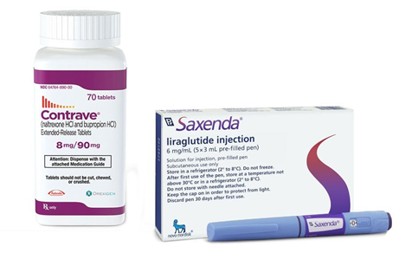
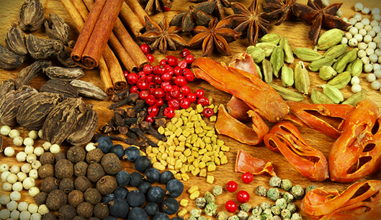
Obesity treatment
Drugs: treat obesity
Cetilistat
Empatic
Liraglutide
Etc.
Side effects:
nausea
constipation
sleep disturbance
Etc.
Traditional remedy
less side effects
MEDICINAL PLANTS
Notes:
In treatment of obesity, numerous drugs are developed and used. Examples are Cetilistat, empatic and more listed here. These drugs have a positive effect to treat obesity but there are some adverse side effects such as dry mouth, nausea, constipation. On the other hand, an alternative method such as traditional remedy is believed to have less side effects. And the use of of medicinal plants are quite common in traditional remedy.

Slide 5
Overall scheme of this project
Screening medicinal plant with anti-obesogenic potential
Isolation and identification of active compounds
in vivo evaluation
Enzymatic pancreatic lipase inhibition
3T3-L1 adipocyte: Lipolysis enhancement
Mechanistic study
Aim of this study: to find active compounds from the candidate plant selected by screening and evaluate its anti-obesogenic potential
Notes:
This is the overall scheme of my study. I focus on these 3 studies which in this presenation I will be only talking about this part, isolation and identification of the candicate plant as well as its activity.
The aim of this study is to identify the active compounds in pod of acacia concinna as well as to evaluate its anti-obesogenic potential.

Slide 6
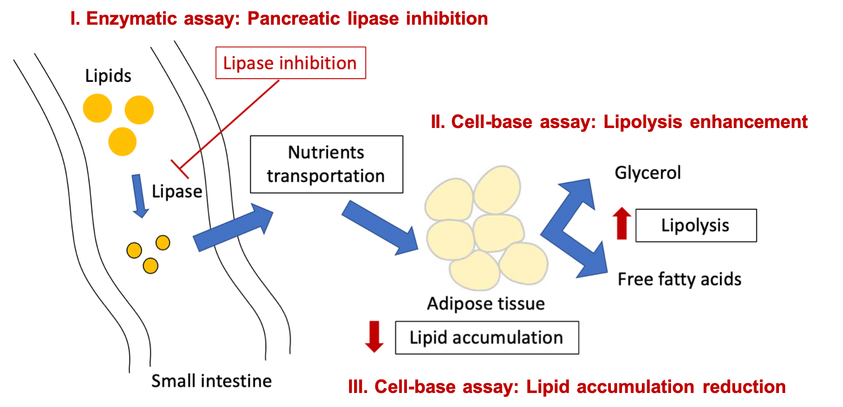
Screening to find anti-obesogenic candidate plant
Notes:
In the screening study, 70 of Thai medicinal plants were studied for their anti-obesogenic potential using in vitro methods. The 3 bio-assays that I used in my screening are inhibition of lipase, enhancement of lipolysis and reduction of lipid accumulation in adipose tissue. This is to select a plant candidates with anti-obesogenic potential foe further studies.

Slide 7
Anti-obesogenic activity of Acacia concinna extract
Ruangaram W, Kato E. Pharmaceuticals, 2020, 13(4): 56.
Result
Acacia concinna was found as one of the promising plant with anti-obesogenic potential
Objective
To find active compounds in pod of Acacia concinna
Notes:
From my screening, acacia concinna is one of the potential plant which showed an positive effect in 3 of the bio-assays including lipase inhibitor, lipolysis enhancer which lead to reduction in lipid accumulation. Thus, after this the main obejective is to find the active compounds within the pod of acacia concinna.

Slide 8
Acacia concinna (Wild.) DC.
Common name: Soap pod
Family: Fabaceae
Part of used: pods
Traditional uses: Laxative effect, cough, antidandruff
Research:
Antioxidant, anti-coagulant, anti-platelet, anti-thrombotic, anti-dermatophytic and immune adjuvant activities
consisted of several alkaloids, flavonoids, saponin and tannin
Notes:
So let’s me briefly introduce acacia concinna, the common name is soap pod which it belongs to Fabaceae. The pod is which is commonly used are traditionally known to be able to treat laxative effect, cough and so on. on the other hand, from researched it tends to have several effects as well as there are reports on its compounds.

Slide 9
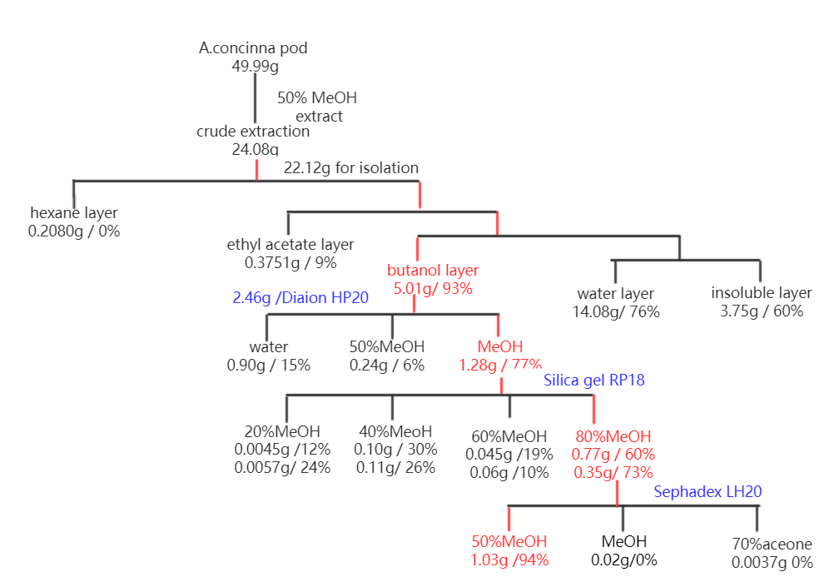
Fractionation
Active fraction
Yield/ Lipase inhibitory activity
Notes:
AC was extracted with 50% methanol and then partition with hexane, acetyl acetate, and butanol to yield 4 fractions. The buOH fraction which shown the highest lipase inhibtion activity was further subjected to 3 times column chromatography pufiracation to yield the active fraction.
Fractionate in different layer → the one with the highest lipase inhibition → subject to further fractionate→ finally we obtain BM-4-1

Slide 10
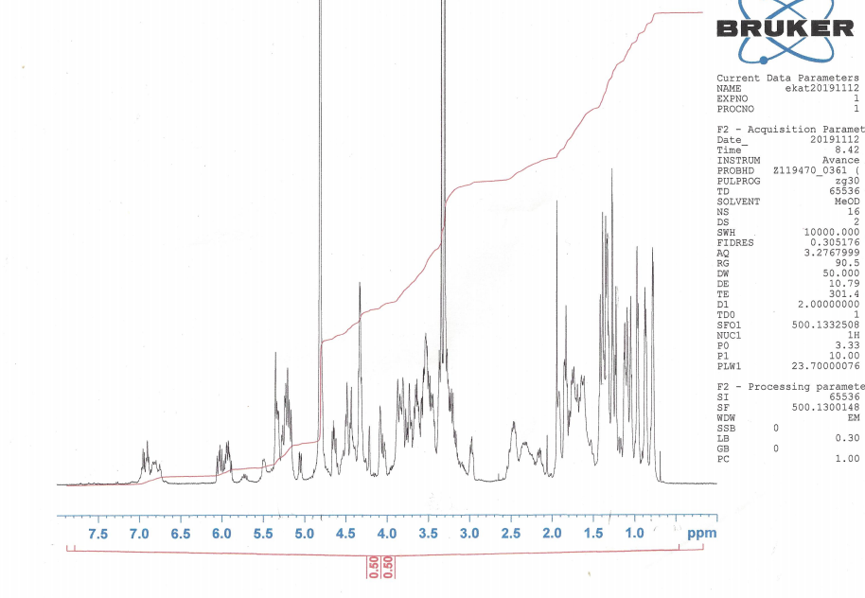
Analysis of the active fraction
HPLC analysis
¹H-NMR analysis
Broad peak
HPLC condition
Column: InertSustain C18
Eluent:30%-85% aq. Acetonitrile+0.1% TFA(0-30min), 80% aq. Acetonitrile +0.1% TFA (30-50 min).
Flow: 1.0 mL/min.
UV: 254nm
Saponins are suggested from the analysis
Structure analysis by decomposition
Notes:
The active fraction was then analysed using analytical HPLC and proton NMR. For HPLC result, it showed the broad peak which are suggested to be a macromolecule. And comparing with NMR Result, we think that the macromolecule might be the saponins. Thus, it will be further decompose for stucutre nalaysis.

Slide 11
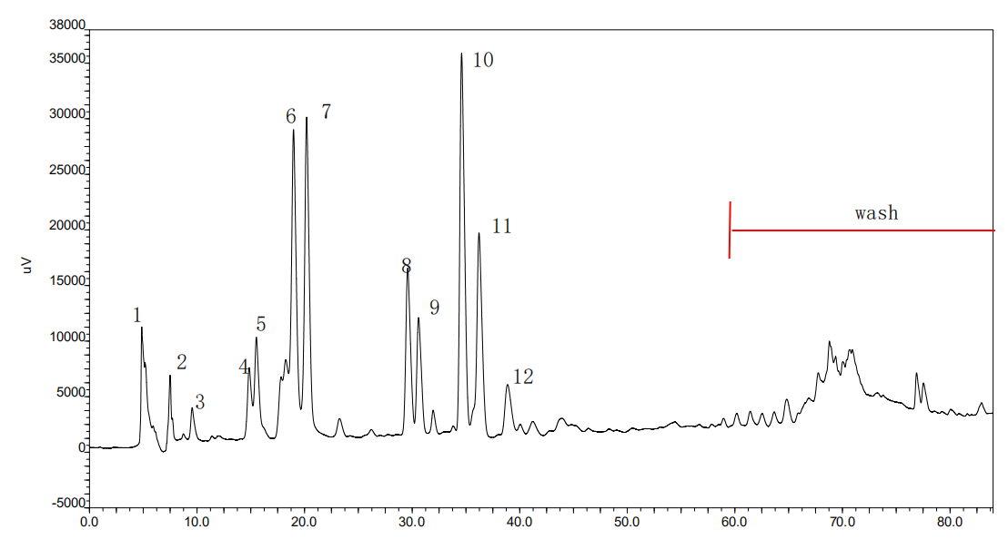
Structure analysis: decomposition by alkaline hydrolysis
Active fraction (97.2mg)
0.5 M NaOH-MeOH (7:1), rt, 24h.
HPLC condition
Neutralization with 1M HCL
Preparative HPLC
Column: InertSustain C18 (25×250 mm).
Eluent: 15%-35% aq. Acetonitrile+0.1% TFA(0-60min) 95% aq. Acetonitrile+0.1% TFA(60-90min)
Flow: 10.0 mL/min.
UV: 254nm
Partition
EtOAc fraction
6.6mg
BuOH fraction
101mg
water fraction
165mg (contains salt)
Analysis
LC-MS
Preparative HPLC
Notes:
The active fraction was undergoing alkaline hydrolysis which treated with 0.5M NaOH and MeOH at room temperature for 24 hours. Afterward, it was neutralise with 1M HCl. The residue was partitionate with acetyl acetate and butanol. The butanol was selected and then analysed with LCMS and preparative HPLC separation. After HPLC separation, 12 peaks were obtained and followed by proton NMR analysis.

Slide 12
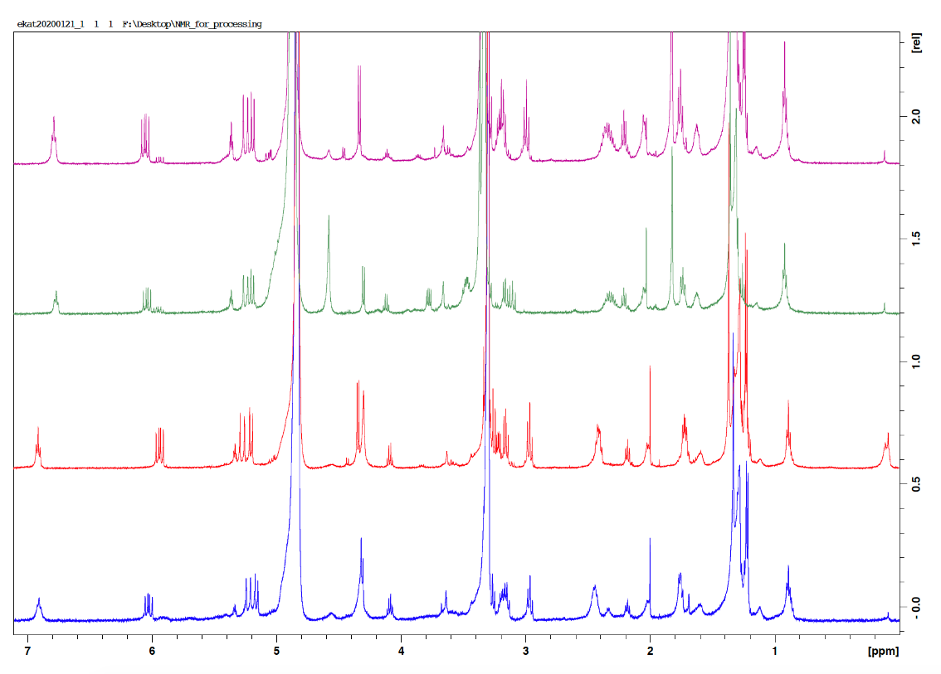
Structure analysis: decomposition by alkaline hydrolysis
NMR analysis of compounds from butanol fraction of alkaline hydrolysis products
Monoterpene Connected with sugar
Peak 6 (R)
Peak 7 (S)
10
8
Quinovose
Quinovose
7
Peak 8 (R)
Peak 10 (R)
6
6,7,8,10
Xylose
Quinovose
Notes:
After comparing NMR data with literature, fraction 6,7,8 and 10 were determined and all of them are monoterpenes connected with xylose or quinovose as shown in the slide.

Slide 13
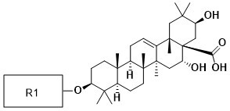
Structure analysis: decomposition by alkaline hydrolysis
LC-MS analysis of butanol fraction of alkaline hydrolysis products
13 prosapogenols → 3-O-glycosides of acacic acid or acacic acid lactone
R1 | Acacic acid | Acacic acid lactone
Glu-Ara/Xylose | √ | √
Glu-Rha | √ | √
Ara-Rha | √ | √
Glu-Glu-Glu | √ | -
Glu-Glu-Ara/xylose | √ | √
Glu-Glu-Rha | √ | √
Glu-Ara-Rha | √ | √
Notes:
Since after alkaline hydrolysis, make it possible to analyse carbon at R1 position connected with the oligosaccharides by LC-MS as shown in table.
The result suggested that alkaline hydrolysate from AC gave 13 prosapogenols, all of which were 3-O-glycosides of acacic acid and acacic acid lactone.
*Prosapogenols = triterpenes connected to sugar

Slide 14
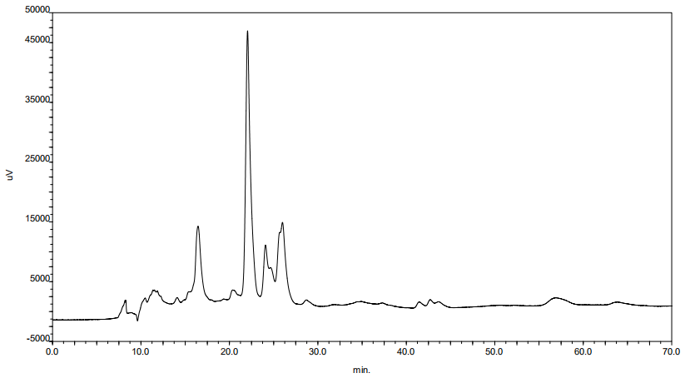
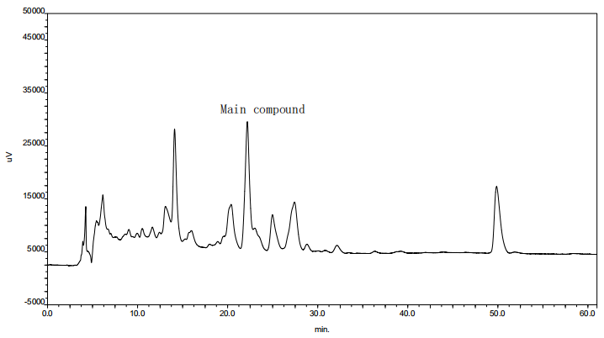
Structure analysis: decomposition by methanolysis
Active fraction (94.2mg)
1.25M methanolic HCL, 90℃, 1.5 hours
Extraction by EtOAc
PTLC separation
Reverse phase TLC separation
purified by HPLC
Compound 1
Compound 1
Compound 2
Compound 2
14
Notes:
moving on, in order to analyse prosapogenol, active fraction was subjected to 1.25M methanolic HCl at 90˚C for 1.5 hrs with reflux equipment, flowing by extraction with acetyl acetate. The active fraction was further purified by PTLC and reverse phase TLC and HPLC to obtain 2 main compounds. Compound 1 and compound 2 then were analysed by proton NMR.

Slide 15
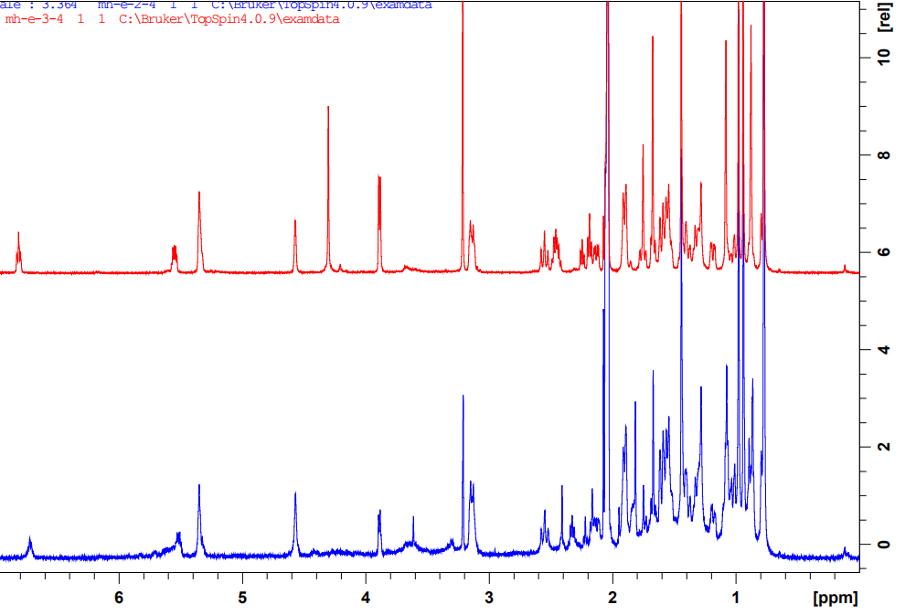
Structure analysis of compound 1,2: NMR analysis
Compound 1
Compound2
Notes:
Here is the data of NMR analysis which it will combine with mass-spectrometry

Slide 16
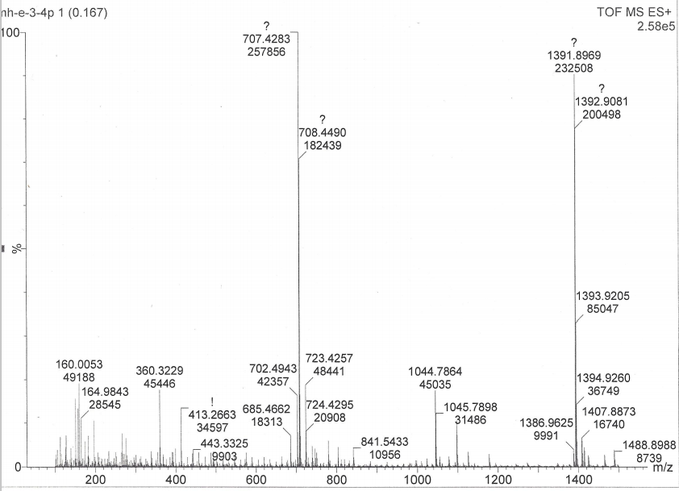
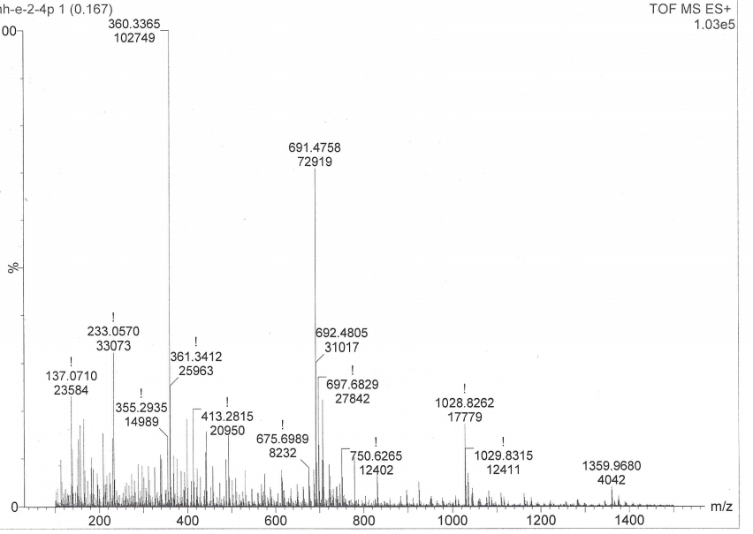
Structure analysis of compound 1,2: MS analysis
Compound 1
Compound 2
[M+Na]⁺ : 707
[M+Na]⁺ : 691
HR-ESI-MS (positive): 684.4609 [M+H]⁺, C41H64O6 calc. 668.4601
HR-ESI-MS (positive): 668.4665 [M+H]⁺, C41H64O7 calc. 668.4652
Notes:
The result suggested that both of them are tritipernoid connected with monoterpenes. The only difference between these 2 compounds are the hydroxy group here.

Slide 17
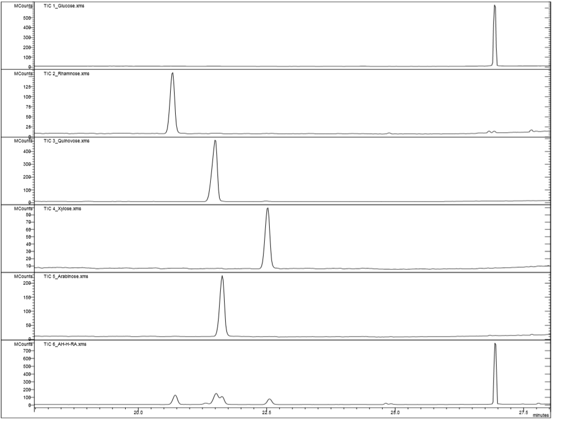
Structure analysis: sugar determination by GC-MS
Pre-treatment— Acidic Hydrolysis, Reduction and acetylation
Hydrolysis: 1M HCl, 100˚C, 6 hrs with reflux equipment
Reduction: 10mg sample was reduced with 0.25M aq.NaBH4 overnight
Acetylation: React with 0.5 ml pyridine and 0.25 ml acetic anhydride with reflux equipment overnight, monitoring by TLC
Glucose
Rhamnose
Quinovose
Xylose
Arabinose
Active fraction
Notes:
Afterward, we want to determine the sugar units. GCMS was utilised and 5 monosaccharides chose as standard according to the published article. The result showed that these 5 monosaccharides existed in the active fraction.

Slide 18
Short conclusion: structure analysis
Alkaline hydrolysis
Monoterpenes connected with sugar (xylose and quinovose)
Methanolysis
triterpene connected with monoterpenes
Sugar components
R1: glucose, rhamnose, quinovose, xylose, arabinose
Notes:
To make a short conclusion about the structure analysis,
monoterpenes connected with sugar, either xylose or quinovose was determined after alkaline hydrolysis. While, after methanolysis gave off the connection between triterpene and monoterpenes and lastly GCMS suggested that the sugar units consisted of glucose, rhamnose, quinovose, xylose and arabinose.

Slide 19
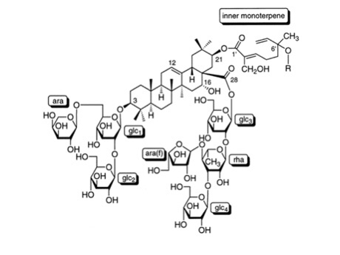
Short conclusion: strcuture analysis
Predicted structure of the active fraction
Reported saponin from A. concinna
Sugars
Glu-Ara/Xylose
Glu-Rha
Ara-Rha
Glu-Glu-Glu
Glu-Glu-Ara/xylose
Glu-Glu-Rha
Glu-Ara-Rha
Tezuka et al. (2000). Journal of Natural Products, 63, 1658-1664.
Evaluation of anti-obesogenic activity
Pancreatic lipase inhibition
Lipolysis enhancement
Notes:
So the predicted structure of active fraction was shown here and it will be further undergoing bio-assay which are enzymatice… and lipolysis …

Slide 20
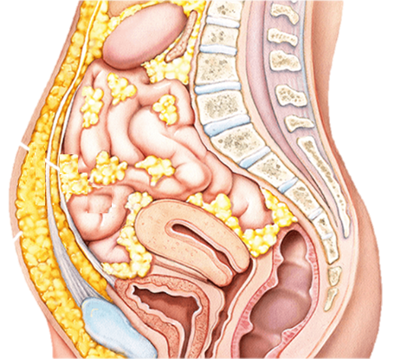
Pancreatic Lipase inhibition
Small intestine
Monoglyceride
Digestion
Absorption
LIPASE
Triglyceride
Fatty acids
Obesity
LIPASE INHIBITOR
Notes:
The first assay, lipase inhibition is related to the digestion of lipids. When triglyceride enter the small intestine, the pancreas secretes lipase and induce the hydrolysis reaction.
Triglyceride will then break down into monoglyceride and fatty acids. The produced monoglyceride and fatty acids will then absorb inside our body.
If high amount of these products are absorbed, our body will develop obesity. But we do not want this to occur and a lipase inhibitor can work to prevent it.
Lipase inhibitor prevents the hydrolysis of the triglycerides, which results in the reduction of the monoglycerides and fatty acid production as well as absorption of these products.

Slide 21
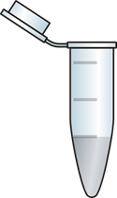
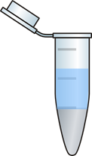
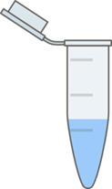
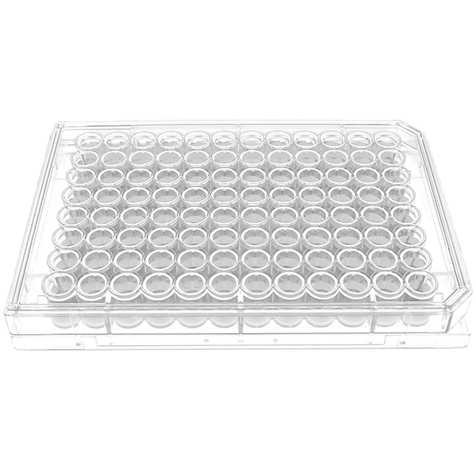
Lipase inhibition: Method
Triolein emulsion
Sample
Lipase
Add 1 M HCl
Add hexane
Transfer hexane layer
Transfer samples to 96 well plate
Evaporate and dissolve in DMSO
Quantitating: NEFA
Measure absorbance
at 550 nm
Notes:
Firstly, triolein emulsion will be added into the micro tubes and followed with sample and lipase solution. Then the sample will be incubated in the water bath at 37˚C for 30mins. Afterwards, 1M Hydrochloric acid will be added, which it will acted as the stop reagent. Next, hexane will be added and mix vigorously to separate the fatty acid from the solution and only hexane layer will be analysed by the absorbance at 550nm.

Slide 22
Lipase inhibition assay result
A. concinna saponin showed strong lipase inhibition with IC50 = 7.93 μg／ml
whole structure is important for the lipase inhibition
PC = active fraction before decomposition (30 µg/mL)
Notes:
the result here showed the liapse inhibitory activity of active fraction before and after decomposition. The active fraction from before decompostion showed that there was a concentration dependency from concentration of 5 to 0.3125 microgram/mL. and the IC50 is equal to 7.93µg/mL.
And for the active fraction after decomposition, it showed that the activity is decreased. This means that the whole structure of the active fraction is important for the lipase inhibition

Slide 23
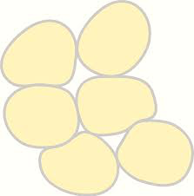
3T3-L1 adipocyte: Lipolysis
Glycerol
Lipolysis
Fatty acids
Adipose tissue
(stored as triglycerides)
Effective to treat obesity
Notes:
The second assay is related to the metabolism of fats in adipocytes.
One of the fat metabolisms related to prevent the development of obesity is lipolysis.
Lipolysis is a process to hydrolyse triglycerides to glycerol and fatty acids. The step is essential for the use of accumulated triglycerides in adipocytes and the lipolysis is important for losing weight.
So, if lipolysis is enhanced, the accumulation of the lipid in adipocytes would decrease, which will be effective to treat obesity.

Slide 24
3T3-L1 adipocyte: Assay method
Cell culture
Seeding
3T3-L1 cells
Day 0
Differentiation
Day 2-4
Enhancement
Day 6
Maintenance
Day 8
Serum starvation
Overnight
Glycerol release assay
Add: crude sample
Add glycerol reagent
Incubate
24 hrs
Supernatant
transfer
Quantify:
released glycerol
Measure absorbance
at 540 nm
Notes:
The method is shown here.The cells were cultured and prepared according to the scheme shown here,
To the prepared cells, inhibitor and samples were added accordingly and underwent along this process to quantify the released glycerol which reflects the lipolysis of the cells.

Slide 25
3T3-L1 adipocyte: Enhancement of Lipolysis
EC₅₀ = 58 μg/mL
In the low concentration
Enhanced lipolysis
no cytotoxicity
PC = Isoproterenol
Notes:
The active fraction showed a concentration dependency from 200 to 6.25 then started decreasing afterward. More importantly, in the low concentration, there is no cell cytotoxicity. The EC50 is equal to 58µg/mL.

Slide 26
3T3-L1 adipocyte: Enhancement of Lipolysis
Decomposition of saponin diminishes the lipolysis activity
PC = forskolin
Notes:
Same as lipase inhibition result, after decomposition, the lipolysis enhancement activity also decreased.

Slide 27
Conclusions
A. concinna saponin was isolated as the major bioactive compound.
A. concinna saponin is an efficient lipase inhibitor.
The saponin also is a lipolysis enhancer in 3T3-Li adipocytes.
A. concinna saponin might be a good source for the treatment of obesity.

