Slide 1
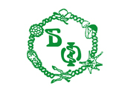
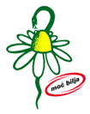
Essential oils of 11 commercial Lamiaceae species cultivated in Serbia: chemical composition, antioxidant and antidiabetic activities
Smiljana Janković^{1,}*, Dejan Pljevljakušić², Mariana Oalđe¹, Ana Alimpić Aradski¹ and Sonja Duletić-Laušević¹
¹University of Belgrade, Faculty of Biology, Institute of Botany and Botanical Garden “Jevremovac”, Takovska 43, 11000 Belgrade, Serbia;
²Institute for Medicinal Plants Research “Dr Josif Pančić”, Tadeuša Košćuška 1, 11000 Belgrade, Serbia;
*corresponding author email: smiljana.jankovic@bio.bg.ac.rs

Slide 2
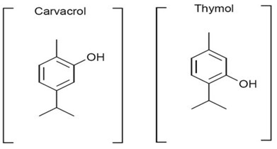
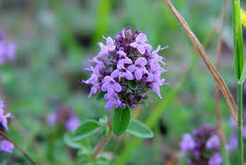
Essential oils of 11 commercial Lamiaceae species cultivated in Serbia:
chemical composition, antioxidant and antidiabetic activities
Graphical Abstract
Chemical composition analysis of the essential oils by GC-FID and GC-MS method
Isolation of the essential oils from 11 selected medicinal plants by hydrodistillation method
Antioxidant and antidiabetic activities by TRP and α-glucosidase inhibition methods

Slide 3
Abstract
Lamiaceae is one of the largest families of flowering plants, especially rich in aromatic plants which are most commonly used in traditional medicine and as spice. The aim of this research was the examination of chemical composition, antioxidant and antidiabetic activity of the essential oils of 11 selected Lamiaceae plants: Hyssopus officinalis, Lavandula angustifolia, Mentha x piperita, Ocimum basilicum, Origanum heracleoticum, Origanum vulgare, Salvia officinalis, Satureja montana, Thymus serpyllum and Thymus vulgaris, commercially cultivated at the Institute for Medicinal Plant Research „Dr Josif Pančić“, Serbia. Essential oils were obtained by hydrodistillation and their chemical composition was analysed using GC-MS. Antioxidant activity was evaluated using total reducing power (TRP) assay, while antidiabetic activity was assessed in terms of inhibition of α-glucosidase. The obtained results showed that the most abundant components in the oils are: linalool, cis-pinocamphone, isomenthol, germacrene D, camphor, 1,8-cineole, geraniole, bornyl-acetate and thymol. The strongest antioxidant activity showed the oil of Th. vulgaris, followed by Th. serpyllum, and the same species showed the most prominent inhibition of α-glucosidase. These results indicate that bornyl-acetate and thymol as the major components of the most active oils should be considered as promising therapeutical agents.
Keywords: essential oil; Lamiaceae; chemical composition; antioxidant activity; antidiabetic activity

Slide 4
Introduction – EOs as therapeutical agents
Essential oils (EOs) are very complex mixtures of different volatile compounds, containing variable aliphatic and aromatic carbohydrates
In the 20th century, it started the expansion in essential oil research, leading to aromatherapy - an important branch of herbal medicine
Numerous studies have shown that terpenoids and phenylpropanoids as the major constituents of the oils provide a great range of biological activities

Slide 5
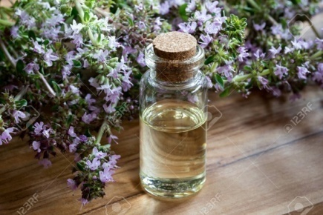
Introduction – EOs as therapeutical agents
The chemistry of EOs is affected by numerous factors including different plant genotypes, ecological, and geographical parameters, plant parts used, harvesting season, isolation techniques and treatment of EOs in bioassays. The correlation between those factors and the bioactivity of the oils is one of the main goals which should be achieved in the upcoming research.
Family Lamiaceae is one of the most important sources of EOs because the aromatic plants from these family contain significant content of terpenes which allows the production of EOs at the commercial level.
In a wide range of bioactivities, EOs are well known in traditional medicine as the healing agents in some metabolic diseases, such as diabetes.
Considering that oxidative stress in an organism could lead to metabolic disorders, this study was aimed to investigate the antioxidant and antidiabetic activities of EOs of 11 selected Lamiaceae plants.
metabolic disorders
oxidative stress

Slide 6
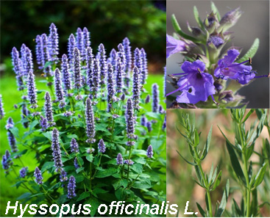
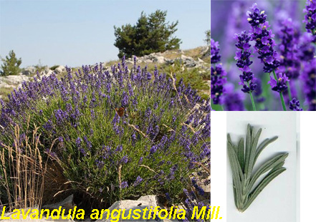
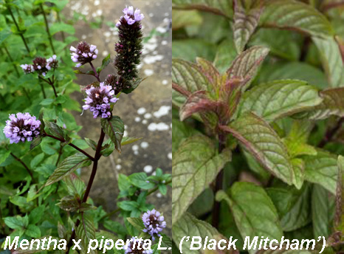
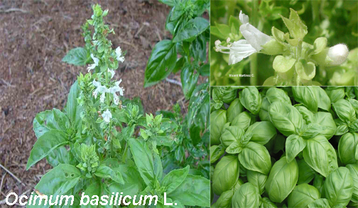
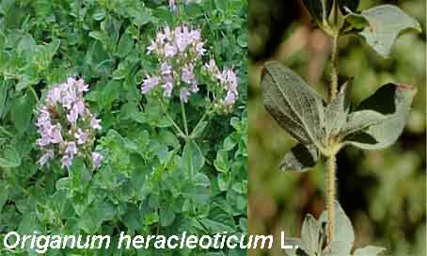
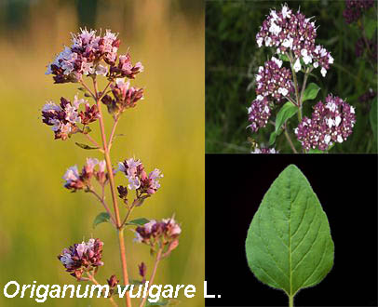
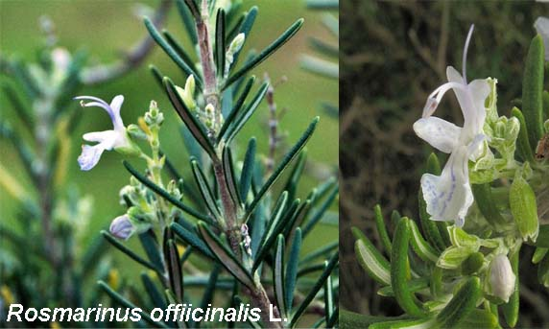
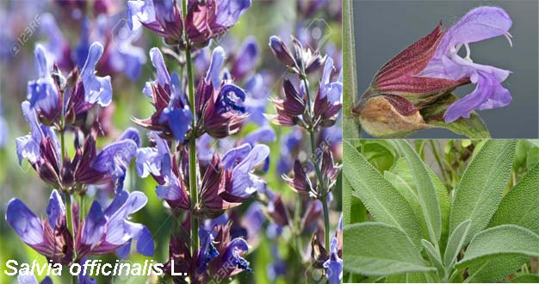
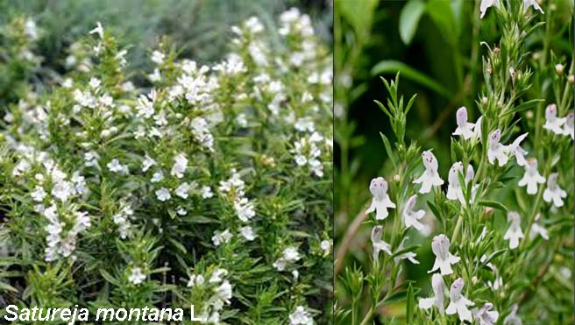
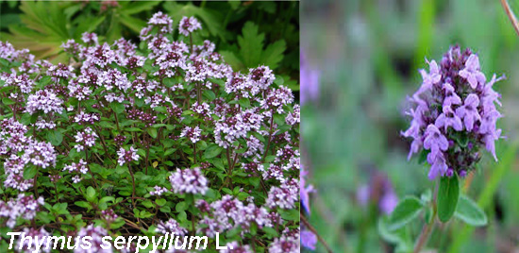
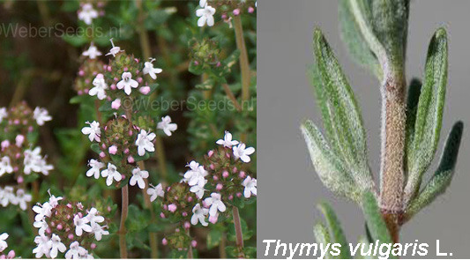
Introduction – Lamiaceae as an important source of EOs
This study encompasses 11 selected Lamiaceae plants.

Slide 7
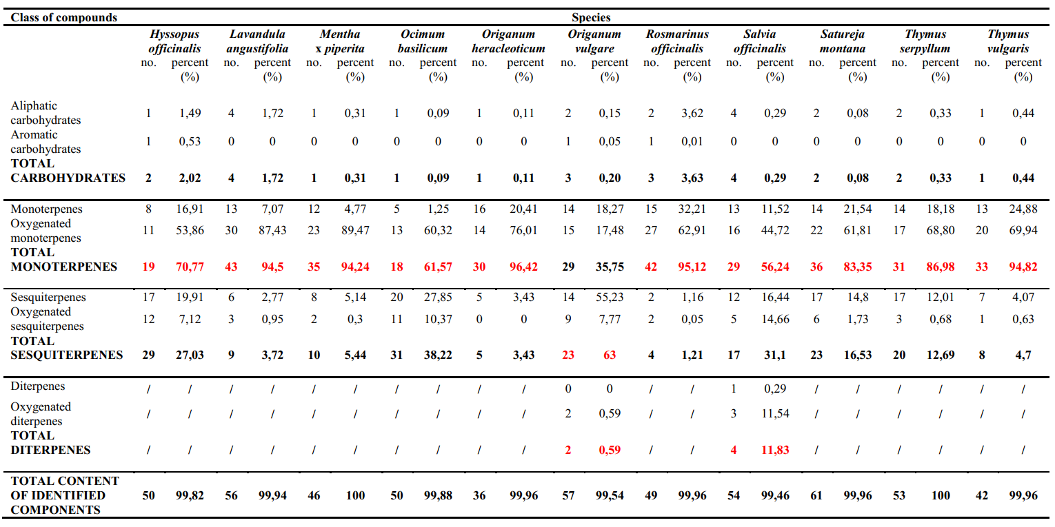
Results and discussion –
EOs chemical composition and dominant classes of compounds

Slide 8
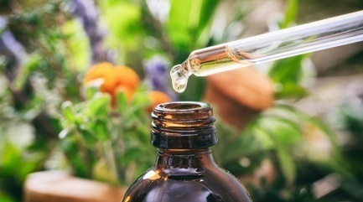
Results and discussion – EOs chemical composition
The analysis of EOs chemical composition showed that the oxygenated monoterpenes are the dominant class of compounds of all examined plants (up to 87.43% of total oil), with the exception of Origanum vulgare where the sesquiterpenes were the dominant class (63% of total oil). The highest variability of compounds is found in Salvia officinalis and O. vulgare essential oils. Only these two plants contain diterpenes as constituents of the oils comprising almost 12% of the oil of S. officinalis.
The dominant components of all tested oils are presented on the chromatograms on Slides 9 and 10.
Peaks: 1, α-pinene; 2, sabinen; 3, β-pinene; 4, p-cymene; 5, 1,8-cineole; 6, trans-β-ocimene; 7, γ-terpinene; 8, linalool; 9, cis-thujone; 10, camphor; 11, iso-menthone; 12, pinocarvone; 13, menthol; 14, borneol; 15, iso-menthol; 16, 4-terpinenol; 17, cis-pinocamphon; 18, methylcavicol; 19, linalool acetate; 20, geraniol; 21, lavandulyl acetate; 22, thymol; 23, bornyl acetate; 24, carvacrol; 25, trans-caryophyllene; 26, 9-epi-trans-caryophyllene; 27, germacren D; 28, β-bisabolene; 29, viridiflorol; 30, τ-cadinol; 31, manool.

Slide 9
Results and discussion – EOs normalized chromatograms of plant aerial parts with dominant compounds

Slide 10
Results and discussion – EOs normalized chromatograms of plant aerial parts with dominant compounds

Slide 11
Results and discussion –
antioxidant activity of the essential oils of 11 selected plants
Among 11 investigated species, the strongest TRP activity is shown by essential oil of Th. vulgaris (174.76 μmol AAE/g at the concentration of 6 mg/mL), followed by Th. serpyllum essential oil (165.81 μmol AAE/g at the concentration of 6 mg/mL). Significant TRP activity is also shown by O. heracleoticum essential oil.

Slide 12
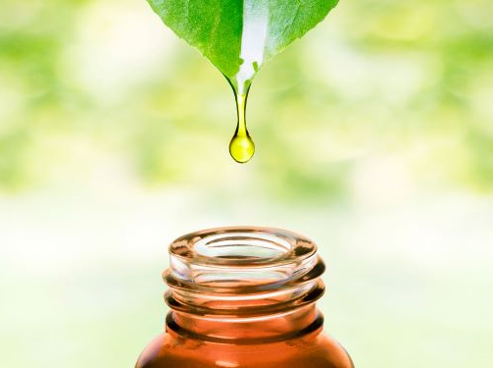
Results and discussion –
antioxidant activity of the essential oils of 11 selected plants
A significant activity of Th. vulgaris oil was demonstrated by using different antioxidant assays in some previous research.
To the best of our knowledge, this is the first report of antioxidant activity of selected plants using TRP method.
It is well-known that essential oils with high proportions of thymol or carvacrol showed very high antioxidant activity, which is in accordance with our results.
Chemical composition analysis of EOs showed that thymol, bornyl-acetate and carvacrol were the main compounds of the most active oils (Slides 9 and 10).

Slide 13
Results and discussion –
antidiabetic activity of the essential oils of 11 selected plants
The highest antidiabetic activity was shown by essential oils of Th. vulgaris (81.80%), Th. serpyllum (79.78%) and O. heracleoticum (59.48%).

Slide 14
Results and discussion –
antidiabetic activity of the essential oils of 11 selected plants
Several studies showed that thymol and carvacrol possess high antidiabetic activity, which is supported by our research. Th. vulgaris and Th. serpyllum EOs are rich in thymol, while O. heracleoticum EO is rich in carvacrol; consequently, those plants showed the highest antidiabetic activity.
In some cases of tested oils, it was shown that the activity wasn't concentration-dependent. Based on this fact, it can be concluded that EOs do not behave the same as the isolated compounds in this bioassay. Changing the ratio of the compounds in oil due to evaporation could lead to different degrees of activity, so further research and method optimization are needed.
Although the EOs of Th. vulgare, Th. serpyllum and O. heracleoticum showed the highest antidiabetic activity, it is important to mention that acarbose as standard show 81,85% inhibition of α-glucosidase at the concentration of 1 mg/mL, while the similar percent of inhibition has been shown by EO of Th. vulgare at 6 mg/mL.

Slide 15
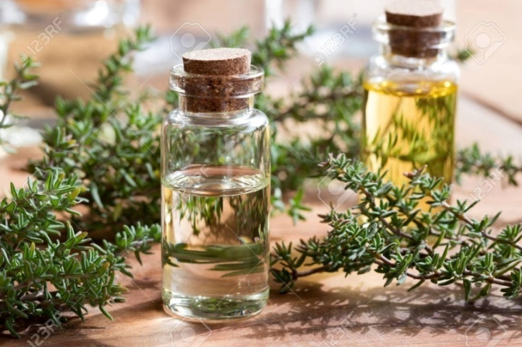
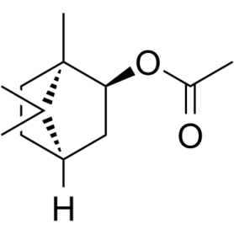
Conclusions
In this study, the highest biological potential is shown by three medicinal plants: Th. vulgaris, Th. serpyllum and O. heracleoticum. Due to significant antioxidant activity, it could be expected that these plants possess a wide range of other related activities. Further investigations should be directed towards revealing other bioactivities of essential oils of these plants.
The data presented in this study suggest that some of the dominant chemical compounds from the oils could be the active principles in expression of the tested bioctivities. Bornyl-acetate, carvacrol and thymol as the major components of the most active oils should be considered as promising antioxidant and antidiabetic agents.
Bornyl-acetate

Slide 16
Acknowledgments
The authors are grateful to the Ministry of Education, Science and Technological Development of Republic of Serbia (Grants No. 451-03-68/2020-14/200178 and III46013) for the financial support.

