Slide 1
Screening of endophytic actinomycetes for antifungal potential and cytotoxicity
Ezza Ashraf¹, Rabia Tanvir¹, Aftab Ahmad Anjum¹ and Hassan Mushtaq²
¹Institute of Microbiology (IOM), University of Veterinary and Animal Sciences (UVAS), Lahore 54000, Punjab, Pakistan
²Department of Epidemiology and Public Health, University of Veterinary and Animal Sciences (UVAS), Lahore 54000, Pakistan
* Corresponding author: rabia.tanvir@uvas.edu.pk; rabiatanvir@outlook.com

Slide 2
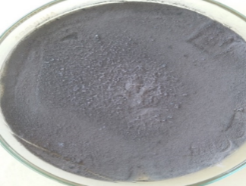
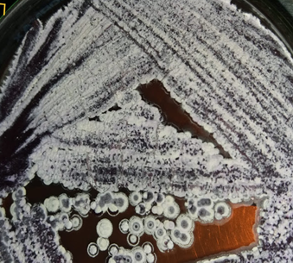
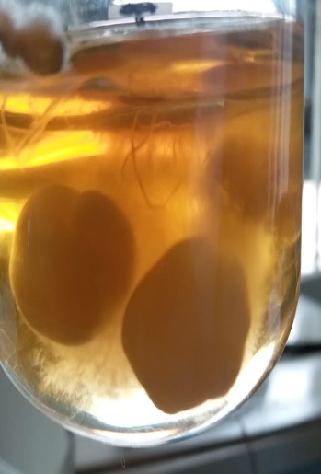
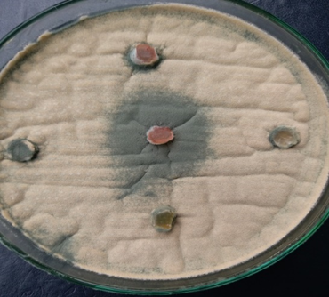
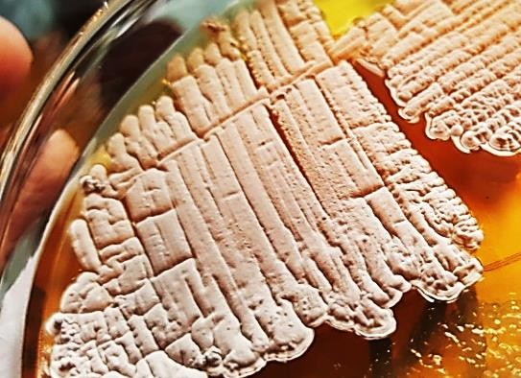
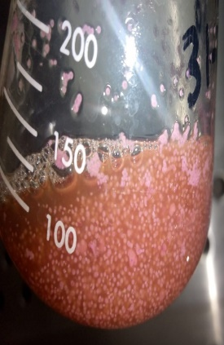
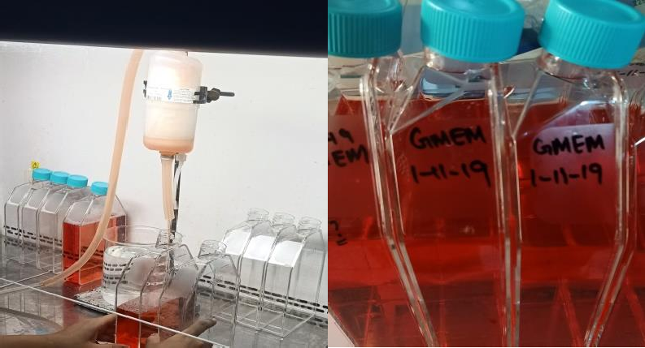
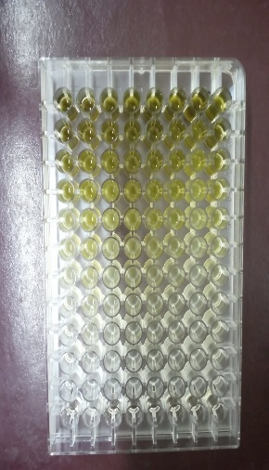
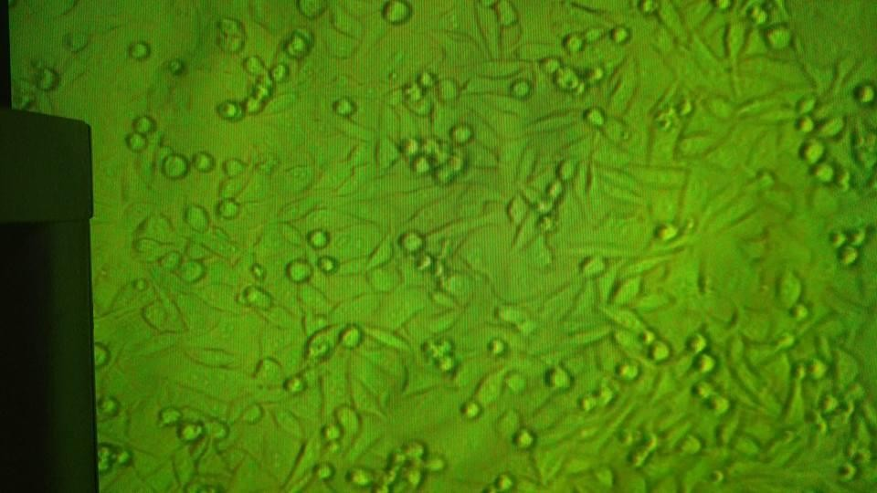
Screening of endophytic actinomycetes for antifungal potential and cytotoxicity
Graphical Abstract

Slide 3
Abstract:
Many diseases in humans and animals are caused by toxins produced by fungus. The most common disease of the respiratory tract is caused by many fungal species and Aspergillus fumigatus is the most prominent and primary pathogen among them. Due to the emergence of multiple drug resistance in the last years, the treatment of pathogenic fungi has become quite difficult. Therefore, the need to find out new biologically active and novel compounds has become a necessity. Medicinal plants of Pakistan such as Ocimum tenuiflorum (Tulsi) and Azadirachta indica (Neem) are well known for their medicinal uses. Endophytic actinomycetes are known for producing a variety of bioactive metabolites that are beneficial for plant health. The purpose of our study was to check the antifungal potential and to carry out the cytotoxicity profiling of endophytic actinomycetes residing within these plants. Agar plug method was used for preliminary screening and 2 isolates with antifungal activity were observed. Further minimum inhibitory concentration (MIC) was done of their concentrated broth and they were observed to be potent against A. fumigatus strains with a MIC value of 16µg/ml. Interestingly, cytotoxicity profiling of endophytic actinomycetes on baby hamster kidney (BHK-21) cell line showed that the concentrated broth of endophytic actinomycetes was most potent at a concentration of 100mg/ml. Our study concludes that endophytic actinomycetes, inhabiting tulsi, and neem plants have potent antifungal activity against A. fumigatus along with cytotoxic activity.
Keywords: Actinomycetes; Endophytes; Aspergillus fumigatus

Slide 4
Introduction
Traditional Medicine
Essential role in the healthcare systems
In Asian countries
80% of the population is dependent on medicinal practices [1]
Medicinal Plants
Attractive targets for discovering novel therapeutic agents [1]
[1] Miller KI, Ingrey SD, Alvin A, Sze MYD, Roufogalis BD, Neilan BA. Endophytes and the microbial genetics of traditional medicines. Microbiology Australia. 2010;31(2):60-

Slide 5
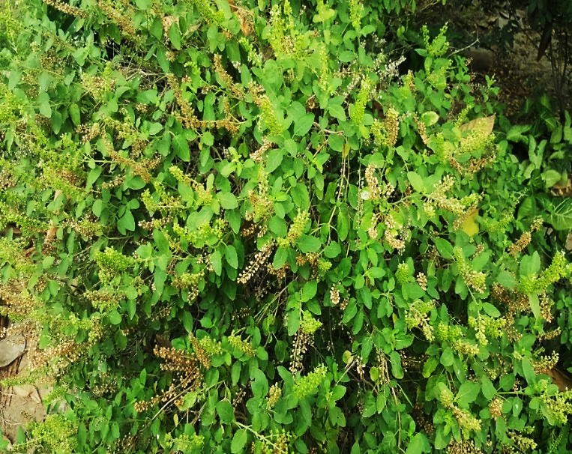
Introduction(Cont.)
Ocimum teniflorum
Locally known as ‘Tulsi’
Widespread throughout the Southeast Asian tropics[2]
Clinical pharmacological properties of oils and extracts from leaves
Antibacterial, anti-inflammatory, anti-pyretic, anti-diabetic, antifungal and anti stress effects [3]
Ocimum teniflorum growing in the nursery of University of Veterinary and Animal Sciences (UVAS), Lahore Pakistan. Photo courtesy: Ms. Ezza Ashraf
[2] Warrier P, Nambiar V, Ramankutty C. Indian Medicinal Plants: A Compendium of 500 Species, vol. III, Orient Longman Pvt. Ltd, Anna Salai, Chennai, India. 1995:38-42.
[3] Singh E, Sharma S, Dwivedi J, Sharma S. 2012. Diversified potentials of Ocimum sanctum Linn (Tulsi): An exhaustive survey. J Nat Prod Plant Resour. 2(1): 39-48.

Slide 6
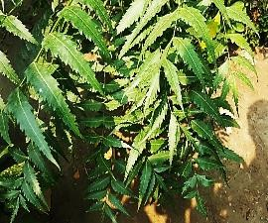
Introduction(Cont.)
Azadirachta indica
Locally known as ‘Neem’
Native to India, Pakistan, Bangladesh, Burma, Malaysia and Sri lanka [4]
Clinical pharmacological properties
Antibacterial, anti inflammatory, antiulcer, antiviral, anti-fungal, anti-diabetic and sedative properties [5]
Azadirachta indica growing in the nursery of University of Veterinary and Animal Sciences (UVAS), Lahore Pakistan. Photo courtesy: Ms. Ezza Ashraf
[4] Babu KS, Naik VKM, Latha J, Ramanjaneyulu K. 2016. Pharmacological review on natural products (Azadirachta indica Linn). IJCS. 4(5): 01-04.
[5] Agrawal D. Medicinal properties of neem: new findings. History of Indian science and. 2001.

Slide 7
Introduction (Cont.)
Actinomycetes
Greek ‘aktis’ (a ray) and ‘mykes’ (fungus)
Producers of a broad array of secondary metabolites
Useful applications in veterinary and
human medicine [6]
Endophytic Actinomycetes
Starting platform
Antibiotics, enzyme, anticancer agents,
immunomodulators, anthelminthic agents,
Long-held alliance, plants and endophytic microorganisms develop good information transfer [7]
Endophytic actinomycetes strain EH-11 isolated from Ocimum teniflorum (Tulsi). Photo courtesy: Ms. Ezza Ashraf
[6] Janso JE, Carter GT. 2010. Biosynthetic potential of phylogenetically unique endophytic actinomycetes from tropical plants. J Appl Environ Microbiol 76(13): 4377-4386.
[7] Zhao K, Penttinen P, Guan T, Xiao J, Chen Q, Xu J, Lindström K, Zhang L, Zhang X, Strobel GA. 2011. The diversity and anti-microbial activity of endophytic actinomycetes isolated from medicinal plants in Panxi plateau, China. Curr Microbiol.
62(1): 182-190.

Slide 8
Introduction (Cont.)
Aspergillus fumigatus in poultry feed
Aspergillus fumigatus is a saprophyte and opportunistic fungal pathogen
In poultry, it causes brooder pneumonia
Pathogenic Member of Aspergillus
Of particular concern is Aspergillus fumigatus

Slide 9
Results and discussion
Total 12 endophytic actinomycetes were isolated from a previous study [8]
Selected isolates were sub-cultured on Glucose yeast extract malt extract (GYM) agar plates
Endophytic actinomycetes from medicinal plants of Punjab
Groups | No. of Isolates
Azadirachta indica (Neem) | 4
Ocimum teniflorum (Tulsi) | 8
[8] Tanvir, R., I. Sajid, and S. Hasnain, Screening of endophytic Streptomyces isolated from Parthenium hysterophorus L. against nosocomial pathogens. Pak J Pharm Sci, 2013. 26: p. 277-283

Slide 10
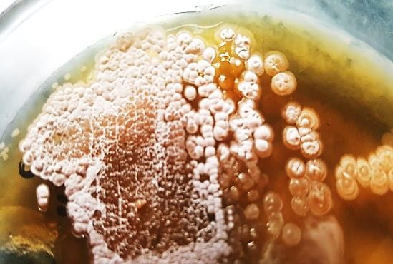
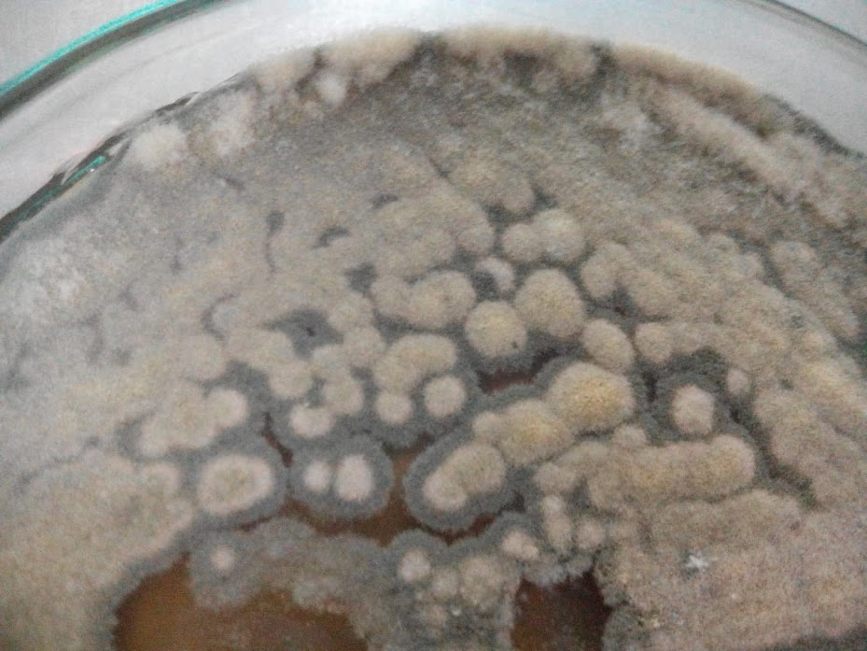
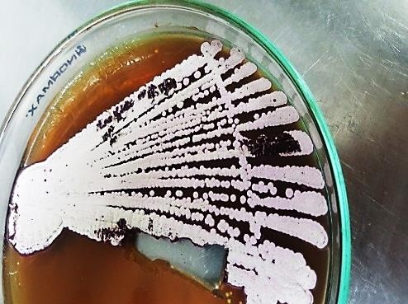
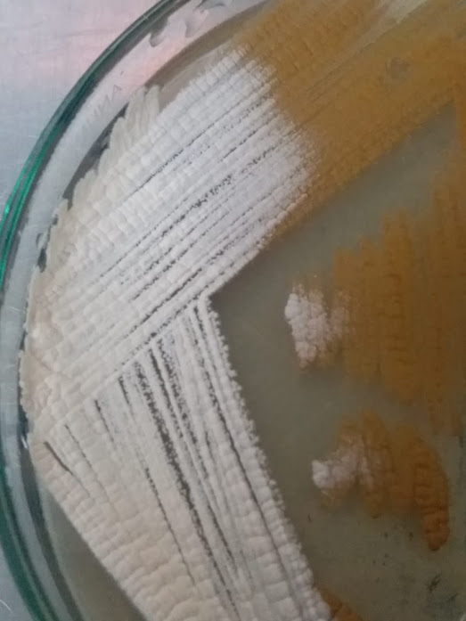
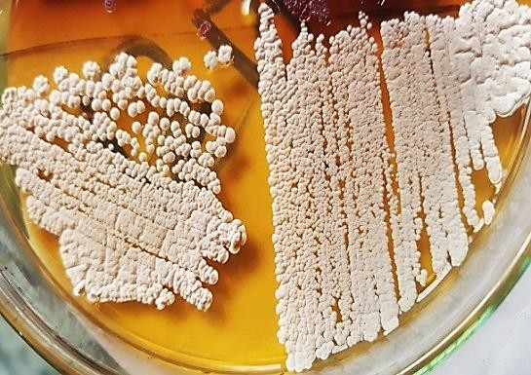
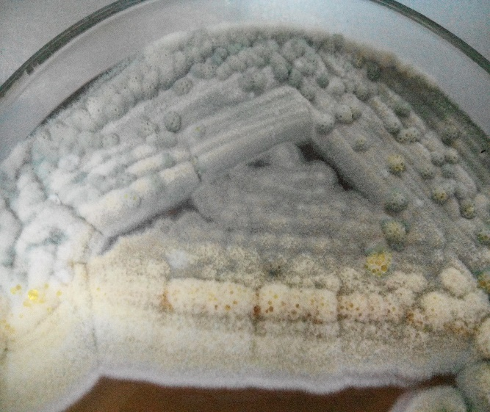
Results and discussion (Cont.)
EH-1
EH-9
EH-6
EH-7
EH-13
EH-5
Photo courtesy: Ms. Hafsa Shahzadi

Slide 11
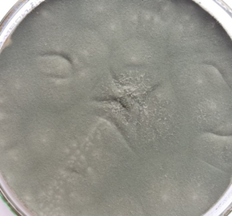
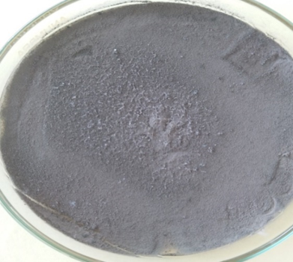
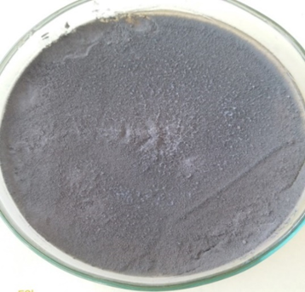
Results and discussion (Cont.)
Cultivation of Aspergillus fumigatus strains
05 fungal isolates (A. fumigatus) were isolated and characterized, from a previous study
Photo courtesy: Ms. Ezza Ashraf

Slide 12
Results and discussion (Cont.)
Screening of endophytic actinomycetes
Concentrated Broth culture [9]
100 mg/ml concentration
Extracts stored in 0.1% DMSO
Biological screening
Agar plug method [10]
Agar well diffusion method [11]
Aspergillus fumigatus
[9] Tanvir, Rabia, Imran Sajid, Shahida Hasnain, Andreas Kulik, and Stephanie Grond. "Rare actinomycetes Nocardia caishijiensis and Pseudonocardia carboxydivorans as endophytes, their bioactivity and metabolites evaluation." Microbiological Research 185 (2016): 22-35.
[10] Balouiri M, Sadiki M, Ibnsouda SK. Methods for in vitro evaluating antimicrobial activity: A review. Journal of pharmaceutical analysis. 2016;6(2):71-9.
[11] Gebreyhannes, Gebreselema, Feleke Moges, Samuel Sahile, and Nagappan Raja. "Isolation and characterization of potential antibiotic producing actinomycetes from water and sediments of Lake Tana, Ethiopia." Asian Pacific Journal of Tropical Biomedicine 3, no. 6 (2013): 426-35.

Slide 13
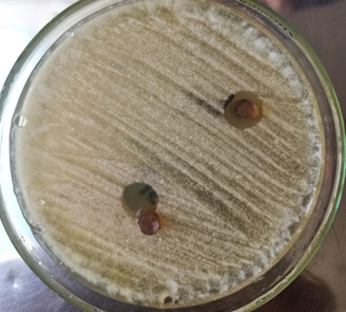
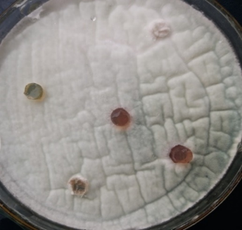
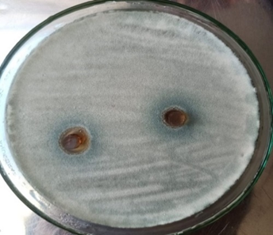
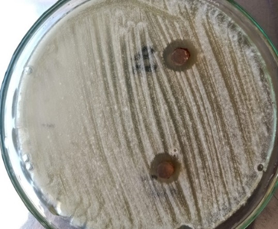
Results and discussion (Cont.)
In vitro antifungal activity testing of endophytic actinomycetes by agar plug method
2 strains showed broad spectrum antifungal activity
Maximum zones of inhibition of 11mm
Photo courtesy: Ms. Ezza Ashraf

Slide 14
Results and discussion (Cont.)
Antifungal activity of endophytic actinomycetes concentrated broth by agar plug method
Endophytic actinomycetes strain code | Zone of Inhibition(mm) against Aspergillus fumigatus strains
 | EF-1 | EF-2 | EF-3 | EF-4 | EF-5
EH-1 | - | 11 | 9 | - | 10
EH-2 | - | - | - | - | -
EH-3 | - | - | - | - | -
EH-4 | - | - | - | - | -
EH-5 | - | - | - | - | -
EH-6 | - | - | - | - | -
EH-7 | - | - | - | - | -
EH-8 | - | - | - | - | -
EH-9 | - | - | - | - | -
EH-10 | - | - | - | - | -
EH-11 | - | 10 | 9 | - | 10
EH-12 | - | - | - | - | -

Slide 15
Results and discussion (Cont.)
Minimum inhibitory concentration (MIC) of endophytic actinomycetes concentrated broth against Aspergillus fumigatus strains
MIC of endophytic actinomycetes was determined for a range of concentrations from 0 to 256 µg/ml.
Endophytic actinomycetes concentrated broth | MIC against A. fumigatus strains
 | EF-2 | EF-3 | EF-5
EH-1 | 16 | 16 | 16
EH-11 | 16 | 16 | 16

Slide 16
Results and discussion (Cont.)
Cytotoxicity results of endophytic actinomycetes EH-1 concentrated broth on BHK-21 cell line
O.D was taken at 595 nm, Values are means of triplicate studies
Sr. No | Concentration of EH-1 broth | Mean O.D on BHK-21 cells | Cell survival percentage
1. | 100 mg | 0.1266 | 25%
2. | 50 mg | 0.1307 | 26%
3. | 25 mg | 0.1352 | 28%
4. | 12.5 mg | 0.1384 | 29%
5. | 6.25 mg | 0.1539 | 36%
6. | 3.125 mg | 0.1684 | 40%
7. | 1.5625 mg | 0.2211 | 58%
8. | 0.7812 mg | 0.2312 | 62%
9. | 0.3906 mg | 0.2561 | 70%
10. | 0.1953 mg | 0.3131 | 90%
11. | Cells control | 0.3410 | 100%
12. | DMSO control | 0.0539 | 100%

Slide 17
Results and discussion (Cont.)
Cytotoxicity results of endophytic actinomycetes EH-11 concentrated broth on BHK-21 cell line
O.D was taken at 595 nm, Values are means of triplicate studies
Sr. No | Concentration of EH-11 broth | Mean O.D on BHK-21 cells | Cell survival percentage
1. | 100 mg | 0.1262 | 25%
2. | 50 mg | 0.1400 | 29%
3. | 25 mg | 0.1711 | 41%
4. | 12.5 mg | 0.2009 | 51%
5. | 6.25 mg | 0.2081 | 54%
6. | 3.125 mg | 0.2271 | 60%
7. | 1.5625 mg | 0.2515 | 69%
8. | 0.7812 mg | 0.2592 | 72%
9. | 0.3906 mg | 0.3021 | 86%
10. | 0.1953 mg | 0.3289 | 96%
11. | Cells control | 0.3410 | 100%
12. | DMSO control | 0.0539 | 100%

Slide 18
Conclusions
Endophytic actinomycetes from Ocmium teniflorum (Tulsi) and Azadirachta indica (Neem)
Rarely studied before
Our study
Diversity of actinomycetes inhabits different plant parts
Biological screening revealed
Broad spectrum activity
Bioactive against Aspergillus fumigatus involved in poultry feed contamination

Slide 19
Conclusions
Metabolically diverse compounds
Potent against Aspergillus fumigatus
Further exploration of these strains
Large scale study
Further bioactivity screening
HPLC-MS and NMR
Antiviral activity against Covid-19

Slide 20
Acknowledgment
Our sincere thanks to Prof. Dr. Tahir Yaqub, Director IOM, UVAS Lahore, for his support by making available the facilities in the institute

