Slide 1
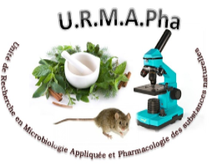
Toxicological characterization of ten medicinal plants used in the endogenous treatment of diarrhea
DOUGNON^{1*} Victorien, KLOTOE¹ Jean Robert, HOUNSA¹ Edna, AGBODJENTO¹ Eric, FABIYI¹ Kafayath, AFATON¹ Anny, SINTONDJI¹ Kevin, AKPODE¹ Benoît, TCHOBO² Fidèle, DOUGNON¹ Jacques
¹Research Unit in Applied Microbiology and Pharmacology of Natural Substances, Research Laboratory in Applied Biology, Polytechnic School of Abomey-Calavi, University of Abomey-Calavi, Abomey-Calavi, Benin
²Training and Research Laboratory in Applied Chemistry, Polytechnic School of Abomey-Calavi, University of Abomey-Calavi, Abomey-Calavi, Benin

Slide 2
Abstract:
This study aimed to explore the phytochemical and toxicological characteristics of ten 10 plants used in traditional treatment of infectious diarrhea in Benin. The acute toxicity of aqueous and hydro-ethanolic extracts of the plants was evaluated following the OECD 423 protocol at a single dose of 2000 mg/kg. This safety test was complemented by a larval cytotoxicity test. Hematological and biochemical examinations as well as a histological study on the liver and kidneys were performed. Larval cytotoxicity was assessed by the sensitivity of Artemia salina larvae to different concentrations of the plant extracts studied. The detection tests of chemical compounds were carried out according basis of differential staining and precipitation reactions. The mean lethal concentration (LC50) was determined by the probit method. The qualitative phytochemical screening of the plants studied revealed the presence of many chemical substances. This composition varied according to the plants studied. Acute toxicity data indicated that there was no mortality and no structural and functional alterations of the liver and kidneys of treated animals. Larval cytotoxicity data suggest that the plants studied were not cytotoxic. These observations reflect the safety of these plants and justify their use in traditional medicine in the treatment of many diseases including diarrheal diseases.
Keywords: Acute toxicity, Medicinal plants, Diarrheal diseases, Benin.

Slide 3
Introduction
Traditional medicine
Based on the use of medicinal plants
First reflex of more than 80% of the world's population for primary health care
In Benin: this widely accepted trend is an ancestral medical practice that is transmitted from generation to generation

Slide 4
Introduction
Traditional medicine
African pharmacopoeia Plants: Directed used against several diseases, particularly infectious ones
Infectious Diseases Prevalence: High level in developing countries
Diarrheal diseases: Deadliest infectious diseases, particularly among children and especially in West Africa.

Slide 5
Introduction
Diarrheal diseases
Responsible for 1.8 million deaths each year worldwide
90% of which are among children under five years of age living in developing countries
In Benin: diarrheal diseases are one of the main causes of morbidity and the pathogens are mainly Bacteria.

Slide 6
Introduction
Diarrheal diseases Traitment
Difficult access to antibiotics by populations
Antimicrobial Resistance
Use of Medicinal Plants
Ethnobotanical studies in West Africa: Provided information on the richness of African flora in the traditional management of diarrheal diseases

Slide 7
Introduction
Benin: West Africa Country
Many Medicinal plants are used to treat diarrheal diseases
But, very few scientific studies exist at this stage on the safety of anti-diarrheal plants
This study was initiated to produce recent data on the toxicological characteristics of selected plants as used in traditional medicine.

Slide 8
Objective
Evaluate the larval cytotoxicity and acute toxicity of aqueous and hydro-ethanolic extracts of the selected plants on Wistar albino rats to predict their safety in the human species.

Slide 9
Material and Methods
Vegetal Material
Scientific Name | Botanical Family | Used Part
Anacardium occidentale | Anacadiaceae | Leaves
Daniellia oliveri | Leguminosae | Leaves
Diospyros mespiliformis | Ebenaceae | Leaves
Khaya senegalensis | Meliaceae | Bark
Manihot esculenta | Euphorbiaceae | Leaves
Occimum gratissimum | Lamiaceae | Leaves
Pterocarpus erinaceus | Euphorbiaceae | Leaves
Rauvoflia vomitoria | Apocynacea | Leaves
Senna italica | Leguminosae | Leaves
Vernonia amygdalina | Asteraceae | Leaves

Slide 10
Material and Methods
Animal Material
Eggs of Artemia salina (ARTEMIO JBL D-67141 Gmbh Neuhofem) used for larval cytotoxicity test of selected medicinal plants.
Wistar albino rats weighing between 130-180g used for acute toxicity testing
Reagents and consumables for chemical characterization

Slide 11
Material and Methods
Methods
Production of extracts
fifty (50) grams of powder were macerated in 500 mL of solvent (water and water-ethanol).
Phytochemical analysis
Detection of chemical groups were carried out according the method described by Houghton and Raman on the (1998) basis of differential staining and precipitation reactions.

Slide 12
Material and Methods
Methods
Cytotoxic effect
Cytotoxic effect evaluated on larvae in the Artemia salina model according to method described by Dougnon et al. (2013)
The LC50s obtained have been interpreted according to the standard established by Moshi et al. (2004)

Slide 13
Material and Methods
Methods
Acute toxicity
Realized according the method described in OECD guideline 423
Oral administration with a single dose of 2000 mg/kg body weight
Duration: 14 days

Slide 14
Material and Methods
Methods
Hematological and Biochemical Examinations
Hematological examination is NFS and Biochemical examinations were urea, creatinine, ASAT and ALAT
Histological Examinations: Carry out on the liver and kidneys
Statistical Analysis: SPSS 26.0

Slide 15
RESULTS AND DISCUSSION:
Phytochemical Screening
Secondary metabolites | Test Reagent’s | AO | DM | DO | KS | ME | OG | PE | RV | SI | VA
Tannins | Ferric chloride | + | + | + | + | + | + | ++ | + | ++ | ++
Cathechic tannins | Stiasny's reagent | + | + | + | + | + | + | ++ | - | ++ | -
Gallic tannins | Ferric chloride and saturation with sodium acetate | + | + | - | - | + | + | ++ | - | - | ++
Flavonoids | Shinoda test with powder Magnesium | - | + | + | + | - | + | ++ | + | - | ++
Anthocyanins | Hydrochloric acid and ammonia at 50% | - | - | - | - |  | + | - | - | - | ++
Leuco-anthocyanins | Hydrochloric acid | + | + | + | + | - | - | - | - | - | -
Alkaloids | Mayer's reagent | - | + | + | + | - | + | - |  | - | ++
Mucilage | Absolute alcohol Test | - | - | + | + | - | - | - | + | ++ | ++
Reducing compounds | Test with Fehling liqueur | + | + | + | + | - | + | + | + | + | +
Sterol-terpenes | Anhydride acetic-sulfuric acid | - | - | - | - | - | - | ++ | + | - | ++
Saponosides | Foam index Test | + | + | + | + | + | + | - | + | + | +
+ : presence ; - : absence ; ++ : strong presence AO : Anacardium occidentale ; DM : Dyospiros mespiliformis ; DO : Daniella oliveri ; KS : Khaya senegalensis ; ME : Manihot esculenta ; OG : Ocimum gratissimum ; PE : Pterocarpus erinaceus ; RV: Rauvoflia vomitoria ; SI: Senna italica ; VA: Vernonia amygdalina ;
Tannins are identified in all the plants studied
This presence and flavonoids justify the medicinal properties of the plants studied and their therapeutic uses in several pharmacopoeias
Similar observations are reported in the literature (Ojo, et al., 2013; Ajayi et al., 2017; and Nkoua Badzi et al., 2018).
Table 2: Qualitative phytochemical screening of the studied medicinal plants

Slide 16
RESULTS AND DISCUSSION:
Larval cytotoxicity
Plants | CL₅₀ (mg/ml) | R²
Anacardium occidentale | 0.65 | 0.93
Daniella oliveri | 0.04 | 0.64
Dyospiros mespiliformis | 1.93 | 0.91
Khaya senegalensis | 1.06 | 0.95
Manihot esculenta | 0.52 | 0.92
Ocimum gratissimum | 0.1 | 0.75
Pterocapus erinaceus | 0.15 | 0.73
Rauvoflia vomitoria | 0.56 | 0.83
Senna italica | 0.02 | 0.92
Vernonia amygdalina | 0.43 | 0.96
According the norm establish by Moshi 2004, the plants are not cytotoxic excep Senna italica and Daniella oliveri
Similar observations were reported by Dehou et al. (2018) and Déguénon et al. (2018) for Ocimum gratissimum and Soha et al. (2019) for Khaya senegalensis
Table 3: LC₅₀ of the studied medicinal plants and their interpretation

Slide 17
RESULTS AND DISCUSSION:
Acute Toxicity
LD₅₀ of the studied plant extracts
No mortality was noted in the animals of the different lots at the doses tested (2000 mg/kg). Also no signs of apparent toxicity were observed.
In the literature, it is reported that plants with an LD₅₀ greater than 1000 mg/kg orally are considered non-toxic (Clarke and Clarke, 1977).

Slide 18
RESULTS AND DISCUSSION:
Acute Toxicity
Weight change of animals in different lots
The data obtained for this parameter indicate that weight growth in all animals lots, reflecting their good physiological condition.
These informations suggests that the aqueous and hydro-ethanolic extracts of the ten plants studied show no apparent toxicity at the dose of 2000mg/kg.

Slide 19
RESULTS AND DISCUSSION:
Acute Toxicity
Konan et al. (2007) and Jintanaporn et al. (2019) reported that at 2000 mg/kg, hydro-ethanolic extract from the leaves of Anacardium occidentale induced no mortality or signs of apparent toxicity.
Same observation is by Ahmadu et al. (2003) for the ethanolic extract of Daniella oliveri and Ebbo et al. (2020) for the methanolic extract of the leaves of Diospyros mespiliformis but at a dose of 5000 mg/kg

Slide 20
RESULTS AND DISCUSSION:
Effect of the studied plant extracts on the biochemical parameters of rats.
the plant extracts studied had no significant influence on the different biochemical parameters compared to the control group (p>0,05).
However, there was a significant decrease in ASAT levels in rats treated with the aqueous extract of Ocimum gratissimum (p<0.05).

Slide 21
RESULTS AND DISCUSSION:
Effect of the studied plant extracts on hematological parameters
All the extracts of the ten plants studied have no significant effect on these different hematological parameters of the animals (p>0.05).

Slide 22
RESULTS AND DISCUSSION:
Histopathology study
From kidney and liver tissues, histological sections were performed to confirm the haematological and biochemical data. For all extracts, histological sections of the organs of treated rats show no structural abnormalities compared to controls.

Slide 23
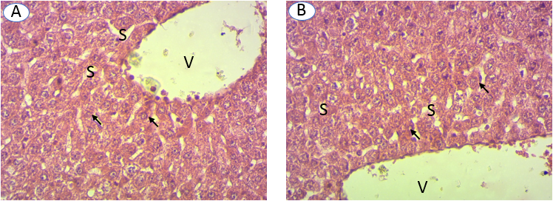
RESULTS AND DISCUSSION:
Histopathology study
Figure 1: Hepatic histology of rats treated with extracts of the plants studied and control rats (A), 400x magnification

Slide 24
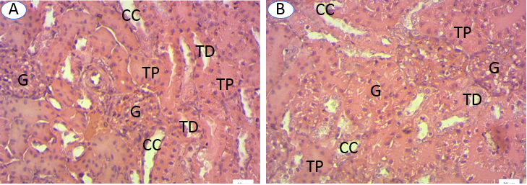
RESULTS AND DISCUSSION:
Histopathology study
Figure 2: Kidney histology of rats treated with the plant extracts studied (Figure B) and control rats (A), 400x magnification

Slide 25
CONCLUSIONS
The purpose of this study was to generate recent data on the phytochemical and toxicological characteristics of ten (10) plants used in the traditional treatment of diarrheal diseases.
Phytochemical screening of the plants studied revealed a varied richness of secondary metabolites.
These plants are not toxic according the data obtained. These results justify the use of plants in Beninese traditional medicine

Slide 26
Acknowledgments

